Slide 1

Lesoni 6 ki he ʻaho 8 ʻo ʻAokosi 2026
NGAAHI FOAKI FAKALAUMĀLIE

Slide 2

“Tuli ki he ʻofa, pea holi ki he ngaahi foaki fakalaumālie, kae lahi pe ke mou kikite. ”
(1 Kolinito 14:1)

Slide 3






ʻ Oku hā mahino naʻe māvahevahe ʻ a e siasi ʻ i Kolinitoó ʻ i he ngaahi ʻ īsiu kehekehe. Naʻe ʻikai ke nau felotoi fekauʻaki mo e kau malanga; fekauʻaki mo e founga kai; pe te nau mali pe nofo taʻemali; pea mo e fe ʻi he ngaahi meʻafoaki fakalaumalie ʻoku totonu ke fakaʻapaʻapaʻi lahi taha.
ʻI heʻene tali pe ʻa e ngaahi ʻuluaki palopalema, ʻoku fakahaaʻi ʻe Paula ʻa e founga ʻoku ʻalu ai ʻa e ngaahi meʻafoaki fakalaumalie mei he hoko ko ha palopalema ki he hoko ko ha founga ʻo e uouangataha (1 Kolinito 12 14).
Ko e fe ʻa e meʻaʻofa lelei taha? ʻIkai ha taha!
Ko e ha hono ʻuhinga?
Ngaahi me’a’ofa fakalaumālie:
  Ngaahi meʻaʻofa lahi, ko e tokotaha foaki pe ʻe taha.
  Tokolahi ʻa e kau memipa, sino pe ʻe taha..
Ko e ‘elemēniti fakatahataha’i:
  Ko e lelei taha ʻo e ʻofá .
Ngaahi me’a’ofa makehe:
  Ko e meʻafoaki ʻo e ngaahi lea kehekehé.
  Ko e meʻafoaki ʻo e kikité .

Slide 4
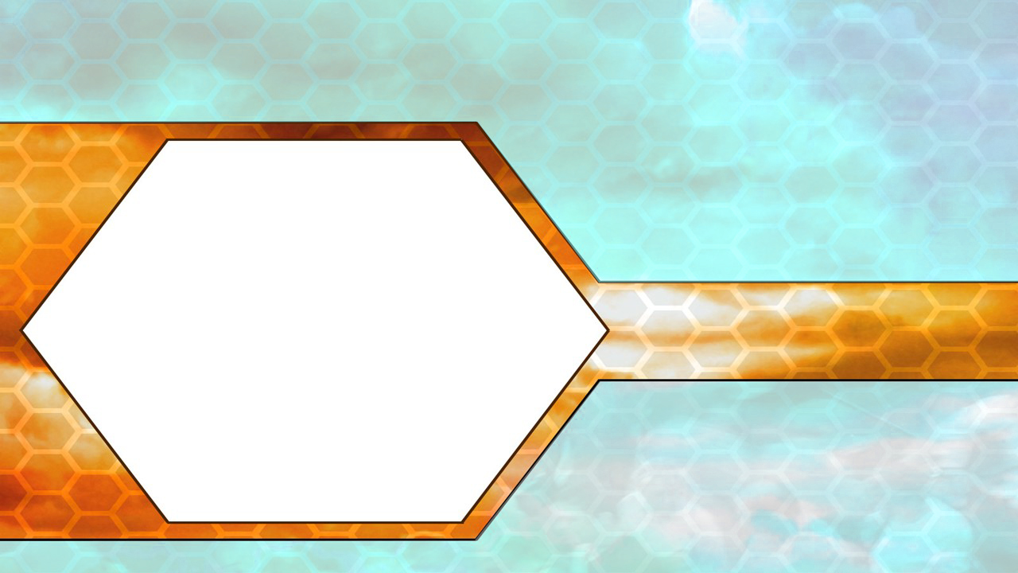

NGAAHI ME'A'OFA FAKALAUMĀLIE

Slide 5





NGAAHI MEʻAʻOFA LAHI, TOKOTAHA FOAKI ʻE TAHA
“Pea ko eni, ʻoku ai ʻae ngaahi foaki kehekehe, ka ko e Laumālie pe taha.” (1 Kolinito 12:4)
Ko hai ʻoku ne foaki ʻa e ngaahi meʻafoaki fakalaumalie? (1 Kolinito 12:4-6)
1 Kol. 12:4 | ʻoku ʻi ai ʻa e ngaahi faikehekehe ʻo e | meʻafoaki | Ka ko e meʻa tatau pe | Laumalie
1 Kol.12:5 |  | Potungaue |  | ʻEiki
1 Kol.12:6 |  | ngaue |  | ʻOtua
meʻafoaki fakalaumālie
Tokotaha Foaki
Ke tokoni ke mahino kiate kitautolu ʻa e fekauʻaki ʻa e ngaahi meʻafoaki fakalaumalie mo honau Tokotaha Foaki mai, ʻoku fakaʻaongaʻi ʻe Paula ha foʻi lea ʻe tolu ke ʻiloʻi kinautolu, ʻo fakamamafaʻi ʻenau kehekehe: ngaahi meʻafoaki; ngaahi minisita; mo e ngaahi ngaue.
Neongo ia, ʻoku taha pe ʻa e Tokotaha Foaki: ko e Laumalie [Maʻoniʻoni]; ko e ʻEiki [Sisu]; pea mo e ʻOtua [ko e Tamai]. ʻA ia ko hono ʻuhinga: ʻoku ngaue fakataha ʻa e ʻOtua (Sione 14:16).
Ka ‘oku ‘ikai ke foaki ‘e he ‘Otua ‘a e ngaahi me’a’ofa ‘o hangē ko ia na’e fai ‘e he “ngaahi ‘otua” Kalisi-Loma (1 Kol. 12:2). ‘Oku ‘ikai ha fiefia lahi, pe ko ha fili fakahokohoko ‘o e kau ma‘u ‘o e ngaahi me‘a‘ofá (hangē ko e fakatātaá, ko e kau taula‘eiki fefiné).

Slide 6
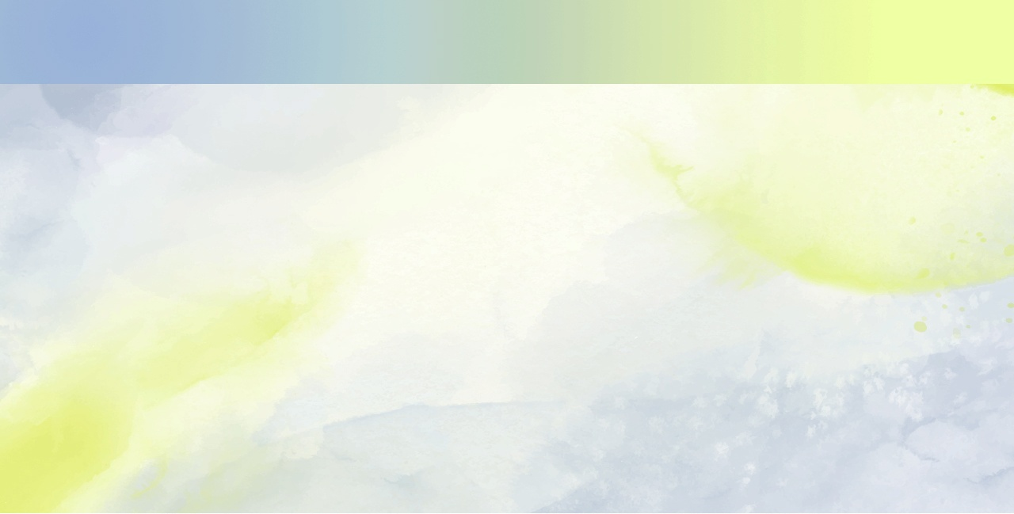

ME'A'OFA LAHI, TOKOTAHA 'A E FOAKI
"Ka ʻoku kehekehe ʻa e ngaahi meʻafoaki, ka ko e Laumalie tatau pe" (1 Kolinito 12:4)
Ko e ha ʻoku foaki ai ʻe he ʻOtua ha ngaahi meʻaʻofa kehekehe ki he kakai kehekehe? (1 Kolinito 12:7)
Ko e hā ʻ a e ngaahi meʻaʻofa ʻ oku ʻ omai ʻ e Paula ko e ngaahi faʻifaʻitakiʻangá, ʻ i he lotolotonga ʻ o e ngaahi meʻaʻofa lahi kehe ʻ oku ʻ (1 Kolinito 12:8-10; Loma 12:6-8; ʻEfeso 4:11-12)
Lea ʻo e poto
Loma 12:6-8
gaue Tokoni
Efeso 4:11-12
Tuʻunga fakaeʻapositolo
1 Kolinito 12:8-10
Lea ʻo e ʻilo
Tui
Moʻui lelei
Ke fakahoko ʻa e ngaahi mana
Kikite
ʻIloʻilo ʻo e ngaahi laumalie
ʻElelo
Fakaʻuhingaʻi ʻo e ngaahi lea kehekehe
Faiako
Naʻinaʻi
Angaʻofa
Tuʻunga Fakatakimuʻa
ʻAloʻofa
ʻEvangelio
Ngaue fakafaifekau mo e mataʻitohi M.A.
ʻOku fakaʻaongaʻi ʻa e ngaahi meʻafoaki fakalaumalie "ki he lelei" ʻa e siasi. Ko e ʻOtua pe ʻoku Ne ʻafioʻi pe ko hai ʻa e kakai te nau lava ʻo fakaʻaongaʻi ha meʻafoaki pau ke aʻusia ʻa e taumuʻa ko ia.

Slide 7





TOKOLAHI ʻA E KAU MEMIPA, SINO PE ʻE TAHA
“He ʻoku hangē ʻoku taha pe ʻae sino, ka ʻoku lahi hono ngaahi kupu, pea ko e ngaahi kupu kotoa pē ʻoe sino pe taha ko ia ʻoku lahi, ka ko e sino pe taha ʻoku pehē pe foki ʻa Kalaisi.” (1 Kolinito 12:12)
ʻOku taha pe ʻa e ʻOtua, ka ʻoku ʻi ai e fatongia ʻo e memipa takitaha ʻo e Toluʻi ʻOtua. Ko e meʻa tatau pe, ʻoku taha pe ʻa e siasi, ka ʻoku ʻi ai hono fatongia ʻo e konga takitaha ko e konga ʻo e sino ʻo Kalaisi ʻi he Mamani (1 Kolinito 12:12-13)
ʻOku fakaʻaongaʻi ʻe Paula ʻa e fakafehoanaki ʻo e sino ʻo e tangata ko e siasi ke fakamamafaʻi ʻa e uouangataha ʻi he kehekehe. ʻOku maʻu ʻe he mata ʻa e "meʻaʻofa" ʻo e sio, ka ʻoku ʻikai maʻu ia ʻe he telinga. Neongo ia, ʻoku fepoupouʻaki ʻa e ongo meʻa ni ʻaki ʻena ngaue fakataha. Ko e meʻa tatau pe, ʻi he siasi, ʻoku fakahoko ʻe he tokotaha takitaha ʻene ngaue ʻo fakatatau ki he ngaahi meʻafoaki kuo nau maʻu
(1 Kolinito 12:28-30).
ʻOku ʻuhinga ʻeni ʻoku fie maʻu ʻa e tokotaha kotoa pe; ʻoku ʻikai ha taha ʻe lahi ange ʻi ha taha; ʻoku totonu ke tokanga ʻa e tokotaha kotoa pe ki he lelei ʻa e niʻihi kehe; pea ʻoku totonu ke ngaue ʻa e tokotaha kotoa pe ki he uouangataha ʻa e siasi (1Kolinito 12:15-27)

Slide 8
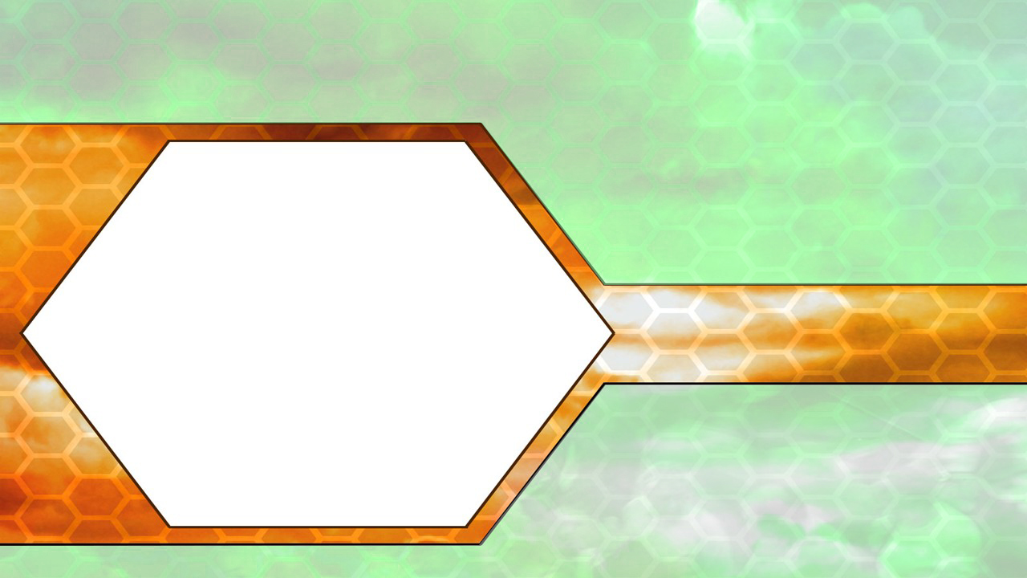
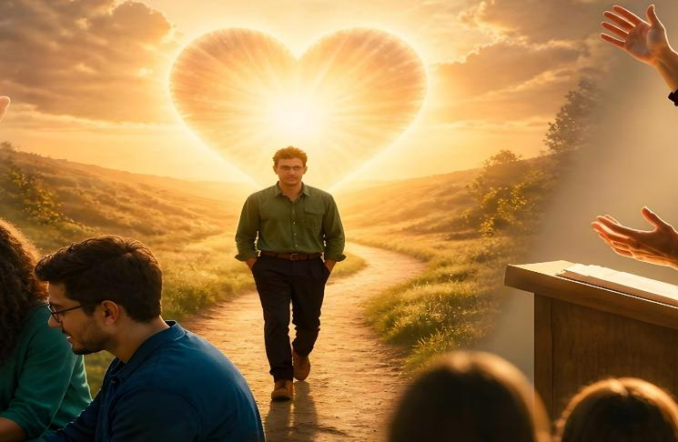
KO E ʻELEMENITI ʻOKU NE FAKATAHATAHAʻI

Slide 9


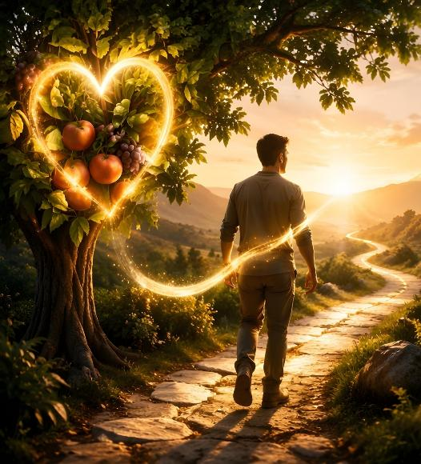
KO E LELEI TAHA ʻO E ʻOFA
“Ke mou holi lahi ki he ngaahi foaki fungani lelei. Pea ʻoku ou toe fakahā kiate kimoutolu ʻae hala ʻoku lelei lahi..” (1 Kolinito 12:31)
Ko e meʻa ʻoku fai ʻe he ʻofa
ʻOku ne faʻa kataki
ʻOku ne angaʻofa
Ko e meʻa ʻOKU ʻIKAI fai ʻe he ʻofa
ʻOku ʻikai ke ne meheka
ʻOku ʻikai ke ne polepole
ʻOku ʻikai ke ne hikisia
ʻOku ʻikai ke ne anga taʻefakaʻapaʻapa
ʻOku ʻikai siokita
ʻOku ʻikai faingofua ʻene ʻita
ʻOku ʻikai ke ne ʻita
ʻOku ʻikai ke ne fiefia ʻi he kovi
ʻOku ne fiefia ʻi he moʻoni
ʻOku ne fakatonuhiaʻi ʻa e meʻa kotoa pe
ʻOku ne tui ki he meʻa kotoa pe
ʻOku fakatatali mai ʻa e meʻa kotoa pe
ʻOku ne katakiʻi ʻa e meʻa kotoa pe
ʻOku ʻikai ko ha meʻaʻofa ʻa e ʻofa, ka ko e "hala lelei taha" (1 Kolinito 12:31). Ko e fua ia ʻo e Laumalie Maʻoniʻoni ʻi he moʻui ʻa e tokotaha tui (Kaletia 5:22). ʻE toki lava pe ke fakaʻaongaʻi totonu ʻa e ngaahi meʻafoaki fakalaumalie ʻi he ʻofa.
Ko e meʻafoaki ʻo e ʻelelo, taʻe ʻi ai ha ʻofa, ko ha "gong leʻo pe ko ha simipale ʻoku tatangi." Ko e meʻafoaki ʻo e kikite, ʻa e meʻafoaki ʻo e ʻilo, mo e meʻafoaki ʻo e tui, taʻe ʻi ai ʻa e ʻofa, ko e meʻa noa pe. ʻOku taʻeʻaonga ʻa e meʻafoaki ʻo e angaʻofa mo e meʻaʻofa ʻo e mate fakamaʻata, taʻe ʻi ai ha ʻofa, (1 Kolinito 13:1-3).
ʻOku ʻomi ʻe he 1 Kolinito 13:4-7 ha fakahinohino fefeka ki he ʻulungaanga totonu ʻi hono fakahoko ʻo e ngaahi meʻafoaki fakalaumalie:

Slide 10
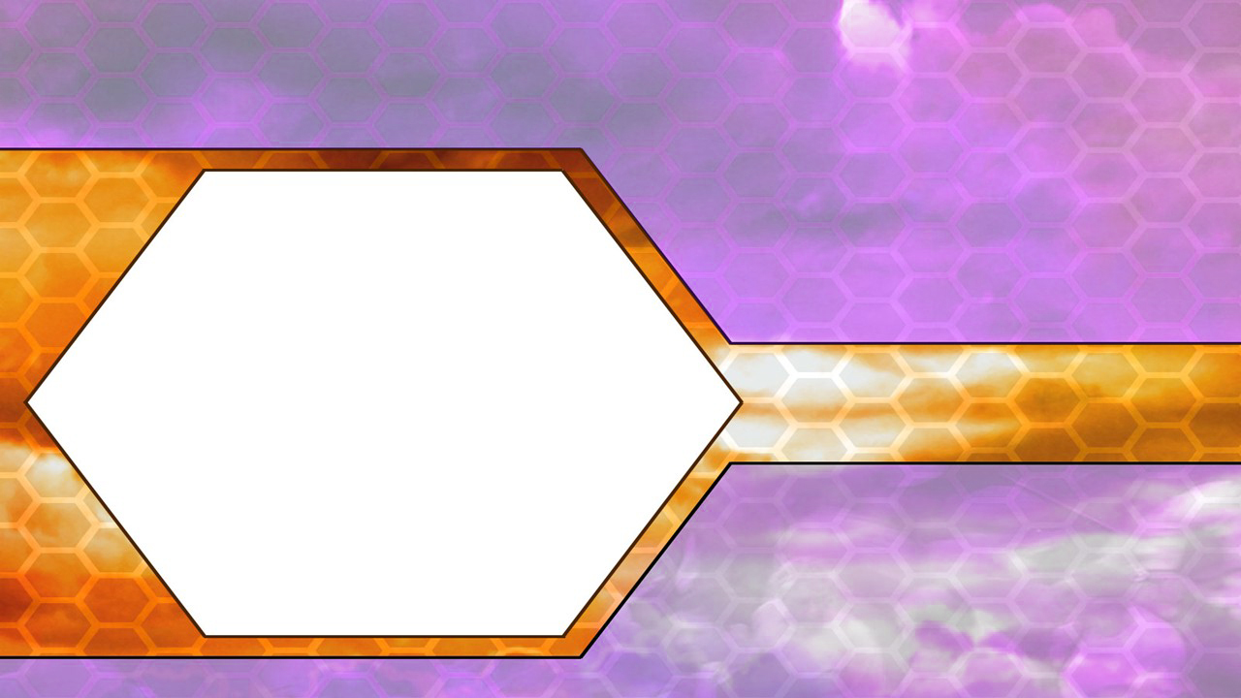

NGAAHI MEʻAʻOFA MAKEHE

Slide 11



MEʻAFOAKI ʻO E NGAAHI LEA KEHEKEHE
“Ko ia ia ʻoku lea ʻi he lea taʻeʻiloa, ke ne kole ʻe ia ke ne fai hono fakamatala. .” (1 Kolinito 14:13)
ʻOku ʻuhinga ʻa e fakamamafa ʻa Paula ki he meʻafoaki ʻo e ʻelelo mo hono fakaʻaongaʻi totonu naʻe ngaue hala ʻaki ia ʻe he kau memipa ʻo e siasi Kolinitoo, ʻo fakatupu ai ʻa e moveuveu mo e puputuʻu ʻi he lotu ʻa e kakai (1 Kolinito 14:23).
Ko e meʻafoaki ʻo e lea ko e malava ko ia ke lea ʻaki ha ngaahi lea fakafonua ʻa e tangata pe ʻangelo ʻoku ʻikai ʻilo ʻe he tokotaha (1Kolinito 13:1). ʻI he taimi ʻoku ʻikai ʻiloʻi ai ʻe he tokotaha fanongo ʻa e lea ko ʻeni, ʻoku fie maʻu ke fakaʻuhingaʻi ia
(Ngaue 2:8; 1 Kolinito 14:2, 13-14, 27-28).
Ko e fakaʻamu ʻa Paula ke lea ʻa e tokotaha kotoa pe ʻi he lea kehekehe kuo fakaʻuhingaʻi hala ia ʻe kinautolu ʻoku nau fakakaukau ʻoku totonu ke tau maʻu kotoa ʻa e meʻafoaki ko ia (1Kolinito 14:5)
Ko hono moʻoni, ʻoku falute ʻe he fakaʻanaua ko ʻeni ʻa e ngaahi meʻafoaki kotoa pe (1 Kolinito 14:1). Naʻe ʻosi fakamahinoʻi ʻe Paula "Ko ʻeni kuo foaki ki he tokotaha taki taha ʻa e fakaha ʻo e Laumalie koeʻuhi ko e lelei fakalukufua" (1 Kolinito 12:7 ). Ko ia ai, ʻoku ʻikai ke maʻu ʻe he tokotaha kotoa pe ʻa e ngaahi meʻafoaki tatau.

Slide 12




KO E MEʻAFOAKI ʻO E KIKITE
“Ka ko ia ʻoku kikite, ʻoku lea ia ki he kakai ke langa hake, mo enginaki, mo fakafiemālie.” (1 Kolinito 14:3)
Kuo pau ke ʻ oua naʻa tau fakangatangata ʻ a e meʻaʻofa ʻ o e kikité ki hono tomuʻa tala pē ʻ a e ngaahi meʻa ʻ e hoko ʻ i he kahaʻú. Ko e tefitoʻi fakaʻaongaʻi ʻo e meʻafoaki ʻo e kikite ke fakamamaʻi, naʻinaʻi, mo fakafiemalieʻi (1Kolinito 14:3).
Kuo pau ke hoko ʻa e ngaahi meʻa ʻe hoko ʻi he kahaʻu kapau ʻoku ʻikai makatuʻunga (Teu. 18:22; Sele. 28:8-9; Siona 4:2)
Kuo pau ke fenapasi ʻ ene pōpoakí mo e pōpoakí naʻe maʻu ʻ e he kau palōfita ki muʻá
(Teu. 13:1-3; ʻIsaia 8:20)
Kuo pau ke ne fakamoʻoni ki he sino ʻo Sisuu
(1 Sione 4:1-3)
Kuo pau ke fakatatau ʻene moʻui mo e popoaki fakatohitapu ʻoku ne malangaʻi (Matiu 7:15-20)
ʻOku fakamamafaʻi ʻe Paula ʻa e meʻafoaki ko ʻeni ʻo maʻolunga ange ʻi he niʻihi kehe (1Kolinito 14:1, 4, 22-25). Ka ʻoku ne toe tapou foki ke fakaʻaongaʻi totonu ia ke ʻoua naʻa fakatupu puputuʻu: "kae tuku ke fai ʻa e meʻa kotoa pe ʻi he taau mo e maau" (1Kolinito 14:40; vakai, 1 Kolinito 14:29-33)
ʻI heʻene hoko ko ha meʻafoaki makehe ʻo e toenga ʻo e siasi, naʻe ha makehe ia ʻi he moʻui mo e ngaue ʻa ʻEleni G. Hina (Fakaha 12:17; 19:10). Ka ʻe lava fefe ke tau ʻiloʻi ha palofita moʻoni?

Slide 13
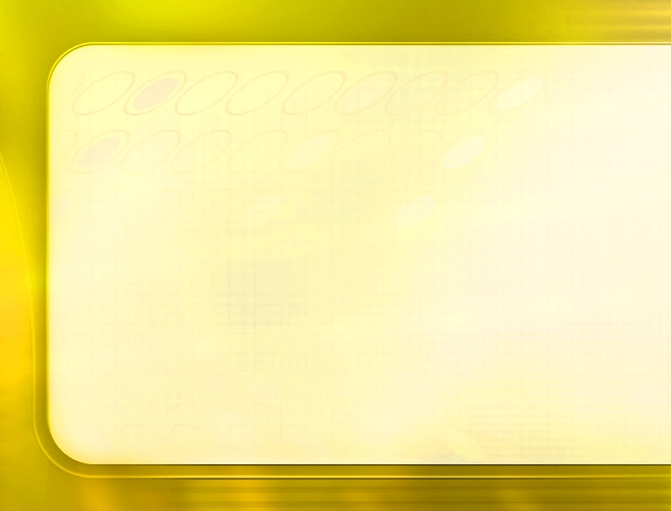
“ʻI he ngaahi fokotuʻutuʻu kotoa pe ʻa e ʻEiki, ʻoku ʻikai ha meʻa ʻe toe fakaʻofoʻofa ange ka ko ʻEne palani ke foaki ki he houʻeiki tangata mo fafine ha ngaahi meʻafoaki kehekehe. Ko e siasi ʻa ʻEne ngoue, ʻoku teuteuʻi ʻaki ha ngaahi ʻuluʻakau, ʻakau, mo ha ngaahi matalaʻiʻakau kehekehe. ʻ Oku ʻ ikai te ne ʻ amanekina ʻ e aʻu ʻ a e haisopé ki he lahi ʻ o e sita, pe ko e ʻ ōlivé ke aʻu ki he māʻolunga ʻ o e paame fakaʻeiʻeikí. ʻOku tokolahi ha niʻihi kuo nau maʻu ha ako fakalotu mo fakaʻatamai fakangatangata, ka ʻoku ʻi ai ha ngaue ʻa e ʻOtua ke fai ʻe he kalasi ko ʻeni, ʻo kapau te nau ngaue ʻi he loto fakatokilalo, ʻo falala kiate Ia..."
ʻOku foaki ha ngaahi meʻaʻofa kehekehe ki he niʻihi kehekehe, koeʻuhi ke ongoʻi ʻe he kau ngaue ʻenau fie maʻu. ʻOku foaki ʻe he ʻOtua ʻa e ngaahi meʻafoaki ko ʻeni, pea ʻoku fakaʻaongaʻi ia ʻi Heʻene ngaue, ʻo ʻikai ke fakalangilangiʻi ʻa e tokotaha ʻoku ne maʻu, ʻikai ke langaki hake ʻa e tangata, ka ke hiki hake ʻa e Huhuʻi ʻo e mamani. ʻOku totonu ke fakaʻaongaʻi kinautolu ki he lelei ʻa e faʻahinga kotoa ʻo e tangata, ʻaki hono fakafofongaʻi ʻa e moʻoni, kae ʻikai fakamoʻoniʻi ha loi.
EGW (Te Mou Maʻu ʻa e Malohi, 1 Siulai)

