Slide 1

LAKANGA NGĀUE’I ‘E HE ‘OFA
Lesoni 9 ki he ʻaho 29 ʻo ʻAokosi 2026

Slide 2

“He ne u tohi atu kiate kimoutolu ʻi he mamahi lahi mo e feinga loto mo e loʻimata lahi: ka naʻe ʻikai ke mou mamahi ai, ka koeʻuhi ke mou ʻilo ʻae ʻofa ʻoku ou maʻu ʻo lahi ʻaupito kiate kimoutolu.”
(2 Kolinitō 2:4)

Slide 3









ʻI heʻetau fekumi ki hono ako ʻo e tohi hono ua ʻa Paula ki he kakai Kolinitoo, ʻoku tau fakatokangaʻi ai ʻoku mahuʻingaʻia ʻaupito ʻa e ʻaposetolo ʻi he lelei ʻa e siasi.
Neongo kuo ʻ ikai ʻ aupito faingofua ke muimui ʻ i he ngaahi founga ʻ a e ʻ Otuá ʻ i he māmani fonu angahala ko ení, ʻ i he ʻ uluaki senitulí ko hono fakahaaʻi ko ha Kalisitiane ia ʻ e lava ke kau ki ai ʻ a e ngaahi faingataʻa mafatukituki.
ʻOku teuteuʻi ʻe Paula ʻa e siasi ke fehangahangai mo e ngaahi faingataʻa ko ʻeni, ʻi loto mo tuʻa fakatouʻosi, pea akoʻi kinautolu ke nau faʻu ha sino ʻoku uouangataha ʻi he ʻofa taʻesiokita. ʻE lava ke tau ako mei he faleʻi ko ʻeni he ʻaho ni ke tau hoko ko e "nanamu ʻo e moʻui ʻoku fakatau ki he moʻui" (2 Kolinito 2:16).
Ko e fakafiemalie ʻa e ʻOtua ʻi he faingataʻaʻia
Maʻoniʻoni mo fakamatoato ʻi he ngāue fakafaifekau
Ke ʻulungaanga fakapotopoto
Fakamolemole mo e fakafoki mai
Ko e ngangatu lelei ʻo Kalaisi

Slide 4


KO E FAKAFIEMALIE ‘A E ‘OTUA ‘I HE MAMAHI
“ʻAia ʻoku ne fakafiemālieʻi ʻakimautolu ʻi heʻemau mamahi kotoa pē, koeʻuhi ke mau faʻa fai ai ke fakafiemālieʻi ʻakinautolu ʻoku mamahiʻia, ʻaki ʻae fakafiemālie ko ia ʻaia ʻoku fakafiemālieʻi ʻaki ʻakimautolu ʻe he ʻOtua. .” (2 Kolinitō 1:4)
Ko e Ua Kolinitoó ko e ʻipiseli ia ʻoku lea lahi taha ai ʻa Paula fekauʻaki mo e fakafiemālié. Naʻe foua ʻe he siasí ha taimi faingataʻa, pea naʻe fakatō kinautolu ʻe he tohi kimuʻa ʻa Paulá ki ha tuʻunga ʻo e loto mamahí.
Ko e fakafiemalie ʻa e ʻOtua
ʻOku ne fakatauʻatainaʻi kitautolu mei he manavahee
ʻOku ne fakamanatu mai ʻa e ngaahi taimi naʻa Ne tokoniʻi ai kitautolu
ʻOkú ne tokoniʻi kitautolu ke tau kātekina ʻ a e faingataʻá
ʻ Okú ne tataki kitautolu ki he matuʻotuʻa fakalaumālié
ʻOku ne poupouʻi kitautolu ke tau taukapo maʻa e niʻihi kehe
ʻOku tau fefakafiemalieʻaki ʻi hono fakafiemalieʻi kitautolu ʻe he ʻOtua
Ka ko e mamahi ko ia, na’e “faka-‘Otua,” ‘o iku ai ki he fakatomala (2 Kol. 7:10). Ko ia ‘oku ‘ikai loto ‘a Paula ke lōmekina kinautolu ‘e he mamahi ko iá, ka ‘oku fiema‘u ke nau fakafiemālie‘i kinautolu.
Naʻa ne foua ʻa e ngaahi taimi naʻe tuʻu fakatuʻutamaki ai ʻene moʻui pea naʻa ne loto foʻi (2 Kolinito 1:8-10). Ka naʻe fakafiemalieʻi ia ʻe he ʻOtua, pea ʻoku ne ʻoatu ʻeni ʻa e fakafiemalie ko ia ki he siasi (2 Kolinito 1:6).

Slide 5
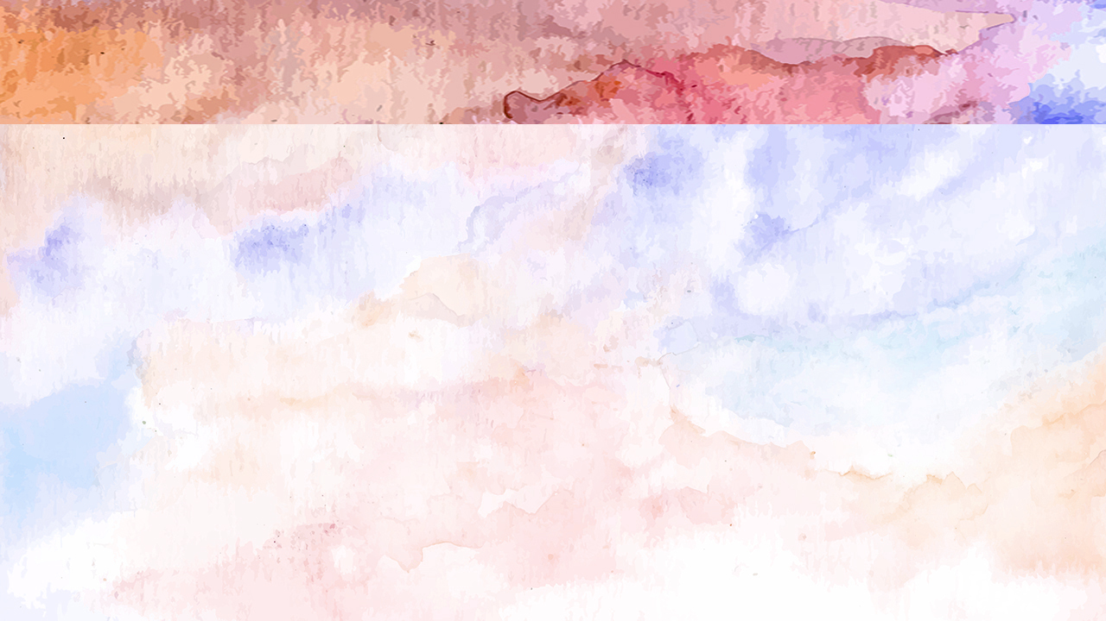



MAʻONIʻONI MO E FAKAMATOATO ʻI HE NGAUE
“He ko ʻemau fiefiaʻanga eni, ko e fakamoʻoni ʻo homau loto, koeʻuhi ʻi he loto taha, mo e moʻoni fakaʻotua, kae ʻikai ʻi he poto fakakakano, kae ʻi he ʻofa ʻae ʻOtua, kuo mau fai homau lakanga ʻi he māmani, kae lahi taha pe kiate kimoutolu.” (2 Kolinitō 1:12)
Naʻe sio lalo ʻa e kakai ʻe niʻihi kia Paula, ʻo tukuakiʻi ia ʻoku vaivai mo veiveiua (2 Kolinito 10:10). ʻI he ʻuhinga ko ʻeni, pea koeʻuhi ke tali mo tali ʻene faleʻi, naʻe fie maʻu ke maluʻi ʻe he ʻaposetolo ia mei he ngaahi tukuakiʻi pehee.
ʻI heʻene hoko ko ha tangata, naʻa ne pehe ʻoku ʻikai hano mahuʻinga (ʻEfeso 3:8). Ka ʻi he ʻaloʻofa ʻa e ʻOtua, naʻa ne lava ʻo polepole ʻi heʻene maʻu ha konisenisi maʻa (2 Kolinito 1:12).
Naʻe lava ke ne pehe mo hono kaunga-ngaue naʻe maʻoniʻoni mo fakamatoato hono ʻulungaanga, ʻi he siasi pea ʻi tuʻa fakatouʻosi.
‘I he ‘uhinga ko ení, na‘e ‘atā ai ‘a e ngaahi tohi ‘a Paulá mei he ngaahi taumu‘a fufū. Na’a ne ‘amanaki ‘e lau mo mahino ‘a e ngaahi tohi ni ‘i he ‘ātakai ko ia ‘o e mā’oni’oni mo e fakamātoato—‘a ia, na’e tohi ‘i he ‘ofa kiate kinautolu pea kumi pē ki honau lelei (2 Kol. 1:13-14).

Slide 6
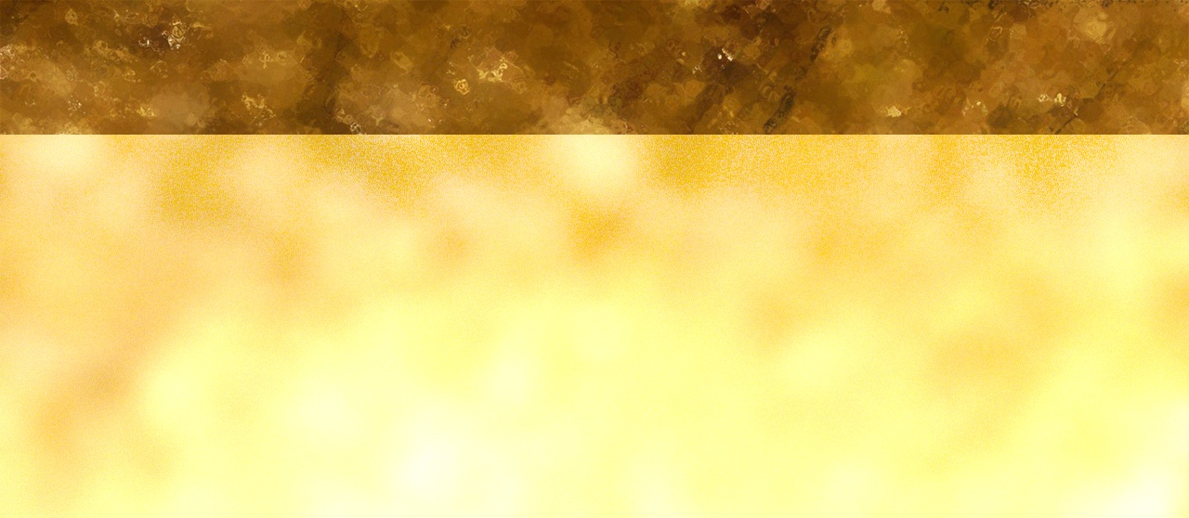


KE TO‘ONGA FAKAPOTO
“Ka ʻoku ou ui ki he ʻOtua ke ne fakamoʻoni ki hoku laumālie, ko e meʻa ʻi heʻeku ʻofa kiate kimoutolu, ʻoku teʻeki te u ʻalu atu ai ki Kolinitō.” (2 Kolinitō 1:23)
ʻI heʻene ʻuluaki tohi, naʻe fakaha ai ʻe Paula ki he kau Kolinito ʻa e hala naʻa ne palani ke fou ai (1 Kolinito 16:5-11):
ʻEfeso
Masitōnia
Kolinito
Siutea
ʻI ha tohi kimui ange (mole, 2 Kolinito 7:8) naʻa ne fakaha kiate kinautolu te ne ʻaʻahi tuʻo ua kiate kinautolu (2 Kolinito 1:15-16):
ʻEfeso
Masitōnia
Kolinito
Siutea
Kolinito
Neongo ia, naʻa ne liliu ʻene palani pea ne fili ke ʻoua naʻa ne fai ʻa e ʻuluaki ʻaʻahi ko ia (2 Kolinito 1:23). Ko e ngaahi liliu ko ení naʻe taki atu ai ʻ a e niʻihi ke nau fakaangaʻi ia ʻ i heʻene taʻepau mo e veiveiua. Ko e ha naʻa ne liliu ai ʻene fakakaukau?
Naʻe hā ngali fiemaʻu ʻ a e ʻ i ai ʻ a Paula ʻ i Kolinitoó koeʻuhi ko e ngaahi palopalema ʻ i aí. Ka ko e fakafepaki te ne fetaulaki mo ia naʻe ʻuhinga ia ki ha fepaki naʻa ne loto ke fakaʻehiʻehi mei ai, koeʻuhi ko ʻene ʻofa lahi kiate kinautolu (2 Kolinito 2:1-4).

Slide 7

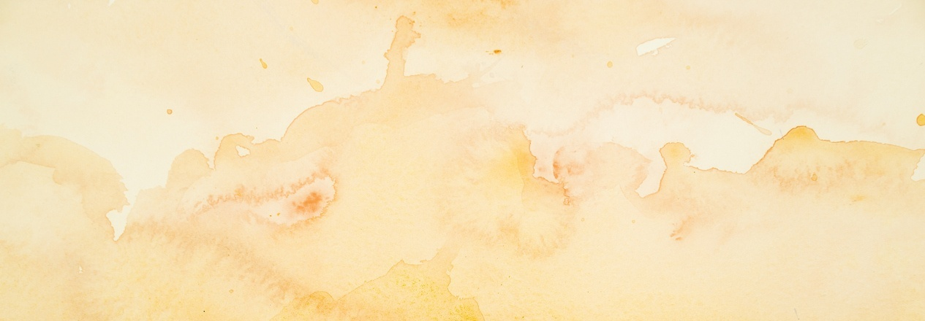



FAKAMOLEMOLE MO E FAKAFOKI MAI ʻO E ONGOONGOLELEI
“Ko ia ʻoku mou fakamolemole ha meʻa ki ai, ʻoku ou fakamolemolea foki: pea ko ia kuo u fakamolemolea, ʻo kapau ne u fakamolemolea ha meʻa, naʻaku fai ia koeʻuhi ko kimoutolu ʻi he ʻao ʻo Kalaisi; ” (2 Kolinitō 2:10)
Lolotonga ʻ a e fononga ʻ a Paula ki Taloasi, naʻe ʻ alu ai ʻ a Taitusi ki Kolinitoó. Naʻe ʻalu ʻa Paula mei Taloasi ki Masitōnia. Ka naʻa ne fuʻu mamahi lahi koeʻuhi naʻe teʻeki ai ke fetaulaki ʻa Taitusi mo ia ʻi Taloasi ke ʻoange kiate ia ʻa e ongoongo fekauʻaki mo e siasi ʻi Kolinitoo (2 Kolinito 2:12-13)
Taimi nounou mei ai, naʻe faifai pea fetaulaki ʻ a Taitusi mo Paula ʻ i Masitōnia. Naʻa ne talaange ʻa e tali lelei ʻa e siasi ki he ngaahi naʻinaʻi ʻa e ʻaposetolo (2 Kolinito 7:5-9, 13-16)
Ko e taha ʻo e ngaahi meʻa naʻe fie maʻu ke fakaleleiʻi naʻe fekauʻaki ia mo e fakatonutonu faka-siasi. ʻI heʻenau talangofua ki he ʻaposetolo, naʻe valokiʻi ʻa e tokotaha naʻe faihala, pea naʻa nau tali ʻa e valoki. ʻOku kole ange ʻe Paula ke nau laka atu ʻi he sitepu hoko: fakamolemole mo e fakafoki mai
(2 Kolinito 2:5-11)

Slide 8





KO E NGANGATU LELEI ʻO KALAISI
“He ko e ngangatu lelei ʻo Kalaisi ʻakimautolu ki he ʻOtua, ʻiate kinautolu kuo fakamoʻui, pea ʻiate kinautolu ʻoku fakaʻauha: ” (2 Kolinitō 2:15)
ʻI heʻene fakamatala ki he founga naʻe "fakaava ai ʻe he ʻOtua ha matapaa" ke malangaʻi lelei ʻa e ongoongolelei ʻi Taloasi, naʻe kalanga ʻa Paula ʻi he fakafetaʻi mo e ikuna: "Kae fakafetaʻi ki he ʻOtua, ʻa ia ʻoku ne tataki maʻu ai pe ʻa kitautolu ko e popula ʻi he fononga ikuna ʻa Kalaisi, pea ʻoku ne fakaʻaongaʻi ʻa kitautolu ke fakamafola ʻa e nanamu ʻo e ʻilo kiate ia ʻi he feituʻu kotoa pe" (2 Kolinito 2:14).
ʻOku aʻu ʻa e ʻilo kia Kalaisi ki he laumalie kotoa pe ʻo hange ha meʻa namu kakala ʻoku ne mafola ʻi he meʻa kotoa pe. Ki he kau Kolinitoo, ʻo hange pe kiate kitautolu, ko e meʻa namu kakala ko ʻeni ʻo e moʻui taʻengata. Neongo ia, kiate kinautolu ʻoku nau fakafisingaʻi ʻa e ui, ko ha nanamu ia ʻo e mate (2 Kolinito 2:15-16).
ʻI he tokangataha ki he fatongia ʻ oku kau ki he meʻá ni, ʻ oku fakamatalaʻi ai ʻ e Paula ko e pōpoakí kuo pau ke ʻ oatu loto - moʻoni, ʻ o ʻ ikai kumi ki ha lelei fakafoʻituitui, ka ko e fakamoʻui ʻ o e kau fanongó (2 Kolinito 2:17)

Slide 9

“Naʻe ʻomi ʻe he talafekau faivelenga ko ʻeni ʻa e ongoongo fakafiefia kuo hoko ha liliu fakaofo ʻi he lotolotonga ʻo e kau tui ʻi Kolinitoo. Naʻe tali ʻ e he tokolahi ʻ a e fakahinohino naʻe ʻ i he tohi ʻ a Paulá pea kuo nau fakatomala mei heʻenau ngaahi angahalá. Naʻe ʻikai kei hoko ʻenau moʻui ko ha manukiʻi ki he tui faka-Kalisitiane, ka naʻa nau ngaue ʻaki ha ivi takiekina malohi ke poupouʻi ʻa e anga faka-ʻOtua. […]
ʻE iku ʻa e fakatomala ko ia ʻoku maʻu ʻe he ivi takiekina ʻo e ʻaloʻofa fakalangi ki he loto ki he vete hia mo e siʻaki ʻo e angahala. Ko e ngaahi fua ia naʻe fakaha ʻe he ʻaposetolo naʻe mamata ki ai ʻi he moʻui ʻa e kakai tui ʻi Kolinitō.
EGW (Ko e Ngaue ʻa e Kau ʻAposetolo, p. 324)

