Slide 1

FATONGIA TAUHI MO E MISIONA
Lesoni 11 ki he ʻaho 12 ʻo Sepitema 2026

Slide 2

“He ʻoku mou ʻilo ʻae ʻulungāanga lelei ʻa hotau ʻEiki ko Sisu Kalaisi, ʻa ʻene mohu koloaʻia, ka naʻe hoko ʻo masiva koeʻuhi ko kimoutolu, koeʻuhi ʻi heʻene masiva ke mou koloaʻia ai.” (2 Kolinitō 8:9)

Slide 3






Ko e fatongia tauhi ko e founga ia ʻoku puleʻi ai ʻe ha taha ʻa e meʻa kuo tuku kiate ia.
ʻI he tuʻunga ʻo e tohi hono ua ʻa Paula ki he kau Kolinitoo, ʻoku ʻuhinga ʻa e tauhi ki ha ngaue pau ʻa e ʻapositolo: ke tanaki ʻe he ngaahi siasi Senitaile ha paʻanga ke tokoni ki he siasi ʻi Selusalema, ʻa ia naʻa ne foua ha ngaahi taimi faingataʻa ʻaupito.
Naʻe ʻosi tukupa ʻa e kau Kolinito ke tokoni, pea naʻe ofi mai ʻa e taimi ke fakahoko ai ʻa e tukupa ko ia. Kuo ʻosi kamata ke kau mai ʻa e ngaahi siasi ʻo Masitōnia. Naʻe ʻikai tokanga ʻa Paula ki he lahi ʻo e paʻanga naʻe kau ki ai, ka ʻi he fakaʻaiʻai mo e loto vekeveke ʻe kau ʻaki ʻe he kakai tui ʻa e faingamalie ko ʻeni ke tali ʻa e ʻaloʻofa kuo nau maʻu.
Tupuʻanga ʻo e fatongia tauhi:
  Ko e faʻifaʻitakiʻanga ʻa Sisuu
  Ko e tali ki he ʻaloʻofa naʻe maʻu
Founga ke fakahoko ai ʻa e tuʻunga tauhi:
  Palani totonu
  Ko ha toʻonga fakakaukau totonu
Ola ʻo e fatongia tauhi:
  Ko e uouangataha ʻa e siasi

Slide 4

TUPUʻANGA ʻO E TAUHI

Slide 5


KO E FAʻIFAʻITAKIʻANGA ʻA SISUU
Neongo naʻa ne koloaʻia, ka naʻa ne hoko ʻo masiva (2 Kolinitō 8:9)
Naʻa ne mavahe mei Langi ke nofo ʻi Mamani
Naʻa ne tuku ʻene pule ʻi he ʻUnivesi kae hoko ko ha tufunga
Naʻa ne mavahe mei ha feituʻu malu ke nofo ai ʻi he tafaʻaki ʻo e fili
Naʻa ne fetongi ʻa e kalauni fakatuʻi ʻaki ha kalauni talatala
“He ʻoku mou ʻilo ʻae ʻulungāanga lelei ʻa hotau ʻEiki ko Sisu Kalaisi, ʻa ʻene mohu koloaʻia, ka naʻe hoko ʻo masiva koeʻuhi ko kimoutolu, koeʻuhi ʻi heʻene masiva ke mou koloaʻia ai.”
(2 Kolinitō 8:9)
Ko e ha ʻa e fekauʻaki ʻa e ʻaloʻofa mo e angaʻofa ʻa e ʻOtua? (2 Kolinitō 8:1-2)
Naʻe foaki ʻe he ʻOtua ʻa ʻene ʻaloʻofa ki he ngaahi siasi ʻo Masitōnia, pea naʻa nau "fonu ʻi he angaʻofa lahi" (2 Kolinitō 8:2). Pea ko e ʻaloʻofa ʻeni ʻa Sisu kiate kinautolu, pea kiate kitautolu:
Pea naʻa Ne fai kotoa ia ʻi heʻene ʻofa kiate kitautolu! (Sione 15:13; ʻEfeso 5:2; Kaletia 2:20 ; 1 Sione 3:16).
ʻE anga fefe haʻatau tali ʻa e ʻaloʻofa ʻa Sisuu? "Kuo mou maʻu taʻetotongi, foaki taʻetotongi" (Matiu 10:8).

Slide 6




KO E TALI KI HE ʻALOʻOFA NAʻE MAʻU
“Pea ʻikai ke hangē ko ʻemau ʻamanaki, ka naʻa nau fuofua foaki ʻakinautolu ki he ʻEiki, pea kiate kimautolu foki ʻi he finangalo ʻoe ʻOtua.” (2 Kolinitō 8:5)
Vakai ki he tali ʻa e kau Masitonia ki he ʻaloʻofa:
Naʻa nau maʻu ʻa e ʻaloʻofa ʻa Sisuu (2 Kolinitō 8:9)
Naʻa nau foaki kinautolu kia Sisu (2 Kolinitō 8:5)
Naʻa nau kole ke maʻu ha faingamalie ke tokoniʻi e niʻihi kehe (2 Kolinitō 8:4)
ʻI heʻenau masiva, naʻa nau foaki ʻo mahulu hake ʻi he meʻa naʻa nau malava (2 Kolinitō 8:2-3)
Ko e ha ʻoku akoʻi mai ʻe he meʻa ni kiate kitautolu?
Houngaʻia ʻi he ʻaloʻofa ʻa e ʻOtua (2 Kolinitō 9:15)
Naʻe foaki ʻe Sisu ʻa e meʻa kotoa pe maʻatautolu. ʻOku fakahaaʻi ʻetau houngaʻia ʻi he holi ke foaki kakato kitautolu kiate Ia.
Holi ke vahevahe ʻa e ngaahi tapuaki ʻa e ʻOtua (2 Kolinitō 9:11a)
ʻOku tau foaki ki he niʻihi kehe koeʻuhi he naʻa tau ʻuluaki maʻu mei he ʻOtua
ʻOfa mo’oni
(2 Kolinitō 8:24)
Ko e nima-homó ko ha fakamoʻoni ia ʻoku nofo ʻa e ʻofá ʻi hotau lotó

Slide 7

FOUNGA KE FAKAHOKO AI ʻA E FATONGIA TAUHI

Slide 8




PALANI TOTONU
“Ke foaki ʻe he tangata taki taha ʻo hangē ko ia kuo pau hono loto ki ai, kae ʻikai ʻi he mamahi, pe ʻi hono puleʻi: he ʻoku ʻofa ʻae ʻOtua ki ha foaki fiefia. ” (2 Kolintō 9:7)
MASITONIA
Ko e palani naʻe fokotuʻu ʻe Paula ke tanaki ha foaki makehe mei he ngaahi siasi ʻo Masitonia mo ʻAkaia (ko e vahefonua naʻe tuʻu ai ʻa Kolinitoo) ke tokoni ki he siasi ʻi Selusalema (Loma 15:26).
Kolinitō
AKAIA
Selusalema
ʻI he taimi naʻe fokotuʻu ai ʻe he ʻaposetolo ʻa e palani ʻi Kolose ʻi he taʻu ʻe taha kimuʻa, naʻe tali loto vekeveke, neongo naʻe ʻikai fokotuʻu ha ngaahi taumuʻa pau ʻi he taimi ko ia (2 Kolinitō 9:1-2). Neongo ia, naʻe fakapapauʻi ʻe he memipa takitaha ʻi hono loto ke foaki ha paʻanga pau (2 Kolinitō 9:7a).
ʻI he taimi ʻoku palani ai ʻa e foaki, ʻoku totonu ke fakafuofuaʻi ʻe he famili takitaha pe ia pea fokotuʻu ha ngaahi taumuʻa moʻoni, ʻo fakatatau ki he tuʻunga fakapaʻanga ʻoku nau ʻi ai.
Ko e meʻa ʻe taha ʻoku fakakau ʻe Paula ʻi heʻene palani ʻoku ʻikai totonu ke nau tatali ke ʻave fakaʻangataha ʻa e meʻa kotoa pe, ka ke tuku mavahe ha kiʻi meʻa siʻisiʻi ʻi he uike takitaha kae ʻoua kuo nau aʻu ki he lahi ʻo e paʻanga ʻoku fokotuʻu atu (1 Kolinitō 16:2). ʻI he founga ni, ʻi he aʻu mai ʻa Paula, ʻe lava ke tanaki fiefia kotoa ʻa e tanaki (2 Kolinitō 9:3-5).

Slide 9


KO HA FAKAKAUKAU TOTONU
“He ʻoku ou fakamoʻoni ki heʻenau mafai mei honau loto, ʻio, ʻo lahi hake ʻi heʻenau faʻa fai;”
(2 Kolinitō 8:3)
Ke fakalototoʻaʻi ʻ a e nima - homo ʻ a e kau Kolosé, ʻ oku ʻ oange ai ʻ e Paula kia kinautolu ʻ a e faʻifaʻitakiʻanga ʻ o Masitōnia. ʻ I he ngaahi siasi ko iá, naʻe fakahāhā ai ʻ e he fanga tokouá ha fakakaukau totonu mo alafaʻifaʻitakiʻanga ʻ i hono foaki ʻ enau ngaahi foakí, he naʻa nau foaki...
ʻi he fiefia
(2 Kolinitō 8:2a)
Naʻa nau ongoʻi fiefia ke lava ʻo foaki
ʻi he angaʻofa (2 Kolinitō 8:2b)
Naʻe ʻikai ko ha fakafaingataʻaʻiaʻanga ʻenau masiva
ʻi he fiefia
(2 Kolinitō 8:3)
Naʻa nau fai ia ʻi he loto fiemalie mo e fakafokifa
ko ha faingamalie (2 Kolinitō 8:4)
Naʻe fakaʻata kinautolu ʻe he ngaue ko ʻeni ke fakahaaʻi ʻenau ʻofa ki he ʻOtua mo e siasi
ko ha ngaue ʻo e fakatapui
(2 Kolinitō 8:5)
Naʻe iku ʻene liʻoa ki he ʻOtua ki heʻene mateaki ki he niʻihi kehe

Slide 10

NGAAHI OLA ʻO E TAUHI

Slide 11


KO E UOUANGATAHA ʻA E SIASI
“He ko e tauhi atu ʻoe ngāue ni, ʻoku ʻikai ngata ʻi he tokoni ki he masiva ʻoe kāinga māʻoniʻoni, ka ʻoku tupulekina ia ʻi he ngaahi fakafetaʻi lahi ki he ʻOtua;.”
(2 Kolinitō 9:12)
Naʻe ʻi ai mo ha ngaahi ola lelei kehe ʻo e feilaulau naʻe ʻave ki Selusalema (2 Kolinitō 9:12).
Ngaahi siasi faka-Siu
ʻOku nau ʻave ʻa e ongoongoleleí .
Ngaahi siasi Senitaile .
ʻOku nau tokoni ʻaki ʻenau ngaahi maʻuʻanga tokoní .
Naʻe haʻi fakataha ʻa e kau Siu mo e kau Senitaile ʻe he ngaahi haʻi ʻo e tokoni mo e loto houngaʻia (Loma 15:26-27). ʻI he founga ni, naʻe aʻusia ai ʻa e taumuʻa taupotu taha ʻa e ʻapositolo: ko e uouangataha ʻi he siasi.
Ko e ola lelei ‘e taha, ko e founga na‘e fai ai ‘a e foakí ‘oku ‘i ai ‘ene lēsoni makehe kiate kitautolu he ‘aho ní: kuo pau ke fai ‘a e me‘a kotoa pē ‘i ha founga maau, pea muimui ki he ngaahi founga totonú.
Siasi Fakalotofonua
Kautaha Lahi
Konifelenisi/Misiona/
ʻIunioni
Vahenga
Naʻe fokotuʻu ʻe Paula ʻa Taitusi ke ne tokangaʻi ʻa e tanaki, pea naʻe fokotuʻu ʻe he ngaahi siasi ʻa e ngaahi tokoua ke tokoni kiate ia ʻi he ngaue ko ʻeni (2 Kolinitō 8:16-24). Naʻe ʻikai ha toe founga totonu ke tanaki mo ʻave ʻa e feilaulau ki Selusalema.

Slide 12
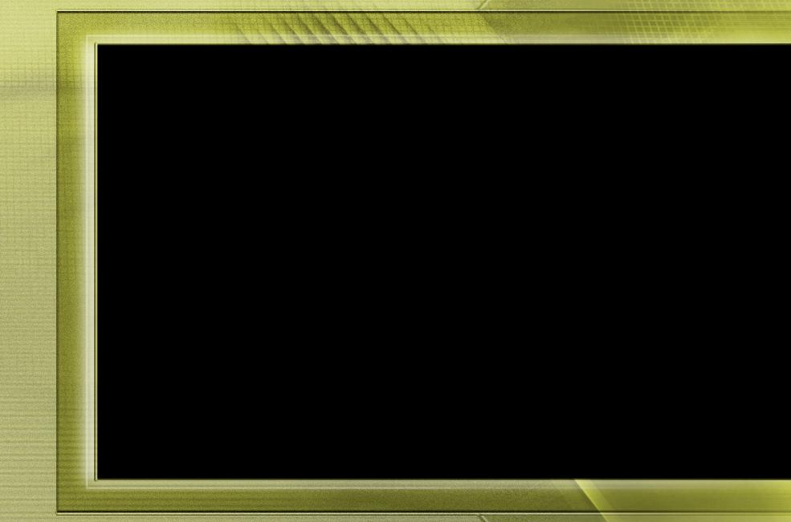
“Kuo pau ke poupouʻi ʻa e ngaue ʻa e ʻOtua ʻaki ʻa e vahehongofulu mo e ngaahi meʻaʻofa mo e ngaahi foaki. ʻOku ui ʻe he ʻEiki he taimi ni ʻa e ngaahi founga kuo Ne fakafalala ki Heʻene kau tauhi. […]
ʻOku ʻikai fie maʻu ʻe he ʻEiki ko Sisuu ha meʻa lahi ange mei Hono kau muimui ʻi he meʻa kuo Ne fakahoko. Ko kinautolu ʻoku nau fakaʻikaiʻi kita mo feilaulauʻi koeʻuhi ko e ngaue ʻa e ʻOtua ʻoku nau muimui pe ki Heʻene sipinga. Naʻa Ne tukuange Hono pulupulu fakaʻeiʻeiki mo e kalauni fakatuʻi, pea fakahifo mei Heʻene pule maʻolunga. Naʻa Ne hoko ʻo masiva, koeʻuhi ke tau lava ʻo maʻu ʻa e koloa taʻengata ʻi Heʻene masiva. Naʻe ʻikai ngata pe ʻi Heʻene foaki ʻEne koloa, ka ko ʻEne moʻui ʻi he fakaʻikaiʻi mo e feilaulau, koeʻuhi ke Ne lava ʻo toʻo ʻa e faingataʻa kotoa pe meiate kinautolu ʻoku fekumi ki he hu ki he puleʻanga ʻo e ʻOtua.
[…] ʻOku fakaafeʻi kitautolu ʻe he ʻEiki ko Sisuu ke tau hoko ko e kau ngaue fakataha mo Ia. Ko Ia ʻoku ʻaʻana pea ʻoku ʻi ai ʻEne totonu ki he meʻa kotoa pe ʻoku tau maʻu. ʻI heʻetau loto fiemalie ke tokoni ʻi Heʻene ngaue, te tau lava ʻo fakahaaʻi ai ʻetau ʻofa kiate Ia.”
EGW (Ko e Sio ki ʻOlungá, ʻEpeleli 9)

