Slide 1

FELĀVE’I MO E KAU AKONAKI HALA
Lesoni 12 ki he ʻaho 19 ʻo Sepitema 2026

Slide 2

“He ko e mahafutau ʻo ʻemau tau ʻoku ʻikai fakakakano, ka ʻoku mālohi lahi ʻi he ʻOtua ke holoki hifo ai ʻae ngaahi kolo mālohi;”
(2 Kolinitō 10:4)

Slide 3





Naʻe ʻai ʻe Paula ko ʻene misiona ke ʻilo maʻu pe ʻa e ngaahi siasi kotoa pe. Ko e ha hono ʻuhinga? Ke ʻiloʻi pe naʻa nau fie maʻu ha tokoni, ha ʻaʻahi, ha fakafiemalie, pe ha lea fakalotolahi
(2 Kolinitō 11:28).
ʻI he taimi ʻe niʻihi naʻe fakaha kiate ia ʻa e kau akonaki loi naʻa nau fakatupu ʻa e humu ʻa e kau faivelenga. ʻI he taimi naʻe hoko ai ʻeni, naʻe fonu ʻa e ʻaposetolo ʻi he ʻita (2 Kolinitō 11:29).
ʻI he fakaʻosinga ʻo ʻene tohi hono ua ki he kakai Kolinitoo, ʻoku fakamatala ai ʻa Paula ki he palopalema ʻo e kau faiako loi ko ʻeni. ʻE lava fefe ke tau ʻiloʻi kinautolu? ʻE lava fefe ke tau tauʻi kinautolu ʻi he tau fakalaumalie ko ʻeni? ʻE lava fefe ke tau ikunaʻi kinautolu?
Tau fakalaumālie:
  Ko e ngaahi meʻatau ke ʻohofi (2 Kolinitō 10:1-11)
  Ko e maluʻi totonu (2 Kolinitō 10:12-18)
Felāve’i mo e kau akonaki hala:
  Kau kākā ʻoku fakapuli ko e kau ʻaposetolo (2 Kolinitō 11:1-15)
  Paula mo e kau akonaki loi (2 Kolinitō 11:16-31)
  Sivisiviʻi kita mo e ikuna (2 Kolinitō 12:14-13:10)

Slide 4


TAU FAKALAUMĀLIE

Slide 5
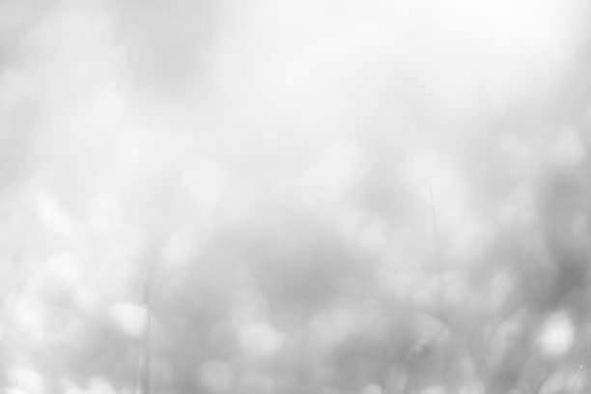




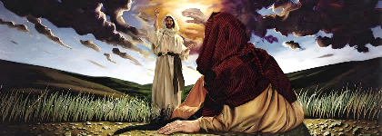
KO E NGAAHI ME'ATAU KI HE 'OHOFI
“He ko e mahafutau ʻo ʻemau tau ʻoku ʻikai fakakakano, ka ʻoku mālohi lahi ʻi he ʻOtua ke holoki hifo ai ʻae ngaahi kolo mālohi” (2 Kolinitō 10:4)
Naʻe tukuakiʻi ʻa Paula ki heʻene foʻi mo taʻeʻamanekina, neongo naʻa ne lea fefeka ʻi heʻene ngaahi tohi (2 Kolinitō 10:10)
ʻI he tali ki he fakakikihi ko ʻeni, naʻe fakahaaʻi mahino ʻe Paula naʻa ne ongoʻi te ne lava ʻo fefeka ʻo hange ko ia ʻi ha tohi, ka he ʻikai ke ne tukulolo ke fakaʻaongaʻi ʻa e "ngaahi mahafu fakakakano" (hange ko e pule fakapuleʻanga, tautea fakaesino, pe fakahikihikiʻi kita), ka te ne fakaʻaongaʻi pe ʻa e ngaahi meʻatau "malohi ʻi he ʻOtua" (2 Kolinitō 10:2-4)
ʻOku kau ʻi he "ngaahi meʻatau" ko ʻeni ʻa e ngaue ʻi he loto fakatokilalo mo e angamalu ʻo Kalaisi (Matiu 11:29). Ka ʻoku kau foki ki ai ʻa e tuʻu maʻu ʻi he faihala, ʻo hange ko ia naʻe fai ʻe Sisu (Matiu 21:12-13), pe lea mahino ʻi he taimi ʻoku fie maʻu ai (Matiu 23:23-27)
Naʻe foaki kiate ia ʻe Kalaisi ʻa e mafai ʻo Paula, pea te ne fakaʻaongaʻi maʻu pe ia ke langa hake, kae ʻikai ke fakaʻauha (2 Kolinitō 10:8)
Notes:
2 Corinthians 10:1-11

Slide 6






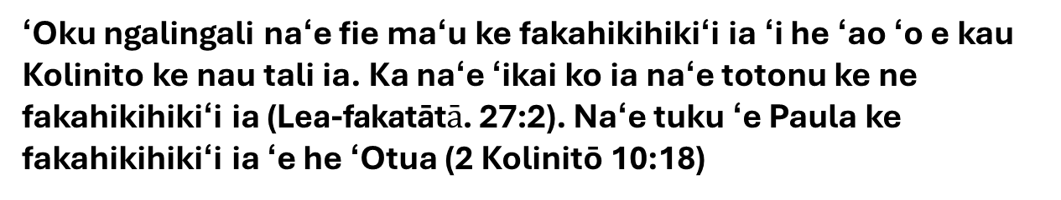
KO E MALUʻI TOTONU
“He ʻoku ʻikai ko ia ʻoku ne fakaongolelei ia ʻe fakamālō ki ai, ka ko ia ʻoku fakaongolelei ia ʻe he ʻEiki.”
(2 Kolinitō 10:18)
Naʻe hilifaki ʻe he kau filosefa Kalisi ha paʻanga lahi ki he fanau ako naʻa nau fie ako meiate kinautolu. Ke tohoakiʻi mai ʻa e fanau ako ko ʻeni, naʻa nau polepole ʻi heʻenau ʻilo, honau tuʻunga fakasosiale, pe ko e kakai mahuʻinga naʻa nau ʻiloʻi mo fakaʻapaʻapaʻi kinautolu. Ko e toʻonga foki ʻeni ʻa e kau faiako loi naʻa nau hu mai ki Kolinito (2 Kolinitō 10:12; 11:19-20).
ʻOua naʻa ke fakahikihikiʻi koe
Tuku ke fakahikihikiʻi kitautolu ʻe he ʻOtua
Ka naʻe ʻikai totongi ʻe Paula ʻene vahevahe ʻene ʻilo, naʻe ʻikai ke ne ʻoatu ha ngaahi tohi fakaongoongolelei, pea naʻe ʻikai ke ne polepole ʻiate ia pe. Pea naʻe tukuhifo ia ʻi he meʻa ni! ʻE anga fefe haʻane maluʻi ia?
ʻOku ngalingali naʻe fie maʻu ke fakahikihikiʻi ia ʻi he ʻao ʻo e kau Kolinito ke nau tali ia. Ka naʻe ʻikai ko ia naʻe totonu ke ne fakahikihikiʻi ia (Lea-fakatāt$ā$. 27:2). Naʻe tuku ʻe Paula ke fakahikihikiʻi ia ʻe he ʻOtua (2 Kolinitō 10:18)
Kapau ʻoku ʻi ai ha meʻa te tau lava ʻo polepole ai pe fakahikihikiʻi kitautolu, ko hono ʻiloʻi ʻo e ʻOtua mo talangofua kiate ia (Selemaia 9:24; 2Kolinitō 10:17)
Notes:
2 Corinthians 10:12-18

Slide 7


FELĀVE’I MO E KAU AKONAKI HALA

Slide 8

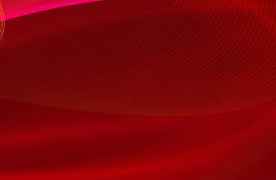



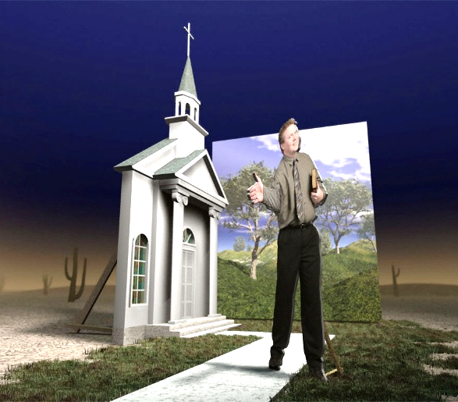
KO E KAU KĀKĀ ʻOKU FAKAPULI KO HA KAU ʻAPOSETOLO
“Ka ko e kau ʻaposetolo loi ʻakinautolu, ko e kau ngāue fakakākā, ʻoku nau fakakehe ʻakinautolu ke hangē ko e kau ʻaposetolo ʻa Kalaisi.” (2 Kolinitō 11:13)
ʻOku holi ʻa Paula ke ʻomi ha siasi haohaoa kia Kalaisi (2 Kolinito 11:2). Ka naʻe ʻi ha tuʻunga fakatuʻutamaki ke kakaaʻi ʻa e siasi, ʻo hange ko ʻIvi, pea ʻikai toe hoko ko e taʻahine mali ʻa Sisu (2 Kolinitō 11:3)
Ko e ha ʻa e fakatuʻutamaki moʻoni? Ko e kau Siu naʻa nau fakahikihikiʻi kinautolu ko e "kau ʻaposetolo lahi" ʻa Sisuu naʻa nau haʻu ki Kolinito ʻo akoʻi ʻa e "Sisu kehe," "laumalie kehe," mo e "ongoongolelei kehe". (2 Kolinitō 11:4-5; Kaletia 1:8)
ʻOku ʻikai ʻuhinga ʻa e malanga ʻa ha taha fekauʻaki mo Sisuu ʻoku nau fakahaaʻi mai kiate kitautolu ʻa Sisu moʻoni, ʻo hange ko ia ʻoku fakaha ʻi he Tohi Tapu. Mahalo ʻe fakaʻofoʻofa ʻenau ngaahi lea, ka ʻoku toe ʻilo foki ʻe Setane ʻa e founga ke lea ʻaki ai ʻa e ngaahi meʻa fakaofo mo fakaha ia "ko e ʻangelo ʻo e mama" (2 Kolinitō 11:14)
ʻI heʻenau ngaahi toʻonga mo e lea, ʻoku akoʻi ai ʻe he kau faiako moʻoni ʻa e "moʻoni ʻa Kalaisi" (2 Kolinitō 11:9-10). Ka ko e kau akonaki loi, ʻa ia ʻoku nau fakangalingali pe ʻoku nau lotu, ko e kau faifekau ʻo e kaka ʻoku fakapuli ko e kau ʻaposetolo (2 Kolinitō 11:13-15).
Notes:
2 Corinthians 11:1-15

Slide 9




PAULA MO E KAU AKONAKI LOI
“Ko e Hepelū ʻakinautolu? ʻOku pehē mo au. Ko e ʻIsileli ʻakinautolu? ʻOku pehē mo au. Ko e hako ʻo ʻEpalahame ʻakinautolu? ʻOku pehē mo au.” (2 Kolinitō 11:22)
Ko e ha e ngaahi meʻa naʻe faitatau ai ʻa Paula mo e kau faiako loi? Ko e kau Siu kotoa kinautolu naʻe ului ki he tui faka-Kalisitiane (2 Kolinitō 11:22).
Ko e ha ʻa e ngaahi faikehekehe ʻiate kinaua? ʻOku kamata heni ʻa e vale ʻa Paula: "Ko e kau tamaioʻeiki ʻa Kalaisi ʻa kinautolu? (ʻOku ou vale ke lea peheni.) ʻOku ou lahi ange" (2 Kolinitō 11:23). Kapau naʻe polepole ʻa e niʻihi kehe ʻi heʻenau mamahi koeʻuhi ko Kalaisi, naʻe feʻunga ange ʻa Paula: kauʻimaea; tuku popula; fakamanamanaʻi ʻaki ʻa e mate; tolomakaʻi; ngoto ʻi tahi; lomekina ʻe he ngaahi fakatuʻutamaki kehekehe kotoa pe; aʻusia ʻa e fiekaia, fieinua, momoko, mo e telefua; tokanga maʻu pe ki he ngaahi siasi (2 Kolinitō 11:23e-29).
Pea ʻoku fakaʻosi heni ʻa e "vale" ʻa Paula. Naʻe ʻikai ke ne loto ke ʻomi ha fakakaukau naʻa ne fie polepole ʻi he meʻa naʻa ne fai maʻana. Ko ʻene polepole moʻoni (pe naunau) ko e meʻa ia naʻe fai ʻe Kalaisi maʻana.
Ko hono malohinga moʻoni naʻe ʻi hono vaivai, ʻa ia naʻe taki ai ia ke ne fakafalala kakato kia Sisu (2 Kolinitō 11:30-31; 12:6-10).
Notes:
2 Corinthians 11:16-31

Slide 10



SIVISIVIʻI KITA MO E IKUNA
“ʻEke kiate kimoutolu, pe ʻoku mou ʻi he tui; ʻahiʻahiʻi ʻakimoutolu. ʻIkai ʻoku mou ʻilo, ʻoku nofoʻia ʻakimoutolu ʻe Sisu Kalaisi, ʻo kapau kuo ʻikai ʻahiʻahiʻi mo siʻaki ʻakimoutolu?” (2 Kolinitō 13:5)
Naʻe ofi mai ʻa e taimi ʻe ʻaʻahi ai ʻa Paula ki Kolinitoo. Ko e ha te ne maʻu pea ʻoku totonu ke ne fai fefe ʻo fakatatau ki ai?
(2 Kolinitō 13:1-2)
Naʻe mateuteu ʻa Paula ke ne fakahoko malohi ʻa e fakatonutonu fakalotu: ke fakafoki mai ʻa e fakatomala, pea ke tauteaʻi ʻa e loto fefeka.
Naʻa ne manavasiʻi naʻa ne ʻilo kinautolu ʻi heʻene aʻu atu ki ai ʻi he fekeʻikeʻi mo e ngaahi angahala kehekehe. Naʻa ne manavasiʻi ke tangi koeʻuhi ko e kau angahala taʻefakatomala (2 Kolinitō 12:20-21)
Ko ia, kimuʻa pea hokosia ʻa e taimi ko ia, ʻoku totonu ke fakakaukauloto mo vakavakaiʻi kinautolu ʻe he kau Kolinito (2 Kolinitō 13:5)
Naʻe lotu ʻa Paula ke tuku ʻenau faikovi kae fai lelei, pea ke nau haohaoa (2 Kolinitō 13:7-9)
Notes:
2 Corinthians 11:16-31

Slide 11

“‘Oku fakahinohino’i ‘a e kakai ‘o e ‘Otua ki he Folofola ko honau malu’i mei he ivi takiekina ‘o e kau faiako loi mo e ivi fakatupu kākā ‘o e ngaahi laumālie ‘o e fakapo’uli. ‘Oku ngāue‘aki ‘e Sētane ‘a e founga kotoa pē ‘e ala lavá ke ta‘ofi ‘a e tangatá mei hono ma‘u ha ‘ilo ki he Tohitapú; he ko hono ngaahi lea mahinongofuá ‘oku fakahaa‘i ai ‘ene ngaahi kākaá. ‘I he fakaakeake kotoa pē ‘o e ngāue ‘a e ‘Otuá, ‘oku fakaakeake ai ‘a e pilinisi ‘o e koví ki ha ngāue mālohi ange; ʻokú ne fai he taimí ni ʻene feinga lahi tahá ki ha tau fakaʻosi mo Kalaisi mo Hono kau muimuí. [...] ‘E meimei tatau ‘aupito ‘a e me‘a loí mo e mo‘oní ‘o ‘ikai malava ke fakafaikehekehe‘i kinaua tuku kehe pē ‘i he Ngaahi Konga Tohitapu Mā‘oni‘oní. Kuo pau ke ʻahiʻahiʻi ʻaki ʻenau fakamoʻoní ʻa e fakamatala kotoa pē mo e mana kotoa pē .”
EGW (Ko e Fakakikihi Lahi, p. 593)

