Slide 1

KELESI, ʻOFA MO E FEOHI
Lesoni 13 ki he ʻaho 26 ʻo Sepitema 2026

Slide 2

“Ko e ʻaloʻofa ʻae ʻEiki ko Sisu Kalaisi, mo e ʻofa ʻae ʻOtua, mo e feohi ʻoe Laumālie Māʻoniʻoni, ke ʻiate kimoutolu kotoa pē. ʻEmeni.”
(2 Kolinitō 13:14)

Slide 3



Ko e founga angamaheni taha ʻi he fakaʻosi ʻo e ngaahi tohi ʻa Paula, ʻa ia ʻoku fakaʻaongaʻi ʻi ha kiʻi faikehekehe siʻisiʻi ʻi he 13 ʻo ʻene ngaahi tohi ʻe 14, ko e: "Ke ʻiate kimoutolu ʻa e ʻaloʻofa ʻa hotau ʻEiki ko Sisu Kalaisi" (Loma 16:24; 1 Kolinito 16:23; Kaletia 6:18; ʻEfeso 6:24; Fili. 4:23; Kolo. 4:18; 1 Tes. 5:28; 2 Tess. 3:18; 1 Tim. 6:21; 2 Tim. 4:22; Taitusi 3:15 ; Filimone 1:25; Hepelu 13:25).
Neongo ia, ʻi he tohi hono ua ki he kakai Kolinitoo, ʻoku ne fai ai ha fakaʻata mahuʻinga. ʻOku kau ʻi heʻene lea fakamavae ʻa e ʻaloʻofa, ʻofa, mo e feohi ʻa e kakai kotoa pe ʻo e Toluʻi ʻOtua: ko e ʻAlo, ko e Tamai, mo e Laumalie Maʻoniʻoni (2 Kolinito 13:14).
“Ko e kelesi ʻa e ʻEiki ko Sisu Kalaisi”
“Ko e ʻofa ʻa e ʻOtua”
“Ko e feohi ʻa e Laumalie Maʻoniʻoni”
“ke ʻiate kimoutolu kotoape Ia”

Slide 4


“KO E KELESI ʻA E ʻEIKI KO SISU KALAISI”
“He ʻoku mou ʻilo ʻae ʻulungāanga lelei ʻa hotau ʻEiki ko Sisu Kalaisi, ʻa ʻene mohu koloaʻia, ka naʻe hoko ʻo masiva koeʻuhi ko kimoutolu, koeʻuhi ʻi heʻene masiva ke mou koloaʻia ai. .” (2 Kolinitō 8:9)
ʻOku kamata mo fakaʻosi ʻe Paula ʻene tohi hono ua ki he kakai Kolinito ʻaki ha lave ki he kelesi ʻa Sisuu. (2 Kolinito 1:2; 13:14). Ko e ha ʻa e kelesi ko ʻeni?
Naʻa Ne liʻaki ʻa e ngaahi koloa taʻengata ʻo e langi pea hoko ʻo masiva koeʻuhi ke tau lava ʻo maʻu ʻene ngaahi koloa (2 Kolinitō 8:9)
Naʻa Ne ʻaʻeva ʻi hotau mamani koeʻuhi ke tau lava ʻo ʻiloʻi Ia, ʻofa kiate Ia, pea faʻifaʻitaki kiate Ia (Sione 15:12)
Naʻa Ne fakavaivaiʻi ia pea talangofua ki he mate ke fakamolemoleʻi ʻetau ngaahi angahala mo foaki mai kiate kitautolu ʻa e moʻui taʻengata (Filipai 2:8)
Ko e hā ʻoku hoko kiate kitautolu ʻoku tau maʻu ʻene ʻaloʻofá?
ʻOku fakatonuhiaʻi kitautolu (Loma 3:24; ʻEfeso 1:7)
ʻOku tau fiefia ʻi he ʻamanaki lelei (Loma 5:2)
ʻOku tau maʻu ʻa e malohi meia Kalaisi (2 Kolinito 12:9)
ʻOku ʻikai pule ʻa e angahala kiate kitautolu (Loma6:14)
Te tau pule ʻi he moʻui fakataha mo Sisu (Loma 5:17,21)

Slide 5

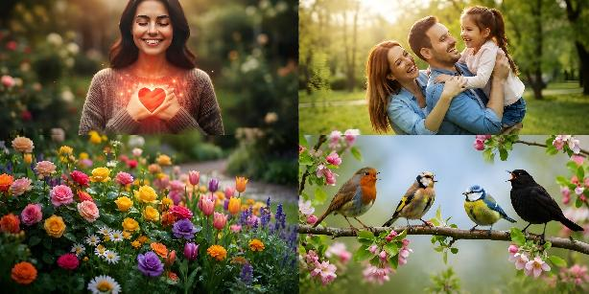

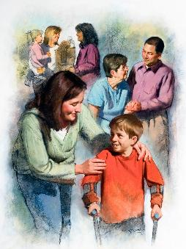
“KO E ʻOFA ʻA E ʻOTUA” (1)
“Ko ia ʻoku ʻikai ʻofa, ʻoku ʻikai ʻiloʻi ʻe ia ʻae ʻOtua; he ko e ʻOtua ko e ʻofa.” (1 Sione 4:8)
ʻOku fakaha mahino ʻe he Tohi Tapu ko e ʻOtua ʻa e ʻofa (1 Sione 4:8). Kuo Ne lilingi hifo ʻa e ʻofa ko ia ki Heʻene fakatupu kotoa. ʻOku lava ke tau sio ki ai ʻi hotau loto; ʻi he va fetuʻutaki ʻa e matuʻa mo e fanau; ʻi he ngaahi matalaʻiʻakau fakaʻofoʻofa; ʻi he fanga manupuna ‘i he fasi; …
Naʻe akoʻi ʻe Paula ʻa e kau Kolinito (pea mo kitautolu) ʻoku langaki hake ʻa e ʻofa (1 Kolinito 8:1); ʻoku ʻikai hano mahuʻinga taʻe kau ai ʻa e ʻofa (1 Kolinito 13:1-3); pea ʻoku totonu ke fai ʻa e meʻa kotoa pe ʻaki ʻa e ʻofa ko ia ʻoku haʻu mei he ʻOtua. (1 Kolinito 16:14).
Ka ʻoku ʻikai ha veiveiua, ko e fakahaaʻi maʻongoʻonga taha ʻo e ʻofa ʻa e ʻOtua ʻe lava ke mamata ki ai ʻi hono foaki ʻo Sisu ko ha feilaulau maʻa ʻetau ngaahi angahala (Sione 3:16).
ʻOku tataki kitautolu ʻe he sipinga ko ʻeni ke tau ʻulungaanga ki he niʻihi kehe ʻaki ʻa e ʻofa tatau kuo fakahaaʻi mai ʻe he ʻOtua kiate kitautolu (1 Sione 3:16)

Slide 6
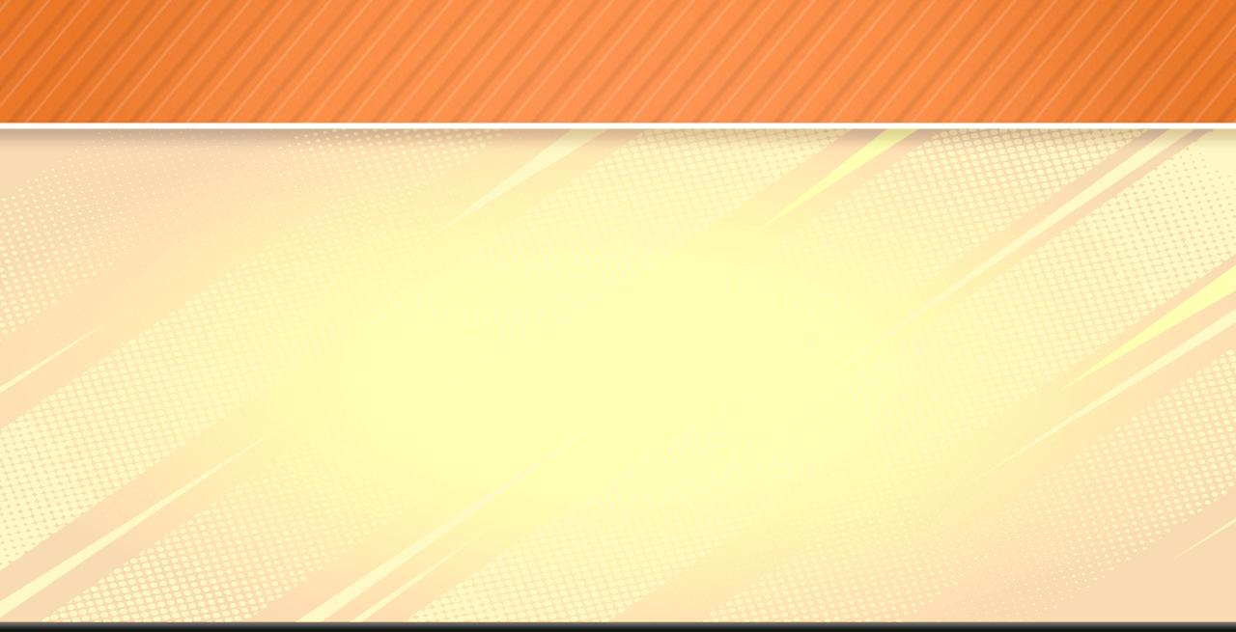
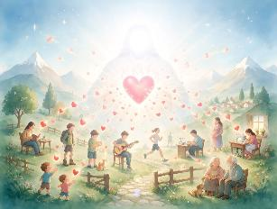
“KO E ʻOFA ʻA E ʻOTUA” (2)
“Ko hono ngata, ʻe kāinga, siʻotoʻofa atu. Ke mou haohaoa, ke mou fiemālie, mou loto taha pe, mou moʻui melino; pea ko e ʻOtua ʻoe ʻofa mo e melino ʻe ʻiate kimoutolu ia.” (2 Kolinitō 13:11)
ʻOku fakahaaʻi ʻ e Paula ʻ a e ʻ Otuá ʻ i ha founga kehekehe:
ʻOku foaki mai ʻe he ʻOtua ko e Tamai ʻa ʻEne ʻofa kiate kitautolu (1 Sione 3:1)
ʻOku fakafonu kitautolu ʻe he ʻOtua ko Kalaisi ʻaki ʻa e kakato ʻo ʻEne ʻofa (ʻEfeso 3:19)
Ke lilingi hifo ʻe he ʻOtua ko e Laumalie Maʻoniʻoni ʻa ʻene ʻofa kiate kitautolu (Loma 5:5)
“ʻOtua ʻo e faʻa kataki" (Loma 15:5)
“ʻOtua ʻo e ʻamanaki lelei" (Loma 15:13)
“Ko e ʻOtua ʻo e melino" (Loma 15:33)
“Ko e ʻOtua [...] ʻo e ngaahi ʻaloʻofa" (2 Kolinito 1:3a)
“Ko e ʻOtua ʻo e fakafiemalie kotoa pe" (2 Kolinito 1:3b)
“ʻOtua ʻo e ʻofa" (2 Kolinito 13:11)
ʻOku ʻikai ngata pe ʻi hono maʻu ʻe he ʻOtua ʻa e ngaahi ʻulungaanga kotoa ko ʻeni, ka ko Ia ʻa e tupuʻanga ʻoku haʻu kotoa mei ai kiate kitautolu.
Hange ko ia ne tau mamata ki ai, ko e ʻOtua ʻa e ʻofa, ka ko Ia foki ʻa e ʻOtua ʻo e ʻofa, ʻa ia ko hono ʻuhinga:

Slide 7

“KO E FEOHI ʻA E LAUMALIE MAʻONIʻONI”
“Ko e ʻaloʻofa ʻae ʻEiki ko Sisu Kalaisi, mo e ʻofa ʻae ʻOtua, mo e feohi ʻoe Laumālie Māʻoniʻoni, ke ʻiate kimoutolu kotoa pē. ʻEmeni.” (2 Kolinitō 13:14)
ʻOku fakaʻamu ʻa Paula ke nau ʻiate kitautolu: ʻa e ʻaloʻofa ʻa ha Tokotaha (ko e ʻEiki ko Sisu Kalaisi); ko e ʻofa ʻa ha Tokotaha (ʻOtua); mo e feohi... ʻo ha malohi pe ʻo ha Tokotaha? (2 Kolinito 13:14). ʻOku lea ʻa Paula ʻo kau ki ha Tokotaha (ko e Laumalie Maʻoniʻoni), kae ʻikai ko ha malohi.
Teuteuʻi ʻa e kakai ki he ngaue fakafaifekau (1 Kolinito 2:4)
ʻOku ne fakaha mai kiate kitautolu ʻa e ngaahi meʻa loloto ʻa e ʻOtua
(1 Kolinito 2:10)
ʻOku Ne akoʻi kitautolu (1 Kolinito 2:13)
ʻOku Ne ʻafio ʻiate kitautolu (1 Kolinito 3:16)
Ngaue fakataha mo Kalaisi ke fakatonuhiaʻi kitautolu (1 Kolinito 6:11)
ʻOku Ne foaki ʻa e ngaahi meʻafoaki fakalaumalie (1 Kolinito 12:7-11)
ʻOku Ne silaʻi kitautolu ki he fakamoʻui (2 Kolinito 1:22)
Fakato ʻa e fono ki hotau loto (2 Kolinito 3:3)
ʻOku Ne foaki mai kiate kitautolu ʻa e moʻui foʻou ʻia Kalaisi (2 Kolinito 3:6)
ʻOku Ne fakatauʻatainaʻi kitautolu mei he angahala (2 Kolinito 3:17)
ʻI heʻene fakamatala ʻe 40 tupu ki he Laumalie Maʻoniʻoni ʻi he ngaahi tohi ki he kakai Kolinitoo, ʻoku fakahaaʻi ai ʻe Paula kiate ia ʻa e ngaahi ʻulungaanga fakafoʻituitui, kae ʻikai ko ha ivi pe ʻoku haʻu mei he ʻOtua:

Slide 8
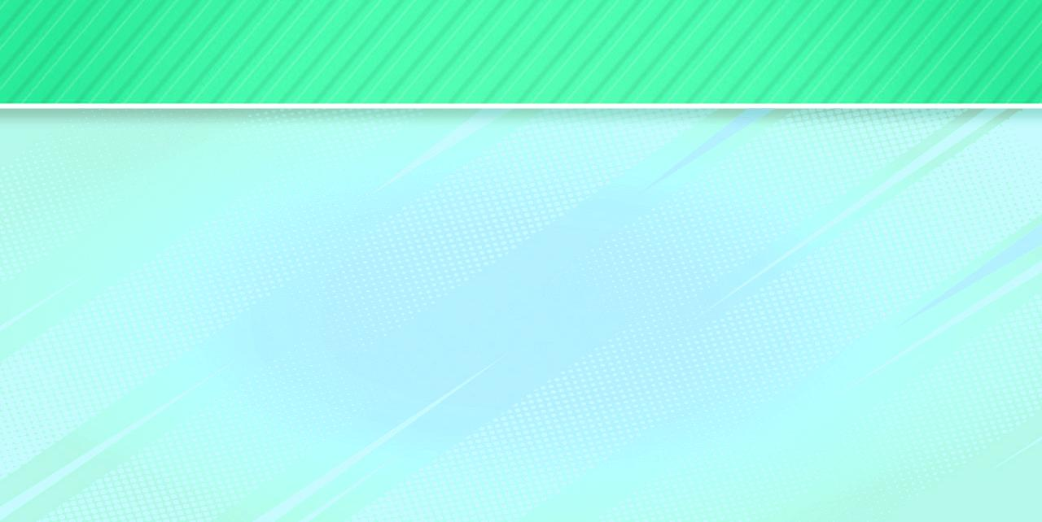

“KE ʻIATE KIMOUTOLU KOTOA PE"
“Kuo fili ʻo fakatatau ki he muʻaki ʻilo ʻoe ʻOtua ko e Tamai, ʻi he fakamāʻoniʻoniʻi ʻoe Laumālie, ki he talangofua, pea ʻi he luluku ʻoe taʻataʻa ʻo Sisu Kalaisi: Ke tupulekina pe kiate kimoutolu ʻae ʻaloʻofa mo e monūʻia.” (1 Pita 1:2)
Neongo ʻoku tau anga ʻaki ʻa e lau ki he Tolu ʻOtua (Toko tolu fakalangi, ʻOtua pe taha) ʻi he fakahokohoko ko e "Tamai, ʻAlo, Laumalie" (Matiu 28:19), ka ʻoku fakahaaʻi ia ʻe Paula ko e "ʻAlo, Tamai, Laumalie" (2 Kolinito 13:14), pea ko Pita ko e "Tamai, Laumalie, ʻAlo" (1 Pita 1:2).
ʻOku ʻikai ke ʻi ai ha tuʻunga fakahokohoko ʻiate kinautolu; ʻoku kehekehe pe honau fatongia ʻi he palani ʻo e fakamoʻui, ka ʻoku nau maʻu kotoa ʻa e ngaahi ʻulungaanga mo e taumuʻa tatau.
KELESI
Mei he Tamai (1 Kolinito 1:3)
Mei he ʻAlo (1 Kolinito 1:3)
Mei he Laumalie (Hepelu 10:29 )
ʻOFA
Mei he Tamai (1 Sione 2:15)
Mei he ʻAlo (Loma 8:35)
Mei he Laumalie (Loma 15:30)
FEOHI
Mei he Tamai (1 Sione 1:3)
Mei he ʻAlo (1 Sione 1:3)
Mei he Laumalie (Fili. 2:1)
Ko ia ai, naʻe fakaʻosi ʻe Paula ʻene tohi, ʻi heʻene fakaʻamu ke ʻiate kitautolu kotoa ʻa e ʻaloʻofa, ʻofa, mo e feohi ʻa e Toluʻi ʻOtua kakato (2 Kolinito . 13:14)

Slide 9

EGW (Ko e Faka'evangelio, p. 615)
“He ʻikai lava ke fakamatalaʻi ʻa e Tamaí ʻaki ʻa e ngaahi meʻa ʻo e māmaní. Ko e Tamaí ko e kakato kotoa ia ʻo e Tuʻunga Fakaʻotuá ʻi he sinó, pea ʻoku ʻikai ke hā ia ki he sio fakamatelié.
Ko e ʻAló ko e kakato kotoa ia ʻo e Tuʻunga Fakaʻotuá ʻoku fakahaaʻí. [...]
Ko e Fakafiemalie na’e tala’ofa ‘e Kalaisi te ne fekau’i mai hili ‘ene ha’ele hake ki langi, ko e Laumalie ‘i he kakato kotoa ‘o e ‘Otua, ‘o ne fakahaa’i ‘a e ivi ‘o e kelesi faka’otua kiate kinautolu kotoa pe ‘oku nau ma’u mo tui kia Kalaisi ko e Fakamo’ui fakafo’ituitui. ʻOku ʻi ai ha toko tolu moʻui ʻo e toko tolu fakalangí; 'i he hingoa 'o e ngaahi malohi lalahi 'e tolu ko 'eni --ko e Tamai, 'Alo, mo e Laumalie Ma'oni'oni--'oku papitaiso 'a kinautolu 'oku nau tali 'a Kalaisi 'i he tui mo'ui, pea 'e fengaue'aki 'a e ngaahi malohi ko 'eni mo e kakai talangofua 'o e langi 'i he'enau feinga ke mo'ui 'aki 'a e mo'ui fo'ou 'ia Kalaisi.”

