Slide 1

‘OKU FOLOFOLA ‘A E TOKOTAHA FAKATUPU
Lesoni 1 ki he ʻaho 3 ʻo ʻOkatopa 2026

Slide 2


"Ko e ʻOtua, ʻaia naʻe folofola ʻi muʻa ʻi he ngaahi kuonga kehekehe mo e ngaahi anga kehekehe ki he ngaahi tamai ʻi he kau palōfita, Kuo ne folofola ʻi he ngaahi ʻaho ki mui ni kiate kitautolu ʻi hono ʻAlo, ʻaia kuo ne tuʻutuʻuni ke ʻaʻana ʻae ngaahi meʻa kotoa pē, ʻaia ne ne ngaohi ai foki ʻae ngaahi maama; .“ (Hepelū 1:1-2)

Slide 3



Kuo ke lea hangatonu nai ki he ʻOtua? Kuo ke lava nai ʻo fanongo ki Heʻene folofola? Ko e tali, ʻoku mahino, ko e: "ʻIkai."
Te tau toki lava pe ʻo lea ki he ʻOtua ʻi ha ngaahi founga ʻoku ʻikai fakahangatonu (lotu, Tohi Tapu, kau palofita, ...)
Ko e ha ʻa e ʻuhinga ʻoku ʻikai ke tau lava ai ʻo lea hangatonu ki he ʻOtua? Kuo pehe maʻu pe ia? Te tau lava nai ʻo fai ia?
Naʻe anga - fēfē ʻ a e muʻaki fetuʻutaki ʻ a e ʻ Otuá mo e faʻahinga ʻ o e tangatá
1
Naʻe anga - fēfē hono taʻofi ʻ e he faʻahinga ʻ o e tangatá ʻ a e fetuʻutaki mo e ‘Otua?
2
Naʻe anga - fēfē ʻ a e feinga ʻ a e ʻ Otuá ke toe fakafoki mai ʻ a e fetuʻutakí?
3
Ko e ha ʻoku ʻikai ke tau lava ai ʻo fetuʻutaki hangatonu mo e ʻOtua he taimi ni?
4
ʻE lava fefe ke tau fetuʻutaki mo e ʻOtua he ʻaho ni?
5

Slide 4


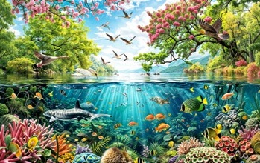



NAʻE ANGA - FĒFĒ ʻ A E MUʻAKI FETUʻUTAKI ʻ A E ʻ OTUÁ MO E FAʻAHINGA ʻ O E TANGATA
“Pea naʻe fekau ʻe Sihova ko e ʻOtua ki he tangata, ʻo pehē, “ʻE ngofua ʻa hoʻo kai mei he ʻakau kotoa pē ʻoe ngoue,” (Senesi 2:16)
ʻI he kamataʻanga, naʻe fakatupu ʻe he ʻOtua ʻa e mamani ke nofoʻi ʻe he faʻahinga ʻo e tangata (ʻIsaia 45:18)
ʻI he maau ʻa e meʻa kotoa pe, naʻa ne fakatupu ʻa ʻAtama mei he efu ʻo e kelekele (Senesi 2:4-7)
ʻI he ʻaho tatau pe, naʻa ne fakatupu ʻa ʻIvi mei he taha ʻo e ngaahi hui vakavaka ʻo ʻAtama (Senesi 2:18, 21-22)
Kuo kakato ʻeni ʻa e faʻahinga ʻo e tangata pea mateuteu ke nofoʻi ʻa e mamani foʻou (Senesi 1:27)

Slide 5




NAʻE ANGA - FĒFĒ ʻ A E MUʻAKI FETUʻUTAKI ʻ A E ʻ OTUÁ MO E FAʻAHINGA ʻ O E TANGATA
“Pea naʻe fekau ʻe Sihova ko e ʻOtua ki he tangata, ʻo pehē, “ʻE ngofua ʻa hoʻo kai mei he ʻakau kotoa pē ʻoe ngoue,” (Senesi 2:16)
Lolotonga ʻa e ngaue ko ʻeni, naʻe lahi ʻa e fetuʻutaki ʻi he vahaʻa ʻo e ʻOtua mo ʻAtama:
Naʻa ne ʻoange kiate ia ha ngaahi fakahinohino fekauʻaki mo e ngaue ke ne fai ʻi ʻIteni (Senesi 2:15).
Naʻa ne fakamahinoʻi hono ngaahi fakangatangata (Senesi 2:16-17).
Naʻa ne kole ange ke ne fakahingoa ʻa e fanga monumanu (Senesi 2:19).
Naʻa ne fakafeʻiloaki ia kia ʻIvi, pea fakatahaʻi kinaua ʻi he mali (Senesi 2:22-24).

Slide 6




NAʻE ANGA - FĒFĒ ʻ A E MUʻAKI FETUʻUTAKI ʻ A E ʻ OTUÁ MO E FAʻAHINGA ʻ O E TANGATA
“Pea naʻe fekau ʻe Sihova ko e ʻOtua ki he tangata, ʻo pehē, “ʻE ngofua ʻa hoʻo kai mei he ʻakau kotoa pē ʻoe ngoue,” (Senesi 2:16)
Naʻe fakahinohinoʻi ʻe he ʻOtua ʻa ʻAtama mo ʻIvi ʻi he founga ʻoku totonu ke na fai mo e meʻa ʻoku totonu ke na kai (Senesi 1:28-29).
Naʻa Ne fakatupu kinautolu ko ha kakai fakasosiale, mo e malava ke fetuʻutaki, ʻo ʻikai ngata pe ʻiate kinautolu, ka mo e kakai kehe (hange ko ʻeni, ko e kau ʻangelo).
Naʻa ne fokotuʻu leva ʻa e ʻaho hono fitu ke na lava ʻo fiefia ʻi heʻena feohi ʻi he ʻaho ko ia.
Talu mei he momeniti ko ia, naʻa ne fakataha mo kinautolu ʻi he ʻaho kotoa pe ʻi he mokomoko ʻo e ʻaho (Senesi 3:8).

Slide 7

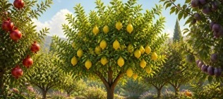
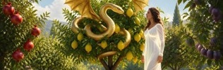



NAʻE ANGA FEFE HONO TAʻOFI ʻE HE FAʻAHINGA ʻO E TANGATA ʻA E FETUʻUTAKI MO E ʻOTUA?
“Pea pehē ʻe ia, “Naʻaku fanongo ki ho leʻo ʻi he ngoue, pea naʻaku manavahē, koeʻuhi kuo u telefua; pea u toitoi ai.”” (Senesi 3:10)
Naʻe fakatupu ʻa ʻAtama mo ʻIvi mo e malava ke na fili tauʻataina. Koeʻuhi ke na lava ʻo fakaʻaongaʻi ʻa e tauʻataina ko ia, naʻe foaki ʻe he ʻOtua ʻa e meʻa kotoa pe kiate kinaua, ka naʻa ne fakatatali ha fuʻu ʻakau maʻana (Senesi 2:16-17).
ʻI he fuʻu ʻakau tatau pe, naʻe fakapuli ʻa e tokotaha fakatauele ko ha ngata mo fakangalingali ʻoku ne fie maʻu ʻa e lelei ʻa ʻAtama mo ʻIvi, ʻo ne tala kiate kinautolu ha ngaahi loi hokohoko (ʻa ia naʻe ʻave ʻe ʻIvi kia ʻAtama): ʻoku mo taʻe-faʻa-mate ("he ʻikai te mo mate"); te mo hoko ko e ngaahi ʻotua ("te ke hange ko e ʻOtua"); ʻoku fufuuʻi ʻe he ʻOtua ʻa e moʻoni meiate koe ("ʻOku ʻafioʻi ia ʻe he ʻOtua...") (Senesi 3:1-5).
ʻI heʻene saiʻia ʻi he fakaofo ʻo e fuaʻiʻakau tapu, naʻe kai ai ʻa ʻIvi pea fakataueleʻi ʻa ʻAtama, ʻa ia naʻa ne kai foki mo ia (Senesi 3:6).
ʻI he momeniti ko ia, naʻe mole atu ʻa e pulupulu ʻo e naunau naʻa ne ʻufiʻufi kinautolu; naʻa nau ʻiloʻi ʻenau telefua; pea naʻa nau kumi ha ngaahi founga ke fufuuʻi ʻaki ʻenau fehalaaki (Senesi 3:7).
Ko e tali kovi hono hoko ko ʻenau ongoʻi halaia ʻi heʻenau talangataʻa ʻo ʻikai ke nau toe fie fetuʻutaki mo e ʻOtua (Senesi 3:8).

Slide 8
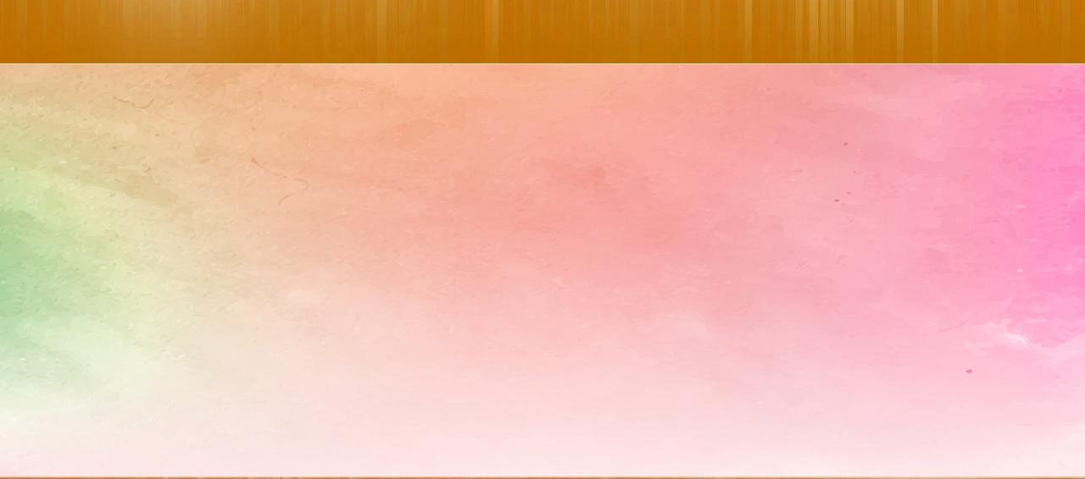




NAʻE ANGA - FĒFĒ ʻ A E FEINGA ʻ A E ʻ OTUÁ KE TOE FAKAFOKI MAI ʻ A E FETUʻUTAKÍ?
“Pea naʻe ui ʻe Sihova ko e ʻOtua kia ʻAtama, ʻo ne pehē kiate ia, “ʻOku ke ʻi fē?”(Senesi 3:9)
ʻI hono ʻafioʻi kuo faiangahala ʻa ʻAtama mo ʻIvi, naʻe haʻu ʻa e ʻOtua—ʻo hange ko ʻene angamaheni—kiate kinaua ke talanoa kiate kinaua. Ko e fuofua taimi ʻeni, naʻe ʻikai ke fiefia ʻa e ʻOtua ke fakafetaulaki kiate ia, ka naʻe pau ke ui kinaua ʻe he ʻOtua ke na feʻiloaki mo ia (Senesi 3:8-9).
Neongo naʻe ʻikai ke nau fie fetuʻutaki mo e ʻOtua, ka naʻe fie fetuʻutaki ʻa e ʻOtua mo kinautolu. Naʻe ʻikai ke ne fakaʻehiʻehi mei he feohi ʻa e angahala, ka naʻa ne fehangahangai mo ia mo ʻene angahala, ʻo fekumi ki heʻene fakatomala (Senesi 3:10-11).
Hili ha ngaahi senituli mei ai, naʻe ʻafio mai ʻa e ʻOtua ʻaki hono fofonga ki ha tokotaha angahala ʻe taha ke maʻu ʻene fakatomala: ko Pita (Luke 22:61-62).
Naʻe kamata ke fakatonuhiaʻi kinaua ʻe ʻAtama mo ʻIvi ʻi he ʻao ʻo e ʻOtua mo tukuakiʻi e niʻihi kehe ʻi heʻena maumaufono (Senesi 3:12-13).
ʻI he ʻaho ni, ʻoku tau muimui ʻi he ngaahi sipinga tatau. ʻOku tau pikitai ki he angahala mo feinga ke fakatonuhiaʻi kitautolu. Neongo ʻoku "pipiki" ʻa e angahala kiate kitautolu, ka ʻoku kei fie maʻu pe ʻe he ʻOtua ke toe fakafoki mai kitautolu, pea ʻoku Ne ui kitautolu: "Haʻu kiate au" (ʻIsaia 55:3).

Slide 9




KO E HA ʻOKU ʻIKAI KE TAU LAVA AI ʻO FETUʻUTAKI HANGATONU MO E ʻOTUA HE TAIMI NI?
“Pea naʻa ne kapusi ai ʻae tangata pea ne tuku ki he potu hahake ʻoe ngoue ʻo ʻIteni, ʻae selupimi, mo e heletā ulo, ʻaia naʻe foli fakatakamilo, ke leʻohi ʻae hala ʻoe ʻakau ʻoe moʻui.” (Senesi 3:24)
Naʻe fakaha ʻe he ʻOtua ki he ongomeʻa faiangahala ʻa e ngaahi nunuʻa ʻo ʻena angahala, ʻa ia naʻe kau ai ʻa e ʻikai malava ke toe lea hangatonu ki he ʻOtua hili ʻena kapusi mei ʻIteni (Senesi 3:16-24).
Ngaahi nunuʻa ki he:
Ivi
Atama
Kotoa
Mole ʻa e tuʻunga tatau mo ʻAtama
amahi lolotonga e faʻele
To ʻo e meʻakai
gaue malohi
Mavahe mei he ʻOtua
Mate
Kimuʻa pea fakaha mai ʻe he ʻOtua ʻa e ngaahi nunuʻa ʻo e angahala, naʻe ʻoange ʻe he ʻOtua kiate kinautolu ʻa e founga ke fakaleleiʻi ʻaki: ʻe fakangata ʻe ha hako ʻo ʻIvi ʻa e malohi ʻo e tevolo pea fakafoki mai ʻa e faʻahinga ʻo e tangata (Senesi 3:15).
Naʻe fakaha mai ʻe he ʻOtua ʻo fakafou ʻi he kau palofita ʻa e founga ʻe fakahoko ai ʻa e huhuʻi: Naʻe hoko tonu ʻa e ʻOtua ko ha sino, naʻa ne katakiʻi ʻa e mate koeʻuhi ko ʻetau ngaahi angahala, toetuʻu, pea foaki mai kiate kitautolu ʻa e moʻui taʻengata (ʻIsaia 9:6; 53:6, 10-11).
ʻI he hoko pe ʻa e angahala, naʻe pehe pe mo e talaʻofa ʻo ha Fakamoʻui.

Slide 10

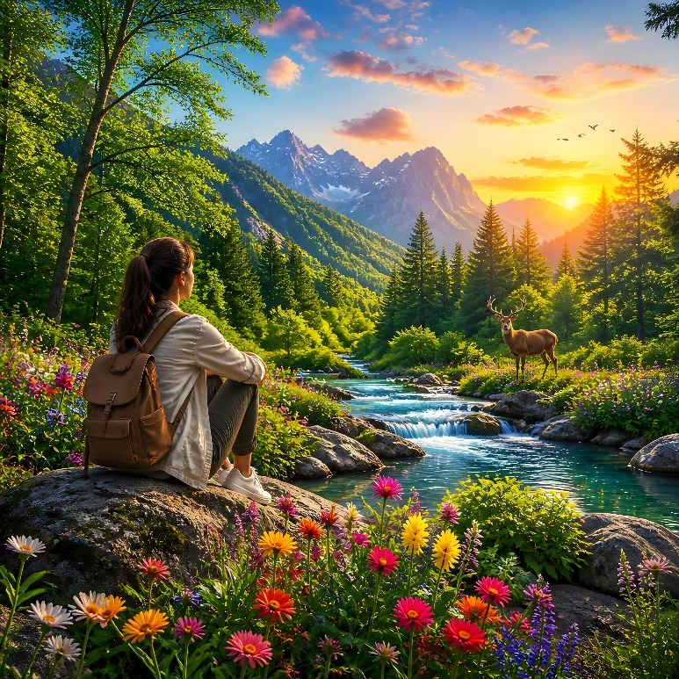



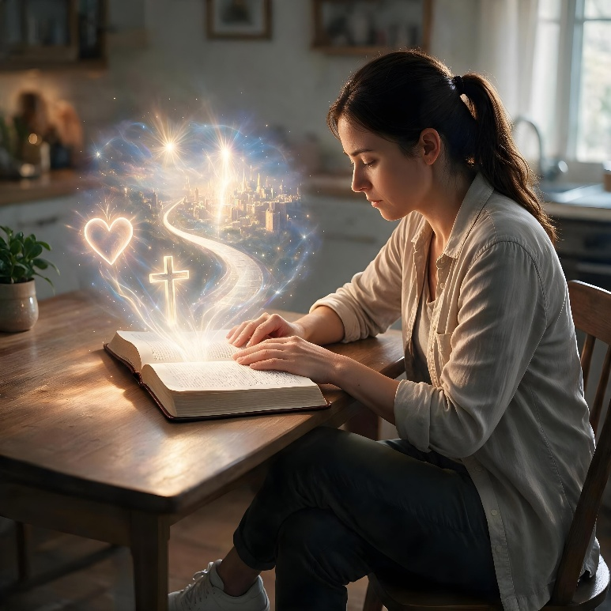

ʻE LAVA FEFE KE TAU FETUʻUTAKI MO E ʻOTUA HE ʻAHO NI?
“Pea ʻoku pehē, ʻE foha ʻoe tangata, kuo u tuku koe ko e leʻo ki he fale ʻo ʻIsileli; ko ia te ke fanongo ki he folofola mei hoku fofonga, pea ke valokiʻi ʻakinautolu meiate au..”
(‘Isikeli 33:7)
Ke fetuʻutaki mo kitautolu he ʻaho ni, kuo tohi ʻe he ʻOtua ha "tohi maʻuʻanga tokoni" ʻe ua: Fakatupu, mo e Tohi Tapu (Loma 1:20; 2 Timote 3:15).
Neongo ʻoku lea mai ʻa e Fakatupu kiate kitautolu ʻo kau ki he Tupuʻanga, ka ʻoku ʻuliʻi lahi ia ʻe he angahala. Ka ʻoku ʻi he Tohi Tapu ʻa e ngaahi fakahinohino mahino mo fakahangatonu, naʻe ʻomai ʻe he kau palofita naʻa nau maʻu ʻa e ngaahi popoaki mei he ʻOtua. ʻOku tau toe maʻu foki ʻi he Tohi Tapu ʻa e fakaha haohaoa taha ʻo e ʻOtua ʻi he moʻui mo e ngaue fakafaifekau ʻa Sisuu (Hepelu 1:1-2).
ʻOku tau ʻiloʻi ai pe ko hai kitautolu, feituʻu ʻoku tau haʻu mei ai, mo e feituʻu ʻoku tau ʻalu ki ai. ʻOku tau maʻu ai ʻa e taumuʻa ʻa e ʻOtua ki heʻetau moʻui.
ʻIkai ngata ai, ʻoku fetuʻutaki mai ʻa e ʻOtua mo kitautolu ʻi he lotu (Saame 5:2); kau ʻangelo (Ngaue 8:26); kau palofita (Sioeli 2:28); kae tautautefito ki he Laumalie Maʻoniʻoni (Sione 14:26).

Slide 11
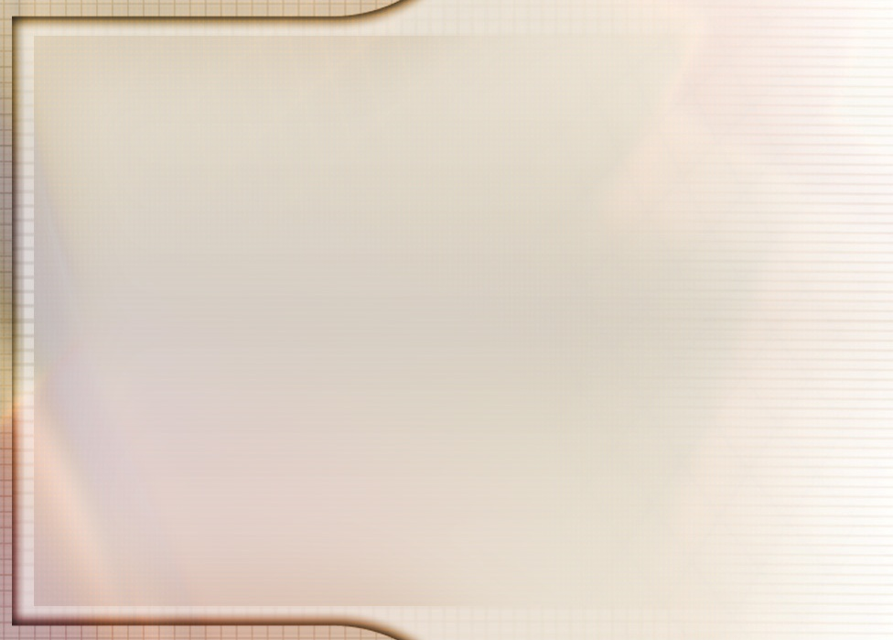
“Naʻe pau ke ʻi ai ha fengaueʻaki ʻi he vahaʻa ʻo e tangata mo e ʻOtua. Ka naʻe fakafeʻatungiaʻi lahi ʻa e palani ko ʻeni ʻe he maumaufono ʻa ʻAtama. Naʻe tataki ia ʻe Setane ki he angahala, pea naʻe ʻikai ke fetuʻutaki ʻa e ʻEiki mo ia hili ʻene faiangahala ʻo hange ko ia naʻa ne fai ʻi he taimi naʻe ʻikai haʻane angahala.
Hili e hinga naʻe hoko ʻa Kalaisi ko e faiako ʻa ʻAtama. Naʻa ne ngaue ʻo fetongi ʻa e ʻOtua ki he faʻahinga ʻo e tangata, ʻo fakahaofi ʻa e matakali mei he mate he taimi pe ko ia. Naʻa Ne toʻo kiate ia ʻa e lakanga ko e fakalaloa. Naʻe ʻoange kia ʻAtama mo ʻIvi ha ʻahiʻahiʻanga ke na foki ai ki heʻena mateaki, pea naʻe tali kotoa hona hako ʻi he palani ko ʻeni.
Ka ne taʻeʻoua ʻa e fakalelei ʻa e ʻAlo ʻo e ʻOtua naʻe ʻikai mei lava ke fai ha fetuʻutaki ʻo e tapuaki pe fakamoʻui mei he ʻOtua ki he tangata. Naʻe meheka ʻa e ʻOtua ʻi he fakaʻapaʻapaʻi ʻo ʻEne fono. Naʻe fakatupu ʻe he maumauʻi ʻo e fono ko ia ha fakamavahevaheʻi fakamanavahe ʻi he vahaʻa ʻo e ʻOtua mo e tangata. Naʻe foaki kia ʻAtama ʻi heʻene taʻehalaia ʻa e fetuʻutaki, fakahangatonu, tauʻataina, mo fiefia mo hono Tupuʻanga. Hili ʻene maumaufono, naʻe fetuʻutaki ʻa e ʻOtua ki he tangata ʻo fakafou ʻia Kalaisi mo e kau ʻangelo.”
EGW (Fepakipaki mo e Lototoʻa, Sanuali 14)

Slide 12
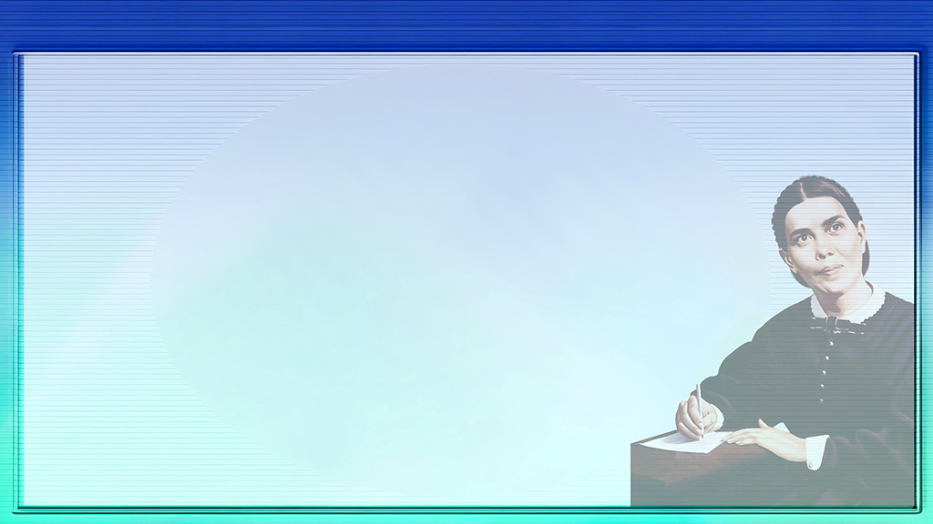



FAKAMATALA FAKALAHI: PIOKALAFI ʻO ELLEN G. WHITE
Naʻe faʻeleʻi ʻa ʻEleni Kouli mo ʻIlisapeti Hamoni, ko e siʻisiʻi taha ia ʻi he fanau ʻe toko valu ʻa ʻIunisi mo Lopeti Hamoni, ʻi he ʻaho 26 ʻo Novema 1827 ʻi Kohami, Meini, USA.
Hili ha taimi nounou mei ai naʻe hiki ʻa e famili ki Portland, ko ha kolo lahi ʻi Maine, ke fakalahi ʻenau pisinisi ngaohi tataa.
ʻI he taʻu hiva ʻa ʻEleni, naʻe tolo ia ʻe hano kaunga ako ʻo lavea lahi hono mata. Naʻe tuʻuloa ʻene lavea ʻo fakamalohiʻi ia ke nofo mei he ako pea fakangatangata ai ʻene moʻui fakasosiale.
Naʻe tali ʻe he famili ʻa e ngaahi akonaki ʻa Viliami Mila, pea naʻe papitaiso ʻa ʻEleni ki he siasi Metotisi ʻi he 1842.
Ka naʻe ongoʻi mole ʻa ʻEleni, pea naʻa ne tui ʻoku ʻikai taau ke fakamoʻui, kae ʻoua kuo tokoniʻi ia ʻe Faifekau Levi Stockman ke mahino kiate ia ʻa e ʻofa moʻoni ʻa e ʻOtua.
Talu mei he momeniti ko iá, naʻá ne ʻ ofa lahi ai kia Sīsū pea tauhi kiate ia ʻ i he toenga ʻ o ʻ ene moʻuí.

