Slide 1

KAU PALOFITA ʻO E FUAKAVA MOTUʻA
Lesoni 3 ki he ʻaho 17 ʻo ʻOkatopa 2026

Slide 2

«naʻe tuʻu ʻa Sihosafate ʻo ne pehē, “ʻE Siuta, mo kimoutolu ʻae kakai ʻo Selūsalema, tokanga kiate au: Tui kia Sihova ko homou ʻOtua, ko ia ʻe fakatuʻumaʻu ai ʻakimoutolu: tui ki heʻene kau palōfita, ko ia te mou monūʻia ai.”»
(2 Me’ahokohoko 20:20)

Slide 3



ʻI he kuonga ʻo e Fuakava Motuʻa, naʻe ui ʻa e kakai naʻa nau maʻu ha ngaahi popoaki mei he ʻOtua ke fetuʻutaki ki he niʻihi kehe ko e kau tangata kikite pe kau palofita (1 Sam. 9:9).
Naʻa nau malava ke ʻiloʻi ʻa e ngaahi meʻa fufuu, pea naʻa mo kinautolu ʻoku teʻeki hoko mai (1 Sam. 9:6), ka naʻe ʻikai fakangatangata pe ʻenau ngaue ki he meʻa ni; naʻe lahi ange ʻa e meʻa naʻe kau ki ai. Ko e moʻoni, naʻe ʻikai haʻu ʻa e malava ko ʻeni meiate kinautolu, ka mei he ʻOtua.
Ka na’e ‘i ai foki mo e kau palōfita loi na’a nau lea ‘aki ‘a e “vīsone ‘o honau loto” (Sel. 23:16).
Ko hai naʻe ui ki he ngāue fakapalōfitá?
Naʻe anga fefe ʻa e ʻulungaanga ʻo e kau palofita?
Ko e ha e ngaue naʻe fai ʻe he kau palofita?
Ko hai ʻa e kau fafine naʻa nau maʻu ʻa e meʻafoaki ʻo e kikite?
Ko e ha e ngaahi ʻulungaanga naʻe maʻu ʻe he kau palofita loi?

Slide 4







KO HAI NAʻE UI KI HE NGAUE FAKAPALOFITA?
“Ko ʻIlaisiā, ko e tangata ia naʻe anga tatau mo kitautolu, pea naʻe lotu fakamātoato ia, ke ʻoua naʻa ʻuha: pea naʻe ʻikai tō ha ʻuha ki he kelekele ʻi he taʻu ʻe tolu mo e māhina ʻe ono. .” (Semisi 5:17)
Te tau lava ʻo maʻu ʻa e fehalaaki ʻo e tui ko e kau palofita ko e "kau tangata maʻolunga ange." Ka naʻe fakatonuhiaʻi ʻe Mosese ia koeʻuhi he naʻe tuai ʻene lea (ʻEkesotoso 4:10); Naʻe pehe ʻe ʻIsaia naʻe ʻi ai hono loungutu taʻemaʻa (ʻIsaia 6:5); Naʻe fakakaukau ʻa Selemaia naʻa ne fuʻu kei siʻi ki he ngaue ko ia (Selemaia 1:6).
ʻOku pehe ʻe ʻIlaisiaa, ʻa ia naʻa ne loto-toʻa ke fakamanamanaʻi ʻa e Tuʻi ko ʻEhapi ʻaki ha fuʻu laʻalaʻa lahi koeʻuhi ko ʻene angakovi: "ko e tangata ia, ʻo hange pe ko kitautolu" (Semisi 5:17).
Hili hono fakahoko ha mana lahi, naʻe to hifo ʻaupito ʻa ʻIlaisia ʻi he fakamanamana ʻo e mate meia Kuini Sisipeli (1 Ngaahi Tuʻi 19:2-4)
ʻOku mahino ʻoku ʻikai fili ʻe he ʻOtua ʻene kau palofita koeʻuhi he ʻoku nau haohaoa. Ko e ha ʻoku ne ʻafioʻi ʻiate kinautolu? Ko ʻenau ʻofa ki he ʻOtua mo ʻenau loto fiemalie ke talangofua kiate ia.

Slide 5





NAʻE ANGA FEFE ʻA E ʻULUNGAANGA ʻO E KAU PALOFITA?
“Pea naʻe pehē ʻe Mikaia, “ʻOku moʻui ʻa Sihova, pea ko ia ʻoku folofolaʻaki kiate au ʻe Sihova, ko ia pe te u leaʻaki.’ ” (1 Ngaahi Tu’i 22:14)
ʻI heʻenau hoko ko e kakai lea ʻa e ʻOtua, naʻe feinga ʻa e kau palofita mo e kau palofita fefine ke moʻui ʻo fakatatau ki honau uiuiʻi (1 Sam. 12:3-4). Naʻe ʻiloʻi kinautolu ʻe he kakai ko e "tangata ʻa e ʻOtua," "tangata fakaʻeiʻeiki" (1 Sam. 9:6).
Ko kinautolu naʻe ʻikai ke nau tali ʻenau popoaki naʻa nau fehiʻa mo fakamanamanaʻi kinautolu (1 Ngaahi Tuʻi 22:8, 27). Ka neongo ʻa e ngaahi teke naʻa nau fehangahangai mo ia, naʻe fakahoko faivelenga ʻe he kau palofita ʻenau popoaki.
Naʻe ha ʻa Maikaia ʻi he ʻao ʻo ha ongo tuʻi, ko ha palofita ʻe toko 400 naʻa na fai ha popoaki lelei, pea mo ha leʻo naʻa ne faleʻi ia ke liliu ki he ngaahi tukunga. (1 Tuʻi 22:10-13). Neongo ia, naʻa ne tuʻu maʻu pea fakafisi ke lea ʻaki ha meʻa kehe mei he meʻa naʻe fakaha ange ʻe he ʻOtua kiate ia (1 Ngaahi Tuʻi 22:14).
Naʻe ʻikai ke nau haohaoa, ka ko e kau tangata mo e kau fafine ʻo e lotu, faivelenga ki he Folofola, mo e kau tamaioʻeiki ʻa e ʻOtua mo hono kakai (1 Sam. 12:23; Selemaia 42:4).

Slide 6





KO E HA E NGAUE NAʻE FAI ʻE HE KAU PALOFITA?
“Pea ko Sehu ko e foha ʻo Nimisi te ke tākai ʻaki ʻae lolo ke ne tuʻi ʻi ʻIsileli: pea ko ʻIlaisa ko e foha ʻo Safati mei ʻEpeli-Mihola, te ke tākai ʻaki ʻae lolo ke hoko ko e palōfita ke ne fetongi koe. .” (1 Ngaahi Tuʻi 19:16)
Naʻe fakahoko ʻe he kau palofita ʻa e ngaahi ngaue ko ʻeni, kau ai ʻa e ngaahi meʻa kehe:
Mo e ngaahi tuʻi
Naʻa nau pani kinautolu
Mo e kau taulaʻeiki
Naʻa nau fehangahangai mo kinautolu ʻi he taimi naʻa nau fai ai ha meʻa hala
Mo e kakai
Naʻa nau fakahinohinoʻi kinautolu ʻi he ngaahi hala ʻo e ʻOtua (Maika 6:8)
Fakataha mo kimautolu
Naʻa nau ʻai ʻenau ngaahi pōpoakí ʻi ha tohi .
(1 Ngaahi Tuʻi 19:16)
Naʻa nau fakalotolahiʻi kinautolu ʻi he taimi naʻa nau fai lelei ai
(2 Me’ahokohoko 15:8)
Naʻa nau fehangahangai mo kinautolu ʻi he taimi naʻa nau fai ai ha meʻa hala
(1 Ngaahi Tuʻi 21:20)
(Mal. 2:1-2)
Naʻa nau fakaha ʻenau angahala kiate kinautolu (ʻIsaia 58:1)
Naʻa nau ui kinautolu ke nau fakatomala (ʻIsikeli 18:32)
(2 Me’ahokohoko 13:22)

Slide 7





KO FE 'A E KAU FEFINE NA'A NAU MA'U 'A E ME'A'OFA 'O E PALOFITA?
“Pea ko Tepola, ko e fefine palōfita, ko e uaifi ʻo Lapetoti, naʻa ne fakamaauʻi ʻa ʻIsileli ʻi he kuonga ko ia.” (Fakamaau 4:4)
ʻOku fakamatala ʻa e Fuakava Motuʻa ki ha kau palofita fefine fefine ʻe toko nima. Ko e taha ʻo kinautolu, ko Noaia, ko ha palofita loi (Nehemaia 6:14). Fekauʻaki mo e uaifi ʻo ʻIsaia, ʻoku ʻikai ke tau ʻilo pe ʻoku ui ia ko ha palofita fefine koeʻuhi he naʻa ne maʻu ʻa e meʻafoaki ko ia, pe koeʻuhi ko e uaifi ia ʻo e palofita (ʻIsaia 8:3).
MELE, ʻI heʻene hoko ko ha palofita fefine, naʻa ne taki ʻa e kakai fefine ʻi he hiva hili ʻenau kolosi ʻi he Tahi Kulokula. Naʻa ne tokoni foki ki hono ngaahi tokoua ke taki ʻa e kakai lolotonga ʻenau fononga pilikimi ʻi he toafa (ʻEkesotosi 15:20; Maika 6:4).
TEPOLA. Naʻa ne maʻu ʻa e lakanga ʻe ua ko e palofita fefine mo e fakamaau, pea naʻa ne taki ʻa e kakai ʻi he tau mo Sisela, fakataha mo Pelaki. Hili ʻa e ikuna, naʻa ne hivaʻi ha hiva fakakikite ʻo e fakafetaʻi (Fakamaau 4:4-9; 5:1).
HULITA. Na‘e fehu‘i kiate ia ‘a Siosaia fekau‘aki mo e tohi Lao na‘e ma‘ú. ‘Ikai ngata pē ‘i hono tali ‘a e fehu‘i ‘a e tu‘í, na‘á ne lea‘aki ‘a e ngaahi lea fakalototo‘a kiate ia (2 Tu‘i 22:14-20).

Slide 8



KO E HĀ HA NGAAHI ULUNGAANGA NAʻE MAʻU ʻE HE KAU PALOFITA LOÍ?
“Pea naʻe pehē ʻe Sihova kiate au, “ʻOku kikite loi ʻi hoku huafa ʻae kau palōfita: naʻe ʻikai te u fekau ʻakinautolu, pe tala kiate kinautolu, pea naʻe ʻikai te u lea kiate kinautolu: kuo nau lea ʻaki ʻae misi loi mo e kikite kākā,mo e meʻa vaʻinga,pea mo e kākā ʻo honau loto.” (Selemaia 14:14)
Naʻe ʻikai ko kinautolu kotoa pe naʻa nau kikite naʻa nau fai ia koeʻuhi he naʻa nau maʻu ha popoaki mei he ʻOtua (Selemaia 14:14). Ko e ha ʻenau popoaki, pea ko e ha naʻa nau fakahoko ai ia?
Naʻa nau faʻu pe ʻenau ngaahi kikite pe ʻanautolu (ʻIsi. 13:2, 17)
Naʻa nau lea ʻaki ʻa e meʻa naʻe fie fanongo ki ai ʻa e kakai (ʻIsikeli 13:16)
Naʻe ʻikai te nau lea ʻo fakafepakiʻi ʻa e angahala (ʻIsikeli 13:22)
Naʻa nau fekumi ki ha lelei fakafoʻituitui (ʻIsikeli 13:19)
Ko e ha ʻoku pehe ai ʻe ha taha ʻoku ne lea maʻa e ʻOtua lolotonga ia ʻoku nau ʻiloʻi ʻoku ʻikai moʻoni? Ko e kakaaʻi pe kita? Ko ha holi ke ʻiloʻi, pe paʻanga pe ha meʻa kehe?
Ko e meʻa fakamamahi taha fekauʻaki mo e kau palofita loi he ʻoku ʻi ai ha kakai ʻoku nau fanongo mo muimui kiate kinautolu. ʻOku nau saiʻia ʻi he meʻa ʻoku nau lea ʻaki koeʻuhi he ʻoku ʻikai fie maʻu ki ai ha ngaue pea ʻikai ueʻi honau konisenisi. Ka ko e muimui ki honau hala ʻoku iku pe ki he mate.
ʻOku fakatokanga maʻu pe ʻa e palofita moʻoni fekauʻaki mo e ngaahi fakatuʻutamaki ʻo e angahala, mo poupouʻi ʻa e kakai ke nau faivelenga ʻo tatau ai pe pe ko e ha hono ngaahi nunuʻa.

Slide 9

“Naʻe ʻikai ha taha ʻo e kau ʻaposetolo mo e kau palofita naʻa ne pehe ʻoku ʻikai haʻanau angahala. Ko e kau tangata naʻa nau moʻui ofi taha ki he ʻOtua, ko e kau tangata naʻa nau feilaulauʻi ʻa e moʻui kae ʻikai fai ha ngaue hala, ko e kau tangata kuo fakalangilangiʻi ʻe he ʻOtua ʻaki ʻa e maama mo e malohi fakalangi, kuo nau vete ʻa e angahala ʻo honau natula. Kuo ʻikai ke nau falala ki he kakano, ʻikai ke nau maʻu ha maʻoniʻoni ʻanautolu, ka kuo nau falala kakato ki he maʻoniʻoni ʻa Kalaisi.”
EGW (Ko e Ngaue ʻa e Kau ʻAposetolo, p. 561)

Slide 10
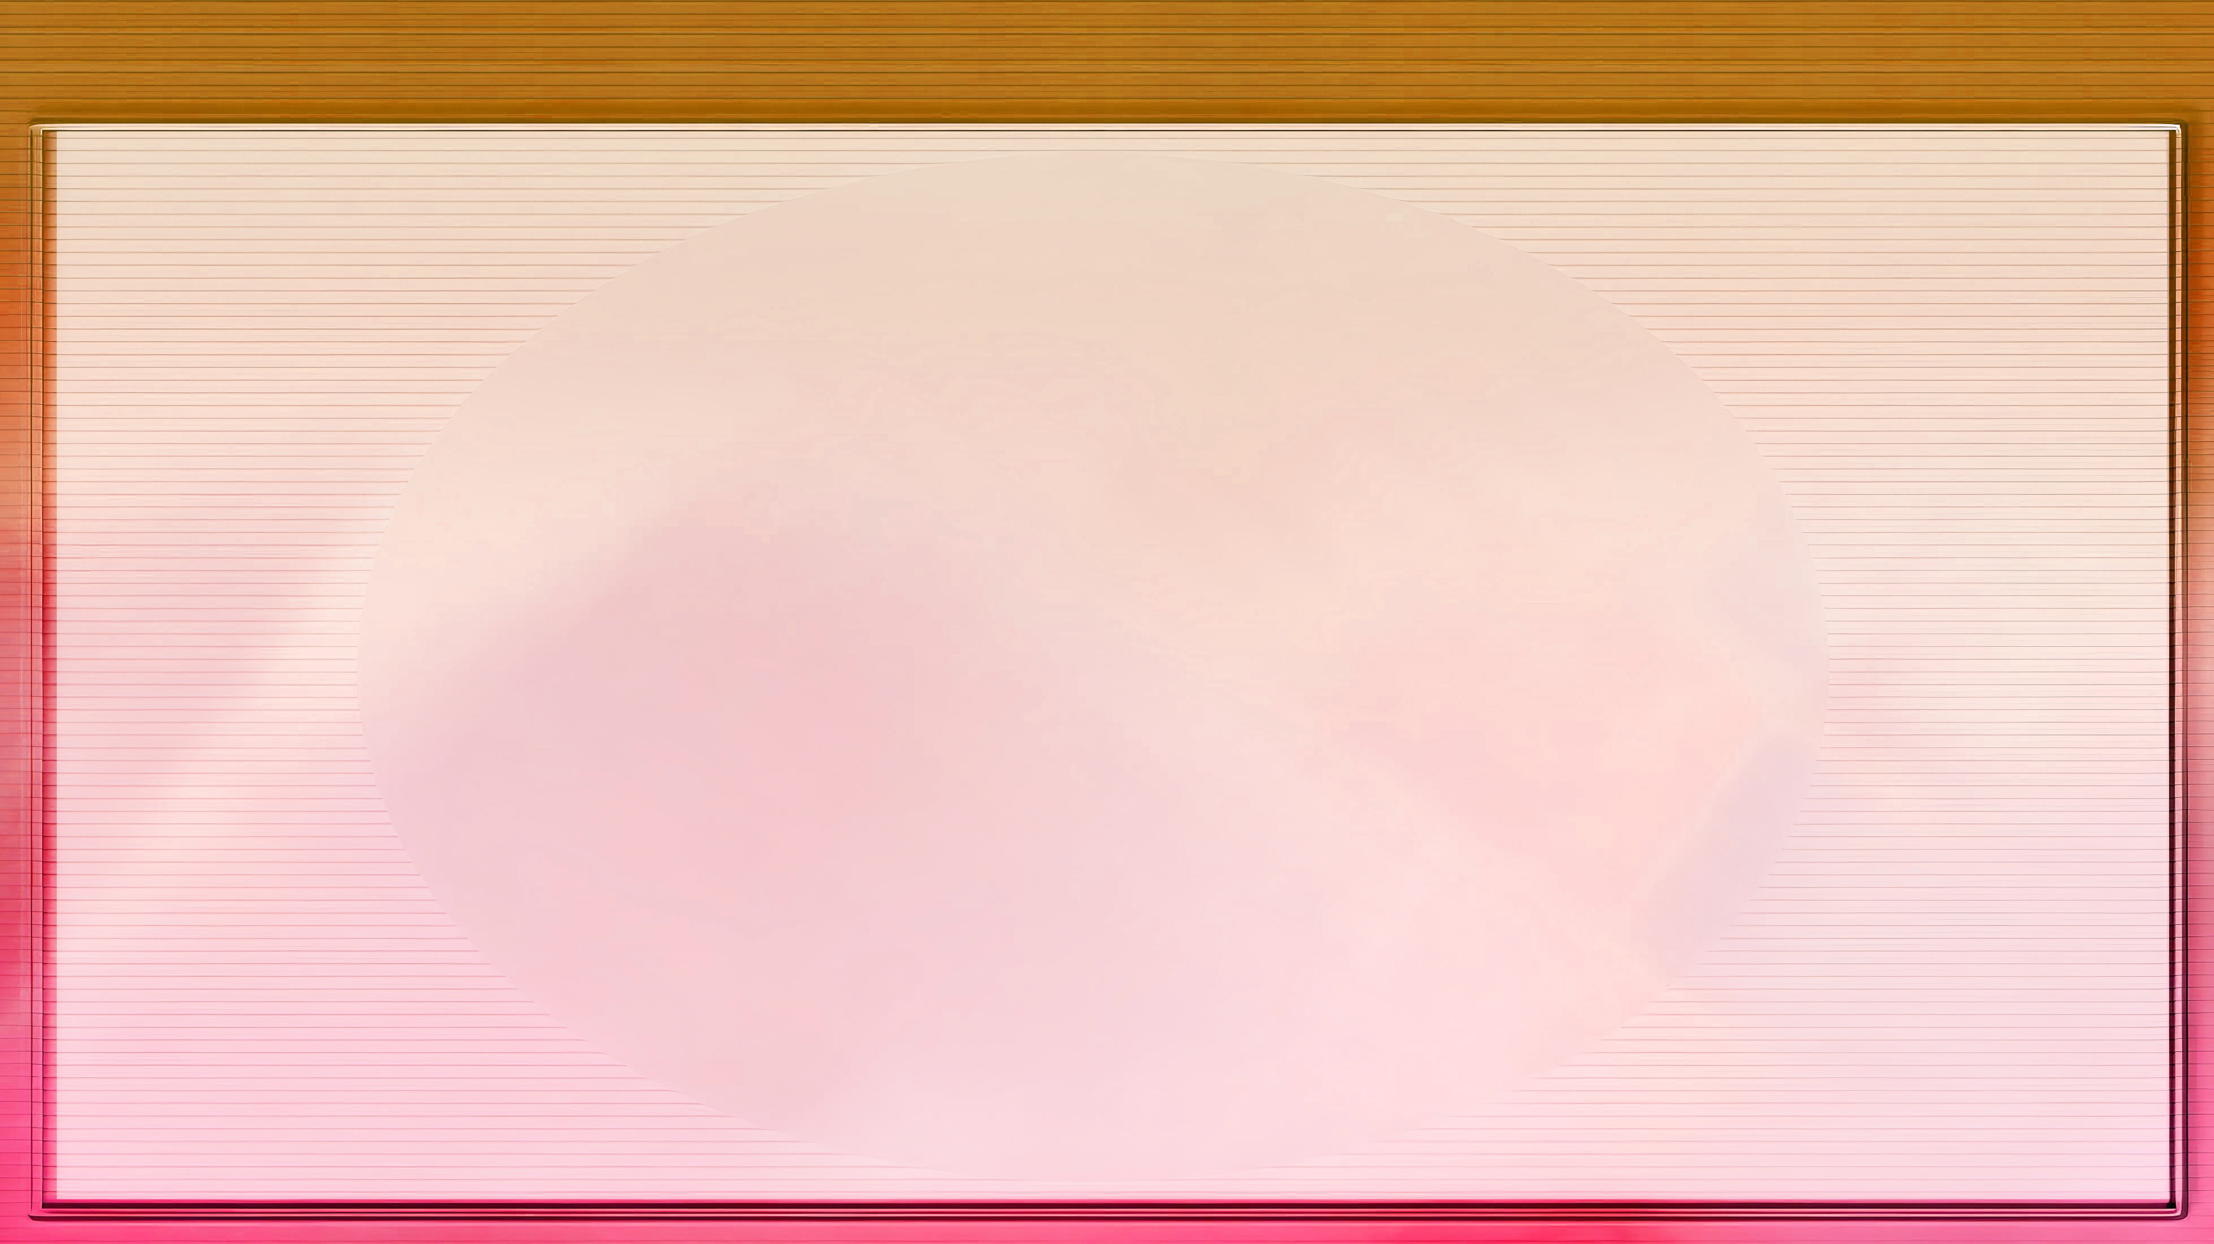



FAKAMATALA FAKALAHI: KO E UIUIʻI FAKAPALOFITA ʻO ELLEN G. WHITE
Hili ʻene ʻuluaki mata-meʻa-ha-mai, naʻe ongoʻi taʻefeʻunga ʻa ʻEleni ke fakahoko ʻene ngaue fakapalofita. Naʻe ongoʻi taʻefeʻunga ʻa e taʻahine taʻu 17 mo ʻikai ke ne lava ʻo fakahoko hono uiuiʻi koeʻuhi ko e mahamahaki mo e siʻisiʻi ʻene ako.
Hili ha uike ʻe taha mei heʻene ʻuluaki mata-meʻa-ha-mai, naʻa ne maʻu ha mata-meʻa-ha-mai hono ua ʻa ia naʻe fakatokanga ange ai ki he ngaahi faingataʻa te ne fehangahangai mo ia. Hili haʻane lotu lahi, mo fakalotolahiʻi ia ʻe ha niʻihi ʻo hono ngaahi tokoua mo e tuofafine, naʻe faifai pea tali ʻe ʻEleni hono uiuiʻi.
Naʻe siʻi hifo ʻi he taʻu ʻe uofulu, hili ʻene maʻu ha ngaahi meʻa-ha-mai lahi, pea poupouʻi ia ʻe hono husepaniti –Semisi Hitini–, naʻa ne tokoni ki hono fokotuʻu ʻo e fakavaʻe ʻo e Siasi ʻAho Fitu (naʻe fokotuʻu fakaʻofisiale ʻi he 1863).
Naʻe tokoni ʻene ngaue ki hono fokotuʻu ʻo e ngaahi polokalama moʻui lelei mo fakaako ʻa e kau ‘Ahofitu, pea naʻa ne tuku mai ha peesi ʻe 100,000 ʻo e ngaahi tohi fakalaumalie ʻoku hokohoko atu hono fakahoko ʻo e fakahinohino fakalangi ʻi he funga ʻo e mamani.

