Slide 1

Lesoni 4 ki he ʻaho 24 ʻo ʻOkatopa 2026
KO E KAU PALOFITA ʻO E FUAKAVA FOʻOU

Slide 2
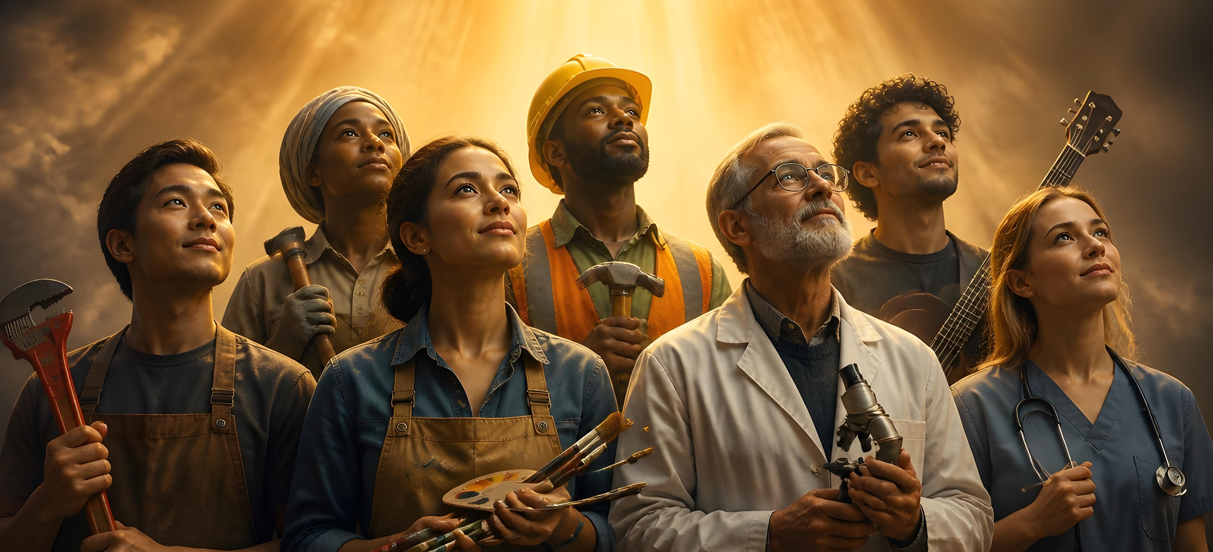
“Pea ko eni, ʻoku ai ʻae ngaahi foaki kehekehe, ka ko e Laumālie pe taha.Pea ʻoku ai ʻae ngaahi tauhi kehekehe, ka ko e ʻEiki pe taha.Pea ʻoku ai ʻae ngaahi ngāue kehekehe, ka ko e ʻOtua pe taha ʻoku fai kotoa pē ʻi he kakai kotoa pē.”
(1 Kolinitō 12:4-6,)

Slide 3










Mei Malakai ʻo faai mai, naʻe ʻosi atu ha taʻu ʻe 400 mo e teʻeki ke ongona ha leʻo ʻo ha palofita ʻi he kakai ʻo e ʻOtua. Koeʻuhi ko e fakalongolongo ko ʻeni, naʻe fakakaukau ʻa e kakai ʻo ʻIsileli kuo tapuni ʻa e ngaahi tohi ʻo e Fuakava Motuʻa.
Neongo ia, naʻe ʻikai ke fakalongolongo fuoloa ʻa e ʻOtua. Naʻa Ne fekauʻi mai ha palofita foʻou: Sione Papitaiso (Matiu 11:7-9). Talu mei he momeniti ko ia, mo e toe ʻasi mai ʻa e kau palofita. Naʻa nau fatongiaʻaki, kau ai mo e ngaahi ngaue kehe, ʻa hono hiki ʻo e Fuakava Foʻou.
Ko e ha e ngaahi fatongia ʻo e kau palofita mo e kau palofita fefine foʻou ko ʻeni? Ko hai kinautolu? Naʻe ʻi ai nai ha kau palofita loi, ʻo hange ko ia ʻi he kuonga ʻo e Fuakava Motuʻa?
Ngaahi fatongia ʻo e kau palofita ʻi he Fuakava Foʻou
Kau Palofita ʻo e Fuakava Foʻou:
    Ko Sisu, ko e palofita naʻe kikiteʻi
    Ko e kau ʻaposetolo mo e kau palofita
    Kau Palofita Fefine
    Ko e kaunga-ngaue ʻo Paula
    Ko e kau palofita loi

Slide 4




NGAAHI FATONGIA ʻO E KAU PALOFITA ʻI HE FUAKAVA FOʻOU
“Ka ko ia ʻoku kikite, ʻoku lea ia ki he kakai ke langa hake, mo enginaki, mo fakafiemālie.” (1 Kolinitō 14:3)
ʻI he Fuakava Foʻou, ʻoku fakahaaʻi ʻa e kikite ko ha meʻafoaki ʻo e Laumalie Maʻoniʻoni, ʻa ia naʻe lilingi lahi (Loma 12:6). ʻI ha siasi pe ʻe taha naʻe fuʻu tokolahi fau ʻa e kau palofita pea naʻe pau ke nau taufetongi ʻi he lea (1 Kolinito 14:29-31).
Ko e ha e ngaahi fatongia naʻe fakahoko ʻe he kau palofita ko ʻeni? (Fakaha 19:10; 1:1; ʻEfeso 4:11-12; 1 Kolinito 14:3; Ngaue 15:32).
Ke fakamoʻoni kia Sisu
Ko ʻene tefitoʻi misiona ke tataki ʻa e kakai kia Sisu
Fanongonongo ʻo e kahaʻu
Naʻa nau fakahaaʻi ʻa e ngaahi meʻa naʻe hoko ʻo aʻu mai ki he ʻaho ni
Fakatupulaki
Ke langa ha siasi malohi te ne lava ʻo matuʻuaki ʻa e ngaahi ʻohofi ʻa e fili
Ko e enginaki
Ke fakahā ‘a e angahalá, koe‘uhi ke lava ‘a e kakaí ‘o fakatomala .
Fiemālie
Naʻe fekauʻi atu ʻa Siutasi mo Sailosi ki he ngaahi siasí koeʻuhí ko e taumuʻa pau ko ʻení .

Slide 5




KAU PALOFITA ʻO E FUAKAVA FOʻOU .

Slide 6
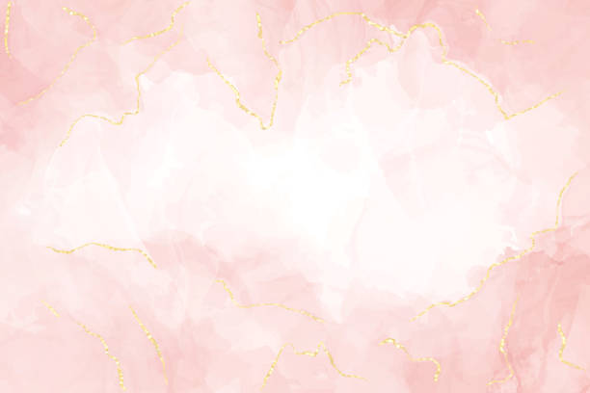





SISU, KO E PALOFITA NA'E KIKITE
““ʻE fokotuʻu ʻe Sihova ko ho ʻOtua ha palōfita kiate koe, ʻi ho ngaahi kāinga, ʻo hangē ko au; ke mou tokanga kiate ia;.” (Teutalonome 18:15)
Naʻe lau ʻa Sisu ko ha palofita ʻe hono toʻumeʻa (Matiu 21:11; Ma’ake 6:15; Lk. 7:16; Sione 6:14).
Naʻa ne pehe ko e hingoa ko ʻeni kiate ia (Ma’ake 6:4; Lk. 13:33).
Na’e fakapapau’i ‘e Pita ko Sisu ‘a e Palofita/Misaia na’e fanongonongo ‘e Mosese mo e kau Palofita kehe (Teut. 18:15; Ngaue 3:18-26).
Ka na'e 'ikai ke tohi 'e Sisu 'a e Folofola 'a e 'Otua, ka ko Ia 'a e FOLOFOLA (Sione 1:16).).
‘Oku ‘ikai ko ha “maama pē ‘oku ulo ‘i ha potu fakapo’uli,” ‘o hangē ko e kau palōfita kehe, ka ko Ia ‘a e MAAMA (2 Pita 1:19; Sione 1:9; 8:12).
ʻOku mahulu hake ʻene ngāué ʻi ha faʻahinga palōfita pē. Ko Sīsū pē ‘e lava ke ne foaki ‘a e ‘itānití kiate kitautolu kotoa ‘i he‘ene mo‘uí, pekiá, mo e toetu‘ú.

Slide 7
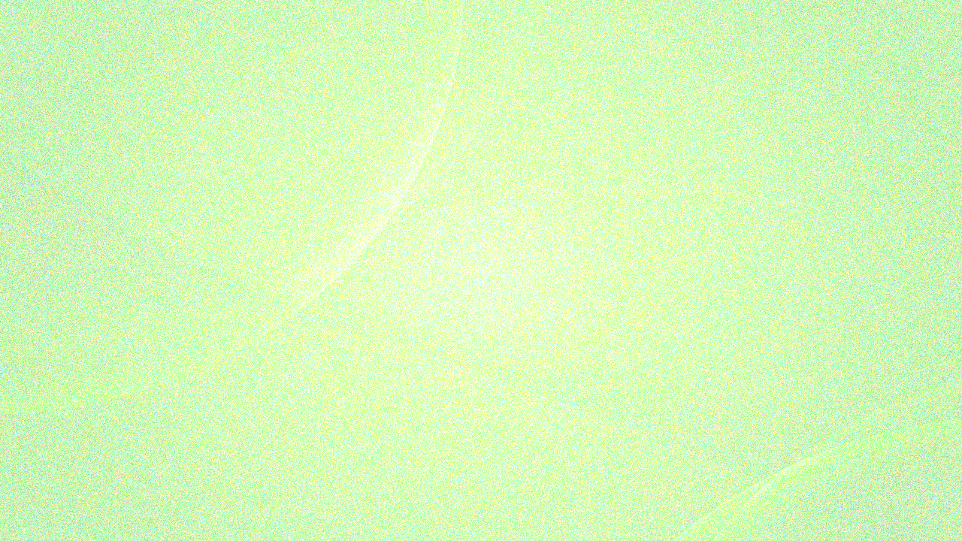




KO E KAU ‘APOSETOLO MO E KAU PALOFITA .
“Aia naʻe ʻikai fakaʻilo ʻi he ngaahi kuonga ʻi muʻa ki he ngaahi foha ʻoe tangata, ʻo hangē ko hono fakahā eni ʻe he Laumālie ki heʻene kau ʻaposetolo māʻoniʻoni mo e kau palōfita; ” (ʻEfesō 3:5 )
ʻOku maʻu ʻe he kau ʻaposetolo mo e kau palōfita ʻo e Fuakava Foʻoú ha ngaahi ʻulungaanga tatau:
Ko e kakai kinautolu kuo fekau'i mai 'e he 'Otua
(Luke 11:49)
ʻOku nau maʻu ʻa e ngaahi meʻaʻofa ke tataki ʻaki ʻa e siasí
(1 Koli. 12:28-29; ’Efeso 4:11-12)
Ko kinautolu ia ‘a e makatu’unga ‘o e siasi (‘Efeso 2:20)
ʻOku nau maʻu ʻa e ngaahi fakahaa (ʻEfeso 3:5)
ʻOku nau fiefia ʻi he fakamaau totonu (Fakaha 18:20)
ʻI he taimi ʻoku lau fakataha ai ki ai, ʻoku muʻomuʻa ʻa e kau ʻaposetolo ʻi he kau palofita (tuku kehe ʻi he Luke 11:49). ʻOku fakatatau ʻe Pita ʻa e kau ʻaposetolo mo e kau palofita ʻo e kuonga muʻa (2 Pita 3:2).
Naʻe fekauʻi makehe ʻa e kau ʻaposetolo ke nau hoko ko e kau fakamoʻoni ʻo e toetuʻu ʻe Sisu tonu (Ngaue 10:40-41).
ʻOku lave ʻa e Fuakava Foʻou ki ha kau palofita tokolahi, ko e hingoa ʻo e niʻihi: Panepasa (ʻaposetolo), Saimone, Lusiasi, Manaeni, Saula (ʻaposetolo), Siutasi, Sailosi, mo ʻAkapusi (Ngaue 11:27; 13:1; 15:32; 19:6-7; 21:10).

Slide 8






KO E KAU PALOFITA FEFINE
“[Ko Filipe ko e ʻevangeliō] K hono ʻofefine tāupoʻou ʻe toko fā, pea naʻe kikite ʻakinautolu. ” (Ngaue 21:9)
Ko e palofita fefine pe ʻe taha ʻoku ha hono hingoa ʻi he Fuakava Foʻou ko ʻAna, ʻa ia naʻa ne "lea ʻo kau ki he tamasiʻi [Sisu] kiate kinautolu kotoa pe naʻe ʻamanaki atu ki hono huhuʻi ʻo Selusalema" (Luke 2:36-38).
Naʻe maʻu foki ʻe he ngaahi ʻofefine ʻe toko fa ʻo Filipe ko e ʻevangelio ʻa e meʻafoaki ʻo e kikite (Ngaue 21:8-9).
ʻIkai ngata ai, ʻoku lau ʻa e kikite ko ha meʻaʻofa angamaheni, ʻi he kakai fefine mo e kakai tangata fakatouʻosi (1 Kolinito 11:4-5).
Naʻe tomuʻa fakaha ʻe Sioeli ʻe ngaue ʻa e Laumalie Maʻoniʻoni koeʻuhi ke kikite ʻa e ngaahi foha, ngaahi ʻofefine, kau tangata motuʻa, kau talavou, kau tamaioʻeiki, mo e kau kaunanga (Sioeli 2:28-29).

Slide 9



KO E KAUNGĀ-NGAUE ʻO PAULA
“E foha ko Timote, ʻoku ou tuku atu ʻae fekau ni kiate koe, ʻo fakatatau mo e ngaahi kikite ʻi muʻa naʻe kau kiate koe, koeʻuhi ke ke faʻa fai mei ai ʻae tau lelei:.” (1 Timote 1:18)
Tānaki atu ki he kau ‘aposetoló, kau palōfitá, mo e kau palōfita fefiné, ‘oku lave ki he ni‘ihi ‘o e kau tokoni ‘o Paulá ‘a ia, ‘o hangē ko Sailosi mo Pānepasá, na‘a nau ma‘u ‘a e me‘a‘ofa ‘o e kikité:
TIMOTÉ
Nʻe kikiteʻi hono uiuiʻi ia ki he ngaue fakafaifekau.
(1 Timote 1:18). Naʻa ne kaunga faʻu mo Paula ʻa e ngaahi tohi: 2 Kolinito (2 Kolinito 1:1); Filipai (Fili. 1:1); Kolose (Kol. 1:1); 1 Tesalonaika (1 Tesalonaika 1:1); 2 Tesalonaika (2 Tesalonaika 1:1); mo Filimone (Fili. 1:1)
TAITUSI
Naʻa ne fakahoko ha ngaahi fatongia fakakikite lahi, hange ko e fakamāmaʻi (2 Kolinitō 8:6); naʻinaʻi (Taitusi 2:6, 9, 15); mo e fakafiemālie(2 Kolinitō 7:13)

Slide 10





KO E KAU PALOFITA LOI
“ʻE Kāinga ʻofeina, ʻoua naʻa tui ki he laumālie kotoa pē, kae ʻahiʻahiʻi ʻae ngaahi laumālie, pe ʻoku ʻoe ʻOtua ʻakinautolu: koeʻuhi kuo tokolahi ʻae kau palōfita loi kuo ʻalu atu ki māmani.” (1 Sione 4:1)
Naʻe fakatokanga ʻa Sisu ʻe tuʻu hake ʻa e kau palofita loi, ʻa ia naʻa ne ui ko e "fanga ulofi fekai" (Matiu 24:24; 7:15). Naʻe kamata ke ʻasi mai ʻa e kau palofita loi ko ʻeni ʻi he kuonga muʻa ʻo e siasi (1 Sione 4:1).
Naʻe fakatokanga ʻa Paula ki he kaumatuʻa ʻo ʻEfeso ʻe tuʻu hake ʻiate kinautolu ʻa e "ulofi fekai" (Ngaue 20:29). Naʻa ne fakatokanga ki he kau Kolinito fekauʻaki mo e ʻi ai ʻa e "kau ʻaposetolo loi" (2 Kolinito 11:13).
ʻOku fenapasi ʻa e kikite moʻoni mo e Folofola ʻa e ʻOtua, tuhu kia Kalaisi, mo langa hake ʻa e siasi, lolotonga ia ʻoku poupouʻi ʻe he kau palofita loi ʻa e ngaahi tokateline fakatupu mavahevahe mo e siokita.
ʻOku ui kitautolu kakai tui ke tau vakavakaiʻi ʻa e kau palofita pea fakapapauʻi ʻoku fenapasi ʻenau ngaahi popoaki kotoa pe mo e Folofola pea ʻoku fakatefito ʻia Kalaisi.
Ko ʻetau maluʻi pe mei he kau palofita loi (pea mo e ngaahi malohi kovi ʻoku nau tataki kinautolu) ko ʻetau tui ʻa e teunga tau kuo ʻomi ʻe he ʻOtua maʻatautolu (ʻEfeso 6:10-18).

Slide 11

“Naʻe lea ʻa e kau peteliake, kau palofita mo e kau ʻaposetolo ʻi hono ueʻi kinautolu ʻe he Laumalie Maʻoniʻoni, pea naʻa nau fakaha mahino naʻe ʻikai ke nau lea ʻaki honau malohi pe ʻonautolu. Naʻa nau fakaʻamu ke ʻoua naʻa fakalangilangiʻi kinautolu, ke ʻoua naʻa lau kinautolu ʻe ha taha ko e tupuʻanga ʻo ha faʻahinga meʻa te nau vikiviki ai. Naʻa nau meheka koeʻuhi ko e fakaʻapaʻapa ʻo e ʻOtua, ʻa ia ʻoku ʻaʻana ʻa e fakafetaʻi kotoa pe. Naʻa nau fakaha ko e meʻa naʻa nau malava mo e ngaahi popoaki naʻa nau ʻomi naʻe foaki kiate kinautolu ko e kau fakafofonga ʻo e malohi ʻo e ʻOtua. Ko e ʻOtua honau mafai mo e feʻunga.”
EGW (Ke Hange ko Sisuu, Siulai 30)

Slide 12
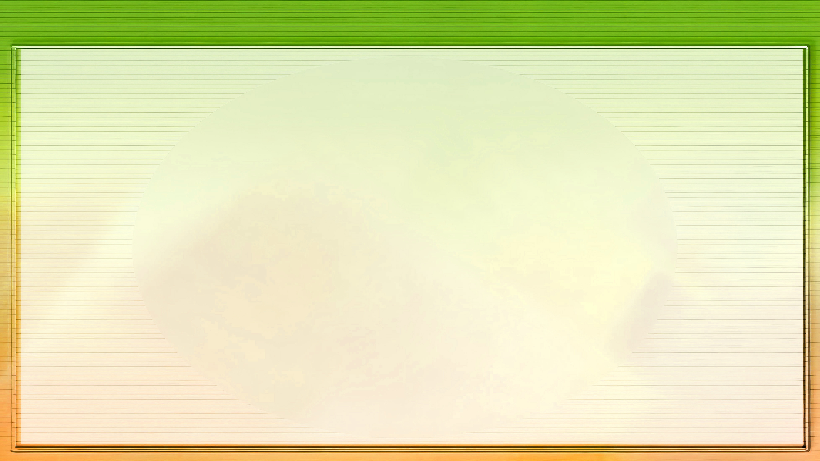




FAKAMATALA FAKALAHI: KO E NGAAHI TEFITOʻI MOʻONI MAHUʻINGA ʻO E NGAUE FAKAFAIFEKAU ʻA ʻELENI G. WHITE
Naʻe ʻi ai ha tefitoʻi meʻa mahuʻinga ʻe ua ʻi he ngaue fakafaifekau ʻa Ellen G. White: ke ʻomi ʻa e kakai kia Sisuu; pea ke taki ʻenau tokanga ki he Tohi Tapu.
'ULUAKI ‘ASIASI: SISU .
Hili ‘a e konifelenisi ‘o e 1888, ‘i hono ‘eke ange fekau‘aki mo e ngaahi kaveinga na‘e lāulea ki aí, na‘á ne tali: “Kuó u ‘oatu ia kiate kimoutolu ‘i he ta‘u ‘e 45 kuohilí—ko e ngaahi faka‘ofo‘ofa ta‘ehanotatau ‘o Kalaisí .” (Ngaahi Malanga mo e Ngaahi lea, vol. 1, p. 116) .
KO E ’ASIASI HONO UA: KO E TOHITAPU
Na‘e ‘ikai ‘aupito ke taukave‘i ‘e Ellen ‘oku mā‘olunga ange ‘ene ngaahi tohí ‘i he Tohitapú ka na‘á ne enginaki ma‘u pē ke ‘ahi‘ahi‘i kinautolu ‘aki ia. ʻI heʻene hoko ko ha talafekau ʻa e ʻEikí, naʻá ne lau ia ko ha “maama siʻisiʻi ange” ʻokú ne tataki ʻa e kakaí ki he “maama lahi angé,” ʻa e Tohi Tapú . (Ngaahi Pōpoaki Filifili, vol. 3, p. 29).

