Slide 1

NGAAHI TOHI FAKAEKIKITE
Lesoni 6 ki he ʻaho 7 ʻo Novema 2026

Slide 2


“He ko e ngaahi meʻa kotoa pē naʻe tohi ʻi muʻa, naʻe tohi ko hotau akonaki, koeʻuhi ko e meʻa ʻi he faʻa kātaki mo e fakafiemālie ʻoe ngaahi tohi, ketau maʻu ai ʻae ʻamanaki lelei.” (Loma 15:4)

Slide 3











Neongo ko e Folofola ia ʻa e ʻOtua, ka naʻe ʻikai ke tohi ʻe he ʻOtua ʻa e Tohi Tapu. Naʻa Ne fakaʻaongaʻi ʻa e kakai naʻa Ne ueʻi fakalaumalie ke fai ia.
Naʻe ʻikai foki ke ne tala ʻa e ngaahi lea naʻe totonu ke nau tohi. Naʻa ne tala pe kiate kinautolu ke nau tohi ʻa e meʻa naʻa ne fakaʻaliʻali kiate kinautolu, pe ko e meʻa naʻa ne fakahu ki honau ʻatamai.
Naʻa Ne ʻoange kiate kinautolu ha tauʻataina ke nau fili pe ko e ha ʻa e ngaahi foʻi lea ke fakaʻaongaʻi; ko e founga tohi; mo e ngaahi fakaikiiki kehe ke fakahoko ʻaki ʻa e popoaki fakalangi.
Ko e ngaahi tohi fakaekikite:
  Ko e fe pea ko e ha naʻe tohi ai kinautolu?
  Ko e ha ʻa e ngaahi sipinga naʻe hiki ai kinautolu?
Fakaʻaongaʻi ʻo e kau sekelitali mo e naunau mei tuʻa:
  Ko e ha naʻe fakaʻaongaʻi ai ʻa e kau tokoni faʻu tohi?
  Ko e ha ha naunau mei tuʻa naʻe fakaʻaongaʻi ʻe he kau palofita?
Tuifio ʻa e faʻahinga ʻo e tangata mo e popoaki:
  Ko e ngaahi taʻehaohaoa ʻ i he Tohi Tapú?

Slide 4

KO E NGAAHI TOHI FAKAEKIKITE

Slide 5


KO E FEITUʻU MO E ʻUHINGA NAʻE TOHI AI KINAUTOLU?
“Te ke ʻalu ni ʻo tohi ia ʻi honau ʻao ʻi he palepale, pea tohi ia ʻi ha tohi koeʻuhi ko e kuonga ki mui ʻo taʻengata pea taʻengata..” (‘Isaia 30:8)
Ko Mosese ʻa e fuofua tokotaha naʻe ueʻi fakalaumalie ʻe he ʻOtua ke ne tohi ʻa e Tohi Tapu. Naʻa ne tohi ʻa Siope mo Senesi ʻi he toafa ʻo Mitiane. Lolotonga ʻa e ʻEkesotosi, naʻa ne maʻu ʻa e fekau ke hiki ʻa e ngaahi meʻa naʻe hoko ʻi ha tohi (ʻEkesotosi 17:14).
Ko e kau palofita kehe naʻa nau maʻu ʻa e fekau ke hiki ha tohi ko ʻIsaia (ʻIsaia 30:8); Selemaia (Selemaia 36:2); Hapakuke (Hapakuki 2:2); mo Sione (Fakaha 1:11).
Naʻe tohi ʻe he kau faʻu tohi ʻo e Tohi Tapu ʻi ha ngaahi tukunga kehekehe:
Fakatangaʻi hange ko Tēvitá
ʻI ha palasi hange ko Solomone
Muli ko Taniela
ʻI he fale fakapopula hange ko Paula
ʻI he fakaheeʻi ko Sione
Naʻe fili ʻe he ʻOtua ʻa e kakai mo e popoaki ke nau hiki ʻi he taumuʻa ke ʻoua naʻa mole ha meʻa mei he meʻa naʻa Ne finangalo ke fakaha mai kiate kitautolu ki hotau fakamoʻui (2 Timote 3:15).

Slide 6






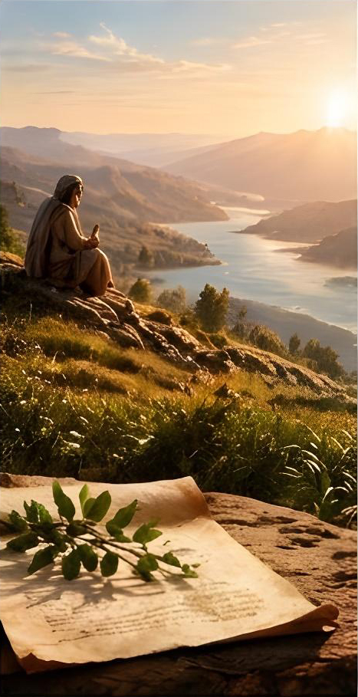











KO E HA ʻA E NGAAHI FOUNGA NAʻE HIKI AI?
“Ko e fungani ʻoe hiva ʻa Solomone” (Hiva ‘a Solomone 1:1)
Naʻe hiki ʻi he taʻu ʻe 1,500 tupu ʻe ha kau faʻu tohi kehekehe ʻe 40 tupu, pea ʻoku ʻi ai ha ngaahi sipinga kehekehe ʻi he Tohi Tapu. ʻI he lotolotonga ʻo e niʻihi kehe:
Ngaahi fakamatala fakahisitolia (Senesi 37:2)
Ngaahi tohi hohoko (Senesi 5:1)
Ngaahi kikite (ʻIsaia 13:1)
Ngaahi visone ‘oku fakaha (Fakaha 12:1)
Maau (konga lahi ʻo ʻIsaia)
Hiva (Hiva ʻa Solomone 1:1)
Faitatau (ʻIsaia 17:7)
Ngaahi talanoa fakatataa (Luke 18:1))
Ngaahi Tohi (2 Tesalonaika 3:17)
ʻOku ʻikai fakafaikehekeheʻi ʻe he Tohi Tapu ʻa e mafai ʻo e ngaahi sipinga kehekehe. ʻOku ʻaonga kotoa kinautolu ki hono ʻoatu ʻo e fakakaukau faka-ʻOtua, koeʻuhi he ʻoku ʻilo lelei ange ʻe he tokotaha takitaha ʻa e popoaki ʻi ha founga ʻe taha.
ʻOku toe fakamahinoʻi foki ʻe Pita ʻoku maʻu ʻe he ngaahi tohi ʻo e Fuakava Foʻou ʻa e mafai tatau mo ia ʻi he Fuakava Motuʻa (2P. 3:15-16).

Slide 7

FAKAʻAONGAʻI ʻO E KAU SEKELITALI MO E NAUNAU MEI TUʻA

Slide 8




KO E HA NAʻE FAKAʻAONGAʻI AI ʻA E KAU TOKONI FAʻU TOHI?
“Pea naʻe toki ui ʻe Selemaia kia Paluki ko e foha ʻo Nelia: pea tohi ʻe Paluki mei he ngutu ʻo Selemaia ʻi he tohi tākai ʻae ngaahi folofola kotoa pē ʻa Sihova, ʻaia naʻa ne folofolaʻaki kiate ia..” (Selemaia 36:4)
Ko Selemaia ko ha taulaʻeiki pea ʻi heʻene pehee, naʻa ne poto he laukonga mo e tohi. Neongo ia, naʻa ne fakaʻaongaʻi ha tokoni—ko Paluki—ke ne tohi ʻa e ngaahi popoaki naʻe kole ange ʻe he ʻOtua ke ne tohi (Selemaia 36:1-4). Neongo naʻe fakangofua ia ʻe he ʻOtua, ka naʻe fakaʻuhingaʻi hala ʻeni ʻi hono taimi pe ʻoʻona (Selemaia 43:2-3).
Naʻe fakaʻaongaʻi ʻe Paula, ʻa ia naʻa ne poto he lea faka-Kalisi, ʻa e kau tokoni ke fai ʻene ngaahi tohi (Loma 16:22). Ke taʻofi ʻa e niʻihi kehe mei heʻenau tohi ha ngaahi tohi loi ʻi hono hingoa, naʻe pau ke ne fakamoʻoni hingoa ʻi he ngaahi tohi naʻa ne lau ʻi heʻene tohinima pe ʻaʻana (2 Tesalonika 3:17).
Naʻe fai ʻe Pita ʻene ngaahi tohi ʻi ha founga faka-Kalisi fakaʻofoʻofa, ko ha meʻa naʻe faingataʻa ke pehe ko e tangata toutai lea faka-Alamaika ko ʻeni. Naʻe tokoniʻi ia ʻe hono fakaʻaongaʻi ʻo e kau tokoni ke ne fakahoko totonu ʻene popoaki ʻi ha lea fakafonua naʻe ʻikai ke ne poto ʻi ai. Ka ʻoku ʻikai holoki ʻe he foʻi moʻoni ko ia naʻe fili ʻe he ongo tokoni ʻa e ngaahi lea naʻa ne fakahaaʻi lelei taha ʻa e ngaahi fakakaukau ʻa Pita ʻa e ueʻi fakalangi ʻo ʻene ngaahi tohi.

Slide 9
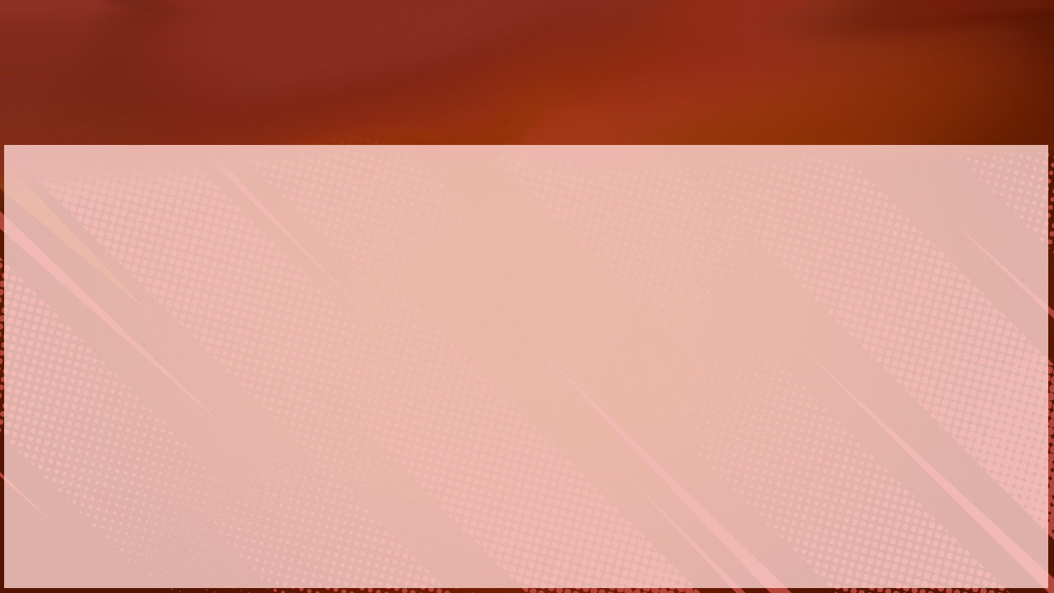





KO E HA E NAUNAU MEI TUʻA NAʻE FAKAʻAONGAʻI ʻE HE KAU PALOFITA?
“‌ʻE Tiofilusi lelei, ko e meʻa ʻi heʻeku kumi fakatotolo ki he meʻa kotoa pē talu hano kamataʻanga, ʻoku ou loto ai ke u tohi fakaholo atu ia kiate koe, ” (Luke 1:3)
Naʻe ngāueʻaki ʻ e ʻ Ēsela ʻ a e ngaahi lēkooti fakahisitōliá pea hiki tatau ʻ a e ngaahi tuʻutuʻuni mo e ngaahi fetohiʻaki mei he ngaahi tuʻi Pēsiá ʻ i heʻene hiki ʻ a e ngaahi tohi Kalonikali mo ʻ Ēselá. ʻ I heʻene tafaʻakí, naʻe fakakau ʻ e Nehemaia ʻ i heʻene tohí ha lekooti tohihohoko naʻe hiki tatau mei ha lekooti tohihohoko ʻ e taha naʻe ʻ i aí.
Koeʻuhi naʻe ʻikai ko ha fakamoʻoni ʻa Luke ki he ngaahi meʻa naʻa ne fakamatalaʻi, naʻa ne hiki ʻene kosipeli mo e konga ʻo e tohi ʻa Ngaue ʻo makatuʻunga ʻi he ngaahi lekooti fakahisitolia mo e ngaahi fakaʻekeʻeke ʻo e kau fakamoʻoni tonu (Luke 1:3)
ʻOku toʻo ʻe Paula ʻa e ngaahi lea meia ʻEpimenitesi mo ʻAlatusi, ko e ongo tangata faʻu tohi faka-Kalisi motuʻa (Ngaue 17:28; Taitusi 1:12). ʻI heʻene tafaʻaki, ʻoku toʻo ʻe Sute ha ngaahi lea mei ha tohi ʻoku ʻikai ko ha tohi ʻoku ʻi ai ʻa e ngaahi kikite ʻa ʻInoke (Siute 1:14)
Naʻe tataki kotoa kinautolu ʻe he Laumalie Maʻoniʻoni ʻi hono fakaʻaongaʻi ʻo e naunau ko ʻeni mei tuʻa. Naʻa nau ʻiloʻi naʻa nau fakamatalaʻi ʻa e moʻoni pea ʻoku nau fakahaaʻi ai ʻa e meʻa naʻe fie maʻu ʻe he ʻOtua ke fakahaaʻi.
Epimenides
Arato
Tohi ʻa ʻĪnoke

Slide 10

TUIFIO ʻA E FAʻAHINGA ʻO E TANGATA MO E POPOAKI

Slide 11


KO E NGAAHI TAʻEHAOHAOA ʻ I HE TOHI TAPÚ?
“Ka ʻoku mau maʻu ʻae koloa ni ʻi he ngaahi ipu ʻumea, koeʻuhi ke ʻi he ʻOtua hono lelei ʻoe mālohi, kae ʻikai ʻiate kimautolu.” (2 Kolinitō 4:7)
Naʻe fili ʻe he ʻOtua ke fakaʻaongaʻi ʻa e kakai taʻehaohaoa—"ngaahi ipu kelekele"—ke fakahoko ʻEne popoaki (2 Kolinito 4:7). Naʻe uesia fefe ʻe he taʻehaohaoa ko ʻeni ʻa e popoaki? ʻOku falalaʻanga 100% ʻa e Tohi Tapu?
Ngaahi lea motuʻa
Ngaahi fehālaaki naʻe fai ʻ e he kau hiki tohí
Ngaahi fehalaaki naʻe fai ʻe he kau faʻu tohi
Ngaahi foʻi lea ʻi he lea faka-Hepeluu, faka-ʻAlamea, pe faka-Kalisi ʻa ia ʻoku ʻikai ke tau ʻiloʻi hono ʻuhinga, pe naʻe fakaʻaongaʻi ʻi ha ʻuhinga kehe ʻi he taimi ʻo e palofita
gaahi fakatātā: Kofeli (גֹּפֶר) ( Sēn. 6:14 ); Sela (סֶלָה) (na‘e ngāue‘aki ‘i ha ngaahi saame lahi)
I hono hiki tatau ʻo e ngaahi konga tohí, pe tohiʻi kinautolu mei he tohi lea, ʻe lava ke fai ha fehālaaki ʻa e tokotaha hiki-tataú (ʻoku lahi ange ʻi he Fuakava Foʻoú) .
I he taimi naʻa nau lau ai ha konga tohi mei heʻenau maʻuloto, pe fakamatala ki ha meʻa naʻe ʻikai ke nau mamata tonu ai, naʻe mei lava ke fai ʻe he kau faʻu tohi Tohi Tapu ha fanga kiʻi fehalaaki iiki mo taʻemahuʻinga
)
Ngaahi fehalaaki ʻi he liliu lea
Ko e kau liliu Tohi Tapú, tautefito ki he faʻahinga ʻoku nau liliu ki he lea fakaeonopōní, ʻ e lava ke tākiekina kinautolu ʻ e he ngaahi fakakaukau ʻ a e tokotaha liliu lea
Fakatātā: ko e “Koma ‘a Sione” (1 Sione 5:7-8). Ko ha fakamatala ia ‘a ha tokotaha hiki tatau na‘e fakakau ki mui ‘i he konga tohí ‘e ha tokotaha hiki tatau ‘e taha .
Sipinga: Ko e lea ʻa Matiu ʻa ia ʻoku ne ui ai ʻa Sakalaia, naʻe fakapoongi ʻe Siasi, ko e "foha ʻo Pelekaia" (ʻa ia ko e tokotaha naʻa ne faʻu ʻa e tohi ʻa Sakalaia) (Matiu 23:35; vakai, Luke 11:51; 2Kolinito 24:22
Sipinga: ʻOku liliu ʻe he ngaahi liliu fakaonopooni ʻe niʻihi (MSG, NMB) ʻa e fakamatala ʻoku ʻuhinga ki he ʻAho ʻo e ʻEiki (Fakaha 1:10) ko e "Sapate," neongo naʻe kamata ke ngaueʻaki ʻa e kupuʻi lea ko ʻeni hili e pekia ʻa e ʻaposetolo
Ko e ngaahi ta‘ehaohaoa pe ngaahi faikehekehe ko ení ‘oku si‘isi‘i ‘aupito pea ‘e lava ke mahino‘i fakalūkufua ia ‘o fakafou ‘i ha ako loloto. ‘E lava ke tau falala ko e ngaahi mo‘oni faka‘otuá kuo ‘omai faitōnunga mai kiate kitautolu ‘i he ngaahi senituli lahi, ‘o hangē pē ko ia ‘oku lēkooti ‘i he ngaahi peesi ‘o e Tohi Tapú ..

Slide 12

“Kuo hōifua ʻa e ʻOtuá ke fakahoko ʻEne moʻoní ki he māmaní ʻaki ʻa e ngaahi potungāue ʻa e tangatá, pea ko Ia tonu, ʻi Hono Laumālie Māʻoniʻoní, naʻá ne fakafeʻungaʻi ʻa e kau tangatá mo fakaʻatā kinautolu ke nau fai ʻa e ngāué ni.Naʻá Ne tataki ʻa e ʻatamaí ʻi hono fili ʻo e meʻa ke leaʻakí mo e meʻa ke tohí.Ko e koloá naʻe tuku ia ki he ngaahi ipu kelekelé notimone is,eventhe is, yet. ʻoku fakahoko mai ʻo fakafou ʻi he fakahaaʻi taʻehaohaoa ʻo e lea ʻa e tangatá, ka neongo ia ko e fakamoʻoni ia ʻa e ʻOtuá;
ʻI Heʻene folofolá, kuo fakatukupaaʻi ʻe he ʻOtuá ki he tangatá ʻa e ʻilo ʻoku fie maʻu ki he fakamoʻuí. Ko e ngaahi Folofola Mā‘oni‘oní ‘oku totonu ke tali ia ko ha fakahā ma‘u mafai, ta‘ehalaia ‘o Hono finangaló ..”
EGW (Ko e Fakakikihi Lahi, p. 6)

Slide 13





FAKAMATALA FAKALAHI: TAʻE-FEHALAAKI ʻO E NGAAHI TOHI ʻA ELLEN G. WHITE
ʻI he taimi naʻe fekauʻi ai ʻe he ʻOtua ʻa ʻEleni ke hiki ʻene popoaki, naʻa ne tali ange, "ʻOku ʻikai ke u lava ʻo tohi." Ka naʻe fakamalohia ia ʻe he ʻOtua, pea kamata leva ke ne tohi. Naʻe ʻalu pe taimi mo ʻene fakaʻaongaʻi ha kau tokoni tohi ke fakatonutonu ʻene sipela hala mo fakaleleiʻi ʻa e fakalea ʻo e ngaahi setesi ʻe niʻihi.
Ko Mele ʻAna “Maliani” Teivi (1847-1904), tokoni tohi. ʻAta mei he “ʻEleni G. Uite ʻEsiteti, Inc.”
Na‘e ‘ikai ‘aupito te nau liliu ‘a e ‘uhinga ‘o e pōpoakí, pe tānaki atu ha me‘a ‘anautolu pē. Ko e ngaahi tohi faka'osi na'e toe vakai'i ma'u pe ia 'e ‘Eleni ..
Sela E. Peki, 1880 tupú. ʻAta mei he “Senitā ki he Fakatotolo ʻa e Kau ʻAhofitu.”
‘I he fekau‘aki mo ‘ene ta‘ehalaia ‘i he tu‘unga ko ha palōfitá, na‘e fakahā ‘e ‘Ēleni: “Fekau‘aki mo e ta‘ehalaia, na‘e ‘ikai ‘aupito te u taukave‘i ‘oku ou ma‘u ia.Ko e ‘Otuá pē ‘oku ta‘ehalaia .” (Ngaahi pōpoaki, vol. 1, p. 42
Fekau‘aki mo e ta‘ehalaia ‘a ‘ene ngaahi tohí, na‘á ne tohi tonu: “‘Oku ‘i ai ‘a e ngaahi taimi ‘oku pau ke fakahaa‘i ai ‘a e ngaahi me‘a anga-mahení, kuo pau ke nofo‘i ‘e he ngaahi fakakaukau anga-mahení ‘a e ‘atamaí, kuo pau ke tohi ‘a e ngaahi tohi anga-mahení, pea kuo pau ke ‘oatu ‘a e fakamatala kuo paasi mei he tokotaha ngāue ‘e taha ki he tokotaha ‘e tahá.” (Ngaahi Pōpoaki Filifili, vol. 3, p. 64).

