Slide 1
1 Sione 5:7-8
Ko e mu‘aki tohi .

Slide 2
5:7 He oku ai ae toko tolu i he lagi oku fakamooni, koe Tamai, moe Folofola, bea moe Laumalie Maonioni: bea oku taha be ae toko tolu ni.
5:8 Bea oku ai ae tolu i mamani oku fakamooni, koe Laumalie, moe vai, bea moe toto: bea oku kau fakataha ae tolu ni.
Ko e fakamatala ʻeni ʻoku ha ʻi he lea faka-Pilitania ʻi he Koe Tohi Tabu Katoa
(TWB)

Slide 3
5:7 He oku ai ae toko tolu i he lagi oku fakamooni, koe Tamai, moe Folofola, bea moe Laumalie Maonioni: bea oku taha be ae toko tolu ni.
5:8 Bea oku ai ae tolu i mamani oku fakamooni, koe Laumalie, moe vai, bea moe toto: bea oku kau fakataha ae tolu ni.
Ko e fakamatala ʻeni ʻoku ha ʻi he lea faka-Pilitania ʻi he Koe Tohi Tabu Katoa
(TWB)
Neongo ia, kuo pulia ʻa e ngaahi foʻi lea kuo kolosi mei he ngaahi liliu ʻo onoponi.
Ko e ha hono ʻuhinga? Ko e ha ʻa e liliu totonu ʻo e ngaahi veesi ko ʻeni?

Slide 4
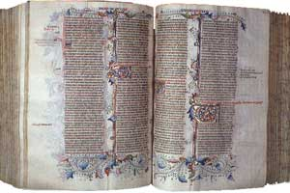
Ko e ngaahi lea “ʻi he langí, ko e Tamaí, mo e Folofolá, mo e Laumālie Māʻoniʻoní: pea ʻoku taha pē ʻa e toko tolú ni, pea ʻoku toko tolu ʻoku fakamoʻoni ʻi māmani” naʻe ʻikai hiki ia ʻe Sione. Kae kehe, na‘a nau ‘i ai ‘i he liliu lahi taha ‘o e Tohi Tapú ‘o a‘u mai ki he senituli hono hongofulu mā onó: ko e Vulgate faka-Latiná ..
Ko e hā naʻa nau ʻasi ai ʻi he liliu ko ʻení kapau naʻe ʻikai ke nau ʻi he ʻuluaki tohí .?

Slide 5
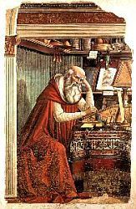
‘I he ta‘u 382 na‘e fekau‘i ai ‘e Tu‘itapu Tamasi I ‘a Selome ke ne liliu ‘a e Tohi Tapú ki he lea faka-Latina Vulgar (ko e Vulgate faka-Latiná).
Na‘e ‘ikai ke ‘asi ‘i he ‘uluaki liliú pe ‘i hono ngaahi pulusinga ki mui aí ‘a e ngaahi lea ‘oku fai ki ai ‘a e fehu‘í.

Slide 6

HHe oku ai ae toko tolu i mamani oku fakamooni: mamani oku fakamooni, koe Laumalie, moe vai, bea moe toto: bea oku kau fakataha ae tolu ni.
i he lagi oku fakamooni, koe Tamai, moe Folofola, bea moe Laumalie Maonioni: bea oku taha be ae toko tolu ni
Koeʻuhi naʻe teʻeki ai ke ʻi ai ʻa e misini pulusi, naʻe ngaohi nima pe ʻa e ngaahi tatau pea naʻe angamaheni ʻaki ke tuku ha ngaahi lea ʻi he taimi naʻe hiki tatau ai, pe fai ha ngaahi fehalaaki.
Naʻe fakatokangaʻi mo fakatonutonu ʻa e ngaahi fehalaaki ko ʻeni ʻi he tafaʻaki ʻo e fakamatala. Ka naʻe hiki foki ʻi he tafaʻaki ʻa e ngaahi fakamatala fakatautaha ʻa e tokotaha faʻu tohi pe tokotaha laukonga.
Ko e taha ʻ o e ngaahi fakamatala ko ení naʻe fakaʻuhingahalaʻi ia ʻ e ha tokotaha hiki tatau ki mui ai, he naʻá ne tui ko hono fakatonutonu ia ʻ o ha fehālaaki naʻe fai ʻ e ha tokotaha hiki tatau ki muʻá.
Naʻe fakakau ʻa e liliu ko ʻeni ʻi ha ngaahi tatau hokohoko ʻo aʻu ki heʻene aʻu ki he senituli hongofulu ma nima, kuo ʻosi hoko ia ko ha konga mahuʻinga ʻo e tohi ʻo e Vulgate.

Slide 7
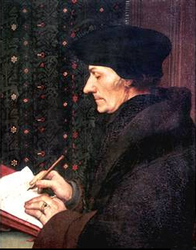
ʻI he 1516 naʻe pulusi ai ʻ e ʻ Ilesimasi ʻ o Rotterdam ʻ a e Fuakava Foʻoú ʻ i he lea faka - Kalisí, ʻ a ia naʻe ʻ ikai kau ai ʻ a e ngaahi konga tohi naʻe lave ki aí.
ʻI he taimi naʻe tohoakiʻi ai ʻe he Siasi ʻene tokanga ki he meʻa ko ʻeni naʻe ʻikai ke fai (ʻa ia naʻe fakataʻeʻaongaʻi ai ʻa e Vulgate), naʻa ne fakamatalaʻi ange naʻe ʻikai ke ne maʻu ha tatau totonu ʻo e lea faka-Kalisi ʻa ia naʻe maʻu ai ʻa e ngaahi kupuʻi lea ko ʻeni, ka naʻa ne loto fiemalie ke fakakau kinautolu kapau naʻe fakaʻaliʻali ange ʻe ha taha kiate ia ha kupuʻi lea ʻe taha.

Slide 8
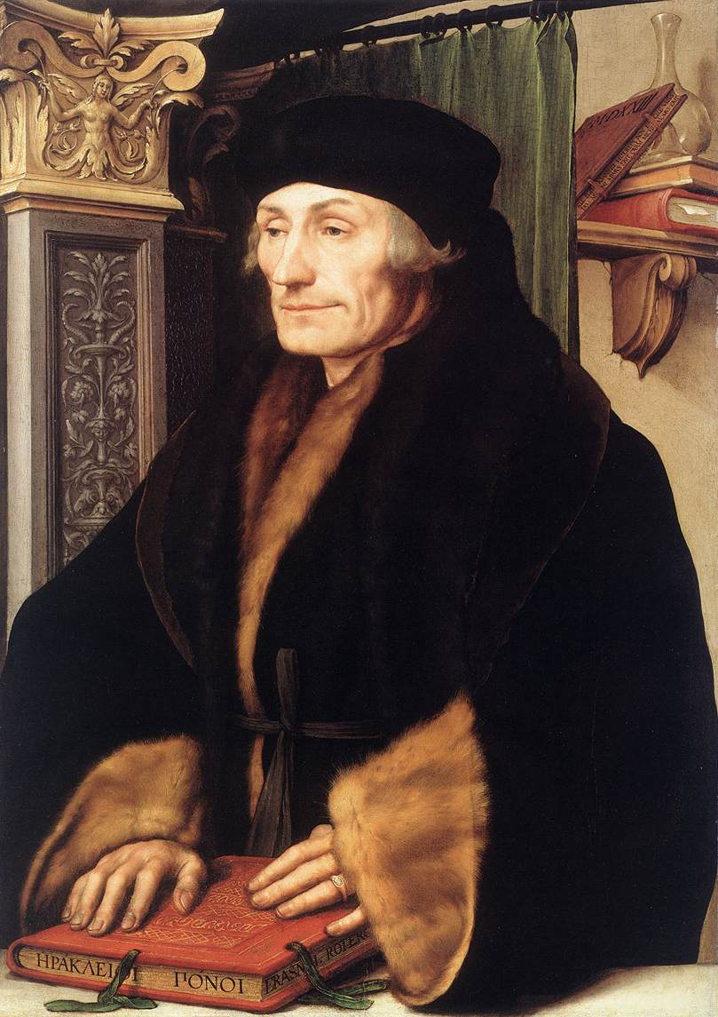
ʻI he 1520 naʻe pulusi ai ʻ e ha monike Falanisēkani naʻe ʻ ikai ʻ iloʻi ʻ a e hingoa ʻ o ha maniusikilipi ʻ i he lea faka - Kalisí ʻ a ia naʻe ʻ i ai ʻ a e ngaahi konga tohi naʻe fakakikihiʻí, ʻ a ia naʻá ne liliu tonu ia mei he lea faka - Latiná.
Koeʻuhi ʻi he ngaahi taimi ko ia naʻe siʻisiʻi ke fakapapauʻi pe fakaʻikaiʻi ha fakamatala pehe, naʻe tali ia ʻe ʻIlesimasi pea tanaki atu ʻa e ngaahi lea ʻi heʻene pulusi’anga hono tolu, naʻe pulusi ʻi he 1522.

Slide 9
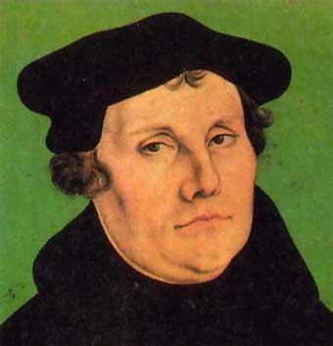
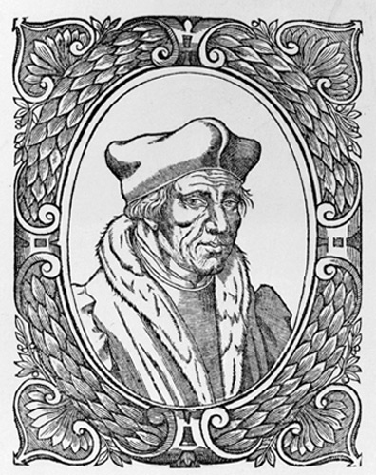
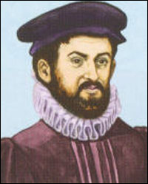
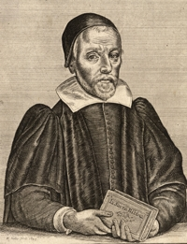
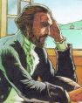
Ko e liliu faka-Kalisi ko eni ‘o e Fuakava Fo‘oú na‘e hoko ia ko e makatu‘unga ki hono liliu ‘o e Tohitapú ki ha ngaahi lea lahi lolotonga ‘a e Fakalelei-Lotú ..
German
Martin Luther
1522
French
Lefèvre d’Étaples
1525
Spanish
Casiodoro de Reina
1569
Italian
Giovanni Diodati
1607
English
Versión King James
1611
Portuguese
João Ferreira de Almeida
1681
Martin Luther
Lefèvre d’Étaples
Casiodoro de Reina
Giovanni Diodati
João Ferreira de Almeida

Slide 10
Kuo ʻosi fakaleleiʻi ʻe he ngaahi visone foʻou ange ʻa e palopalema.
“‘Oku tolu ‘a e fakamo‘oní: ko e Laumālié, mo e vaí, pea mo e ta‘ata‘á. Pea ‘oku taha ‘enau fakamo‘oní” (Ko e Fuakava Fo'ou (Ko e TAULUA) [TCNT])
“He ʻoku ʻi ai ʻa e toko tolu ʻoku fakamoʻoni: ko e Laumālie, mo e vai mo e taʻataʻa; pea 'oku loto taha 'a e toko tolu .” (KO E TOHITAPU KATOA [TMB])
“οτι τρεις εισιν οι μαρτυρουντες, το πνευμα και το υδωρ και το αιμα”
“he ʻoku ʻi ai ha toko tolu ʻoku fakamoʻoni, ko e Laumālie mo e vai mo e taʻataʻa .” (Ko e tohi faka-Kalisi ʻa Nestlé)

