Slide 1

MAMATA
KIA SISU
Visone ʻa Elena G. White lesisita ki he Ngaahi Tohi ʻo e Muʻakí, peesi 79-81

Slide 2




Naʻe hangē ne u tangutu ʻi ha loto-moʻua lahi, mo hoku fofongá ʻi hoku ongo nimá, ʻo fakakaukau ʻo hangē ko ʻení:
Kapau naʻe ʻi he mamani ʻa Sisu, te u ʻalu kiate Ia, ʻo to hifo ʻi Hono vaʻe, pea fakaha kiate Ia ʻa e kotoa ʻo ʻeku ngaahi faingataʻaʻia. He ʻikai ke Ne tafoki meiate au, te Ne ʻaloʻofa mai kiate au, pea ʻoku totonu ke u ʻofa mo tauhi maʻu ai pe kiate Ia.
ʻI he taimi pe ko ia naʻe ava mai ʻa e matapaa, pea hu mai ha taha naʻe fotunga mo fofonga fakaʻofoʻofa. Naʻá ne sio mai kiate au ʻ i he manavaʻofa peá ne pehē mai: "ʻ Okú ke fie sio kia Sīsū? ʻOku Ne ʻi heni pea te ke lava ʻo mamata kiate Ia kapau ʻoku ke fie fai ia. Toʻo ʻa e meʻa kotoa pe ʻoku ke maʻu pea muimui ʻiate au."

Slide 3
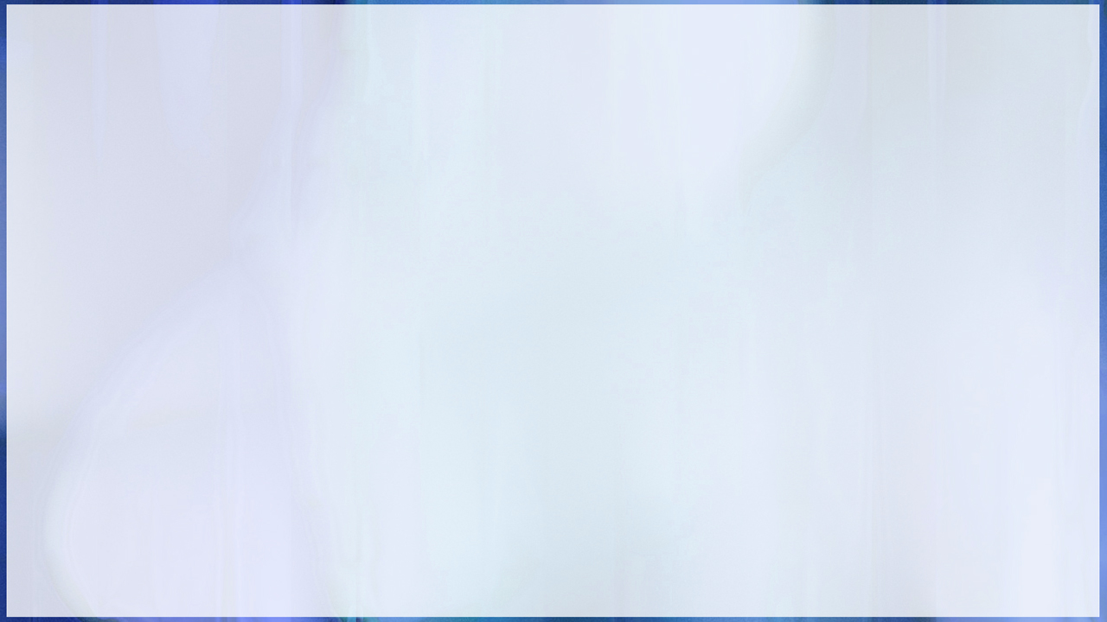



Naʻa ku fanongo ki ai ʻi he fiefia taʻe-mafakamatalaʻi, pea u tanaki fiefia kotoa ʻeku fanga kiʻi koloa, ʻa e ngaahi meʻa mahuʻinga kotoa pe, ʻo muimui ʻi hoku fakahinohino.
Naʻa ne taki atu au ki ha sitepu tahifo mo ngali vaivai.
ʻI he kamata ke u kaka hake ʻi he sitepu, naʻa ne fakatokanga mai ke u sio fakamamaʻu ki ʻolunga, telia naʻa ku ninimo pea to. Naʻe tokolahi mo ha niʻihi kehe naʻa nau kaka hake ʻi he kaka tahifo naʻa nau to kimuʻa pea nau toki aʻu ki he tumutumu.

Slide 4
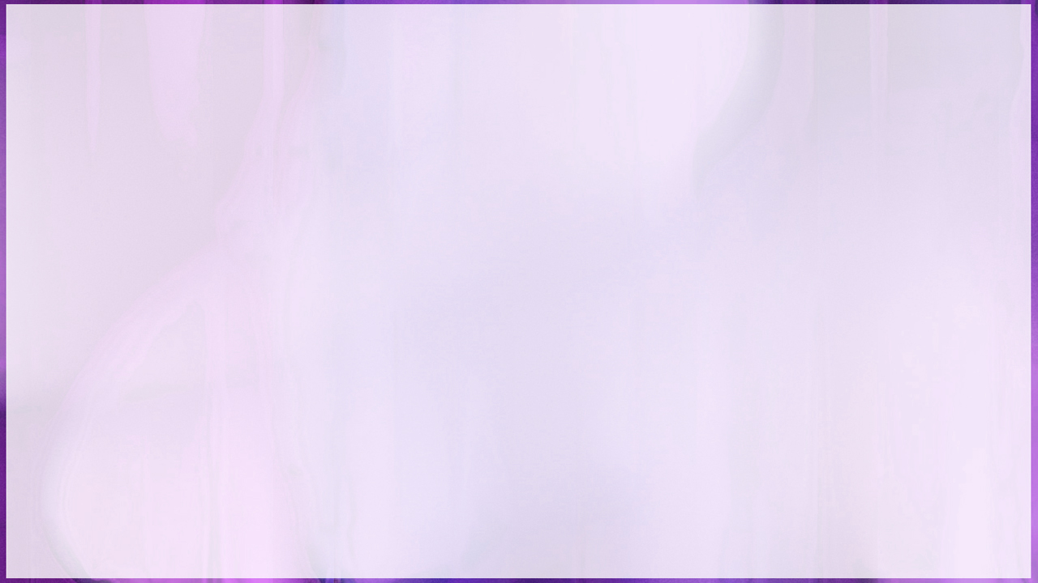



Naʻe faifai pea mau aʻu ki he sitepu fakaʻosi ʻo tuʻu ʻi muʻa ʻi he matapaa.
Naʻe fakahinohinoʻi au heni ʻe heʻeku tokotaha takimamata ke tuku ʻa e ngaahi meʻa kotoa pe naʻa ku ʻomi mo au. Naʻa ku fakatokoto fiefia kinaua.
Naʻa ne fakaava mai leva ʻa e matapaa ʻo fekau ke u hu ki loto.

Slide 5



Taimi siʻi pe naʻa ku tuʻu ʻi he ʻao ʻo Sisuu. Naʻe ʻikai ha toe veiveiua ʻi he fofonga fakaʻofoʻofa ko ia. Ko e faʻahinga fakahaaʻi ngingila pehe ʻo e angalelei mo e fakaʻeiʻeiki he ʻikai lava ke maʻu ia ʻe ha taha.
ʻI he tuku mai ʻEne vakai mai kiate au, naʻa ku ʻiloʻi he taimi pe ko ia naʻa Ne maheni mo e tukunga kotoa pe ʻo ʻeku moʻui pea mo e kotoa ʻo ʻeku ngaahi fakakaukau mo e ngaahi ongo ʻi loto.
Naʻa ku feinga ke maluʻi au mei Heʻene ʻafio mai, ʻi heʻeku ongoʻi ʻoku ʻikai ke u lava ʻo katakiʻi Hono fofonga fakaʻilo, ka naʻa Ne ʻunuʻunu mai mo malimali, pea hilifaki Hono toʻukupu ki hoku ʻulu ʻo folofola mai: "ʻOua ʻe manavahe."
Naʻe fakafiefiaʻi hoku loto ʻe he ongo mai Hono leʻo fakaʻofoʻofa ʻaki ha fiefia kuo teʻeki ai ke u aʻusia kimuʻa.

Slide 6



Naʻa ku fuʻu fiefia ke lea ʻaki ha foʻi lea, ka ʻi heʻeku lomekina ʻe he fiefia taʻe-mafakamatalaʻi, naʻa ku fakatomapeʻe hifo ʻi Hono toʻukupu kelekele.
Lolotonga ʻeku tokoto ʻo ʻikai ke u lava ha meʻa, naʻe ʻasi mai ʻi muʻa ʻiate au ha ngaahi meʻa fakaʻofoʻofa mo naunau, pea hange kuo u aʻu ki he malu mo e nonga ʻo e langi.

Slide 7




Naʻe faifai pea foki mai hoku ivi, pea u tuʻu hake. Naʻe kei siofi pe au ʻe he fofonga ʻofa ʻo Sisuu, pea naʻe fakafonu hoku laumalie ʻe Heʻene malimali ʻaki ʻa e fiefia. Naʻe fakafonu au ʻe Heʻene ʻi ai ʻaki ʻa e ʻapasia maʻoniʻoni mo ha ʻofa ʻoku ʻikai lava ke fakamatalaʻi.
Naʻe fakaava mai leva ʻe heʻeku takimamata ʻa e matapaa, pea ma fakatou pongia.
Naʻa ne fekau mai ke u toe toʻo hake ʻa e ngaahi meʻa kotoa pe naʻe ʻikai ke u maʻu.

Slide 8
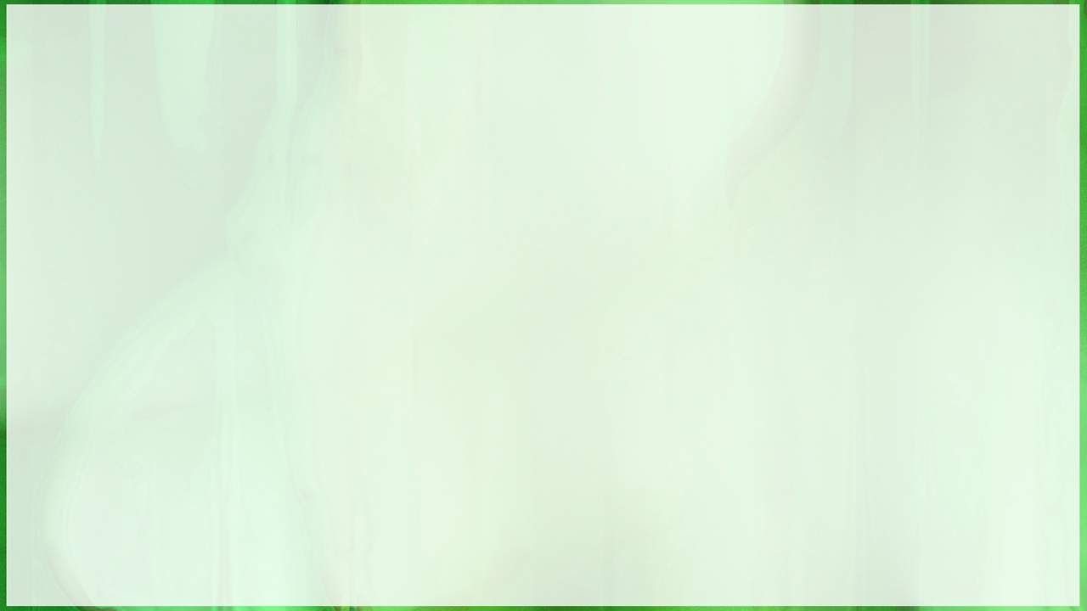

ʻI heʻene fai ʻeni, naʻa ne mono mai ha maea lanu mata naʻe takai ofi mai. Naʻa ne fakahinohinoʻi au ke u tuku ʻeni ʻi hoku tafaʻaki, pea ʻi he taimi ʻoku ou fie mamata ai kia Sisu, toʻo mei hoku fatafata ʻo mafao atu ki hoku taupotu taha. Naʻa ne fakatokanga mai ke ʻoua naʻa tuku ke takai ia ʻi ha vahaʻa taimi loloa, telia naʻa fakapoʻo pea faingataʻa ke fakatonutonu ia.

Slide 9



Naʻa ku tuku ʻa e maea ʻo ofi ki hoku mafu pea u hifo fiefia hifo ʻi he sitepu fasiʻi, ʻo fakafetaʻi ki he ʻEiki mo fakaha fiefia kiate kinautolu kotoa pe naʻa ku fetaulaki mo ia ʻa e feituʻu te nau lava ʻo maʻu ai ʻa Sisuu.
Naʻe ʻomi ʻe he misi ko ʻeni ha ʻamanaki lelei kiate au. Naʻe fakafofongaʻi ʻe he afo lanumata ʻa e tui ki hoku ʻatamai, pea naʻe kamata ke mahino ki hoku laumalie ʻa e fakaʻofoʻofa mo e faingofua ʻo e falala ki he ʻOtua.

