Slide 1

Ko e Lelei Taha
ʻo e ʻOfa ʻe Hongofulu Ma Nima

Slide 2
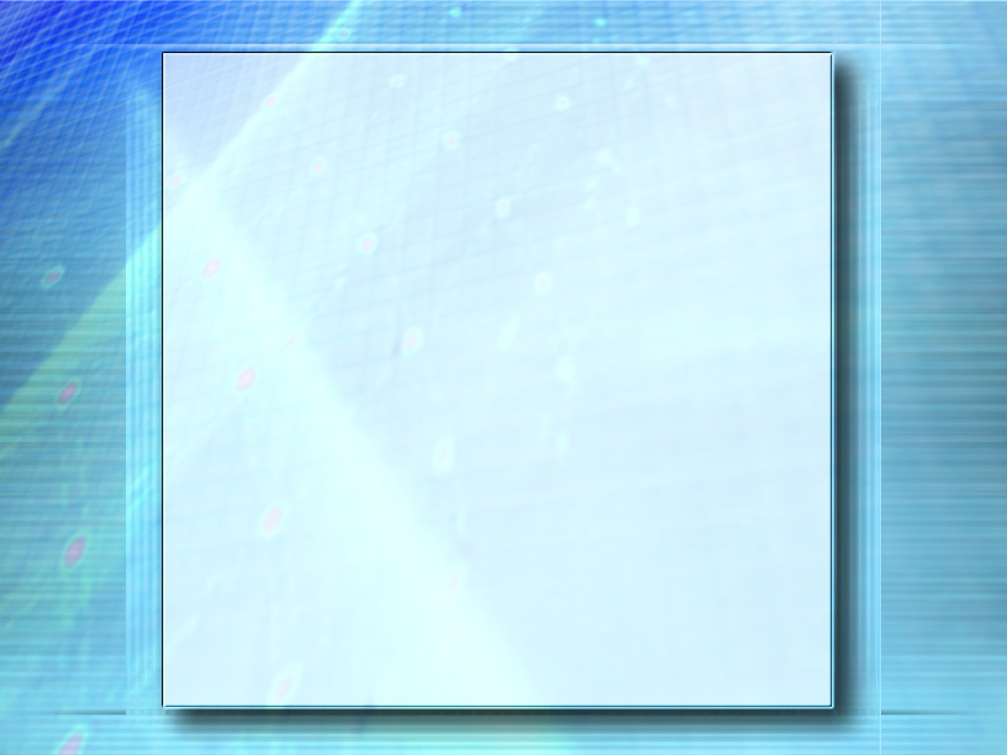
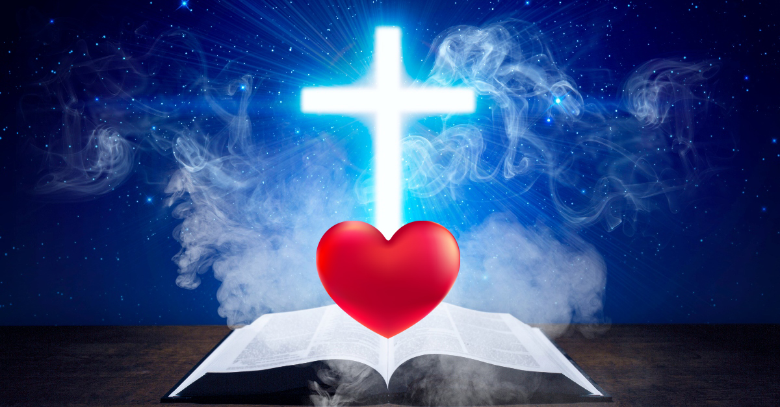

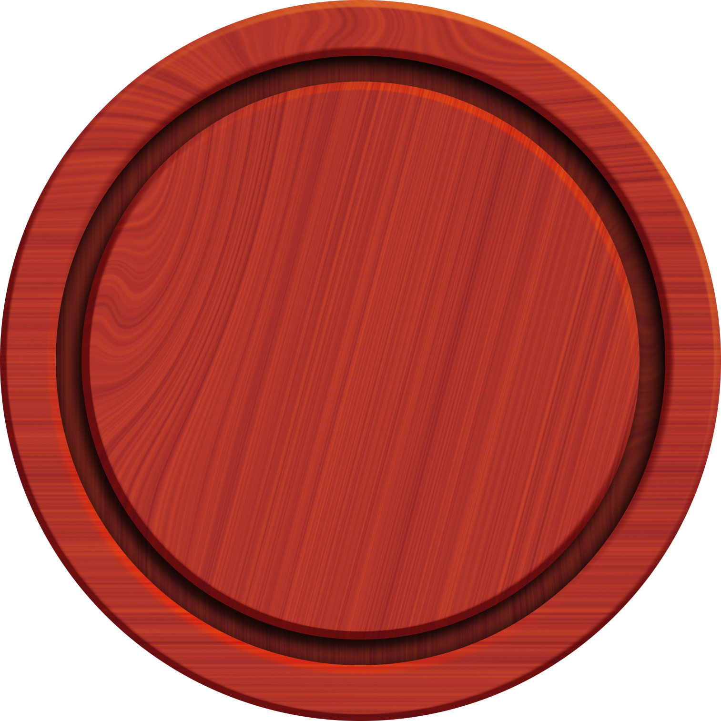



Te tau ʻiloʻi ʻa e natula ʻo e ʻofa, hono mahuʻinga mo e tolonga taʻengata. ʻ Oku fakahāhā ʻ e Paula ha meʻaʻofa ʻ a ia ʻ oku mahuʻinga ange ia ʻ i ha toe ʻ ulungaanga lelei pē ʻ oku ʻ iloʻí, pea ko e meʻaʻofa ko iá ʻ oku ala maʻu ia ki he tokotaha kotoa.
ʻOku fakaʻaongaʻi ʻe he 1 Kolinito 13 ʻa e foʻi lea faka-Kalisi ko e ákape, ʻa ia ko e "ʻofa" ʻi hono ʻuhinga maʻolunga taha, ʻo ʻiloʻi ha meʻa mahuʻinga ʻi he tokotaha pe meʻa ʻoku ʻofaʻi; ʻofa ʻoku makatuʻunga ʻi ha tefitoʻi moʻoni kae ʻikai ʻi he ngaahi ongo; Ko e ʻ ofa ʻ oku haʻu mei he fakaʻapaʻapa ki he ngaahi ʻ ulungaanga fakaʻofoʻofa ʻ o e tokotaha ʻ oku ʻ ofaʻí.
Ko e ʻofa ko ʻeni ʻoku ʻi he vahaʻa ʻo e Tamai mo Sisuu. "Pea kuo u fakaha ho huafa kiate kinautolu, pea te u toe fakaha ia, koeʻuhi ke ʻiate kinautolu ʻa e ʻofa naʻa ke ʻofa ʻaki au, pea ʻoku ou ʻiate kinautolu" (Sione 17:26).
Ko e ʻofa huhuʻi ia ʻa e ʻOtua ki he faʻahinga ʻo e tangata kuo mole. "Naʻe fakaha ʻi he meʻa ni ʻa e ʻofa ʻa e ʻOtua kiate kitautolu, koeʻuhi naʻe fekau mai ʻe he ʻOtua hono ʻAlo pe taha naʻe fakatupu ki mamani, koeʻuhi ke tau moʻui ʻiate ia." (1 Sione 4:9).
Ko e ʻ ulungaanga makehe ia ʻ oku fakahāhā ʻ i he ngaahi feangainga ʻ a e kau Kalisitiané. "Ko e fekau foʻou ʻoku ou fai kiate kimoutolu, Ke mou feʻofaʻaki kiate kimoutolu; ʻo hange ko ʻeku ʻofa kiate kimoutolu, ke pehe foki mo hoʻomou feʻofaʻaki. ʻI he meʻa ni ʻe ʻilo ai ʻe he kakai kotoa pe ko ʻeku kau akonga ʻa kimoutolu, ʻo kapau te mou feʻofaʻaki kiate kimoutolu" (Sione 13:34-35).
ʻOku fakahoko ia ke fakahaaʻi ʻa e va fetuʻutaki ʻo e tokotaha tui mo e ʻOtua. "Kuo teʻeki ai mamata ha taha ki he ʻOtua. Kapau te tau feʻofaʻaki, ʻoku nofoʻia kitautolu ʻe he ʻOtua, pea ʻoku haohaoa ʻene ʻofa ʻiate kitautolu" (1 Sione 4:12).

Slide 3
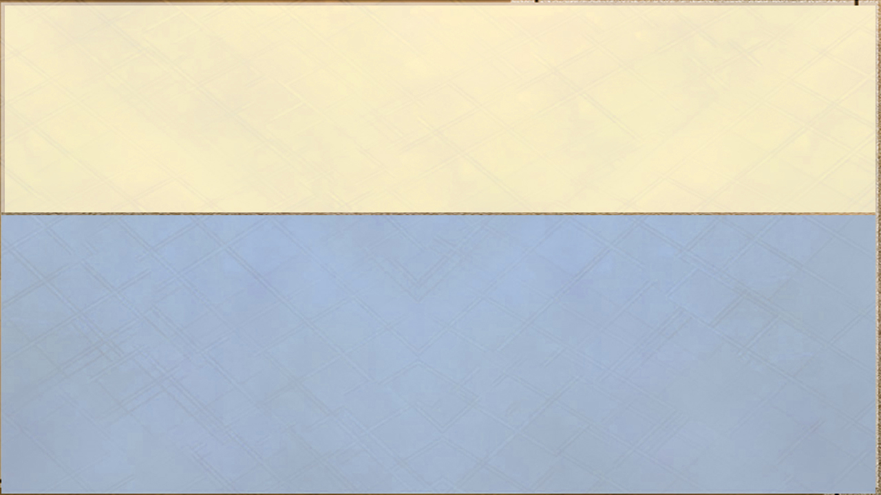
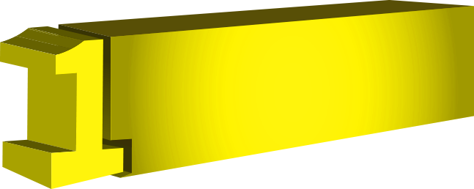

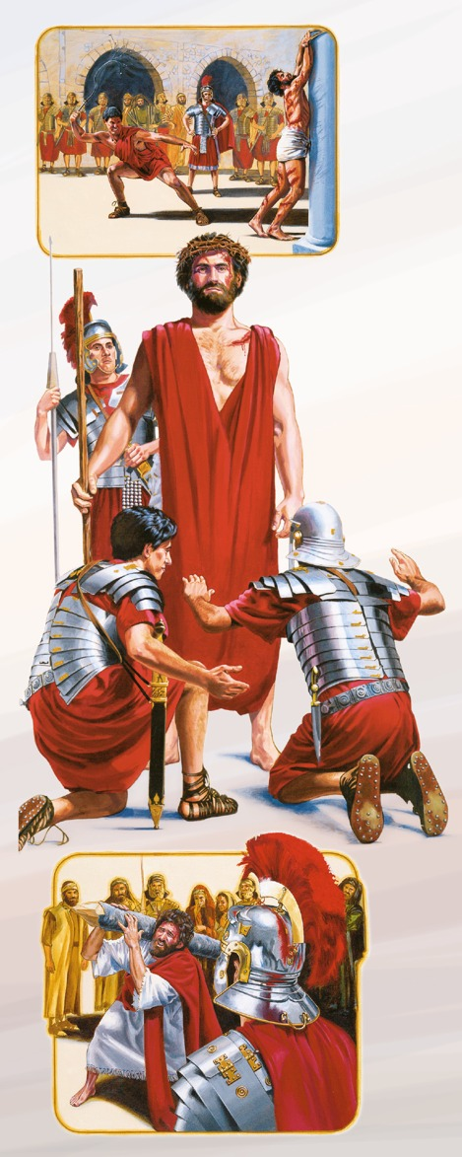

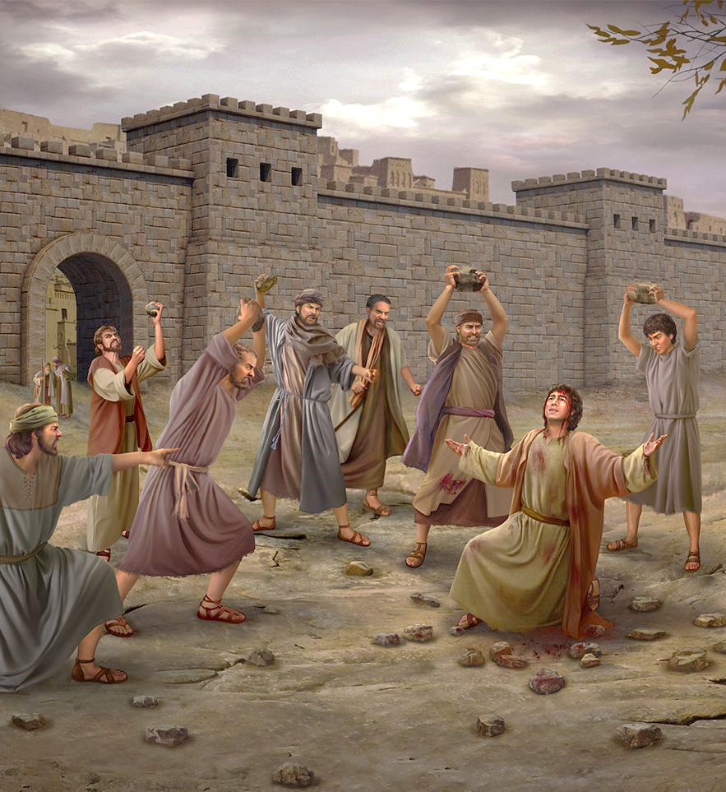
"ʻOku fakamatalaʻi ʻe he faingataʻaʻia" ʻa e tuʻunga ʻo e ʻatamai ʻoku ne ʻai ʻa e tangata ke nonga ʻi he faʻa kataki ʻi he taimi ʻoku ngaohikovia, lauʻikoviʻi, mo fakatangaʻi.
ʻOku ʻuhinga ki he ha?
ʻOku Faingataʻaʻia Fuoloa ʻa e ʻOfa
Ko ha ʻulungaanga mahuʻinga ʻa e faʻa kataki pe kataki fuoloa, ʻi ha mamani ʻoku lahi ai ʻa e taʻe-faʻa kataki mo e taʻe faʻa kataki. ʻOku angavaivai ʻa e ʻofa ʻi he ngaahi fehalaaki, taʻelavameʻa, mo e vaivai ʻa e niʻihi kehe. ʻOku ne ʻiloʻi ʻoku fehalaaki ʻa e faʻahinga kotoa pe ʻo e tangata, pea ko ia ai, ʻoku totonu ke ʻi ai ha ngaahi fakaha te ne fakahaaʻi ʻa e ngaahi fehalaaki ʻoku tupu mei he natula angahalaʻia ʻo e tangata. Ko e faʻa kataki ko e fehangahangai ia ʻo e fakavavevave, ʻo e ngaahi lea mo e ngaahi fakakaukau ʻoku loto vekeveke, pea mo e ʻitangofua.
Naʻe anga - fēfē hono fakahāhā ʻ e Sīsū ʻ a e tafaʻaki ko eni ʻ o e ʻ ofá?
Pea naʻe ʻave ʻe he kau tau ʻa e kovana ʻa Sisu ki he fale fakapuleʻanga, ʻo nau fakataha kiate ia ʻa e kau tau kotoa pe. Pea naʻa nau vete ia, ʻo nau ʻai kiate ia ʻa e pulupulu kula ʻahoʻaho. Pea hili ʻenau ta ʻa e kalauni talatala, naʻa nau ʻai ia ki hono ʻulu, mo e kuta ʻi hono nima toʻomataʻu: pea nau punou honau tui ʻi hono ʻao, ʻo manuki kiate ia, ʻo pehe, ʻMalo ʻa e Tuʻi ʻo e kau Siu! Pea naʻa nau ʻaʻanu kiate ia, ʻo toʻo ʻa e kuta, ʻo taaʻi hono ʻulu. Pea hili ʻenau manukiʻi ia, naʻa nau toʻo ʻa e pulupulu meiate ia, ʻo ʻai hono kofu ʻoʻona, ʻo taki atu ia ke tutuki ia. (Matiu 27:27 31).

Slide 4

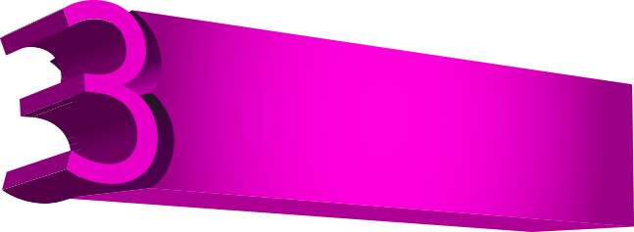
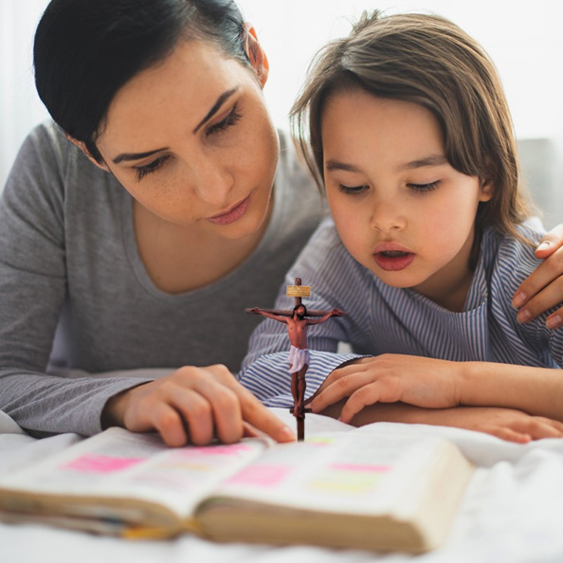

ʻOku Faingataʻaʻia Fuoloa ʻa e ʻOfa
Ko e fe ʻa e ngaahi tohi ke manatuʻi?
[ʻAʻeva] ʻi he loto-fakatokilalo mo e angamalu kotoa pe, ʻi he faʻa kataki fuoloa, ʻo fekatakiʻaki ʻiate kimoutolu ʻi he ʻofa. (ʻEfeso 4:2).
ʻOku monuʻia ʻa kimoutolu, ʻo ka lauʻikoviʻi mo fakatangaʻi ʻa kimoutolu ʻe he kakai, pea te nau lea loi ʻaki ʻa kimoutolu ʻi he faʻahinga kovi kotoa pe, koeʻuhi ko au. Fiefia, pea nekeneka lahi ʻaupito: he ʻoku lahi hoʻomou totongi ʻi he langi: he naʻe pehe ʻenau fakatangaʻi ʻa e kau palofita naʻe muʻomuʻa ʻiate kimoutolu. (Matiu 5:11-12).
Lolotonga ʻoku moʻui kotoa ʻa kita, ʻoku tau mateuteu maʻu pe ke maluʻi ia mei he mamahi mo e fakamamahi; ka ʻi he taimi ʻoku mate ai ʻa kita, pea fufuuʻi ʻetau moʻui mo Kalaisi ʻi he ʻOtua, ʻe ʻikai ke tau tokanga ki he ngaahi meʻa ʻoku ʻikai ke tau tokanga ki ai. Te tau tuli ki he manuki pea kui ki he manuki mo e fakamamahi. "ʻOku kataki fuoloa ʻa e ʻofa, pea ʻoku angaʻofa" RC 263.

Slide 5
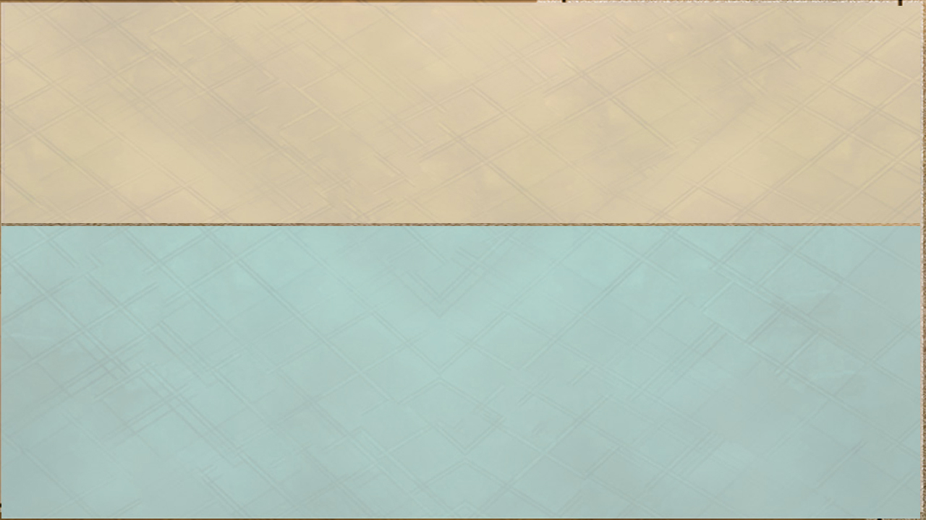
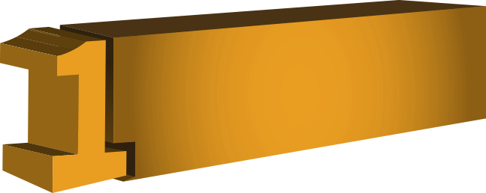

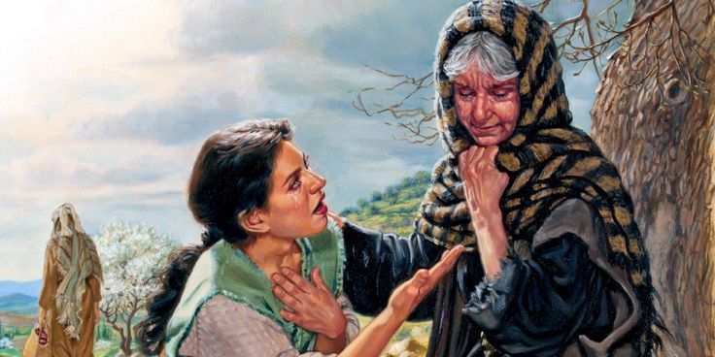

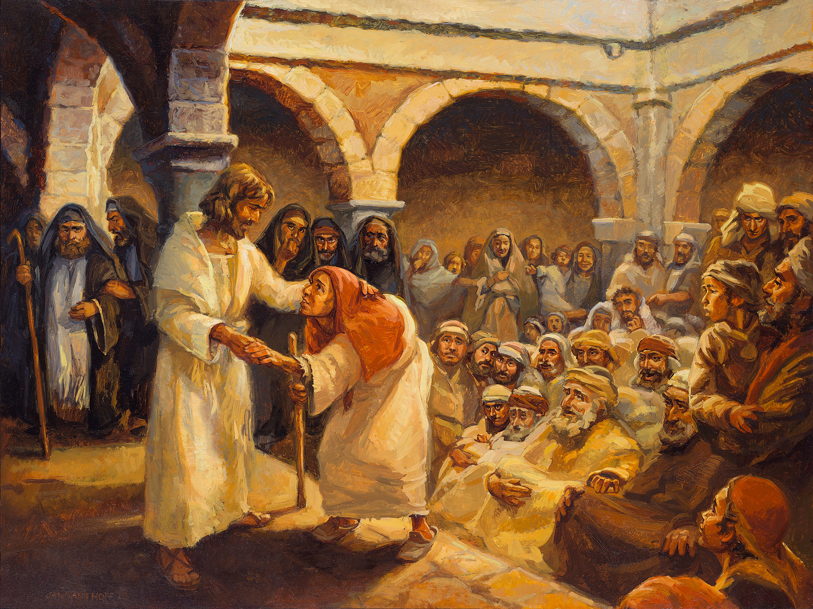
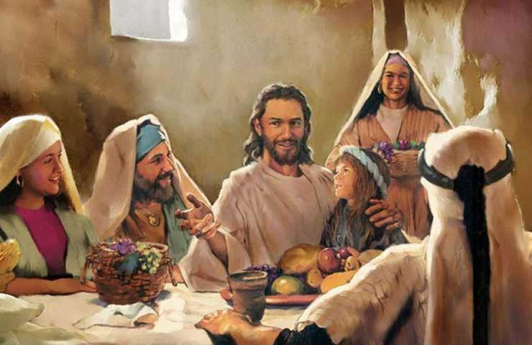
ʻOku ʻuhinga ki he ha?
ʻOku ʻuhinga ia ke "angavaivai," "ke fakahaaʻi ʻa e angaʻofa," "ke fakaʻatuʻi mo angavaivai."
ʻOku Angalelei ʻa e ʻOfa
ʻOku ne fakamatalaʻi ʻa e natula angaʻofa ʻo ha taha ʻoku ueʻi ʻe he Laumalie ʻo e ʻOtua, ʻa ia ʻoku ne feinga maʻu pe ke fakahaaʻi, ʻi he lea mo e ngaue, ʻa e mahino mo e ongoʻingofua ʻo e ngaahi faingataʻaʻia mo e faingataʻaʻia ʻa e niʻihi kehe. Ko e fakakaukau ʻo e foʻi lea, ʻoku vaivai mo angavaivai ʻa e ʻofa ʻi he tukunga kotoa pe ʻo e moʻui, ʻo tatau ai pe pe ʻoku faingataʻa pe fakaʻita, fakamamahi pe fakamamahi. Ko e ʻofa ko e fehangahangai ia ʻo e taufehiʻa, ʻa ia ʻoku fakahaaʻi ia ʻi he fefeka, ʻita, fefeka, mo e sauni. Ko ia ʻoku ʻofa moʻoni ki ha taha ʻoku angaʻofa kiate ia, ʻoku ne fakaʻamu ke fai lelei kiate ia; ʻOku ne angavaivai mo anga fakaʻapaʻapa koeʻuhi he ʻoku ʻikai ke ne loto ke fakalaveaʻi ʻene ongo, ka ʻoku ne feinga ke tokoniʻi ia ke fiefia.
Naʻa Ne mahuʻingaʻia ʻi he tapa kotoa pe ʻo e faingataʻaʻia naʻa Ne fakatokangaʻi, pea naʻa Ne ʻomi ha fakafiemalie ki he tokotaha faingataʻaʻia kotoa pe, ʻo ʻi Heʻene ngaahi lea ʻofa naʻe ʻi ai ha lolo fakanonga... ka naʻe mavahe atu meiate Ia ʻa e angamaʻa—ʻa e malohi faifakamoʻui ʻo e ʻofa—ki he mahaki mo e faingataʻaʻia. DA 92
Naʻa Ne tangutu ʻi he tepile ʻa e kau tanaki tukuhau ko ha fakaafe fakalangilangi, ʻi Heʻene manavaʻofa mo e angaʻofa fakasosiale ʻo fakahaaʻi ai ʻEne ʻafioʻi ʻa e ngeia ʻo e faʻahinga ʻo e tangata; pea naʻe fakaʻamu ʻa e tangata ke nau moʻui taau mo ʻEne falala.
¿Naʻe anga - fēfē hono fakahāhā ʻ e Sīsū ʻ a e tafaʻaki ko eni ʻ o e ʻ ofá?
Naʻe fakaake ʻa e ngaahi ongo foʻou, pea naʻe fakaava ki he kau liʻekina ko ʻeni ʻo e sosaieti ʻa e faingamalie ʻo ha moʻui foʻou.—Ko e Potungaue ʻo e Fakamoʻui, 26 (1905). 2MCP 623
Naʻa Ne fakaʻaongaʻi ʻa e fakapotopoto lahi taha, mo e faʻa fakakaukau, mo e angaʻofa ʻi Heʻene feohi mo e kakai. Naʻe ʻikai ke Ne anga taʻefakaʻapaʻapa, ʻikai ke ne lea taʻeʻaonga, naʻe ʻikai ke ne fai ha mamahi taʻeʻaonga ki ha laumalie ongoʻingofua. DA 353.

Slide 6

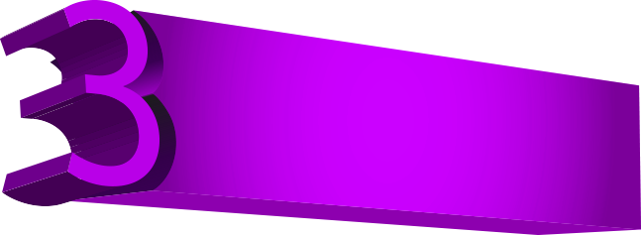

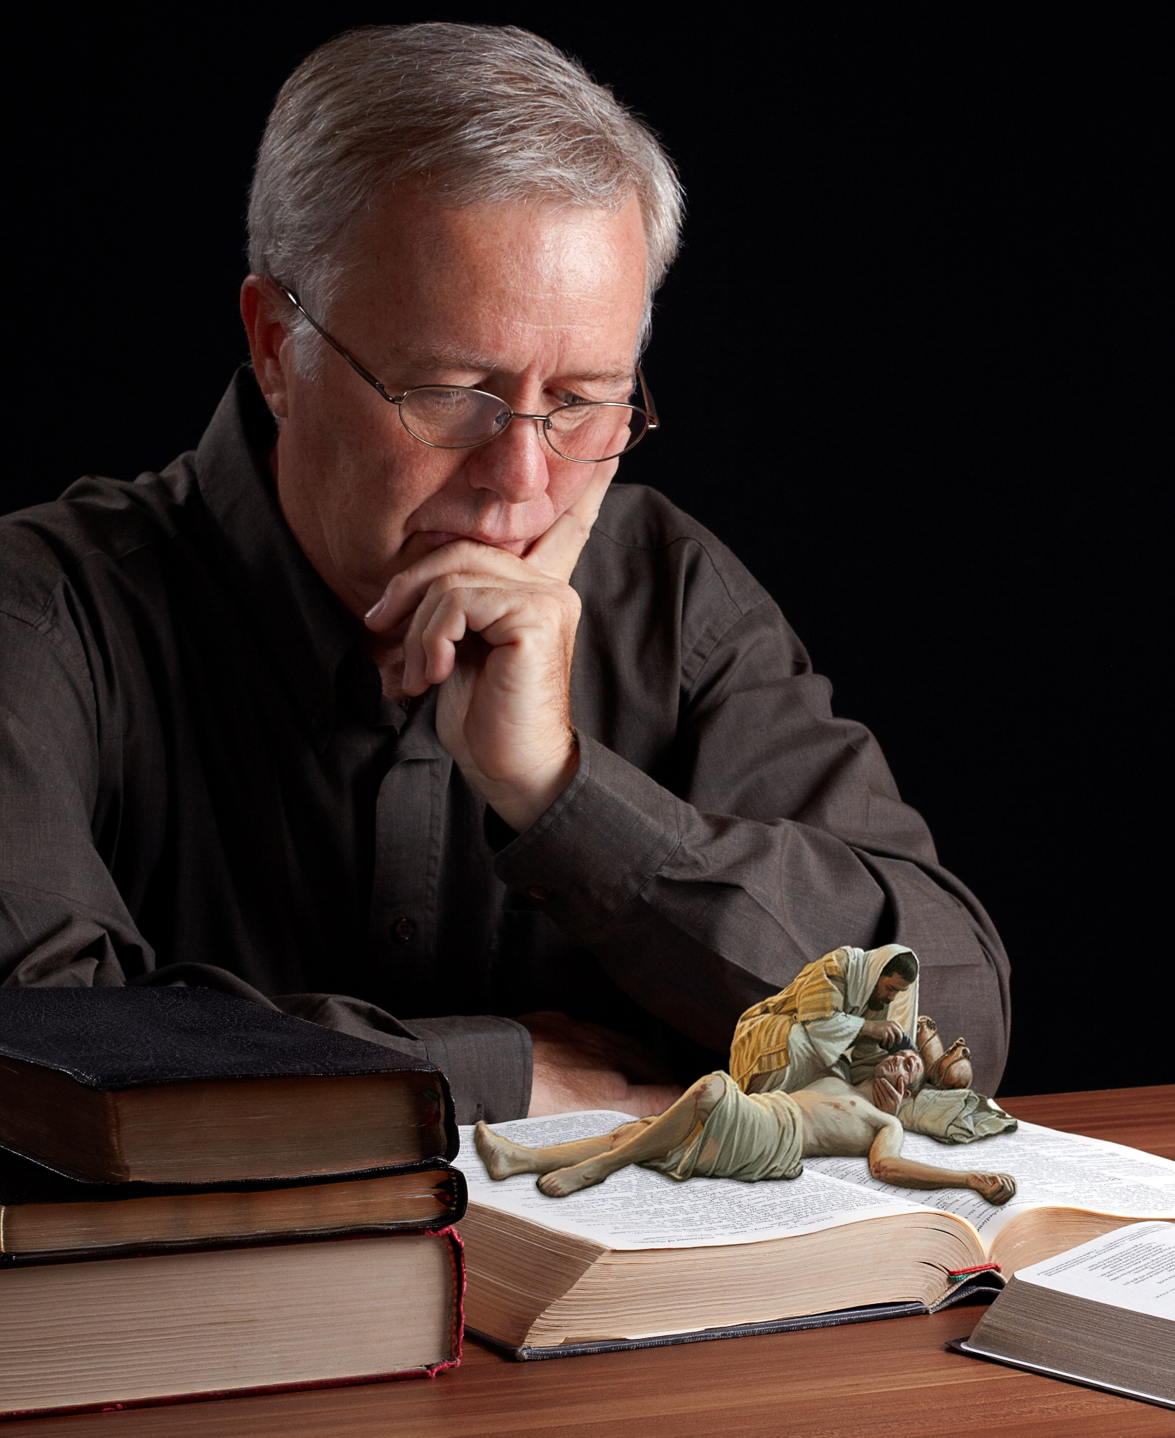
Ko e fe ʻa e ngaahi tohi ke manatuʻi?
Ko hono fakaʻosi, ke mou fakakaukau taha kotoa pe, ʻo femanavaʻofaʻaki, ʻofa ʻo hange ko e kainga, fakaʻofaʻia, fakaʻapaʻapa (1 Pita 3:8).
ʻOku Angalelei ʻa e ʻOfa
Fakafetaʻi ki he ʻEiki; he ʻoku lelei ʻa e ʻEiki: hiva ʻa e fakafetaʻi ki hono huafa; he ʻoku lelei. (Saame 135:3).
Ko ia, ʻai ʻa e loto ʻo e ʻaloʻofa, mo e angaʻofa, mo e loto-fakatokilalo, mo e angamalu, mo e faʻa kataki fuoloa ʻo hange ko e kakai fili ʻa e ʻOtua, mo e maʻoniʻoni mo e ʻofeina.
Ka ʻoku mou ʻofa ki homou ngaahi fili, pea fai lelei, pea no ʻo ʻikai toe ʻamanaki ki ha meʻa ʻe taha; pea ʻe lahi hoʻomou totongi, pea te mou hoko ko e fanau ʻa e Fungani Maʻolunga: he ʻoku ne angalelei ki he taʻehoungaʻia mo e angakovi. (Luke 6:35).
Ko e Malohi ʻo e Angaʻofa—He ʻikai te ke teitei ʻiloʻi ʻa e ivi takiekina ʻo ha hala angaʻofa mo fakaʻatuʻi ki he ngaahi meʻa ʻoku ʻikai tatau, taʻefakaʻatuʻi, mo taʻefeʻunga. 2MCP 775
Kapau hili haʻanau fakaʻitaʻi mo fakamaau taʻetotonu ʻi heʻenau tafaʻaki, te ke fakafeangai kiate kinautolu ʻo hange ko haʻo fai ki ha taha taʻehalaia, pea aʻu ʻo ke feinga ke fakahaaʻi kiate kinautolu ha ngaahi ngaue makehe ʻo e angaʻofa, ta kuo ke fai leva ʻa e fatongia ʻo ha Kalisitiane, pea nau ʻohovale mo ma pea sio lelei ange ki heʻenau toʻonga mo e angakovi ʻi haʻo fakaha mahino ʻenau ngaahi toʻonga kovi ke valokiʻi kinautolu. Vahe 7

Slide 7
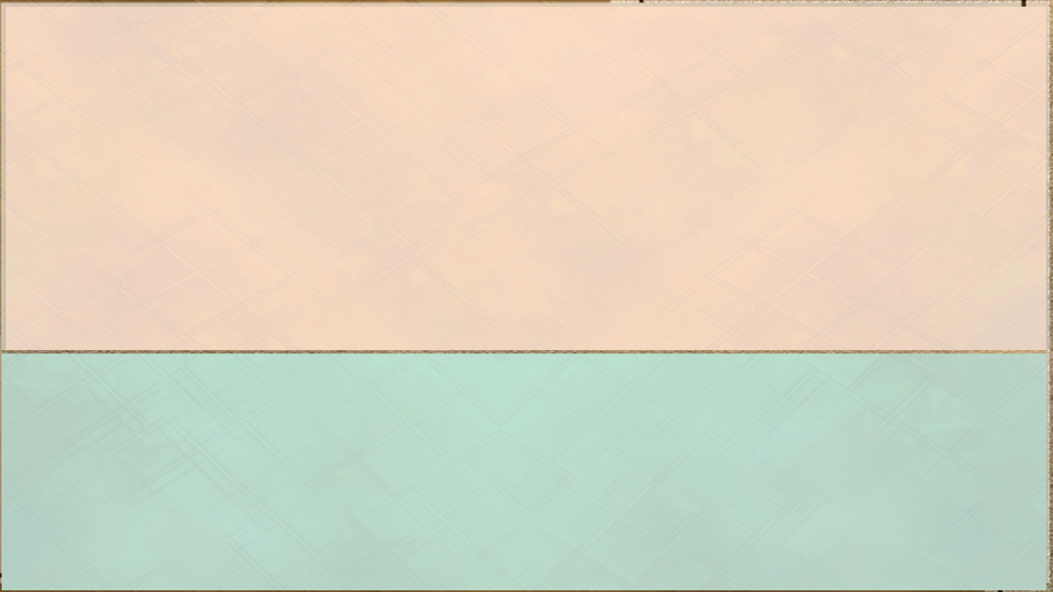
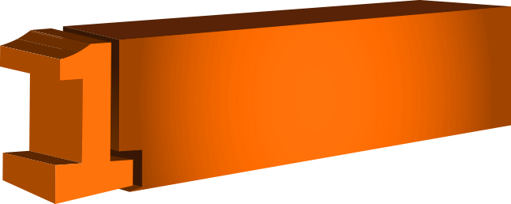

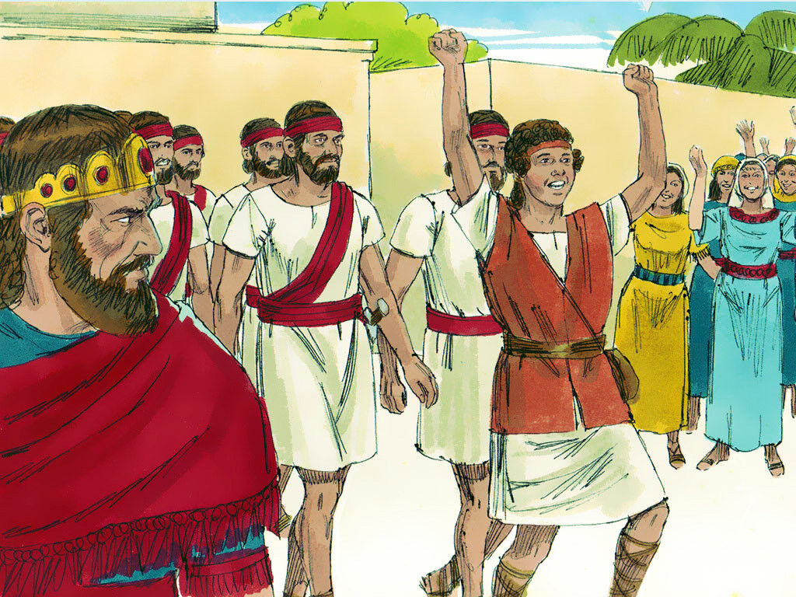
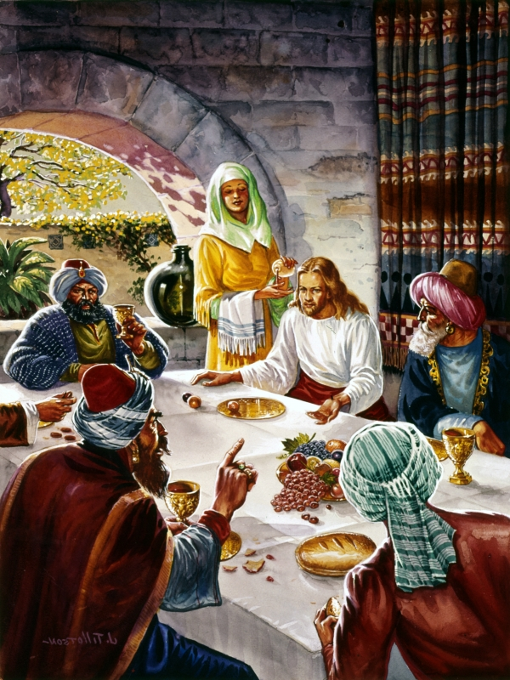

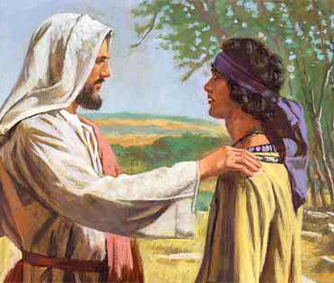
ʻOku ʻuhinga ki he ha?
Ko e meheka ko ha "fakaʻamu taufehiʻa ia ki he ngaahi koloa, tuʻunga, koloa, lavameʻa, pe lavameʻa ʻa ha taha kehe." Ko e "meheka," ʻi ha ʻuhinga lelei pe kovi.
ʻOku ʻIkai Meheka ʻa e ʻOfa
ʻOku ʻuhinga heni, ʻi ha ʻuhinga ʻoku ʻikai lelei, ke "meheka" pe fakahaaʻi ha ngaahi ongo kovi pe taʻefakafiemalie ki he niʻihi kehe koeʻuhi he ʻoku nau maʻu ha faingamalie ʻi ha taha. ʻOku fakatupu ʻe he faʻahinga ongo pehee ʻa e fekeʻikeʻi mo e mavahevahe, ʻa ia ʻoku matuʻaki fepaki mo e ngaahi akonaki ʻa Sisuu, he naʻa Ne naʻinaʻi ki he tangata ke nau feʻofaʻaki pea nofo fakataha (vakai, Sione 15:12; 17:22; 1 Sione 3:23). Ko e meheka pe meheka, ʻi he ngaahi mele kotoa pe ʻa e tangata, ko e taha ia ʻo e ngaahi mele fakamamahi mo fakalielia taha (vakai, Lea Fakatata 27:4; Qty. 8: 6). Naʻe lomeheka ʻa Lusifa pea mole ai hono ngeia maʻolunga. Talu mei heʻene hinga, mo ʻene feinga ke fakato ʻa e meheka ʻi he loto ʻo e tangata kotoa pe koeʻuhi ke mole ʻa e meʻa kotoa pe ʻo hange ko ia. Ko e ʻofa pe te ne lava ʻo tekeʻi ʻa e meheka. Ka ʻoku ʻikai taʻofi kitautolu ʻe heʻetau fiemalie ʻi he meʻa kuo tuku mai ʻe he ʻEiki ke tau maʻu mei heʻetau holi fakamatoato ki he ngaahi meʻafoaki lelei taha mo e fakaʻamu fakamatoato ki he "hala ʻoku toe lelei ange" ʻo e ʻofa.
Naʻe anga - fēfē hono fakahāhā ʻ e Sīsū ʻ a e tafaʻaki ko eni ʻ o e ʻ ofá?
Tau fakakaukau angé naʻe toʻo ʻe Sīsū ʻa e ngaahi faingataʻaʻia mo e faingataʻaʻia kotoa pē ʻa e tangatá ki Hono lotó pea ʻai ia ko ha konga ʻo e meʻa naʻá Ne aʻusiá. Neongo ko Ia ʻa e Pilinisi ʻo e moʻui, ka naʻe ʻikai ke Ne tuʻu ʻi Hono tuʻunga fakataha mo e kau maʻongoʻonga mo fakaʻeiʻeiki, ka ʻi he lotolotonga, ngaohikovia, mo e faingataʻaʻia. Ko e tangata Nasaleti ia naʻe fehiʻanekinaʻi. Naʻe ʻikai ke Ne maʻu ha feituʻu ke tokoto ai Hono ʻulu. Naʻa Ne hoko ʻo masiva koeʻuhi ko kitautolu, koeʻuhi ke tau koloaʻia ʻi Heʻene masiva. 4T 620

Slide 8

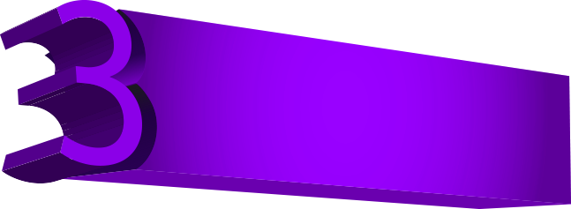

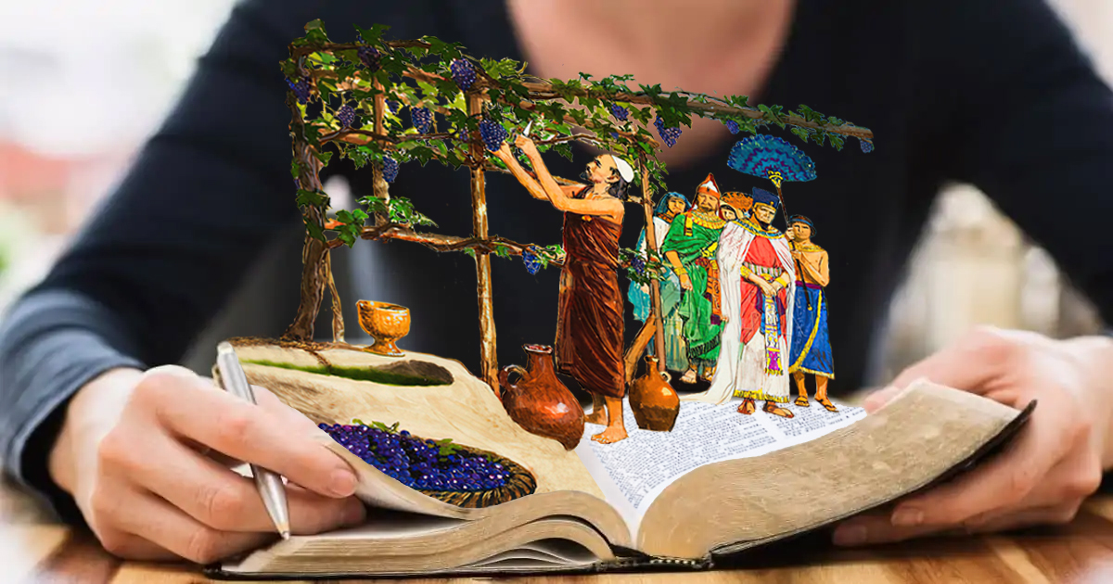
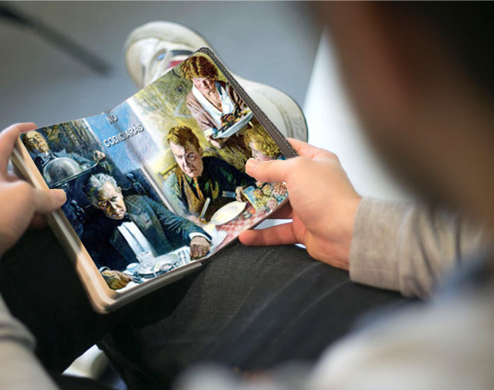
Ko e fe ʻa e ngaahi tohi ke manatuʻi?
He ko e feituʻu ʻoku ʻi ai ʻa e meheka mo e fekeʻikeʻi, ʻoku ʻi ai ʻa e puputuʻu mo e ngaue kovi kotoa pe. (Semisi 3:16).
ʻOku ʻIkai Meheka ʻa e ʻOfa
Ko e loto lelei ko e moʻui ia ʻo e kakano: ka ke meheka ʻi he popo ʻo e ngaahi hui (Lea Fakatata 14:30).
Kapau ʻoku tau moʻui ʻi he Laumalie, tau ʻaʻeva foki ʻi he Laumalie. ʻOua naʻa tau holi ki he langilangi taʻeʻaonga, ʻo fefakaʻitaʻi, mo femehekaʻaki. (Kaletia 5:25-26).
ʻOua naʻa meheka ho loto ki he kau angahala: ka ke manavahe kia Sihova ʻi he ʻaho kotoa pe (Lea Fakatata 23:17).
ʻOku ʻomi mahino heni ʻa kinautolu ʻe hoko ko e ngaahi vaka ki he fakalangilangiʻi, he te nau maʻu ʻa e ʻuha fakaʻosi. Ko e laumalie kotoa pe ʻoku ulo atu ʻi hotau hala ʻe fakakuihi ia pea te ne tali ʻa e ngaahi loi ʻoku haʻu meia Setane. ʻOku tau ofi atu ʻeni ki he ngataʻanga ʻo e hisitolia ʻo e mamani. ʻOku ʻi fe ʻa e kau tangata leʻo faivelenga ʻi he ngaahi ʻa ʻo Saione ʻa ia ʻe ʻikai mohe, ka ʻoku nau fakaha faivelenga ʻa e taimi ʻo e poʻuli? ʻOku haʻele mai ʻa Kalaisi, ke fakaʻofoʻofaʻia ʻiate kinautolu kotoa pe ʻoku tui. Meʻa fakamamahi ke fakakaukau atu ki he ʻEiki ko Sisu. ʻOku tokosiʻi ʻoku nau fakalahi ʻEne ʻaloʻofa mo hakeakiʻi ʻEne manavaʻofa mo e ʻofa taʻefakangatangata. He ʻikai ha meheka, pe meheka, ʻi he loto ʻo kinautolu ʻoku feinga ke hange ko Sisu. .— 7LtMs, Lt 15, 1892, par. 12.

Slide 9
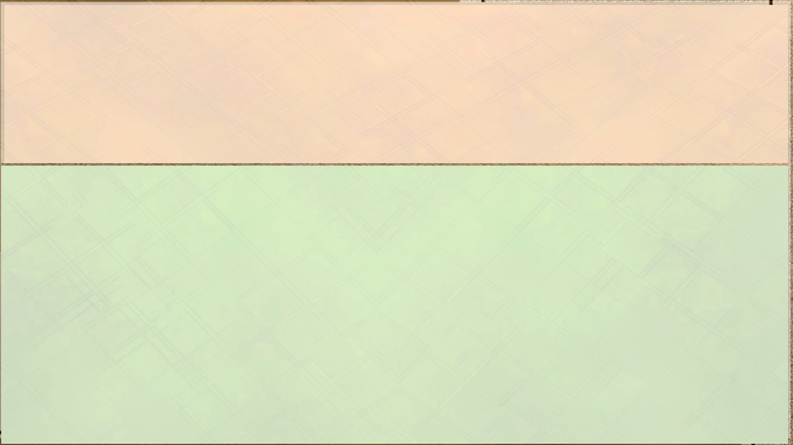
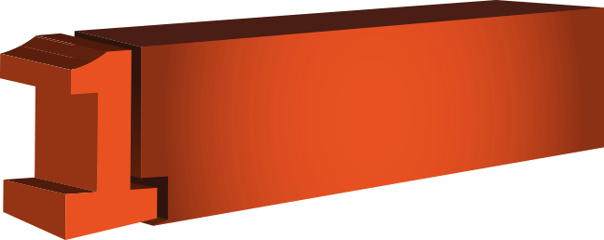

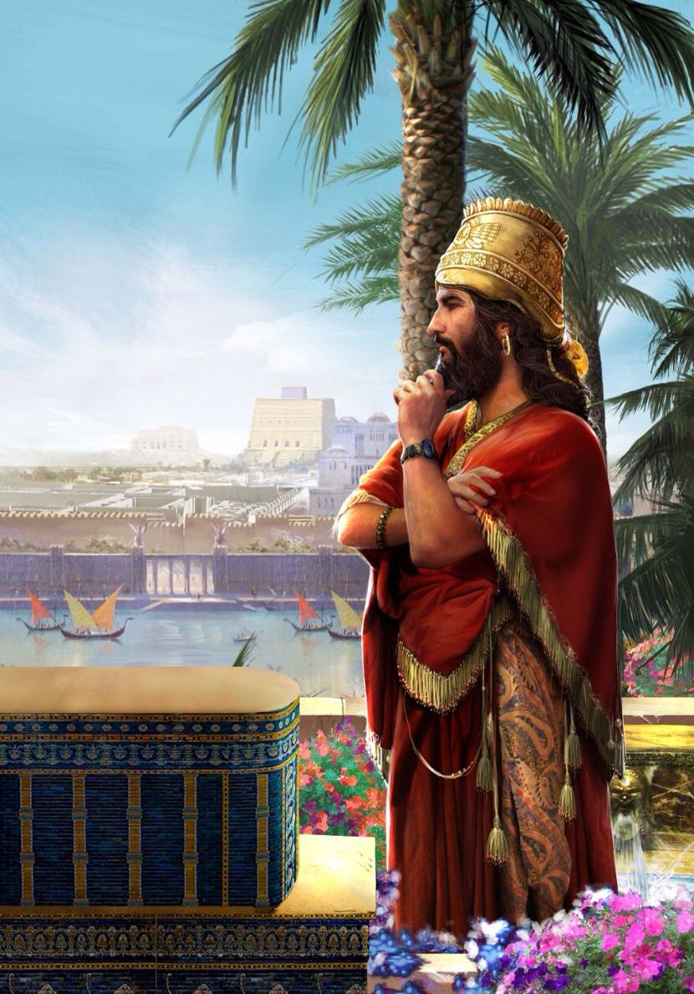
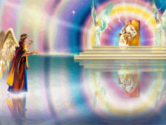

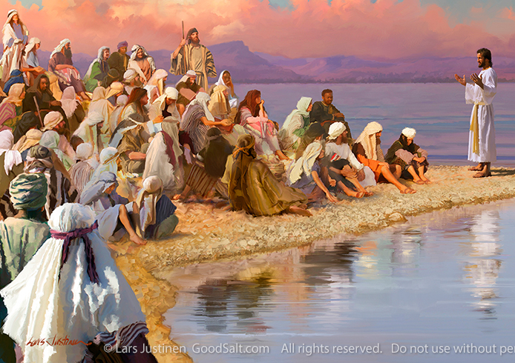
ʻOku ʻuhinga ia ki he "fielahi ", "ke polepole". ʻOku ʻikai talaki ʻe he ʻofa ʻene ngaahi fakahikihiki; ʻoku ʻikai ke ne polepole ʻi heʻene ngaahi lelei mo e ngaahi ngaue lelei; ʻoku ne loto fakatokilalo, ʻoku ʻikai feinga ke hakeakiʻi ia.
¿ʻOku ʻuhinga ki he ha?
ʻOku ʻIkai Polepole ʻa e ʻOfa
Ko ia ʻoku maʻu ʻi hono loto ʻa e ʻofa moʻoni, ʻoku ne manatuʻi ʻa e moʻui mo e pekia ʻa Sisuu, pea ʻoku ne fakafisingaʻi he taimi pe ko ia ʻa e fakakaukau pe fokotuʻu kotoa pe ʻoku ne tataki ia ki he fakatonuhiaʻi pe ia. Ko e ʻofa ko e meʻaʻofa ʻa e Laumalie ʻoku ne lau ʻa e ʻulungaanga lelei kotoa pe ʻoku haʻu mei he ʻOtua pea ʻoku Ne foaki mai, pea ko ia ai ʻoku ʻikai ha ʻuhinga ia ke polepole taʻeʻaonga ai koeʻuhi ko hono maʻu ʻo e meʻaʻofa kotoa pe ʻoku haʻu ia mei he ʻOtua.
Naʻe anga - fēfē hono fakahāhā ʻ e Sīsū ʻ a e tafaʻaki ko eni ʻ o e ʻ ofá?
Ko e Fakamoʻui ʻo mamani ko e ʻofa ia ʻa e kau ʻangelo, ko ha pilinisi Ia ʻi he ngaahi fakamaauʻanga fakatuʻi ʻo e langi; ka naʻa Ne liʻaki Hono naunau pea fakakofuʻi Hono tuʻunga faka-ʻOtua ʻaki ʻa e faʻahinga ʻo e tangata. Naʻa Ne hoko ko e Sisu angavaivai mo fakatokilalo. Naʻa Ne liʻaki ʻEne koloa mo e naunau ʻi he langi pea hoko ʻo masiva koeʻuhi ke tau koloaʻia ʻi Heʻene masiva. Naʻa Ne fononga holo mei he feituʻu ki he feituʻu ʻe tolu, ko ha tokotaha ʻauhee tukuhausia. 4T 219
ʻOku pehe ʻe he Faiako Maʻongoʻonga, "Ako ʻiate au [ʻoku ʻikai te u polepole, ʻoku ou fufuuʻi hoku naunau]; he ʻoku ou angamalu mo loto fakatokilalo." ʻI hoʻomou ako ʻiate au, "te mou maʻu ʻa e fiemalie ki homou laumalie." TM 222

Slide 10

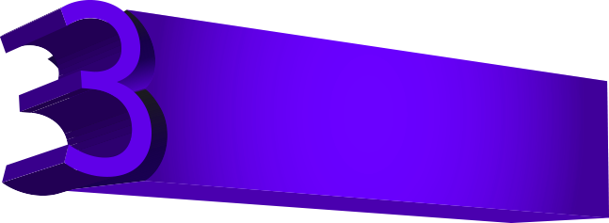

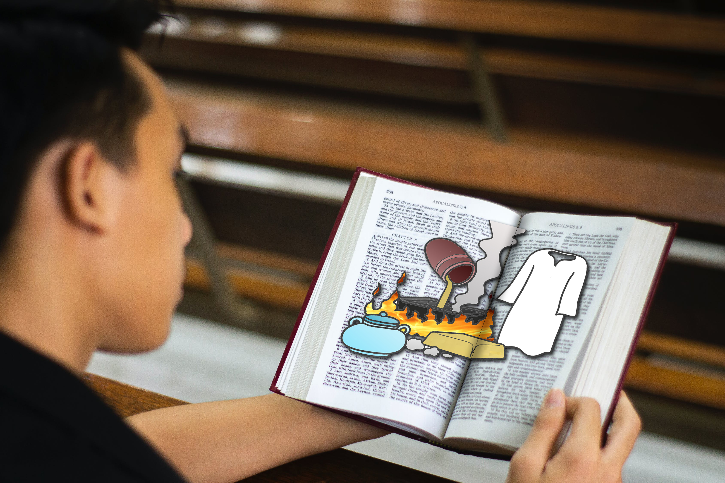
Ko ia ke fua ʻaki ʻa e fua ʻoku taau mo e fakatomala: Pea ʻoua naʻa mou fakakaukau ke pehe ʻi homou loto, ʻOku mau maʻu ʻa ʻEpalahame ko ʻemau tamai: he ʻoku ou tala atu kiate kimoutolu, ʻoku faʻa ʻe he ʻOtua ʻi he ngaahi maka ni ke fokotuʻu hake ʻa e fanau kia ʻEpalahame. Matiu 3:8-9.
ʻOku ʻIkai Polepole ʻa e ʻOfa
Ko e fe ʻa e ngaahi tohi ke manatuʻi?
Koeʻuhi ʻoku ke pehe, ʻOku ou koloaʻia, pea fakatokolahi ʻi he koloa, ka ʻoku ʻikai te u masiva ʻi ha meʻa; pea ʻoku ʻikai te ke ʻilo ʻoku ke mamahi, mo mamahi, mo masiva, mo kui, mo telefua: ʻoku ou faleʻi koe ke ke fakatau meiate au ʻa e koula kuo ʻahiʻahiʻi ʻi he afi, koeʻuhi ke ke koloaʻia; mo e kofu hinehina, koeʻuhi ke ke fakakofuʻi, pea ke ʻoua naʻa ha mai ʻa e ma ʻo hoʻo telefua; pea takai ho mata ʻaki ʻa e mata, koeʻuhi ke ke mamata. (Fakaha 3:17-18).
Kapau he ʻikai fakaʻaongaʻi ʻa e ʻatamai, ʻe ʻikai toe mafola ia; kapau he ʻikai fakatupulaki ʻa e saiʻia ʻi he Tohi Tapu, ʻe ʻikai ke ne toe fiefia ʻi he ngaahi moʻoni ʻo e Folofola ʻa e ʻOtua. ʻE lava pe ʻe he tokotaha ako ʻo sio ki he loloto ʻo e meʻa kuo ne fakatotoloʻi, pea he ʻikai ke ne lava ʻo fakahoungaʻi ʻa e meʻa ʻoku mahulu atu ʻi he kapasa ʻo hono ngaahi fakangatangata fasiʻi. Ka ʻe hanga ʻe heʻene taʻeʻilo ʻo ʻai ia ke ne fielahi, talanoa mo polepole. DG 79
Ko kinautolu ʻoku nau aʻusia ʻa hono fakamaʻoniʻoniʻi ʻo e Tohi Tapu te nau fakahaaʻi ha laumalie ʻo e loto fakatokilalo. Hange ko Mosese, kuo nau maʻu ha vakai ki he fakaʻeiʻeiki fakalilifu ʻo e maʻoniʻoni, pea ʻoku nau sio ki heʻenau taʻefeʻunga ʻi hono fakafehoanaki ki he haohaoa mo e haohaoa ʻo e Tokotaha Taʻefakangatangata. MAʻASI 235.

Slide 11
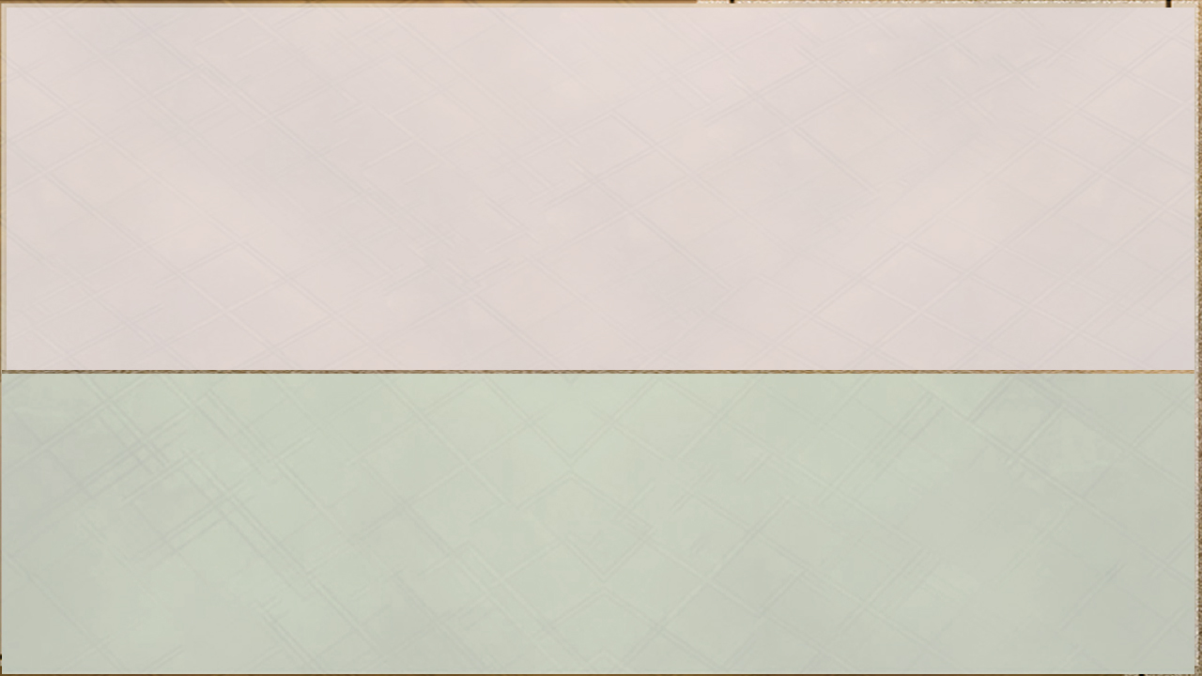
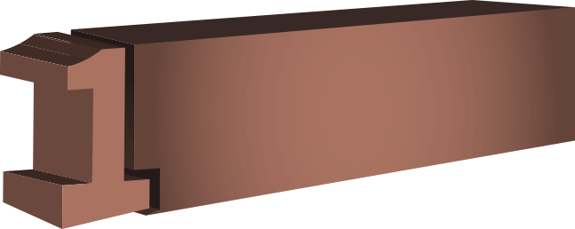

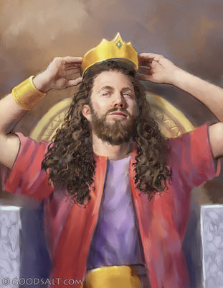
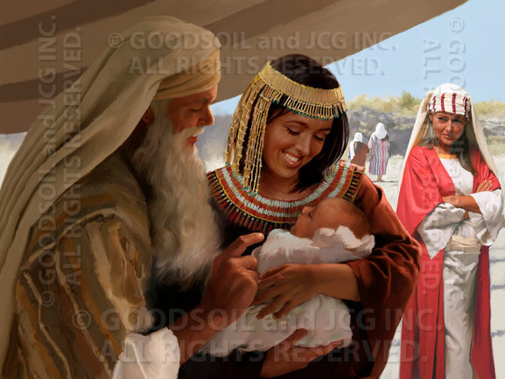
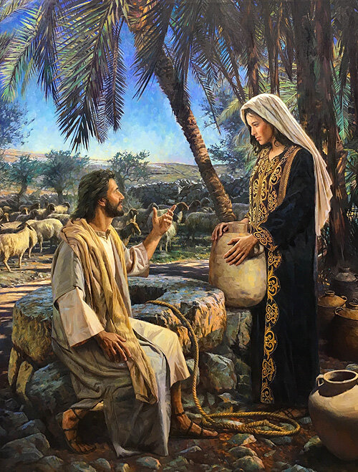
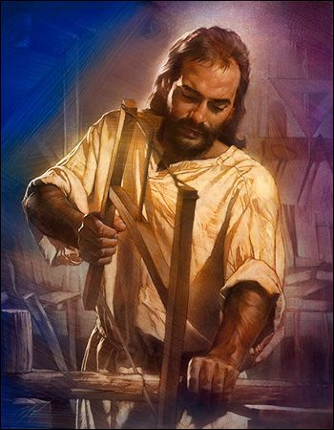

ʻOku ʻuhinga ki he ha?
ʻOku ʻuhinga ʻa e fakafuofuolahi ki he "pupula," ʻi he lea fakatata "ke hikisia." ʻOku ʻikai fakahikihikiʻi ʻe he ʻofa ha taha ʻaki ʻa e fielahi; ʻoku ʻikai ke ne fakatupu ʻa e fielahi mo e fakahikihiki. ʻOku fakahaaʻi ʻe he foʻi lea ko ʻeni ʻa e tuʻunga ʻo e hikisia mo e fiemalie ʻa ia ʻoku faʻa ʻulungaanga ʻaki ʻe kinautolu ʻoku nau maʻu ha ʻilo maʻolunga mo lavameʻa ʻaupito. ʻOku ʻikai ke fakaʻapaʻapaʻi pe kita ʻe he ʻofa, ʻa ia ʻoku ne pehe ʻoku ne maʻu ʻa e ngaahi meʻafoaki lelei taha, pea ʻoku fakahehema ke taʻeʻaonga. ʻOku ʻikai fakatupu ʻe he ʻofa ʻa e ongoʻi mahuʻinga, pe fekumi ki he fakahikihikiʻi ʻe he niʻihi kehe ha faʻahinga meʻa kuo lavaʻi.
ʻOku ʻIkai Fakafuofuolahi ʻa e ʻOfa
Ko kinautolu naʻe lavameʻa taha ʻi hono maʻu ʻo e laumalie ko e kau tangata mo e kau fafine naʻe ʻikai ke nau polepole ʻi he meʻa ʻoku nau malava, ka naʻa nau feinga ʻi he loto fakatokilalo mo e tui ke tokoniʻi ʻa kinautolu naʻa nau feohi. Naʻe fai ʻe Sisu ʻa e ngaue ko ʻeni. Naʻa Ne ofi kiate kinautolu naʻa Ne fakaʻamu ke aʻu ki ai. Vahe 117
Naʻe anga - fēfē hono fakahāhā ʻ e Sīsū ʻ a e tafaʻaki ko eni ʻ o e ʻ ofá?
Neongo naʻa Ne tupulaki ʻi he ʻilo, pea naʻe ʻiate Ia ʻa e ʻaloʻofa ʻa e ʻOtua, ka naʻe ʻikai ke Ne hikisia pe ongoʻi naʻa Ne maʻolunga ange ʻi hono fai ʻo e ngaue fakatokilalo taha. Naʻa Ne fua Hono ʻinasi ʻi he kavenga, fakataha mo ʻEne tamai, faʻee, mo e ngaahi tokoua. LHU 77

Slide 12

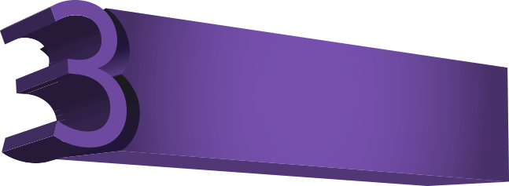
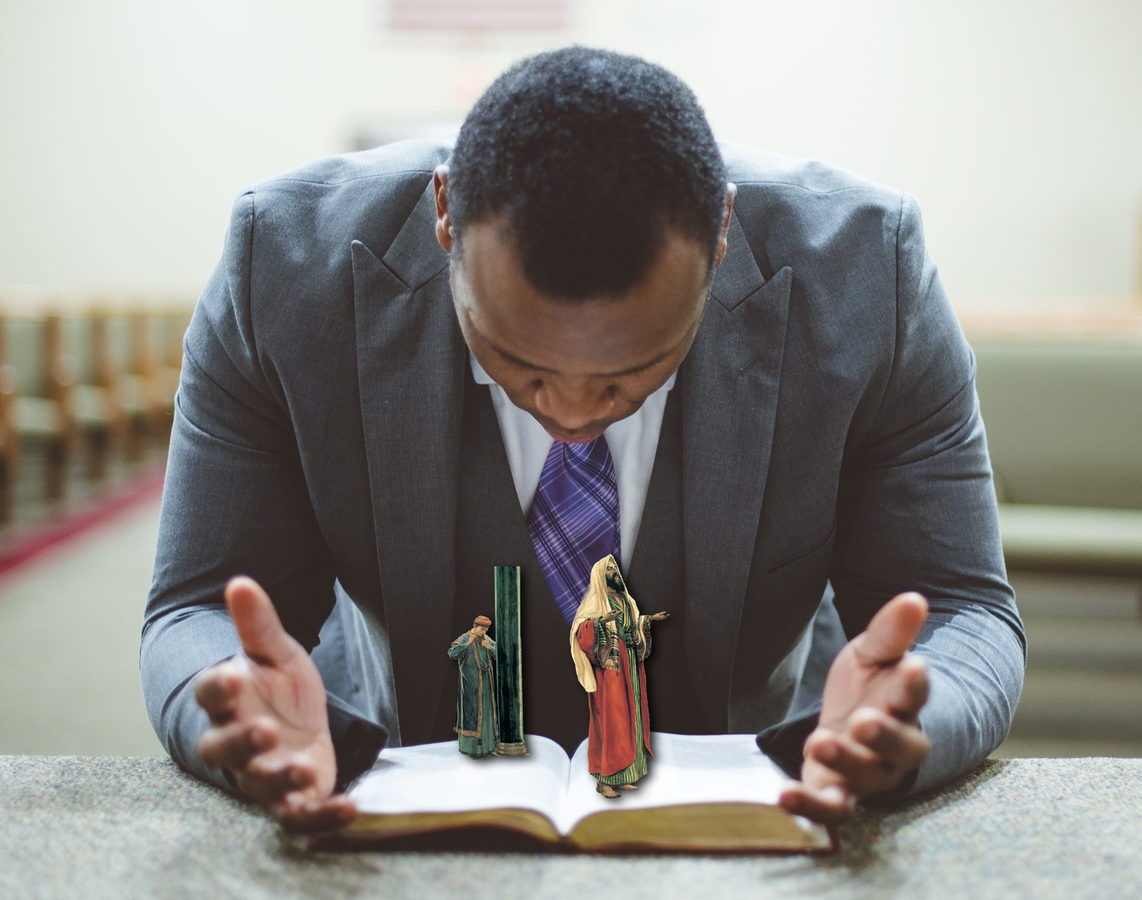

ʻOku ʻIkai Fakafuofuolahi ʻa e ʻOfa
Ko e fe ʻa e ngaahi tohi ke manatuʻi?
Tuku ke ʻoua naʻa fai ha meʻa ʻi he fakakikihi pe taʻeʻaonga; ka ʻi he loto fakatokilalo tuku ke taki taha fakaʻapaʻapaʻi lelei ange ʻa e niʻihi kehe ʻiate kinautolu. (Filipai 2:3).
Vakai, ko hono laumalie ʻoku hiki hake ʻoku ʻikai angatonu ʻiate ia: ka ʻe moʻui ʻa e angatonu ʻi heʻene tui. (Hapakuki 2:4).
ʻE hoku kainga tokoni, fekumi kia Sisu ʻi he loto fakatokilalo mo e angamalu kakato. ʻOua naʻa mou feinga ke tohoakiʻi e tokanga ʻa e kakai kiate kimoutolu. Tuku ke ngalo meiate kinautolu ʻa e meʻalea, lolotonga hoʻo hakeakiʻi ʻa Sisu. Talanoa fekauʻaki mo Sisu; mole ʻia Sisu. ʻOku fuʻu lahi ʻa e femoʻuekina mo e longoaʻa fekauʻaki mo ʻetau tui fakalotu, ka ʻoku ngalo ʻa Kalevale mo e kolosi. 2TT 27.

Slide 13
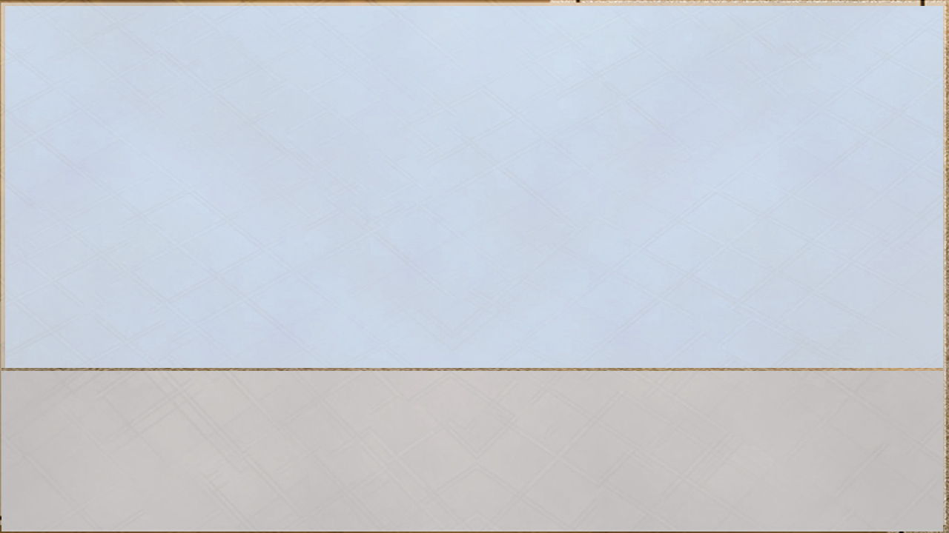

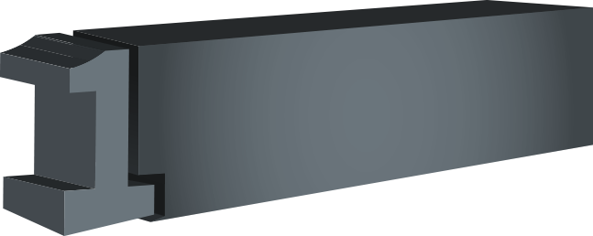
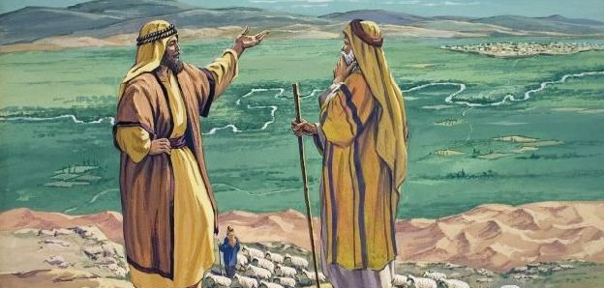
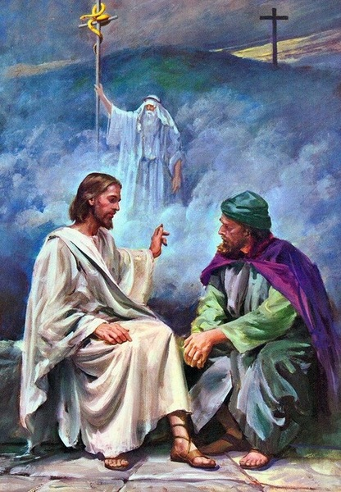
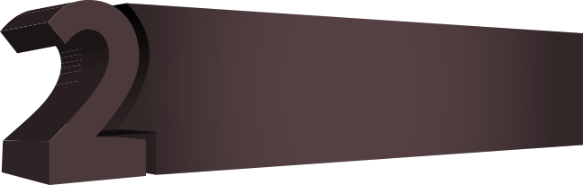
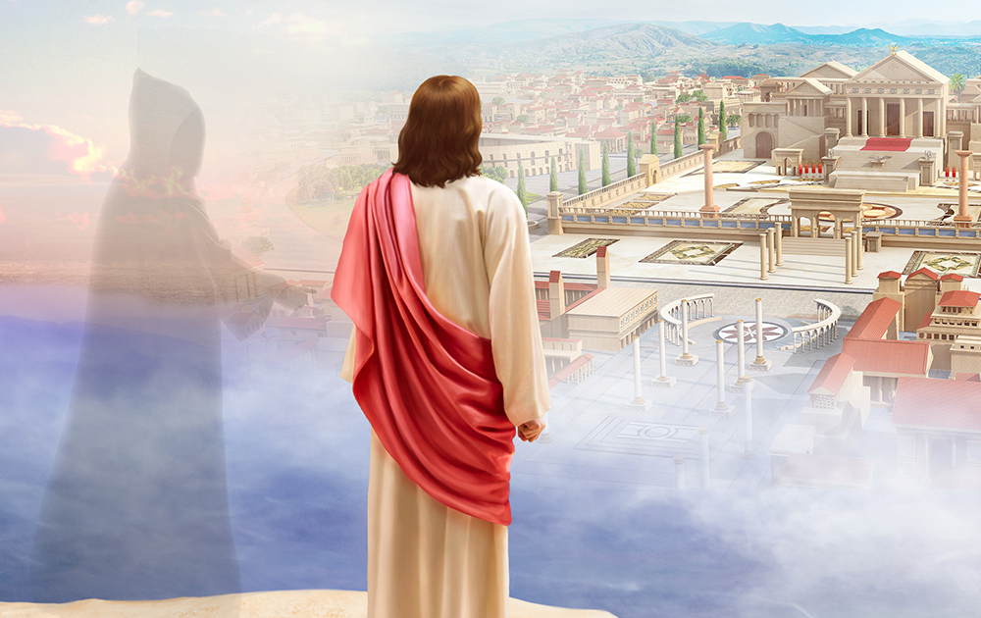
ʻOku ʻikai ke ne "toʻonga taʻefeʻunga," ʻoku ʻikai ke ne "ʻulungaanga taʻefakaʻapaʻapa." ʻOku ʻikai teitei taʻefakaʻapaʻapa, fefeka pe taʻefeʻunga ʻa e ʻofa; ʻOku ʻikai ʻaupito ke ne ʻulungaanga ʻi ha founga te ne lava ʻo fakalaveaʻi ʻa e ongoʻi ʻa e niʻihi kehe.
ʻOku ʻuhinga ki he ha?
ʻOku ʻIkai Hala ʻa e ʻOfa
ʻE anga fakaʻapaʻapa maʻu pe ʻa e tokotaha muimui moʻoni kotoa pe ʻo e ʻEiki pea he ʻikai ke ne teitei tali ʻa e ngaahi ueʻi ʻa e loto fakakakano ke totongi fakafoki ʻa e anga taʻe-fakaʻapaʻapa mo e anga fefeka ʻaki ʻa e anga taʻefakaʻapaʻapa. ʻOku fekumi maʻu pe ʻa e ʻofa ki he meʻa ʻoku totonu mo totonu ʻi he ngaahi fetuʻutaki kotoa pe ʻo e moʻui, he ʻoku ne feinga ke fakatupulaki ʻa e fiefia ʻa e niʻihi kehe, pea ʻoku iku ʻeni ki he fakaʻehiʻehi mei he meʻa kotoa pe te ne fakatupu ha fakamamahi pe fakafeʻatungiaʻi ʻa e fiefia moʻoni.
ʻOku taʻofi ʻe he ʻulungaanga totonu ʻo e ʻofa ʻa e loto totuʻa mo e ngaahi tuʻunga ʻoku fuʻu totuʻa ʻa ia ʻoku iku ki he ngaahi ʻita fakaeloto taʻe-mapuleʻi mo taʻefakaʻapaʻapaʻi ʻa e ngaue ʻa e ʻOtua. ʻOku fakahaaʻi ʻe he fakamatala ko ʻeni ʻoku ʻikai teitei fai ʻe he ʻofa ha meʻa taʻetotonu ʻoku ne fakahaaʻi ʻoku ʻi he malumalu maʻu pe ia ʻo e pule ʻa e ʻuhinga pea ko ia ai he ʻikai lava ke hoko ia ko ha ongo pe ongoʻi. Ko e meʻa ko ia ʻoku hoko ko ha tali pe ʻo e ngaahi ongo mo e ongo—ʻoku ui hala ko e ʻofa—ʻoku ʻikai ke ne ngaue ʻi ha founga ʻoku ʻuhinga lelei pe fakakaukauʻi ʻa e ngaahi ongo mo e ongoʻi ʻa e niʻihi kehe.
[Sisu] ʻI heʻene hoko ko e Tokotaha taʻe-ha-angahala, naʻe holomui Hono natula mei he kovi. Pr 173.
Naʻe anga - fēfē hono fakahāhā ʻ e Sīsū ʻ a e tafaʻaki ko eni ʻ o e ʻ ofá?
ʻI he taimi naʻe moʻui ai ʻa Kalaisi ʻi he mamani, naʻa Ne fakakaukauʻi maʻu pe ʻa e ngaahi ongo ʻa e tangata pea Ne ngaue ʻi he fakaʻapaʻapa mo e totonu ki he kakai kotoa pe .

Slide 14

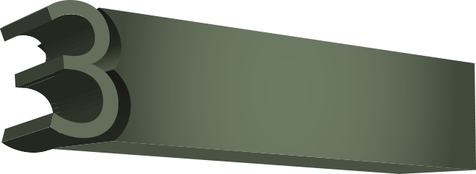

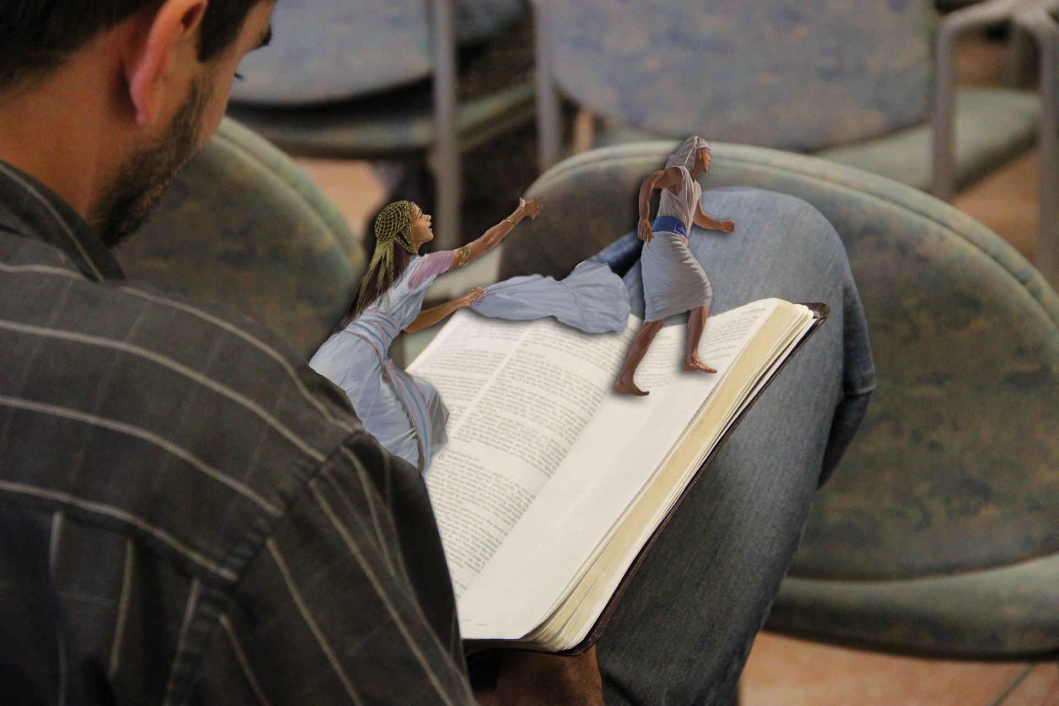
Ko ia ia ʻoku fanauʻi ʻi he ʻOtua ʻoku ʻikai te ne fai angahala; he ʻoku nofo ʻiate ia ʻa hono hako: pea ʻoku ʻikai faʻa fai angahala ia, koeʻuhi kuo fanauʻi ia ʻi he ʻOtua (1 Sione 3:9).
ʻOku ʻIkai Hala ʻa e ʻOfa
Ko e fe ʻa e ngaahi tohi ke manatuʻi?
ʻOku ʻikai ha taha ʻe maʻongoʻonga ange ʻi he fale ni ʻiate au; pea kuo ʻikai foki te ne taʻofi ha meʻa meiate au ka ko koe pe, koeʻuhi ko hono uaifi koe: pea te u lava fefe ʻo fai ʻa e fuʻu angahala lahi ni, pea u fai angahala ki he ʻOtua? (Senesi 39:9).
He ʻe kainga, kuo ui ʻa kimoutolu ki he tauʻataina; kae ʻoua naʻa fakaʻaongaʻi ʻa e tauʻataina koeʻuhi ko ha meʻa ki he kakano, ka ko e fetauhiʻaki ʻi he ʻofa. He ʻoku fakamoʻoniʻi ʻa e fono kotoa pe ʻi he folofola pe ʻe taha, ʻio ʻi he foʻi lea ni; Ke ke ʻofa ki ho kaungaʻapi ʻo hange pe ko koe. Ka ʻo kapau ʻoku mou uʻu mo fekeloʻaki ʻiate kimoutolu, tokanga ke ʻoua naʻa mou fefakaʻauhaʻaki ʻiate kimoutolu. Ko ia ʻoku ou lea ʻaki ʻeni, ʻAʻeva ʻi he Laumalie, pea ʻe ʻikai te mou fakafiemalieʻi ʻa e holi ʻo e kakano. (Kaletia 5:13-16).

Slide 15
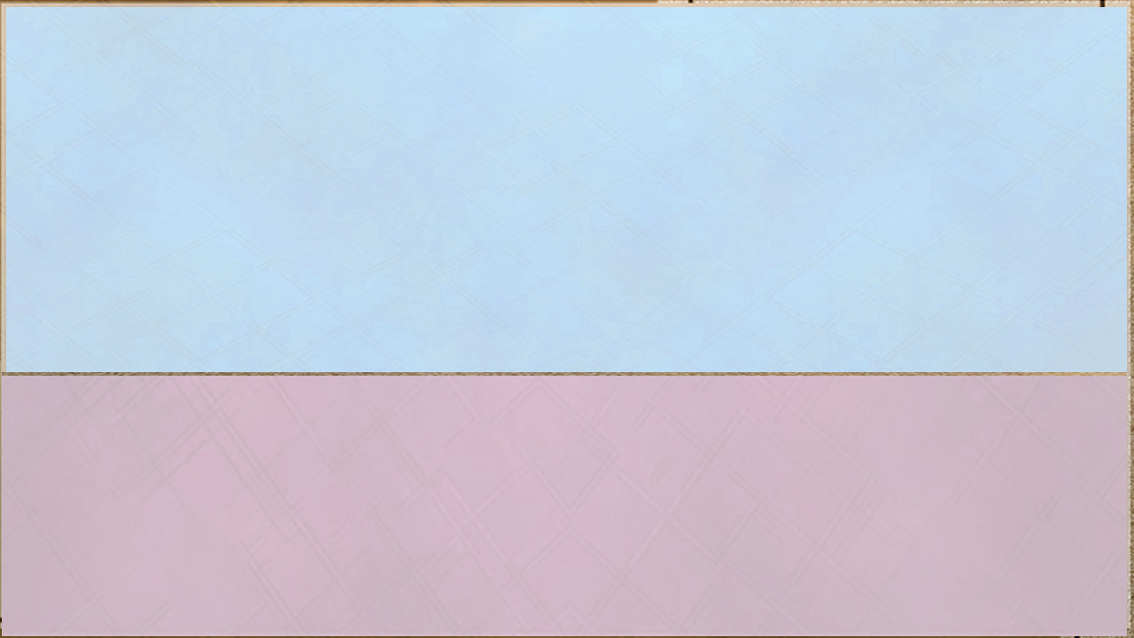
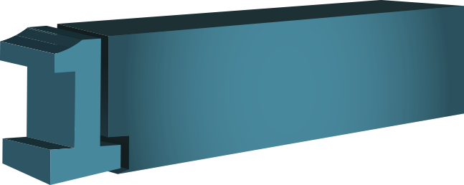

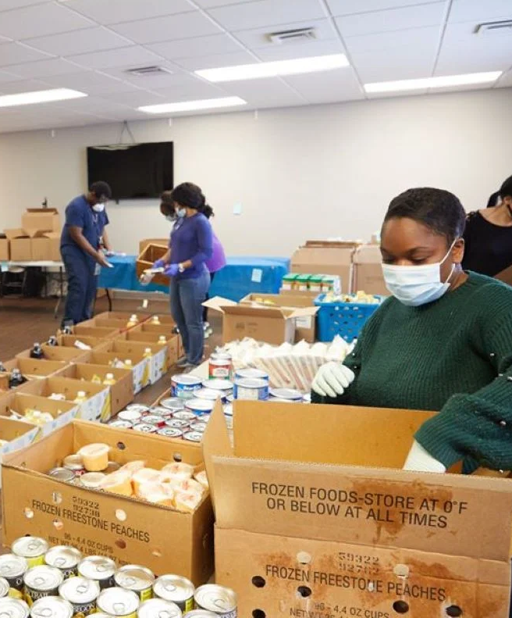



ʻOku ʻuhinga ki he ha?
Ko e meʻa ʻoku fehangahangai mo e natula ʻo e ʻofa moʻoni ko e tulifua siokita ki he lelei, ivi takiekina, pe langilangi ko e taumuʻa pe ia ʻe taha ʻo e moʻui. Ko e ʻulungaanga ʻeni ʻo e ʻofa, ʻa ia ʻoku faingataʻa taha ke mahino ki he loto taʻe-maʻoniʻoni. ʻOku mahuʻingaʻia ʻa e faʻahinga ʻo e tangata ʻiate kinautolu, pea ʻoku faʻa mahuʻingaʻia ʻa e meʻa ko ʻeni ʻi he toenga kotoa pe. Ko e natula siokita ʻo e tangata ko ha toe fakamoʻoni ia kuo fulihi fakaʻaufuli ʻe he angahala ʻa e fokotuʻutuʻu fakalangi ʻi he meʻa ʻoku aʻusia ʻe he faʻahinga ʻo e tangata, ʻo fakaʻaiʻai ʻa e tangata ke tukutaha ʻenau ngaahi ʻofa mo e ngaahi meʻa ʻoku nau mahuʻingaʻia ai ʻiate kinautolu. Ko ia ʻoku puleʻi ʻe he ʻofa taʻesiokita ʻa e ʻOtua ʻoku ne fakangaloʻi ia pea ʻoku puleʻi kakato ia ʻe he holi ke fai e finangalo ʻo e ʻOtua. Ko e ʻ uhinga ia ʻ okú ne loto - lelei ai ke foaki ʻ ene moʻuí ʻ i he ngāue fakafaifekau ʻ ofa maʻá e niʻihi kehé.
ʻOku ʻIkai Kumi ʻa e ʻOfa Kiate Ia
Naʻe anga - fēfē hono fakahāhā ʻ e Sīsū ʻa e tafaʻaki ko eni ʻ o e ʻofá?
"ʻA hono pani ʻe he ʻOtua ʻa Sisu ʻo Nasaleti ʻaki ʻa e Laumalie Maʻoniʻoni mo e malohi: ʻa ia naʻa ne faʻa feʻaluʻaki ʻo fai lelei mo fakamoʻui ʻa kinautolu kotoa pe naʻe ngaohikovia ʻe he tevolo; he naʻe ʻiate ia ʻa e ʻOtua" (Ngaue 10:38). Naʻe ʻikai moʻui ʻa Kalaisi maʻana, pe ko ʻEne taumuʻa ke paotoloaki ʻEne ngaahi fie maʻu pe ʻAʻana. Naʻa ne fakamuʻomuʻa ia mo e niʻihi kehe. Naʻa ne loto fiemalie ke feilaulauʻi ʻene fiemalie, hono taimi, ʻene nonga, ʻene ngaahi maʻuʻanga tokoni mo hono ngaahi taleniti koeʻuhi ko e lelei mo e fakamoʻui ʻo e faʻahinga ʻo e tangata.

Slide 16






ʻOku ʻIkai Kumi ʻa e ʻOfa Kiate Ia
¿Ko fe tohi ke manatu’i?
Hange foki ko ʻeku fakahoifua ki he kakai fulipe ʻi he ngaahi meʻa kotoa pe, ʻo ʻikai kumi ke ʻaonga kiate au, ka ke ʻaonga ki he tokolahi, koeʻuhi ke fakamoʻui ʻa kinautolu. (1 Kolinito 10:33).
Ko ia ko e meʻa kotoa pe ʻoku mou loto ke fai ʻe he kakai kiate kimoutolu, mou fai ia kiate kinautolu: he ko e fono ʻeni mo e kau palofita. (Matiu 7:12).
He naʻe ʻikai haʻu ʻa e Foha ʻo e tangata ke tauhi, ka ke tauhi, mo foaki ʻene moʻui ko e huhuʻi ʻo e tokolahi. (Maʻake 10:45).
Tuku ke ʻoua naʻa fai ha meʻa ʻi he fekeʻikeʻi pe taʻeʻaonga; ka ʻi he loto fakatokilalo, tuku ke taki taha fakaʻapaʻapaʻi ʻa e niʻihi kehe ʻiate kinautolu. ʻOua naʻa sio ʻa e tangata taki taha ki heʻene ngaahi meʻa ʻaʻana, ka ki he ngaahi meʻa ʻa e niʻihi kehe foki. (Filipai 2:3-4).

Slide 17







ʻOku ʻuhinga ki he ha?
He ʻikai ha meʻa te ne lava ʻo uesia ʻa e nonga (fakakaukau lelei pe nonga) ʻo e ʻofa haohaoa pea fakahaaʻi ai ʻa e fehiʻa, taʻe faʻa kataki, pe ʻita
ʻOku ʻIkai Fakaʻitaʻi ʻa e ʻOfa
Ko e Kalisitiane ko ia ʻoku ne ʻiloʻi ʻoku fakafepakiʻi ʻe he loto fakakakano ʻa e finangalo ʻo e ʻOtua, ka kuo ne foaki ia ki he ʻEiki pea mate ki he angahala, he ʻikai ha meʻa te ne lava ʻo fakaʻitaʻi pe taʻefakafiemalieʻi ia. ʻOku ne foaki ʻa e meʻa kotoa pe ki he toʻukupu ʻo e ʻOtua mo e fakapapau, neongo pe ko e ha e meʻa ʻe hoko, ʻoku ne tokangaʻi ia ʻe he fofonga ʻofa mo tokanga ʻa e Tokotaha ʻoku ne puleʻi ʻa e meʻa kotoa pe ki he lelei ʻa kinautolu ʻoku falala kiate ia. Ko e taha ʻo e ngaahi nunuʻa ʻo e ului ko e liliu fakaofo ʻi he ʻulungaanga ʻo ha taha naʻe ʻita, fonu ʻi he ʻita, mo ʻitangofua. ʻOku hoko ʻa e kakai ko ʻeni ʻo angaʻofa, angavaivai, mo nonga ʻi he ivi takiekina ʻo e Laumalie Maʻoniʻoni. ʻOku taʻeʻaonga ʻa e ngaahi feinga kotoa ʻa Setane ke ʻai ke nau taʻefiemalie mo tauʻataina ki heʻenau ʻita kimuʻa.
Naʻe anga - fēfē hono fakahāhā ʻ e Sīsū ʻ a e tafaʻaki ko eni ʻ o e ʻ ofá?
Pea naʻe haʻu ʻa e kau Falesi, ʻo nau fakafehuʻi ia, ʻo kumi kiate ia ha fakaʻilonga mei he langi, ʻo ʻahiʻahiʻi ia. Pea mapuhoi lahi ia ʻi hono laumalie, ʻo ne pehe, Ko e ha ʻoku kumi ai ʻe he toʻu tangata ni ha fakaʻilonga? Ko e moʻoni ʻoku ou tala atu kiate kimoutolu, ʻE ʻikai tuku ha fakaʻilonga ki he toʻu tangata ni. (Maʻake 8:11-12).
Pea toe fehuʻi ange ʻe Pailato kiate ia, ʻo pehe, ʻOku ʻikai te ke tali ha meʻa? vakai ki he lahi ʻo e ngaahi meʻa ʻoku nau talatalaakiʻi koe. Ka naʻe ʻikai tali ʻe Sisu ha meʻa; ko ia naʻe ofo ai ʻa Pailato. (Maʻake 15:4-5)

Slide 18




He ʻoku ʻikai fakatupu ʻe he houhau ʻa e tangata ʻa e maʻoniʻoni ʻa e ʻOtua (Semisi 1:20).
ʻOku ʻIkai Fakaʻitaʻi ʻa e ʻOfa
Ko e fe ʻa e ngaahi tohi ke manatuʻi?
Ko ia ʻoku fakatuotuai ke ʻita ʻoku lelei ange ia ʻi he mafimafi; pea ko ia ʻoku pule ki hono laumalie ʻi he taha ʻoku ne faʻao ha kolo (Lea Fakatata 16:32).
tuku ʻa e ʻita pea liʻaki ʻa e houhau: ʻoua naʻa ke manavasiʻi ʻi ha founga ʻe taha ke faikovi (Saame 37:8).
ʻOua naʻa ke fakavavevave ʻi ho laumalie ke ke ʻita: he ʻoku ʻi he loto ʻo e kau vale ʻa e houhau (Tangata Malanga 7:9).
ʻOua naʻa mou ʻita, pea ʻoua naʻa fai angahala: ʻoua naʻa to ʻa e laʻaa ʻi homou houhau (ʻEfe. 4:26).
Tuku ke toʻo meiate kimoutolu ʻa e loto mamahi kotoa pe, mo e ʻita, mo e ʻita, mo e kaila, mo e lea kovi, fakataha mo e loto kovi kotoa pe (ʻEfeso 4:31).
Toʻo kiate kimoutolu ʻeku haʻamonga, pea ako ʻiate au; he ʻoku ou angamalu mo loto-fakatokilalo: pea te mou maʻu ʻa e fiemalie ki homou laumalie (Matiu 11:29).

Slide 19








ʻOku ʻuhinga ki he ha?
Naʻe ʻomi ʻe he tohi faka-Kalisi ʻa e fakakaukau ke ʻoua ʻe fakakaukauʻi ʻa e kovi kuo fai; ʻikai ke fikaʻi, tukuakiʻi pe tukuakiʻi ʻa e kovi ki he fakamatala ʻa ha taha kehe. Ko ha toe ʻulungaanga faka-Kalisitiane fakaʻofoʻofa ʻeni ʻe taha ʻo e ʻofa. ʻ Oku fakahaaʻi ai ʻ oku fakamatalaʻi ʻ e he ʻ ofá ʻ i he founga lelei tahá ʻ a e tōʻonga ʻ a e niʻihi kehé. Ko e tokotaha ʻ oku puleʻi ʻ e he ʻ ofá ʻ oku ʻ ikai ke fefeka, ʻ oku ʻ ikai te ne loto - lelei ke kumi fehālaaki ki he niʻihi kehé pe ke tukuakiʻi kiate kinautolu ʻ a e ngaahi taumuʻa halá.
ʻOku ʻIkai Ke ʻItaʻia ʻa e ʻOfa
Naʻe anga - fēfē hono fakahāhā ʻ e Sīsū ʻ a e tafaʻaki ko eni ʻ o e ʻ ofá?
Pea ko kinautolu kotoa pe naʻe ʻi he fale lotu, ʻi heʻenau fanongo ki he ngaahi meʻa ni, naʻa nau fonu ʻi he ʻita, pea nau tuʻu hake, ʻo kapusi ia ki tuʻa mei he kolo, ʻo taki ia ki he tumutumu ʻo e moʻunga ʻa ia naʻe langa ai honau kolo, koeʻuhi ke nau li hifo ia ki lalo. Ka naʻa ne fou atu ʻiate kinautolu naʻa ne ʻalu atu ʻi hono hala, (Luke 4:28-30).
Pea toki pehe ʻe Sisu, ʻE Tamai, fakamolemole ʻa kinautolu; he ʻoku ʻikai te nau ʻiloʻi ʻa e meʻa ʻoku nau fai. Pea naʻa nau vahevaheʻi hono kofu ʻo talotalo (Luke 23:34).

Slide 20




ʻOua naʻa mou manatu ki he ngaahi meʻa muʻa, pea ʻoua naʻa mou fakakaukau ki he ngaahi meʻa ʻo e kuonga muʻa (ʻIsaia 43:18).
ʻOku ʻIkai Ke ʻItaʻia ʻa e ʻOfa
Ko fe tohi ke manatu’i?
ʻOua naʻa ke sauni, pe ʻita ki he fanau ʻa ho kakai, ka ke ʻofa ki ho kaungaʻapi ʻo hange pe ko koe: ko au ko SIHOVA (Levitiko 19:18).
Mou fekatakiʻaki, mo fefakamolemoleʻaki, kapau ʻoku fakakikihi ha taha ki ha taha: ʻo hange ko e fakamolemole ʻa Kalaisi ʻa kimoutolu, ke pehe foki mo kimoutolu (Kolose 3:13).
Siʻi ʻofeina, ʻoua naʻa mou sauni, ka ke tuku ha potu ki he houhau: he kuo tohi, ʻOku ʻaʻaku ʻa e sauni; Te u totongi ki ai, ʻoku folofola ʻe he ʻEiki. (Loma 12:19).
Ko hai ha ʻOtua ʻoku tatau mo koe, ʻa ia ʻoku ne fakamolemoleʻi ʻa e angahala, pea fakalaka atu ʻi he maumau-fono ʻa e toenga ʻo hono tofiʻa? ʻoku ʻikai te ne taʻofi ʻene houhau ʻo taʻengata, koeʻuhi he ʻoku ne fiefia ʻi he ʻaloʻofa (Maika 7:18).
Pea toki haʻu ʻa Pita kiate ia, ʻo ne pehē, “ʻEiki, ʻe tuʻo fiha ʻeku fakamolemole kiate ia, ka angahala hoku tokoua kiate au? ʻo aʻu ki he tuʻo fitu? Pea tali ʻe Sisu kiate ia, ʻOku ʻikai te u tala kiate koe, ʻo liunga fitu: ka, ʻo liunga fitungofulu. ( Mātiu 18:21-22 ).

Slide 21






Ko e hā hono ‘uhingá?
‘Oku ‘ikai ke faka‘atā ‘e he ‘ofá ha fa‘ahinga fakamaau ta‘etotonu, tatau ai pē pe ko e ngaahi kaume‘a pe ngaahi fili. Ko e fakamaau taʻetotonú, ʻa ia ko e angahalá, ʻoku mātuʻaki muli ia ki he natula fakaʻotua ʻo e ʻofá.
ʻOku ʻIkai Fiefia ʻa e ʻOfá ʻi he Fakamaau Taʻetotonú .
Ko ia ai, ko e tokotaha ‘oku ‘ofá ‘e ‘ikai lava ke ne hōifua ki ha me‘a ‘oku ‘ikai hoa mo e finangalo ‘o e ‘Otuá. ‘Oku ‘ikai ke fiefia ‘a e ‘ofá ‘i he ngaahi tōnounou ‘a e ni‘ihi kehé, pe fiefia ‘i hono ‘ilo‘i ‘oku nau halaia ‘i ha hala. ‘Oku ‘ikai te ne ma‘u ha fiefia fakatupu maumau ‘i he fanongo ki he ongoongo kuo fai ‘e ha taha ha fehālaaki. ‘Oku fiefia ‘a e loto fulikivanú ‘i he taimi ‘oku tō ai ha fili ki he angahalá, pe ‘i he taimi ‘oku fai ai ‘e ha fili ha fehālaaki ‘o fakatupu maumau kiate ia; ka ʻoku ʻikai pehē ʻa e ʻofá, he ʻokú ne muimui ʻi he hala fehangahangai diametrically pea feinga ke tokoniʻi ʻa e filí ʻi he taimi ʻokú ne faingataʻaʻia aí.
Pea ʻe ʻikai te ne fakamaau ʻo fakatatau ki he sio ʻa hono mata, pe valoki ʻo fakatatau ki he fanongo ʻa hono telinga; Ka te ne fakamaau ʻaki ʻae masiva ʻaki ʻae totonu, pea te ne valoki ʻaki ʻae angavaivai ʻoe fonua ʻaki ʻae totonu: pea te ne taaʻi ʻae fonua ʻaki ʻae tokotoko ʻo hono ngutu, pea ʻaki ʻae mānava ʻo hono loungutu te ne tāmateʻi ʻae angahala. Pea ʻe hoko ʻae māʻoniʻoni ko e noʻo ʻo hono kongaloto, pea ko e faitotonu ko e noʻo ʻo hono kongaloto. ( ‘Aisea 11:3-5 ).
Na‘e anga-fēfē hono fakahāhā ‘e Sīsū ‘a e tafa‘aki ko eni ‘o e ‘ofá?
‌ʻOku pehē foki ʻa kimoutolu, ʻoku mou hā māʻoniʻoni ʻi tuʻa ki he kakai, ka ʻoku mou fonu ʻi loto ʻi he mālualoi mo e angahala. ‘Oiauē kimoutolu, sikalaipe mo e Fālesi, ko e mālualoi! koeʻuhi ʻoku mou langa ʻae ngaahi fonualoto ʻoe kau palōfita, mo teuteuʻi ʻae ngaahi faʻitoka ʻoe kau māʻoniʻoni, pea mou pehē, Kapau naʻa mau ʻi he kuonga ʻo ʻemau ngaahi tamai, naʻe ʻikai te mau kau mo kinautolu ʻi he toto ʻoe kau palōfita... Ko ia, vakai, ʻoku ou fekau atu kiate kimoutolu ha kau palōfita, mo ha kau tangata poto, mo ha niʻihi ʻo kinautolu te mou kalusefai; pea te mou haha honau ni‘ihi ‘i homou ngaahi falelotu, pea te mou fakatanga‘i mei he kolo ki he kolo: koe‘uhi ke hoko kiate kimoutolu ‘a e toto kotoa pē ‘o e kau mā‘oni‘oni kuo lilingi ki māmani, mei he toto ‘o e mā‘oni‘oni ko ‘Ēpeli ‘o a‘u ki he toto ‘o Sākalaia foha ‘o Palakaia, ‘a ia na‘a mou tāmate‘i ‘i he vaha‘a ‘o e Temipale mo e ‘ōlita. ( Mātiu 23:28-35 ).

Slide 22





‌ʻOua naʻa mou fai taʻemāʻoniʻoni ʻi he fakamaau: ʻoua naʻa ke tokaʻi ʻae mata ʻoe masiva, pea ʻoua naʻa ke fakaʻapaʻapaʻi ʻae mata ʻoe mālohi: ka te ke fakamaau totonu ho kaungāʻapi. ( Levitiko 19:15 )
ʻOku ʻIkai Fiefia ʻa e ʻOfá ʻi he Fakamaau Taʻetotonú .
Ko fe tohi ke manatu’i?
Kapau ʻoku fiekaia ho fili, ʻoange ha meʻakai ke ne kai; pea kapau ʻoku ne fieinua, ʻoange ha vai ke ne inu: he te ke fokotuʻu malalaʻi afi ki hono ʻulu, pea ʻe totongi kiate koe ʻe Sihova. (Lea fakatata 25:21-22).
ʻOua naʻa ke fiefia ʻo ka to ho fili, pea ʻoua naʻa tuku ke fiefia ho loto ʻi heʻene humu. (Lea Fakatata 24:17).
Ko e me’a ‘oku totonu ‘aupito te ke muimui ki ai, koe’uhi ke ke mo’ui, pea ke ma’u ‘a e fonua ‘oku foaki kiate koe ‘e Sihova ko ho ‘Otua (Teutalonome 16:20).
Ko e taʻemāʻoniʻoni kotoa pē ko e angahala . (1 Sione 5:17a).

Slide 23







Ko e hā hono ‘uhingá?
ʻOku ʻikai fiefia ʻa e ʻofá ʻi he ngaahi fehālaakí, ka ʻi he ngaahi ʻulungaanga lelei ʻo e niʻihi kehé. ʻOku tokanga ʻa e ʻofá ki he fakalakalaka ʻo e moʻoní mo e fiefia ʻa e tangatá. Ko e ‘uhinga ia ‘oku ne fai ai ‘a e fakafeta’i ‘i he taimi kotoa pe ‘oku poupou’i ai ‘a e tupu’anga ‘o e mo’oni.
‘Oku Fiefia ‘a ‘Ofá ‘i he Mo‘oní .
He ʻikai lava ʻe he ʻofá ʻo fiefia ʻi ha faʻahinga angahala pe ʻi he tautea ʻoku ʻa e tokotaha angahalá, ka ʻokú ne fiefia ʻi hono fakatauʻatāinaʻi ʻo e tangatá mei he ngaahi haʻi ʻo e angahalá, he ʻoku ʻomi ia ʻe he fakatauʻatāina peheé ke ne fenāpasi mo e moʻoní pea ʻoku ne hoko ai ko ha kanititeiti ki he fiefia ʻo e langí ʻa ia naʻe fakatupu ai iá.
Ko Sisu ʻa e faiako maʻongoʻonga taha kuo faifai pea ʻiloʻi ʻe he mamani. Naʻa Ne fakamatalaʻi ʻa e moʻoni ʻi ha ngaahi founga mahino mo malohi, pea naʻe lelei ʻaupito ʻa e ngaahi sipinga naʻa Ne fakaʻaongaʻi. Naʻe ʻikai ke Ne teitei fio ha ngaahi fakaʻilonga maʻamaʻa pe ngaahi talanoa taʻemahuʻinga mo ʻEne ngaahi lesoni, pea naʻe ʻikai ke Ne feinga ke fakafiefiaʻi pe ʻa e kakai pe fakafiemalieʻi ʻa e fieʻilo noa. Naʻe ʻikai ke ne fakavalevale ʻa e moʻoni toputapu ki he kakai angamaheni... Naʻe haohaoa mo langaki moʻui ʻene ngaahi lea... Naʻe ʻikai ke Ne tukuhifo ʻa e moʻoni ke feʻunga mo e tuʻunga hinga ʻo e kakai pe holoki ʻa e ngaahi tuʻunga moʻui ʻo e maʻoniʻoni ke tatau mo ʻenau ngaahi fehalaki; ka naʻa Ne fakavaivaiʻi Ia pea talangofua ʻo aʻu ki he tuʻunga ʻo e mate ʻi he kolosi, ke fakahaofi ʻa e faʻahinga ʻo e tangata mei he moveuveu naʻe fakatupu ʻe he angahala... Naʻa Ne tauhi ʻa e moʻoni taʻengata ke ʻataʻata mei he ivi takiekina ʻo e fehalaki, ʻo ʻai ke ulo ngingila mo fakaʻofoʻofa. Naʻá ne fokotuʻu ʻ a e moʻoní ʻ i ha tuʻunga māʻolunga koeʻuhi ke lava ʻ o hoko ko ha māmá, ʻ o fakamaama ʻ a e fakapoʻuli fakaeʻulungaanga ʻ o e māmaní....
Naʻe anga - fēfē hono fakahaaʻi ʻ e Sīsū ʻ a e tafaʻaki ko eni ʻ o e ʻ ofá?

Slide 24




Pea pehē ʻe Sisu ki he kakai Siu naʻe tui kiate ia, “Kapau te mou nofo maʻu ʻi heʻeku lea, pea ko ʻeku kau ākonga moʻoni ʻakimoutolu; Pea te mou ‘ilo ‘a e mo‘oni, pea ‘e fakatau‘atāina‘i kimoutolu ‘e he mo‘oni. ( Sione 8:31-32 ).
‘Oku Fiefia ‘a ‘Ofá ‘i he Mo‘oní .
Ko fe tohi ke manatu’i?
Tataki au ʻi hoʻo moʻoni, pea akoʻi au: he ko koe ko hoku ʻOtua fakamoʻuiʻanga; ʻoku ou tatali kiate koe ʻi he ʻaho kotoa pē. (Saame 25:5).
‌ʻE SIHOVA, ko hai ʻe nofo ʻi ho fale fehikitaki? ko hai ʻe nofo ʻi ho moʻunga tapu? Ko ia ʻoku ʻeveʻeva angatonu, mo fai totonu, mo lea ʻaki ʻae moʻoni ʻi hono loto. (Saame 15:1-2).
Fakatau ʻae moʻoni, pea ʻoua naʻa fakatau ia; foki mo e poto, mo e akonaki, mo e ʻilo. ( Lea Fakatata 23:23)
He kapau te mou fakaleleiʻi ʻaupito hoʻomou ngaahi hala mo hoʻomou ngaahi faianga; kapau te mou fai totonu ‘a e fakamaau ‘i he vaha‘a ‘o ha tangata mo hono kaungā‘api... Te u toki tuku ke mou nofo ‘i he potu ni, ‘i he fonua na‘a ku foaki ki ho‘omou ngaahi kui, ‘o ta‘engata pea ta‘engata. (Selemaia 7:5,7).

Slide 25






Ko e ha hono ‘uhinga?
Ko e 'Ofa 'oku ne fuesia 'a e me'a kotoa pe .
Ko Gr. stegei, "ke 'ufi'ufi", "ke malu'i", "ke fakafepaki'i", "ke kataki". "Ko e me'a kotoa pe 'oku faka'uhinga"; "ko e me'a kotoa pe 'oku ne fakapulipuli“.
‘Oku fufū mo fakasīlongo‘i ‘e he ‘ofá ‘a e ngaahi me‘a hangē ko e ngaahi fehālaaki ‘a e ni‘ihi kehé, ‘a ia ‘e fakahaa‘i fiefia ‘e he siokita ‘o e loto fakanatulá. ‘Oku ‘ikai ha holi ‘a e ‘ofá ke sivisivi‘i ‘a e ngaahi vaivai‘anga ‘o e ni‘ihi kehé pe faka‘atā ke sivisivi‘i kinautolu ‘e ha taha kehe.
Na‘e anga-fēfē hono fakahāhā ‘e Sīsū ‘a e tafa‘aki ko eni ‘o e ‘ofá?
Naʻe fakaofiofi atu ha kulupu ʻo e kau Fālesí mo e kau sikalaipé kiate ia, ʻo nau toho ha fefine ilifia, ʻa ia, ʻi ha leʻo fefeka mo vēkeveke, naʻa nau tukuakiʻi ia ʻokú ne maumauʻi ʻa e fekau hono fitú...
[Sīsū] pea sio fakamamaʻu Hono matá ki he kelekelé, naʻá ne kamata tohi ʻi he efú. ʻI he ʻikai ke nau kātaki ʻi Heʻene toloí mo e hā ngali taʻetokangaʻí, naʻe ofi ange ʻa e kau tukuakiʻí, ʻo nau fakaʻaiʻai ʻa e meʻá ki Heʻene tokangá. Ka ʻi he tō honau matá, ʻo muimui ʻi he mata ʻo Sīsuú, ki he veʻehalá ʻi Hono vaʻé, naʻe liliu honau fofongá. Naʻe ʻi ai, naʻe fakaʻilongaʻi ʻi muʻa ʻiate kinautolú, ʻa e ngaahi fakapulipuli halaia ʻo ʻenau moʻuí tonu. Naʻe sio ʻa e kakaí, ʻi heʻenau sió, ki he liliu fakafokifā ʻo e fofongá, pea nau teke atu ki muʻa ke ʻiloʻi pe ko e hā ʻa e meʻa naʻa nau fakakaukau ki ai ʻi he ofo mo e mā lahi faú. DA 461
Ko ʻeni kuo toʻo honau ʻimisi maʻoniʻoni loi, naʻa nau tuʻu ai, ʻo ongoʻi halaia mo fakahalaiaʻi, ʻi muʻa ʻi he maʻa moʻoni. Naʻa nau tetetete, ʻi heʻenau manavasiʻi naʻa ʻilo ʻe he tokotaha kotoa pe ʻa e ngaahi fehalaaki fakapulipuli ʻi heʻenau moʻui; pea naʻa nau lue fakalongolongo, ʻo punou honau ʻulu mo punou honau mata, ʻo tuku pe ʻa e tokotaha naʻa nau maʻukovia mo e Fakamoʻui manavaʻofa ko DA. 461

Slide 26




Ko ha taha ʻoku ne fufuuʻi ha fehalaaki ʻoku ne fekumi ki he ʻofa, ka ko ha taha ʻoku ne toutou ʻohake ʻa e ngaahi palopalema ʻoku ne fakamavahevaheʻi ʻo aʻu ki he ngaahi kaungameʻa ofi (Lea Fakatata 17:9).
ʻOku katakiʻi ʻe he ʻofa ʻa e meʻa kotoa pe
Ko e fe ʻa e ngaahi tohi ʻoku totonu ke.manatuʻi?
ʻOku ʻikai lava ʻe he ngutu lau ʻo tauhi ha meʻa fakapulipuli, ka ko ha taha falalaʻanga te ne tauhi ʻa e ngaahi meʻa maʻana pe (Lea Fakatata 11:13).
Ko e tangata ʻoku ʻikai ke tala kovi he ʻo ʻene lea, pea ʻoku ʻikai ke fai ha kovi ki he kaungāʻapi, pea ʻoku ʻikai ke fakatēfito ha fakaʻuhinga ki he kaungāʻapi. ʻI he mata ʻene, ʻoku ʻikai ke fakaʻuhinga ʻa e tangata ʻilo kovi; kae ʻe fakaʻapaʻapaʻi ʻa e kau ʻe ʻi ai ʻa e ʻEiki. Ko e tangata ʻoku kau palōmesi ʻi he kovi ʻene fai pea ʻikai ke ne liliu. Ko e tangata ʻoku ʻikai ke ko e ʻi he paʻanga ʻoku ne kamata, pea ʻikai ke ne totongi ʻa e tokotaha maʻama. Ko e tangata ʻoku fai ʻeni ʻa e ngaahi meʻa ʻe ʻikai ke nau fiefiaʻi mai. (Saame 15:3-5)
ʻI he taimi ʻoku fuʻu lahi ai ʻa e talanoa ʻa e kakai, ʻoku faingofua ke faingataʻaʻia, ka ko e tokotaha ʻoku ne taʻofi ʻenau lea ʻoku poto. (Lea Fakatata 10:19)

Slide 27







Koe ha nai hono ‘uhinga?
ʻOku ʻikai ʻuhinga ʻa e kupuʻi lea ko ʻeni ko ha taha ʻoku ʻofa ʻi hono kaungaʻapi ʻoku kakaangofua feʻunga ke tui ki he ngaahi meʻa fakaoli kae ʻikai tala ʻa e meʻa ʻoku moʻoni mei he meʻa ʻoku hala,
ʻOku Tui ʻa e ʻOfa ki he Meʻa Kotoa
Ko ia ʻoku ke iku ʻo tui ki ha meʻa loi ʻo hange pe ʻoku moʻoni. ʻOku loto fiemalie ʻa e ʻofa ke sio ki he lelei taha ʻi he kakai, ʻo ʻoange kiate kinautolu ʻa e lelei ʻo e veiveiua mo fakakaukau ʻoku ʻi ai haʻanau taumuʻa lelei.
Ko e anga fakanatula ʻeni ʻo e ʻofa koeʻuhi he ʻoku ne loto ke fiefia ʻa e niʻihi kehe. ʻOku ʻikai ke ne pehe ʻa e kovi taha fekauʻaki mo e kakai kae ʻoua kuo ʻi ai ha fakamoʻoni fefeka. ʻOku ʻuhinga ʻa e ʻofa ki he ʻOtua ke tui ki ha faʻahinga meʻa pe ʻoku fakahaaʻi mai ʻe he finangalo ʻo e ʻOtua ʻo ʻikai toe fehuʻia ia. ʻOku ʻikai ha veiveiua fekauʻaki mo e folofola pe ngaahi fakahinohino ʻa e ʻOtua. ʻOku tali ʻa e meʻa kotoa pe pea muimui ki ai ʻi he loto fakafetaʻi.
Naʻe anga - fēfē hono fakahaaʻi ʻ e Sīsū ʻ a e tafaʻaki ko eni ʻ o e ʻ ofá?
Naʻe fanongo ʻa Sakeasi fekauʻaki mo Sisuu. Naʻe mafola ʻa e ongoongo fekauʻaki mo ha taha naʻa ne angaʻofa mo fakaʻapaʻapa ki he niʻihi naʻe liʻekina.
ʻ I he tānaki tukuhau ko ení, naʻe kamata ke tupulaki ai ha holi ki ha moʻui lelei ange. Naʻe malanga ʻa Sione Papitaiso ʻi Soatani ʻi ha ngaahi maile siʻi pe mei Sieliko, pea naʻe fanongo ʻa Sakeasi fekauʻaki mo e ui ke fakatomala. Naʻe ongo kiate ia ʻa e fakahinohino naʻe fai ki he kau tanaki tukuhau, "ʻOua naʻa mou tanaki ʻo lahi hake ʻi he meʻa ʻoku fie maʻu meiate kimoutolu" (Luke 3:13), neongo naʻe ʻikai ke ne fai maʻu pe ia. Naʻá ne ʻ iloʻi ʻ a e Tohi Tapú pea ʻ iloʻi naʻe hala ʻ ene ngaahi ngāué. ʻ I he taimi ko ení, ʻ i heʻene fanongo ki he meʻa naʻe leaʻaki ʻ e he kakaí naʻe haʻu ia mei he Faiako Lahí, naʻá ne ongoʻi hangē ha tokotaha angahala ʻ i he ʻ ao ʻ o e ʻ Otuá. Neongo ia, ko e meʻa naʻá ne fanongo ai fekauʻaki mo Sīsuú naʻá ne langaʻi ʻ a e ʻ amanaki ʻ iate ia. Naʻe malava ke liliu ʻene moʻui—ʻo aʻu pe kiate ia; he ko hono moʻoni, ʻikai ko e taha ʻo e kau akonga ofi taha ʻa Sisuu ko ha tanaki tukuhau foki? Naʻe kamata leva ke ngāue ʻ a Sākeasi ʻ o fakatatau ki he tuipau naʻá ne ongoʻí pea kamata ke fakaleleiʻi ʻ a e faʻahinga naʻá ne faihala ki aí. DA 552. Naʻe tui ʻa Sisu kia Sakeasi.

Slide 28




ʻOku tui ʻa e ʻofa ki he meʻa kotoa
Ko fe tohi ke manatu’i?
Naʻe pehe ʻe Sisu kiate ia, ʻKapau te ke faʻa tui, ʻoku faʻa fai ha meʻa kotoa pe ʻe ia ʻoku tui.ʻ (Maʻake 9:23)
Naʻa nau ʻa hengihengia hake ʻo ʻalu ki he toafa ʻo Tekoa. ʻI heʻenau ʻalu, naʻe tuʻu ʻa Sihosafate ʻo pehe, ʻFanongo mai kiate au, ʻe kakai ʻo Siuta, mo e kakai kotoa pe ʻi Selusalema: Falala kia Sihova ko homou ʻOtua, pea te mou malu; fakafanongo ki heʻene kau palofita, pea te ke fai lelei.ʻ (2 Fakamatala Meʻa Hokohoko 20:20)
Ko ia ʻoku ou talaatu kiate koe, ko e ha pe ha meʻa ʻoku ke kole ʻi he lotu, tui kuo ke maʻu ia, pea ʻe ʻaʻau ia. (Maʻake 11:24)
Ka he ʻikai te ke lava ʻo fakahoifua ki he ʻOtua taʻe kau ai ʻa e tui. Ka ʻi ai ha taha ʻoku haʻu kiate Ia kuo pau ke ne tui ʻoku Ne moʻui pea ʻoku Ne fakapaleʻi ʻa kinautolu ʻoku fekumi fakamatoato kiate Ia. (Hepelu 11:6)
ʻOku ʻikai kole ʻe Sisu ki he tangata ni ke tui kiate Ia. ʻOku ne pehe mai, "Tuʻu hake, toʻo ho mohenga, pea lue." Ka ʻoku pikitai ʻa e tui ʻa e tangata ki he fekau ko ia. ʻOku moʻui ʻa e neave mo e uoua kotoa pe, pea kamata ke toe ngaue hono vaʻe mamate. Naʻe ʻikai toe momou ʻene fakakaukau ke muimui ki he tuʻutuʻuni ʻa Sisuu, pea naʻe tali ia ʻe hono sino kotoa. ʻOku ne puna hake ki ʻolunga pea fakafokifa pe kuo ne longomoʻui mo ngaue.
Naʻe ʻ ikai talaʻofa ange ʻ e Sīsū kiate ia ha tokoni makehe mei ʻ olunga. Naʻe mei veiveiua ʻa e tangata pea ʻikai ke ne lava ʻo fakamoʻui. Ka naʻá ne falala ki he meʻa naʻe leaʻaki ʻ e Sīsuú, pea ʻ i heʻene ngāue ki ai, naʻá ne toe maʻu ai hono mālohí. DA 203

Slide 29








Ko e ha nai hono ‘uhinga?
ʻOku ʻamanaki ʻa e ʻofa ki he meʻa kotoa pe
Tatau ai pe pe ko e ha e ngaahi meʻa ʻoku ngali taʻemahino pe ko e ha e lahi ʻo e ngaahi ʻuhinga ʻoku tau veiveiua ai ʻi he faitotonu ʻa e niʻihi kehe, ʻoku kei ʻamanaki pe ʻa e ʻofa ʻe lelei ʻa e meʻa kotoa pe pea nofo maʻu ʻi he ʻamanaki lelei ko ia kae ʻoua kuo ngali taʻelava. ʻOku hanga ʻe he faʻahinga tui ko ʻeni ki he niʻihi kehe, ʻa ia ʻoku fakatupu ʻe he ʻofa, ʻo teke ʻa e kakai ke nau taukaveʻi e niʻihi kehe, ʻo aʻu ai pe ki he taimi ʻoku faingataʻa ai. ʻOku makatuʻunga ʻa e ʻofa ʻi he falala, pea ko e falala ko ia ʻoku makatuʻunga ia ʻi he ʻOtua. Ko e ʻuhinga ia ʻoku loto fiemalie ai ʻa e ʻofa ke fekuki mo e fakamatalili, fakakikihi, mo e taʻefakaʻapaʻapa ke taukaveʻi ʻa e niʻihi kehe, koeʻuhi he ʻoku ne ʻiloʻi ʻe ʻasi mai ʻa e moʻoni ʻi he ngataʻanga.
Naʻe anga - fēfē hono fakahaaʻi ʻ e Sīsū ʻ a e tafaʻaki ko eni ʻ o e ʻ ofá?
Pea ʻi he hokosia ʻa e ʻaho, naʻa ne ui ʻene kau akonga ʻo ne fili hanau toko hongofulu ma ua, ʻo ui foki ʻa kinautolu ko e kau ʻaposetolo: ... Ko Siutasi ko e tokoua ʻo Semisi, mo Siutasi ʻIsikaliote, ʻa ia naʻe hoko ko e lavaki (Luke 6:13, 16).
Pea naʻe ʻalu atu ha taha ʻo e toko hongofulu ma ua, ko hono hingoa ko Siutasi ʻIsikaliote, ki he kau taulaʻeiki lahi ʻo fehuʻi, ʻKo e ha te mou foaki kiate au kapau te u tuku ia kiate kimoutolu?ʻ Naʻa nau felotoi ke totongi kiate ia ʻa e konga siliva ʻe tolungofulu. Talu mei ai, naʻá ne kumi ki ha faingamālie ke lavakiʻi ai ʻ a Sīsū. (Matiu 26:14-16)

Slide 30





‌ʻOku lelei ke fakatou ʻamanaki mo tatali fakalongolongo ʻae tangata ki he fakamoʻui ʻa Sihova. (Tangilaulau 3:26).
ʻOku ʻamanaki ʻa e ʻofa ki he meʻa kotoa pe
Ko fe tohi ke manatu’i?
Talu mei he kamataʻanga ʻo e mamani, kuo teʻeki fanongo pe mahino ki ha taha, pea kuo teʻeki mamata ha taha, ʻOtua, ki ha meʻa kuo ke teuteu maʻanautolu ʻoku tatali kiate koe. (ʻIsaia 64:4)
Ko e ha ʻoku ke fuʻu loto-mamahi ai, hoku laumalie? Ko e ha ʻoku ke fuʻu loto mamahi ai ʻiate au? ʻAmanaki lelei ki he ʻOtua—te u kei fakafetaʻi pe kiate ia, ʻa e tokotaha ʻoku ne ʻomi kiate au ʻa e malohi pea ko hoku ʻOtua ia. (Saame 43:5)
Ko ia, ʻe kainga, faʻa kataki, kae ʻoua kuo haʻele mai ʻa e ʻEiki. Vakai ki ha tangata ngoue—ʻoku nau tatali ki he ngoue mahuʻinga mei he kelekele pea faʻa katakiʻi kinautolu, ʻo tatali ki he ʻuha vave mo e tomui fakatouʻosi. (Semisi 5:7)

Slide 31




ʻ Oku kātakiʻi anga - mokomoko ʻ e he ʻ ofá ʻ a e ngaahi palopalema, ngaahi faingataʻa, ngaahi fakatangá, mo e ngaahi mamahi kotoa pē mei he kakaí, pea pehē ki ha faʻahinga ʻ ohofi pē ʻ oku fakaʻatā ʻ e he ʻ Otuá ʻ a e filí ke ne fakahokó.
Ko e ha nai hono ‘uhinga?
ʻOku ʻamanaki ʻa e ʻofa ki he meʻa kotoa pe
ʻOku fakahaaʻi ʻe he fakamatala ko ʻeni fekauʻaki mo e ʻofa ʻa e faʻa kataki taʻefakangatangata ʻa ha taha ʻoku tataki maʻu pe ʻe he ʻofa. ʻOku nau katakiʻi mokomoko ʻa e ʻulungaanga faikehe pe fakatupu loto-foʻi ʻa e niʻihi kehe, neongo kapau ʻe ngali fakataumuʻa ia ke fakamamahiʻi kinautolu, koeʻuhi he ʻoku nau sio ki he tokotaha kotoa pe ʻa e kakai naʻe pekia maʻa Kalaisi ko ha ngaahi laumalie ʻoku takihalaʻi mo fie maʻu ʻa e manavaʻofa mo e tokoni, kae ʻikai ko e fakamaau pe ngaohikovia. Ko e ʻofa, ʻi heʻene hoko ko e fakahaaʻi haohaoa ʻo e fono ʻa e ʻOtua, ʻoku fakataumuʻa maʻu pe ia ki he lelei lahi taha maʻa e niʻihi kehe, ko ia ʻoku mateuteu ai ke fakaleleiʻi ʻa e ʻulungaanga kovi ʻa e niʻihi kehe ʻi he mahino mo e loto fonu ʻi he angaʻofa ʻoku ueʻi ʻe he ʻOtua.

Slide 32








Naʻe anga - fēfē hono fakahaaʻi ʻ e Sīsū ʻ a e tafaʻaki ko eni ʻ o e ʻ ofáʻ?
Naʻe foua ʻe Sisu ʻa e fakamaa, fakamamahiʻi, fakafisingaʻi, pea naʻa mo e mate ke fakahaofi ʻa kinautolu naʻe hee. TMK 314.
Naʻa ne katakiʻi foki hono tukuakiʻi loi. ATO 40.
ʻOku Katakiʻi ʻe he ʻOfa ʻa e Meʻa Kotoa Pe
Naʻa ne ongoʻi leva ʻa e houhau fakamanavahe ʻa e ʻOtua ki he angahala, ʻo hange pe ko ia ʻe ongoʻi ʻe ha taha faiangahala ʻi he ʻaho lahi ʻo e fakamau. Naʻa ne fehangahangai mo e taʻefemahinoʻaki mo e taʻefalala ʻo aʻu pe ki ʻapi; ʻ e lava ke maʻu ʻ e he niʻihi ʻ a e fiemālie ʻ i hono ʻ iloʻi naʻe foua ʻ e Sīsū ʻ a e meʻa tatau. Naʻe foua ʻe Sisu ʻa e ngaahi faingataʻaʻia mo e faingataʻaʻia ʻi loto. Naʻa ne fehangahangai mo e tukuakiʻi mo e fakatanga. Naʻa ne foua ʻa e masiva mo e masiva ʻo ʻikai launga.
Naʻe foua ʻe Sisu ʻa e fakamaa, fakamamahiʻi, fakafisingaʻi, pea naʻa mo e mate ke fakahaofi ʻa kinautolu naʻe hee. CSW 120.
Naʻa ne moʻui masiva. ʻOku fie maʻu ʻe Sisu ke ʻilo ʻe he masiva ʻoku mahino kiate Ia ʻa e meʻa ʻoku nau foua. Koeʻuhi naʻa Ne foua ʻa e meʻa kotoa pe ʻoku nau fehangahangai mo ia, te Ne lava moʻoni ʻo maʻu ia mo tokoniʻi kinautolu. SJ 29.
Naʻa Ne fehangahangai mo e ʻahiʻahi maʻatautolu, pea naʻa Ne ikuna ʻi hotau tuʻunga ke fakahaaʻi mai ʻa e founga te tau lava ai ʻo ikunaʻi foki... RC 124.
Kapau naʻe ʻi ai ha meʻa naʻe pau ke tau foua ka naʻe ʻikai ke foua ʻe Sisuu, ʻe lava ke fakaʻaongaʻi ia ʻe Setane ke tau fakakaukau ʻoku ʻikai feʻunga ʻa e malohi ʻo e ʻOtua kiate kitautolu. Ko e ʻuhinga ia naʻe "ʻahiʻahiʻi ai ʻa Sisu ʻi he meʻa kotoa pe, ʻo hange pe ko kitautolu" (Hepelu 4:15). Naʻa Ne foua ʻa e faingataʻa kotoa pe naʻe lava ke tau foua, pea naʻe ʻikai ke Ne teitei taʻofi ha faʻahinga malohi ʻoku ʻikai ke tau maʻu tauʻataina. ʻI Heʻene hoko ko e tangata, naʻa Ne fehangahangai mo e ʻahiʻahi pea ikunaʻi ia ʻaki ʻa e malohi naʻe foaki ange ʻe he ʻOtua kiate Ia. ʻOku Ne folofola, "ʻOku ou fiefia ke fai ho finangalo, ʻe hoku ʻOtua; ʻoku ʻi hoku loto hoʻo fono" (Saame 40:8). BLJ 55He
Naʻa Ne tuku ʻa e naunau naʻa Ne maʻu ki he Tamai kimuʻa pea toki ʻi ai ʻa e mamani. "Naʻe mamahi ia koeʻuhi ko ʻetau ngaahi angahala, naʻe laiki koeʻuhi ko ʻetau ngaahi faihala: ko e tautea naʻa ne ʻomi ʻa e melino kiate kitautolu naʻe ʻiate Ia; pea ʻoku tau fakamoʻui ʻi Hono ngaahi kafo." Naʻa ne katakiʻi ʻi he faʻa kataki ʻa e ngaahi lea kovi mo e manuki kotoa pe. 1T 150.

Slide 33



Loto-fakatokilalo mo angavaivai, faʻa kataki, pea fekatakiʻaki ʻi he ʻofa (ʻEfeso 4:2).
ʻE lava ʻe he ʻofa ʻo matuʻuaki ha fa
Ko fe tohi ke manatu’i?
Ko e ha ha meʻa lelei kapau ʻe tauteaʻi koe ʻi hoʻo fai hala pea ke tali pe ia? Ka ʻo kapau te ke fai lelei pea ngaohikovia koeʻuhi ko ia, pea ke fai ia ʻi he faʻa kataki, ko e meʻa ia ʻoku hoifua ki ai ʻa e ʻOtua (1 Pita 2:20).
ʻOku ke monuʻia ʻi he taimi ʻoku fakamamahiʻi ai koe ʻe he kakai, fakatangaʻi koe, mo faʻu ha ngaahi loi kehekehe fekauʻaki mo koe koeʻuhi ko au. Fiefia mo fiefia moʻoni, koeʻuhi he ʻoku lahi hoʻo pale ʻi he langi. Ko e founga tofu pe ia naʻe fai ki he kau palofita kimuʻa ʻiate koe. (Matiu 5:11-12)
Ko ia ʻoku totonu ke tau tokoniʻi ʻa e vaivai ʻi heʻenau ngaahi palopalema, kae ʻoua ʻe tokanga pe ki he meʻa ʻoku tau fiefia ai (Loma 15:1).
ʻOku ʻikai ngata ai, ka ʻoku tau laukau ʻaki ʻetau ngaahi faingataʻaʻia koeʻuhi he ʻoku tau ʻiloʻi ʻoku langaki ʻe he faingataʻaʻia ʻa e faʻa kataki; pea ʻoku langaki ʻe he faʻa kataki ʻa e ʻulungaanga; pea ʻoku langaki ʻe he ʻulungaanga ʻa e ʻamanaki lelei. (Loma 5:3-4)

Slide 34
ʻOfa kotoa pe, tau feʻofaʻaki koeʻuhi he ʻoku haʻu ʻa e ʻofa mei he ʻOtua. Ko ha taha pe ʻoku ʻofa ʻoku fanauʻi ia ʻi he ʻOtua pea ʻoku ne ʻiloʻi moʻoni ʻa e ʻOtua. Ka ʻo kapau ʻoku ʻikai ke ke ʻofa, ʻoku ʻikai ke ke ʻiloʻi ʻa e ʻOtua, koeʻuhi he ko e ʻOtua ʻa e ʻofa.
Ko e founga ʻeni naʻe fakahaaʻi ai ʻe he ʻOtua ʻEne ʻofa kiate kitautolu: Naʻa Ne fekauʻi mai Hono ʻAlo pe taha ki mamani koeʻuhi ke tau lava ʻo moʻui ʻiate Ia.
Koeʻuhi naʻe ʻofa pehe ʻa e ʻOtua ʻiate kitautolu, ʻoku totonu ke tau feʻofaʻaki foki.
Kuo teʻeki ai ke mamata ha taha ki he ʻOtua. Ka ʻo kapau te tau feʻofaʻaki, ʻoku nofo ʻa e ʻOtua ʻiate kitautolu, pea ʻoku kakato ʻEne ʻofa ʻiate kitautolu...
Kuo tau ʻiloʻi mo tui ki he lahi ʻo e ʻofa ʻa e ʻOtua ʻiate kitautolu. Ko e ʻOtua ʻa e ʻofa, pea kapau ʻoku tau moʻui ʻi he ʻofa, ʻoku moʻui foki mo e ʻOtua ʻiate kitautolu.
Ko e founga ʻeni ʻoku fakahaohaoaʻi ai ʻetau ʻofa, koeʻuhi ke tau lava ʻo ongoʻi loto falala ʻi he ʻaho fakamau. Koeʻuhi he ʻoku tau ʻi he mamani foki ʻo hange pe ko Ia.
ʻOku ʻikai ha manavahe ʻi he ʻofa; Ko hono moʻoni, ʻoku tekeʻi ʻe he ʻofa haohaoa ʻa e manavahee, koeʻuhi he ʻoku haʻu ʻa e manavahee mo e tautea. Kapau ʻoku ilifia ha taha, kuo teʻeki ai ke kakato ʻenau ʻofa. ʻOku tau ʻofa ʻi he niʻihi kehe koeʻuhi he naʻe ʻuluaki ʻofa ʻa e ʻOtua ʻiate kitautolu. Kapau ʻe pehe ʻe ha taha, ʻʻOku ou ʻofa ki he ʻOtuaʻ kae fehiʻa ki honau tokoua, ʻoku nau loi. ʻE lava fefe ke ke ʻofa ki he ʻOtua, ʻa ia kuo teʻeki ai ke ke mamata ki ai, kapau ʻoku ʻikai te ke ʻofa ʻi ho tokoua, ʻa ia kuo ke mamata ki ai? Pea ko e fekau ʻeni ʻoku tau maʻu mei he ʻOtua: kapau ʻoku ke ʻofa ki he ʻOtua, ʻoku totonu ke ke ʻofa foki ki ho tokoua.
(1 Sione 4:7-12, 20-21)

