Slide 1
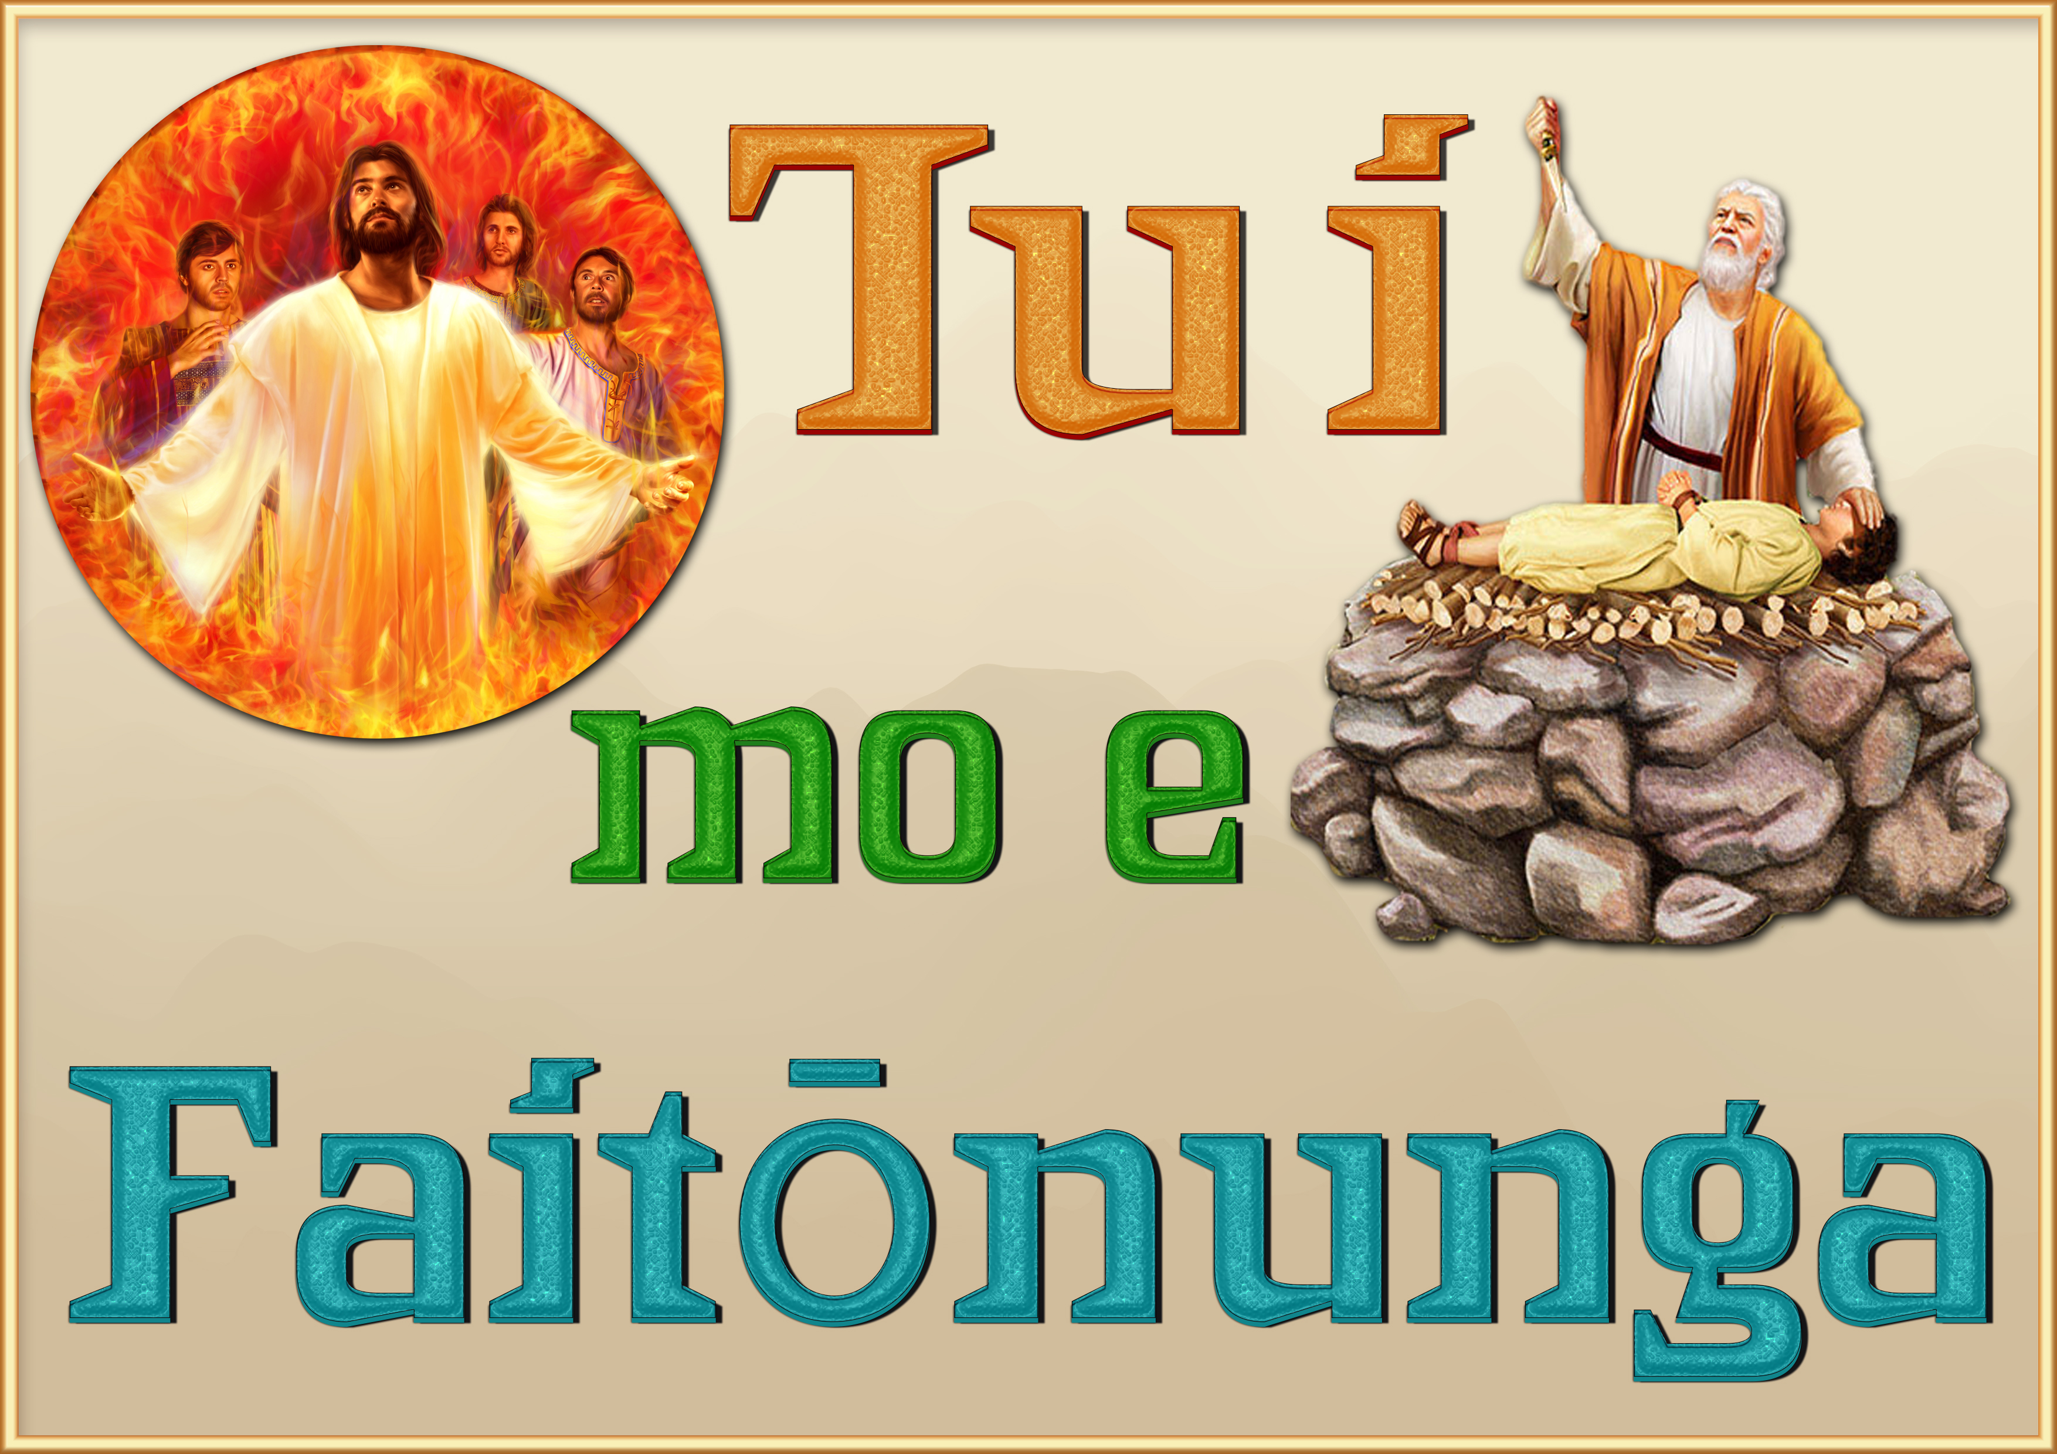

Slide 2

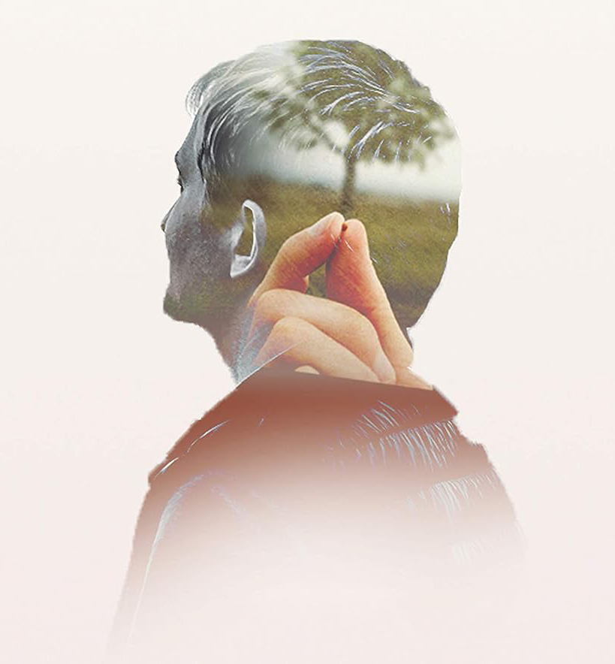
ʻOku ui ʻa e Hepelu 11 ko e "vahe ʻo e tui," pe "fale ʻo e tui." ʻOku ne fakamamafaʻi ʻa e kakai ʻi he Tohi Tapu naʻa nau moʻui ko ha kau pilikimi, ʻo falala ki he ngaahi talaʻofa taʻengata mo ʻikai fakaemamani. Ko ha ui ia ki he faivelenga, talangofua mo e vilitaki ʻi he lotolotonga ʻo e ngaahi faingataʻa.
Ko e ha ʻa e tui? ʻOku tali ia ʻe he ʻaposetolo ko Paula ʻi he veesi 1: "Ko e tui ko e fakavaivaiʻi ia ʻo e ngaahi meʻa ʻoku ʻamanaki lelei ki ai, ko e tui ki he ngaahi meʻa ʻoku ʻikai ke mamata ki ai."
Naʻa ne hoko atu ʻo talamai ʻi he veesi 6, "Ka ka ʻoku ʻikai ha tui ʻoku ʻikai faʻa fakafiemalie ki he ʻOtua; he ko ia ia ʻoku haʻu ki he ʻOtua kuo pau ke ne tui ʻoku ʻi ai, pea ko e totongi ia kiate kinautolu ʻoku fekumi faivelenga kiate ia."
Te tau manatuʻi ʻi he fakamatala ko ʻeni ʻa e kakai naʻa nau fakahaaʻi ʻenau tui, ʻa e ngaahi ngaue naʻa ne tataki kinautolu ke nau ʻiloʻi ʻa e tui ko ia mo hano fakaʻaongaʻi fakatautaha.
"Ko e tui ko e falala ia ki he ʻOtua,—tui ʻoku Ne ʻofa ʻiate kitautolu, mo ʻafioʻi ʻa e meʻa ʻoku lelei taha kiate kitautolu. Ko ia ai, ʻoku ʻikai ko ʻetau founga pe ʻatautolu, ka ʻoku ne tataki kitautolu ke tau fili Hono hala. ʻOku ne tali Hono poto kae ʻikai ko ʻetau taʻeʻilo; ʻo fetongi ʻaki hotau vaivai, ʻa Hono malohi; ko ʻEne maʻoniʻoni ʻo fetongi ʻaki ʻetau angahalaʻia. Kuo ʻosi ʻAʻana ʻetau moʻui; ʻoku fakahaaʻi ʻe he tui ʻoku ʻaʻana ʻa Ia, pea tali hono ngaahi tapuaki. ʻOku fakamahinoʻi mai ʻa e moʻoni, angatonu, mo e maʻa, ko e ngaahi fakapulipuli ia ʻo e lavameʻa ʻo e moʻui. Ko e tui ʻoku ne ʻai ke tau maʻu ʻa e ngaahi meʻa ni. Ko e ueʻi pe fakaʻanaua lelei kotoa pe ko e meʻaʻofa ia ʻa e ʻOtua; ʻoku maʻu ʻe he tui mei he ʻOtua ʻa e moʻui ko ia pe te ne lava ʻo ʻomi ʻa e tupulaki mo e lavameʻa moʻoni." — Kau Ngaue ʻi he Ongoongolelei 259

Slide 3

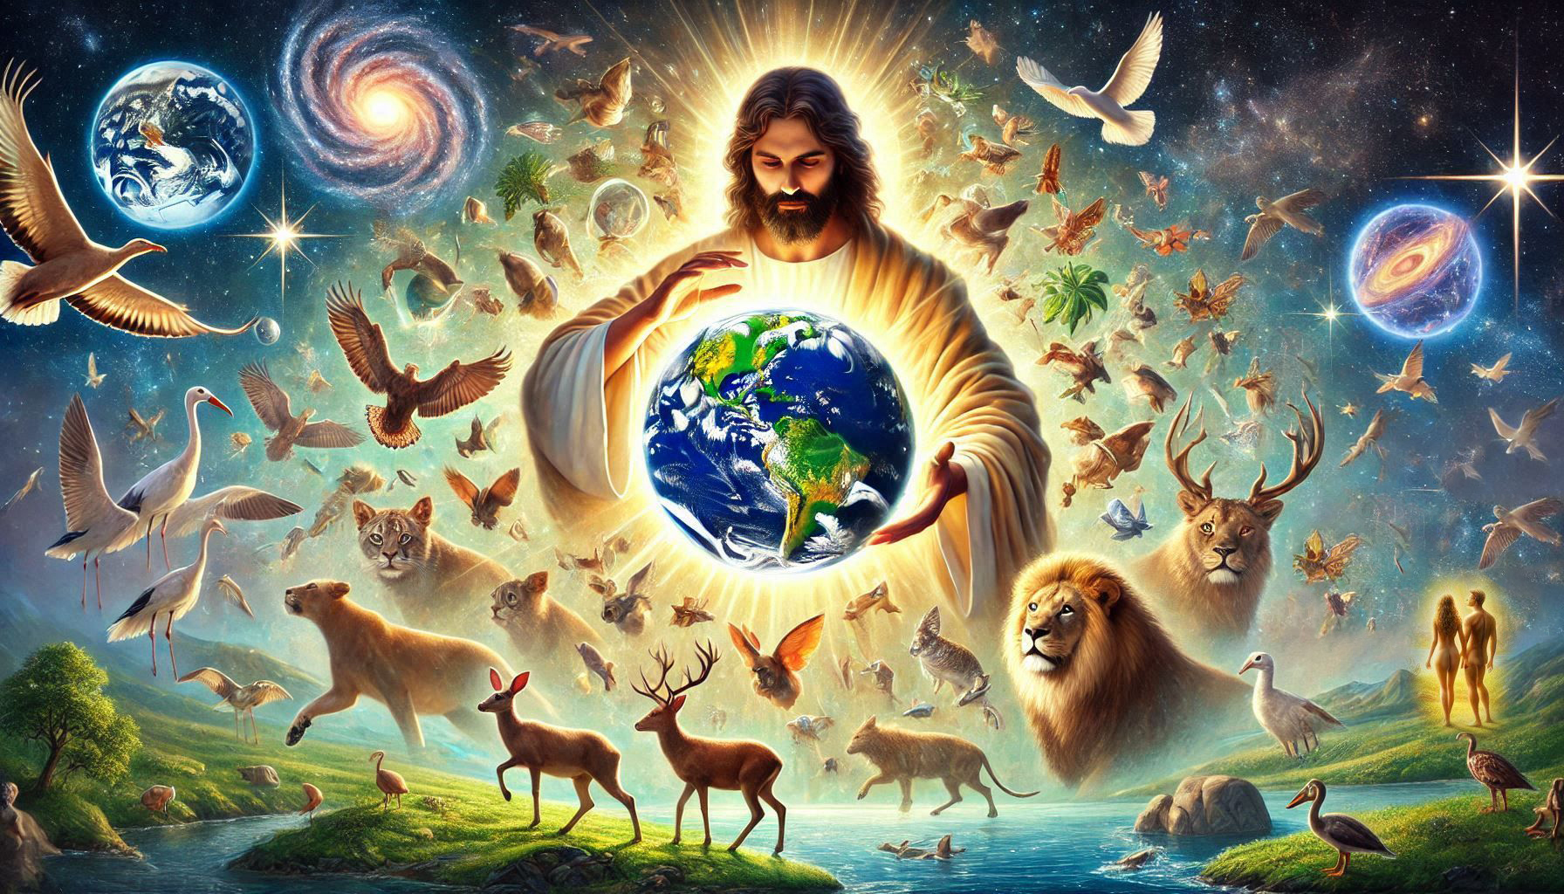
ʻOku tau ʻuhinga ʻi he tui naʻe ngaohi ʻa e ʻunivesi ʻe he folofola ʻa e ʻOtua, ko ia ko e meʻa ʻoku mamata ki ai naʻe ngaohi ia mei he meʻa naʻe ʻikai ke mamata ki ai. (v. 3) [Senesi 1]
ʻOku ou tui naʻe fakatupu ʻe he ʻOtua ʻa e ʻunivesi pea poupouʻi ia.
Notes:
Creó que Dios creó el universo y lo sustenta.

Slide 4

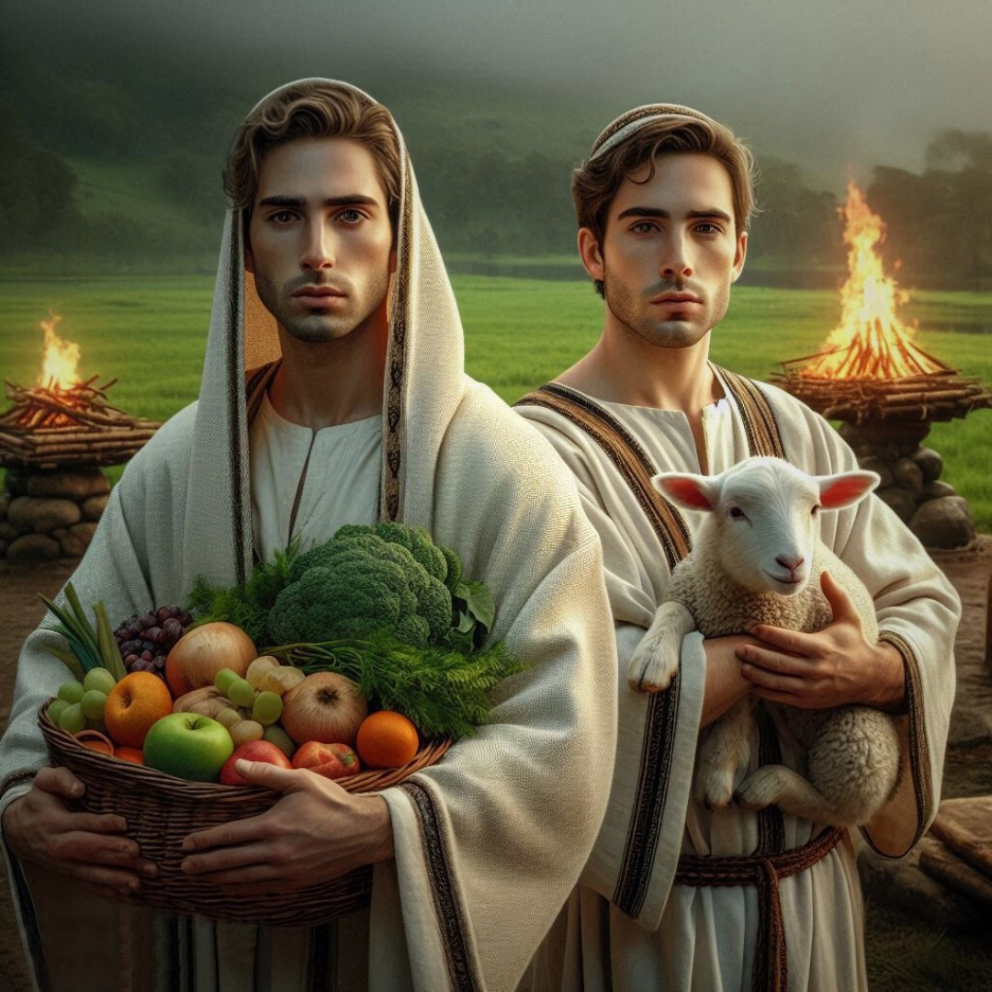
ʻI he tui, ʻoku ou muimui ai ki he ngaahi fakahinohino ʻa e ʻOtua
Ko e tui naʻe fai ai ʻe ____ ki he ʻOtua ʻa e feilaulau ʻoku lelei ange ʻia Keini, ʻa ia naʻa ne maʻu ai ʻa e fakamoʻoni naʻa ne maʻoniʻoni, ko e fakamoʻoni ʻa e ʻOtua ki heʻene ngaahi meʻafoaki: pea ko e meʻa ia naʻe mate ai, ka ʻoku lea ia.
(v. 4) [Senesi 4:2-8]
ʻEpeli
Notes:
Obedezco, obedezco, obedezco

Slide 5

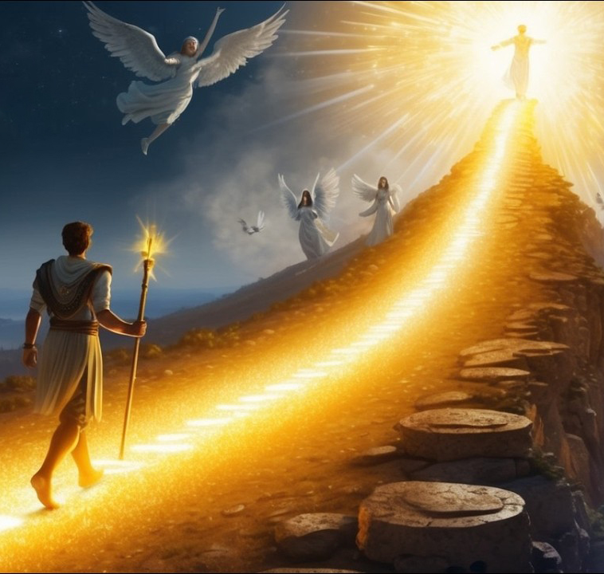
Ko ʻeku taumuʻa ʻi he moʻui ni ke fakahoifua ki he ʻOtua mo ʻaʻeva mo Ia
ʻI he tui ‘a______ naʻe liliu ai ke ʻoua naʻa ne mamata ki he mate; pea naʻe ʻikai ʻiloʻi, koeʻuhi kuo liliu ia ʻe he ʻOtua: he ʻi he teʻeki ai ke liliu ia naʻa ne maʻu ʻa e fakamoʻoni ko ʻeni, naʻa ne hoifua ki he ʻOtua.
(v. 5) [Senesi 5:24]
ʻInoke
Notes:
Mi meta en esta vida es agradar a Dios y caminar con Él

Slide 6

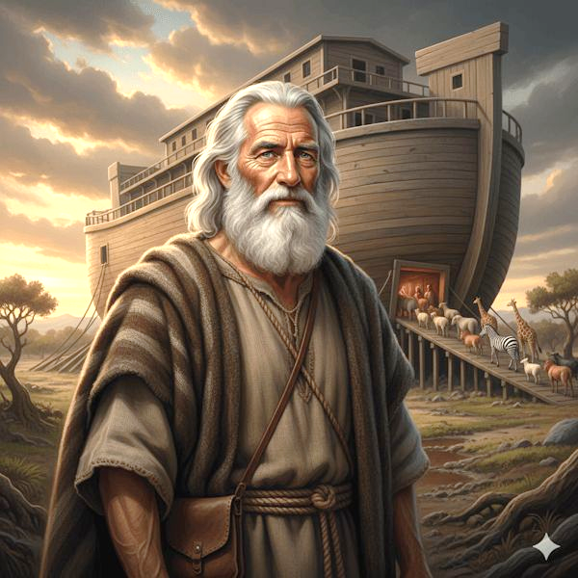
Neongo kapau ʻoku ʻi ai ha meʻa ʻoku taʻe-malava, kapau kuo folofola mai ʻa e ʻOtua ʻe hoko, ʻoku ou tui ki ai pea u ngaue ʻo fakatatau mo ia.
Ko e tui ʻa ____, ʻi he fakatokanga ʻa e ʻOtua ki he ngaahi meʻa ʻoku teʻeki ai ke mamata ki ai, naʻe ueʻi ia ʻi he manavahee, ʻo ne teuteu ʻa e puha tapu ke fakamoʻui ai hono fale; ʻa ia naʻa ne fakahalaiaʻi ai ʻa mamani, ʻo ne hoko ko e ʻea-hoko ki he maʻoniʻoni ʻa ia ʻoku ʻi he tui. (v. 7) [Senesi 6]
Noa
Notes:
Aunque algo sea imposible si Dios ha dicho que sucederá yo lo creo

Slide 7

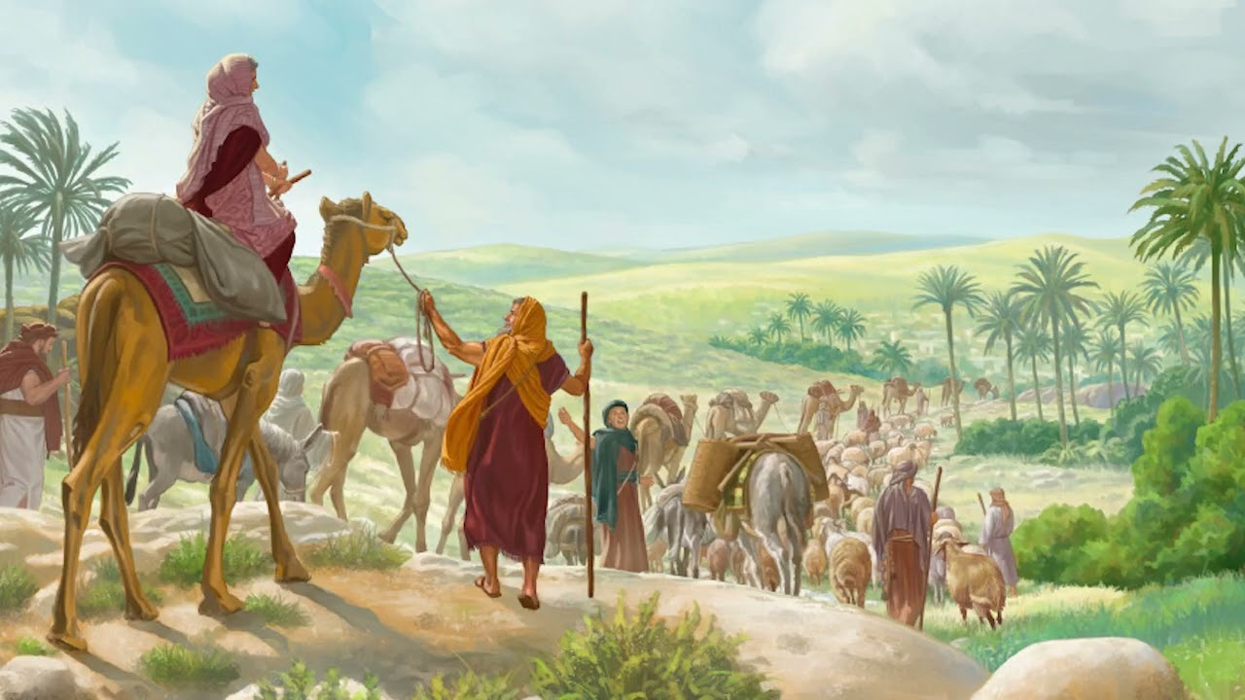
ʻOku ʻikai ke u sio ki he lolotonga, ka ki he kahaʻu naunauʻia ʻoku teuteu ʻe he ʻOtua maʻaku
ʻI he tui ʻa _________ na’e ʻaunofo ai ʻi he fonua ʻo e talaʻofa, ʻo hange ʻi ha fonua foʻou... He naʻa ne ʻamanaki ki ha kolo ʻoku ʻi ai hono ngaahi tuʻunga, ko hono tufunga mo e tufunga ko e ʻOtua ia. (v. 8-10) [Senesi 12:1-4]
ʻEpalahame
Notes:
No miro el presente sino el futuro glorioso que Dios me está preparando

Slide 8

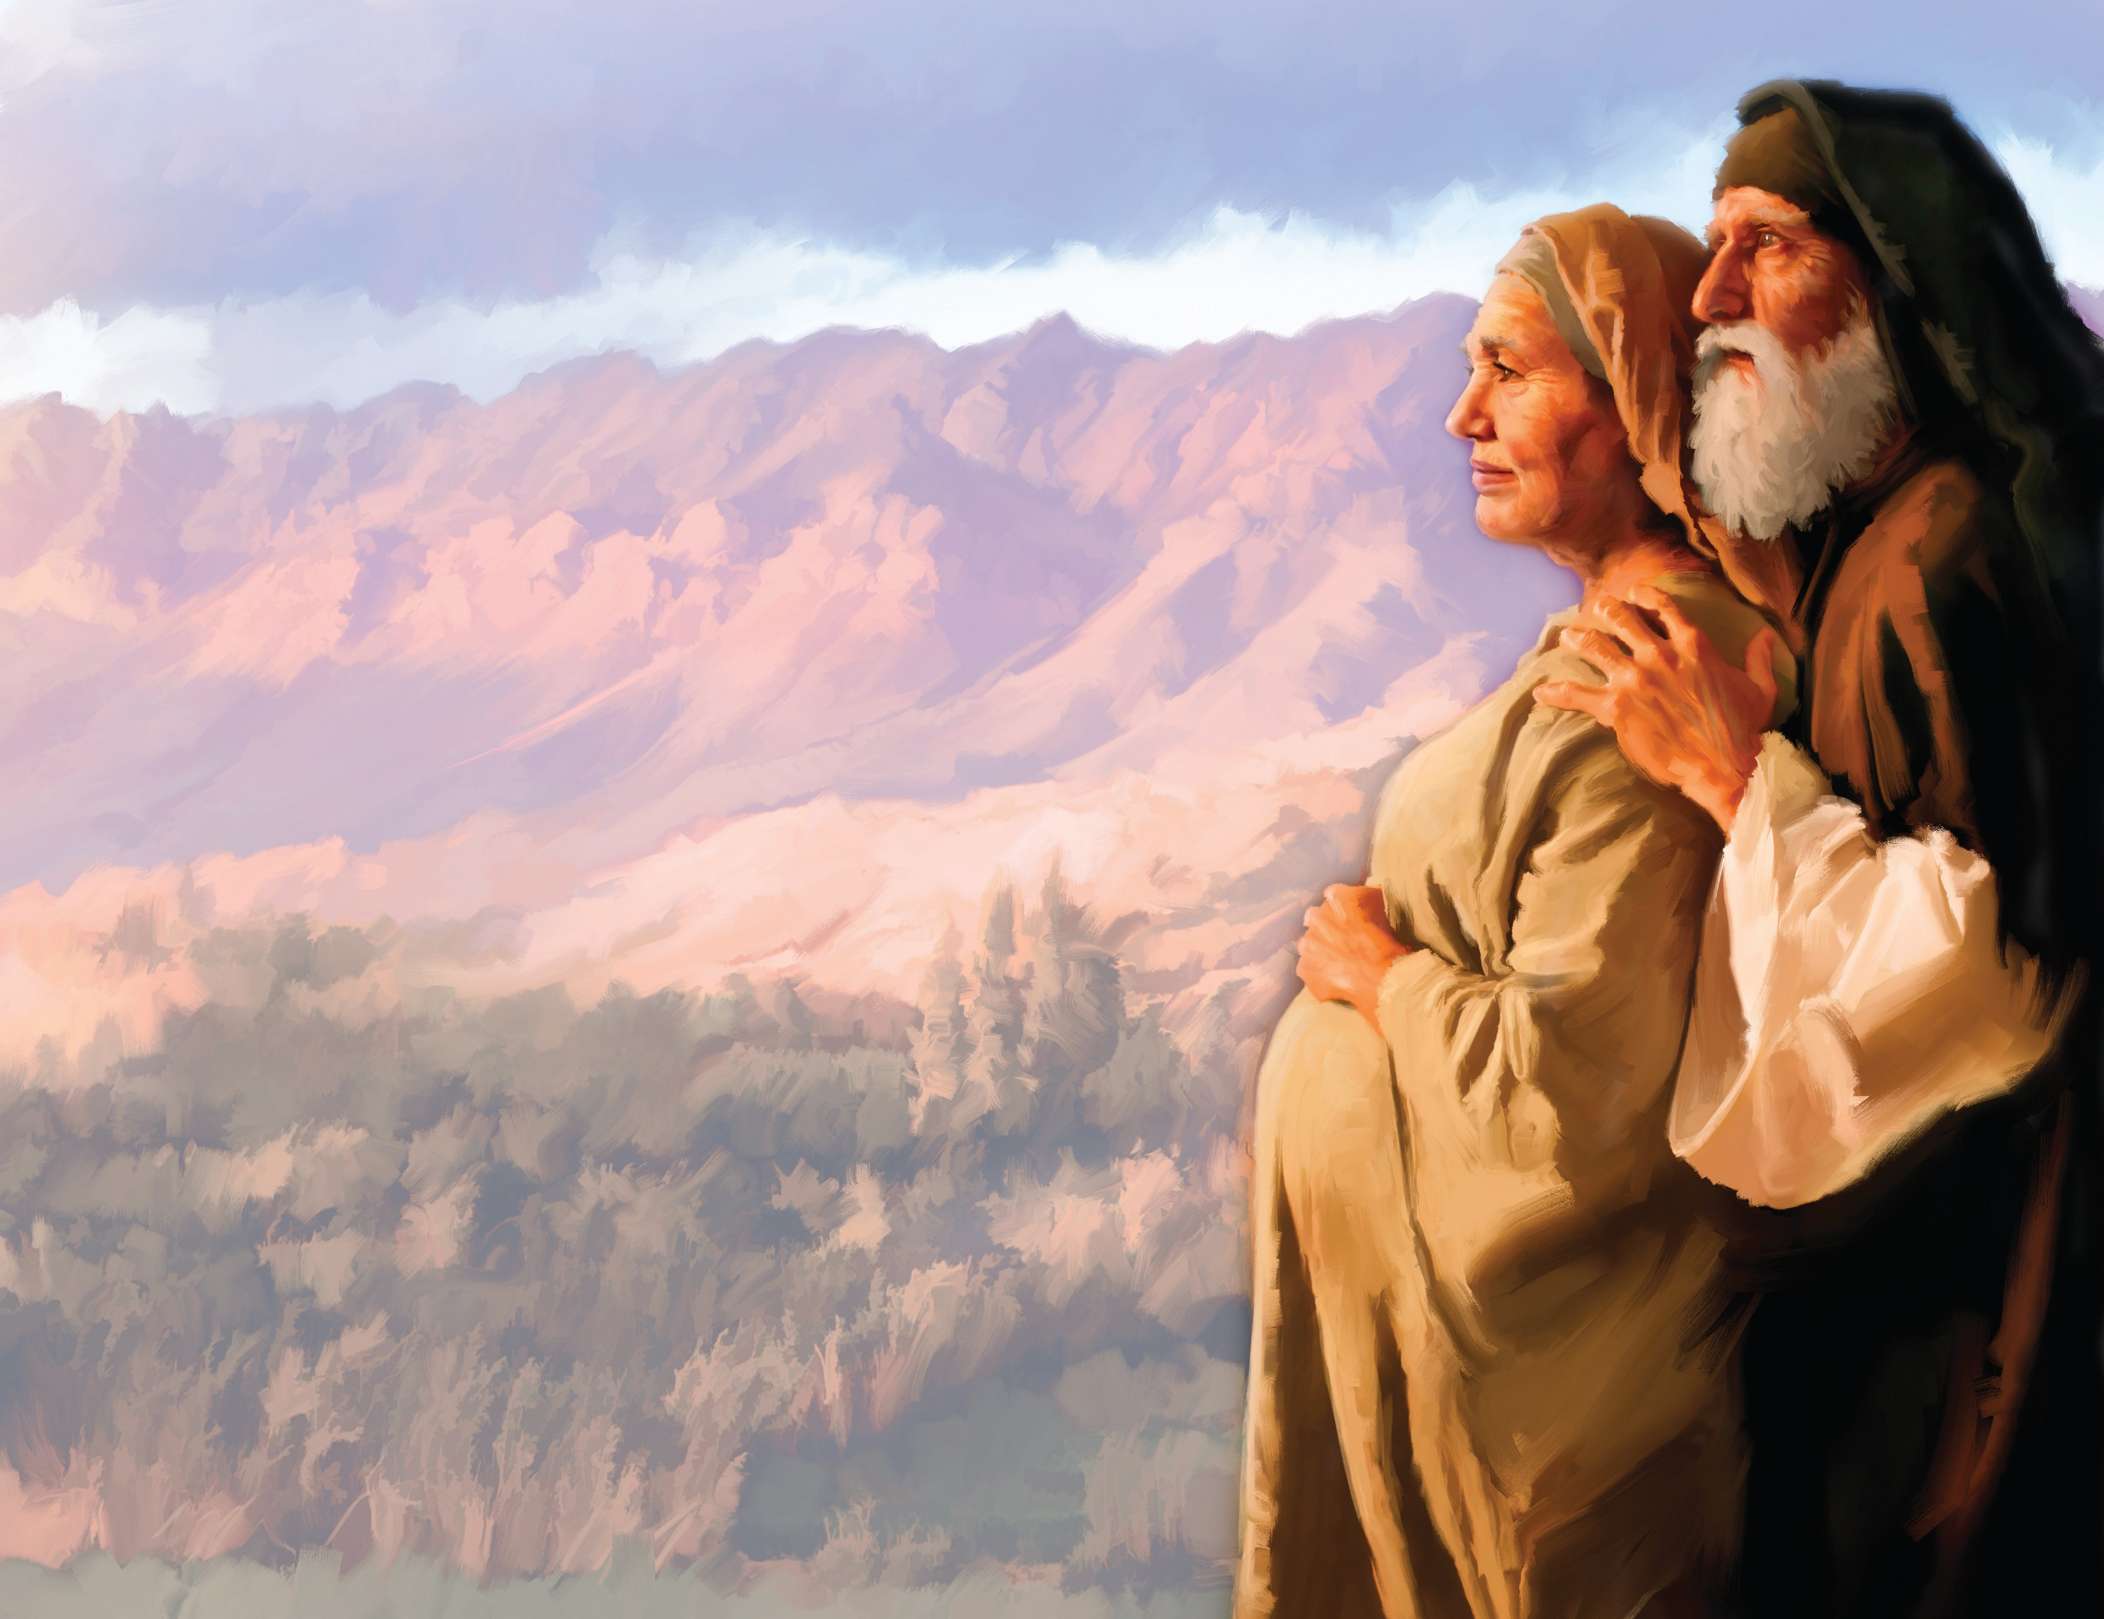
ʻOku ou tui ki heʻenau ngaahi talaʻofa, neongo kapau ʻe fuoloa pea toki fakahoko.
ʻI he tui foki naʻa ne maʻu ai ʻa e malohi ke tuʻituʻia’a _____ ha hako, pea naʻe faʻeleʻi ʻene tama ʻi heʻene taʻu motuʻa, koeʻuhi he naʻa ne pehe ʻoku angatonu ʻa ia naʻe talaʻofa.
(v. 11) [Senesi 21:1-7]
Sela
Notes:
Creo en sus promesas por más que tarden en cumplirse

Slide 9

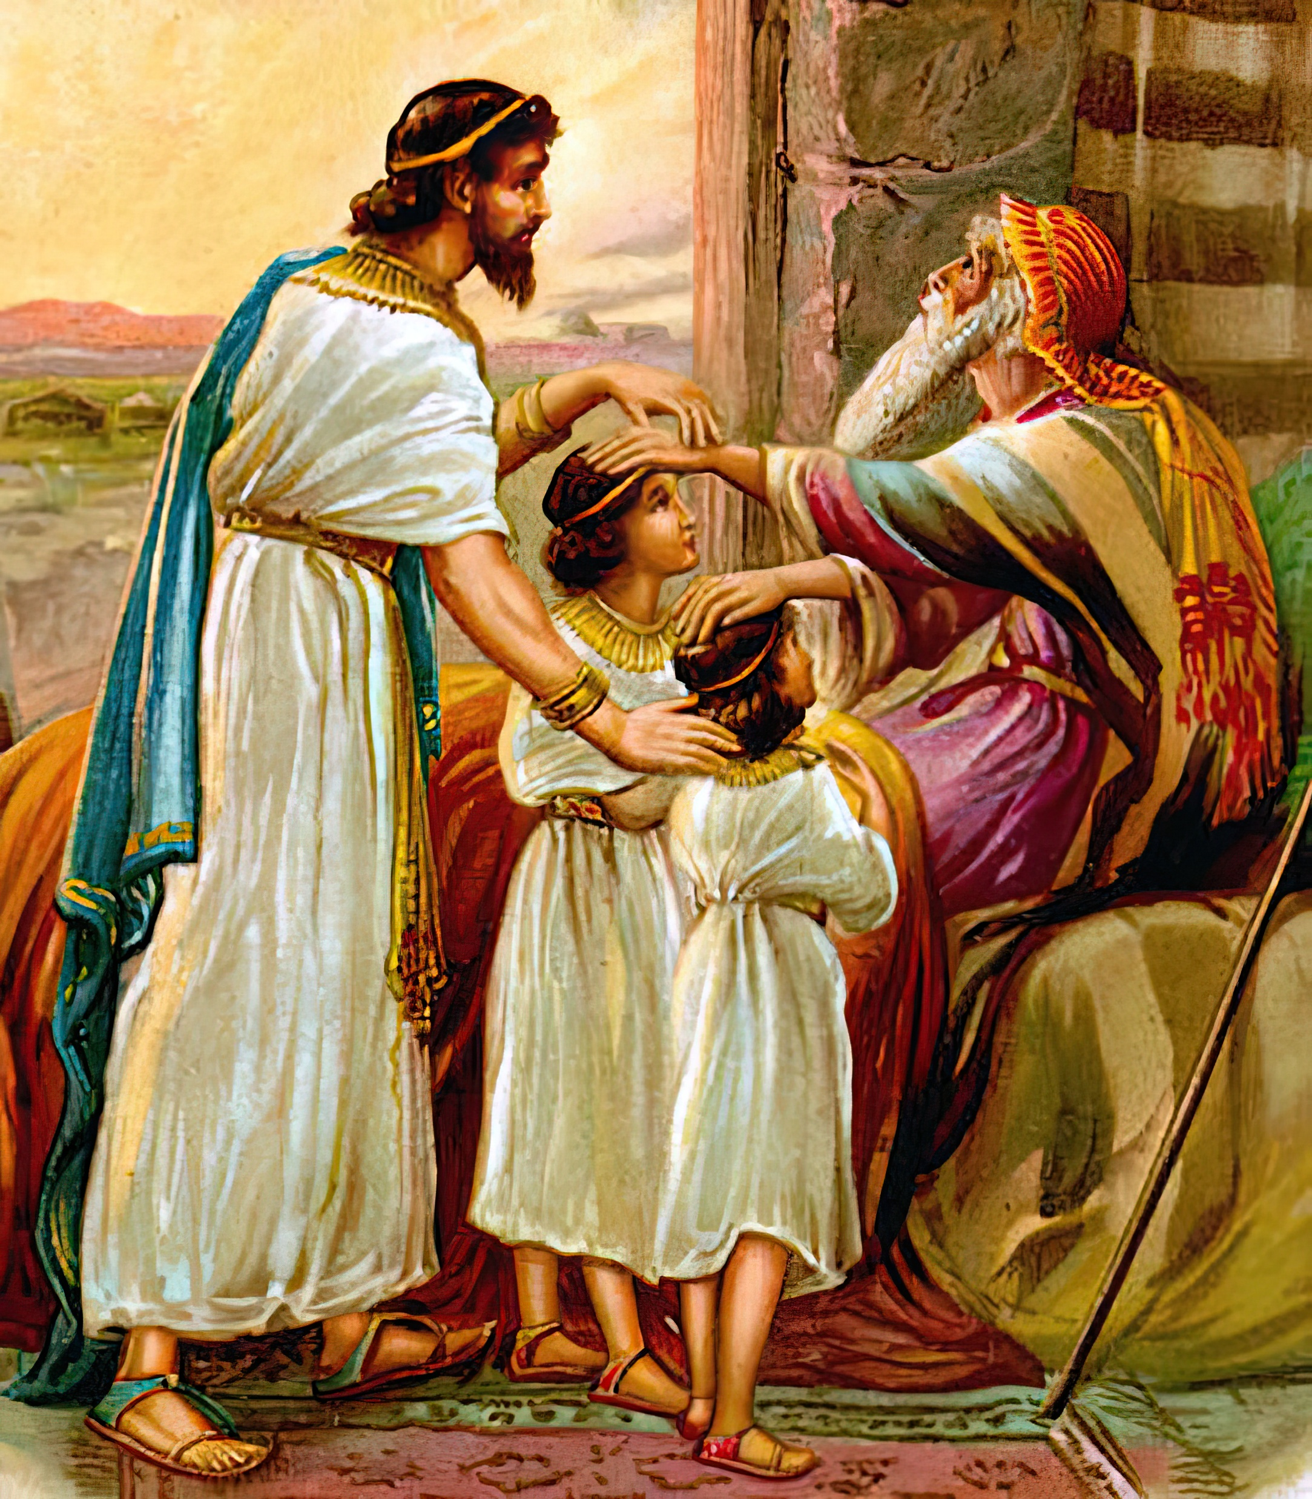
ʻOku ou hu ki he ʻOtua mo tapuakiʻi, ʻo aʻu ai pe ki he taimi ʻoku ou ʻamanaki ai ke mate.
ʻI he tui naʻe tapuakiʻi ai ʻe _____ ʻi heʻene mei mate, ʻa e ongo foha fakatouʻosi ʻo Siosefa; pea naʻa ne lotu, ʻo falala ki he tumutumu ʻo hono tokotoko.
(v. 21)
[Senesi 48:8-20]
Sekope
Notes:
Adoro a Dios aun cuando estoy a punto de morir

Slide 10

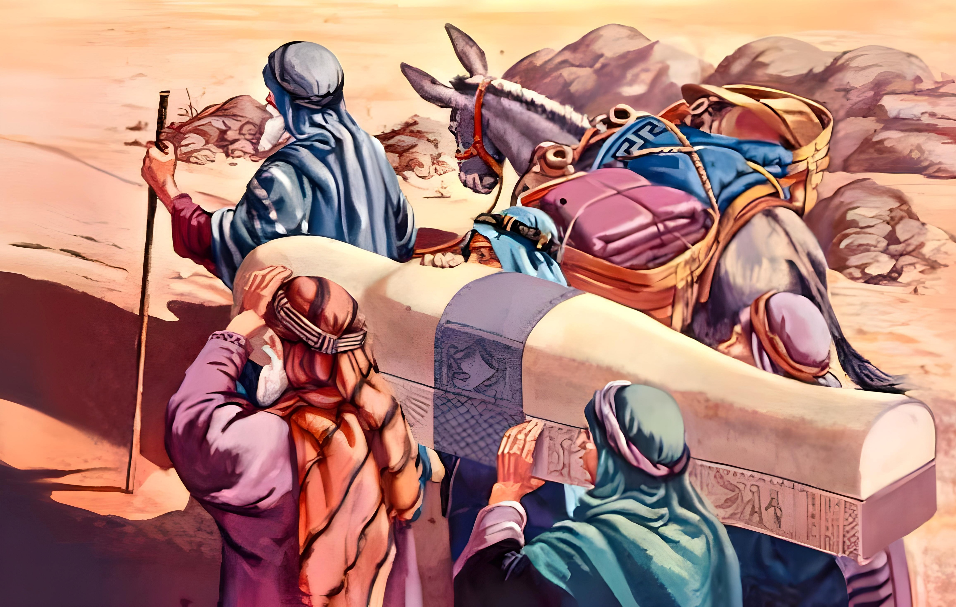
ʻI heʻene pekia ʻi he tui ‘a _______, naʻa ne fakamatala ki he mavahe ʻa e fanau ʻa ʻIsileli; ʻo ne fai ʻa e fekau ʻo kau ki hono ngaahi hui. (v. 22) [Senesi 50:25-26]
Siosefa
ʻOku ou tuku ha fakamoʻoni ki he ngaahi toʻu tangata hoko maí ki he fakapapau ʻe hāʻele mai ʻa e ʻOtuá ke fakatauʻatāinaʻi kitautolú.
Notes:
Creo que lo que Dios ha dicho se cumplirá

Slide 11

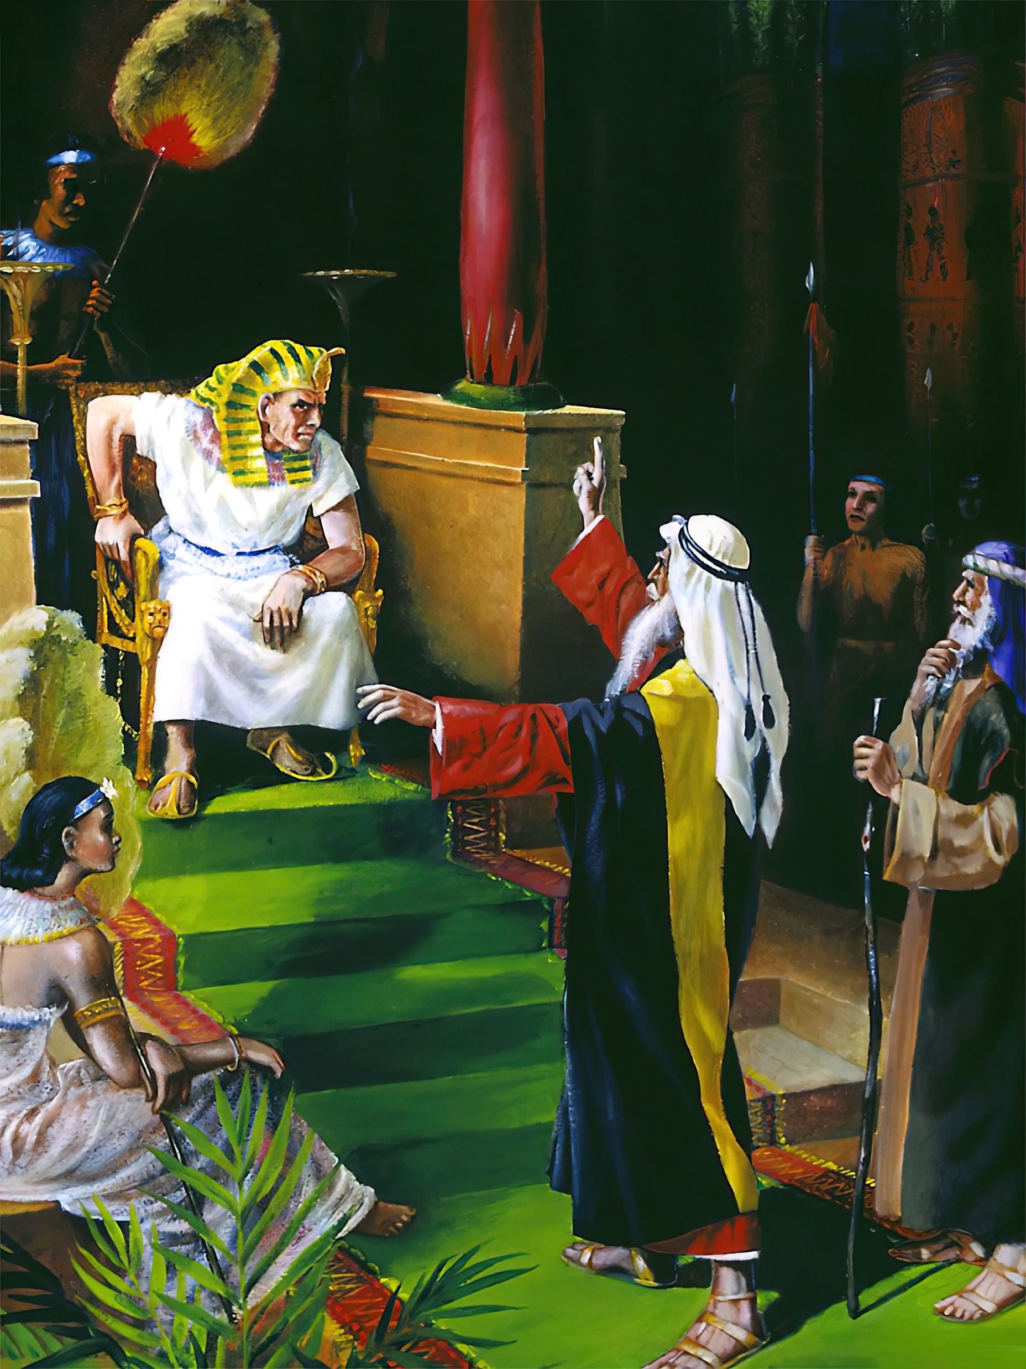
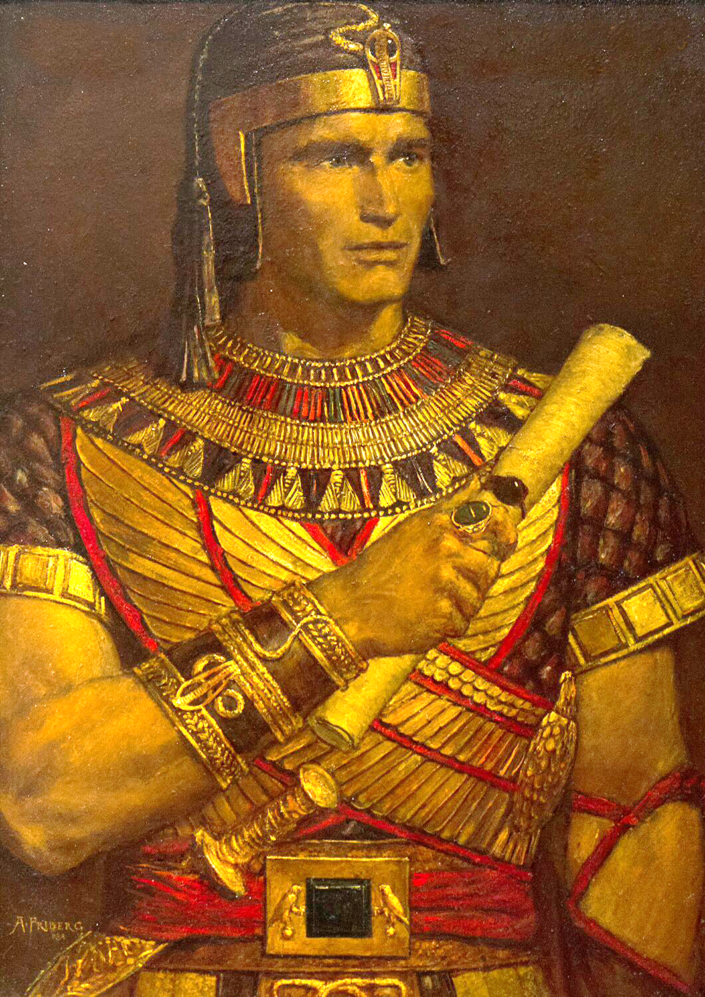
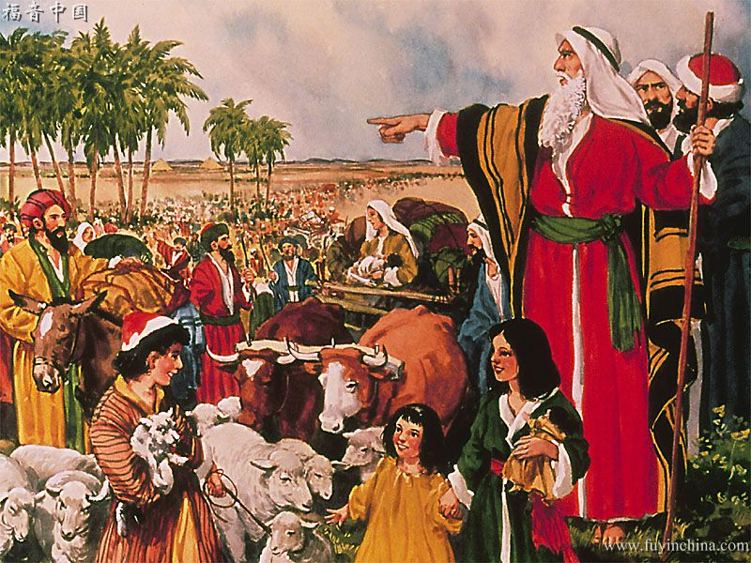
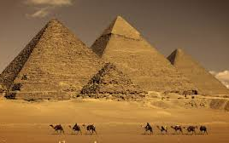
ʻOku ou fakafisingaʻi ʻa e ngaahi langilangi mo e ngaahi naunau ʻo e mamani, pea ʻoku ou fili ke u hoko ko ha konga ʻo e kakai ʻa e ʻOtua.
Ko e tui naʻe fakafisi ʻa ______ ʻi heʻene motuʻa, ke ui ia ko e foha ʻo e ʻofefine ʻo Felo; ʻO fili lelei ange ke faingataʻaʻia fakataha mo e kakai ʻo e ʻOtua, ʻi he fiefia ʻi he ngaahi fiefia ʻo e angahala ʻi ha kiʻi kuonga; ʻI heʻenau lau ʻa e manuki ʻa Kalaisi ko e koloa lahi ange ia ʻi he koloa ʻi ʻIsipite: (v. 24-27) [ʻEkesotosi 5:1]
Mosese
Notes:
Rechazo los honores y glorias mundanas por ser parte del pueblo de Dios

Slide 12

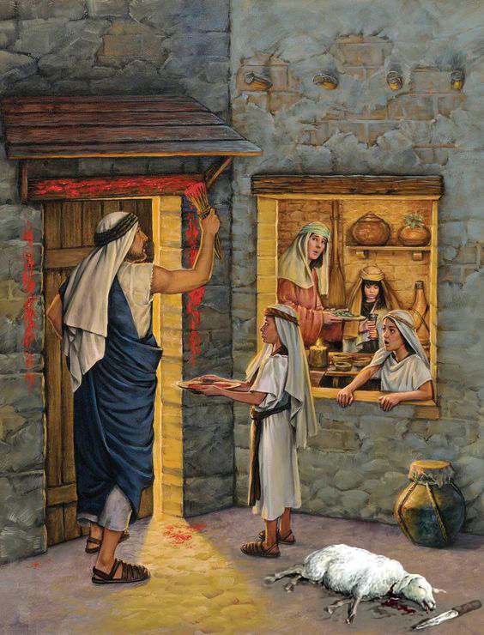
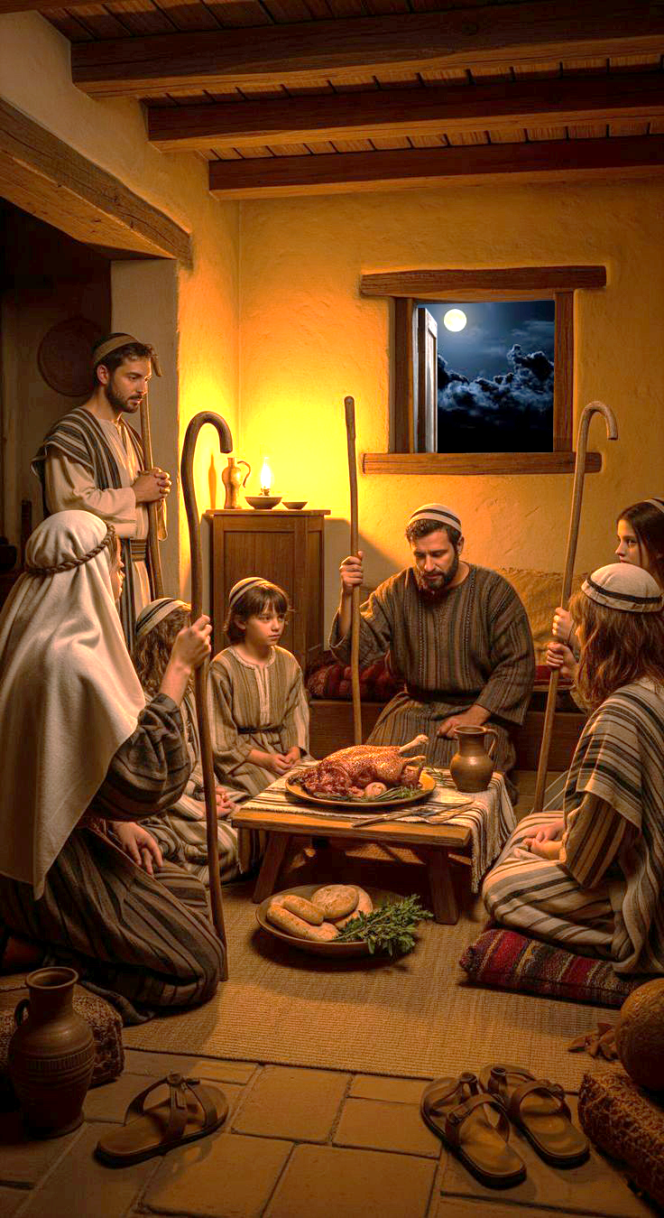
Ko e meʻa ʻi he tui ‘a ________ naʻe fai ai ʻa e Lakaatu, mo e afuhi ʻo e toto, telia naʻa ala kiate kinautolu ʻe ia ʻoku ne fakaʻauha ʻa e ʻuluaki fānau.
(v. 28) [ʻEkesotosi 12]
Mosese
ʻOku ou tali ʻa e fetongi naʻe teuteuʻi ʻe he ʻOtua
Notes:
Acepto al sustituto que Dios preparó

Slide 13

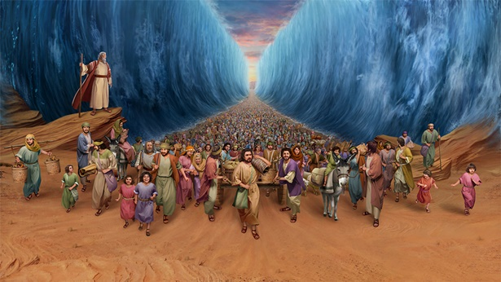
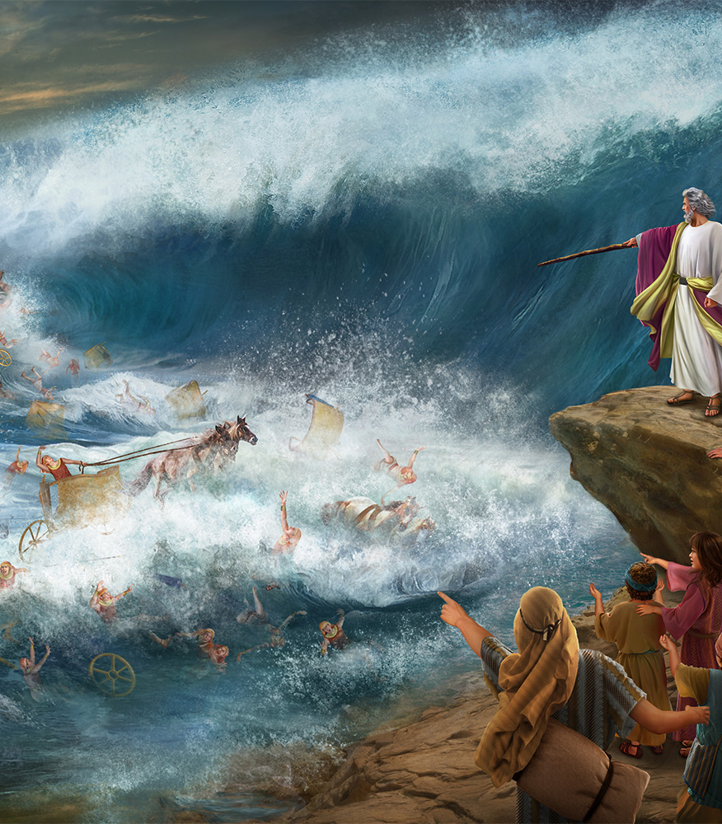
Ko e tui ʻa e_____________ na’a nau ʻalu atu ai ʻi he Tahi Kulokula ʻo hange ko e kelekele momoa: ʻa ia naʻe feinga ʻa e kau ʻIsipite ke fai naʻa nau melemo.
(v. 29) [ʻEkesotosi 14]
kau ʻIsileli
ʻOku ou laka atu ki muʻa ʻi he lotolotonga ʻo e ngaahi fakatanga, ʻo ʻiloʻi ʻe iku fakaʻauha ʻe he ʻOtua ʻa e kovi.
Notes:
Avanzo en medio de persecuciones sabiendo que Dios destruirá el mal

Slide 14

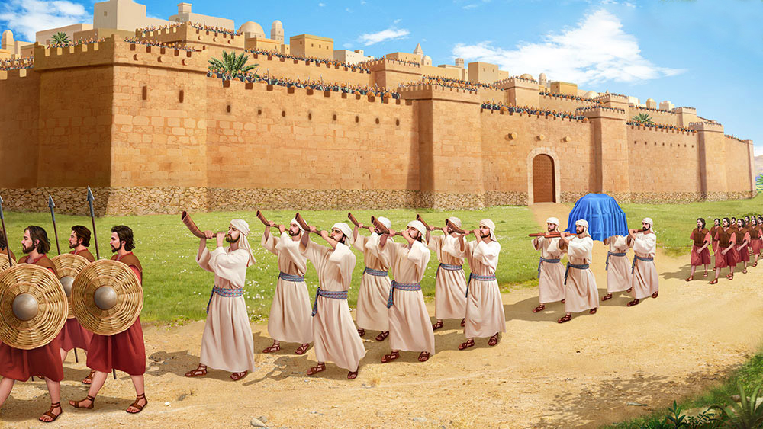
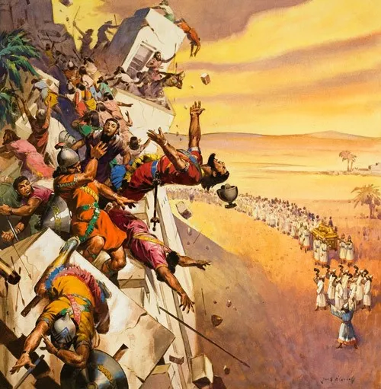
ʻOku ou fai ʻa e meʻa ʻoku fekau mai ʻe he ʻOtua kiate au, ʻi heʻeku ʻiloʻi ʻe fai ʻe he ʻOtua ʻEne tafaʻaki.
ʻI he tui __________________naʻe holo ai ʻa e ngaahi ʻa ʻo Selikoo ʻi he tui hili hono takatakaiʻi kinautolu ʻi he ʻaho nai ʻe fitu.
(v. 30) [Sosiua 6]
’a e kakai ʻo ʻIsileli
Notes:
Hago lo que Dios me ordena sabiendo que Dios hará su parte

Slide 15

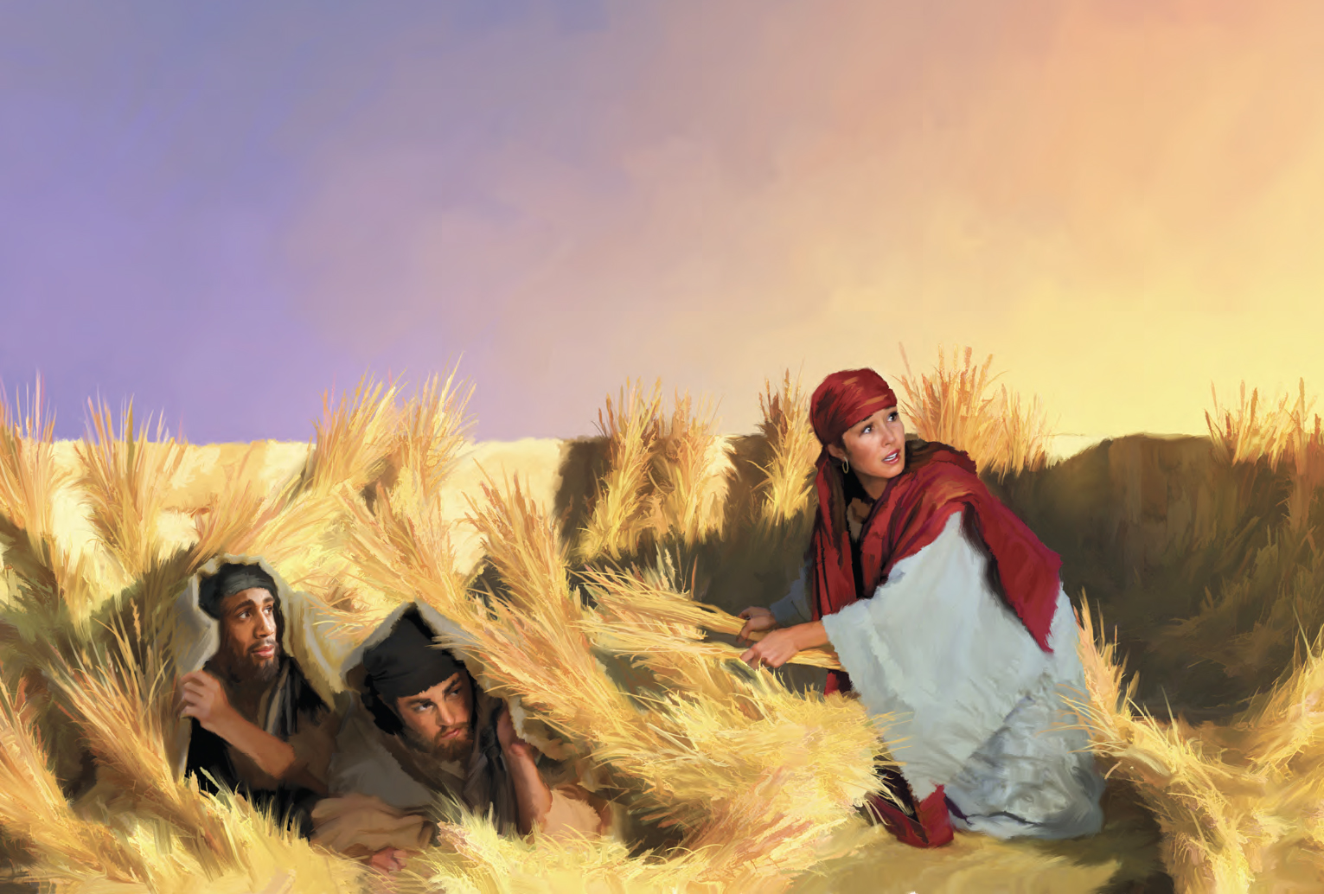
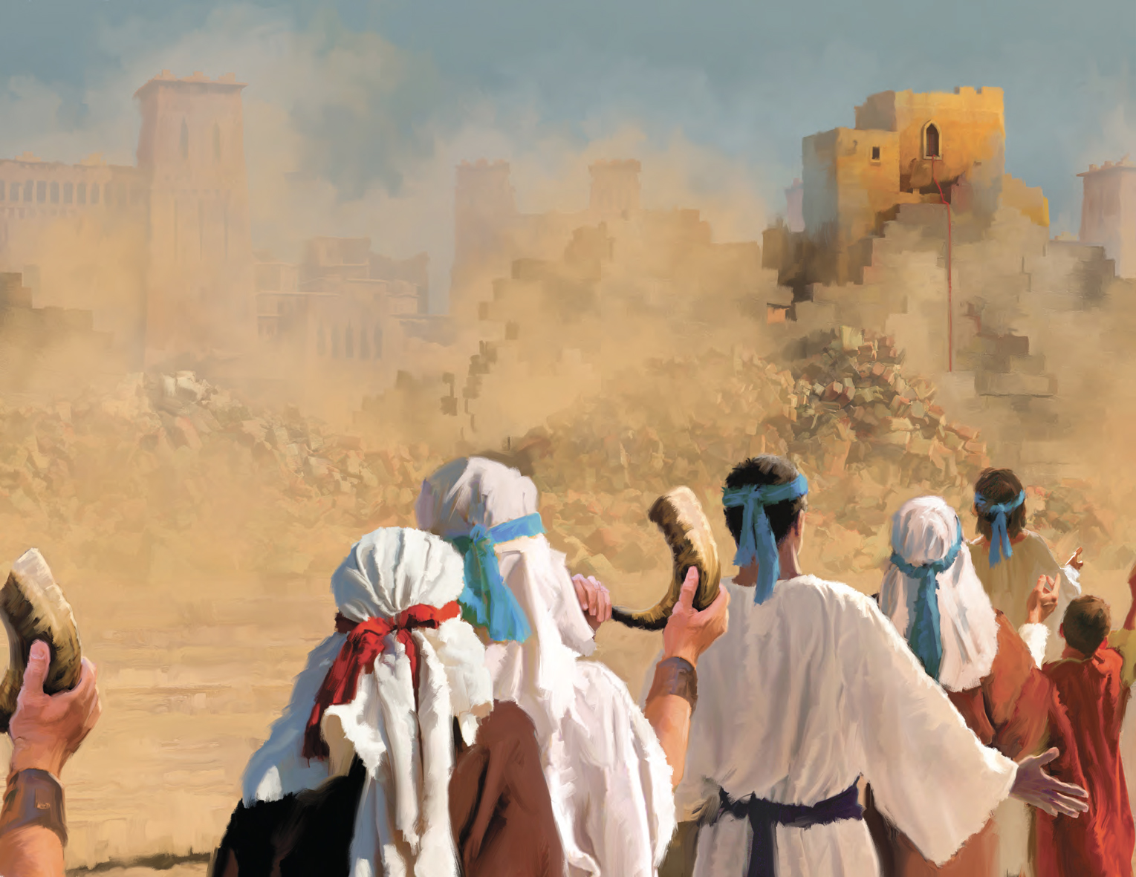
ʻOku ou tauhi lelei ʻa e kau talafekau ʻa e ʻOtua
Ko e tui naʻe ʻikai mate fakataha ʻa e feʻauaki mo kinautolu naʻe ʻikai tui, ʻi he tui ‘a _______naʻe ʻikai ke ne maʻu ʻa e kau mataki ʻi he melino.
(v. 31) [Sosiua 2]
Lēhapi
Notes:
Trato bien a los mensajeros de Dios

Slide 16

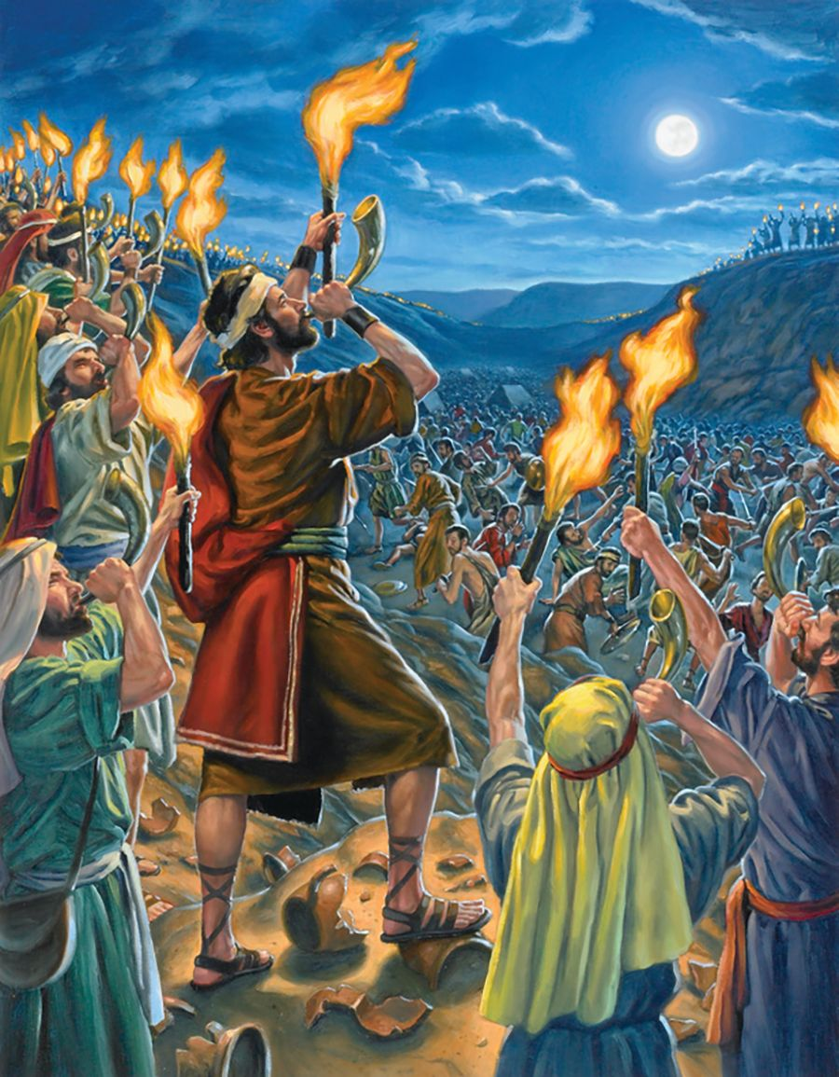
Kitione
ʻ I he tuí ʻa ________ na ne ikunaʻi ai ʻ a e kau tau ʻ o e kau Mitianí mo e kau ʻ Amalekī, ʻ a ia naʻa nau hangē ha fanga heʻe ʻ i he fuʻu tokolahi, ʻ a ia ko e kau tangata pē ʻ e toko 300, ko kinautolu kotoa pē naʻa nau maʻu ʻ a e talupite ʻ i honau nimá, mo e ngaahi maama ʻ i loto ʻ i he ngaahi sioki. (v. 32) [Fakamaau 7]
ʻOku ou fehangahangai mo ha faʻahinga palopalema pe mo e ʻOtua, pea ʻoku ou fakaʻaongaʻi ʻa e poto naʻa Ne ʻomi kiate au.
Notes:
Enfrento lo que sea con Dios y uso el ingenio

Slide 17

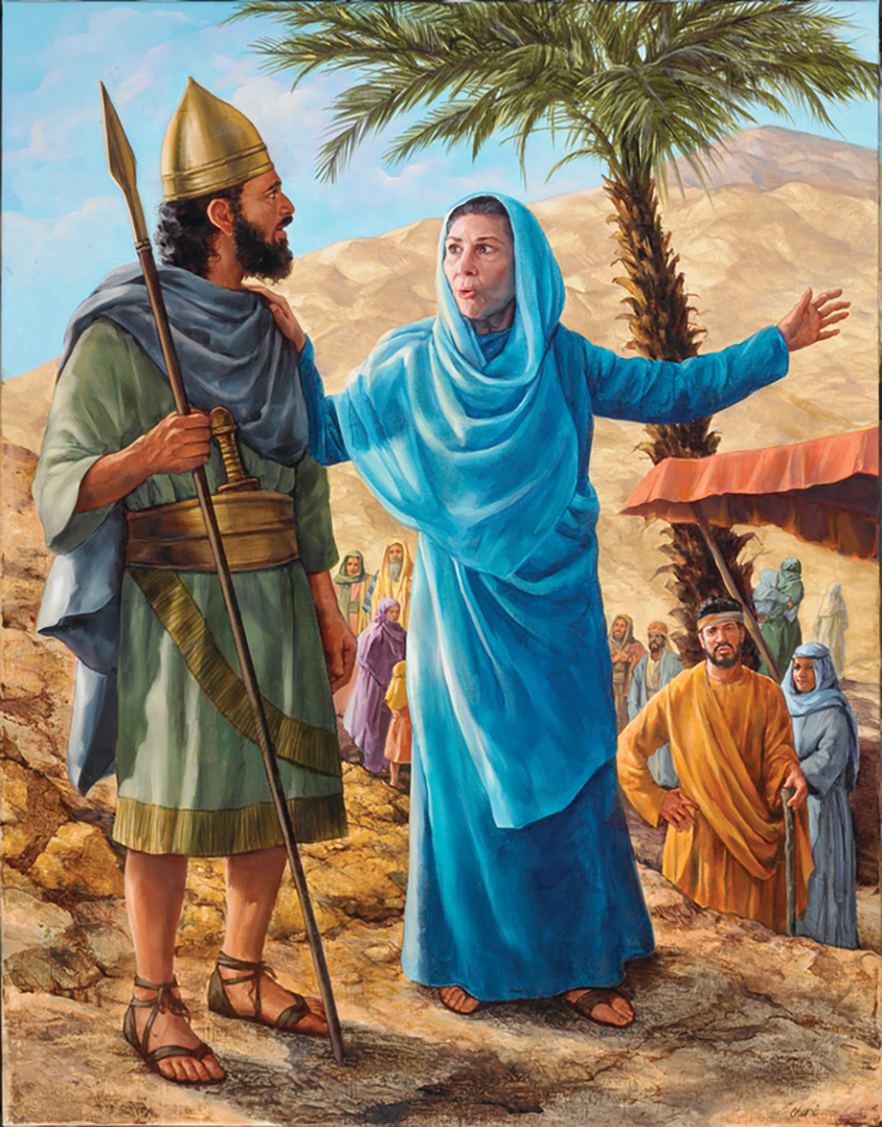
ʻOku ou ikuna ʻa e ngaahi tau, ʻoku ʻikai mahuʻinga ia
neongo pe ko e ha hono lahi pe malohi ʻo hoku fili.
Pelaki
Ko e tui ʻa ______ na’a nau ʻalu hake ai ke tauʻi ʻa Sisela mo e kau tangata ʻe toko mano, ʻa ia naʻe ʻi ai ʻene ngaahi saliote ʻe hivangeau mo e kakai tokolahi. Naʻe tau ʻa Pelaki kae ʻoua kuo ʻikai ke ne tuku ha taha. (v. 32) [Fakamaau 4]
Notes:
Con Dios libro mis batallas no importa cuan grande o poderoso sea mi enemigo.

Slide 18

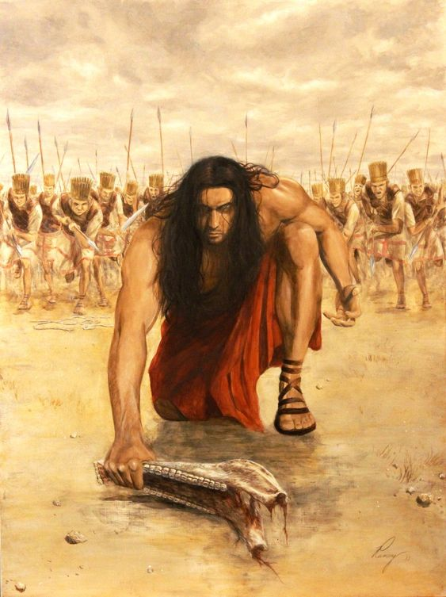
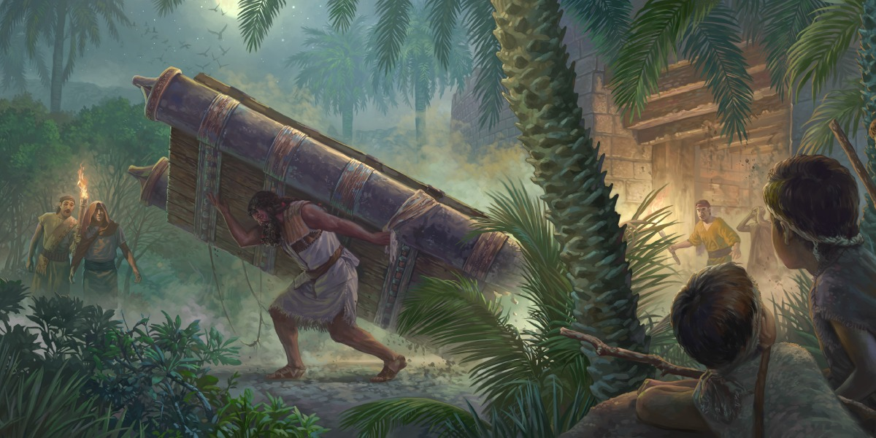
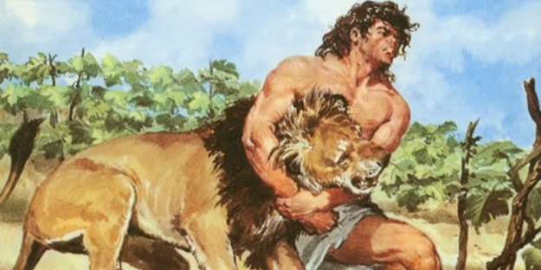
ʻI he mālohi ʻo e ʻOtuá te u lava ʻo fai ha ngaahi meʻa ʻoku mahulu hake ʻi hoku malavá .
ʻI he tuí naʻe tāmateʻi ai ʻe ________ ha kau tangata ʻe toko taha afe ʻaki ha hui ʻo e kaungao, haeʻi ʻa e matapā ʻo ha kolo, pea fakamaauʻi ʻa ʻIsileli ʻi ha taʻu ʻe 20. (vahe 32) [Fakamaau 15:15-20].
Samisoni

Slide 19
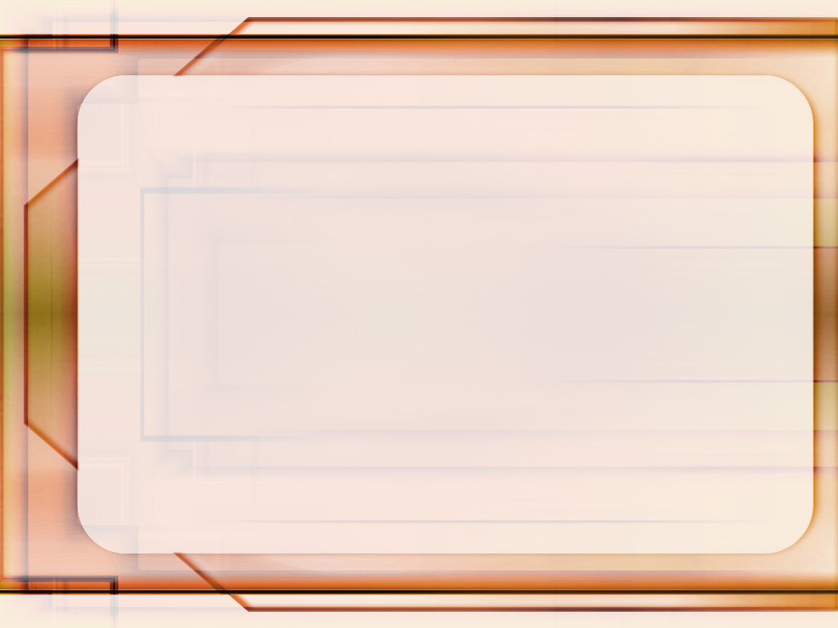
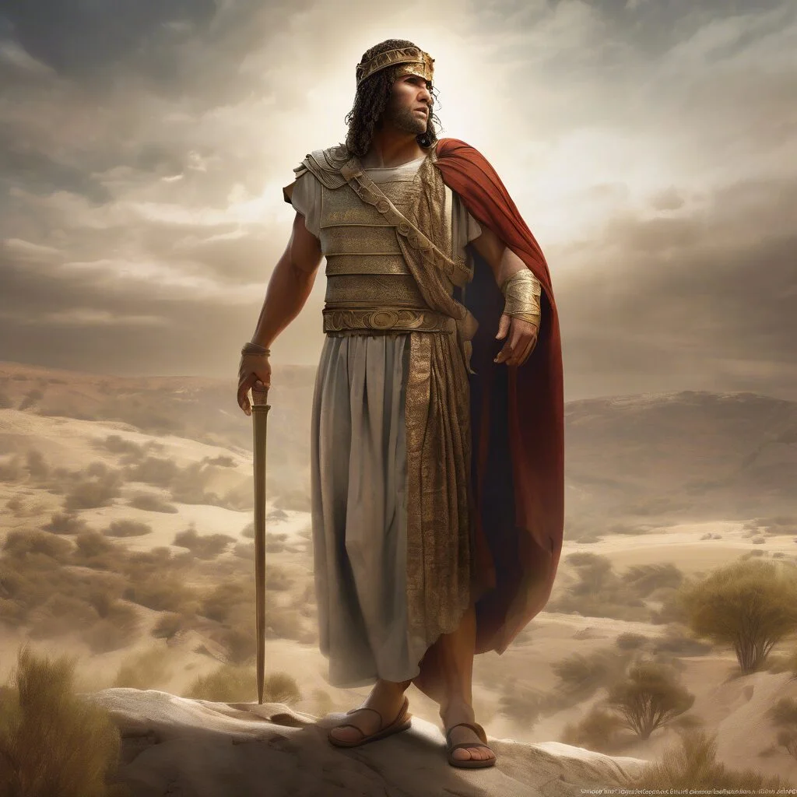
Neongo ʻoku fakafisingaʻi au ʻe he tangata, ka ʻoku ou tui ʻoku ʻi ai ha misiona ʻa e ʻOtua maʻaku.
ʻ I he tuí ‘a______, naʻe fakahaofi ai ʻ e he fakamaau Kiliatí ʻ a e kau ʻ Isilelí mei he kau ʻ Āmoní, ʻ o maumauʻi ai honau mālohí. (v. 32) [Fakamaau 11:32-33]
Sēfita

Slide 20

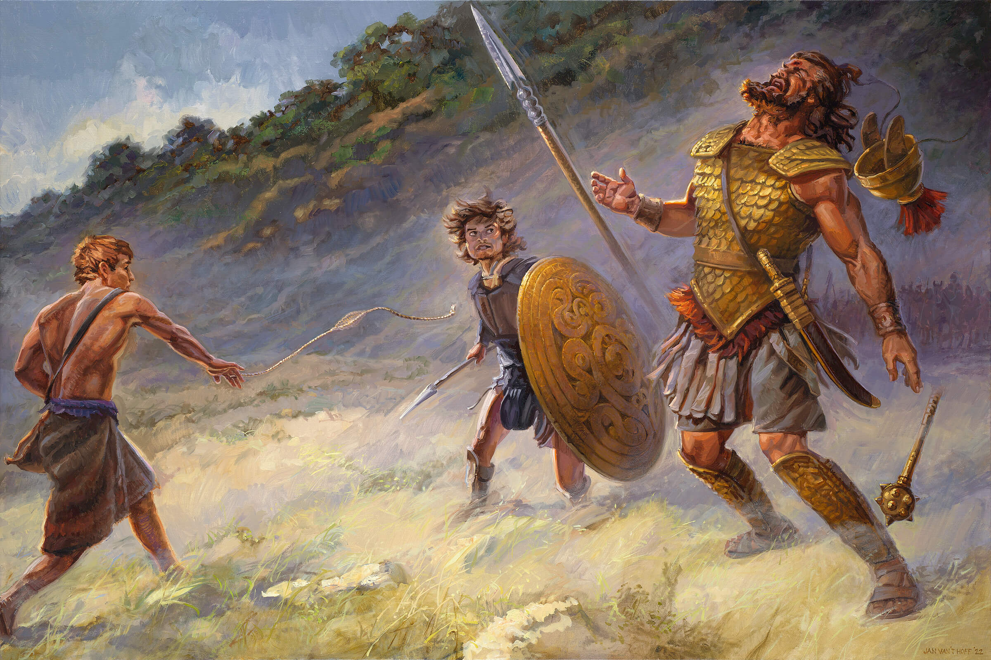
ʻI he tui, ‘a ______ na’a ne fehangahangai ai mo Kolaiate, ko ha saieniti, pea ikunaʻi ia ʻaki ʻene maka-ta mo ha maka. (v. 32) [1 Samuela 17]
Tevita
ʻOku siʻisiʻi ange ʻa e saieniti ʻi he taimi ʻoku ou falala ai ki he ʻOtua.
Notes:
Derroto al enemigo confiando en Dios y con lo que se hacer.

Slide 21

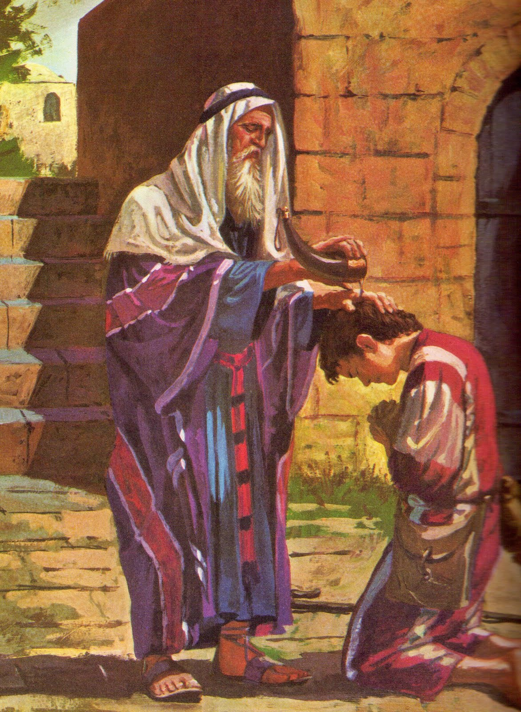
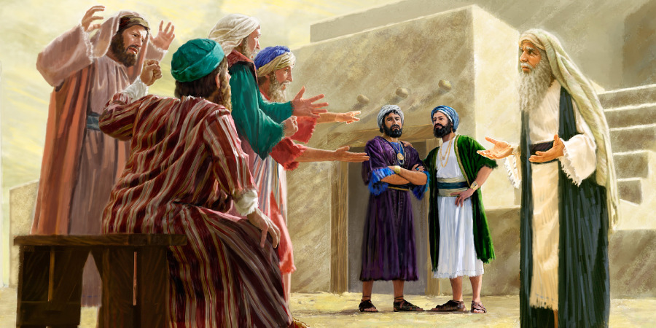
ʻOku ou ʻiloʻi, ʻo aʻu mai ki he tuʻunga ko ʻeni, kuo ngaue ʻa e toʻukupu ʻo e ʻOtua ʻi heʻeku moʻui.
ʻI he tui ‘a________, naʻe fokotuʻu ai ʻe he fakamaau fakaʻosi ʻo ʻIsileli ha maka fakamanatu: "Kuo tokoniʻi kitautolu ʻe he ʻEiki ʻo aʻu mai ki he taimi ni"
(vahe 32) [1 Samiuela 7:12-17].
Samiuela
Notes:
Sigo mi andar sabiendo que “hasta aquí me ha ayudado Dios”.

Slide 22

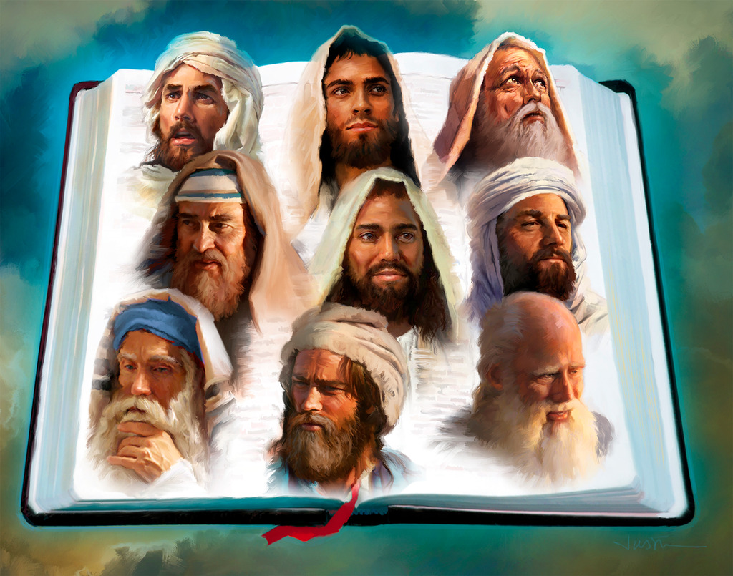
ʻI he tuí, naʻe ʻalu ai ʻa e ____________ ʻo ʻoatu ʻa e pōpoaki ʻa e ʻOtuá ʻi ha feituʻu pē mo ha taimi pē naʻe fakahinohinoʻi ai kinautolu ʻe he ʻOtuá.
(v. 32) [1 Tuʻi 19:15; ‘Ēmosi 7:15; Siona 1:1-2; Hakeai 1:1 ].
kau palōfita
‘Oku ou ‘alu ki ha feitu’u pe ‘oku fekau’i au ‘e he ‘Otua ke ‘ave ‘ene Folofola.
Notes:
Llevaré el mensaje de Dios aún en medio de dificultades

Slide 23

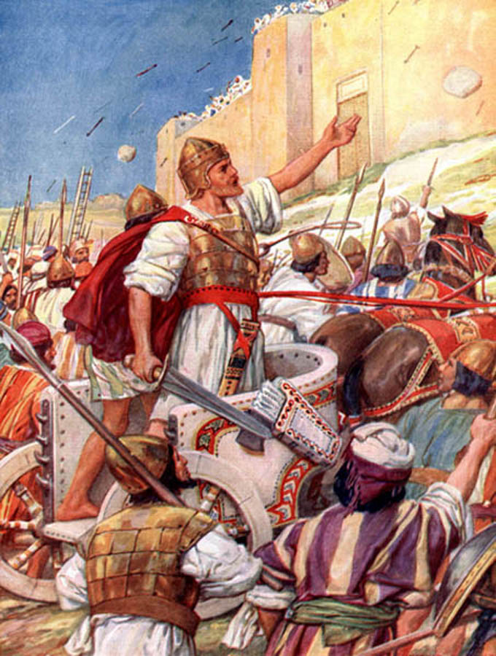
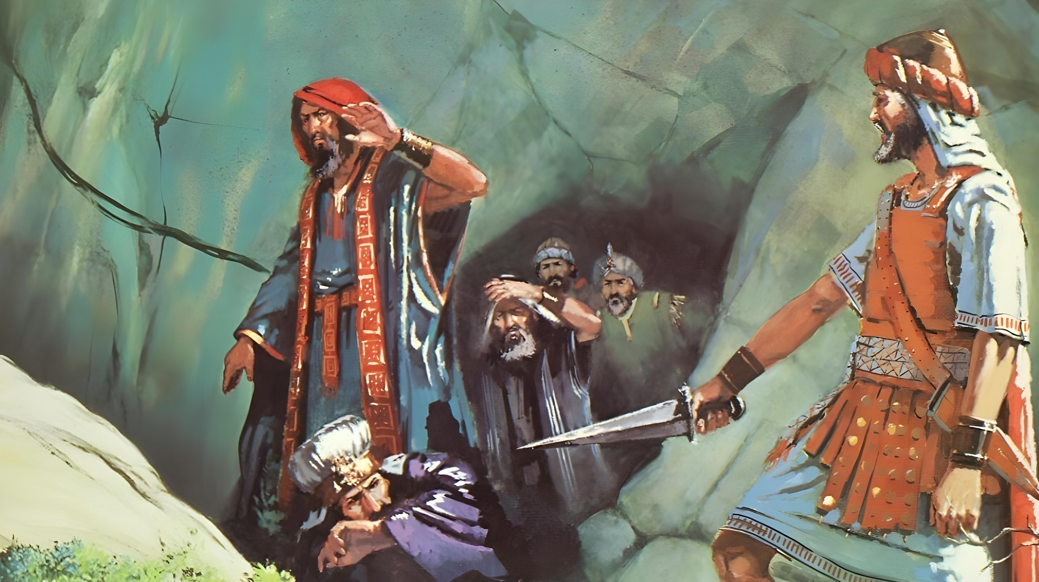
Ko e ngaahi ikuna ʻo ʻeku moʻuí ʻoku maʻu pē ia ke fakalāngilangiʻi ʻa e ʻOtuá.
ʻI he tui ʻa _________________na’a na ikunaʻi ai ʻa e ngaahi puleʻanga. (v. 33) [Nomipa 31:8; 2 Samuela 5:6-9]
Siosiua mo Tevita

Slide 24

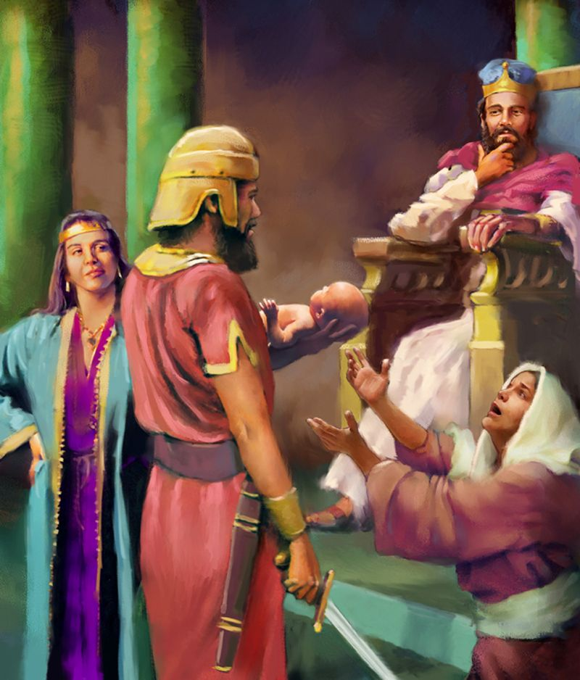
ʻOku foaki mai ʻe he ʻOtua kiate au ʻa e poto ke fai ʻa e fakamaau totonu.
ʻI he tui ʻa _________ na’a ne fai ai ʻa e maʻoniʻoni mo e fakamaau totonu ʻaki ʻa e poto naʻe talaʻofa ange ʻe he ʻOtua kiate ia.
ʻE lava ke fakakau ʻa e kau fakamaau mo e ngaahi tuʻi tokolahi ʻi he faʻahinga ko ʻeni. (v. 33) [1 Tuʻi 3:16-28]
Solomone
Notes:
Confío en la sabiduría que Dios le había dado.

Slide 25
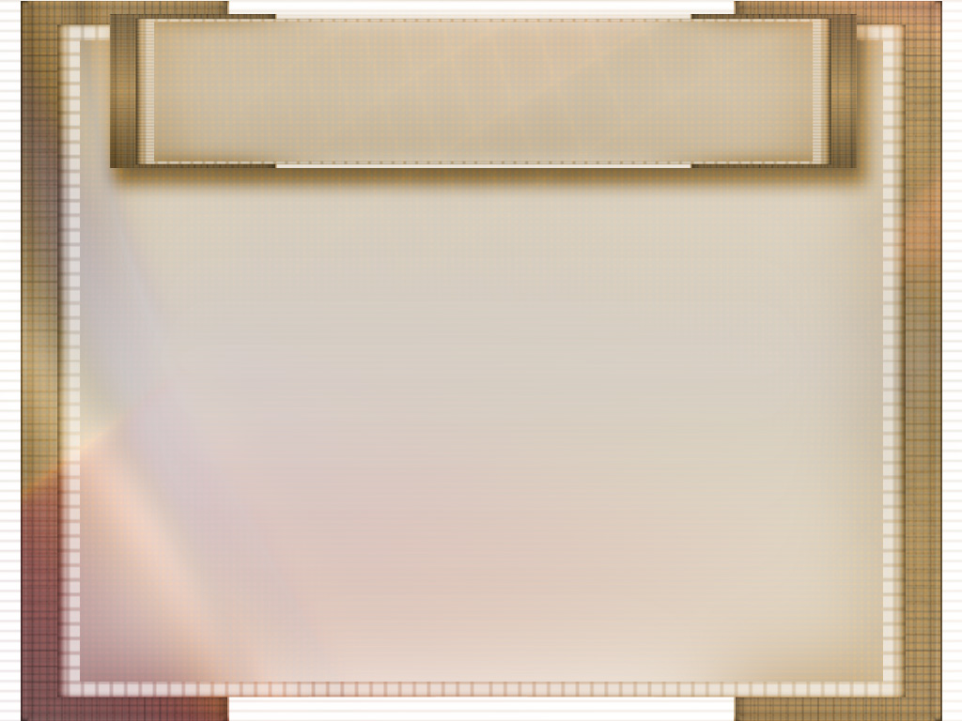
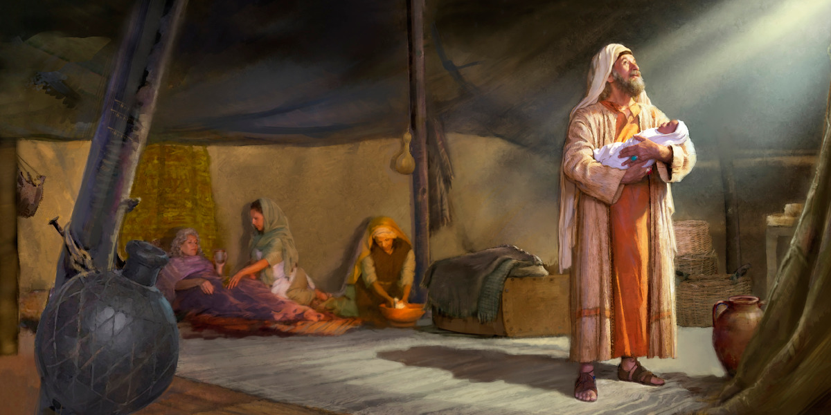
Naʻe ma’u ‘e ___________ e tui ʻa e talaʻofa naʻe fai ange ʻe he ʻOtua kiate ia. (v. 33) [Senesi 15:4; 21:2-5]
ʻEpalahame
ʻOku ou tui ʻoku fakahoko maʻu pe ʻa e ngaahi talaʻofa ʻa e ʻOtua.

Slide 26

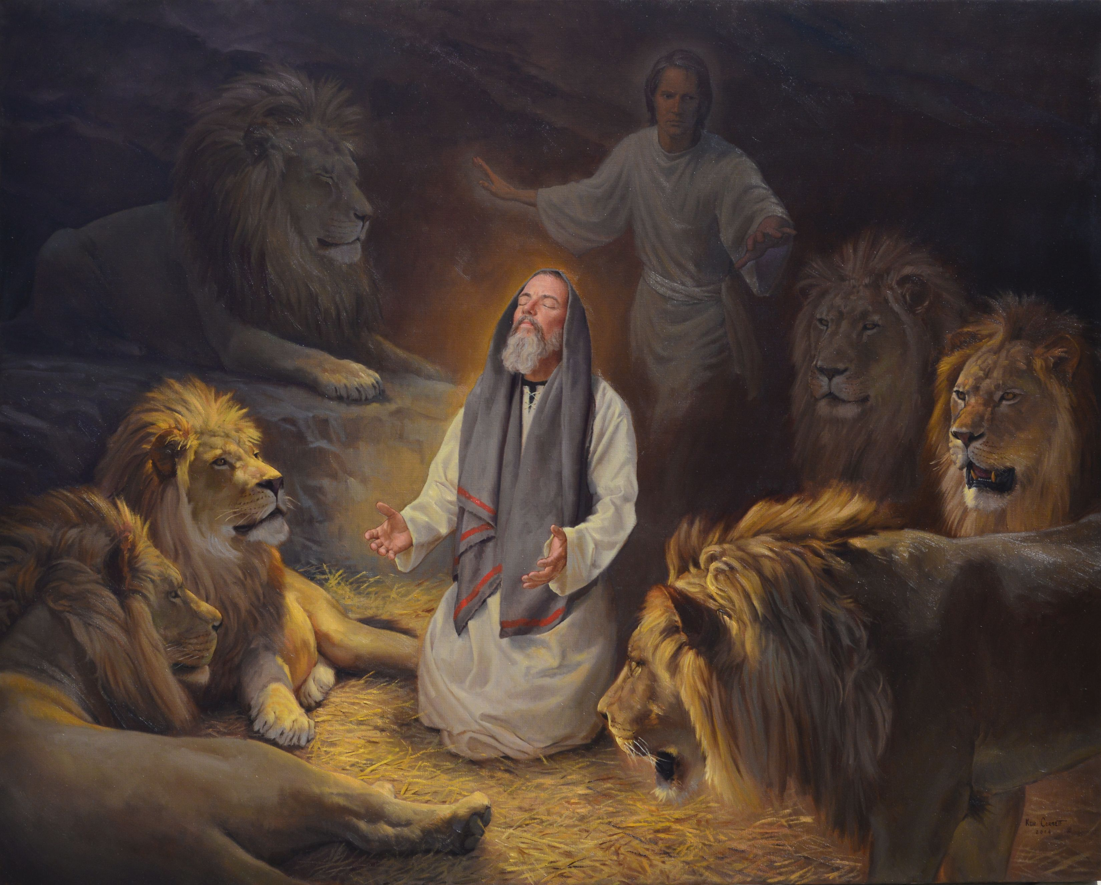
ʻOku ou ʻilo ʻe lava ke fakahaofi au ʻe he ʻOtua ʻo aʻu pe ki he mate pau.
ʻI he tui ʻa ______ na’a ne tapuni ai ʻa e ngutu ʻo e fanga laione.
(v. 33) [Taniela 6]
Taniela

Slide 27

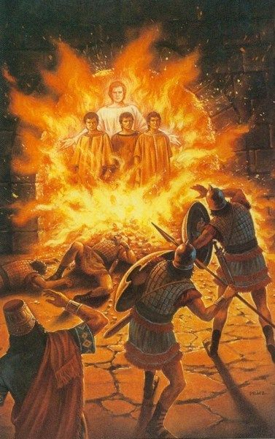
ʻI he ngaahi momeniti faingataʻa taha, ʻoku ou ʻiloʻi ʻoku ʻiate au ʻa e ʻOtua.
ʻI he tui __________________________________
naʻe ʻikai lavea ʻi he taimi naʻe li ai kinautolu ki ha ʻovani naʻe vela liunga fitu ʻi he angamaheni.
(v. 34) [Taniela 3]
Setaleki, Mesake, mo ʻApetenikoo

Slide 28

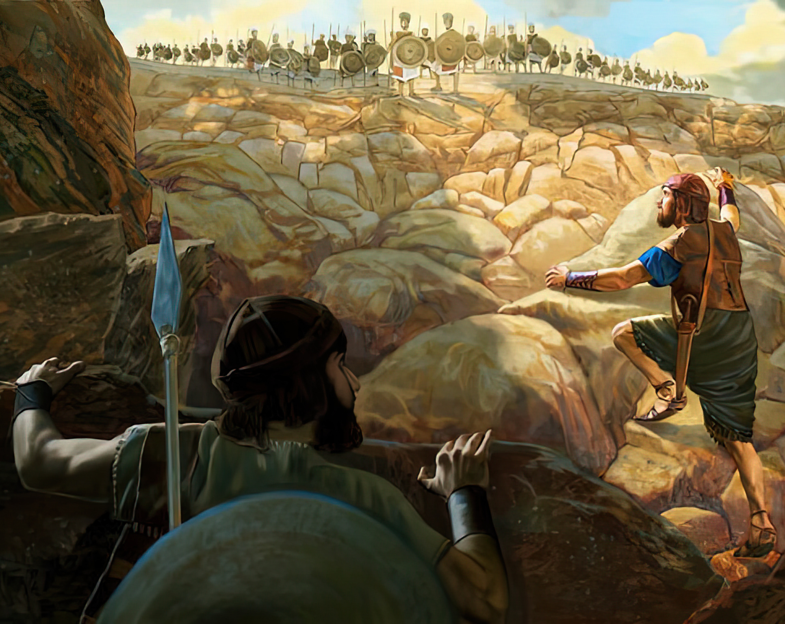
ʻI he tui ‘a _________ na’a ne hao ai mei he mata ʻo e heleta ʻi heʻene tauʻi ʻa e kau Filisitia, fakataha mo ʻene tangata toʻo teunga tau. (vahe 34) [1 Samiuela 14:1-23].
Sonatane
ʻOku ou ʻiloʻi ʻoku ʻomi ʻe he ʻOtuá ʻa e ikuná, ʻo tatau ai pē pe ʻoku tau tokosiʻi pe tokolahi.

Slide 29

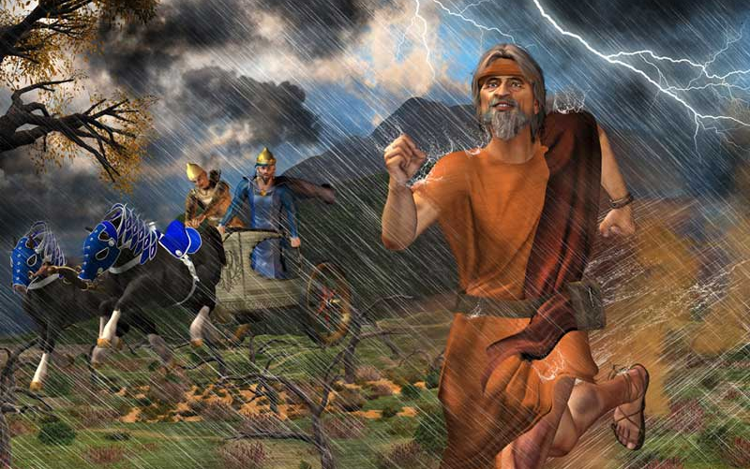
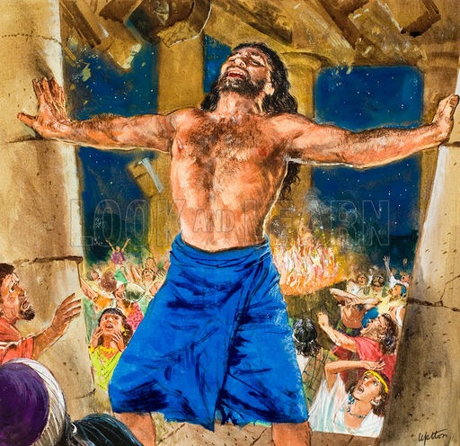
Ko ________________ na’a na maʻu ʻi he tui ʻa e malohi mei he vaivai. Hili ʻa e mana ʻo Kameli, naʻe lele ʻa ʻIlaisiaa ʻi muʻa ʻia ʻEhapi ʻa ia naʻe heka ʻi heʻene saliote. Naʻe kole ʻe Samisoni ki he ʻOtua ha malohi ke fakaʻauha ʻa e kau Filisitia. (v. 34) [1 Ngaahi Tuʻi 18:42-46] [Fakamaau 16:23-30]
ʻIlaisiā mo Samisoni
ʻOku foaki mai ʻe he ʻOtua ʻa e malohi ʻoku ou fie maʻu ʻi he ngaahi momeniti ʻo e vaivai.

Slide 30

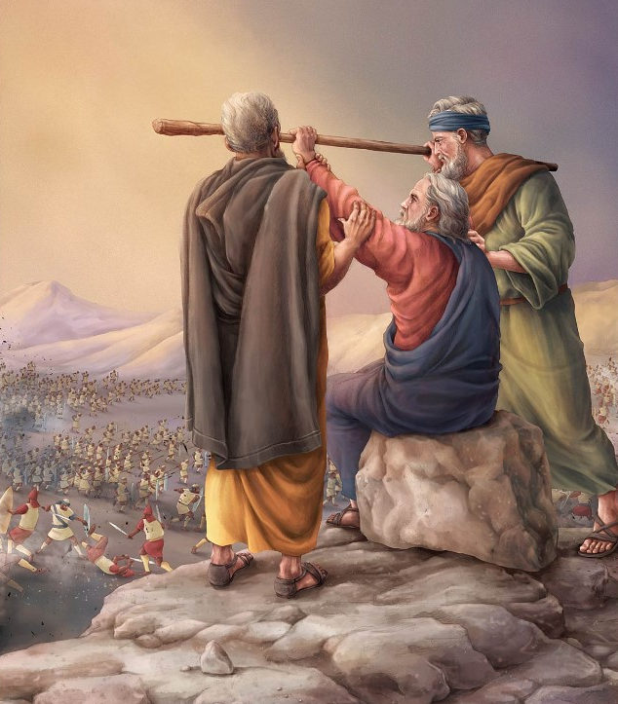
Siosiua
ʻI he tui ʻa _______na’a na hoko ai ʻo malohi ʻi he tau. Naʻa ne tau mo e kakai ʻo ʻIsileli mo ʻAmaleki. Naʻe ikuna ʻa ʻIsileli lolotonga ia naʻe hiki hake ʻe Mōsese ʻa hono nimá, ʻo poupouʻi ia ʻ e ʻElone mo Huá.
(v. 34) [ʻEkesotosi 17:8-13]
ʻOku ngaohi au ʻe he ʻOtua ke u malohi mo ʻomi kiate au ʻa e ikuna ʻi he taimi ʻoku ou falala ai kiate Ia.

Slide 31

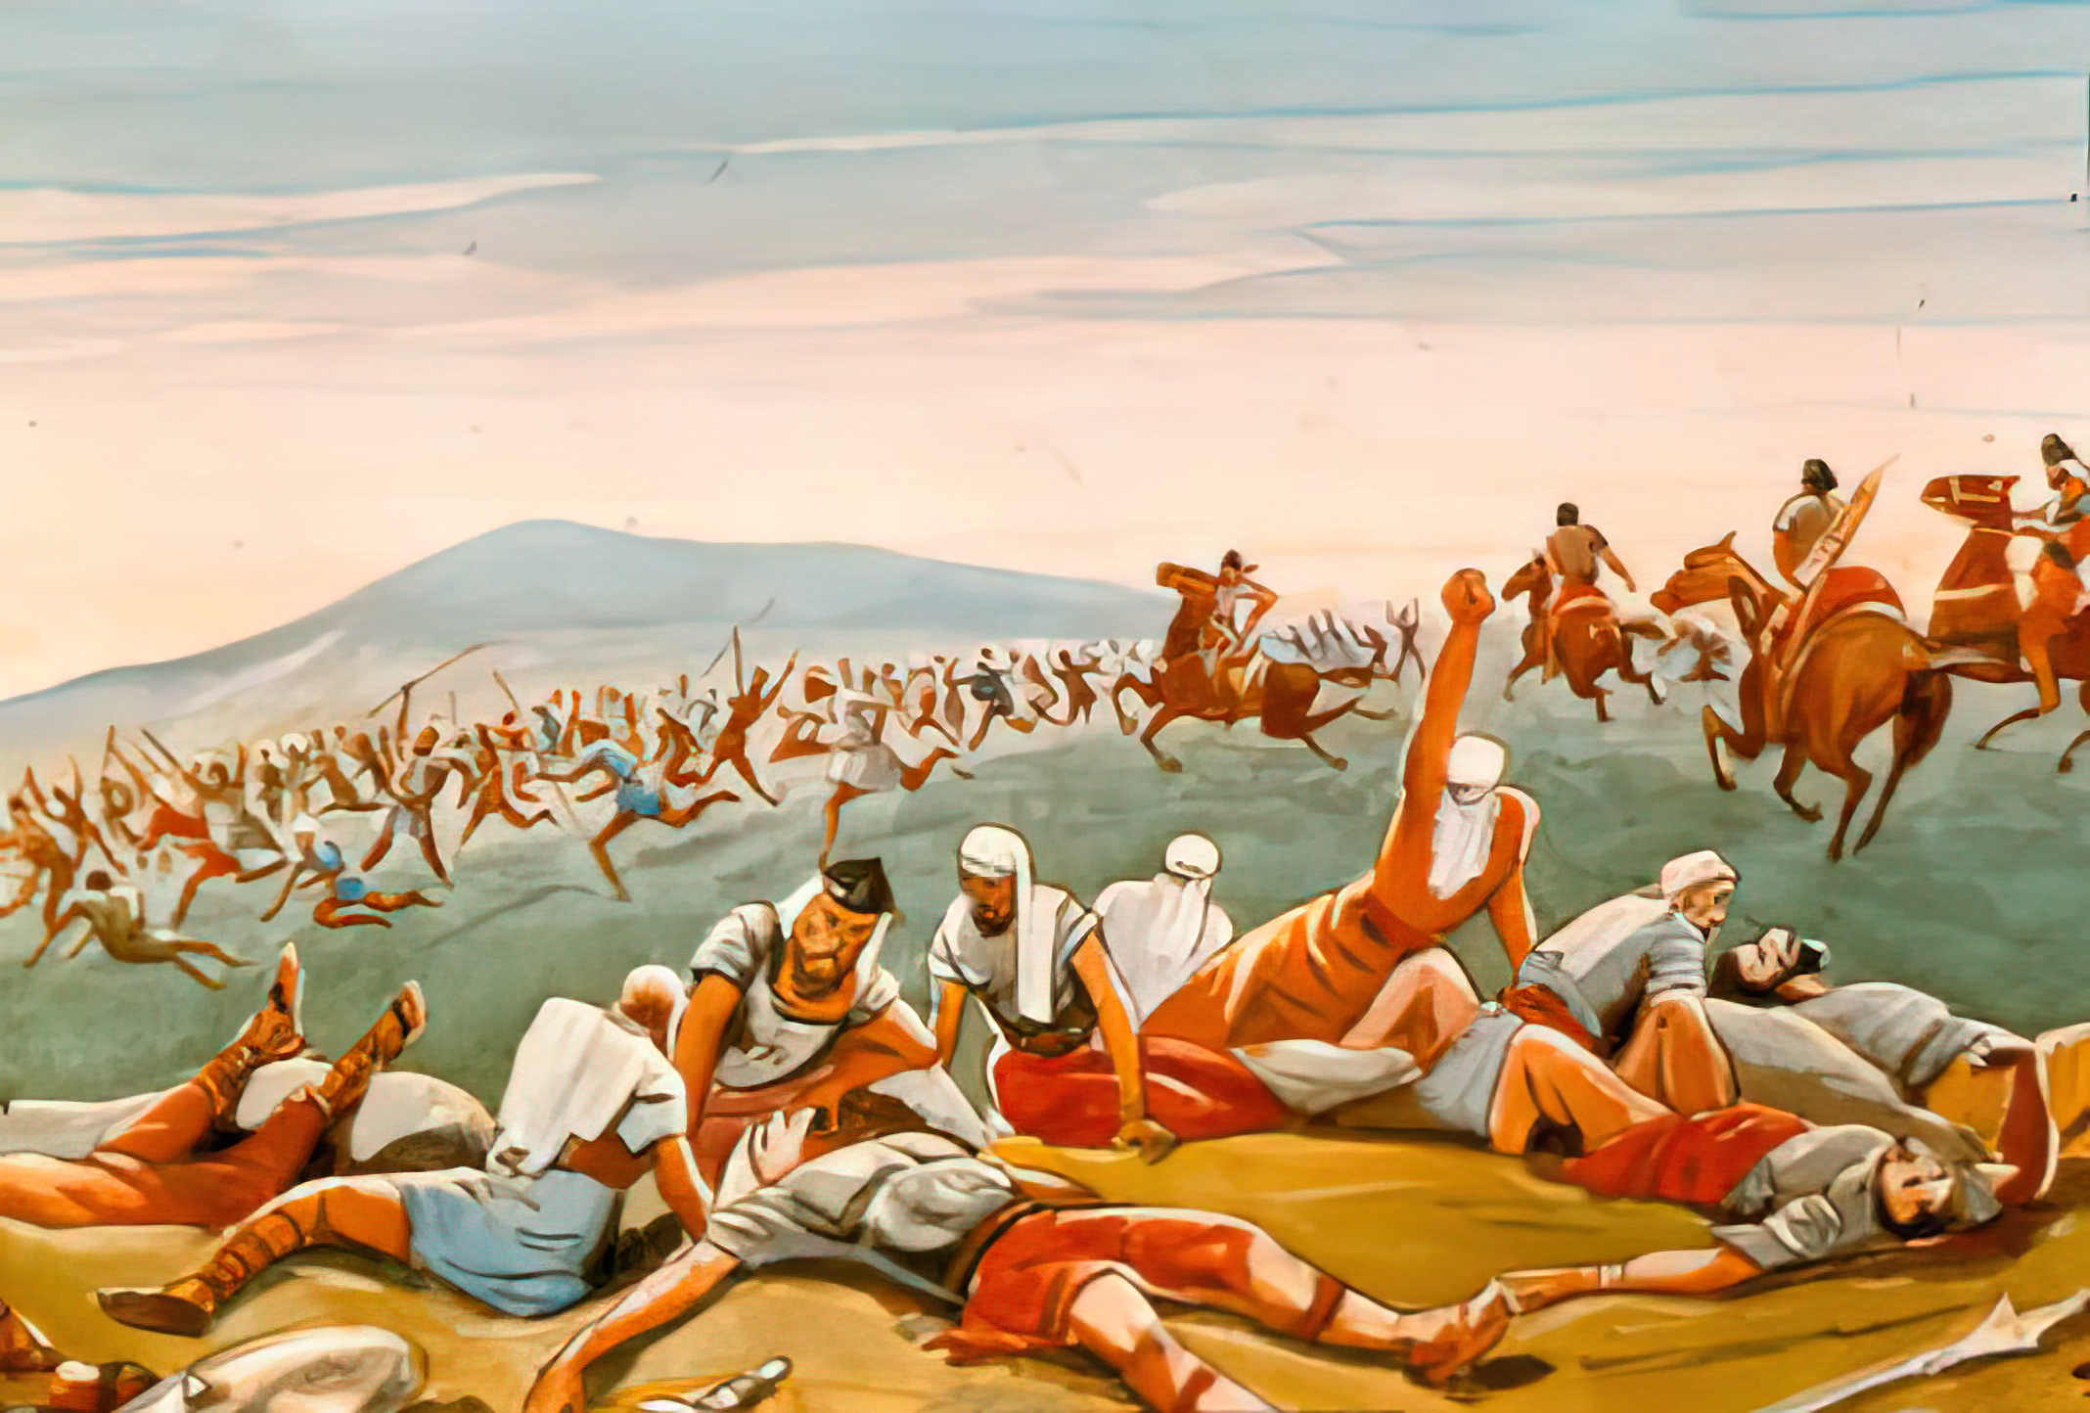
ʻOku hola ʻa e fili meiate au ʻi he huafa ʻo e ʻOtua.
ʻIa _____he tui naʻe hola ai ʻa e ngaahi kau tau muli ʻi he tui.
(v. 34) [2 Samuela 10: 6-14]
Soape

Slide 32

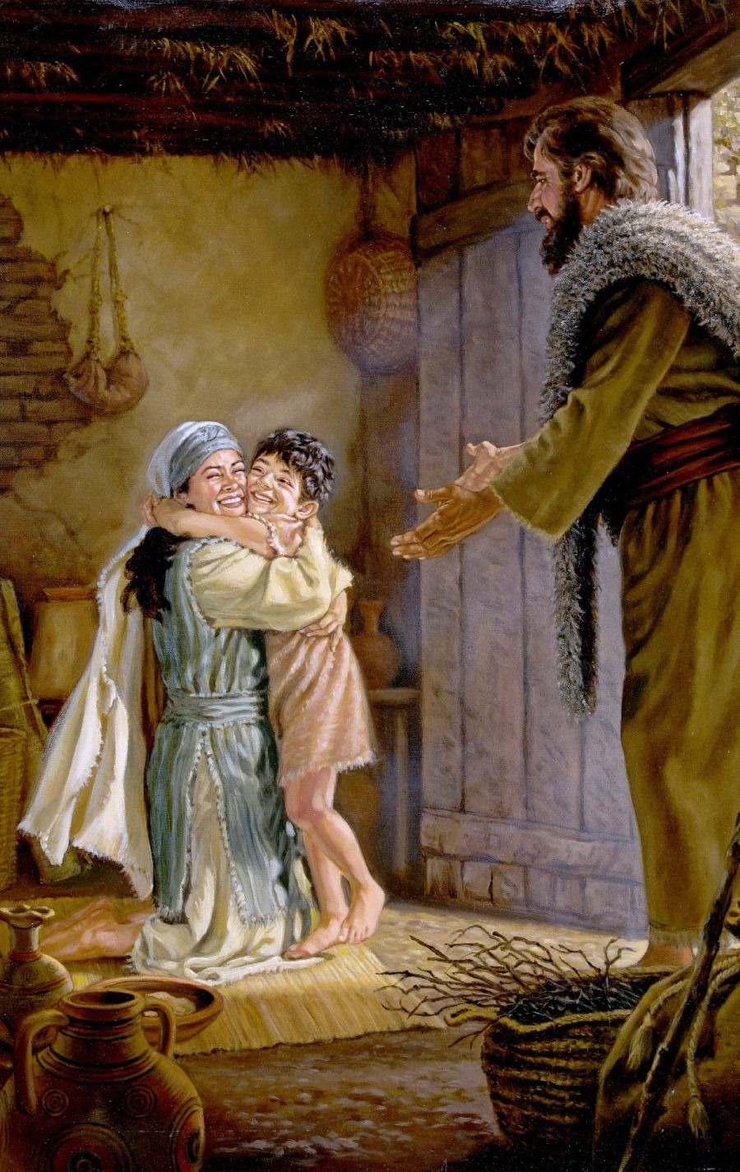
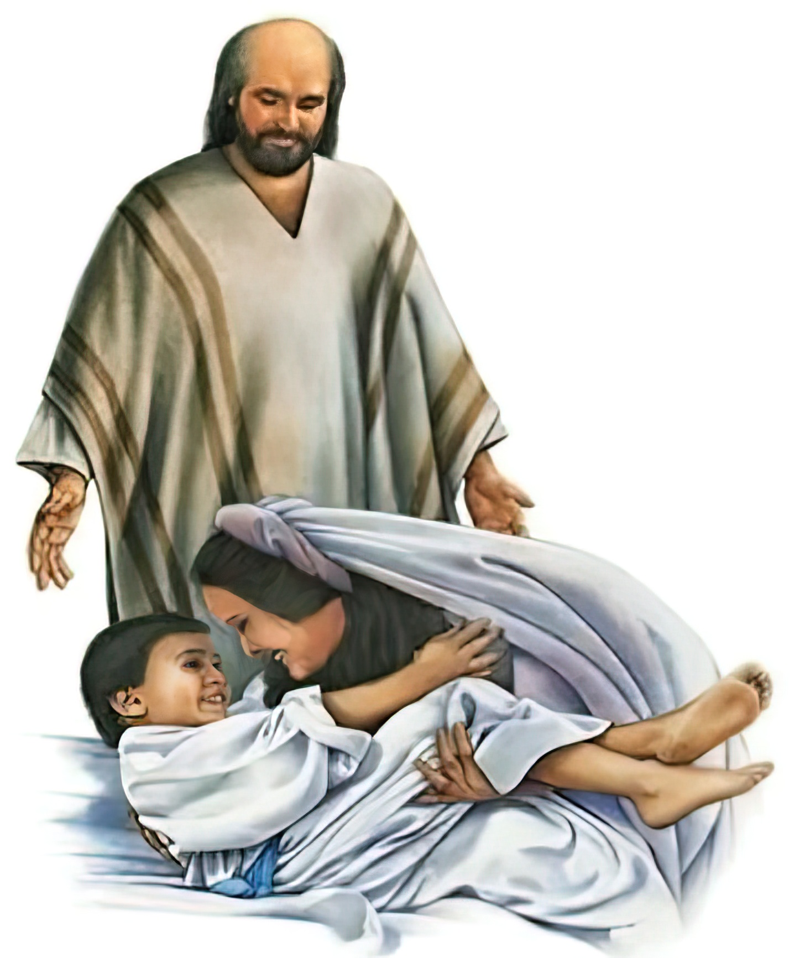
Naʻa mo e maté ʻ oku ʻ ikai ko ha palopalema ia ki he ʻ Otuá.
ʻI he tuí ʻa e _________________________________ tali ai honau kau maté kuo fokotuʻu hake ki he moʻuí.
(v. 35) [2 Ngaahi Tuʻi 4:18-37]
[1 Tuʻi 17:17-24]
fefine Sunemi .
pea mo e uitou ʻo Salifati

Slide 33

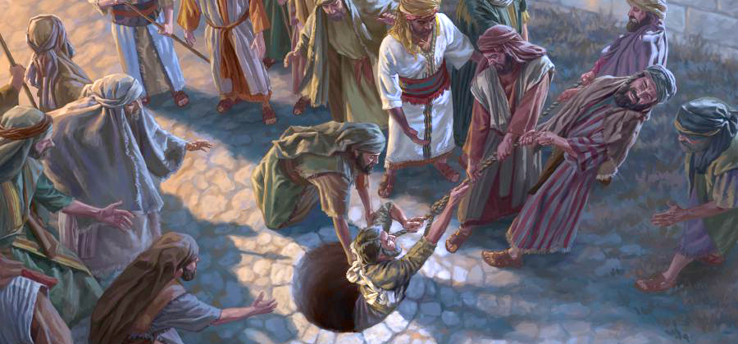
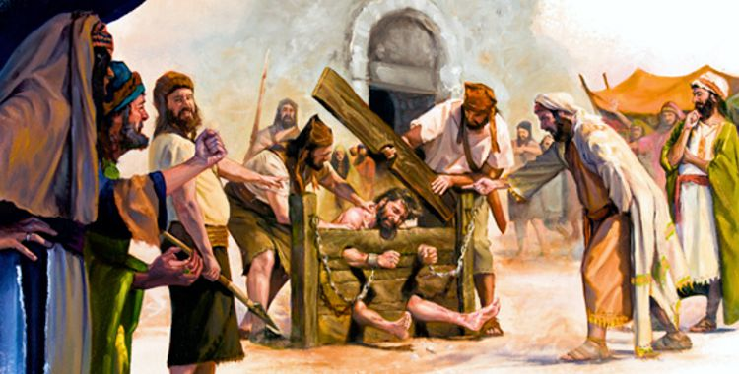
Te u tuʻu maʻu, ʻo aʻu pe ki he tuʻunga fakatuʻutamaki ʻo ʻeku moʻui, ʻo falala ki he toetuʻu.
Ko e tui naʻe fakamamahiʻi ai ʻa _________, ko e fakahaofi; koeʻuhi ke nau lava ʻo maʻu ha toetuʻu lelei ange. (v. 35)
[Selemia 20:2; 38:6]
Selemaia

Slide 34

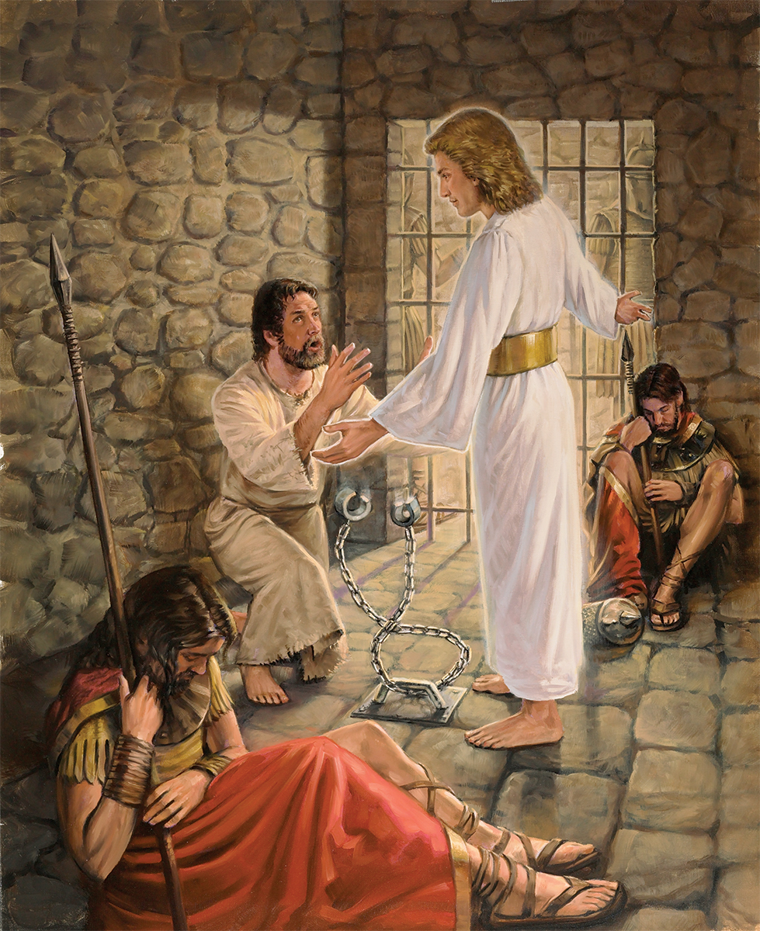

ʻI he lotolotonga ʻo e ngaahi palopalema, ʻoku ou mohe fiemalie pe hiva fiefia, ʻo falala ki he ʻOtua.
He naʻe faingataʻaʻia ʻa e tui ______, _______, ________, mo e ala meʻa pehee ʻi he ngaahi manuki mo e kauʻimaeaʻi, ʻa e ngaahi pilisone mo e fale fakapopula. (v. 36) [Senesi 37:13-24; Ngaue 12:1-19; Ngaue 16:19-24]
Siosefa
Pita
Paula

Slide 35



Kapau kuo pau ke u mate ke u kei faivelenga, pe ke fakamoʻoni ki he moʻoni, he ʻikai ke u veiveiua.
He naʻe tolomakaʻi ʻa ______________________ mo _________ ʻi he tui.
(v. 37) [1 Tu‘i 21:1-16; Ngāue 7:59 .]
Napoti koe tangata Sesilili
Sitīveni

Slide 36


Isaia
ʻI he tui naʻa ______ mate ai ʻo kili ua.. (fakatatau ki he talatukufakaholo). (v. 37) (ST Fepueli 17, 1898)
ʻOku tatau ai pe pe ko e ha ʻa e faʻahinga mate te ke fehangahangai mo ia. Te u faivelenga ki he ʻOtua.

Slide 37



Te u tuʻu maʻu ʻi he taimi ʻe siviʻi ai ʻeku tui.
Ko e tui naʻe siviʻi ai ___________________ ʻi he meʻa te nau kai. (v. 37) [Taniela 1]
Taniela mo hono ngaahi kaungameʻa

Slide 38




Neongo kapau te u mate taʻetotonu ʻi heʻeku faingataʻaʻia ʻi he houhau ʻa e niʻihi kehe, ʻoku fakapapauʻi ʻeku pale.
ʻI he tui naʻe tamateʻi ai ʻa e _________ taulaʻeiki ʻo _____ mo _______, ʻa e tokoua ʻo Sione ʻi he heleta. (v. 37) [1 Samuela 22:6-23; Selemaia41:2; Ngaue 12:1-2]
Ketalia
Nopi
Semisi

Slide 39


Ko e tui naʻe ʻalu holo ai ʻa _______________, fakataha mo ha niʻihi tokolahi, ʻi he ngaahi sipi mo e kiliʻi kosi, ʻi he masiva, faingataʻaʻia, mo fakamamahiʻi. (v. 37)
[Matiu 3:1-6]
Sione Papitaiso
Te u malangaʻi ʻa e popoaki kuo pau ke u ʻoatu, ʻo tatau ai pe pe ko e ha hoku tukunga fakatautaha.

Slide 40



Neongo ʻoku ou faingataʻaʻia he taimi ni, ka ʻoku ou ʻiloʻi ʻe aʻu ki ha taimi, ʻe fakahoko ʻe he ʻOtua ʻa e meʻa naʻa Ne talaʻofa mai.
ʻI he tuí naʻe hēhētuʻu ai ʻa ______ ʻi he ngaahi toafá, mo e ngaahi moʻungá, mo e ngaahi ʻana mo e ngaahi ʻana ʻo e māmaní, ʻo ne falala, ʻi he taimi te ne loto ki aí, ʻe foaki ange ʻe he ʻOtuá kiate ia ʻa e puleʻangá.(v. 38) [1 Samuela 24]
Tevita

Slide 41



‘I he tui ___________________
(Tuku heni ho hingoa)
ʻOku ou ʻamanaki te u ikuna pea te u fetaulaki mo Sīsū ʻi ha taimi vave ʻaupito, ʻi he Māmani Foʻoú, ʻo taʻengata.

Slide 42

Pea ko e tui naʻe maʻu ai ʻekinautolu ni kotoa pē ʻae ongoongolelei, ka naʻe ʻikai lavaʻi ʻae talaʻofa: Ko e meʻa ʻi he teuteu ʻe he ʻOtua ʻae meʻa lelei hake moʻotautolu, ke ʻoua naʻa fakahaohaoa ʻakinautolu taʻekau ai ʻakitautolu. (Hepelu 11:39-40)

