Slide 1
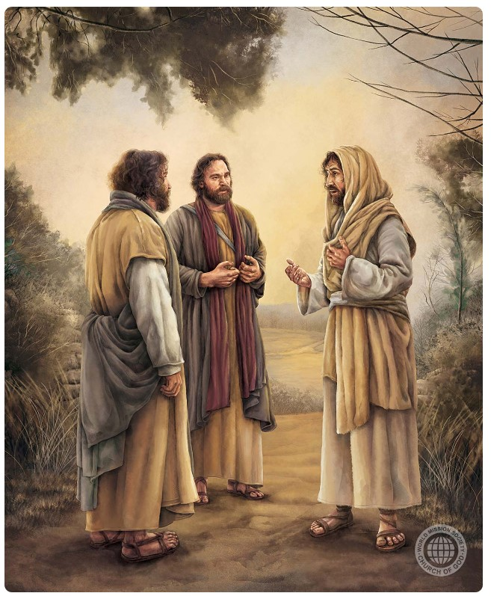
“Pea pehē ʻe ia kiate kinautolu, “Ko eni ʻae ngaahi lea naʻaku lea ʻaki kiate kimoutolu ʻi heʻeku kei ʻiate kimoutolu, koeʻuhi ke fakamoʻoni ʻae ngaahi meʻa kotoa pē, ʻaia kuo tohi kiate au, ʻi he fono ʻa Mōsese, mo e kau palōfita, mo e ngaahi Saame.”Pea toki toʻo ʻe ia ʻa honau loto, koeʻuhi ke nau ʻilo ʻae ngaahi tohi,”
(Luke 24:44, 45)

Slide 2
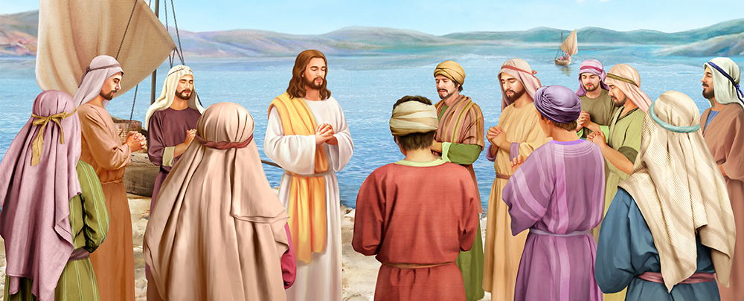
“Pea naʻe pehē, naʻe lotu ia ʻi he potu ʻe taha, pea hili ia, naʻe pehē ʻe he tokotaha ʻo ʻene kau ākonga kiate ia, “ʻEiki, akonakiʻi ʻakimautolu ke lotu, ʻo hangē ko e ako ʻa Sione ki heʻene kau ākonga.” (Luke 11:1)

Slide 3
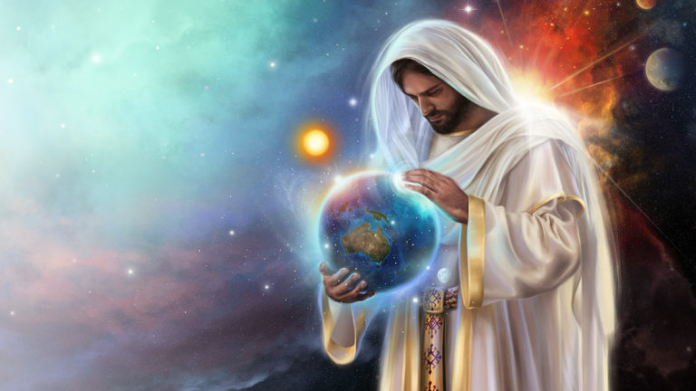
“Oku pule ʻa Sihova, ʻoku kofuʻaki ia ʻae nāunau lahi;
ʻoku kofuʻaki ʻa Sihova ʻae māfimafi,
ʻaia kuo ne nonoʻo ʻaki ia kuo fokotuʻumaʻu foki ʻa māmani,
pea ʻe ʻikai faʻa ueʻi ia.”
(Saame 93:1)

Slide 4
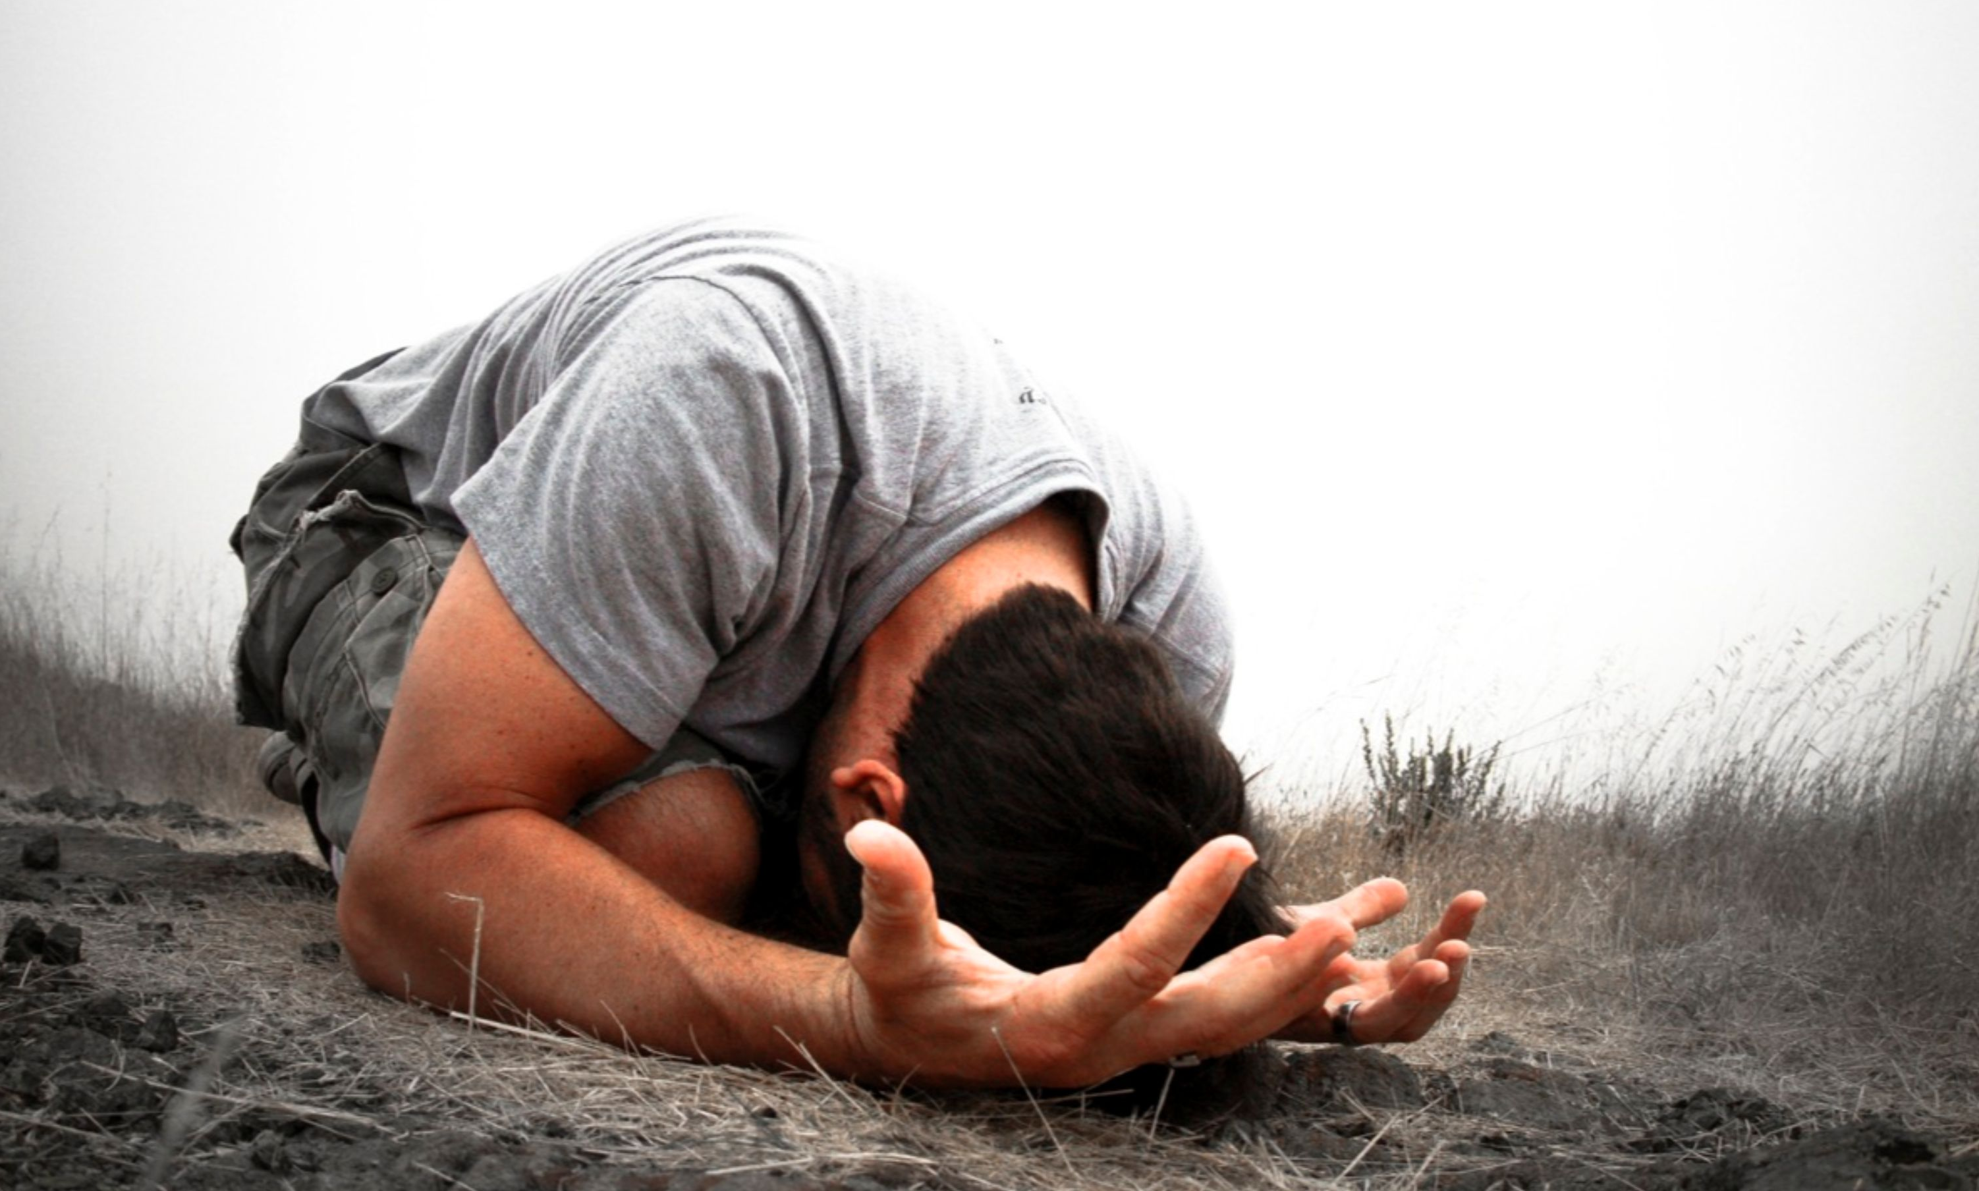
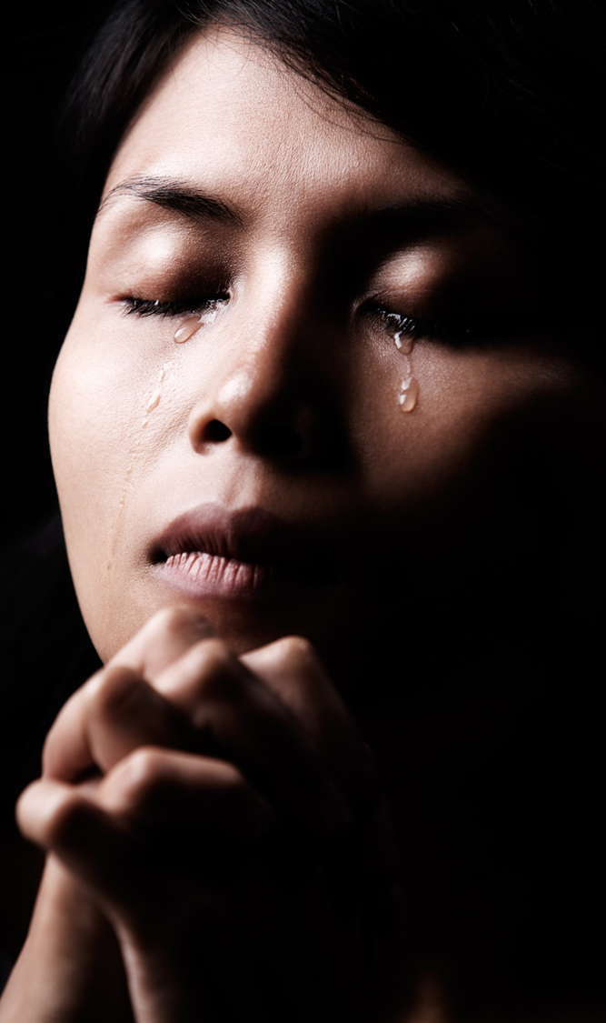
“ʻOku tangi ʻae māʻoniʻoni, pea ongoʻi ʻe Sihova,
ʻo ne fakamoʻui ʻakinautolu mei heʻenau ngaahi mamahi kotoa pē.” (Saame 34:17)

Slide 5
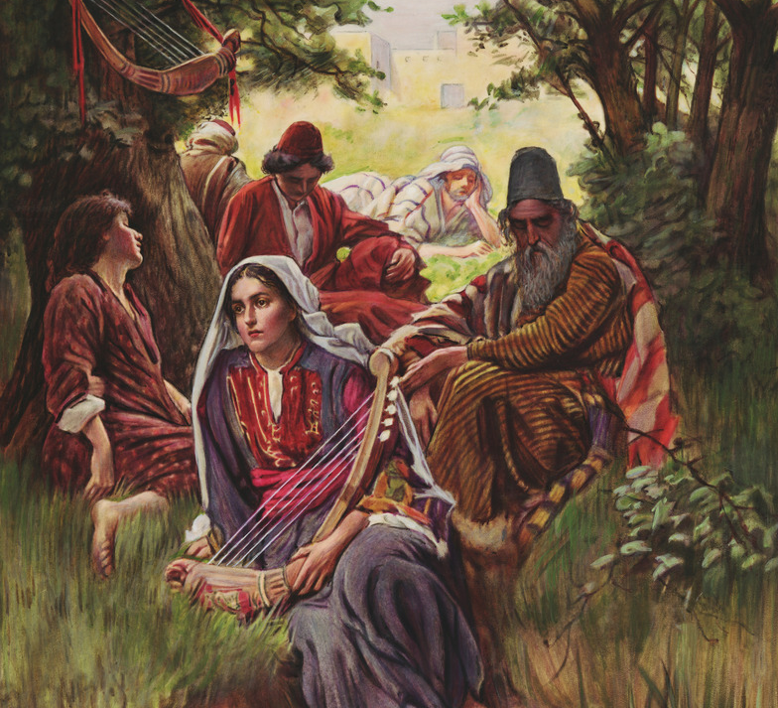
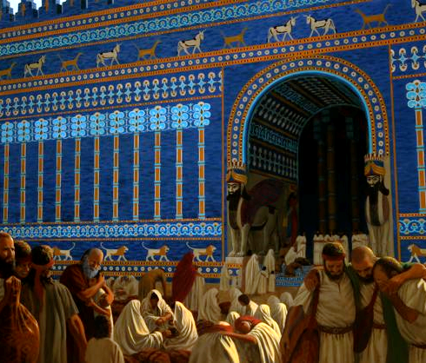
“ʻE fēfē ʻemau hiva ʻaki ʻae hiva ʻa Sihova ʻi he fonua ʻoe muli?”
(Saame 137:4)

Slide 6
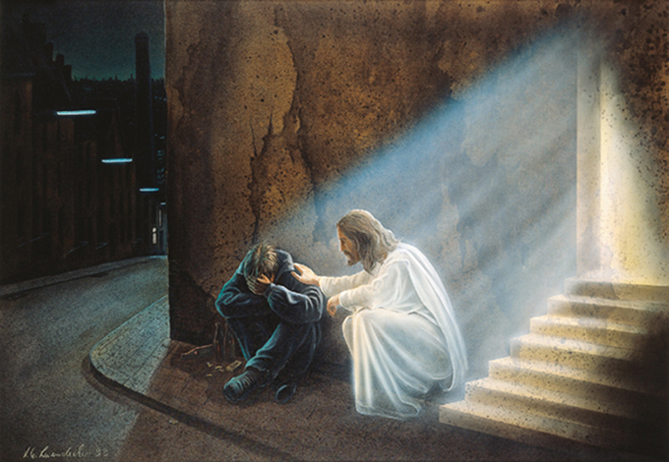
ʻOku pehē ʻe Sihova, “Ko e meʻa ʻi he fakamālohiʻi ʻoe masiva, mo e ngaahi mafulu ʻoe vaivai,
te u tuʻu hake;”
(Saame 12:5)

Slide 7

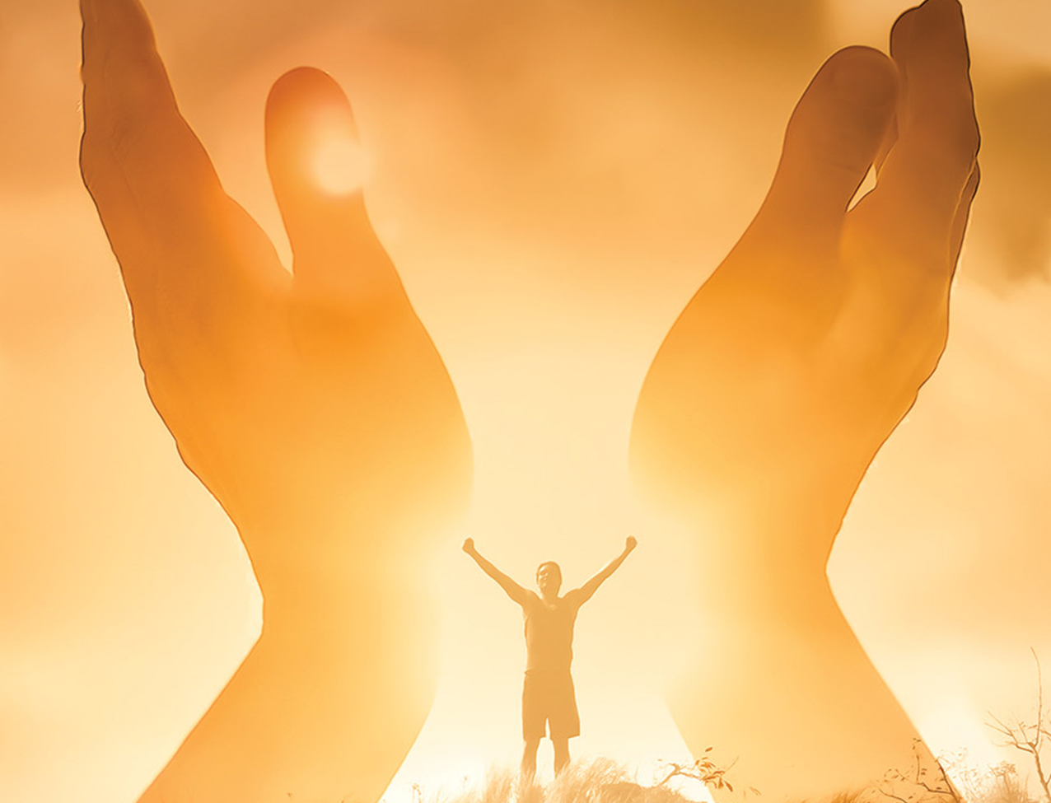
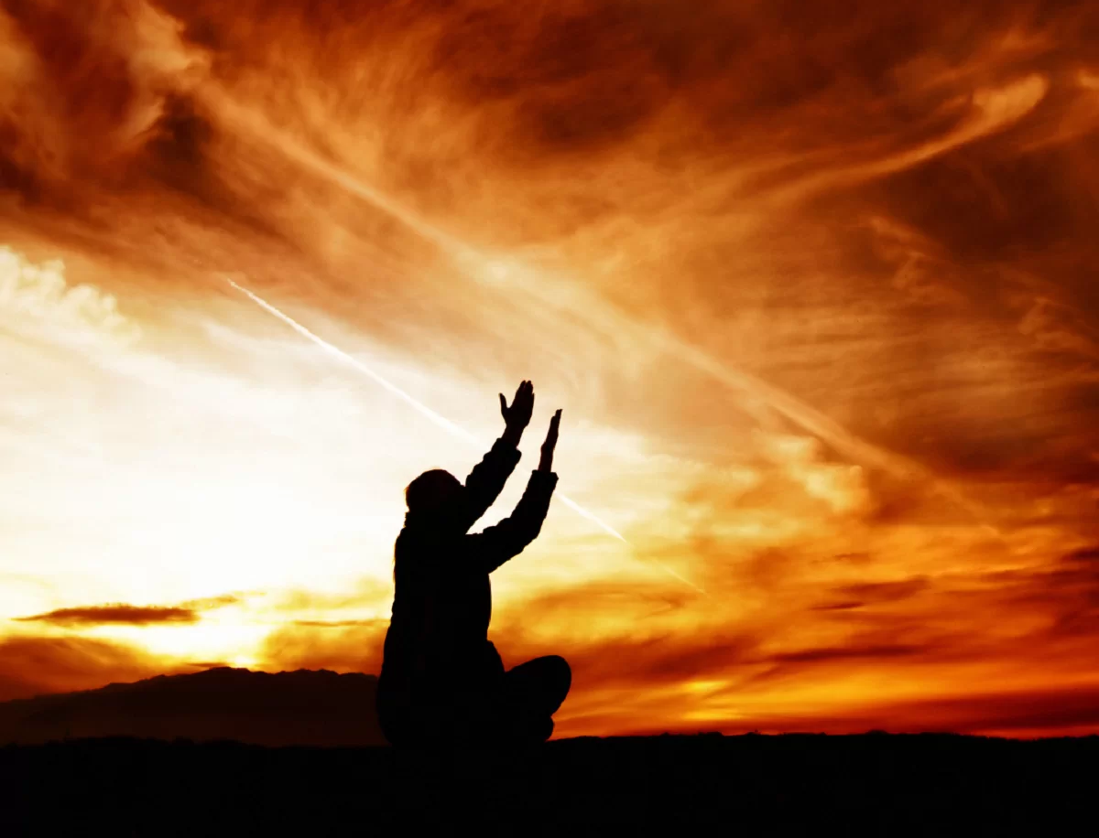
“‌ʻE ʻEiki, te u fakamālō kiate koe ʻi he ʻao ʻoe kakai:
te u hiva kiate koe ʻi he ngaahi puleʻanga.
He ʻoku lahi hoʻo ʻaloʻofa ʻo aʻu ki he ngaahi langi,
mo hoʻo moʻoni ki he ngaahi ʻao.”
(Saame 57:9, 10)

Slide 8
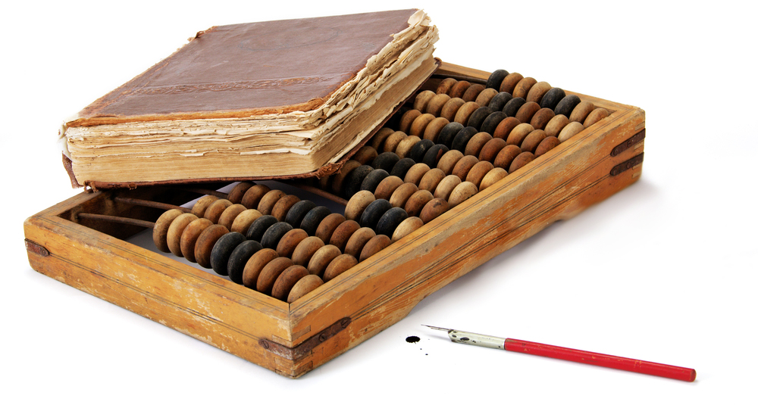

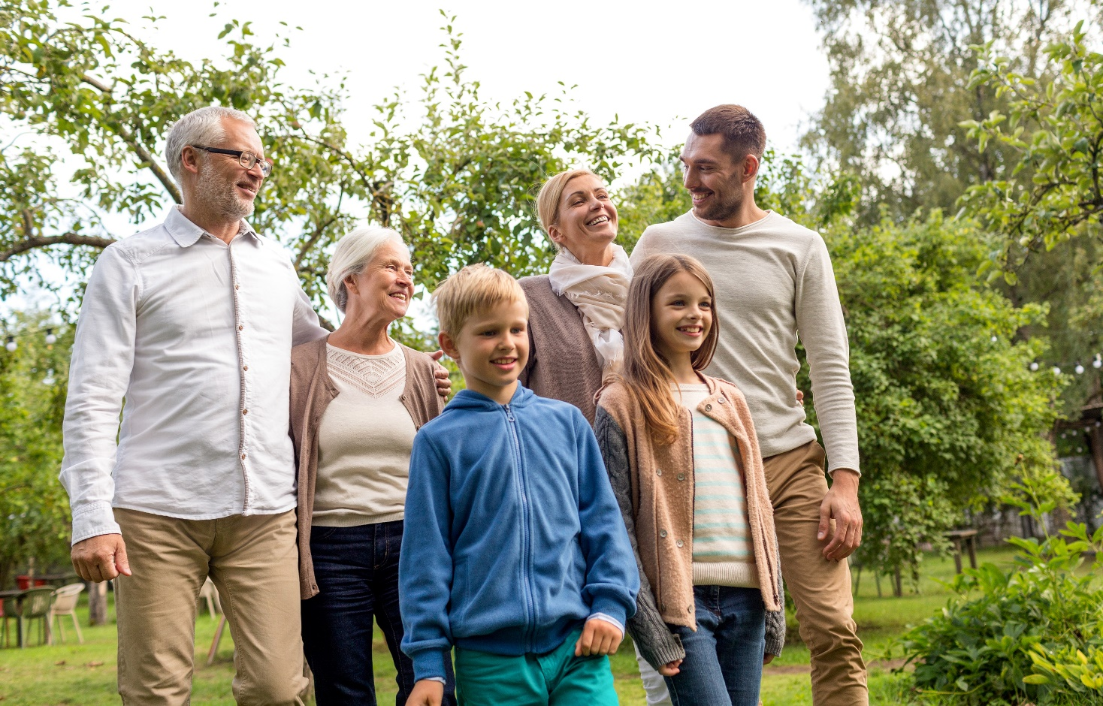
“Ke pehē hoʻo akonakiʻi ʻakimautolu ke mau lau homau ngaahi ʻaho,
koeʻuhi ke mau fakatokangaʻi homau loto ki he poto.”
(Saame 90:12)

Slide 9
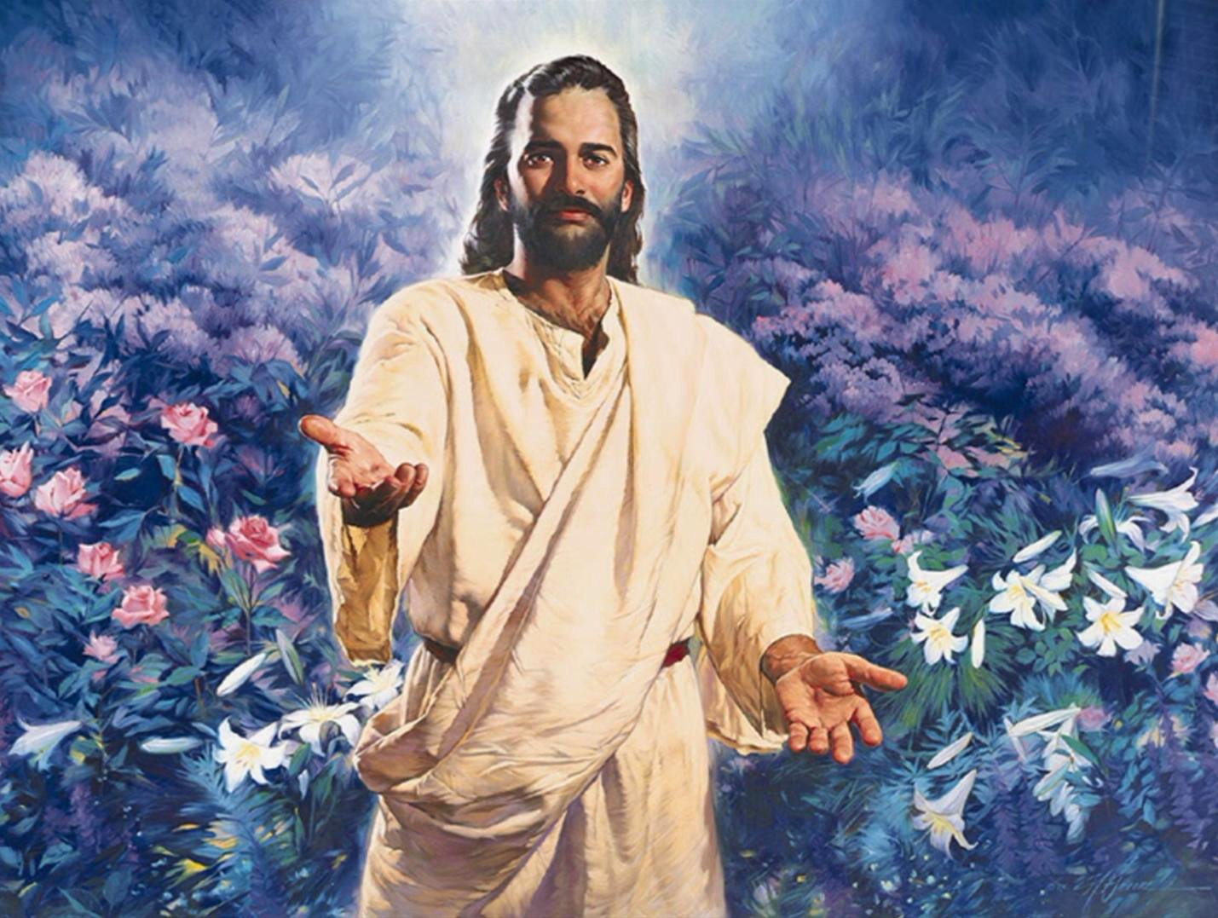
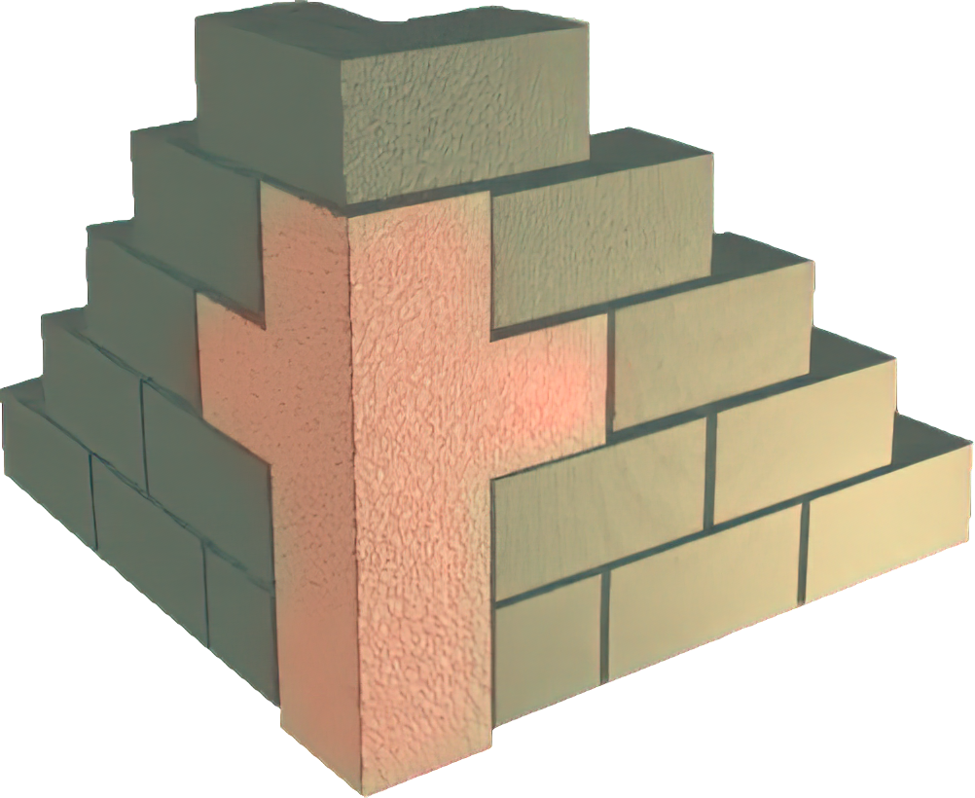
“Ko e maka naʻe liʻaki ʻe he kau tufunga kuo hoko ia ko e fungani maka ʻoe tuliki.Ko e ngāue eni ʻa Sihova;
pea ko e meʻa fakaofo ʻi hotau ʻao.”
(Saame 118:22, 23)

Slide 10
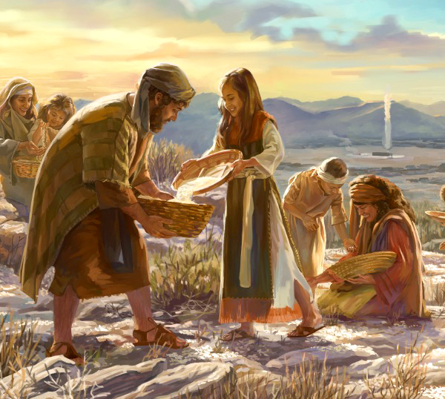
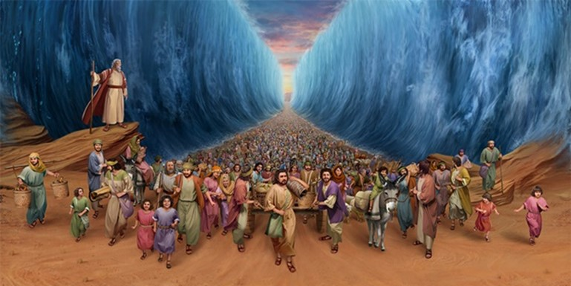
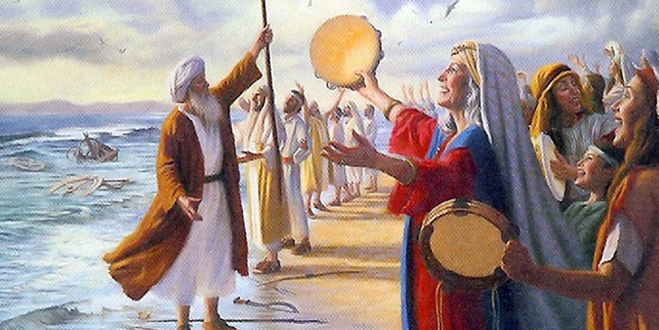
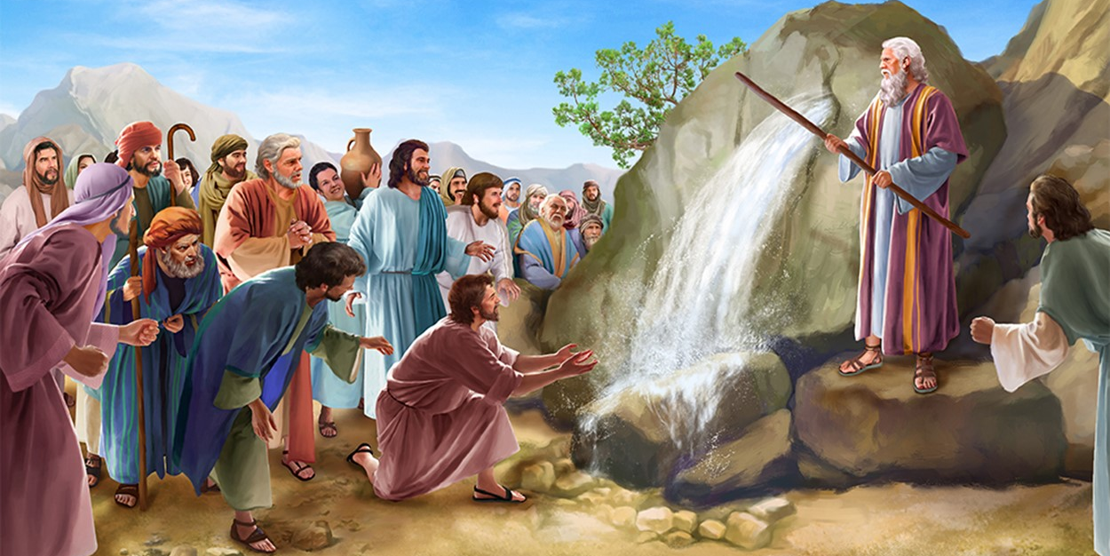
“‌ʻAia kuo tau fanongo ki ai pea ʻiloʻi,
pea naʻe tala ia kiate kitautolu ʻe heʻetau ngaahi tamai.‌ʻE ʻikai te tau fufū ia mei heʻenau fānau,ka ʻe fakahā ki he toʻutangata ʻe hoko ʻae ongoongolelei ʻo Sihova,mo hono mālohi, mo e ngaahi ngāue mana naʻa ne fai.” (Saame 78:3, 4)

Slide 11
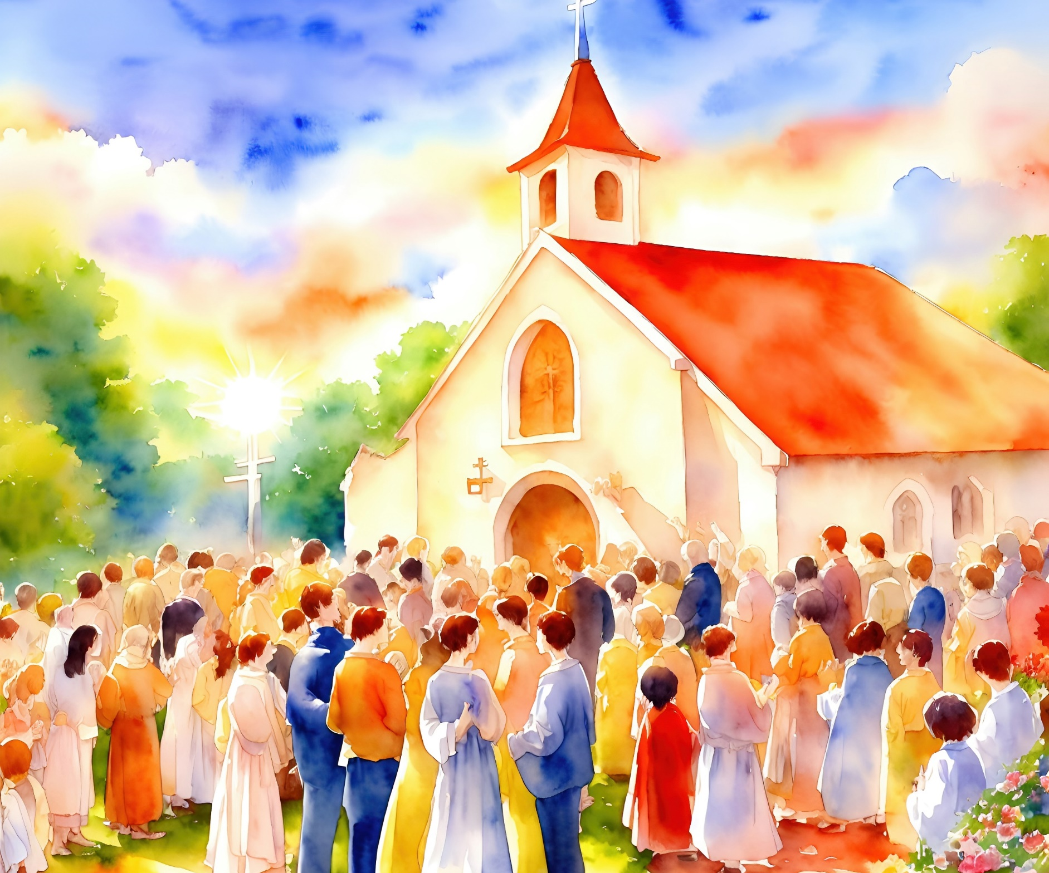
“ʻE fēfē hono fuoloa mo hoʻomou fakamaau taʻetotonu,
pea filifilimānako ki he kakai angahala?”
(Saame 84:2)

Slide 12
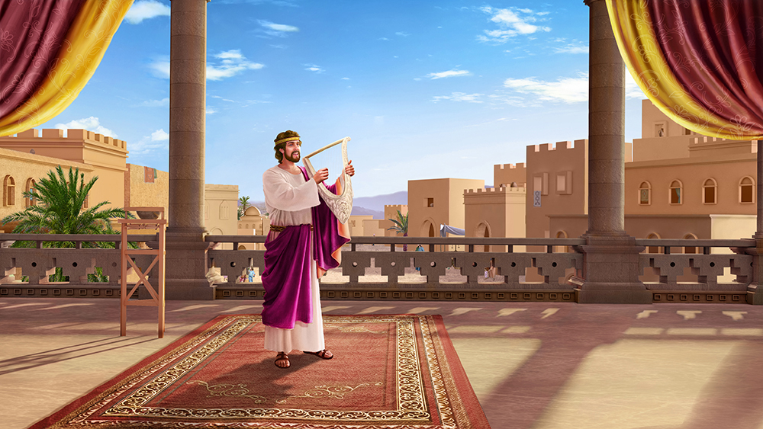
“Te u hiva kia Sihova ʻi heʻeku kei moʻui: te u hiva fakamālō ki hoku ʻOtua ʻi he lolotonga ʻo ʻeku moʻui.” (Saame 104:33)

Slide 13
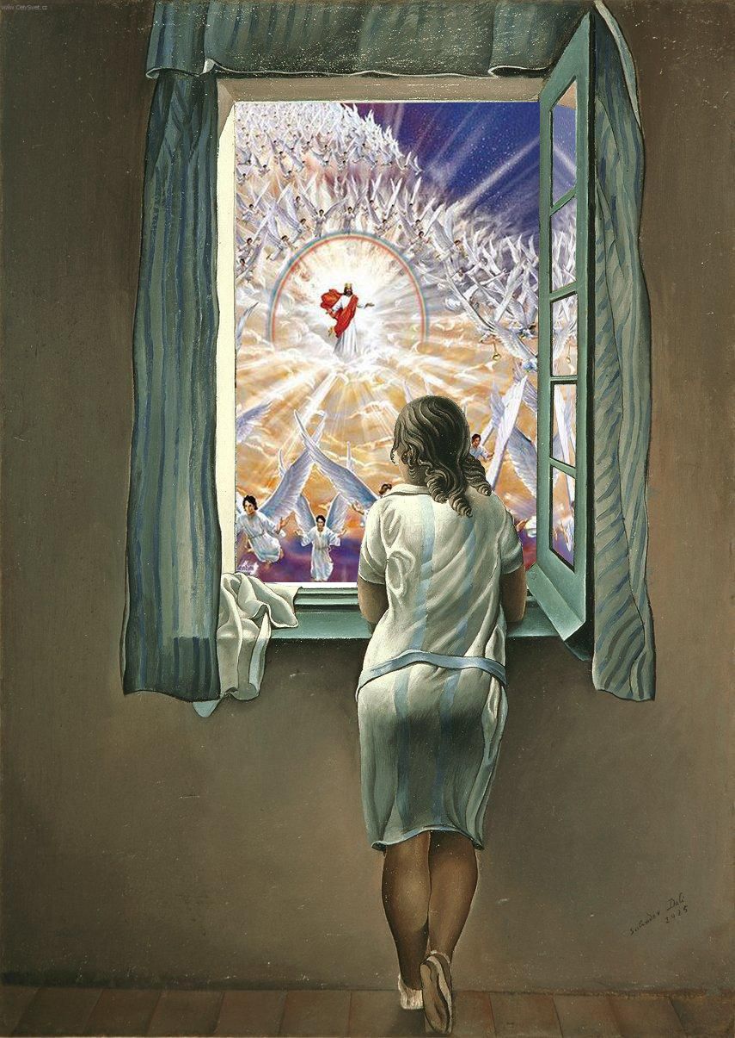
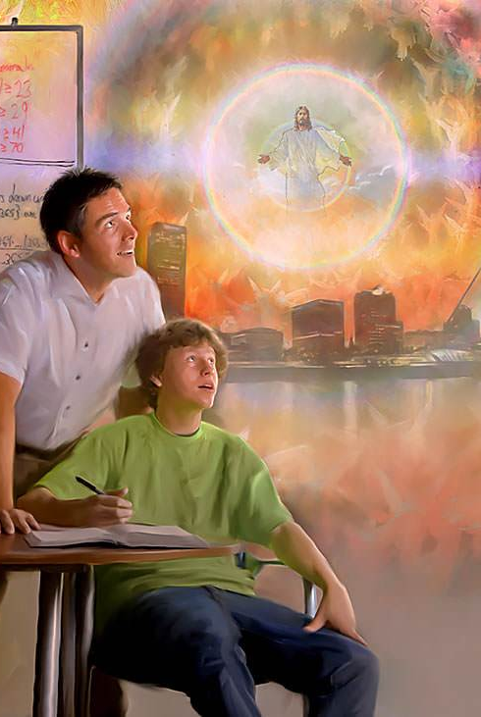
“‌ʻAmanaki lelei kia Sihova:
pea ke lototoʻa, pea te ne fakamālohi ho loto:
ʻoku ou pehē, ʻamanaki lelei kia Sihova.!”
(Saame 27:14)

