Slide 1
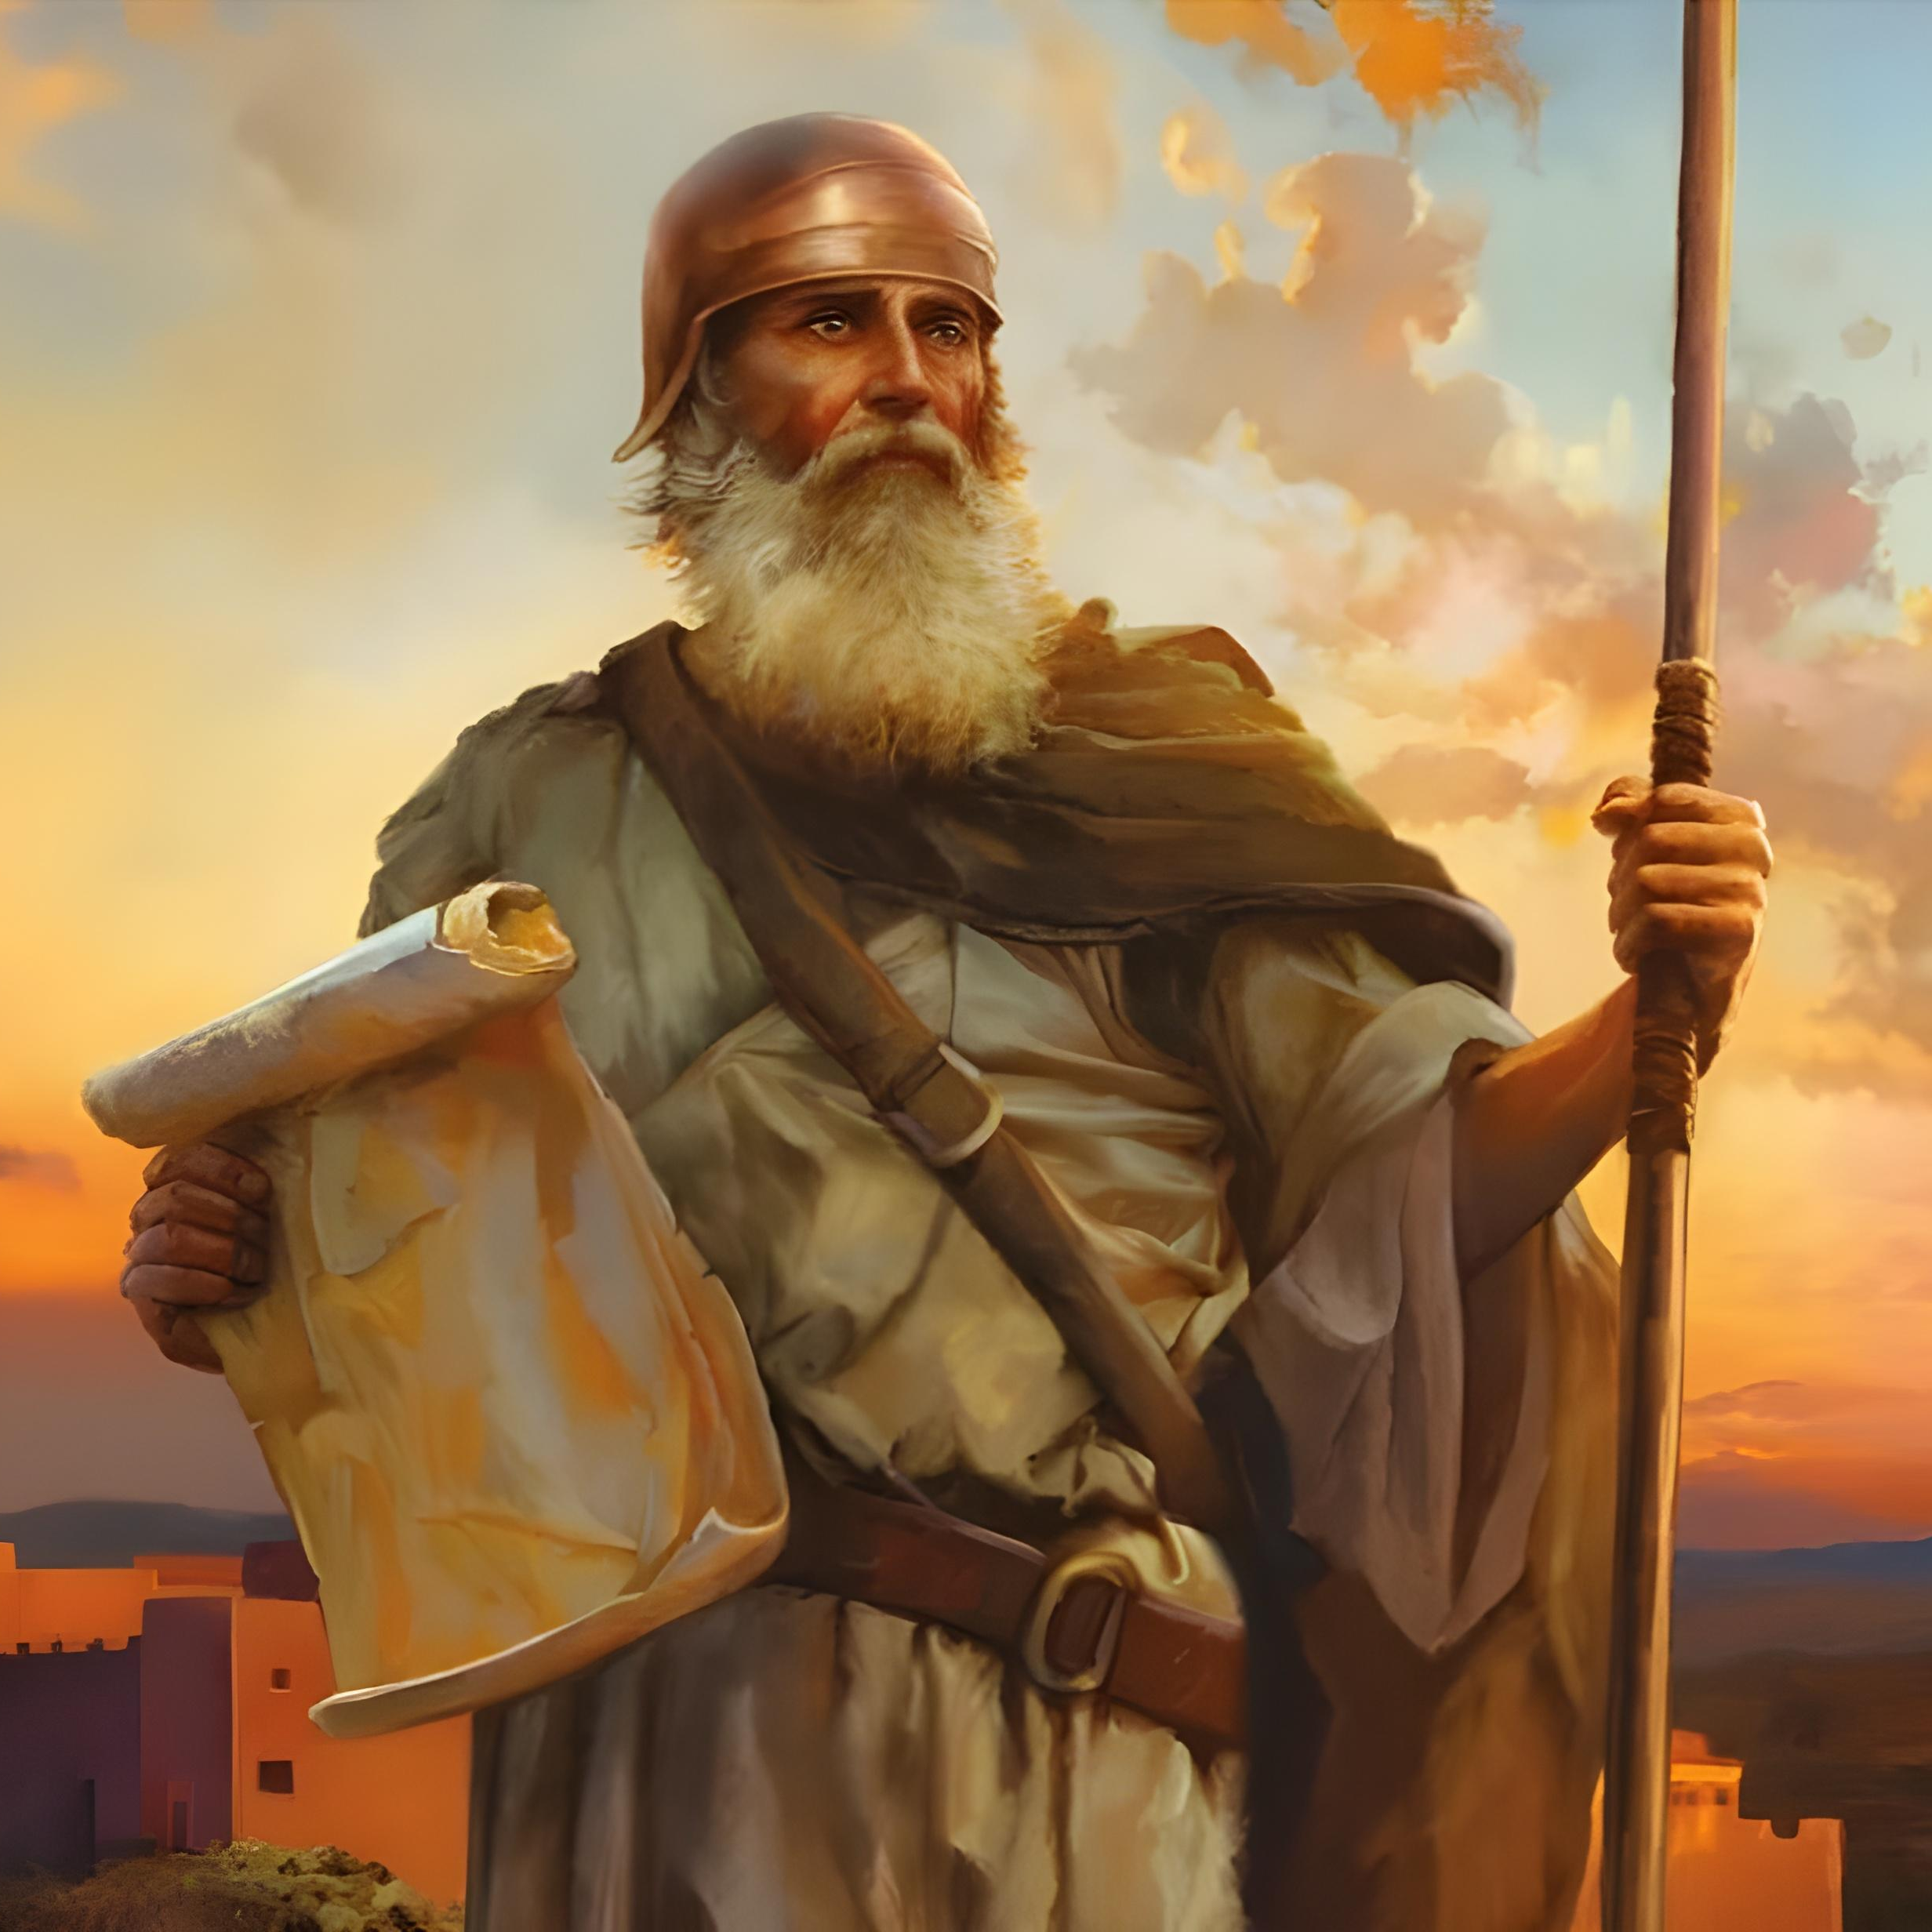
“Kae kehe ke mālohi pe ʻa koe mo ke lototoʻa ʻaupito, koeʻuhi ke ke tokanga ʻo fai ʻo fakatatau ki he fono kotoa pē, ʻaia naʻe fekau kiate koe ʻe heʻeku tamaioʻeiki ko Mōsese: ʻoua naʻa ke tafoki mei ai ki he nima toʻomataʻu pē ki he toʻohema, koeʻuhi ke ke monūʻia koe ʻi he potu kotoa pē ʻoku ke ʻalu ki ai. ” Sōsiua 1:7

Slide 2

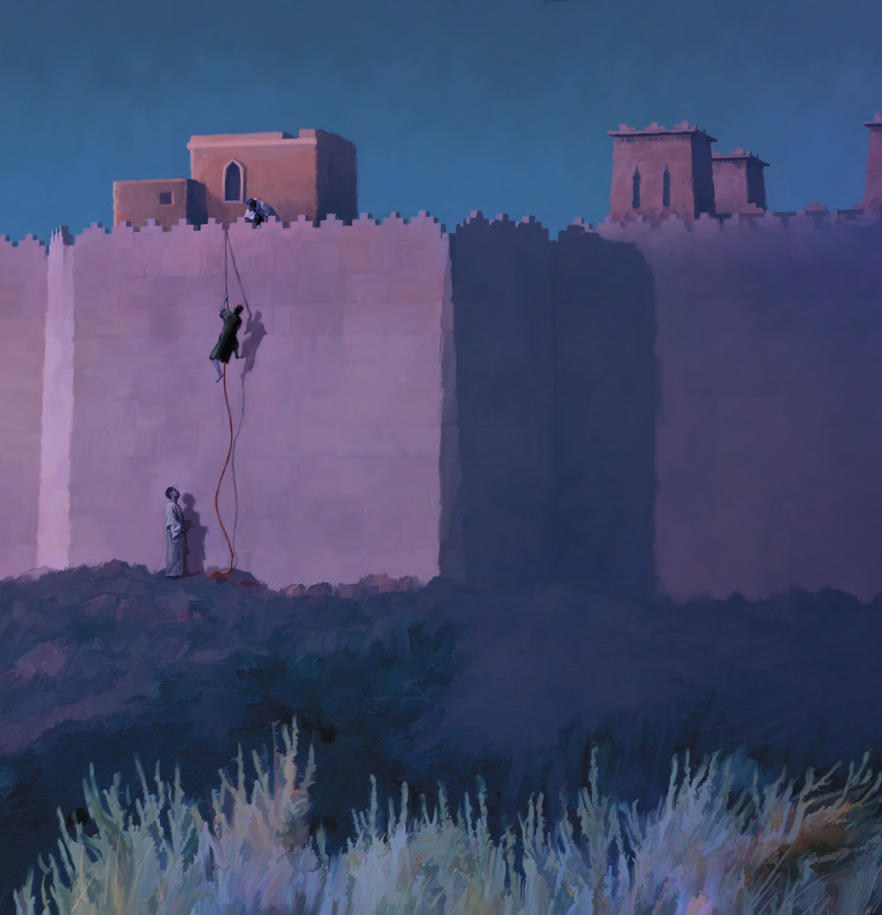
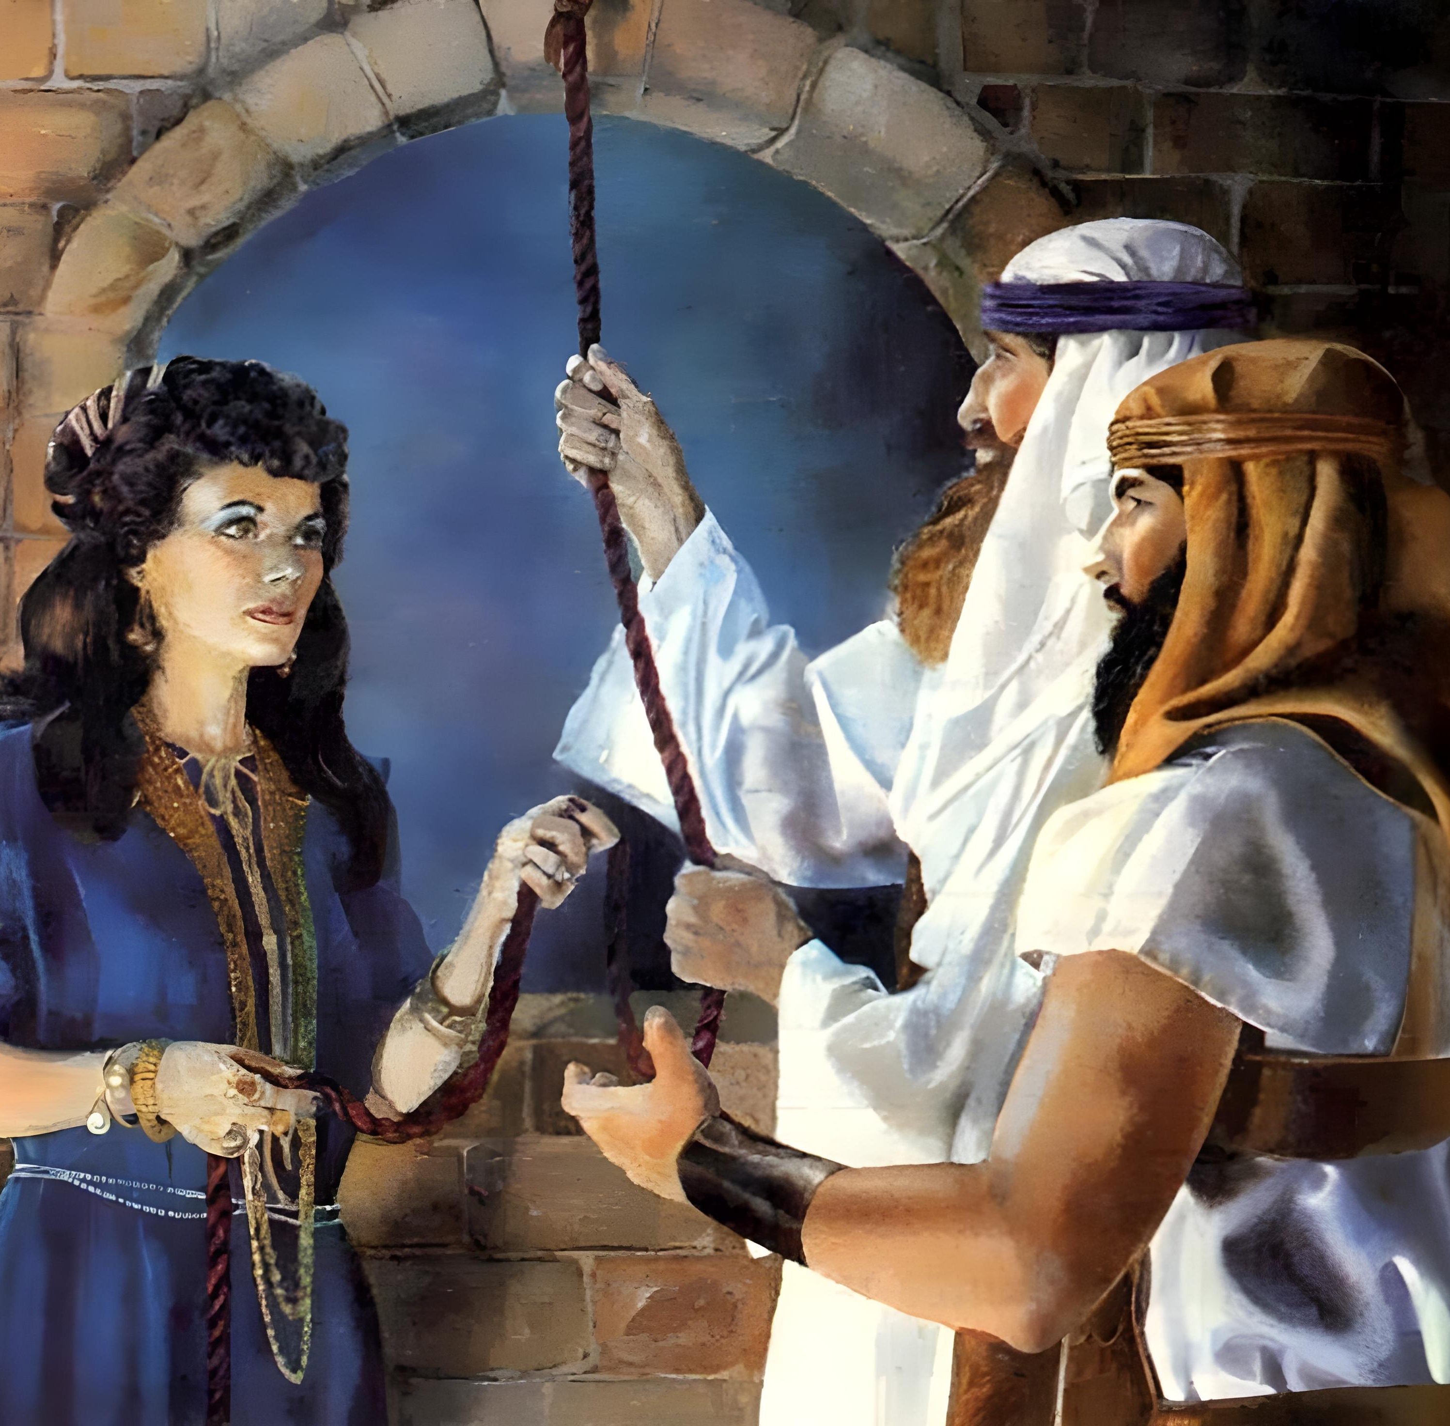
“Ko e tui naʻe ʻikai ʻauha ai ʻa Lehapi, ko e fefine feʻauaki, fakataha mo kinautolu naʻe ʻikai tui, ko ʻene tali lelei pe ʻae kau mataki.”
(Hepelū 11:31)

Slide 3

“He ko Sihova ko homou ʻOtua naʻe fakamōmoa ʻae ngaahi vai ʻo Sioatani mei homou ʻao, ke mou hoko atu ki he kauvai ʻe taha ʻo hangē ko ia naʻe fai ʻe Sihova ko homou ʻOtua ki he Tahi Kulokula, ʻaia naʻa ne fakamōmoa ʻi homau ʻao, ke ʻoua ke mau lava atu ki he kauvai ʻe taha; Koeʻuhi ke hoko ʻo ʻilo ʻae nima ʻo Sihova ʻe he kakai kotoa pē ʻo māmani, mo hono māfimafi: pea ke mou manavahē kia Sihova ko homou ʻOtua ʻo taʻengata.””
Sōsiua 4:23, 24

Slide 4
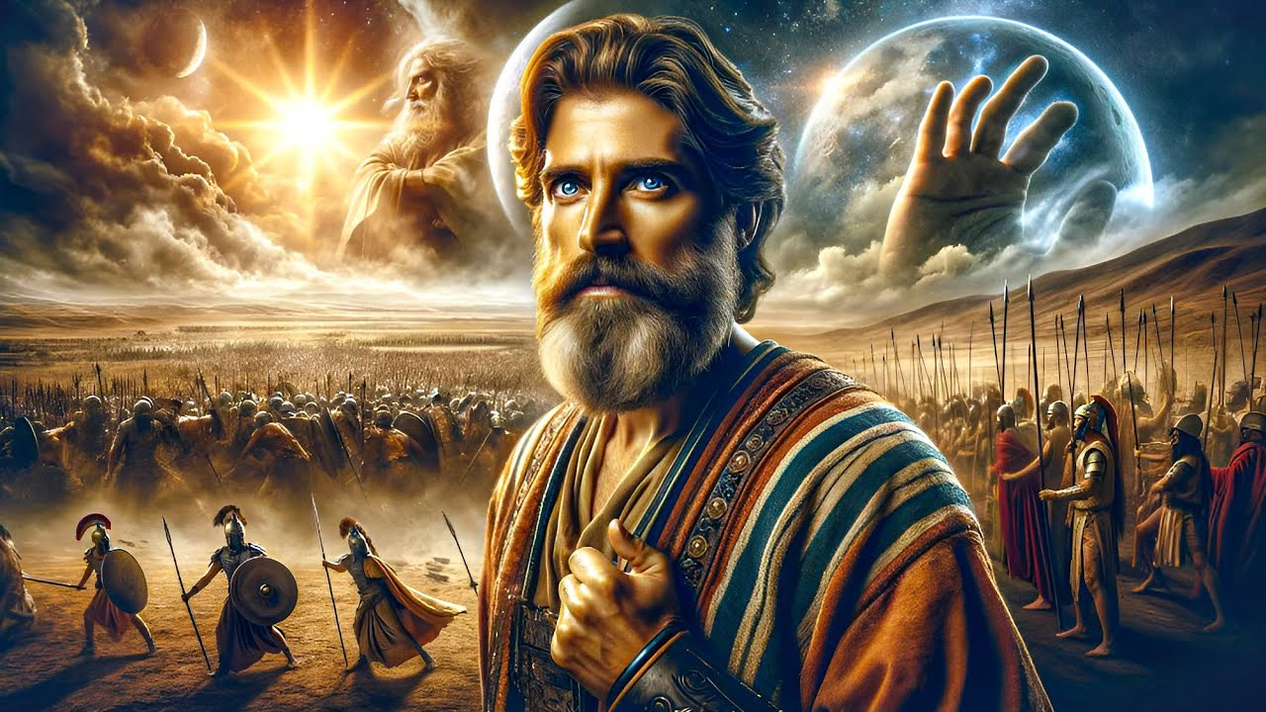
“Pea naʻe ʻikai ha ʻaho ʻo hangē ko ia ʻi muʻa pe kimui ʻo ia, koeʻuhi ke tokanga ʻa Sihova ki he leʻo ʻoe tangata: he naʻe tau ʻa Sihova koeʻuhi ko ʻIsileli.”
Sōsiua 10:14

Slide 5

“Pea ko e ngaahi tuʻi ni mo honau fonua naʻe maʻu ʻe Siosiua ʻi he kuonga pe taha, he ko Sihova ko e ʻOtua ʻo ʻIsileli naʻa ne tau maʻa ʻIsileli. ”
Sōsiua 10:42

Slide 6


“Ko au Sihova ʻoku ou vakili ʻae loto,ʻoku ou hakule ʻae ngaahi mahalo,
ke foaki ki he tangata taki taha ʻo fakatatau mo ʻene ngaahi ʻulungāanga,”
Selemaia 17:10

Slide 7


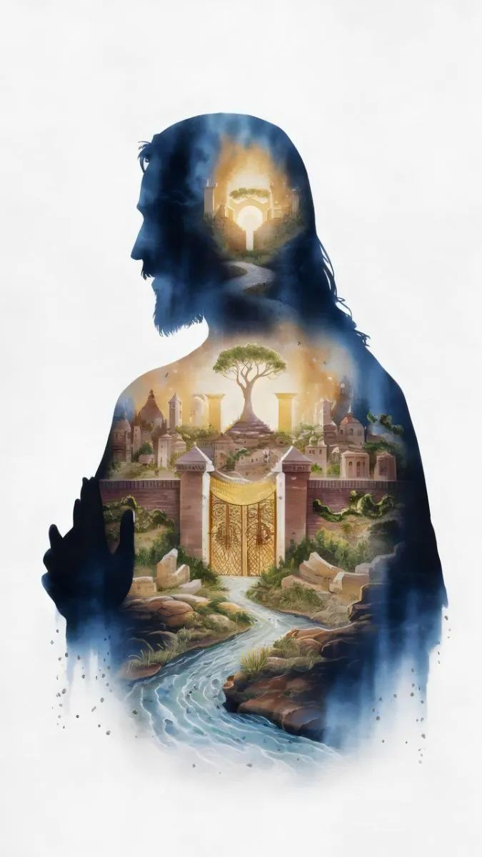
“Ka mou fuofua kumi ʻae puleʻanga ʻoe ʻOtua, mo ʻene māʻoniʻoni; pea ʻe fakalahi ʻaki ʻae ngaahi meʻa ni kotoa pē kiate kimoutolu.”
Mātiu 6:33

Slide 8
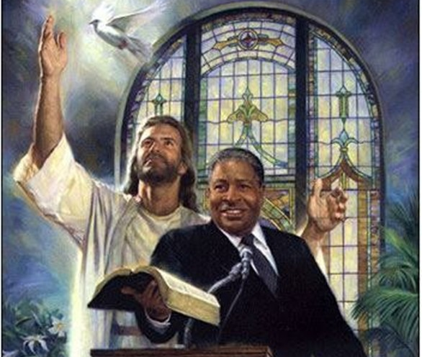
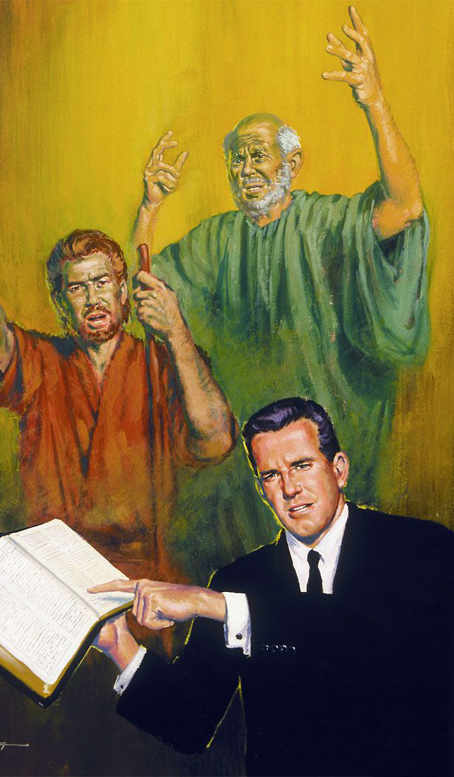
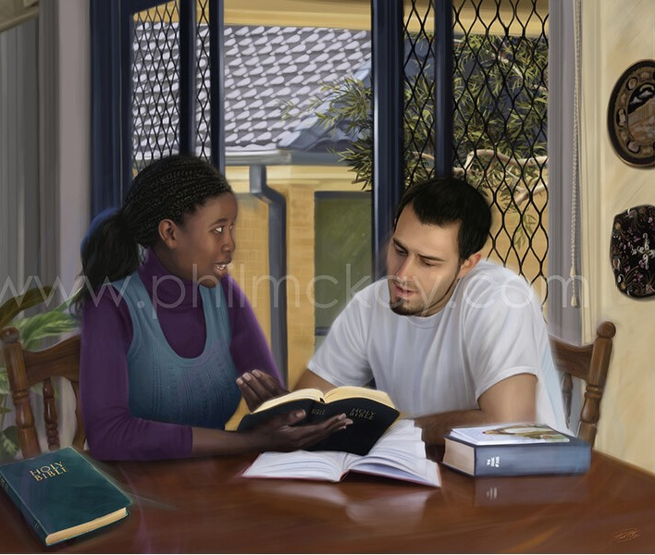
“Manatuʻi ʻa homou kau fakahinohino, ʻakinautolu naʻe leaʻaki ʻae folofola ʻae ʻOtua kiate kimoutolu, pea faʻifaʻitaki ki heʻenau tui, ʻo fakatokanga ki he ngataʻanga ʻo ʻenau ʻulungāanga.”
(Hepelū 13:7)

Slide 9
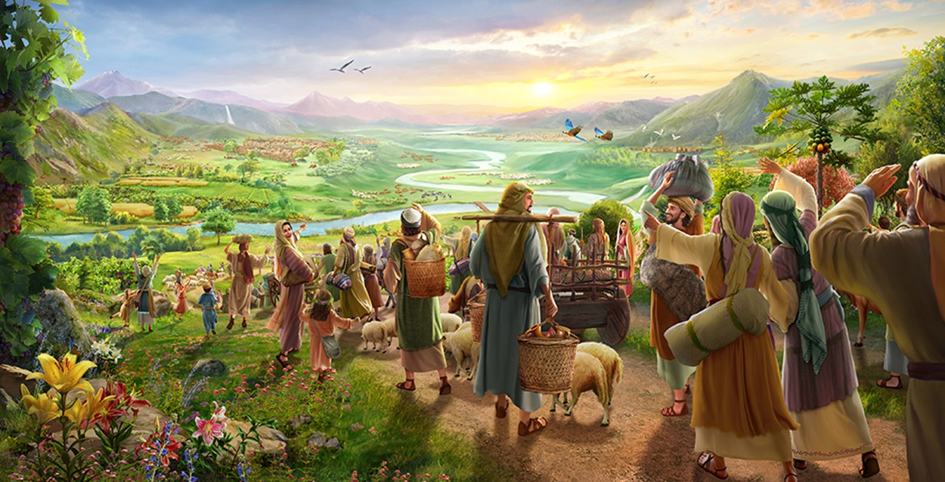
“Mou foki mai ki he hūfanga mālohi, ʻakimoutolu ʻoku pōpula ka e ʻamanaki lelei: ko e moʻoni ʻoku ou fakahā he ʻaho ni, te u totongi ke liunga ua kiate koe:” (Sakalaia 9:12)

Slide 10
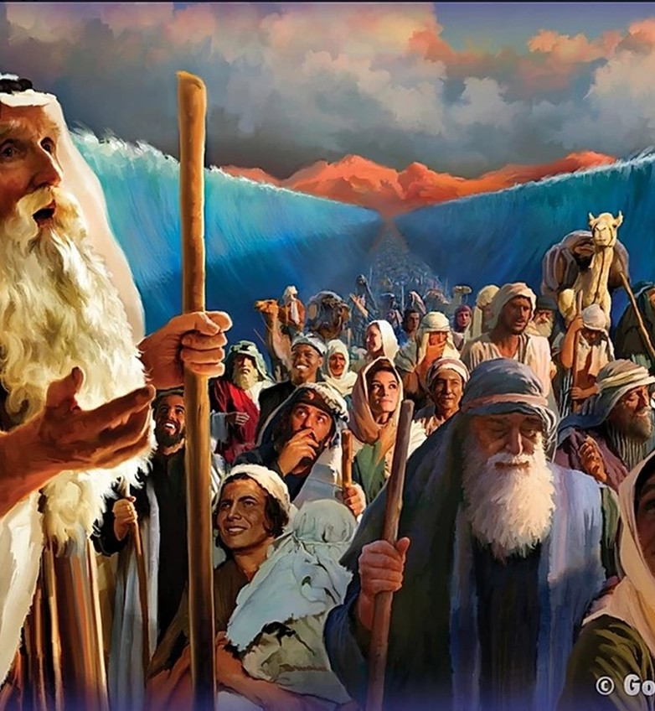
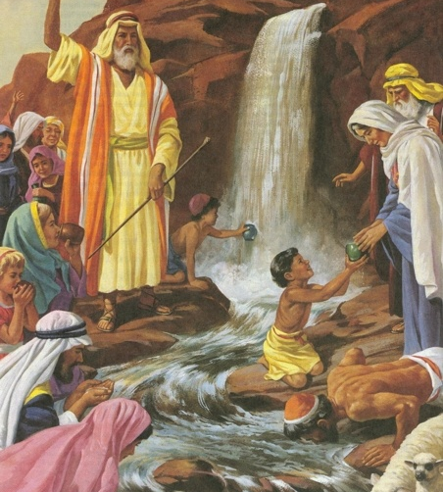
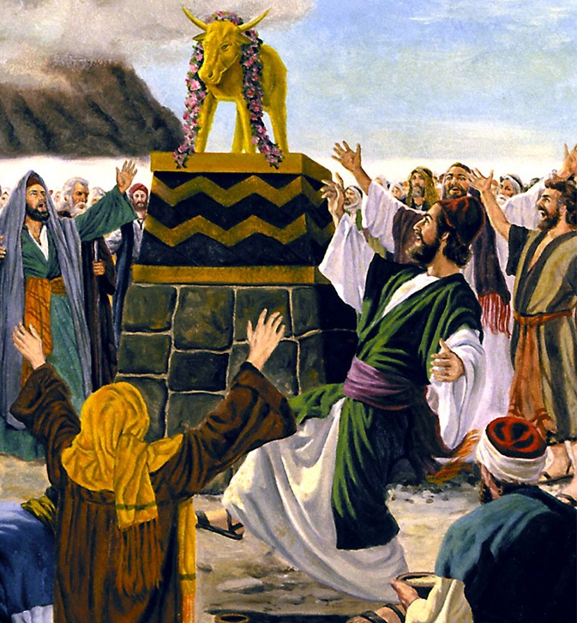
“Pea naʻe hoko ʻae ngaahi meʻa ni kotoa pē kiate kinautolu ko e ngaahi fakaʻilonga: pea kuo tohi ia ko hotau akonakiʻi, ʻakitautolu kuo hoko ki ai hono ngataʻanga ʻoe kuonga. ” (1 Kolinitō 10:11,)

Slide 11
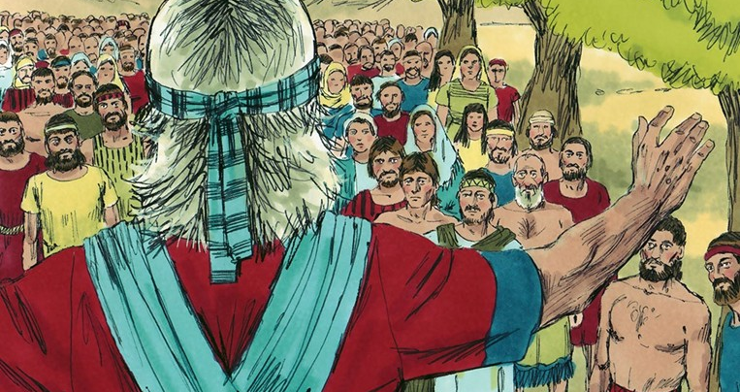

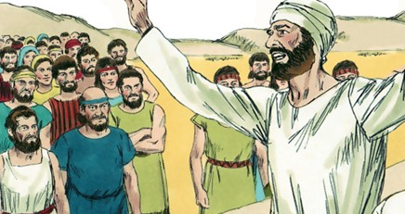
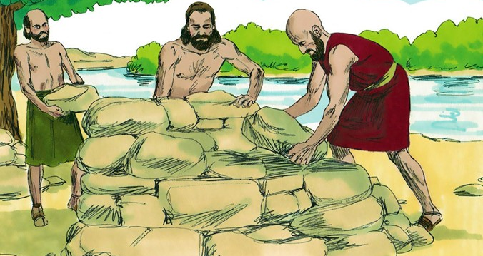
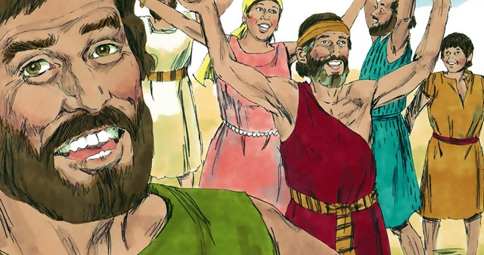
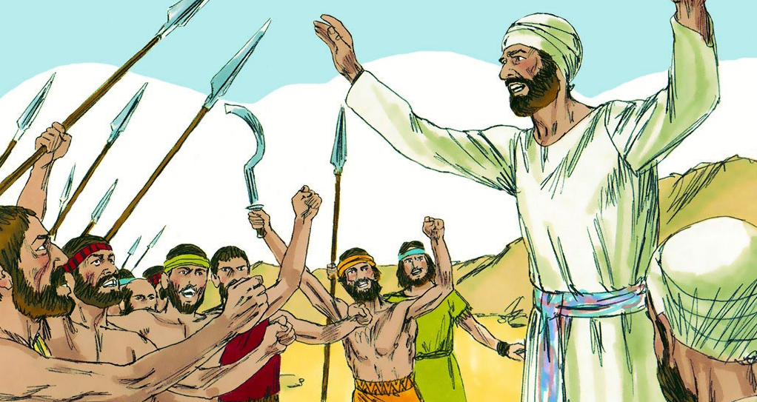
“‌ʻOku tekeʻi atu ʻae houhau ʻe he tali fakavaivai:ka ʻoku fakatupu ʻae ʻita ʻi he lea fakamamahi.”
(Lea Fakatātā 15:1,)

Slide 12

“Naʻe ʻikai liʻaki ha meʻa ʻe taha ʻi he meʻa lelei kotoa pē naʻe folofola ki ai ʻa Sihova ki he fale ʻo ʻIsileli; naʻe hoko kotoa pē.” (Sōsiua 21:45)

Slide 13
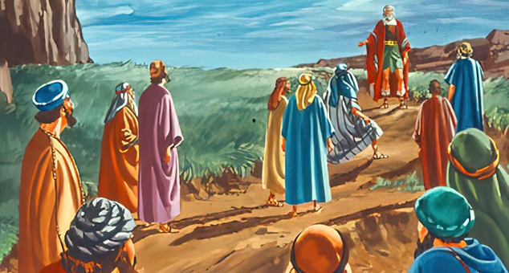
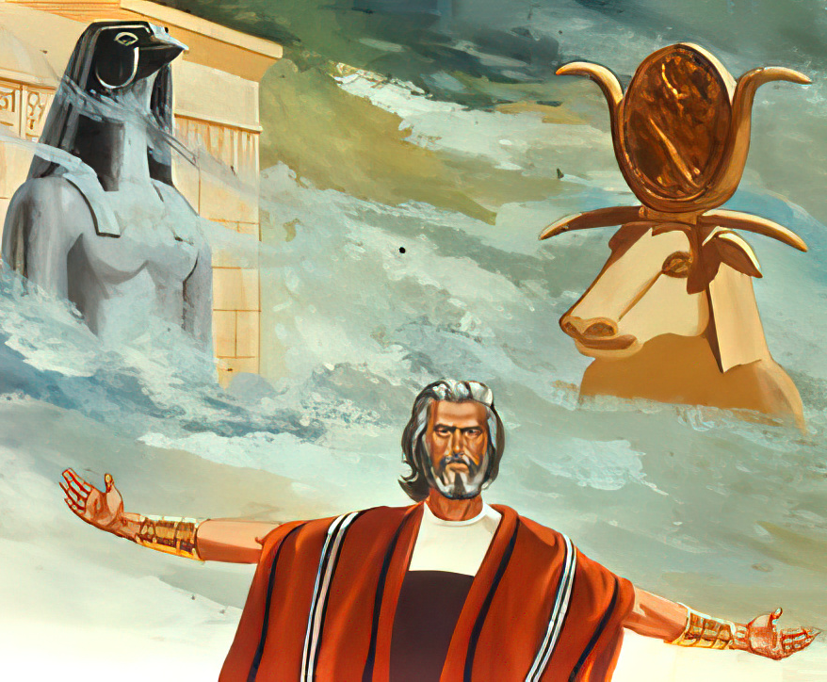
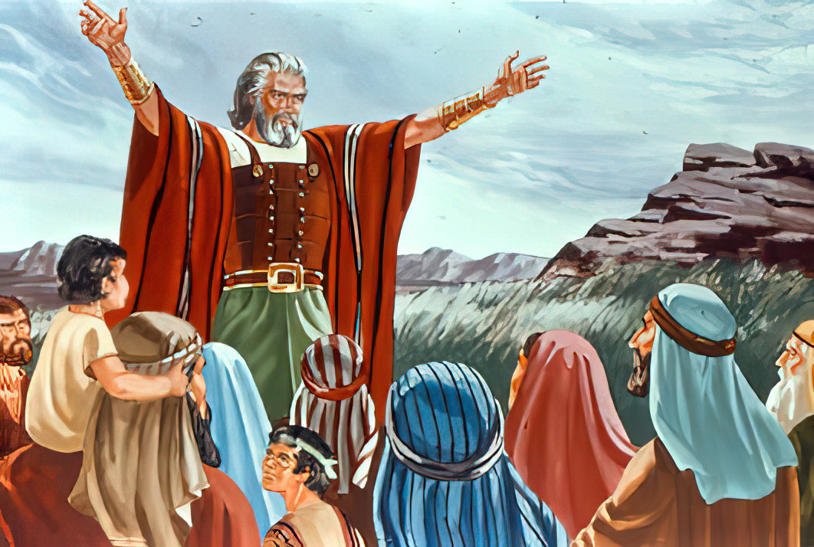
“Pea kapau ʻoku matamata kovi kiate kimoutolu ke tauhi ʻa Sihova, mou fili he ʻaho ni ʻaia te mou tauhi;..ka ko au mo hoku fale te mau tauhi ʻa Sihova. ”
(Sōsiua 24:15,)

