Slide 1

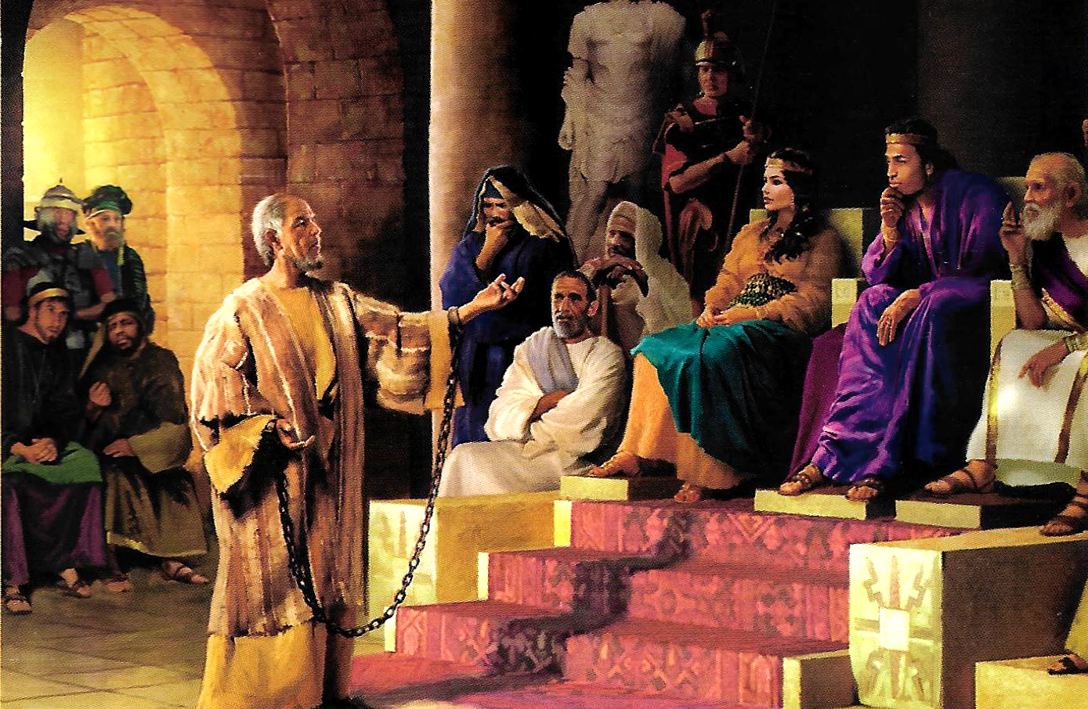
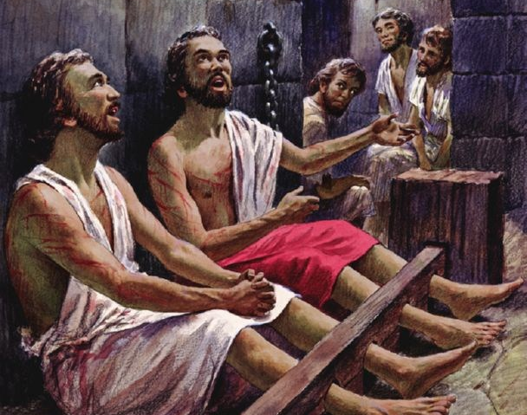
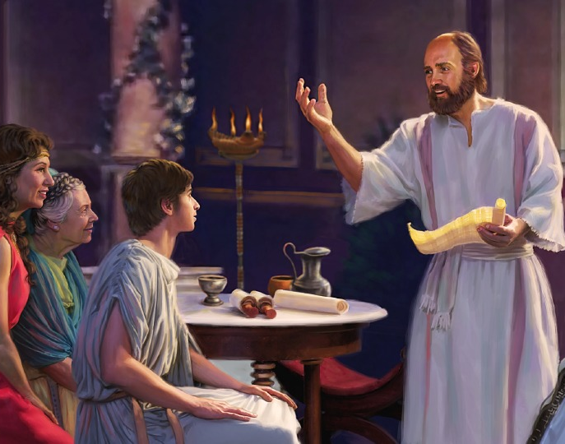
“Fiefia maʻuaipē ʻi he ʻEiki: ʻoku ou toe pehē, Fiefia!”
Filipai 4:4

Slide 2
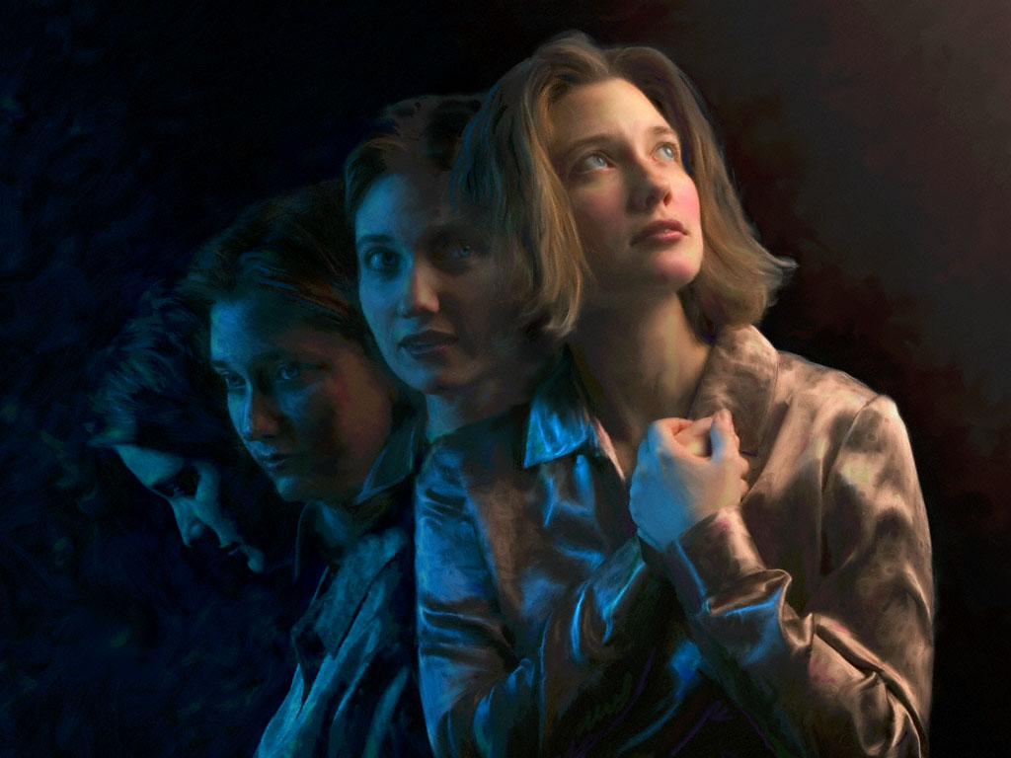

“‌ʻOku ou ʻilo pau ʻae meʻa ko eni, koeʻuhi ko ia kuo ne kamata ʻae ngāue lelei ʻiate kimoutolu, te ne fakahaohaoa ia ʻo aʻu ki he ʻaho ʻo Sisu Kalaisi:”
Filipai 1:6

Slide 3

“He ko e moʻui kiate au ko Kalaisi ia, ka ʻe ʻaonga lahi ʻae mate. ”
Filipai 1:21

Slide 4
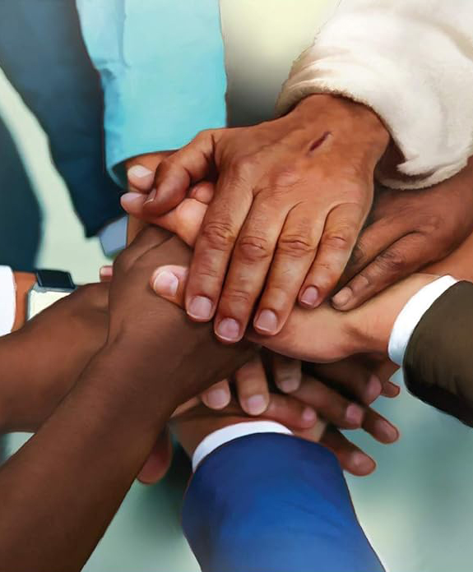
“Mou fakakakato ʻeku fiefia, ke mou felototatau pe, ʻo maʻu ʻae ʻofa pe taha, ke mou ʻulungāanga taha pe, mo uouangataha pe.”
Filipai 2:2

Slide 5

“Fai ʻae ngaahi meʻa kotoa pē ʻo taʻelāunga mo e taʻefakakikihi:Koeʻuhi ke mou taʻehalaia mo taʻekovi, ko e fānau taʻevalokiʻia ʻae ʻOtua, ʻi he lotolotonga ʻoe kakai anga pikopiko mo fefeka, ʻakinautolu ʻoku mou ulo atu ki ai, ʻo hangē ko e ngaahi maama ʻo māmani;”
Filipai 2:14, 15

Slide 6


“Koeʻuhi ke u ʻiloʻi ia, mo e mālohi ʻo ʻene toetuʻu, peau kau ʻi heʻene ngaahi mamahi, ʻi he fakatatau au ki heʻene pekia; 11 Kapau teu faʻa lavaʻi ʻi he meʻa kotoa pē ʻae toetuʻu mei he mate.”
Filipai 3:10, 11

Slide 7
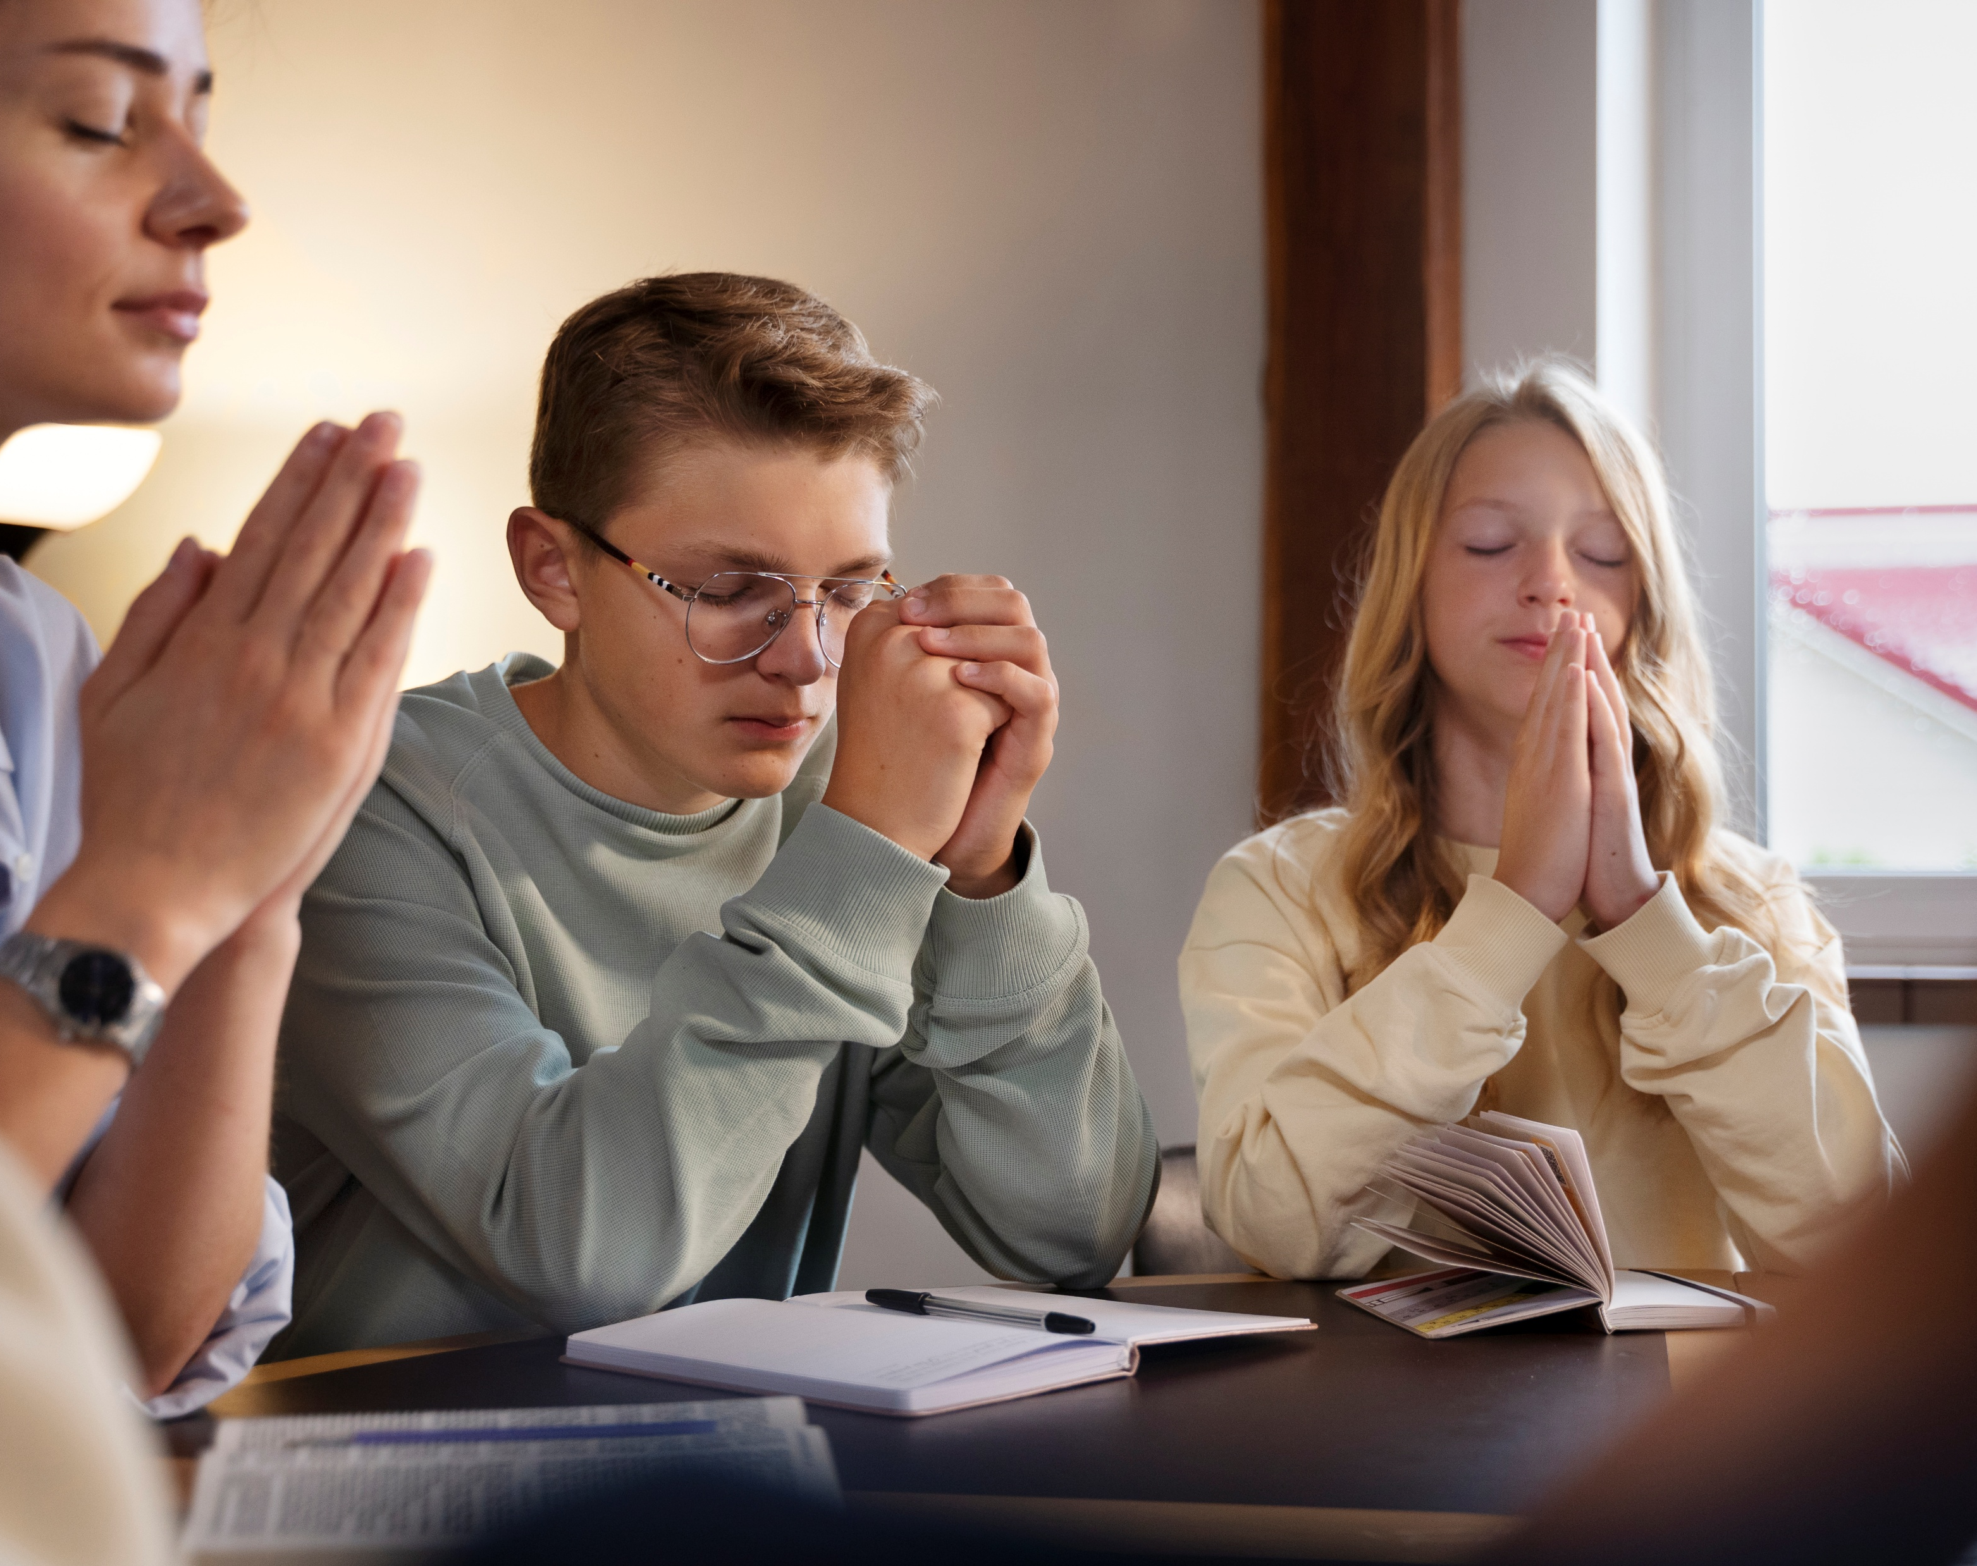
“‌ʻOua naʻa tokanga mamahi ki ha meʻa ʻe taha; kae fakahā atu hoʻomou holi ʻi he meʻa kotoa pē, ki he ʻOtua, ʻi he lotu mo e lotu tāumaʻu mo e fakafetaʻi.”
Filipai 4:6

Slide 8
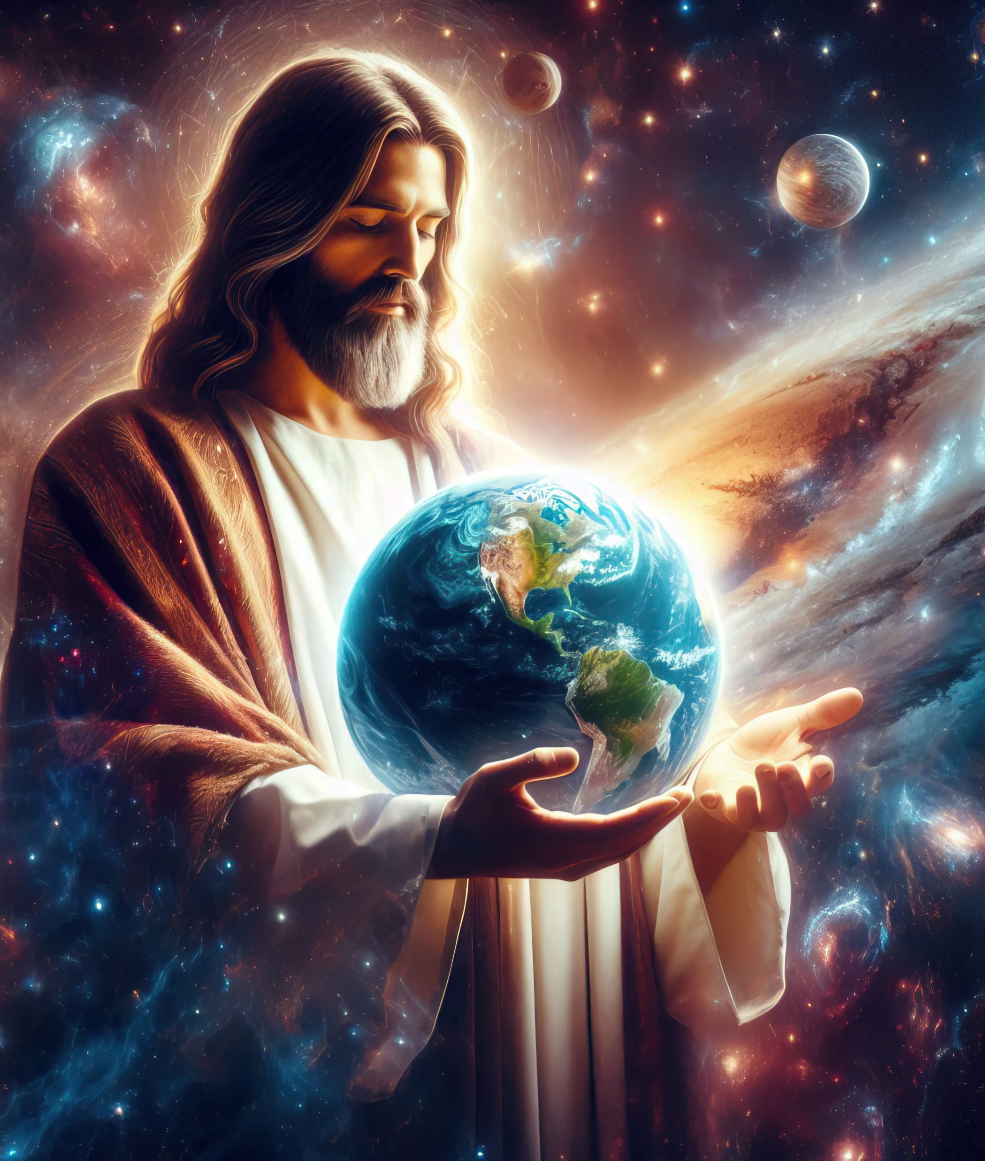
“ʻAia ko hono tatau ʻoe ʻOtua taʻehāmai, ko e ʻuluaki fānau ʻi he meʻa fakatupu kotoa pē:He naʻe fakatupu ʻe ia ʻae ngaahi meʻa kotoa pē, ʻaia ʻoku ʻi he langi, pea mo ia ʻoku ʻi māmani, ʻae meʻa hā mai mo e taʻehāmai, pe ko e ngaahi nofoʻa fakaʻeiʻeiki, pe ko e ngaahi ʻeikiʻanga, pe ko e ngaahi pule, pe ko e ngaahi mālohi: naʻe fakatupu ʻe ia ʻae ngaahi meʻa kotoa pē, pea naʻe maʻana ia:Pea ʻoku ki muʻa ia ʻi he ngaahi meʻa kotoa pē, pea ʻoku tuʻumaʻu ʻiate ia ʻae ngaahi meʻa kotoa pē.”
Kolose 1:15–17

Slide 9


2 Kolinitō 5:21
“He naʻa ne ngaohi ia, ʻaia naʻe ʻikai haʻane angahala, koe feilaulau ʻi he angahala koeʻuhi ko kitautolu; kae hoko ai ʻakitautolu ko e māʻoniʻoni ʻae ʻOtua ʻiate ia.”

Slide 10
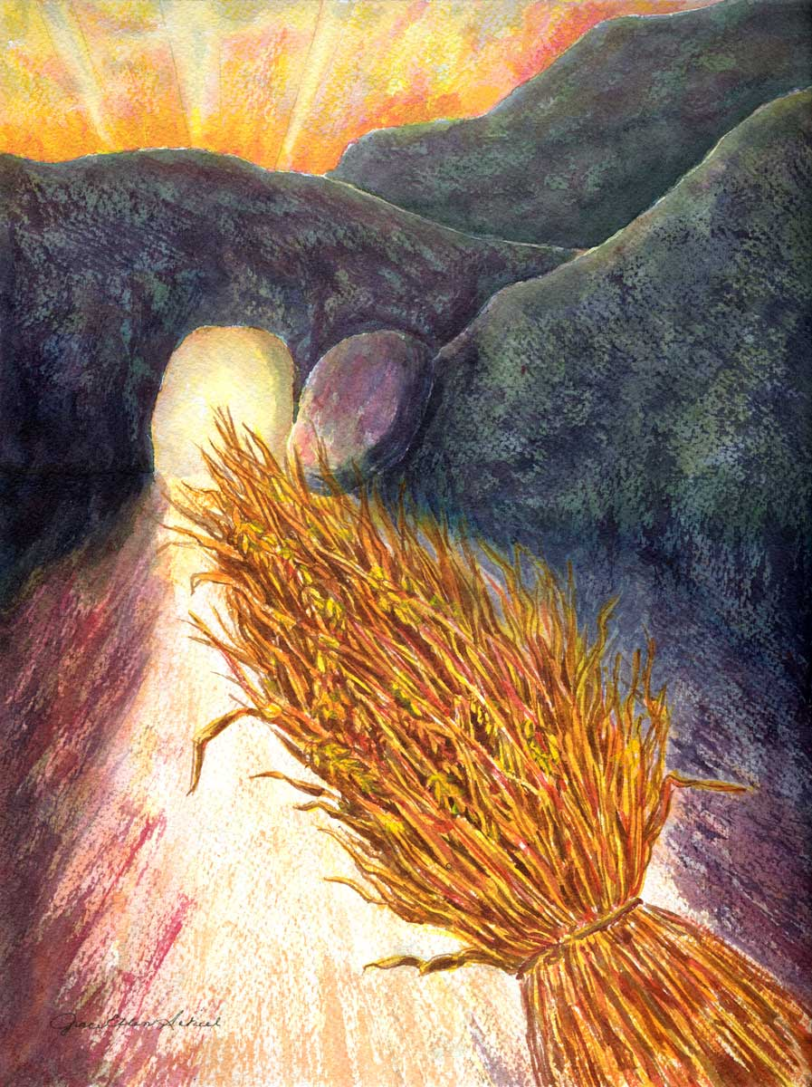
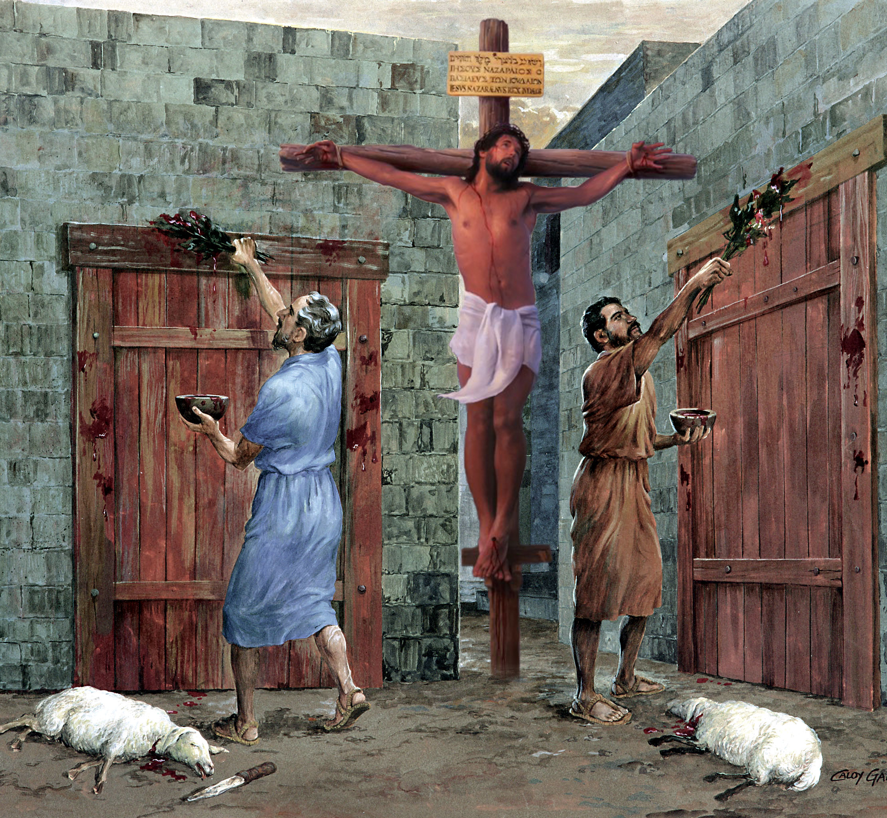
“Ko ia ke ʻoua naʻa ai ha taha ʻe fakaanga kiate kimoutolu ʻi ha meʻakai, pe ha meʻainu, pe ki ha ʻaho kātoanga, pe ʻi ha tuʻu efiafi, pe ʻi he ngaahi Sāpate:ʻAia ko e ngaahi ʻata ʻoe meʻa ʻoku haʻu; ka ko hono sino ʻoku ʻia Kalaisi. ” Kolose 2:16, 17

Slide 11

“Pea ke ʻufiʻufi ʻaki ʻae ngaahi meʻa ni kotoa pē ʻae ʻofa, ʻaia ko e noʻo ʻoe haohaoa.”
Kolose 3:14

Slide 12
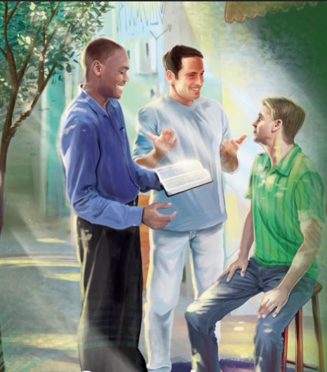
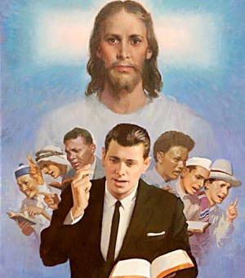
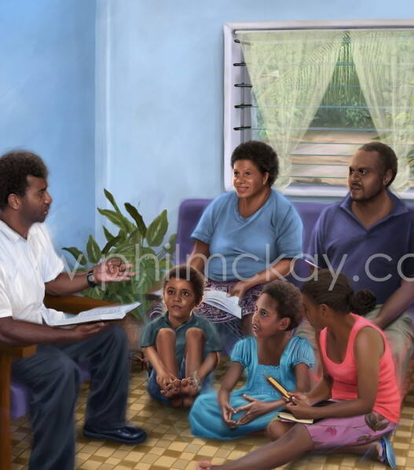
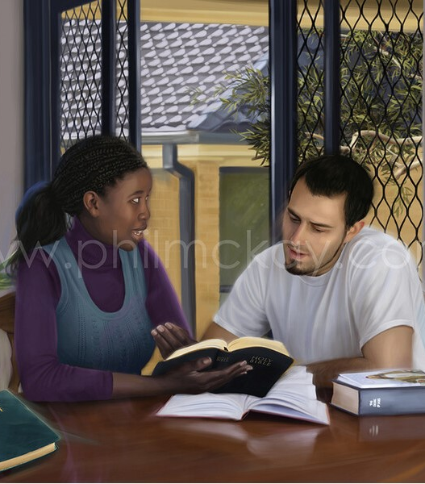
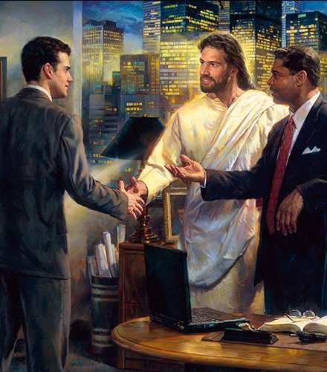

“Ke lelei maʻuaipē hoʻomou lea, ʻo fakalelei ʻaki ʻae māsima, koeʻuhi ke mou ʻilo ke tali totonu ʻae tangata kotoa pē. Kolose 4:6

Slide 13


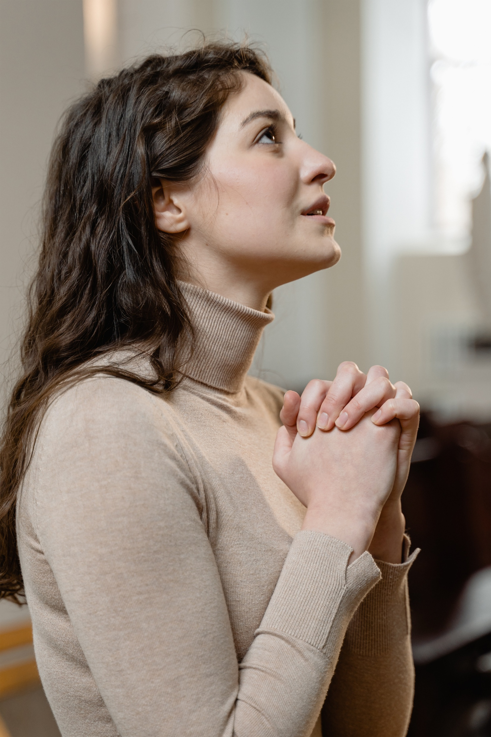
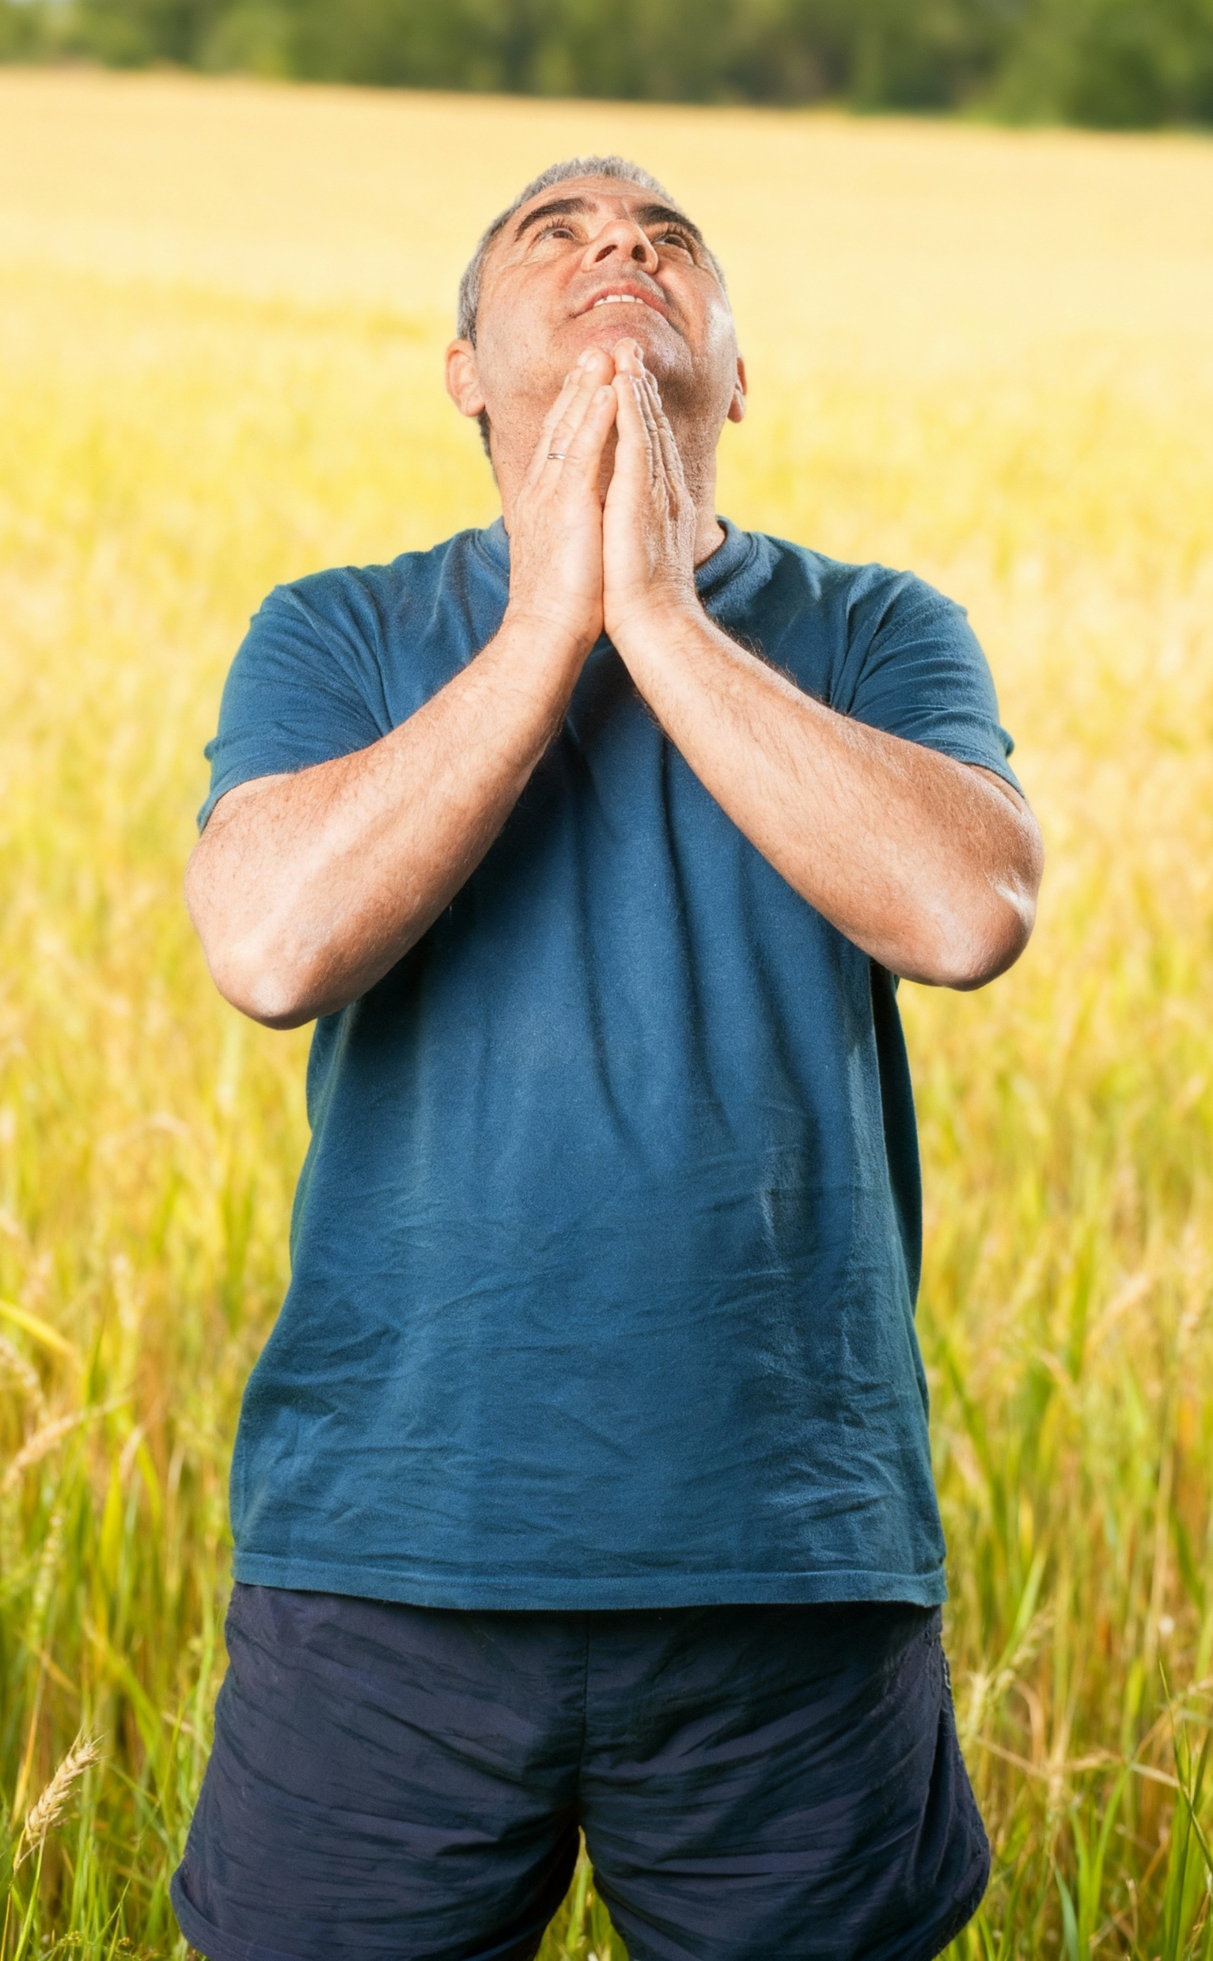
“Fakafetaʻi ʻi he meʻa kotoa pē: he ko e finangalo ia ʻoe ʻOtua ʻia Kalaisi Sisu kiate kimoutolu.”
1 Tesalonaika 5:18

