Slide 1
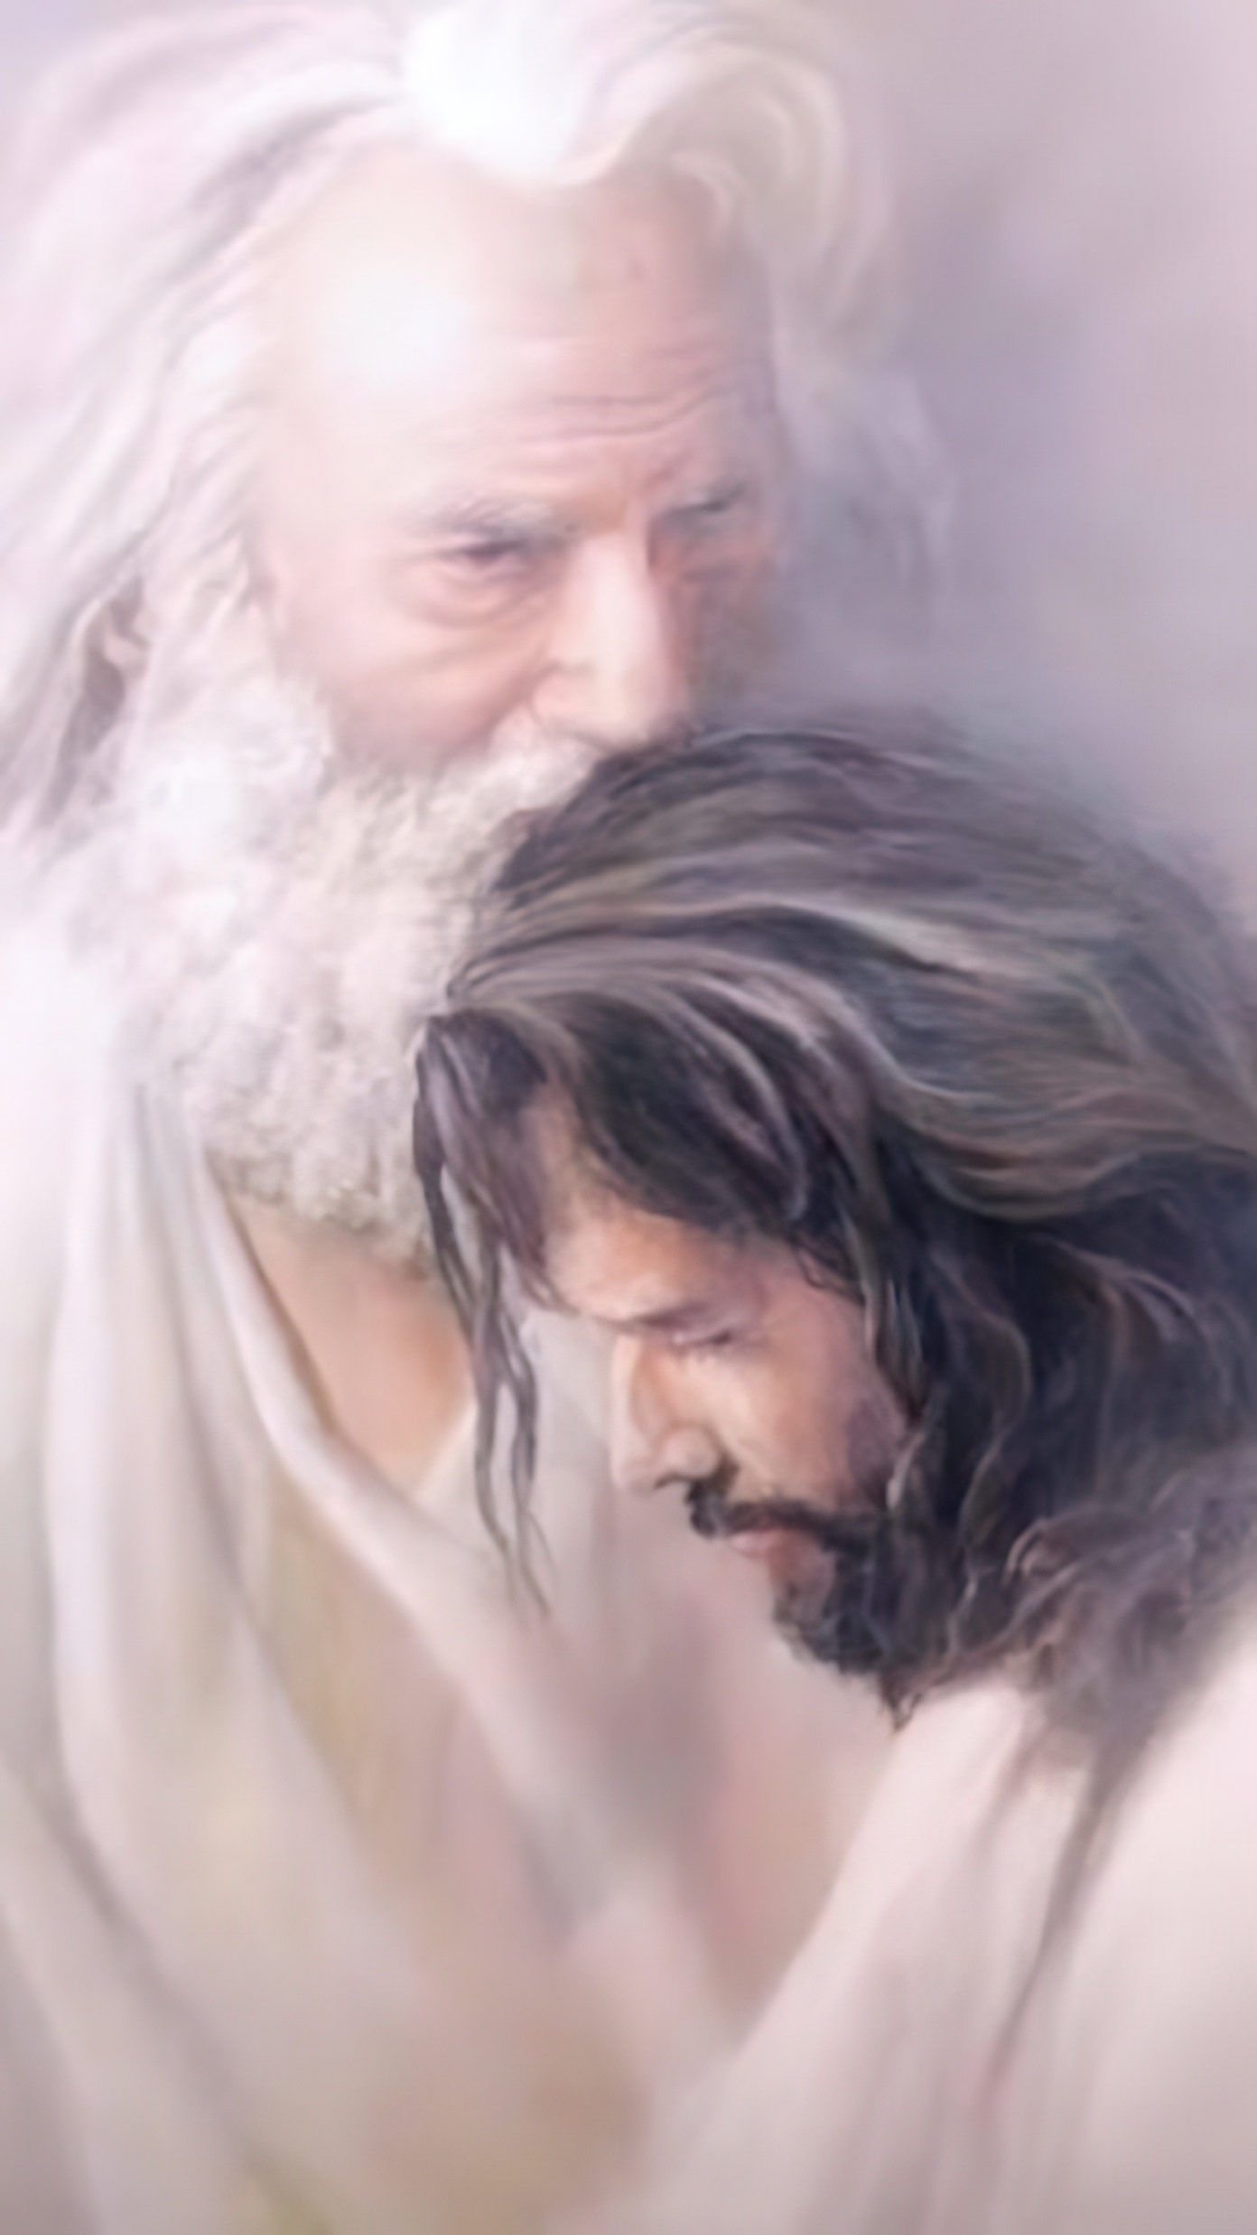
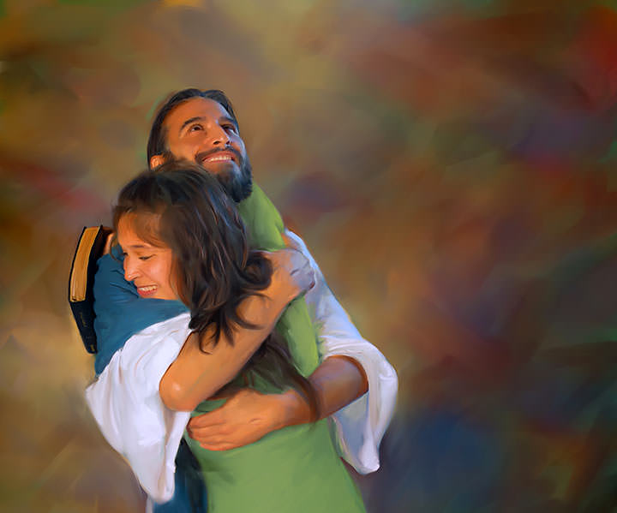
“Hangē ko e ʻofa ʻae Tamai kiate au, kuo pehē ʻeku ʻofa kiate kimoutolu:mou nofomaʻu ʻi heʻeku ʻofa.”
(Sione 15:9)

Slide 2

“Pea ko eni ʻae moʻui taʻengata, ko ʻenau ʻilo koe ko e ʻOtua moʻoni pe taha, mo Sisu Kalaisi, ʻaia naʻa ke fekau.”
(Sione 17:3)

Slide 3

“He ko ia ia ʻoku hiki hake ia, ʻe fakavaivai ia; pea ko ia ʻoku fakavaivai ia, ʻe hakeakiʻi ia.””
(Luke 14:11)

Slide 4

“He ko e folofola ʻae ʻOtua ʻoku moʻui, mo mālohi, pea māsila lahi ʻi ha heletā ʻoku fakatoumata, ʻoku ʻasi ki hono vaheʻi ʻoe loto mo e laumālie, mo e ngaahi hokotanga hui mo e uho, pea ʻoku ne fakahā ʻae ngaahi mahalo mo e filioʻi ʻoe loto. ” (Hepelū 4:12)
Notes:
Buscar en biblia-espada

Slide 5

“ʻE pehē ʻeku folofola ʻaia ʻoku ʻalu atu ʻi hoku fofonga:
ʻe ʻikai foki taʻefua kiate au,
ka e lavaʻi ia ʻaia ʻoku ou faʻiteliha ki ai,
pea ʻe monūʻia ia ʻi he meʻa ʻoku ou fekau ia ki ai.” (‘Isaia 55:11)

Slide 6

“ʻOku ou ʻofa kia Sihova, koeʻuhi kuo ne ongoʻi hoku leʻo mo ʻeku lotu tāumaʻu.Koeʻuhi kuo ne fakatokangaʻi hono fofonga kiate au,
ko ia te u ui ai ki heʻene ʻafio ʻi hoku ngaahi ʻaho.” (Saame 116:1, 2)

Slide 7
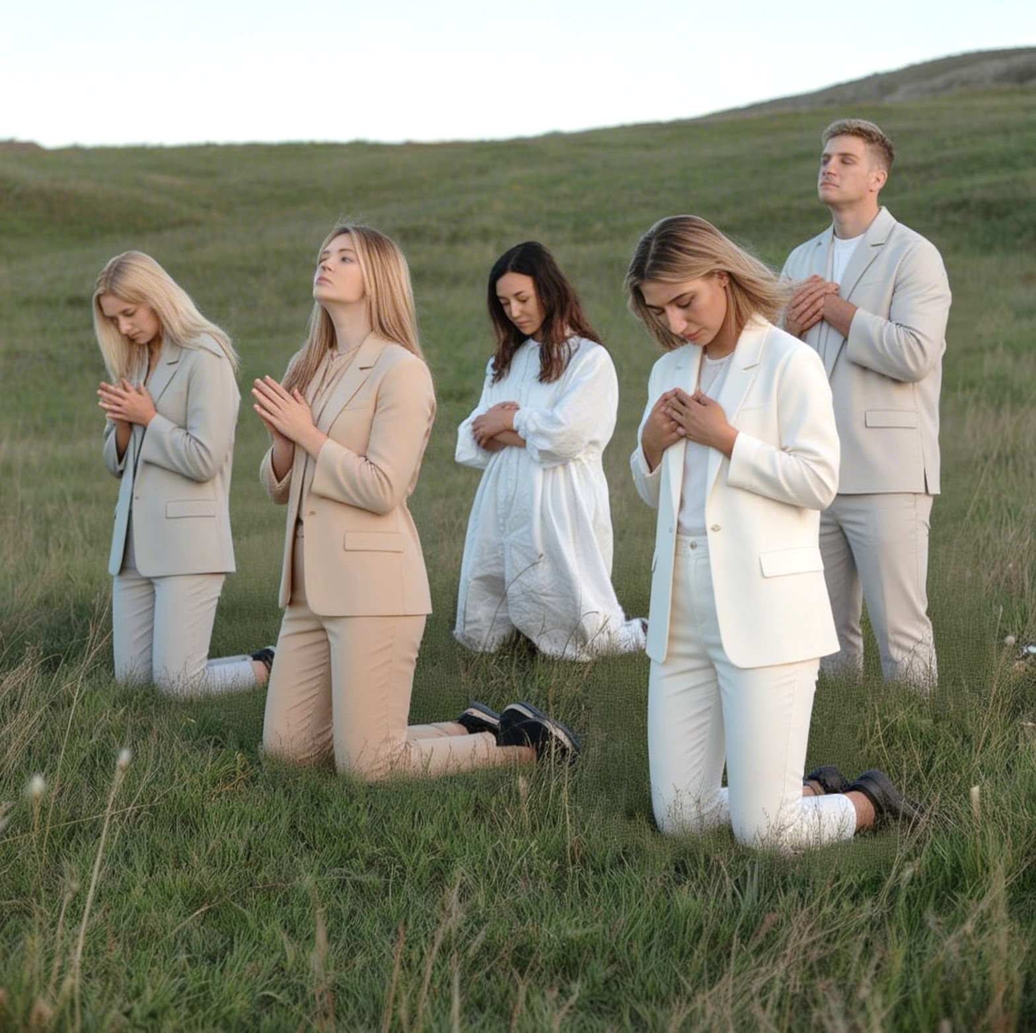
“Falala maʻuaipē kiate ia; ʻakimoutolu ʻae kakai,
lilingi homou loto ʻi hono ʻao:
ko e hūfanga ʻae ʻOtua kiate kitautolu.”
(Saame 62:8)

Slide 8

“Ko eni, ko e tui ko e tuʻunga ia ʻoe ngaahi meʻa ʻoku ʻamanaki lelei ki ai, ko e fakamoʻoni ʻoe ngaahi meʻa taʻehāmai.”
(Hepelū 11:1)

Slide 9
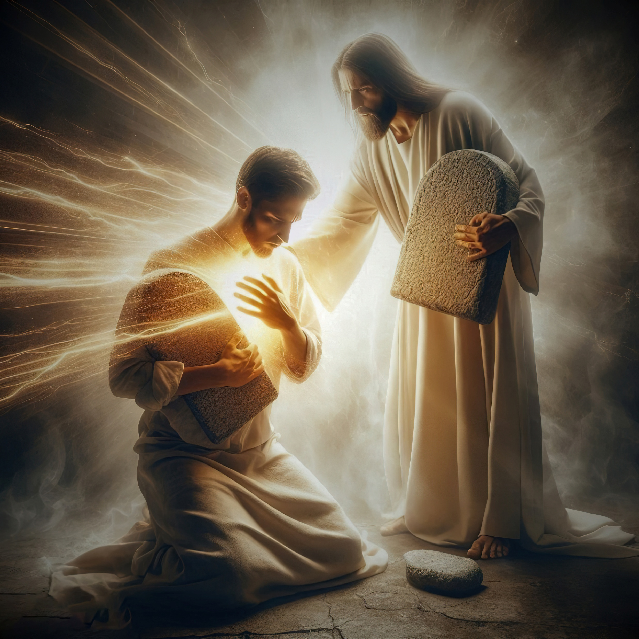
“‌ʻE ʻikai siʻi ngalo ʻiate au hoʻo ngaahi akonaki ʻo lauikuonga: he ko ia kuo ke fakamoʻui ai au.ʻOku ʻaʻau au ke ke fakamoʻui au he kuo u kumi ki hoʻo ngaahi akonaki.,”
(Saame 119:93,94)

Slide 10
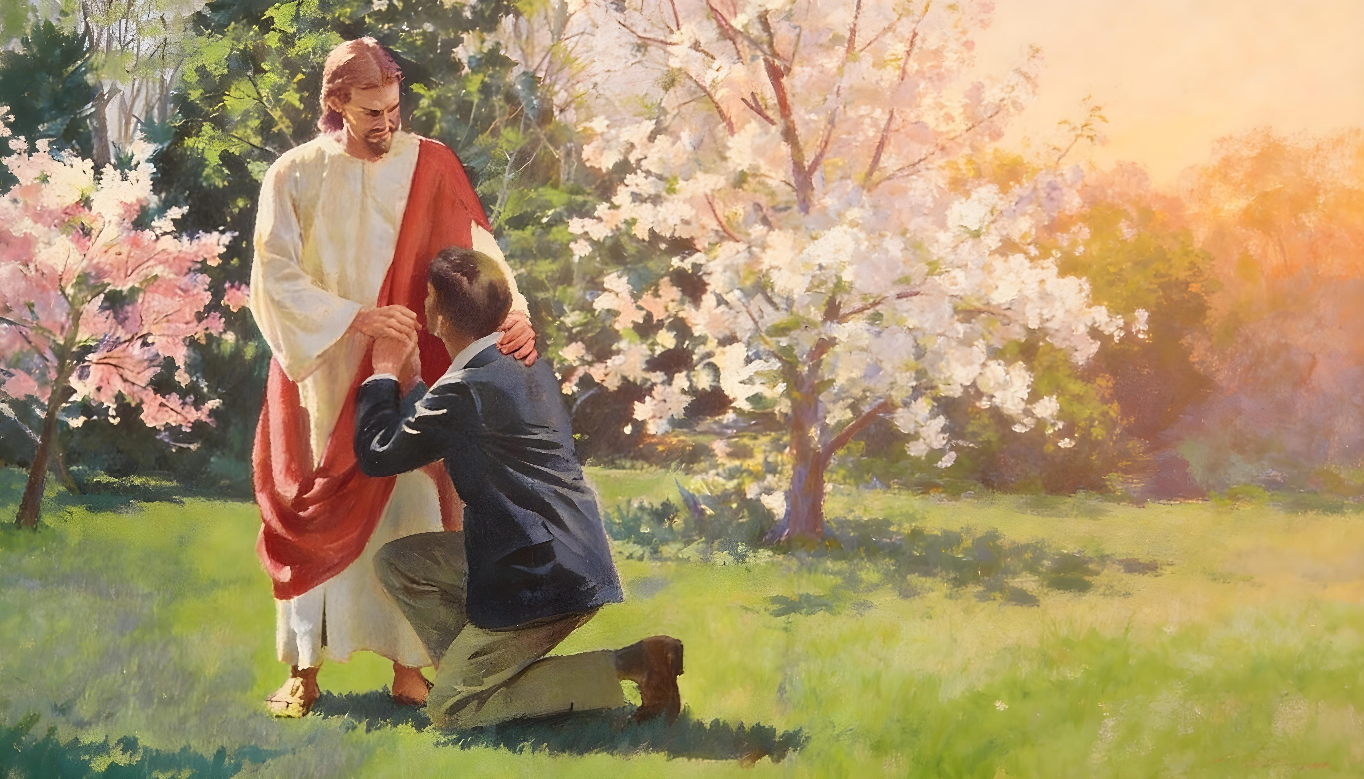
“Kapau te tau vete ʻetau ngaahi angahala, ʻoku moʻoni mo angatonu ia ke fakamolemolea ʻetau ngaahi angahala, mo fakamaʻa ʻakitautolu mei he taʻemāʻoniʻoni kotoa pē.”
(1 Sione 1:9)

Slide 11
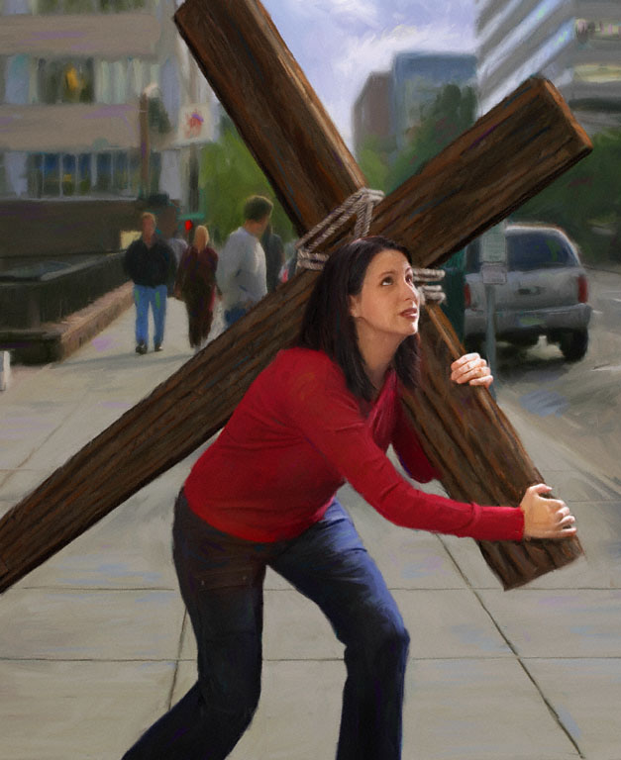

“Pea ʻoku ʻikai ke ngata ai, ka ʻoku tau vikiviki ʻi he ngaahi mamahi foki: ʻi heʻetau ʻilo ʻoku tupu mei he mamahi ʻae faʻa kātaki; Pea mei he faʻa kātaki, ʻae ʻilo; pea mei he ʻilo, ʻae ʻamanaki lelei:Pea ʻoku ʻikai fakamā ʻe he ʻamanaki lelei; he koeʻuhi kuo lilingi ʻae ʻofa ʻae ʻOtua ki hotau loto ʻi he Laumālie Māʻoniʻoni, ʻaia kuo foaki kiate kitautolu.”
(Loma 5:3–5)

Slide 12
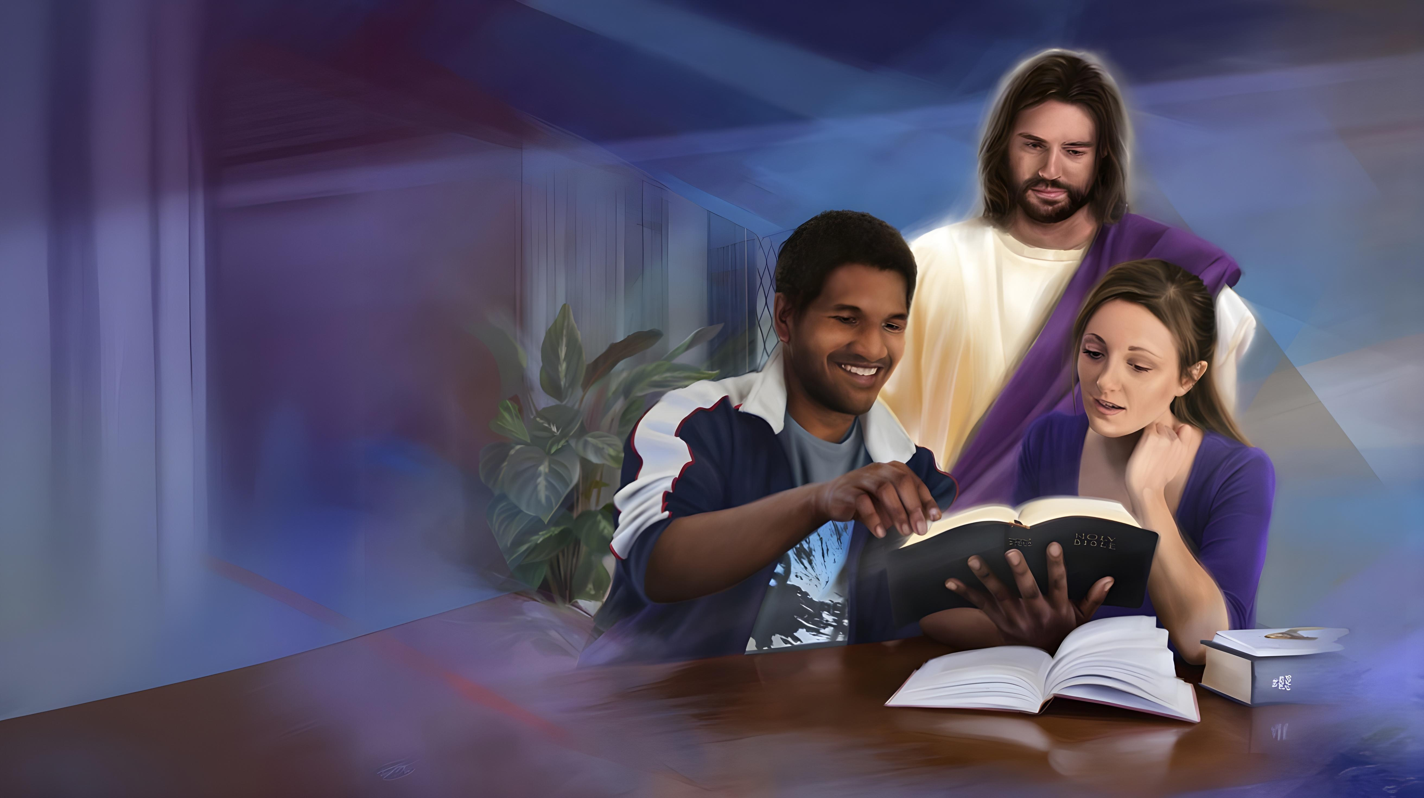
“Kuo foaki kiate au ʻe he ʻEiki ko Sihova ʻae ʻelelo ʻoe poto,
koeʻuhi ke u ʻilo ke lea ʻaki ha lea ʻi he kuonga totonu kiate ia ʻoku vaivai:
ʻoku ne ʻa ʻi he pongipongi kotoa pē,
ke ne fafangu hoku telinga ke ongoʻi ʻo hangē ko e poto.”
(‘Isaia 50:4)

Slide 13
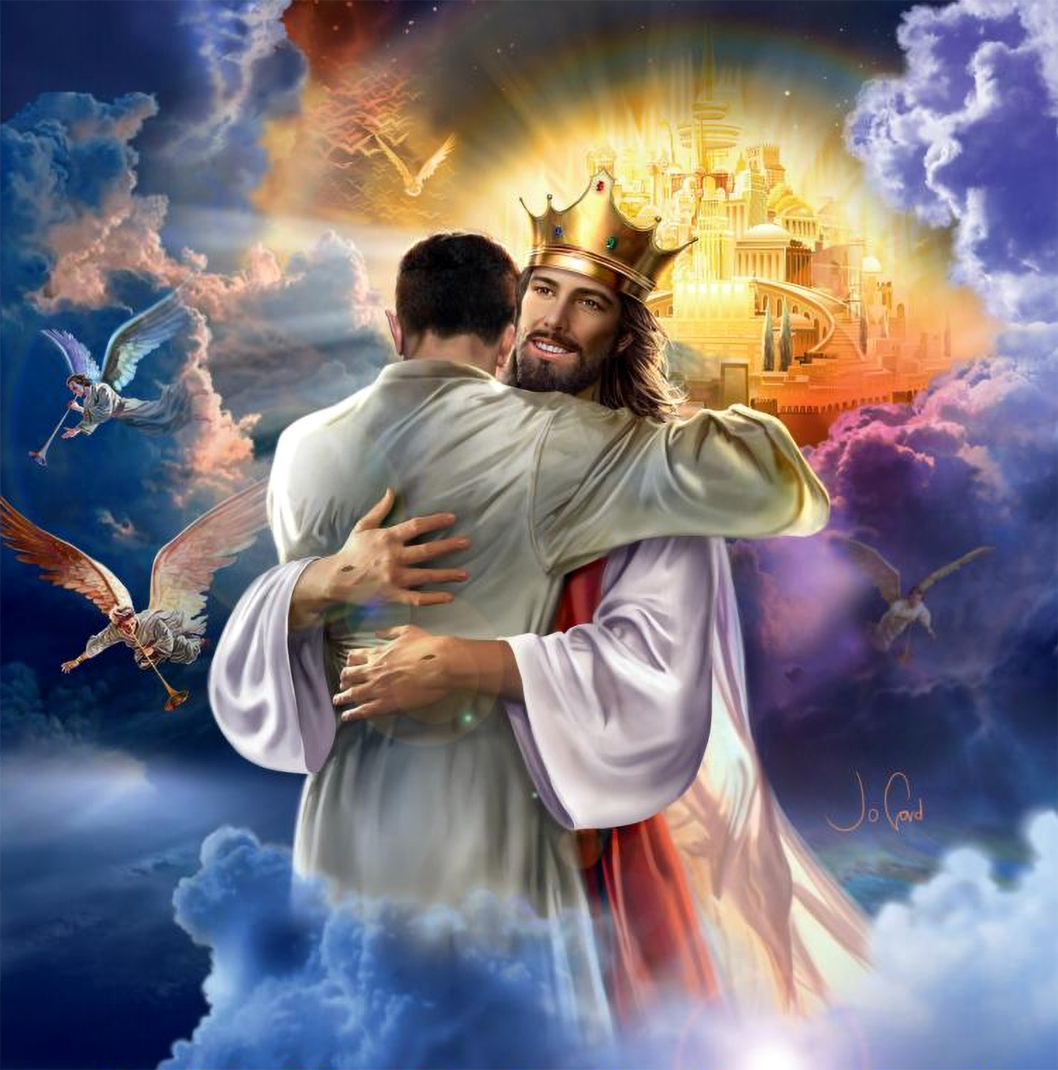

“ʻE kāinga ʻofeina, ko eni ko e fānau ʻae ʻOtua ʻakitautolu, pea ʻoku teʻeki ai hā mai pe te tau hoko ko e hā: ka ʻoku tau ʻilo, ʻoka hā mai ia, te tau tatau pe mo ia; he te tau mamata totonu kiate ia.”
(1 Sione 3:2)

