Slide 1
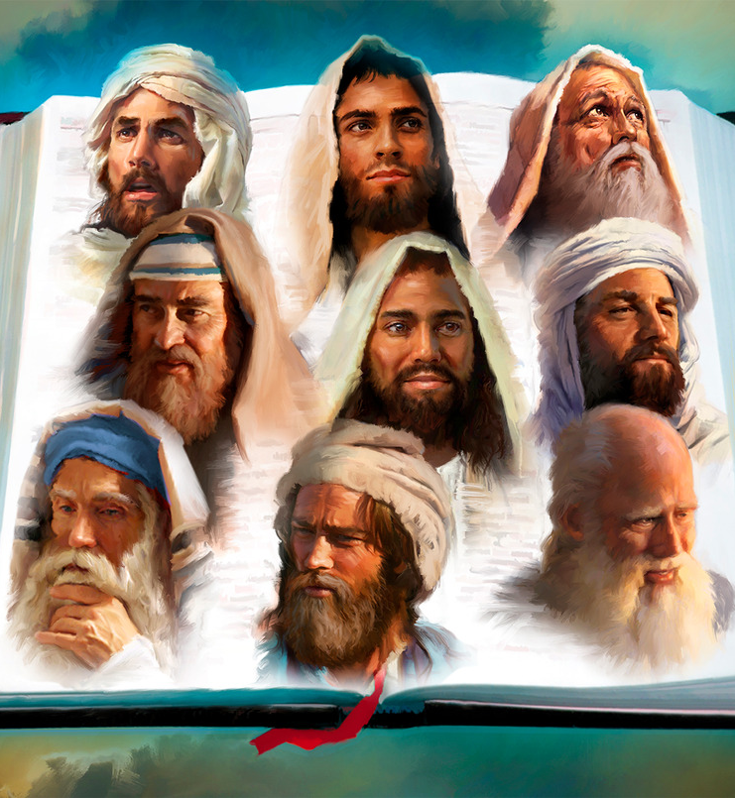
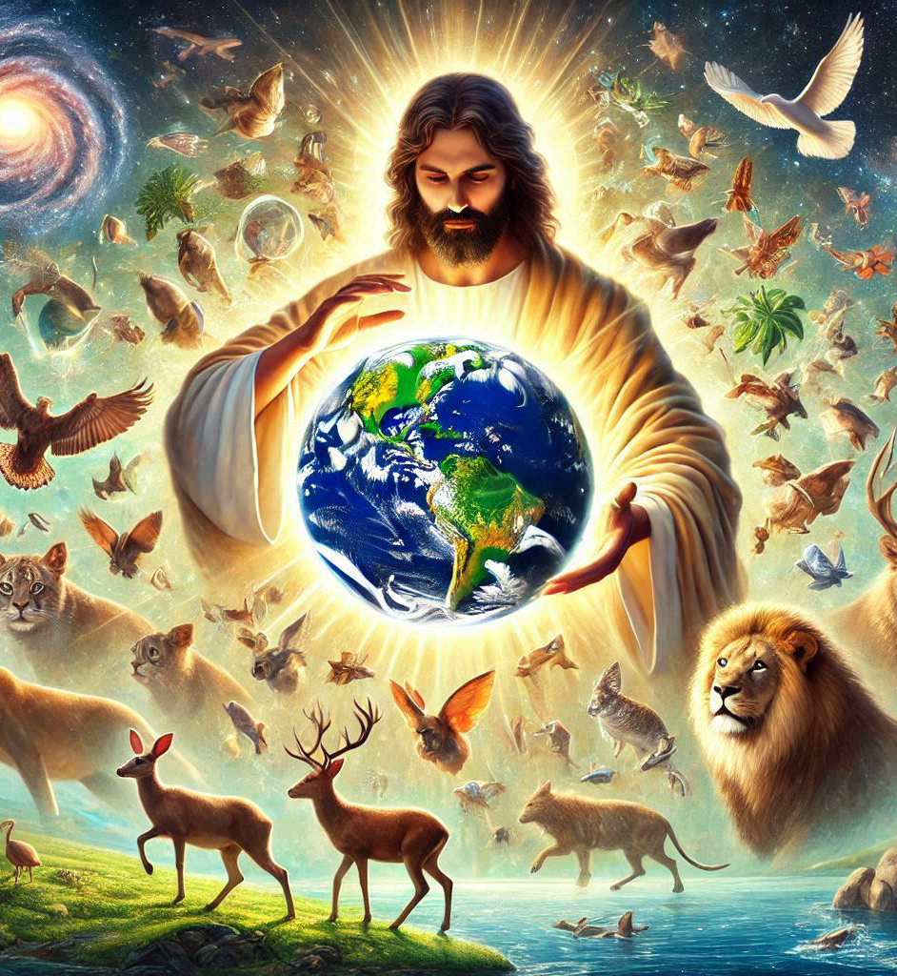
“Ko e ʻOtua, ʻaia naʻe folofola ʻi muʻa ʻi he ngaahi kuonga kehekehe mo e ngaahi anga kehekehe ki he ngaahi tamai ʻi he kau palōfita, Kuo ne folofola ʻi he ngaahi ʻaho ki mui ni kiate kitautolu ʻi hono ʻAlo, ʻaia kuo ne tuʻutuʻuni ke ʻaʻana ʻae ngaahi meʻa kotoa pē, ʻaia ne ne ngaohi ai foki ʻae ngaahi maama;”
(Hepelū 1:1-2)

Slide 2

«Pea ne u fanongo foki ki he leʻo ʻo Sihova, naʻe pehē, “Ko hai te u fekau, pea ko hai ʻe ʻalu maʻamautolu?”
Pea ne u toki pehē, “Ko au eni; ke ke fekau au.”.”»
(Isaia 6:8)

Slide 3

«naʻe tuʻu ʻa Sihosafate ʻo ne pehē, “ʻE Siuta, mo kimoutolu ʻae kakai ʻo Selūsalema, tokanga kiate au: Tui kia Sihova ko homou ʻOtua, ko ia ʻe fakatuʻumaʻu ai ʻakimoutolu: tui ki heʻene kau palōfita, ko ia te mou monūʻia ai.”.”»
(2 Me’a hokohoko 20:20)

Slide 4
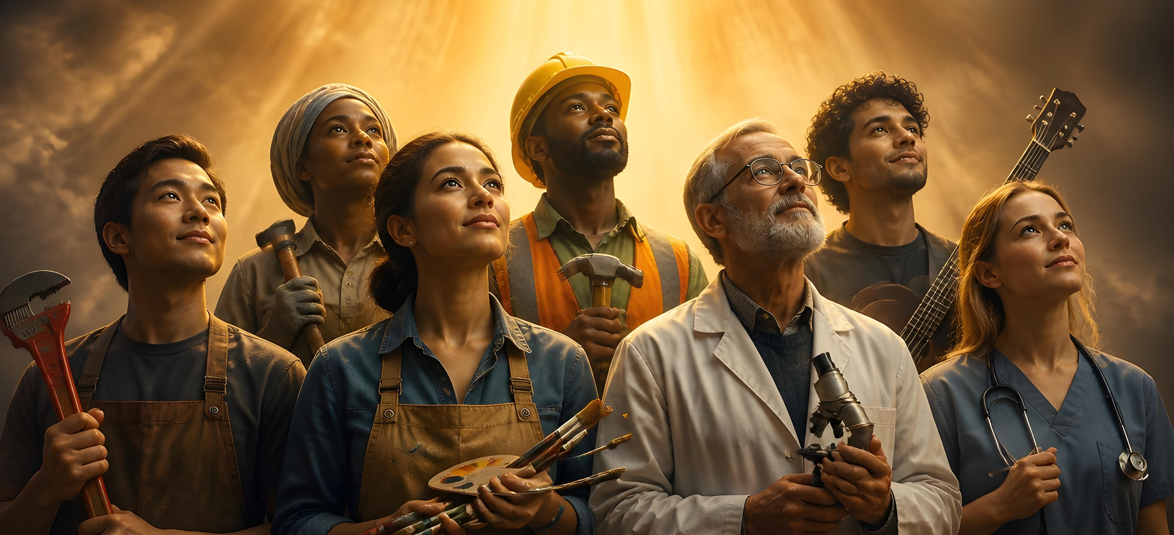
“Pea ko eni, ʻoku ai ʻae ngaahi foaki kehekehe, ka ko e Laumālie pe taha. Pea ʻoku ai ʻae ngaahi tauhi kehekehe, ka ko e ʻEiki pe taha.Pea ʻoku ai ʻae ngaahi ngāue kehekehe, ka ko e ʻOtua pe taha ʻoku fai kotoa pē ʻi he kakai kotoa pē.”
(1 Kolinitō 12:4-6)

Slide 5

“Ko e Fakahā ʻa Sisu Kalaisi, ʻaia naʻe foaki ʻe he ʻOtua kiate ia, ke fakaʻilo ki heʻene kau tamaioʻeiki ʻae ngaahi meʻa ʻoku totonu ke vave ʻa ʻene hoko; pea ne fekau mo fakaʻilo ia ʻe heʻene ʻāngelo ki heʻene tamaioʻeiki ko Sione: ‌ʻAia naʻa ne fakahā ʻae folofola ʻae ʻOtua, pea mo e fakamoʻoni ʻa Sisu Kalaisi, pea mo e ngaahi meʻa kotoa pē naʻa ne mamata ai.” (Fakahā 1:1-2)

Slide 6


“He ko e ngaahi meʻa kotoa pē naʻe tohi ʻi muʻa, naʻe tohi ko hotau akonaki, koeʻuhi ko e meʻa ʻi he faʻa kātaki mo e fakafiemālie ʻoe ngaahi tohi, ketau maʻu ai ʻae ʻamanaki lelei.” (Loma 15:4)

Slide 7







“Pea naʻe hoko ʻae ngaahi meʻa ni kotoa pē kiate kinautolu ko e ngaahi fakaʻilonga: pea kuo tohi ia ko hotau akonakiʻi, ʻakitautolu kuo hoko ki ai hono ngataʻanga ʻoe kuonga.” (1 Kolinitō 10:11)

Slide 8

“Pea kamata ia meia Mōsese, ʻo hoko ki he kau palōfita kotoa pē, ʻa ʻene fakamatala kiate kinaua mei he tohi ʻae ngaahi meʻa kotoa pē ʻoku kau kiate ia. ”
(Luke 24:27)

Slide 9
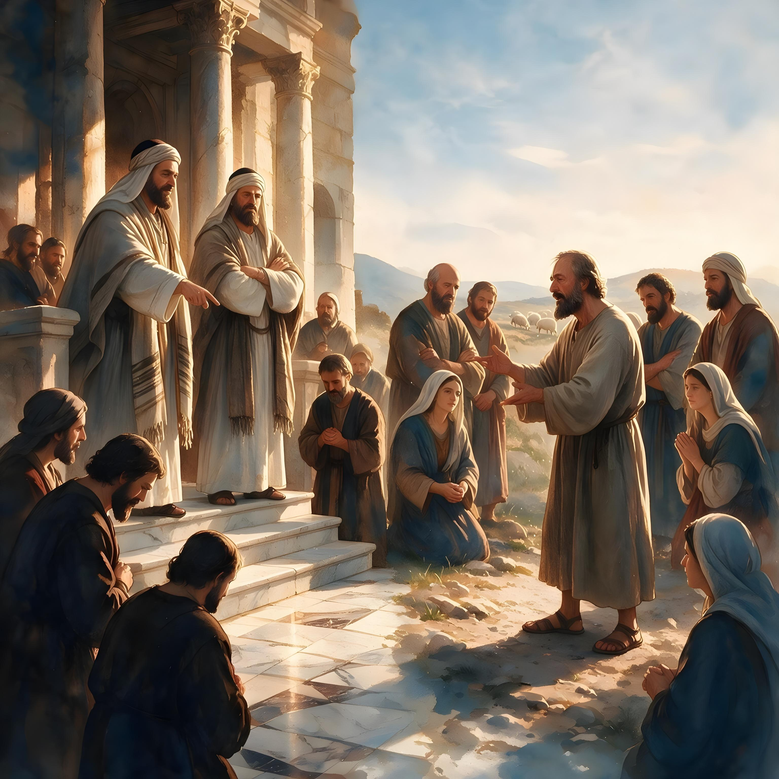

“ʻE Kāinga ʻofeina, ʻoua naʻa tui ki he laumālie kotoa pē, kae ʻahiʻahiʻi ʻae ngaahi laumālie, pe ʻoku ʻoe ʻOtua ʻakinautolu: koeʻuhi kuo tokolahi ʻae kau palōfita loi kuo ʻalu atu ki māmani. ”
(1 Sione 4:1)

Slide 10
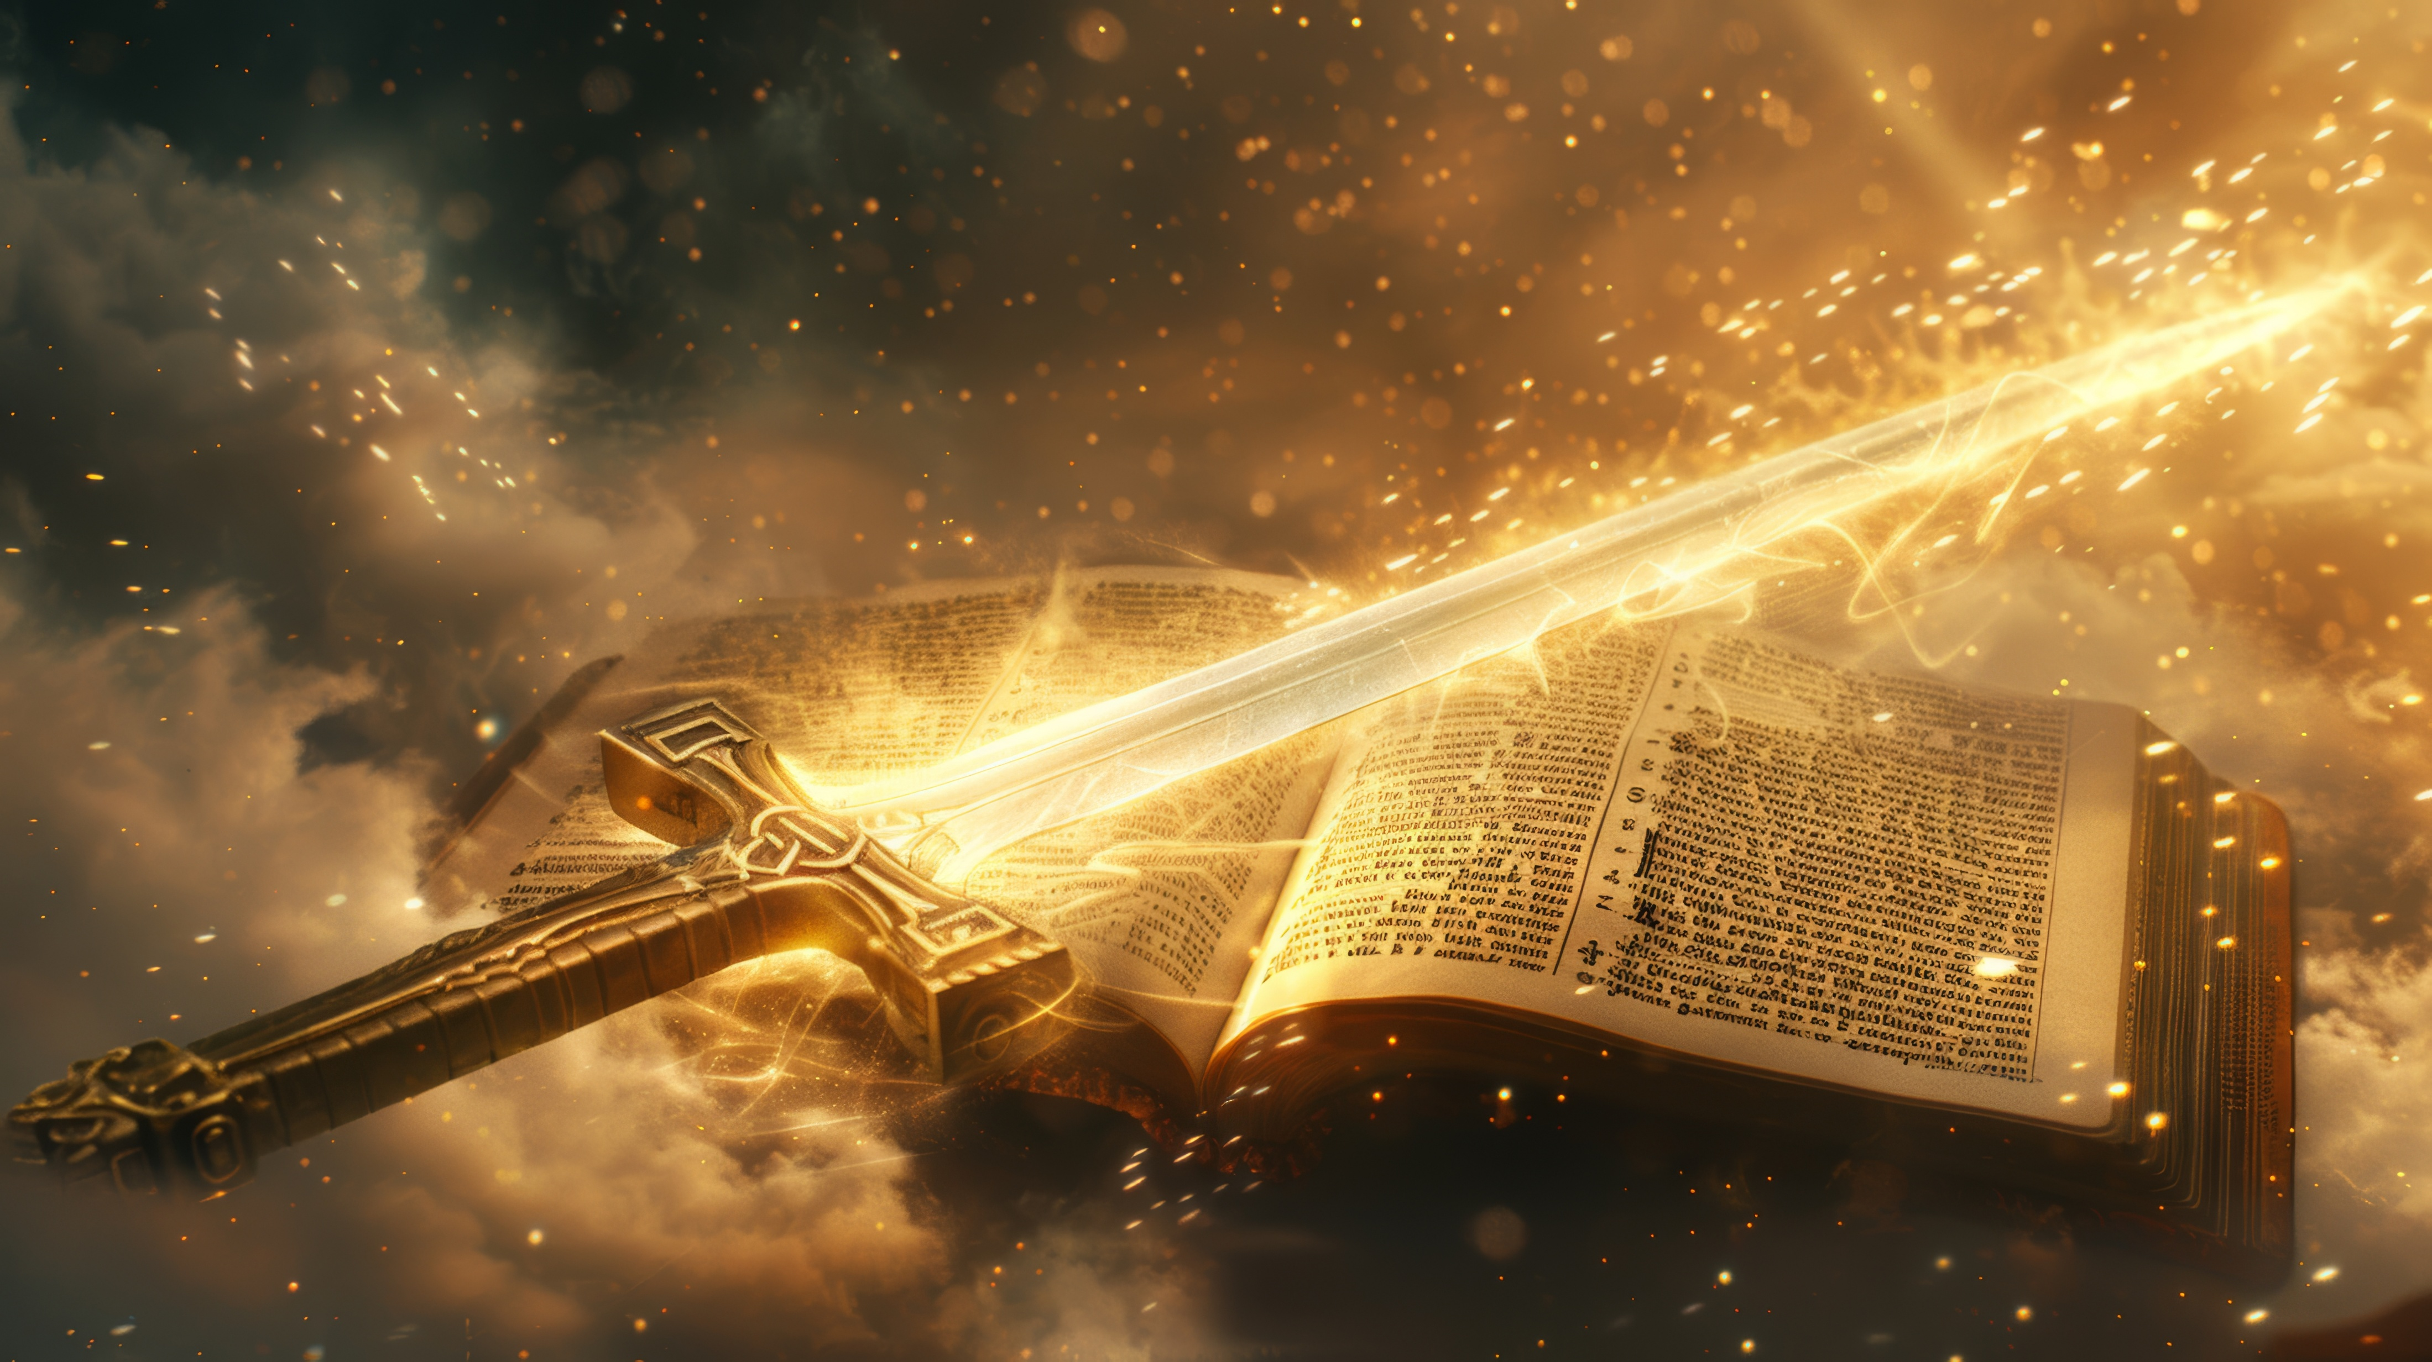
“He ko e folofola ʻae ʻOtua ʻoku moʻui, mo mālohi, pea māsila lahi ʻi ha heletā ʻoku fakatoumata, ʻoku ʻasi ki hono vaheʻi ʻoe loto mo e laumālie, mo e ngaahi hokotanga hui mo e uho, pea ʻoku ne fakahā ʻae ngaahi mahalo mo e filioʻi ʻoe loto.” (Hepelū 4:12)

Slide 11

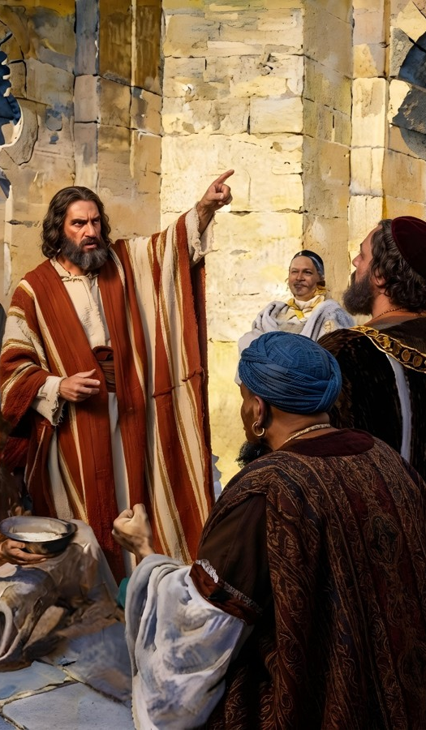
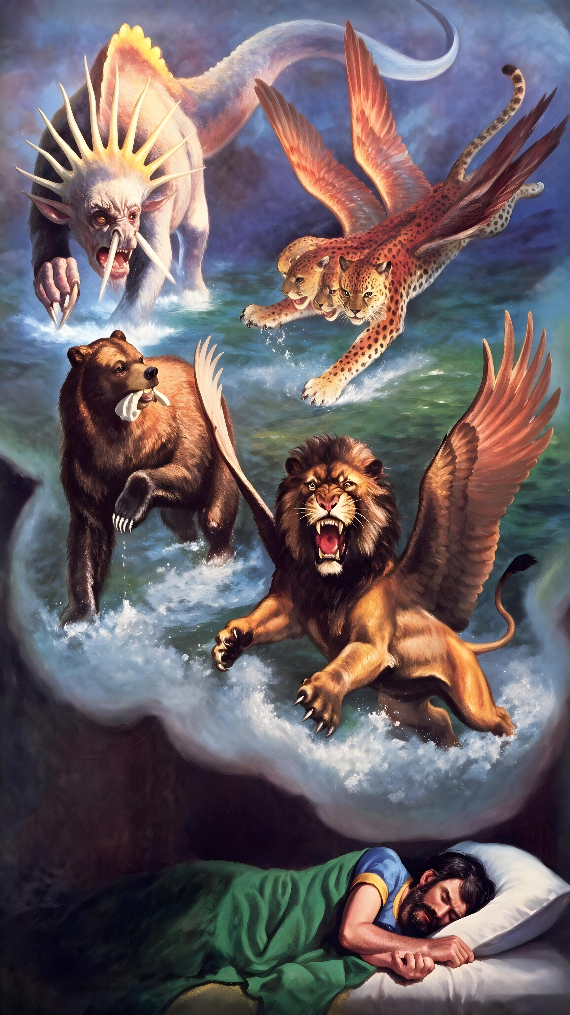
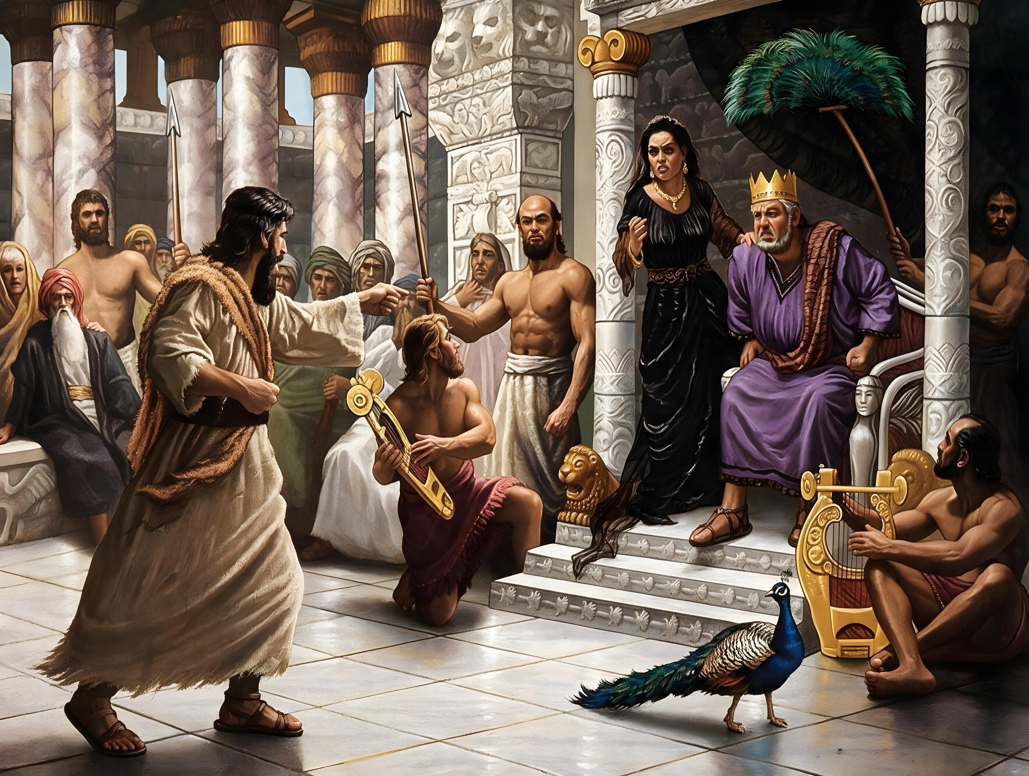
“Ko e moʻoni ʻe ʻikai fai ha meʻa ʻe Sihova ko e ʻOtua,
kae taʻefakahā ia ki heʻene kau tamaioʻeiki ko e kau palōfita.”
(Amosi 3:7)

Slide 12
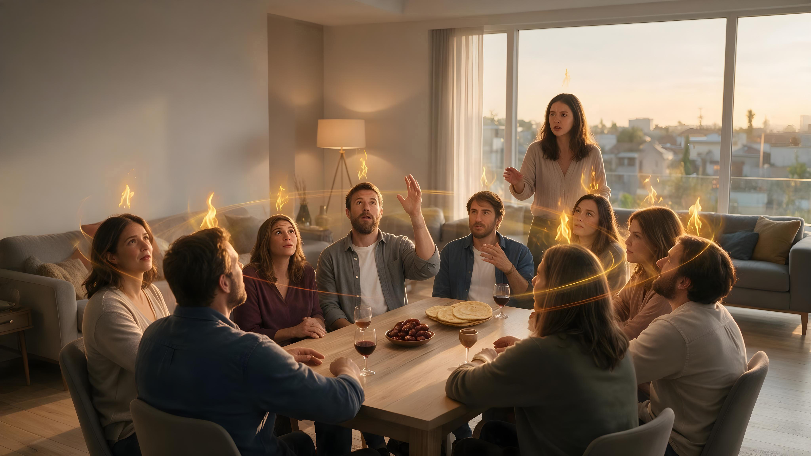
“Pea ʻe hoko ʻamui, te u huaʻi hoku Laumālie ki he kakai kotoa pē; pea ʻe kikite homou ngaahi foha mo homou ngaahi ʻofefine, pea ʻe misi ʻe hoʻo kau mātuʻa ʻae ngaahi misi, pea ʻe mamata ʻae ngaahi meʻa hā mai ʻe hoʻo kau talavou: Pea ki he kau tamaioʻeiki mo e kau kaunanga,
te u huaʻi foki hoku Laumālie ʻi he ngaahi ʻaho ko ia.”
(Soeli 2:28-29)

Slide 13
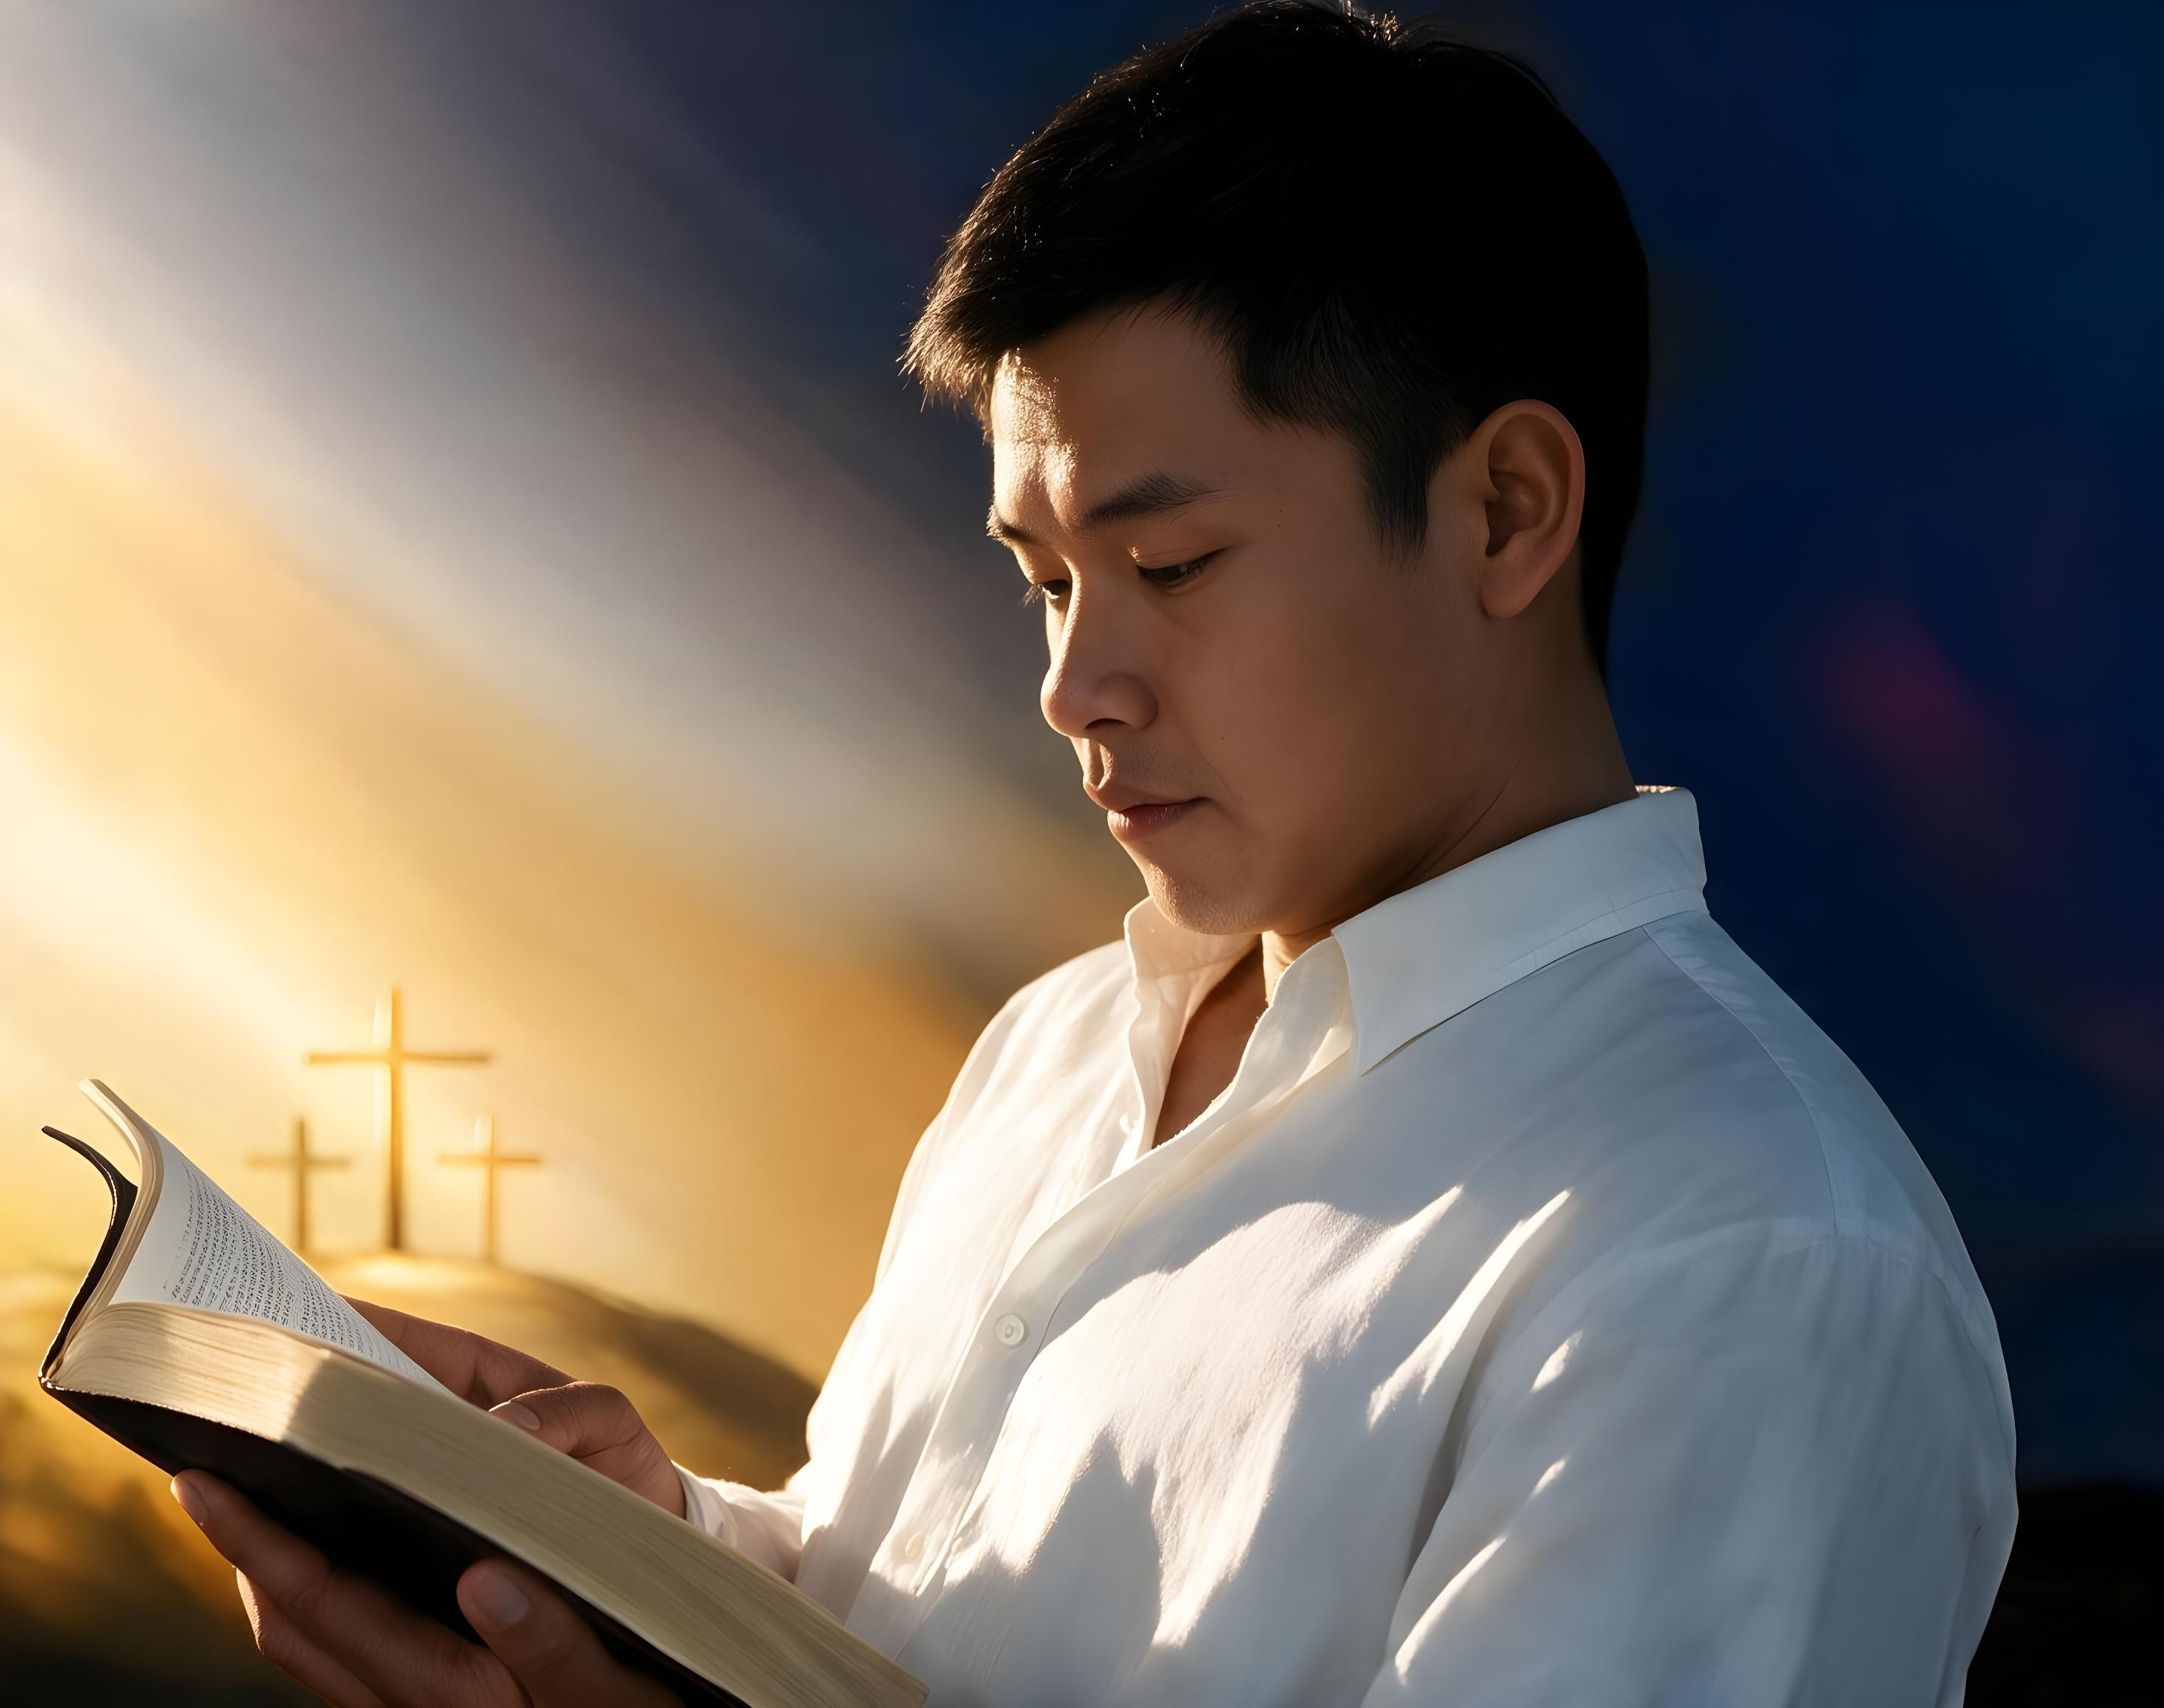
“‌ʻOku foaki mai ʻae Tohitapu kotoa pē ʻi he fakamānava ʻae ʻOtua, pea ʻoku ʻaonga ia ki he akonaki, mo e valoki, mo e fakatonutonu, mo e fakapoto ki he māʻoniʻoni: Koeʻuhi ke haohaoa ʻae tangata ʻoe ʻOtua, pea kakato hono teuteu ki he ngaahi ngaue lelei kotoa pē.”
(2 Timote 3:16-17)

