Slide 1
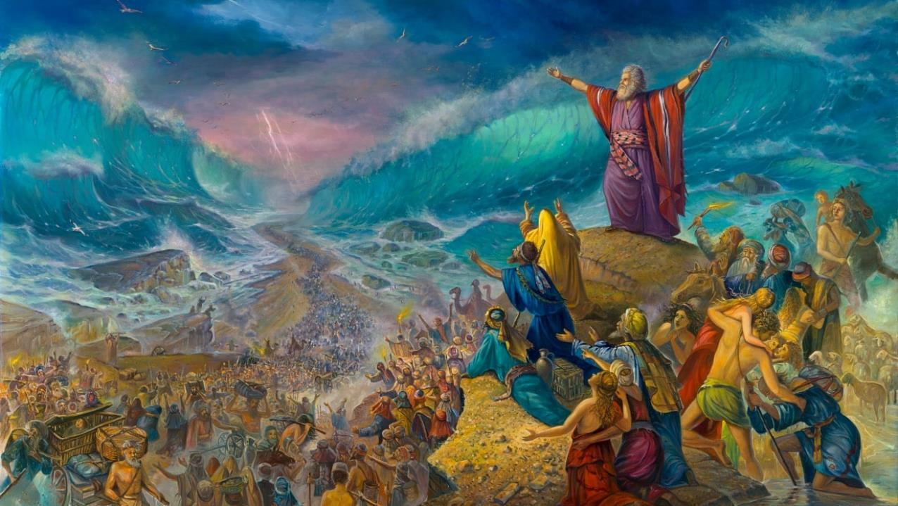
UKUCANDA KULWANDLE OLUBOMVU
Isifundo 6 – 9 KweyeThupha (Agasti) 2025

Slide 2
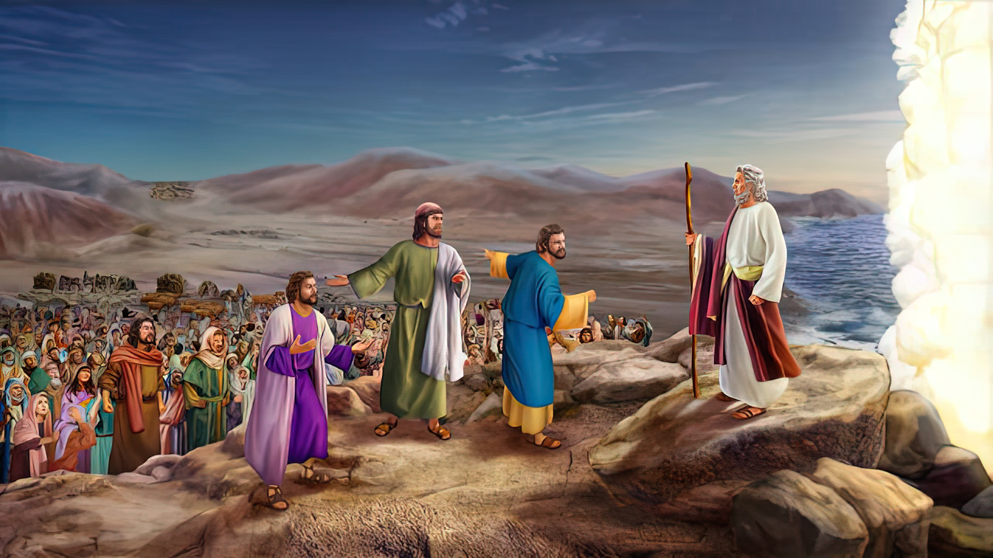
“Wathi uMoses ebantwini, Musani ukoyika; misani, nilubone usindiso lukaYehova aya kunenzela lona namhla; kuba amaYiphutha lawo niwabonileyo namhlanje, anisayi kuphinda niwabone naphakade. Uyehova uya kunilwela, ke nina niya kuthi cwaka” Exodus 14:13, 14.

Slide 3

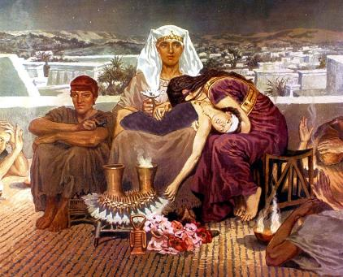
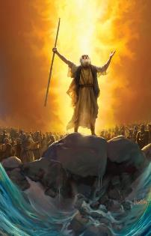
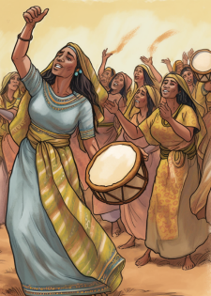



UThixo walumkisa kwasekuqaleni ukuba imfuduko esuka eYiphutha iza kuquka ukufa—okanye isoyikiso sokufa—sezibulo likaFaro (Eksodus 4:22-23).
Ukuphepha ukufa kwamazibulo nokuze akwazi ukubakhupha eYiphutha, uThixo wabacela isenzo sokholo: isithethe sePasika. Ngoku, njengoko wayebakhokelela kwangqingetye, yayilixesha lokuthabatha inyathelo lesibini lokholo: babheke phambili.
Emveni kokuwela uLwandle Olubomvu, bekhululekile ebukhobokeni, uSirayeli wagqabhuka, wavuma izango zengoma kuMkhululi wabo.
Imfuduko esuka eYiphutha:
Sukani niphume! (Eksodus 12:31-36)
Ukungcwaliswa kwamazibulo (Eksodus 13:1-16)
Ukunqumla kuLwandle Olubomvu:
Ukuvaleleka entlango (Eksodus 13:17-14:12)
Indlela elwandle (Eksodus 14:13-31)
Umbhiyozo:
Ingoma kaMoses (Eksodus 15:1-21)

Slide 4
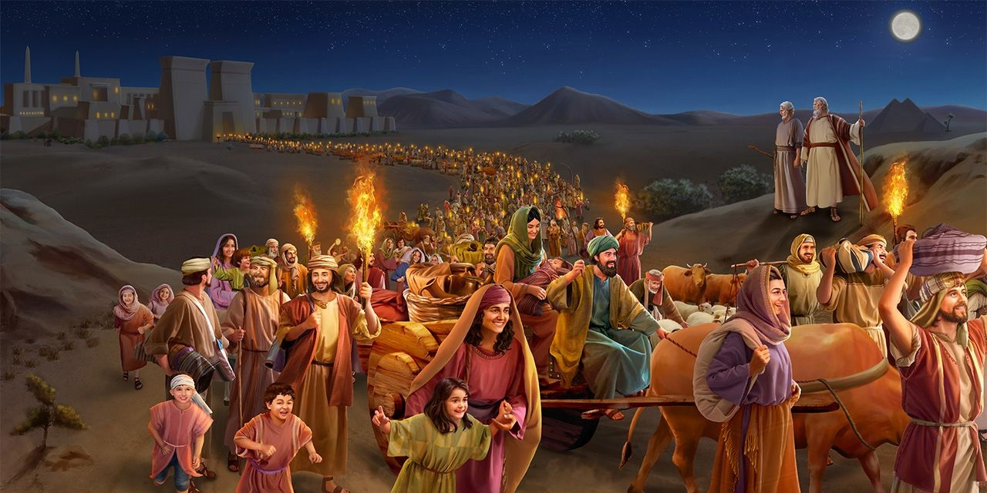
IMFUDUKA ESUKA EYIPHUTHA

Slide 5


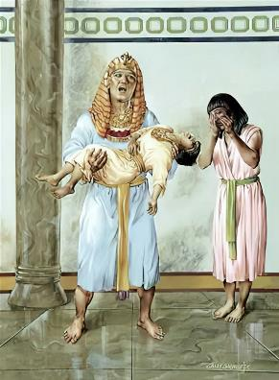
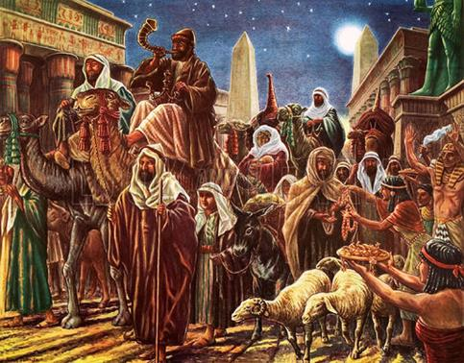
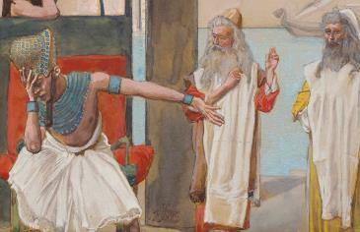
SUKANI NIPHUME!
“AmaYiphutha ajokisa ukubandulula abantu ngobungxamo kwelo zwe; kuba abesithi, Sonke sesifile. (Eksodus 12:33)
Yonke amaYiphutha yayiyinkangala, “kuba akubangakho ndlu ingenamntu ufileyo” (Eks. 12:30). Imvume kaFaro yokundulula uSirayeli yafika sekwaphulwe.
Ngokusebenzisa ibninzana elithi, “nam nindisikelele” (Eks. 12:32), uFaro wayevakalisa imvakalelo zabantu bakhe: nceda, masingaphindi sihlelwe yinto!
Wayengabonisi ukuzisola okunyanisekileyo, kodwa wayenqwenela kunqamke imbubhiso
Ngethuba uSirayeli ecela intlawulo kumaYiphutha ngokuwakhonza iminyaka emininzi, amaYiphutha “abanika konke awayekufuna” (Eksod. 12:36). Ngale ndlela, uThixo waqinisekisa ukuba izibulo laKhe limka eYiphutha likhuselekile-kwaye lixhakazela.

Slide 6

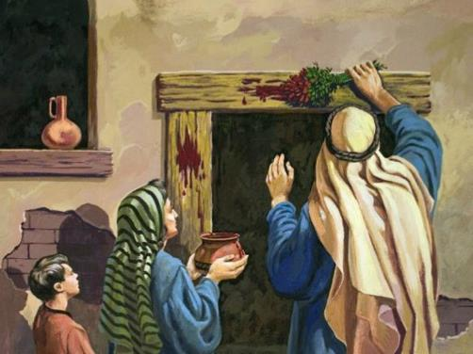
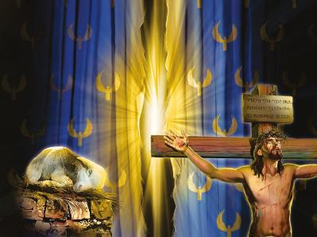

UKUNGCWALISWA KWAMAZIBULO
“Ndingcwalisele onke amazibulo, yonke into evula isizalo phakathi koonyana bakaSirayeli, kumntu nakwinkomo yeYam.” (Exodus 13:2)
Angcwaliswa njani amazibulo?
Angcwaliswa ngokufa. Izibulo ngalinye kwakufuneka lifile. Kodwa umsindleko wawusele wenziwe endaweni yawo, ukuba omnye afe endaweni yawo.
Phawula ulwalamano: uSirayeli lizibulo likaThixo (Eks. 4:22); iBandla namhlanje nguSirayeli wakwamoya (Gal. 6:16); ngako oko, sonke simelwe kukufa ukuze singcwaliselwe kuThixo; kodwa kukho uMntu ofe endaweni yethu.
UYesu, “iMvana kaThixo” (Yoh. 1:29), yafa ukuze bonke abaqaba igazi emigubasini yentliziyo zabo bangafi, koko babe noBOMI OBUNGUNAPHAKADE.
UThixo sele eyidlalile eyakhe indima. Luxanduva lwethu ukumvumela asigubungele ngegazi laKhe elikhululayo.

Slide 7
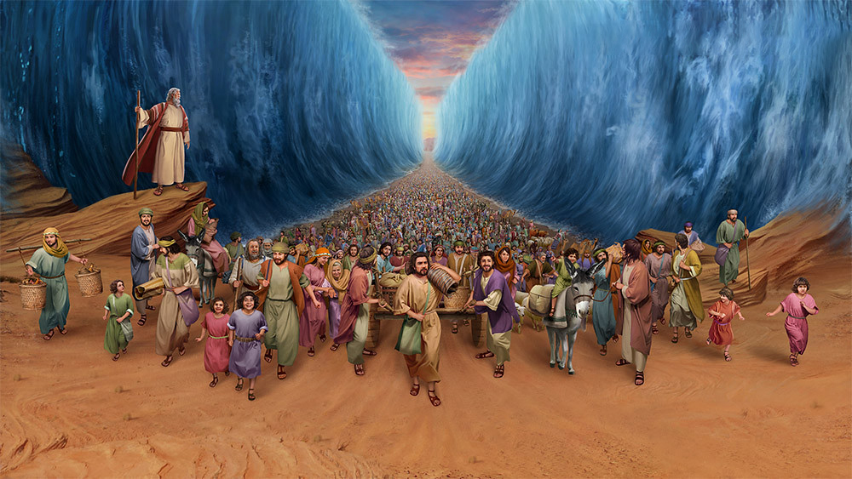
UKUNQUMLA KULWANDLE OLUBOMVU

Slide 8


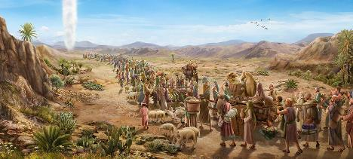
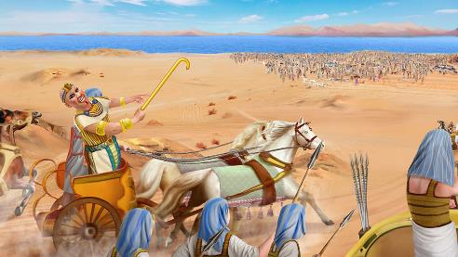
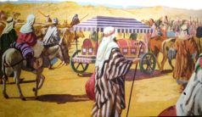
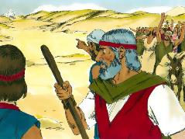
UKUVALELEKA ENTLANGO
“Uya kuthi uFaro ngoonyana bakaSirayeli, Badidekile ezweni, intlango ibavingcele.” (Eksodus 14:3)
Ngemvume kaFaro, uSirayeli waphuma eYiphutha “exhobile” (Eksod. 13:18 NIV). Kodwa uThixo zange afune bajamelane nemfazwe, wabakhokelela kwenye indlela (Eksod. 13:17).
Ngelo lixa, uFaro wazisola ngokubandulula, wabuya kwisigqibo sakhe, wamlandela uSirayeli (Eksod. 14:5). Ngoku uSirayeli wayevaleleke entlango, kungekho ndlela yokuqhwesha (Eksod. 14:2-3, 9).
Ngesenzo sokholo, banyuka namathambo kaYosefu (Eks. 13:19). Ngaphaya koko, uThixo wayebakhokela ngokumangalisayo (Eks. 13:21).
Nangona kunjalo, ukholo lwabo lwasilela xa bebona umkhosi kaFaro. (Eks. 14:10-12). Yaba sisiquphe ukulibala kwabo imimangaliso abayobonayo! Ingaba oku kunokwenzeka nakuthi?
“Khumbulani imisebenzi yakhe ebalulekileyo awayenzayo” (1 Kron. 16:12)

Slide 9

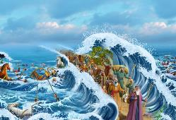
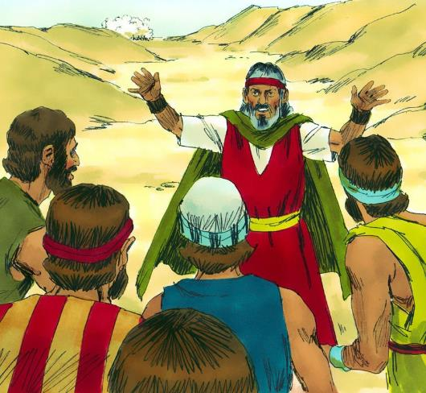
INDLELA ELWANDLE
“Wathi uMoses ebantwini, Musani ukoyika; misani, nilubone usindiso lukaYehova aya kunenzela lona namhla; kuba amaYiphutha lawo niwabonileyo namhlanje, anisayi kuphinde niwabone naphakade. UYehova uya kunilwela, ke nina niya kuthi cwaka.” (Eksodus 14:13-14)
Ekusileleni kokholo lwabantu, uMoses uyabakhuthaza ukuba bamthembe uThixo (Eks. 14:13-14):
“Musani ukoyika”
Ukuthemba uThixo linyathelo lokuqala lokuzuza uloyiso.
“Misani”
Masime endaweni esibekwe kuyo, singandumzeli, sikhalaza.
“Nilubone usindiso”
Ukuba siyamvumela uThixo asikhokele, uloyiso luqinisekile.
“UYehoza uya kunilwela”
UThixo uyasilwela kwisono nakuSathana. IKhalvari bobona bungqina boku.

Slide 10

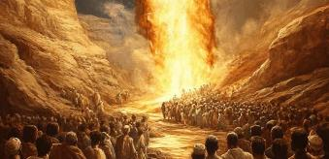
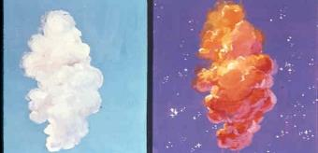
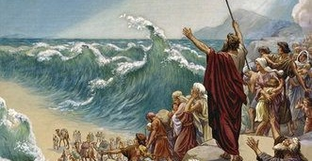
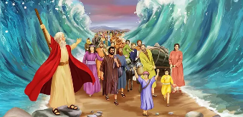
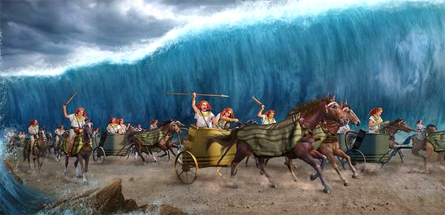
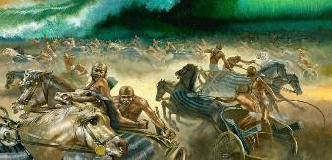
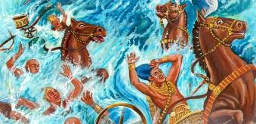
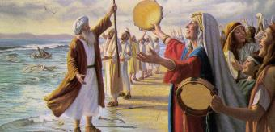
INDLELA ELWANDLE
UThixo wabanika abantu umyalelo omnye kuphela: “ndulukani” (Eksodus 14:15). Ukusukela apha, kwaqalisa into ebingalindelekanga (Eksodus 14:19-31):
Sasuka isithunywa sikaThixo nomqulu welifu zema phakathi kwemfuduka yamaSirayeli nempi yamaYiphutha
Ngexesha lasebusuku, umqulu waba bubumnyama kumaYiphutha, wawakhanyisela amaSirayeli.
UMoses wayiphakamisa intonga lwaze ulwandle lwa hluleka kubini ukuze uSirayeli awele kwindawo eyomileyo.
Wangena uSirayeli elwandle, amanzi eludonga macala.
Angena nawo amaYiphutha elwandle.
Ngojekejeke, uThixo wawenza umsindo amayiPhutha.
Athe xa ezama ukujika, abuya amanzi, ayigubungela yonke impi, akwasala nomnye.
AmaSirayeli awabona amaYiphutha efile elunxwemeni lolwandle, bakholwa nguYehova nanguMoses.

Slide 11
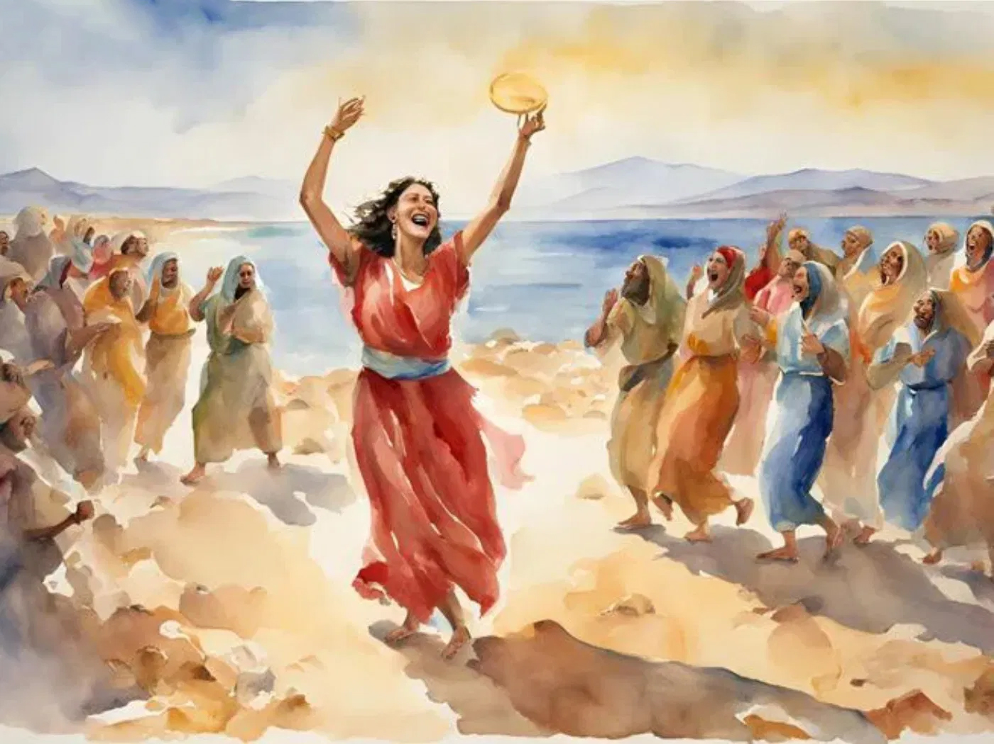
Umbhiyozo

Slide 12


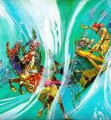
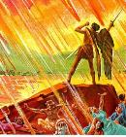
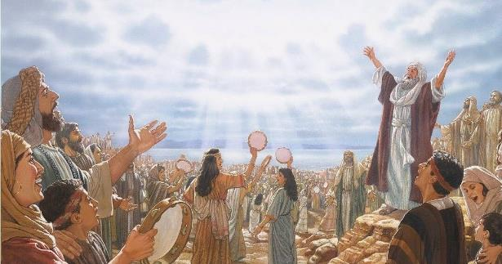
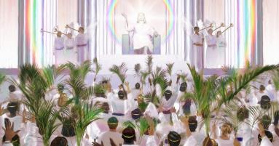
INGOMA KAMOSES
“Bayivuma ingoma kaMoses, umkhonzi kaThixo, nengoma yeMvana, besithi: “Mikhulu ingummangaliso imisebenzi yakho, Nkosi, Thixo Somandla; Zinobulungisa, ziyinyaniso iindlela zakho, Kumkani weentlanga.” (IsiTyhilelo 15:3)
Bekubonile okwenzekileyo, uMoses ukhokela uSirayeli ngengoma yokudumisa, ngeli lixa uMiriyam esabela ngomdudo nomkhosi weentokazi (Eks. 15:1, 20-21).
Kule ngoma, akukho nto ikhankanywayo ngokwenziwe nguSirayeli. Ayipheleli nje ekudumiseni uThixo ngokutshabalalisa utshaba (Eks. 15:6), ikwancoma nemisebenzi yaKhe eyincamisa (Eks. 15:11). Sichazelwa indlela ezasabela ngayo iziwe ezevayo ngoku (Eks. 15:14).
Ngaphaya koko, saziswa ngawayesezakwenza uThixo: “Uya kubangenisa, ubatyale entabeni yelifa lakho” (Eks. 15:17).
Emveni kokuba ziwisiwe izigwebo zikaThixo, ububi nengcinezelo zincothulwe nengcambu, abakhululweyo bezizwe baza kumdumisa ngokugweba ngobulungisa, becula ingoma kaMoses neyeMvana (IsiTyh. 15:3).

Slide 13

“Ekukhululeni imiphefumlo yethu kubukhoboka besono, uThixo uye wasenzela inkululeko enkulu ngakumbi kunaleyo yamaHebhere kuLwandle oluBomvu. Njengomkhosi wamaHebhere, sifanele simdumise uYehova ngentliziyo nangomphefumlo nangelizwi “ngemisebenzi yakhe emangalisayo ebantwaneni babantu.” Abo bahlala kwiinceba ezinkulu zikaThixo, kwaye bengazikhathaleli izipho zakhe ezincinci, baya kubhinqa umbhinqo wovuyo kwaye bacule ezintliziyweni zabo eNkosini. Iintsikelelo zemihla ngemihla esizifumana esandleni sikaThixo, yaye ngaphezu kwako konke ukufa kukaYesu ukuze kuzise ulonwabo nezulu esilifumanayo, zimele zibe ngumxholo wombulelo ongaguqukiyo..”
EGW (Conflict and Courage, March 28)

