Slide 1

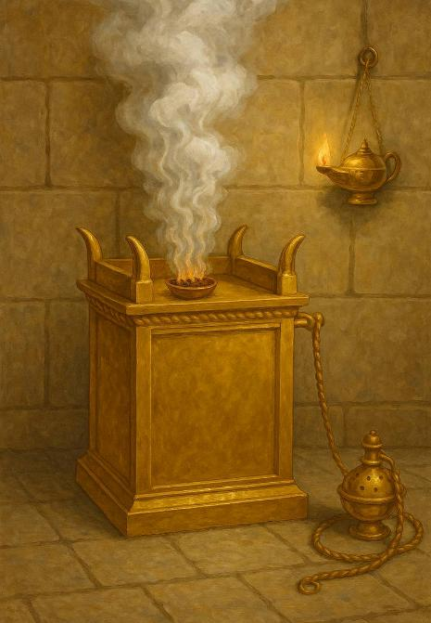
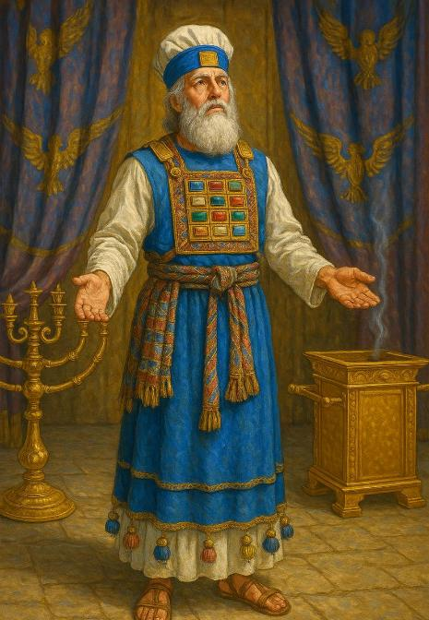
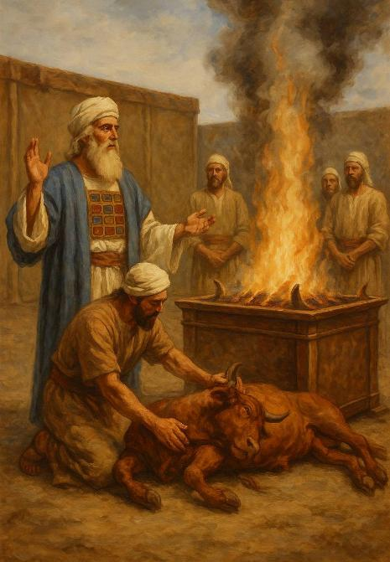
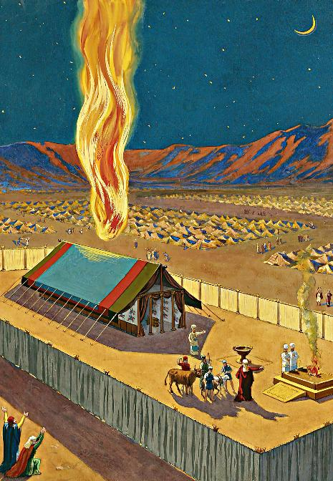
UMNQUBA
ISifundo 13: 27 kweyoMsintsi 2025

Slide 2
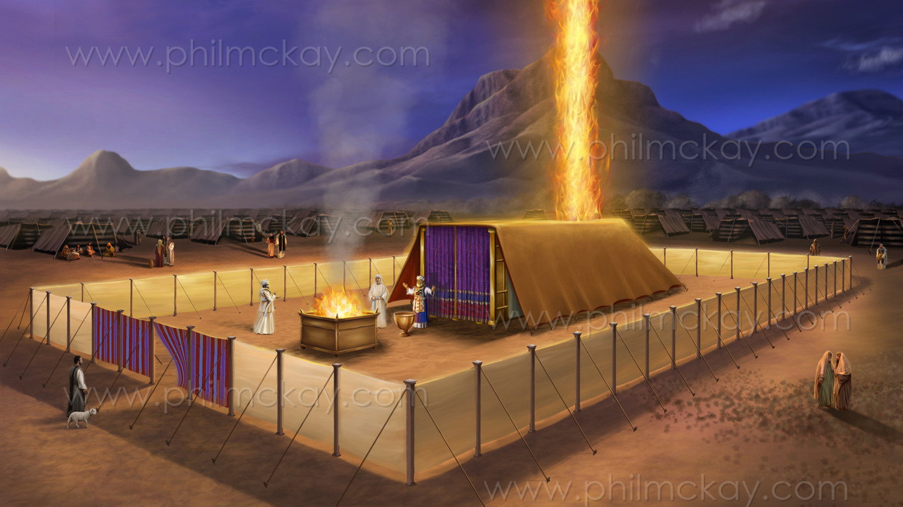
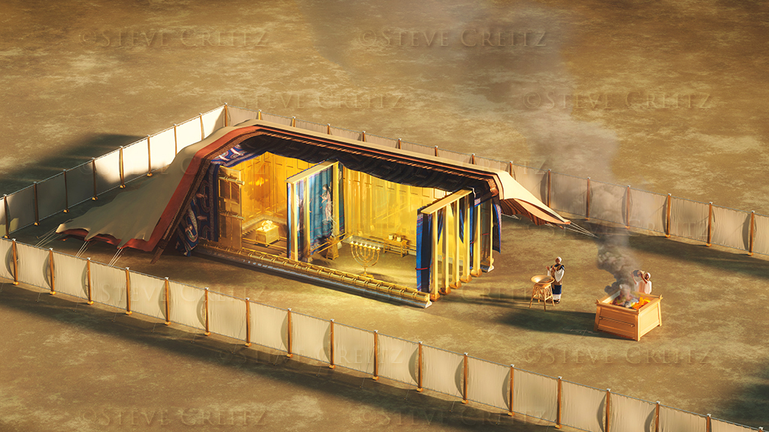
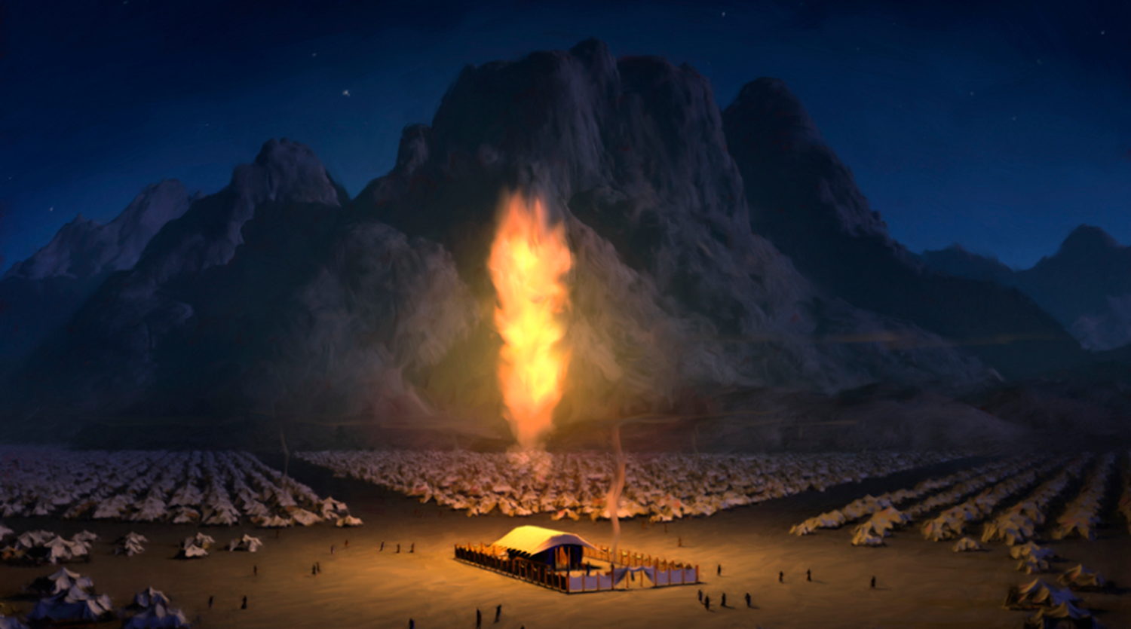
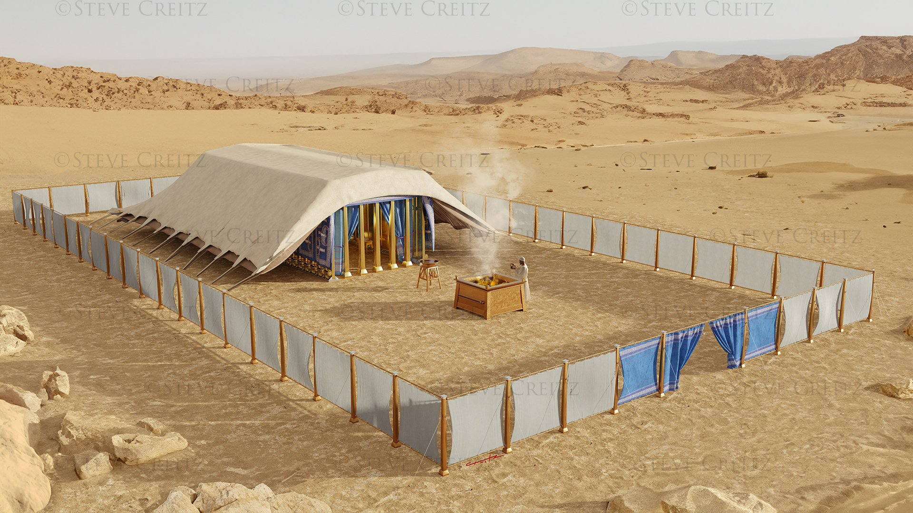
“Ilifu layigubungela intente yokuhlangana, ubuqaqawuli bukaYehova bawuzalisa umnquba…. Kuba ilifu likaYehova beliba phezu komnquba Emini, Umlilo ube phezu kwawo ebusuku, phambi kwendlu yonke kaSirayeli, ekundulukeni kwabo konke”
Eksodus 40:34, 38

Slide 3

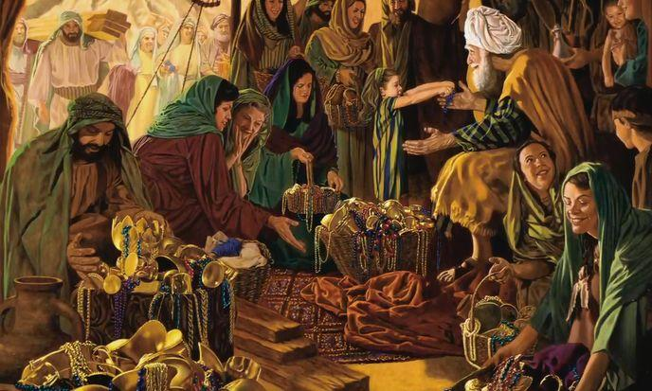


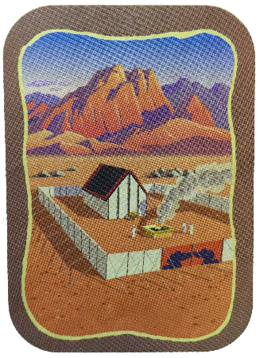
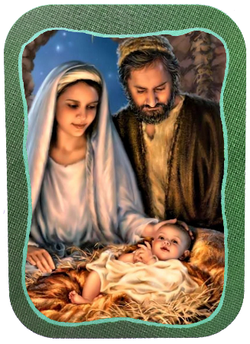
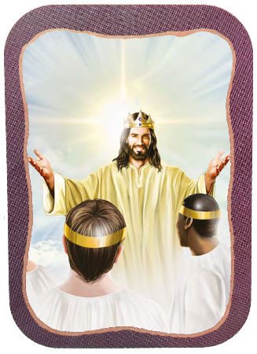






Izahluko zokugqibela ze-Eksodus zinikelwe kwinkcazelo eneenkcukacha zokwakhiwa nokunikezelwa koMnquba.
La yayingamathuba akhethekileyo, apho abantu bathatha inxaxheba ngovuyo, benikela—ngamnye njengoko babenako—kulo msebenzi mkhulu kaThixo.
Esona sizathu siphambili uThixo asinikayo sokwakha le Tempile iphathwayo ngumnqweno waKhe wokuhlala phakathi kwabantu baKhe (Eks. 25:8). Lo mnqweno wazalisekiswa emntwini uYesu, kwaye uya kuzaliseka ngokupheleleyo xa sonke sikunye naYe kuMhlaba oMtsha.
Ukulungiselela:
ISabatha (Eksodus 35:1-3)
Umnikelo ngokuqhutywa yintliziyo (Eksodus 35:4-36:7)
Umnquba:
Ukwakhiwa (Eksodus 36:8-39:43)
Ukunikezelwa (Exodus 40:1-38)
Eminye iminquba:
UYesu neYerusalem eNtsha

Slide 4
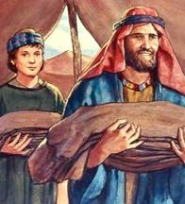
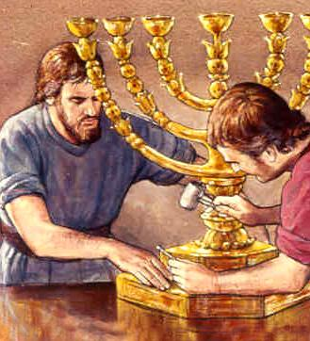
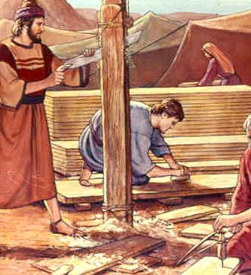
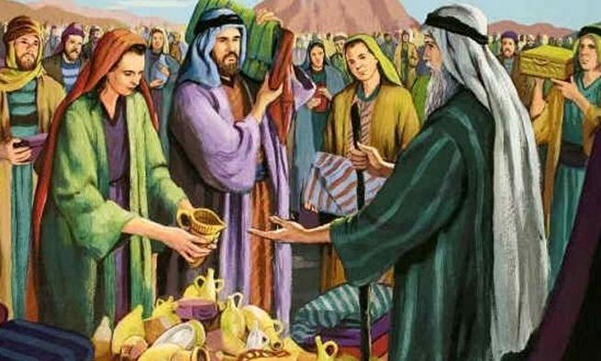
UKULUNGISELELA

Slide 5

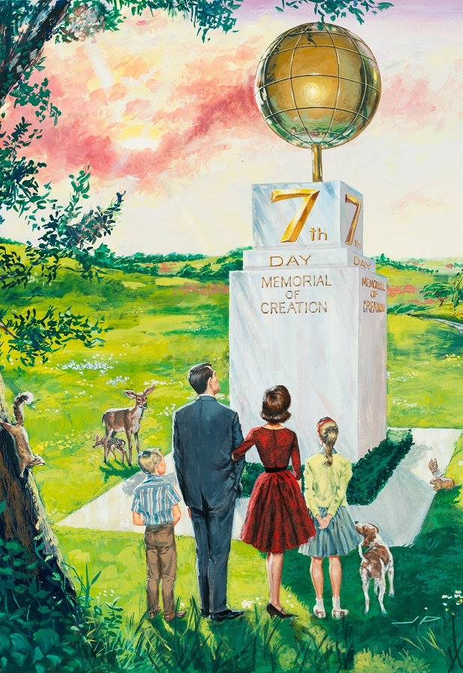
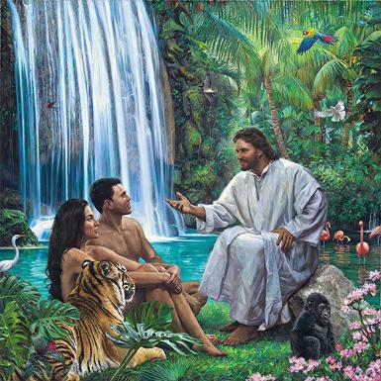
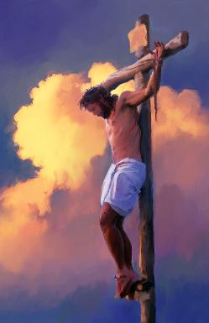
ISABATHA
“Wosebenza imihla emithandathu ; ke umhla wesixhenxe woba yingcwele kuni, isabatha kasabatha; bonke abenza umsebenzi ngayo bobulawa.” (Eksodus 35:2)
Emva kokuba nombono wozuko lukaThixo, uMoses wadlulisela ebantwini “oko uYehova abemwisele umthetho ngako” (Eks. 35:1, 4). Le miyalelo yayiquka ubudlelwane babo noThixo ekuhambeni kwexesha (iSabatha) nasesibhakabhakeni (uMnquba).
UThixo wayibekela bucala iSabatha njengexesha elikhethekileyo lokuba sinandiphe ukuba kunye naYe kwiNdalo ngokwayo (Gen. 2:1-3; Eks. 20:11) yaye wakhumbuza amaSirayeli ngako oku ngaphambi nje kokuba avakalise iMithetho Elishumi (Eks. 16:22-29).
ISabatha isikhumbuza ukuba uThixo unguMdali noMhlawuleli wethu (Dut. 5:15), kwaye isise kwixesha elizayo apho sinokuyonwabela ukuba kunye naYe ngonaphakade (Isa. 66:22-23).

Slide 6

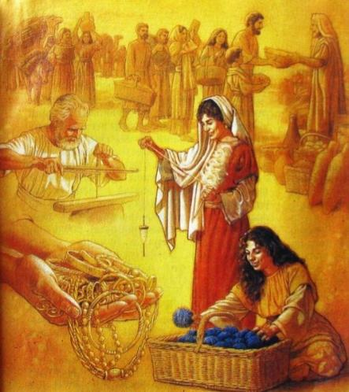
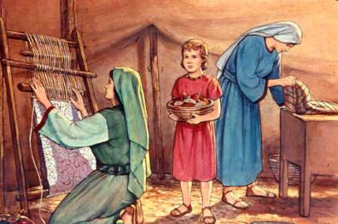
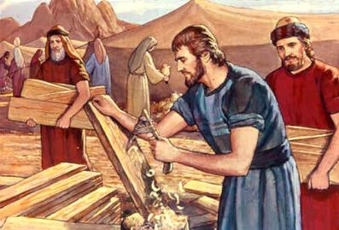
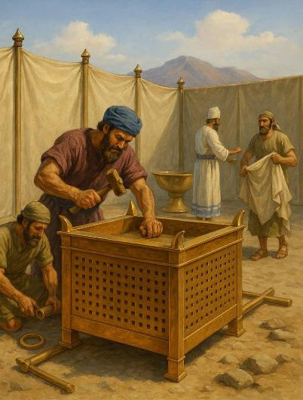
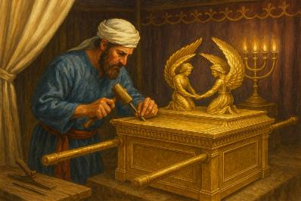
UMNIKELO NGOKUQHUTYWA YINTLIZIYO
“Thabathani phakathi kwenu, nise umrhumo kaYehova; bonke abantliziyo zibaqhubayo mabazise umrhumo kaYehova: igolide, nesilivere, nobhedu [ …] Bonke benentliziyo elumkileyo kuni mabeze, benze zonke izinto uYehova awise umthetho ngako.” (Eksodus 35:5,10).
Kwakukho iindlela ezimbini zokunikela kumsebenzi woMnquba: ukunikela ngezinto zokusebenza kunye nokwenza umsebenzi.
Kwasetyenziswa ngaphezu kwetoni yegolide, malunga neetoni ezi-3,75 zesilivere, neetoni ezimalunga ne-2,5 zobhedu, kwanomthi namalaphu awahlukahlukeneyo (Eks. 38:21-31).
Ivela phi yonke le nto? Uninzi lwazo lwaluvela kwinto eyathathwa nguSirayeli kumaYiphutha xa ayenduluka (Eks. 11:2).
Ukongezelela, umsebenzi wabajikelezisi, abathungi, abachweli, nabachweli bamatye anqabileyo, njl.njl.
Wonke umntu wayekulungele ukunceda de uBhetsaleli, uAholiyabhi, nabanye abasebenzi bacela uMoses ukuba abanqande abantu ekuziseni iminikelo ( Eks. 36:3-7 ).
Ukuphumeza lo msebenzi, uMoya oyiNgcwele wajizeka bonke abasebenzi ababandakanyekayo ngezipho (Eks. 35:30–36:2). Ngokukwanjalo, uyaqhubeka enikela izipho eziyimfuneko kubo bonke abo basebenzisanayo emsebenzini kaThixo.

Slide 7

“UThixo unike amadoda nabafazi izipho ezixabisekileyo. Kwabahlukeneyo ubanike izipho ezahlukahlukeneyo. Asingabo bonke abanamandla afanayo obuntu okanye ubunzulu obufanayo bolwazi. Kodwa ngamnye makasebenzise iziphiwo zakhe enkonzweni yeNkosi, enoba esi sipho sisenokubonakala sisincinane kangakanani na. Igosa elithembekileyo lirhweba ngobulumko ngezinto eziphathiswe lona.”
EGW (The Upward Look , December 31)

Slide 8
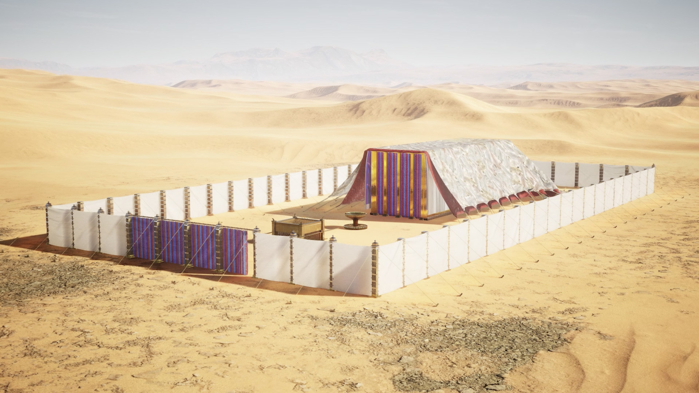
UMNQUBA

Slide 9

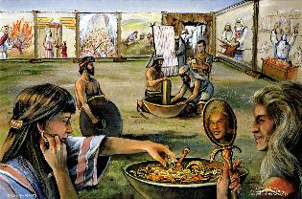
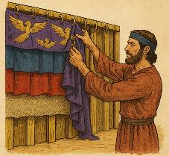
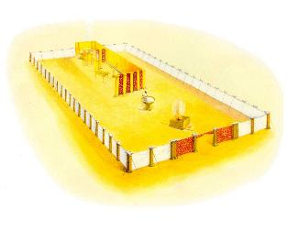
UKWAKHIWA
“Wawukhangela uMoses wonke umsebenzi, nango ke bewenzile;,njengoko uYehova abemwisele umthetho ngako, bawenjenjela. Wabasikelela ke uMoses” (Eksodus 39:43)
Ziziphi izinto ezaziyimfuneko ukuze uMnquba Wokuhlangana wenze imisebenzi yawo?
UMnquba wentente yokuhlangana (INgcwele neNgcwele kaNgcwele)
Ityeya yesingqino
Itafile yezonka
Isiphatho sezibane
Isibingelelo sokuqhumisela
Isibingelelo sedini elinyukayo
Uhehema lwesitya sokuhlambela
Intendelezo
iEfodi
Umqala wesigcinasifuba
Nezinye iingubo

Slide 10

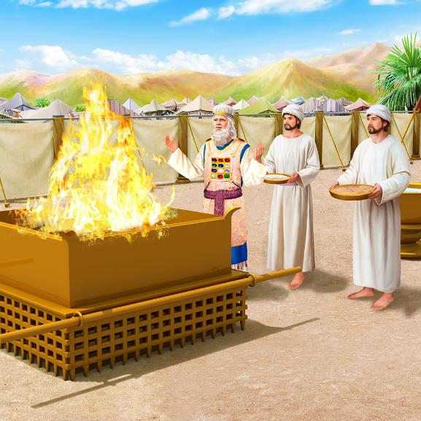
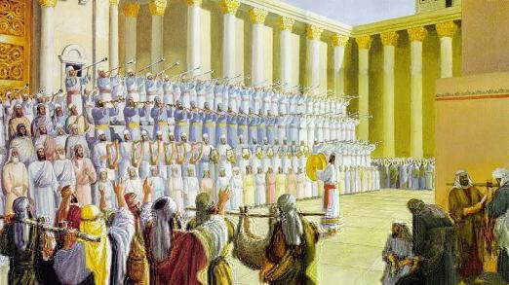
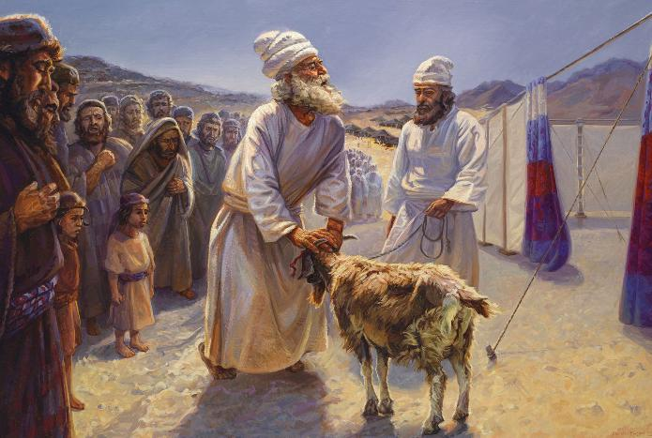
UKWAKHIWA
Yakuba yakhiwe, ingcwele (uMnquba nentendelezo) yayilikhaya leenkonzo ezimbini ezahlukeneyo: yemihla ngemihla neyonyaka. Imisitho yabo eyahlukeneyo, ehlanganiswe kunye, isifundisa oko:
UThixo usithiyile isono
UThixo uyamsindisa umoni
UThixo uza kubatshabalalisa aboni
UThixo uqinisekisa kamva elimimithekayo
Ngenkonzo yemihla ngemihla, uThixo wabonisa indlela axolela ngayo, ngobabalo, umoni: ngokufa kwesilwanyana esingenatyala, “iMvana kaThixo ethwala isuse isono sehlabathi” (Yoh. 1:29).
Ngenkonzo yaminyaka le (uMhla Wocamagusho), uThixo wabonisa indlela aya kusitshayela ngayo isono kwindalo iphela, ebonisa isicombululo sokugqibela kwingxaki yobungendawo (INdu. 73:17).
INgcwele yayikwayindawo yokunqula uThixo, yokumdumisa nokuvakalisa umbulelo kuye.

Slide 11

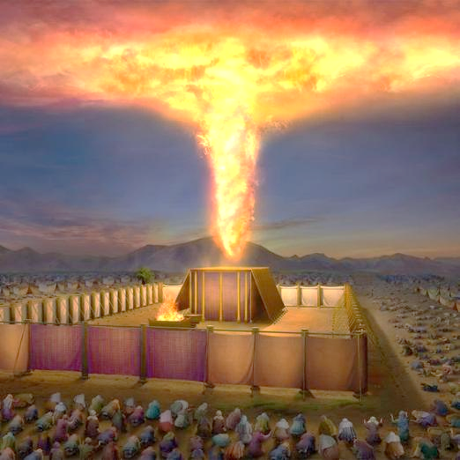
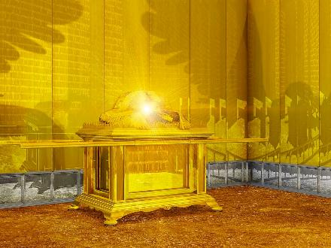
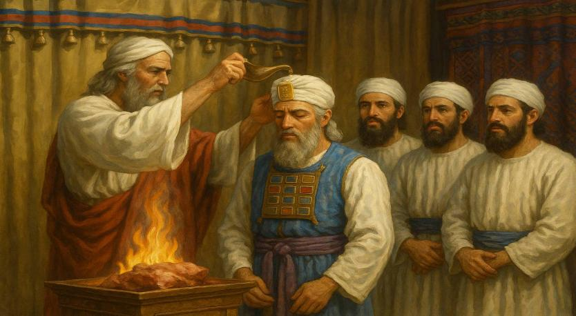
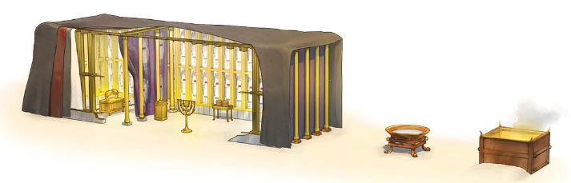
UKUNIKEZELWA
“Ilifu layigubungela intente yokuhlangana, ubuqaqabuwuli bukaYehova bawuzalisa umnquba” (Eksodus 40:34)
Incwadi ye-Eksodus iqukumbela ngokunikezelwa kwengcwele nababingeleli bayo. Umlinganiswa oyintloko wesi sahluko ngokungathandabuzekiyo nguThixo, ogcwalisa yonke into ngobukho bakhe obuzukileyo (Eks. 40:34). Obu bukho baqhubeka buhamba nomnquba efini naseShekina (yimbonakaliso yobuqaqawuli bukaThixo phakathi kweekerubhi zetyeya).
Emva kweenyanga zomsebenzi, ingcwele yamiswa ngosuku lokuqala lwenyanga yokuqala yonyaka wesibini emva kokumka kwabo eYiphutha (Eks. 40:2, 17). Yonke into yacwangciswa ngolungelelwano (ityeya, umkhusane, itafile, ikhanyile, isibingelelo segolide, isibingelelo sobhedu, isitya sokuhlambela), yaza yangcwaliswa (Eks. 40:9).
Ekugqibeleni, uAron noonyana bakhe banxiba izambatho zabo zobubingeleli, baza bathanjiswa kuthumo lwabo (Eks. 40:12–15).

Slide 12

EGW (Patriarchs and Prophets, p. 349)
“Akukho lwimi lunokuchaza ubuqaqawuli bombono obekwe ngaphakathi kwengcwele—iindonga ezityatyekwe ngegolide ezibonisa ukukhanya okuphuma kwisiphatho sesibane segolide, imibala eqaqambileyo yamalengalenga ahonjiswe ngokutyebileyo nezithunywa zawo ezibengezelayo, itafile, nesibingelelo sesiqhumiso, esimenyezela ngegolide; ngaphaya kwekhuselo lesibini ityeya yengcwele, ineekerubhi ezifihlakeleyo, naphezu kwayo yiShekina engcwele, imbonakaliso ebonakalayo yobukho bukaYehova; yonke kodwa imbonakaliso emfiliba yobuqaqawuli betempile kaThixo esezulwini, isazulu somsebenzi wentlawulelo yomntu..”

Slide 13
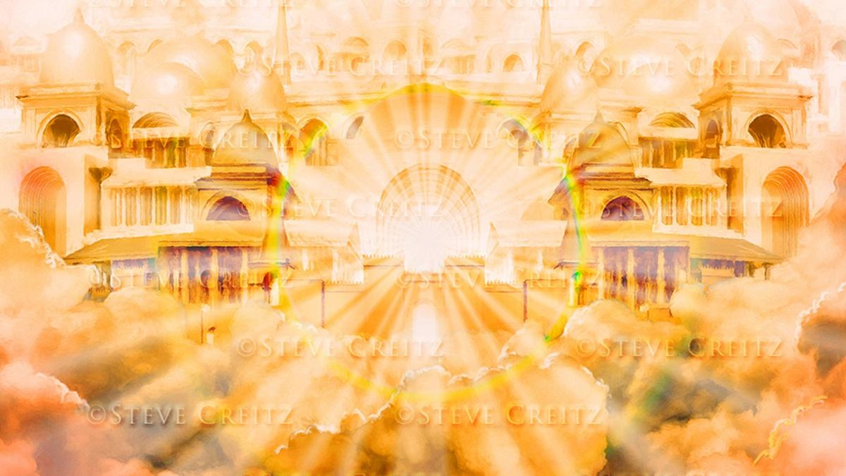
EMINYE IMINQUBA

Slide 14
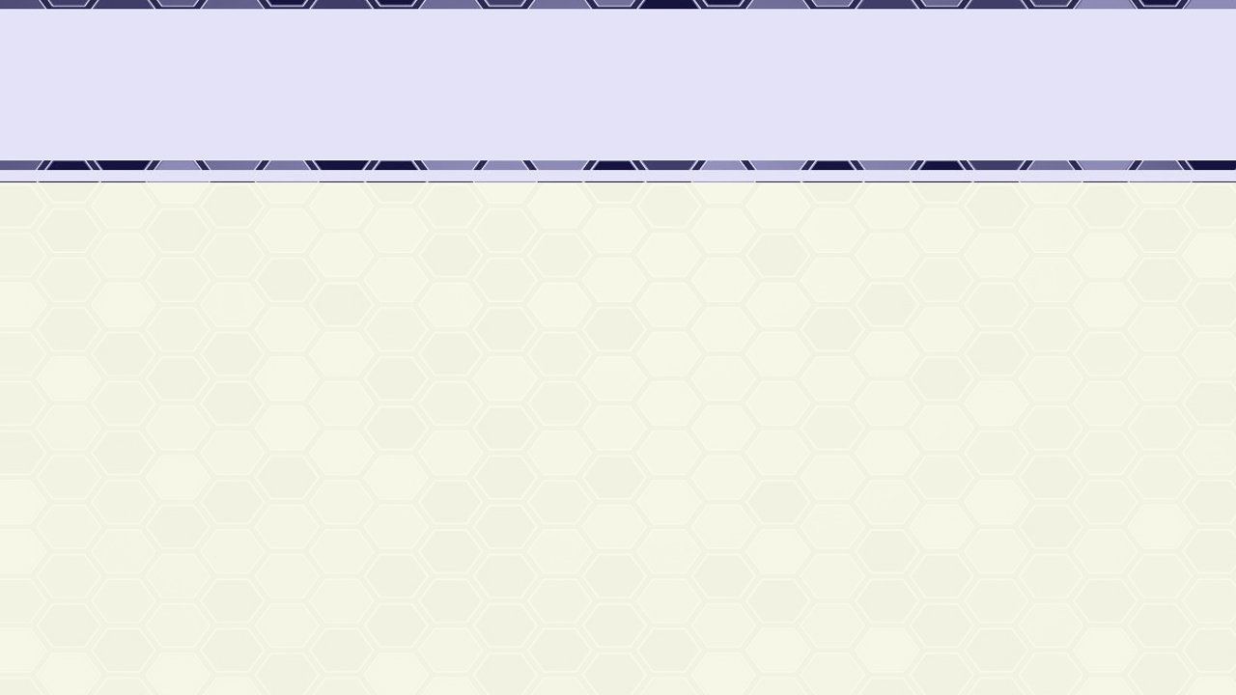
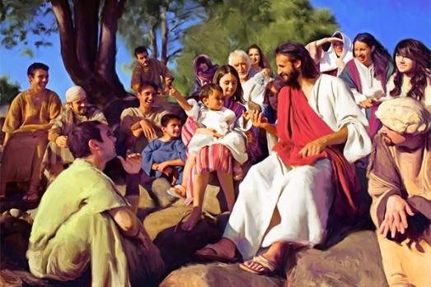

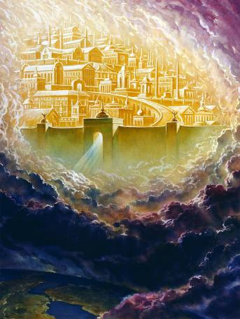
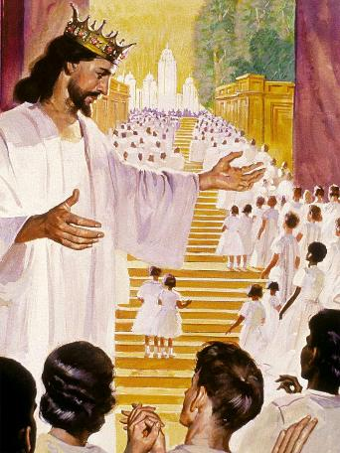
UYESU NEYERUSALEM ENTSHA
“ULizwi waba yinyama, wahlala phakathi kwethu” (Yoh 1:14a)
“Ndeva izwi elikhulu liphuma emazulwini, lisithi: Yabona, umnwuba lo kaThixo unabantu; Uya kuhlala nabo emnqubeni, Bona babe ngabantu baKhe, Yena uThixo abe nabo, enguThixo wabo” (Isityhilelo 21:3)
UYohane 1:14 uthi uYesu waba yinyama waza “wahlala” (wangumnquba) phakathi kwethu. Ngokuzalwa kwakhe, uYesu, uThixo ongunaphakade, wazalisekisa umnqweno waKhe wokuhlala ngokoqobo phakathi kwethu. Waba nguEmanuweli, uThixo unathi (Mat. 1:23).
NgoMoya oyiNgcwele, uThixo usaqhubeka ehlala nathi namhlanje (Mt. 18:20; 1 Kor. 3:16).
Kodwa imini iya kufika kamsinya xa siya kuba nako ukuma ubuso ngobuso noThixo wethu, sihlale naYe, kumnquba wobukumkani awasilungisela wona: iYerusalem eNtsha (ISityh. 21:3).
Oku kuya kwenzeka xa iCebo loSindiso ligqityiwe, kwaye nobubi bupheliswe ngokupheleleyo.

Slide 15

EGW (The Desire of Ages, p. 23)
“UThixo wayalela uMoses ngoSirayeli, esithi: “Mabandenzele umnquba, ndihlale phakathi kwabo.” (Eksodus 25:8), wahlala engcweleni phakathi kwabantu baKhe. Kuko konke ukubhadula kwabo entlango, umqondiso wobukho baKhe wawunabo. Ngoko ke uKristu wawumisa umnquba waKhe phakathi kwenkampu yethu yabantu. Wayimisa intente yaKhe ecaleni kweminquba yabantu, ukuze ahlale phakathi kwethu, asenze siqhelane nesimilo saKhe sobuThixo nobomi baKhe.”

