Slide 1
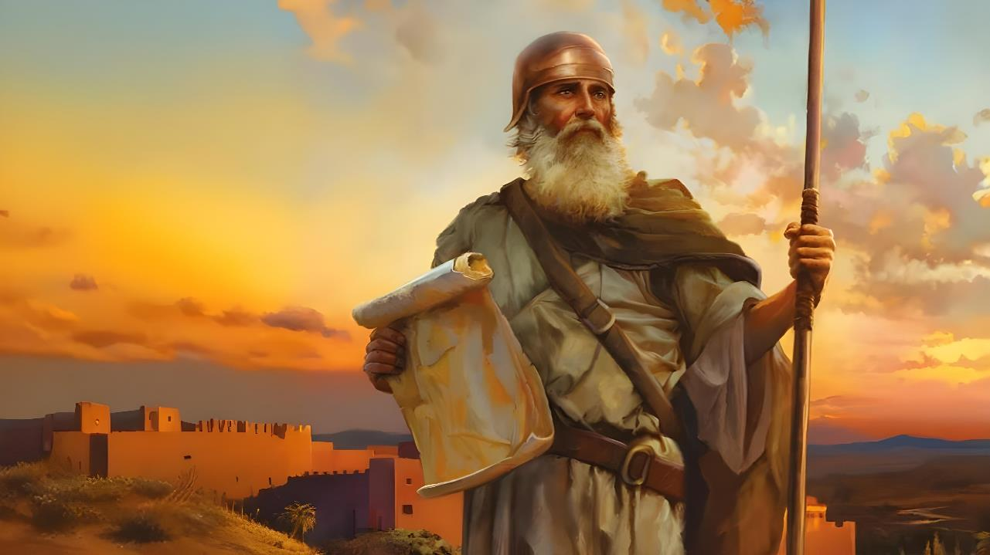

  IQWILI LEMPUMELELO
Lesson 1 for October 4, 2025

Slide 2
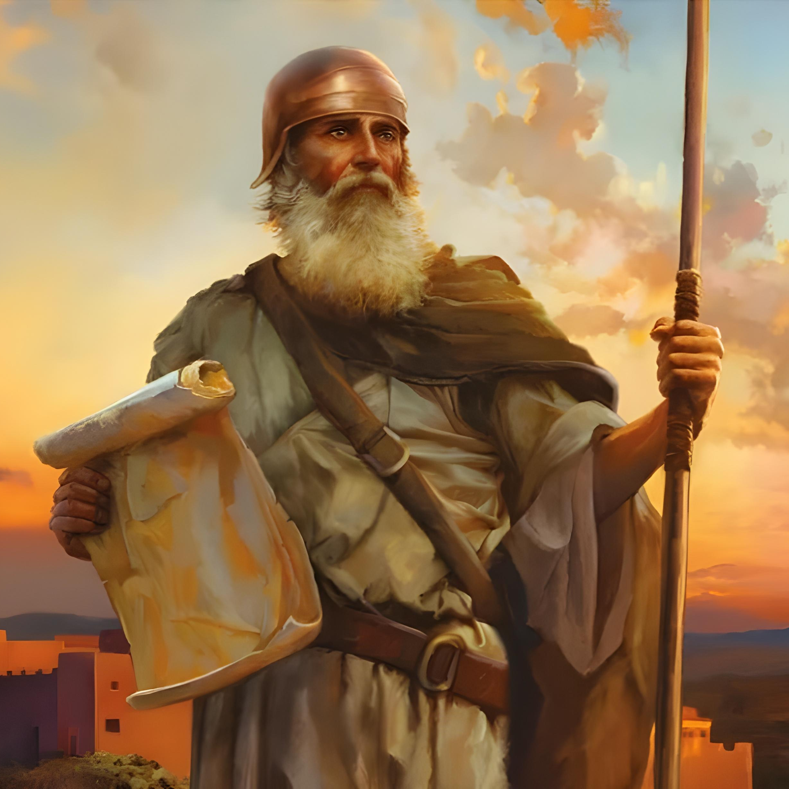
“Kodwa ke yomelela, ukhaliphe kunene, ukuze ugcine ukwenza ngokomyalelo wonke, awakuwisela wona uMoses umkhonzi wam. Musa ukutyekela ekunene ngasekhohlo kuwo, ukuze wenze ngengqiqo apho sukuba usiya khona”
Yoshuwa 1:7.

Slide 3

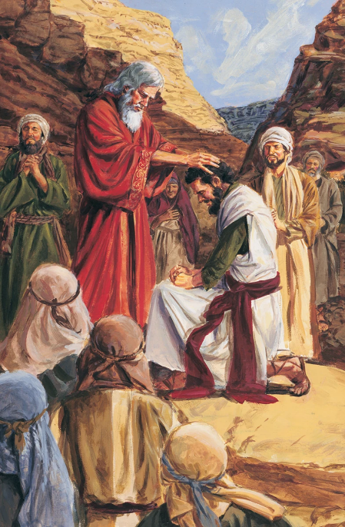
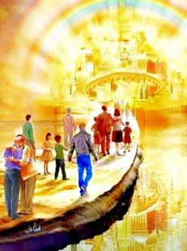


Emva kweminyaka engama40 yokubhadula, kuye kwavela isizukulwana esitsha, yaye lifikile ixesha lokoyisa iLizwe leDinga. UMoses ufile, kwaye inkokheli entsha inyuliwe nguThixo kulo msebenzi: uYoshuwa.
Ngaphambi kokuba siqalise uloyiso, inkokheli entsha nesizukulwana esitsha babizelwa ukuba bakholose ngokupheleleyo ngoThixo.
Njengoko isizukulwana sangoku (thina) simi kumda weKanan yasezulwini, ubizo lobuthixo lusavakala ngamandla: “Kodwa yomelela, ukhaliphe kunene” ( Yosh. 1:7 ).
Intshayelelo (Yoshuwa 1:1-3):
  UMoses noYoshuwa
  Isakhiwo sencwadi
Umsebenzi kaYoshuwa (Yoshuwa 1:4-9):
  Zidle ilifa izithembiso
  Yomelela kwaye ukhaliphe
  Impumelelo yomsebenzi

Slide 4
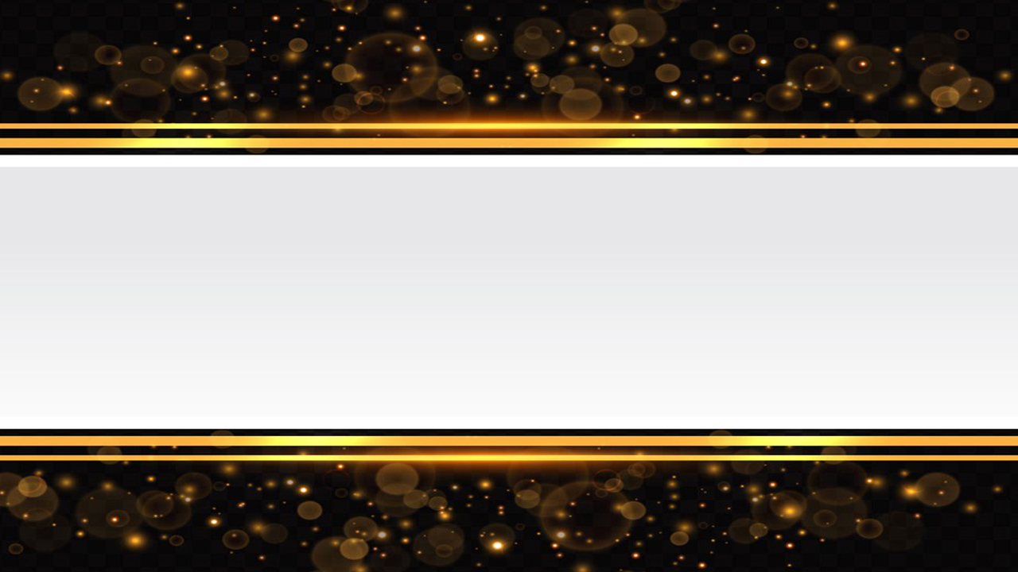
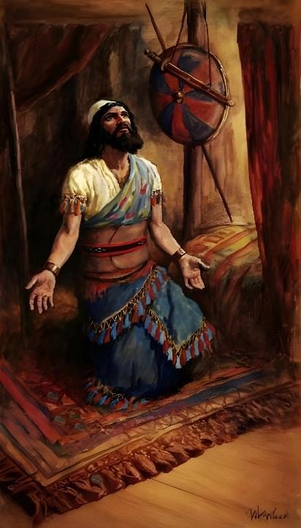
INTSHAYELELO
(YOSHUWA 1:1-3)

Slide 5







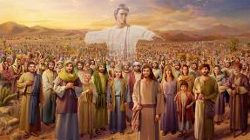
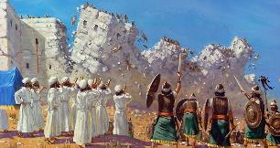








UMOSES noJOSHUA
UThixo wavela kubo
(Eks. 3:2-4; Yosh. 5:13-14)
Bacelwa bakhulule iimbadada zabo
(Eks. 3:5 ; Yosh. 5:15)
UThixo wathembisa ukuba nabo (Eks. 3:12; Yosh. 1:5)
Babhiyozela iPasika
(Eks. 12:21-23; Yosh. 5:10)
Bawela kumhlaba owomileyo phakathi kwamanzi (Eks. 14:21-22; Yosh. 3:14-17)
Komnye kwawa imana, komnye yanqamnka
(Eks . 16:4-5, 31; Yosh. 5:11-12)
Bathumela iintlola ziyokuhlola ilizwe
(Num. 13:1-3; Yosh. 2:1)
“Kwathi emva kokufa kukaMoses umkhonzi kaYehova, wathetha uYehova kuYoshuwa unyana kaNun, umlungiseleli kaMoses” (Yoshuwa 1:1)
Kwisahluko sokuqala sikaYoshuwa, uMoses ukhankanywa izihlandlo ezilishumi elinanye, yaye igama lakhe livela ngokuphindaphindiweyo kuyo yonke le ncwadi.
Kukho ukufana okuninzi phakathi kweenkokeli ezimbini:
Nangona isahluko sokuqala sikaYoshuwa sibhala ngenguqu phakathi kweenkokeli ezimbini ezinkulu zakwaSirayeli, ingenguye nomlinganiswa wokwenyani wale ncwadi. Oyena mntu ubalulekileyo nguThixo ngokwakhe, omazwi akhe ayivulayo le ncwadi, yaye ubunkokeli bakhe bungumxholo obalaseleyo. Alithandabuzeki elokuba yayingubani inkokeli yokwenyaniso yakwaSirayeli.

Slide 6

“Ngoku uYoshuwa wayeyinkokeli eyaziwayo yakwaSirayeli. Wayesaziwa ngokuyintloko njengomphumi-mkhosi, yaye iziphiwo zakhe nezinto ezintle awayenazo zazixabiseke ngokukhethekileyo ngeli xesha kwimbali yabantu bakhe. Unenkalipho, uzimisele, nozingisayo, okhawulezayo, ongenakonakala, ongakhathaliyo kwizilangazelelo zokuzingca ekunyamekeleni kwakhe abo bazinikele kulawulo lwakhe, yaye, ngaphezu kwako konke, ephefumlelwe lukholo oluphilileyo kuThixo—leyo yayiyisimilo sendoda eyayinyulwe ngokobuthixo ukuba iqhube imikhosi kaSirayeli ekungeneni kwayo kwiLizwe Ledinga. Ebudeni bokuphambukela entlango wayesebenze njengenkulumbuso kuMoses, nangokuzola kwakhe, ukuthembeka kwakhe okungazenzisiyo, ukungagungqi kwakhe xa abanye behexa, ukuqina kwakhe ekuyigcineni inyaniso phakathi kwengozi, wabunikela ubungqina bokufaneleka kwakhe ukuba angene ezihlangwini zikaMoses, nangaphambi kokuba abizelwe kweso sikhundla ngelizwi likaThixo..”
EGW (Patriarchs and Prophets, p. 481)

Slide 7

ISAKHIWO SENCWADI
“UMoses umkhonzi wam ufile, suka ke ngoko, uyiwele iYordan le, wena naba bantu bonke, niye kwelo zwe ndibanika lona oonyana bakaSirayeli” (Yoshuwa 1:2)
Incwadi kaYoshuwa iveza inzaliseko yezithembiso uThixo awazenzayo kuSirayeli xa wayewakhupha eYiputa, oko kukuthi, ukubanika iKanan. Zombini iintshayelelo (isahluko 1) kunye nencwadi ngokwayo zahlulwe yangamacandelo amane amakhulu:
UKUWELELA eKanana
Yoshuwa 1:1-9
Yoshuwa 1:1-5:12
UKUTHABATHA iKanana
Yoshuwa 1:10-11
Yoshuwa 5:13-12:24
UKWAHLULA umhlaba
Yoshuwa 1:12-15
Yoshuwa 13:1-21:45
UKUKHONZA ngokuthobela uMthetho
Yoshuwa 1:16-18
Yoshuwa 22:1-24:33

Slide 8
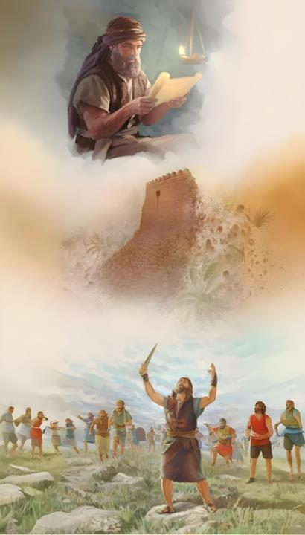
UMSEBENZI KAYOSHUWA
(Yoshuwa 1:4-9)

Slide 9

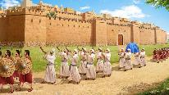
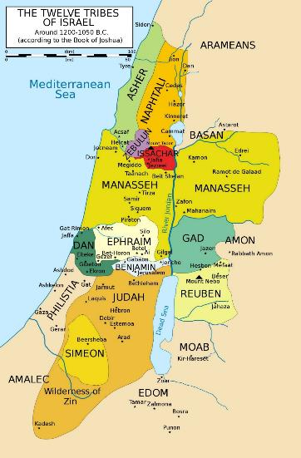
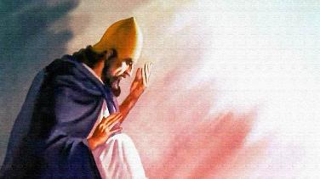
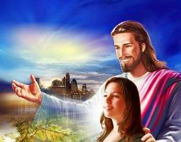
ZIDLE ILIFA IZITHEMBISO
“Iindawo zonke eziya kunyathelwa yintende yonyawo lwenu, ndininikile, njengoko ndathethayo kuMoses” (Yoshuwa 1:3)
KuYoshuwa 1:3, uThixo uthetha ngexesha langoku lesiprofeto. Uthetha ngeKanana ngokungathi yayisele inikiwe kuSirayeli. Oku kuthetha ukuba uThixo wabanika isiqinisekiso esipheleleyo sokuphumelela kolo loyiso.
EUPHRATES
Wandula ke abakhumbuze ngemida oluya kufikelela kulo uloyiso (Yosh. 1:4): ummandla ophakathi koMlambo iYordan (empuma) noLwandle lweMeditera (entshona), ukusuka entlango (emazantsi) ukusa kuMlambo umEfrati (emantla).
Wandula ke aphethukele kuYoshuwa aze amqinisekise ukuba ukuba womelele yaye ukhaliphile, akukho mntu uya kukwazi ukumelana naye (Yosh. 1:5-6).
MEDITERRANEAN
JORDAN
Kodwa uloyiso aluxhomekekanga kwimigudu kaYoshuwa, kodwa lwaluxhomekeke kubukho bukaThixo. Wamqinisekisa, njengoko eqinisekisa ngamnye wethu esithi: “Ndiya kuba nawe.” (Yosh. 1:5; Mat. 28:20).
DESERT

Slide 10

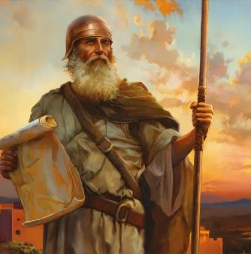
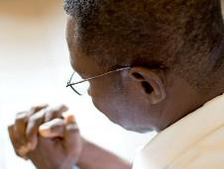
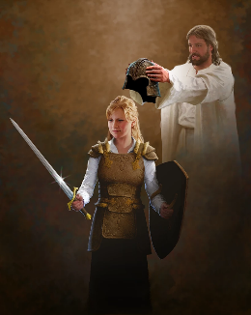
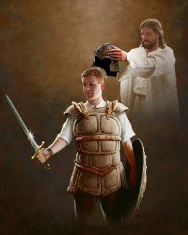
YOMELELA KWAYE UKHALIPHE
“Yabona, ndikuwisele umthetho wokuba womelele, ukhaliphe. Musa ukunkwantya, ungaqhiphuki umbilini; ngokuba uYehova uThixo wakho unawe; apho sukuba usiya khona.” (Yoshuwa 1:9)
Ngaphambi kokuba acele amandla nenkalipho kuYoshuwa edabini (Yosh. 1:9), uThixo wamcela ukuba amnike amandla nesibindi sokuthobela uMthetho (Yosh. 1:7).
Oku kunjalo nanamhlanje. UThixo usicela ukuba sizabalazele ukugcina umthetho waKhe (ISityh. 14:12). Oku kufuna inkalipho enkulu kwicala lethu.
KwelaKhe icala, uthembisa ukuba “uya kuba nawe naphi na apho uya khona” (Yosh. 1:9) Esinceda ukuba silwe idabi esikulo. Asilodabi lokwenyama, kodwa “nxamnye nabalawuli, namagunya, nawo amagunya obumnyama beli phakade, ngokunxamnye nomoya okhohlakeleyo kwezasezulwini iindawo” (Efe. 6:12). Amagunya alawula ubumnyama balo eli phakade. Ukwenza oku, usilungiselele izixhobo eziyimfuneko (Efe. 6:13–17).
Isitshixo sempumelelo kukuthembela ngokupheleleyo kuThixo. Kwaye ukwenza njalo, kufuneka sinxulumane naYe yonke imihla (Efe. 6:18).

Slide 11


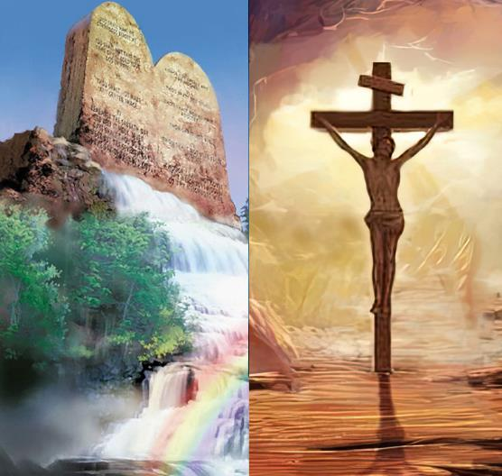
IMPUMELELO YOMSEBENZI
“Ize ingesuki incwadi yalo myalelo emlonyeni wakho; uze ucinge ngayo imini nobusuku, ukuze ugcine, ukwenze konke okubhaliweyo kuyo; ngokuba woba nokuphumelela ngendlela yakho oko, ukwenze ngengqiqo oko” (Yoshuwa 1:8).
Impumelelo ngokwembono kaThixo ayihambelani nempumelelo ngokwembono yomntu.
Impumelelo ekhawulezileyo kweli hlabathi inokufumaneka ngokwaphula imithetho kaThixo neyabantu, kodwa impumelelo eyinyani neyanaphakade ayinako (Yosh. 1:8).
Siya kuphumelela ukuba silandela imigaqo nemilinganiselo echazwe kuMthetho kaThixo. Kodwa ngaba olu asilulo usindiso ngokwasemisebenzini?
Hayi akunjalo. Ukholo noMthetho azizozinto zombini, kodwa ziyaphelelisana (KwabaseRoma 3:31). Xa sithetha ngoMthetho, sithetha ngendlela esimele siphile ngayo, kungekhona indlela esisindiswa ngayo. Ulwalamano lwethu noThixo lubonakaliswa kukuthobela kwethu ukuthanda kwakhe.

Slide 12

“UmKristu usoloko enomncedi owomeleleyo eNkosini. Sisenokungayazi indlela yoncedo lweNkosi; kodwa esikwaziyo kukuba, akasoze abalahle abo bakholose ngaye. Ngaba amaKristu ayenokuqonda ukuba kukangaphi uYehova eyala indlela yawo, ukuze zingafezeki iinjongo zotshaba ngawo, ebengayi kukhubeka ekhalaza. Ukholo lwawo lwaluya kuhlala kuThixo, yaye akukho silingo sasinokuba namandla okubashukumisa. Babeza kuMamkela njengobulumko babo nokusebenza kakuhle kwabo, kwaye wayeya kukwenza oko anqwenela ukukufeza ngabo.”
EGW (Prophets and Kings, p. 576)

