Slide 1
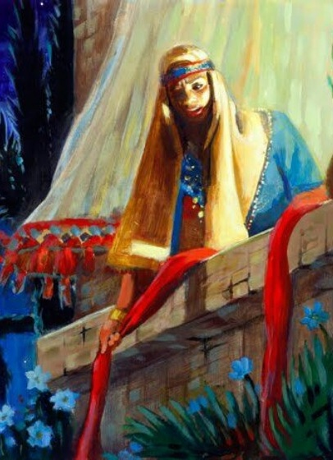
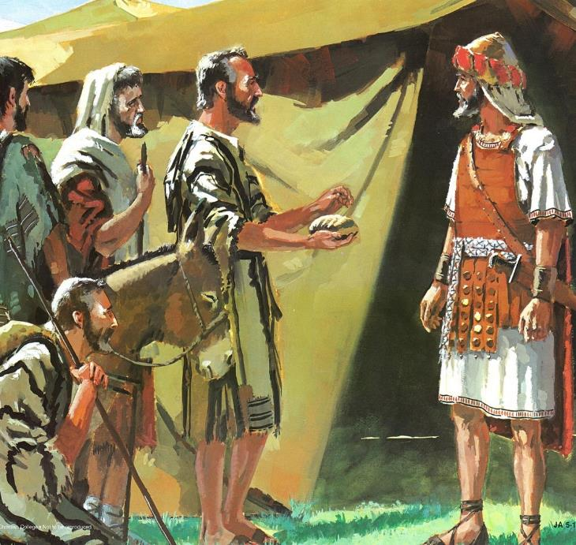
UKUMANGALISWA LUBABALO
Isifundo 2: 11 kweyeDwarha (Okthobha) 2025

Slide 2

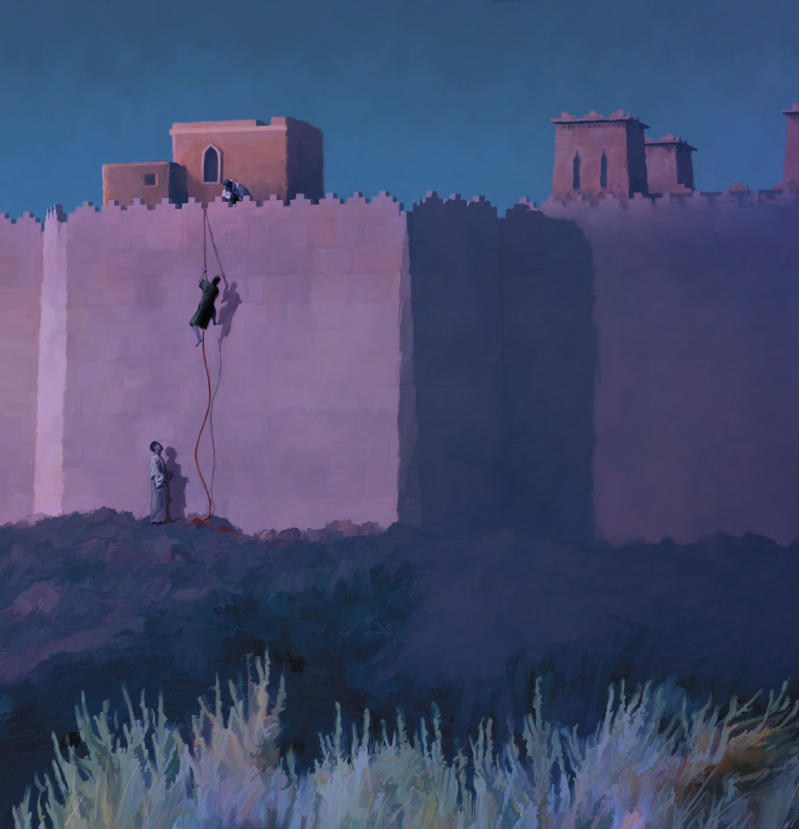
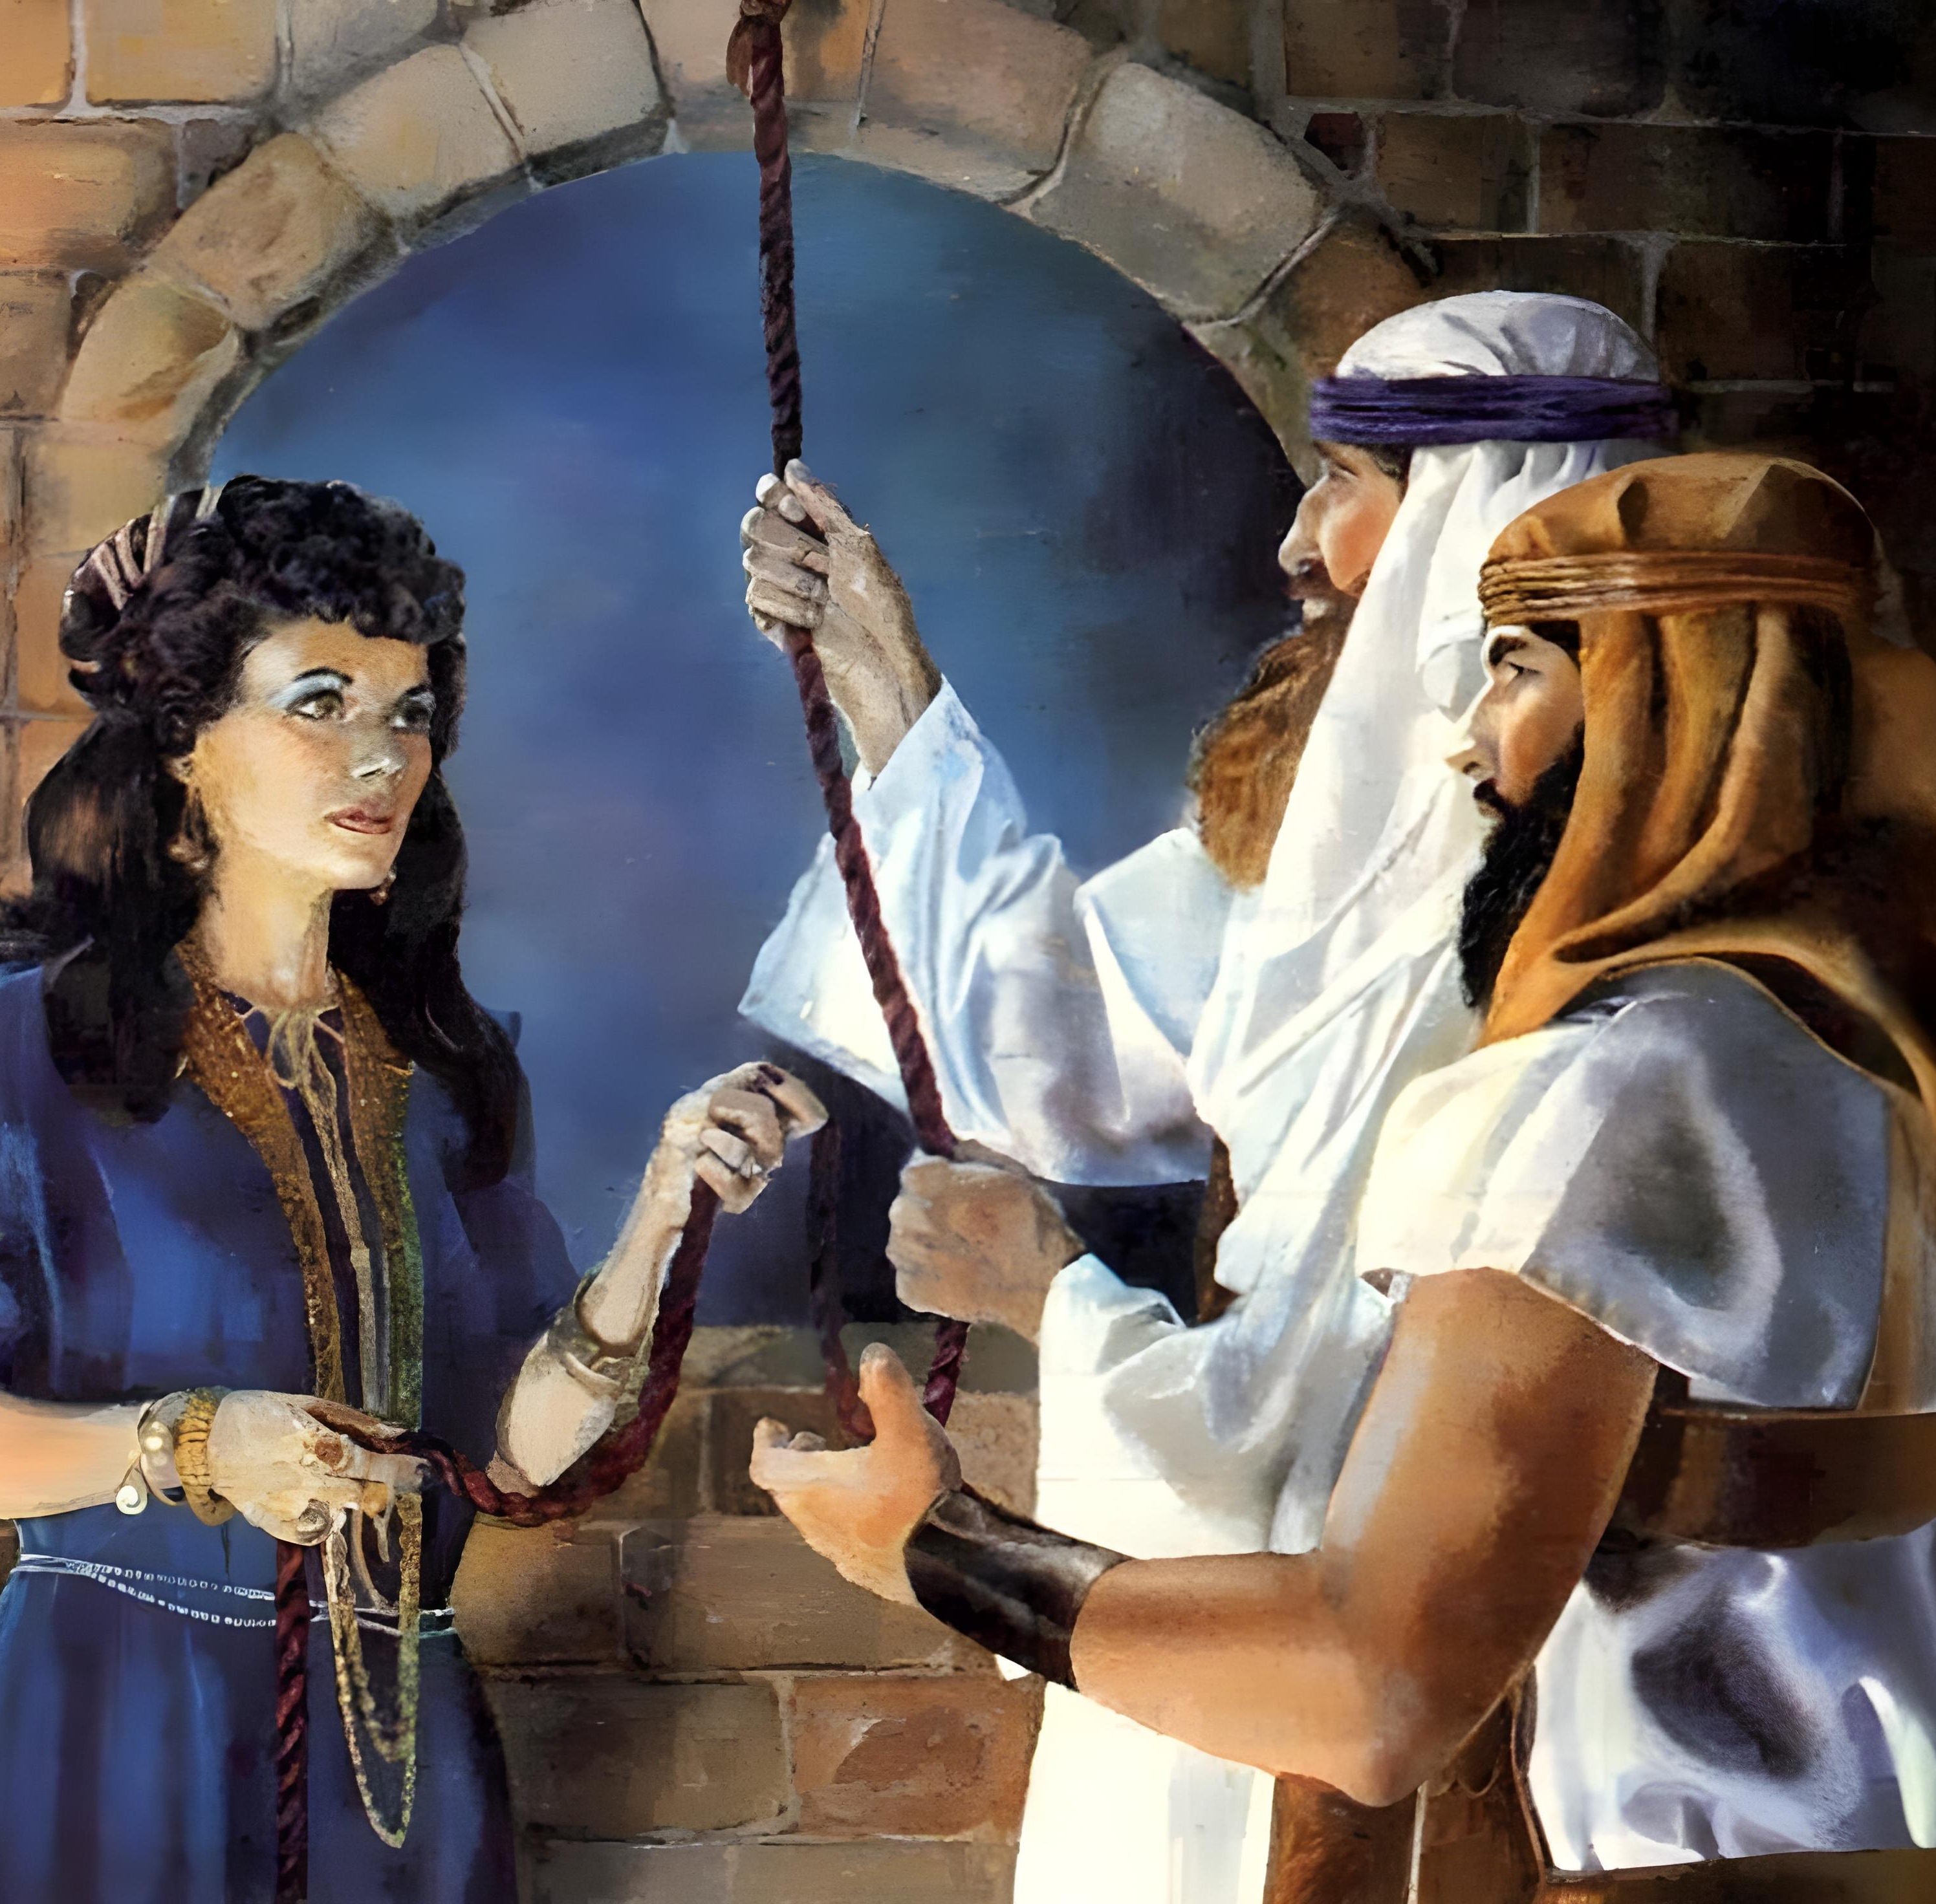
“Ngokholo uRahabhi ihenyukazi akatshabalalanga nabo bangevayo, akuba ezamkele iintlola ngoxolo”
(KumaHebhere 11:31)

Slide 3

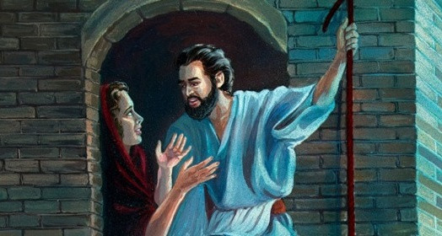
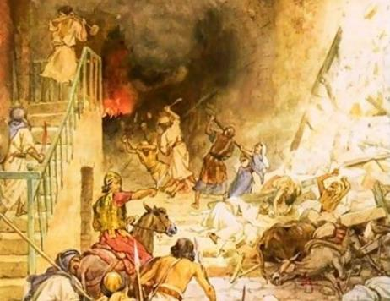



AmaKanan ayeyigqithile imida yobabalo. Ngeso sizathu, umthetho kumaSirayeli wawusithi: ngenani, nibabulale bonke, nithimbe izinto zabo.
Noko ke, kwakusekho abantu eKanan ababengekayigqibi loo mida. Bonke abo babezimisele ukwamkela ubabalo lukaThixo awayefuna ukubadlulisela kubo basindiswa kwintshabalalo.
Ubabalo ngakumaSirayeli (Yoshuwa 2:1, 22-24):
  Ithuba lesibini
Ubabalo ngakuRahabhi (Yoshuwa 2:2-21):
  Ukholo lokhozo lwemostade
  Umnqophiso usandiselwa kuRahabhi
Ubabalo ngakumaGibheyon (Yoshuwa 9):
  Onozakuzaku abanenkohliso
  Intsikelelo nesiqalekiso

Slide 4
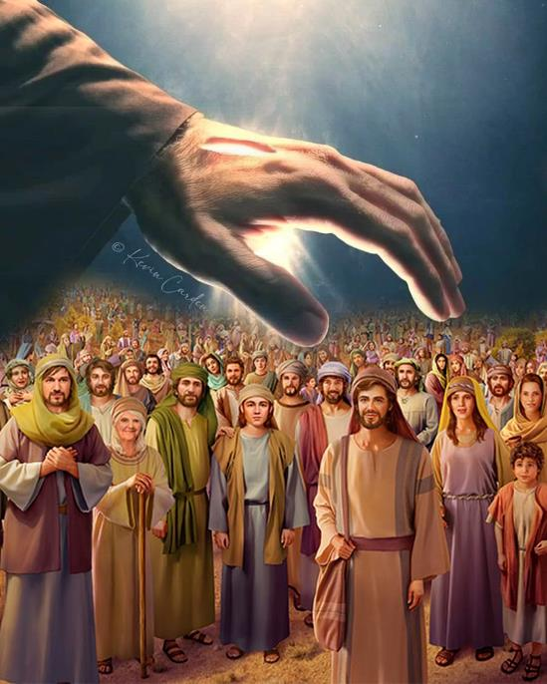
UBABALO NGAKUMASIRAYELI
(YOSHUWA 2:1, 22-24)

Slide 5


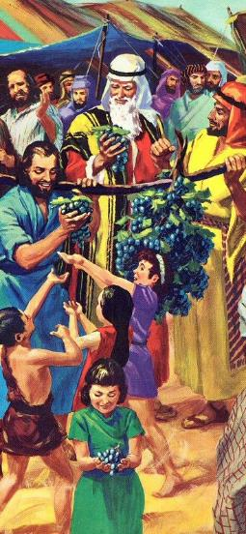
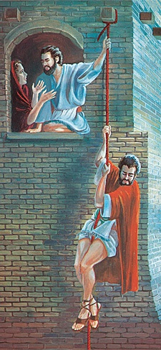
ITHUBA LESIBINI
“UYoshuwa unyana kaNun wesusa amadoda amabini aziintlola, esithi ngasese, Hambani niye kulikhangela ilizwe neYeriko (Yoshuwa 2:1a NIV)
Xa uMoses wathumela iintlola ukuba ziye kuhlola iKanan, abantu abazange bavume ukungena. Kwiminyaka engama40 kamva, kwathunyelwa iintlola ezintsha, zaza neziphumo ezahlukileyo.
Ukuthunywa kweentlola
Ekuhleni (iintlola ezili12)
Ngasese (iintlola ezi2)
Ukusebenza kweentlola
Iintsuku ezingama zokuhlola
Iintsuku ezi3 zizimele
Ingxelo yeentlola
Zatyhafisa abantu
Zamkhuthaza uYoshuwa
Nangona isizukulwana esitsha saye soyisakala ngokulusizi ekujonganeni nesilingo sikaBhileham, uThixo wasinika ithuba lesibini (Num. 25:1-3, 31:16; Yosh. 2:1).
Ngesi sihlandlo kwakungekho zidiliya, kungekho ziqhamo zomhlaba. Kuphela libali lokholo (elo likaRahabhi), elakhuthaza uSirayeli ukuba alidle ilifa iLizwe leDinga.

Slide 6
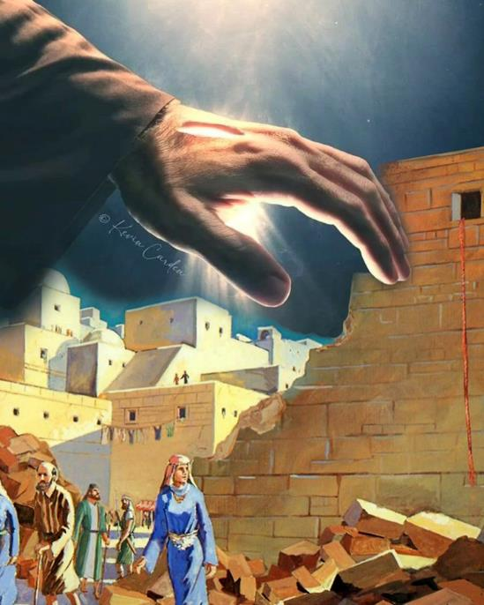
UBABALO NGAKURAHABHI
(YOSHUWA 2:2-21)

Slide 7

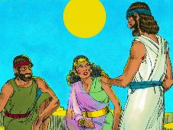
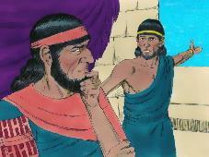
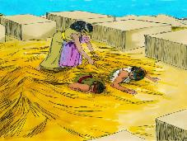
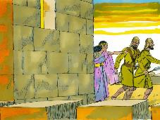
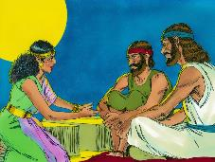
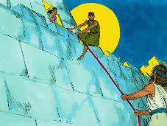
UKHOLO LOKHOZO LWEMOSTADE
“Ngokholo uRahabhi ihenyukazi akatshabalalanga nabo bangevayo, akuba ezamkele iintlola ngoxolo” (KumaHebhere 11:31).
Lalisekelwe entweni ukholo lukaRahabhi (Yosh. 2:9-11)?
Phawula ukuba uRahabhi uthetha ngeziganeko ezazisaziwa ngumntu wonke, njengokuwela uLwandle Olubomvu. Kodwa ngoxa abanye babesoyika uThixo wamaHebhere, yena wakhetha ukuzimela phantsi kwamaphiko akhe (Yosh. 2:12-13).
Kwakutheni, ukuba uyakholelwa kuThixo, asebenzise ubuxoki ukunceda iintlola?
Ukholo lwakhe lutsha aluzange lubonise ukuqonda ngokupheleleyo ukuthanda kukaThixo. Wenza konke okusemandleni akhe ukuze ancede iintlola aze asindise ubomi bakhe nobentsapho yakhe. Ulwazi lwaluza kuza kamva.
IBhayibhile iyamncoma ngesigqibo awasenzayo; ukuze aqonde indlela kaThixo yokwenza; nangendlela awawaxhasa ngayo amazwi akhe ngezenzo ezibambekayo (Yakobi 2:25).
URahabhi ngumzekelo wento engeyayenzekileyo kuye nawuphi umhlali waseYeriko ozingqonge ngoThixo.

Slide 8

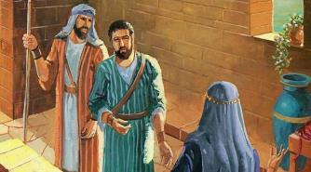
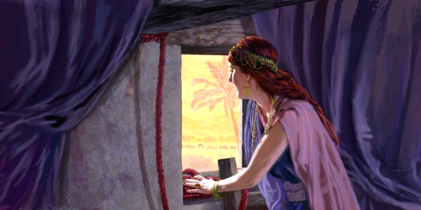
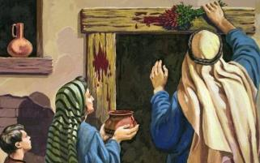
UMNQOPHISO USANDISWELWA KURAHABHI
“Kothi, bonke abasukuba bephuma emnyango endlwini yakho, besiya phandle, igazi labo loba phezu kwentloko yabo, sibe msulwa thina; ke bonke abasukuba bekuwe endlwini, igazi labo loba phezu kwentloko yethu, ukuba kuthe kwasiwa isandla kubo” (Yoshuwa 2:19)
USirayeli kwiPasika
Kwakufuneka baqabe igazi emigubasini
(Eks. 12:7)
Ukuba bathe baphuma endlweni, bayafa (Eks. 12:13)
URahabhi eYeriko
Kwafuneka afake intsontela ebomvu efestileni yakhe (Yosh. 2:18)
Ukuba uthe waphuma endlwini, uza kufa
(Yosh. 2:19)
Ingqiqo kaRahabhi yayingenakuphikiswa: Ndenze ngobubele ndaza ndakusindisa; ngoku yenza ububele, undisindise nezalamane zam (Yosh. 2:12-13).
Nangona wayengakuqondi oko, uRahabhi wayecela uSirayeli ukuba enze kuye njengoko uThixo ngokwakhe wakwenzayo kuSirayeli, oko kukuthi, ngobubele [hesed] (Dut. 7:12).
Iintlola zacela uRahabhi ukuba azalisekise imiqathango ezaziyifezile ukuze zibaleke ukufa eYiphutha. Ngale ndlela, waqukwa kumnqophiso kaThixo noSirayeli.

Slide 9
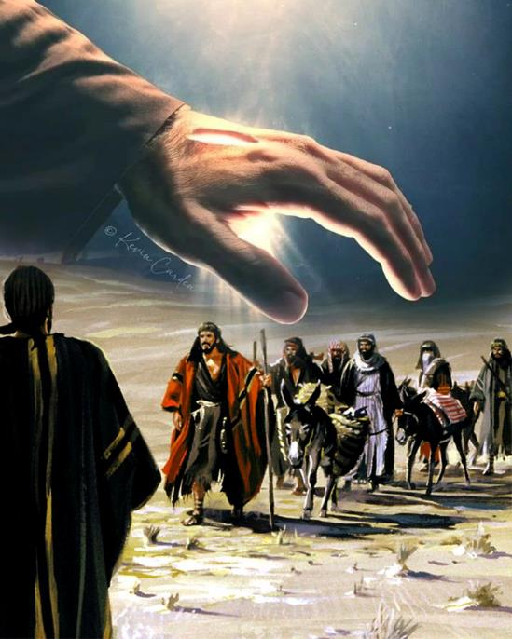
UBABALO NGAKUMAGIBHEYON
(YOSHUWA 9)

Slide 10


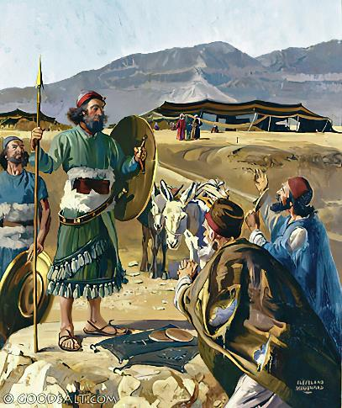
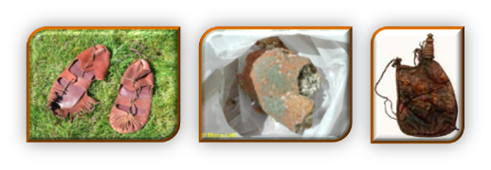
ONOOZAKUZAKU ABANENKOHLISO
“Beza kuYoshuwa emkhosini eGiligali, bathi kuye nakumadoda akwaSirayeli, Sivela ezweni elikude; simiseleni ngokomnqophiso” (Yoshuwa 9:6)
Phawula ukufana nomahluko phakathi kukaRahabhi namaGibheyon:
Imiba yoKholo | Rahabhi | Gibheyon
Isiseko | Ukuva (2:10) | Ukuva (9:3)
Iindlela | Ubuxoki (2:4-5) | Ubuxoki (9:4)
Imigomo | Ukusindiswa (2:13) | Ukusindiswa (9:24)
Iziphumo zangoku | Ukuhlangulwa (6:23) | Ukuhlangulwa (9:26)
Iziphumo zexesha elide | Umi opheleleyo (6:25) | Ukukhonza (9:27)
URahabhi waxoka ukuze akhulule iintlola. Noko ke, amaGibheyon axoka ngabom, enenjongo yokukhohlisa, esebenzisa amaqhinga (bona iGenesis 3:1a). Ngaphezu koko, iinkokeli zakwaSirayeli zasilela ngokungabuzisi kuThixo (Yosh. 9:14).
Oku kwawabeka engxakini: ukuwatshabalalisa amaGibheyon, okanye ahlonele isifungo (Yosh. 9:18).

Slide 11

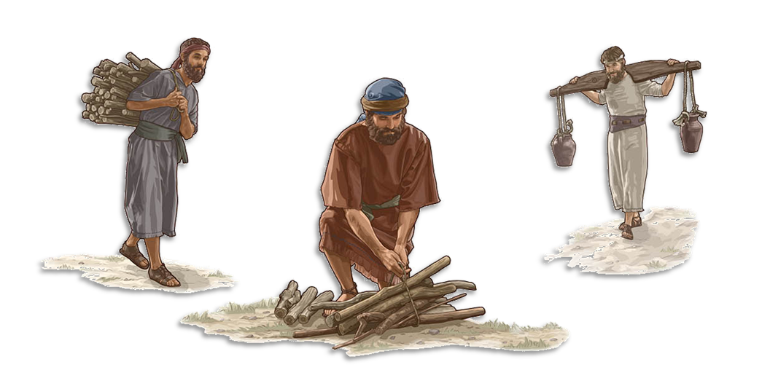
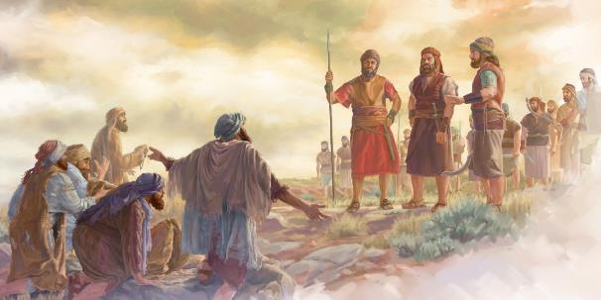
INTSIKELELO NESIQALEKISO
“Niqalekisiwe ngoko; kuni akuyi kunqumka bakhonzo, bathezi beenkuni, bakhi bamanzi bendlu kaThixo wam” (Yoshuwa 9:23)
Ukusindisa ubomi bamaGibheyon kwakuya kuba kukungawuthobeli umyalelo othe ngqo ovela kuThixo (Dut. 7:1-2). Ukwaphula isifungo njengalowo ufungiswe kubo nako kwakugqalwa njengesono (Yosh. 9:19; INdu. 15:4b). Yaconjululwa njani le ngxaki?
Ubomi babo basinda, kodwa babekwa phantsi kwesiqalekiso (Yosh. 9:20–23). Isiqalekiso sasiza kukuba ngabakhonzi ukusuka kwisizukulwana ukuya kwesinye. Oku kwababeka kulwalamano olusondeleyo nabantu bakaThixo, abangazange bahlulwe kubo (Neh. 7:6, 25).
Ngokubhekele phaya, ukuba ngabathwali bamanzi nabagawuli beenkuni zendlu kaThixo kwabenza banxulumana ngokuqhubekayo noThixo. Ngobabalo lukaThixo, isiqalekiso saba yintsikelelo. “Andiyoliswa kukufa kongendawo, kodwa kukuba abuye ezindleleni zakhe, aphile” (Hez. 33:11).

Slide 12

“Oonyana bakaSirayeli bamele bawume wonke ummandla ababewumiselwe nguThixo. Ezo ntlanga zalugatyayo unqulo nenkonzo yoThixo oyinyaniso zaziza kuhluthwa. Kodwa yayiyinjongo kaThixo ukuba ngokutyhilwa kwesimilo sakhe ngoSirayeli amadoda atsaleleke kuYe. Isimemo sevangeli sasiza kunikwa kulo lonke ihlabathi. […] Bonke abo, njengoRahabhi umKanan, noRute umMowabhikazi, balushiya unqulozithixo banqula uThixo oyinyaniso, babefanele bazimanye nabantu bakhe abanyuliweyo..”
EGW (Christ’s Object Lessons, p. 290)

