Slide 1

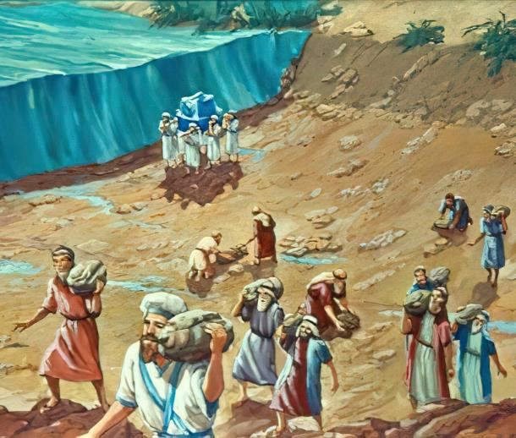
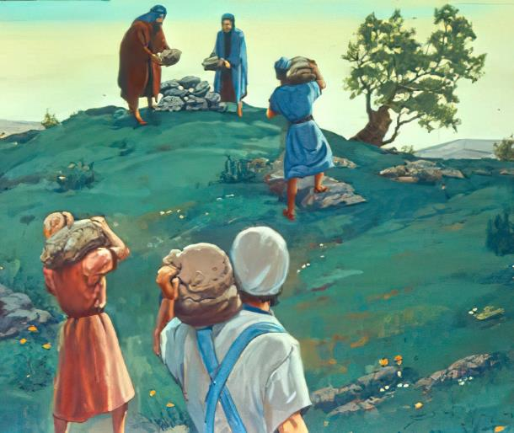

ISifundo 3 – 18 kweyeDwarha 2025
IZIKHUMBUZO ZOBABALO

Slide 2

“kuba oko uYehova uThixo wenu wenza ukuba atshe amanzi aseYordan phambi kwenu, nada nawela; waxelisa oko uYehova uThixo wenu wakwenzayo kuLwandle oluBomvu, lona wenza ukuba lutshe phambi kwethu, sada sawela; ukuze zonke izizwe zehlabathi zisazi isandla sikaYehova ukuba somelele; ukuze nimoyike uYehova uThixo wenu imihla yonke”
UYoshuwa 4:23, 24.

Slide 3

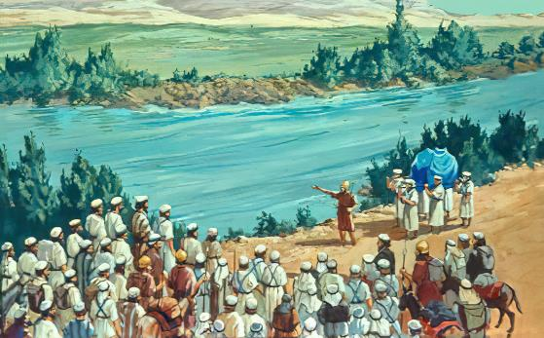
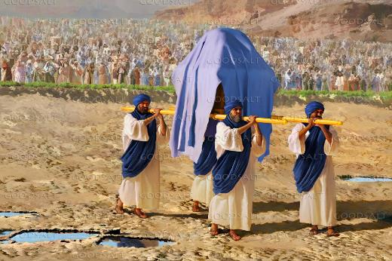







ENtwasahlobo. Imvula nekhephu elinyibilikayo zayibetha yaphuphuma iYordan. Izikhukhula zakhukhuliseka ukuya kuLwandle lweTyuwa. Nakwiindawo ezingekho nzulu – iindawo zokuwela eYordan - ukuwela umlambo kuyingozi.
Ingawela njani ilali yonke, ithwele abantu abadala, abakhulelweyo, abantwana nemfuyo?
Kubantu, akunakwenzeka. KuThixo, kulula: “Zingcwaliseni niwele iYordan.”
Ukuwela iYordan (Yoshuwa 3):
Isidingo sokuba ngcwele
Imimangaliso kaThixo
Ukukhumbula noKulibala (Yoshuwa 4):
Imiqondiso yokukhumbula
Ubungozi bokulibala
Izikhumbuzo zomlambo iYordan

Slide 4

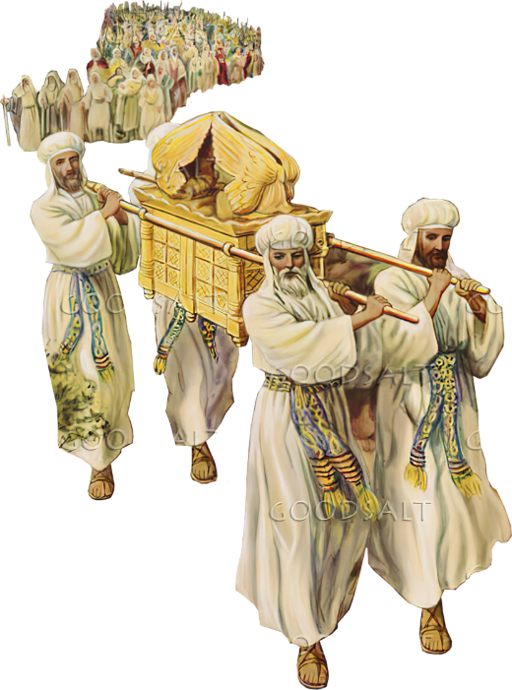
UKUWELA IYORDAN
(YOSHUWA 3)

Slide 5
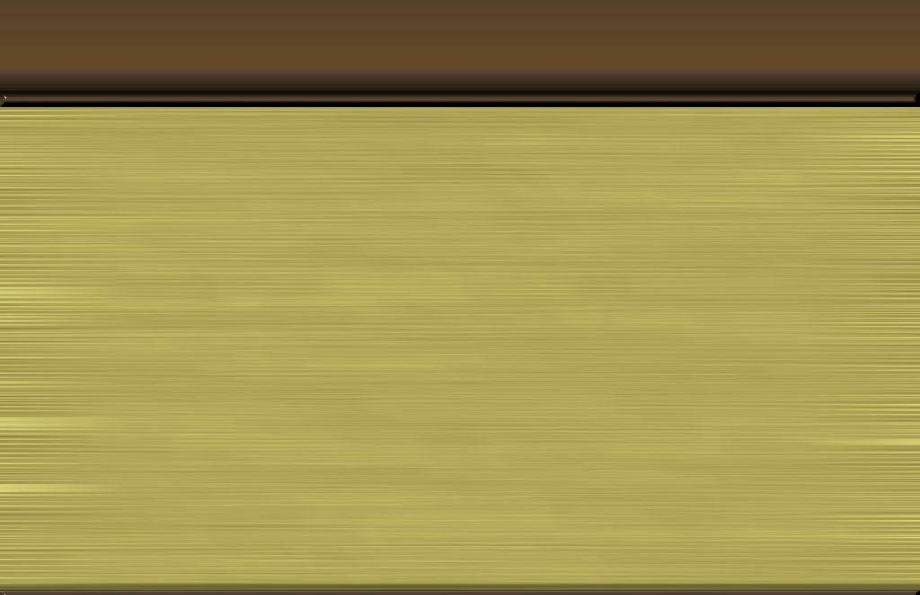
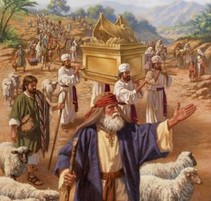
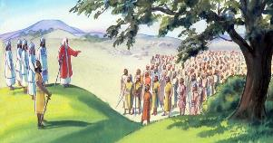
ISIDINGO SOKUBA NGCWELE
So uYehova“Wathi uYoshuwa ebantwini, Zingcwaliseni; ngokuba ngengomso uYehova uya kwenza imisebenzi ebalulekileyo phakathi kwenu.” (Yoshuwa 3:5)
Kangangeminyaka engama40, ilifu lalibonisa ixesha lokunduluka nokunduluka, yaye ityeya yakhokelela amaSirayeli kwindawo entsha (Num. 9:17; 10:33).
Ukulandela ityeya kwakuquka
Thobela uThixo (ImiThetho eliSumi)
Ukuthembela kuThixo (Isitya esinemana)
Hlonipha iinkokheli ezibekwe nguThixo God (Intonga ka-Aron)
Kwafika ixesha lokuhamba. Banduluka eShitim, bamisa iintente iintsuku ezintathu phesheya kweYordan. Bandula ke bafumana umyalelo wokulandela ityeya ukuya kwiLizwe ledinga (Yosh. 3:1-3).
Kodwa kwakukho imfuneko: babefanele bangcwaliswe (Yosh. 3:5). Oku kuzingcwalisa kwakubandakanya ukuhlanjululwa okungokwesithethe (ukuhlamba iimpahla nomzimba), ukulahla isono nokuba nesimo sengqondo sokuvuma ukuthobela imiyalelo kaThixo.

Slide 6

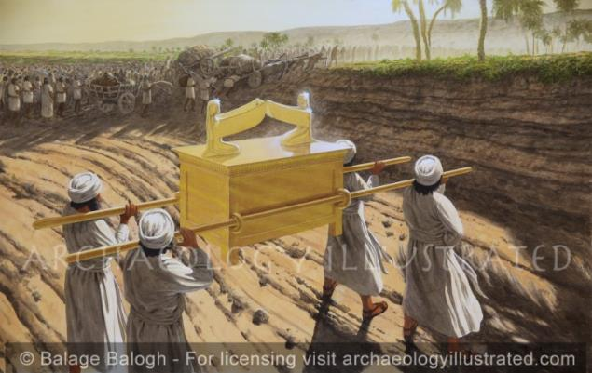
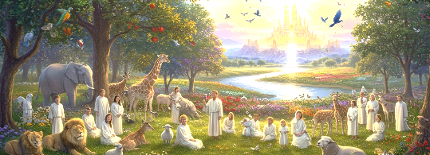
IMIMANGALISO KATHIXO
“asuka ema amanzi avela ngasentla, aphakama aba mfumba-nye, kude kakhulu eAdam, umzi ongasecaleni leTsaretan, athi la ahlayo aya elwandle lweArabha, eLwandle lweTyuwa, anqamka aphela. Bawela ke abantu malunga neYeriko.” (Yoshuwa 3:16)
UThixo “Nguye kuphela owenza izinto ezimangalisayo” (INdumiso 72:18). Ngoko ke, simgqala njengoThixo Mnye (INdu. 86:10); sikhumbula imisebenzi yakhe emangalisayo (INdu. 77:11); yaye sibalisa ngemisebenzi yakhe emangalisayo ( Indumiso 96:3 ).
Akukho nto inzima okanye imangalisayo kuye, owadala zonke izinto (Yer. 32:17; Luka 1:37). Ngoko sinokumthemba ukuba unako ukwenza imimangaliso ebomini bethu (INdumiso 107:8).
Ukuwela iYordan ngomnye wemimangaliso kaThixo, eyalatha ngesiprofeto komnye wemimangaliso emikhulu athe uThixo wathembisa ukuyenza kuthi: ukungena eKanan yasezulwini (Zek. 8:6-8).

Slide 7

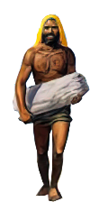
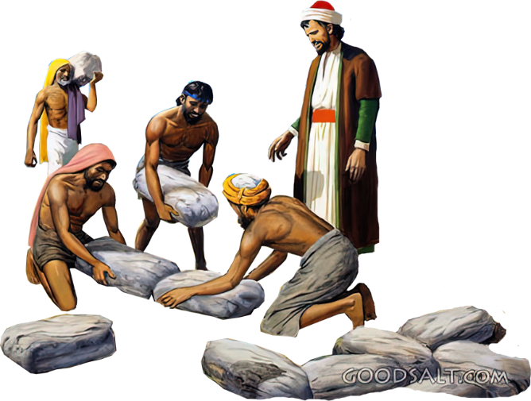
UKUKHUMBULA NOKULIBALA
(YOSHUWA 4)

Slide 8
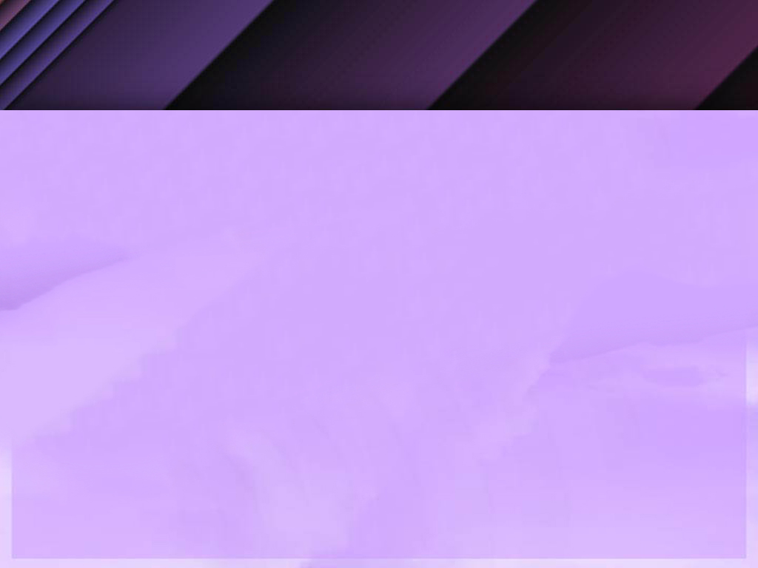
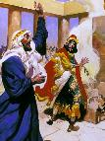
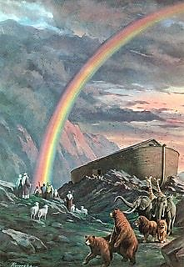
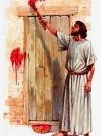

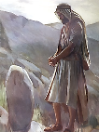
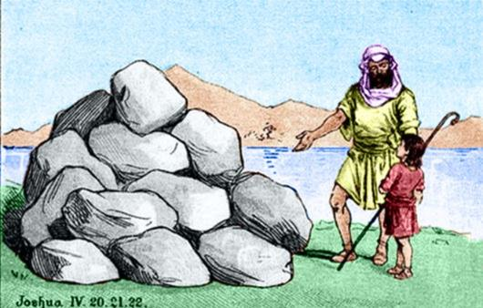
IMIQONDISO YOKUKHUMBULA
“ukuze oku kube ngumqondiso phakathi kwenu, xa bathe banibuza oonyana benu ngexesha elizayo, besithi, Ayintoni na la matye kuni? Nothi kubo …” (Yoshuwa 4:6-7)
Ebhayibhileni uphawu lunganeentsingiselo ezininzi:
Isenzo esimangalisayo (1 Kumkani 13:3)
Uphawu lwento ethile (Gen. 9:13)
Uphawu lwesilumkiso (Eks. 12:13)
Uphawu olwahlukileyo (Hez. 20:20)
Isikhumbuzo (Gen. 28:18)
Amatye ali-12 athatyathwe eYordan awawamisa uYoshuwa njengomqondiso awawokugqibela: sisikhumbuzo.
Ngaphandle kwenkumbulo ngokwayo, yayiyintoni injongo kaThixo xa wayecela ukuba kumiswe la matye (Yosh. 4:6-7)?
Izizukulwana ezitsha kwakufuneka zazi oko uThixo akwenzileyo. Ukholo lwabo lwalumele lusekelwe kwimimangaliso kaThixo. Yayiluxanduva lwabazali ukudlulisela olu lwazi kubantwana babo (Dut. 4:9). Ngolu lwazi, ngamnye kuthi kufuneka aphile ngokholo lwakhe.

Slide 9
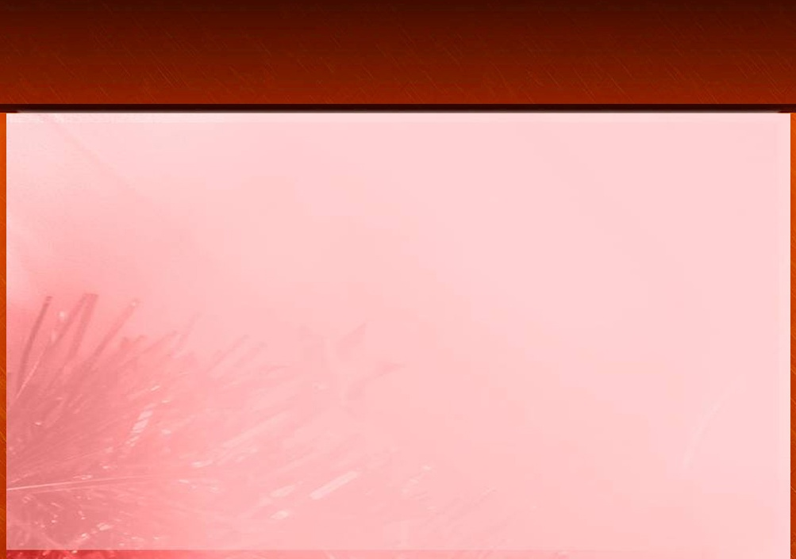
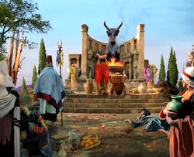
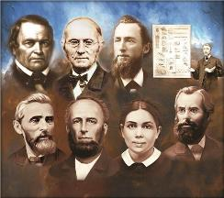
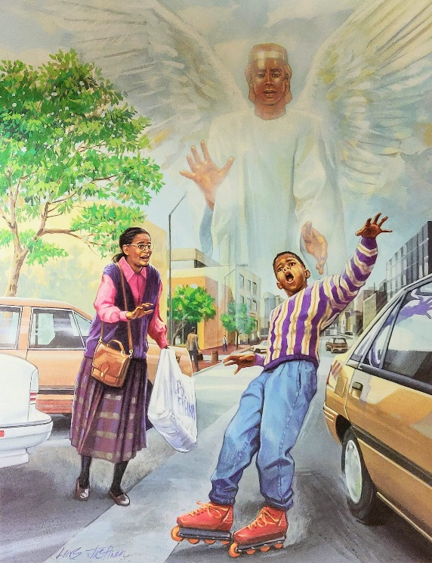
UBUNGOZI BOKULIBANA
“Oonyana bakaSirayeli benza ububi emehlweni kaYehova, bamlibala uYehova uThixo wabo, bakhonza ooBhahali nooAshera.” (AbaGwebi 3:7)
Ekumiseni amatye esikhumbuzo ali-12 eGiligali, uYoshuwa wagxininisa iingongoma ezimbini (Yosh. 4:23 ):
UThixo walomisa uLwandle oluBomvu phambi kwethu (uYoshuwa, uKalebhi, kunye nembinana eyayisaphila kwisizukulwana esaphuma eYiputa.)
UThixo wawomisa umlambo iJordan phambi kwenu (isizukulwana esitsha esazalelwa entlango, esasimiselwe ukuyoyisa iKanana)
Isizukulwana esitsha sasisengozini yokwenza impazamo efanayo neyabazali baso: ukulibala izenzo zamandla zikaThixo. Ngelishwa, balibala, baza bahlawula imiphumo (AbaGwe. 3:7-8).
Ngoko ke, hayi indlela ekubaluleke ngayo ukuba sihlale sithe thaa ezingqondweni zethu indlela uThixo aye wabanyamekela ngayo ookhokho bethu, namathuba esiye sazibonela ngawathu isandla esinamandla sikaThixo!

Slide 10
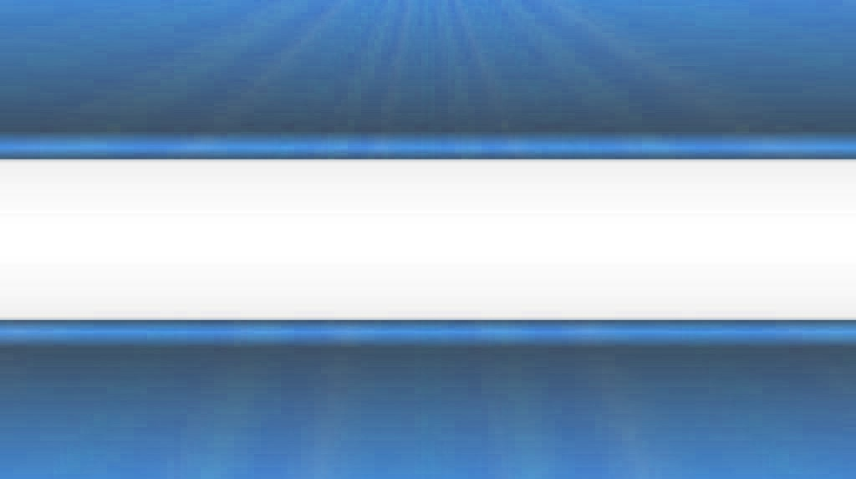
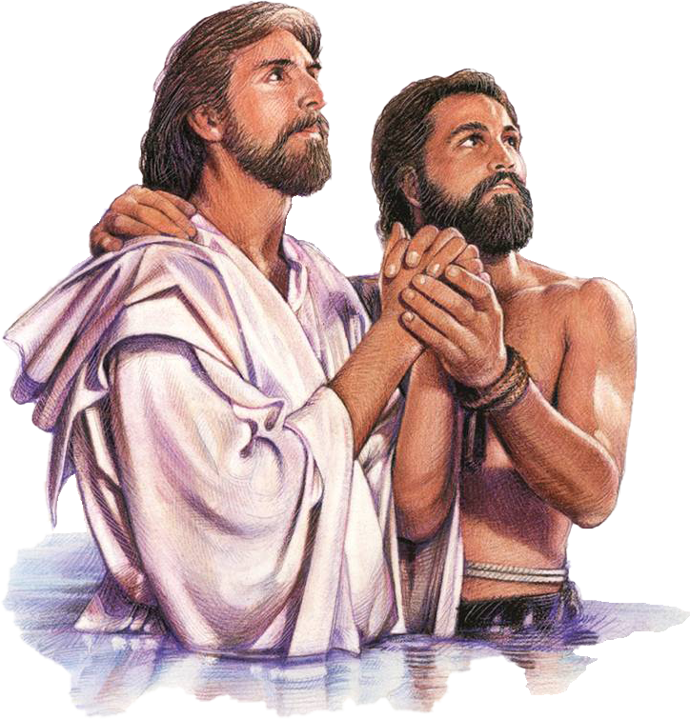
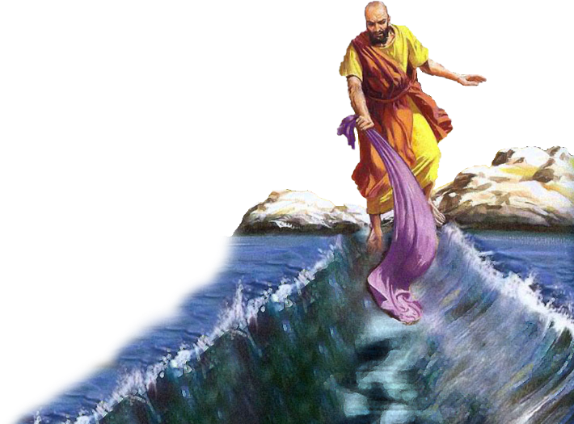
IZIKHUMBUZO ZOMLAMBO IYORDAN

Slide 11

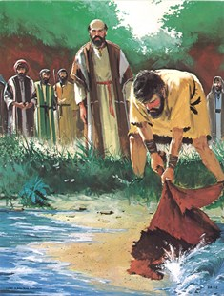
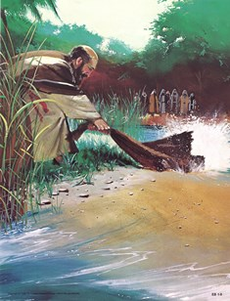
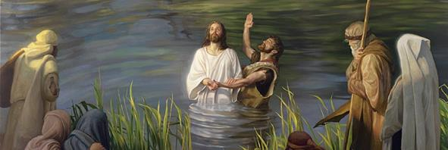
“Waluguqula ulwandle lwayinto eyomileyo; Bawuwela umlambo ngeenyawo; Apho savuya ngaye!” (INdumiso 66:6)
“Ulwandle lwabona, lwasaba, iYordan yabuya umva.” (INdumiso 114:3)
Ukuwela uLwandle oluBomvu kunye neYordan ziziganeko ezibini zembali eziye zadibana njengeziganeko ezibalulekileyo kwimbali yentlawulelo (Nd. 66: 6; 114). Xa zizonke, ziphawula ukukhululwa kwethu esonweni nasekufikeleleni kwethu kubomi obungunaphakade.
Ukuwela uMlambo iYordan ngokungummangaliso nokuziswa kwa kanye ebusweni bukaThixo kwakuyinyani kuEliya (2 Kumkani 2:1, 7, 8, 11).
KuElisha, nangona kunjalo, isiganeko esifanayo sasingumqondiso wokwamkelwa koMoya oyiNgcwele, owamenza ukuba afeze umsebenzi wakhe (2 Kumkani 2:14-15).
Ukungena emanzini eYordan kwaba nempembelelo efanayo kuYesu, owanikwa amandla nguMoya oyiNgcwele ukuzalisekisa umsebenzi wakhe: ukusikhulula esonweni aze asinike ubomi obungunaphakade (Marko 1:9-11; Yoh 1:29; 3:16).

Slide 12

“Masikhumbule ke ngoko inceba kaYehova, nobuninzi benceba yaKhe. Njengabantu bakwaSirayeli, masimise amatye ethu obungqina, size sibhale kuwo ibali elixabisekileyo loko asenzele kona uThixo. Yaye njengoko sihlolisisa indlela asiphethe ngayo kuhambo lwethu lwezonqulo, masithi, ngeentliziyo ezinyibilikileyo ngumbulelo, masivakalise, “Ndiya kumbuyisela ngantoni na uYehova konke ukundiphatha kwakhe kakuhle?." Psalm 116:12-14”
EGW (The Desire of Ages, p. 348)

