Slide 1
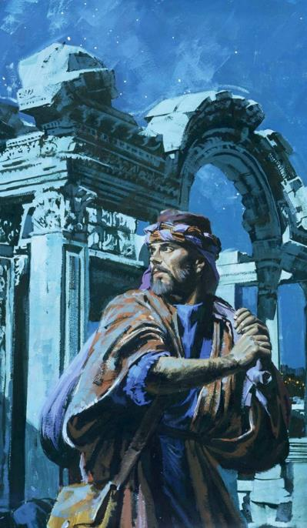
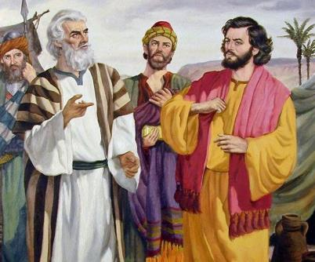
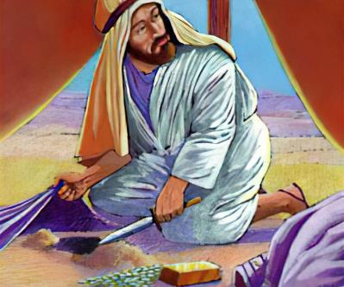
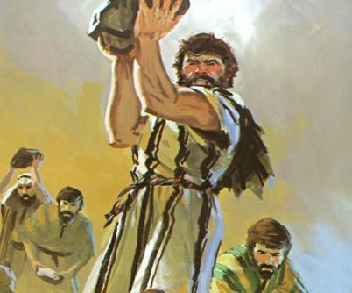
Lesson 6 for November 8, 2025
UTSHABA NGAPHAKATHI

Slide 2


“Mna, Yehova ndiyayigocagoca intliziyo, ndiyazicikida izintso, ukuze ndinike ulowo nalowo ngokwendlela yakhe, ngokwesiqhamo seentlondi zakhe”
UYeremiya 17:10

Slide 3


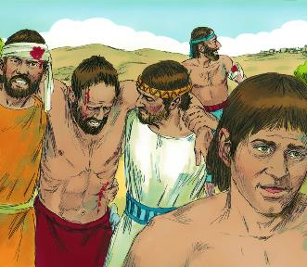
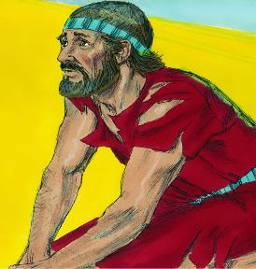





Emva kweqhinga lomkhosi elingenangqiqo, iindonga zaseYeriko zawa. USirayeli wangena kwisixeko wasitshabalalisa. Uloyiso! Ngubani? NguThixo, kuba uSirayeli wayengenanto yakwenza nayo.
Emva kweqhinga lomkhosi elinengqiqo, iAyi iyaphumelela. Ukoyiswa! Ngubani? Ngabantu bakwaSirayeli, kuba babengathembelanga kuThixo.
Xa ekugqibeleni bambuza uThixo, impendulo yayivakala: USirayeli wonile kwaye akanakukwazi ukoyisa iintshaba zakhe. Angayifumana njani inceba kaThixo?
Unobangela wokoyiswa (Yosh. 7:1-5, 10-13)
Udakumbile kwaye ubandezelekile (Yosh. 7:6-9)
Ukufumana umenzi wobubi (Yosh. 7:14-19)
Isono sika-Akan (Yosh. 7:20-26)
Uloyiso kwakhona (Yosh. 8:1-29)

Slide 4

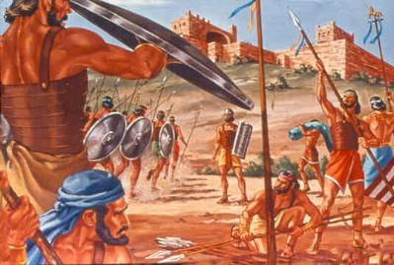
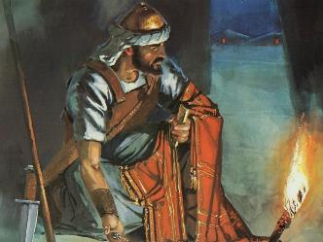
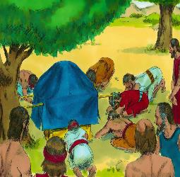
UNOBANGELA WOKOYISWA
“Onile amaSirayeli; ewe, awugqithile umnqophiso wam endawawisela umthetho ngawo; ewe, athabathile entweni esingelwe phantsi; ebile, akhanyele, ewe, ayibeke ezimpahleni zawo” (Yoshuwa 7:11)
Emva kwengxelo entle evela kwiintlola ezazithunyelwe eYeriko, uYoshuwa wabuza kuThixo waza wafumana kuye icebo lokuthimba isixeko.
Ukuba uYoshuwa, emva kokufumana ingxelo evela kwiintlola ezazithunyelwe eAyi, wayenokwenza okufanayo, ukufa kwabantu abangama-36 ngekwakuphetshiwe. (Yoshuwa 7:1-5).
Kodwa yayiyintoni esona isizathu sokoyiswa, okanye yayiyintoni isizathu sokuba uThixo axelele uYoshuwa ukuba angahlaseli iAyi (Yosh. 7:11)?
UThixo wayebonile ukuba “uSirayeli wonile.” Akukho ndawo eBhayibhileni apho isono sichazwa ngolu hlobo: “baphule umthetho… bathathile… bebile… baxokile… bababeke nezinto zabo.”
Qaphela isininzi. Isono senziwa ngumntu omnye, kodwa uThixo wababeka ityala bonke abantu. Babephule umnqophiso; isono kwafuneka sisuswe ukuze sibuyiselwe.

Slide 5

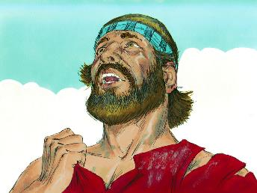
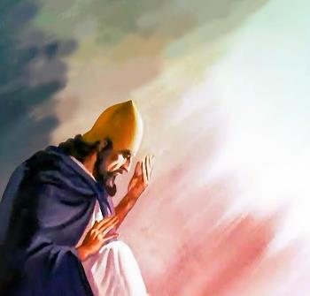
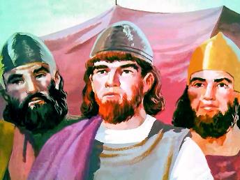
UDAKUMBILE KWAYE UBANDEZELEKILE
“Wathi uYoshuwa, Awu, Nkosi, Yehova, yini na ukuba aba bantu ubaweze iYordan, usinikele esandleni sama-Amori ukuba asibhubhise? Akwaba kanye bekukholekile kuthi ukuhlala phesheya kweYordan!’ ” (Yoshuwa 7:7)
UYoshuwa namadoda amakhulu babedakumbile kukoyiswa eAyi, baza babonisa iimpawu ezicacileyo zokuzila (Yosh. 7:6).
Emva koko uYoshuwa uphendula ngomsindo ofana nowamaSirayeli ngexesha lokuhambahamba iminyaka engama-40: “Yini na ukuba usiweze…? Akwaba bekukholekile kuthi ukuhlala …!” (Yosh. 7:7).
Nangona kunjalo, umoya kaYoshuwa wawungafani nowamaSirayeli entlango. Isikhalazo sakhe sasingashukunyiswa kukudana, kodwa kukoyika ukuba igama likaThixo liza kuhlaziswa phakathi kweentlanga (Yosh. 7:8-9).
Wabona ngokucacileyo ukuba ubuntu bukaThixo buya kutolikwa ngabangakholwayo ngokwezenzo zabantu baKhe. Namhlanje sisebubungqina bukaThuxo ehlabathini. Uxanduva olungako!

Slide 6
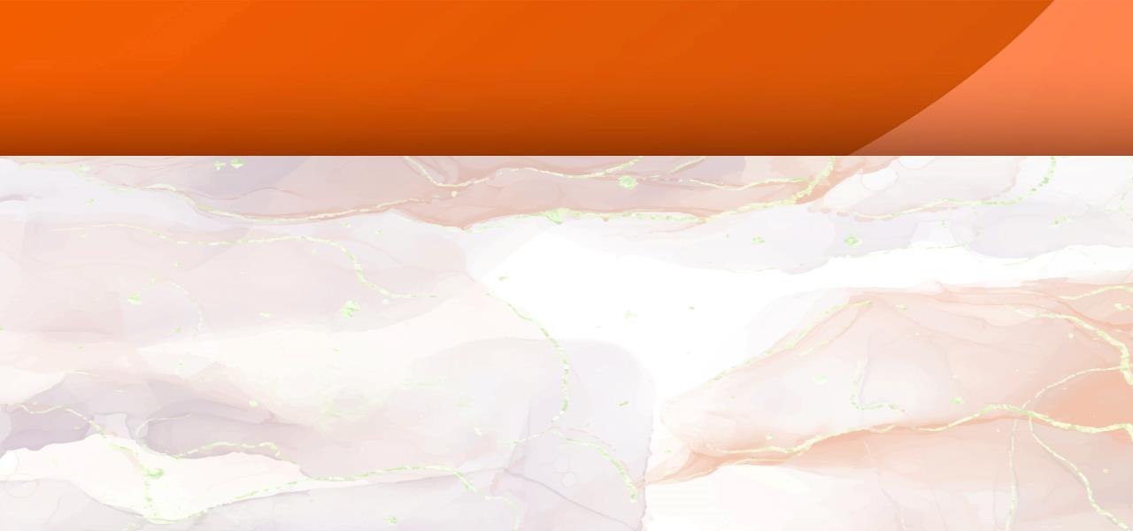
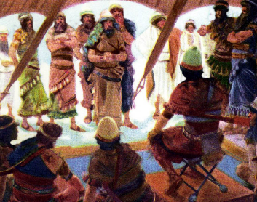
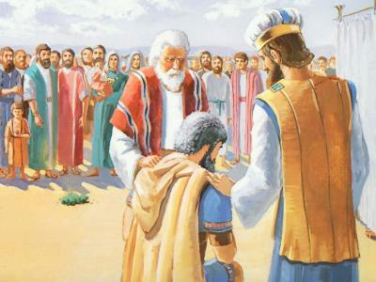
UKUFUMANA UMENZI WOBUBI
“Ize nisondele kusasa ngokwezizwe zenu, isizwe athe wacisha sona uYehova sisondele ngokwezindlu zaso; indlu athe wacisha yona uYehova isondele ngokwamadoda ayo;” (Yoshuwa 7:14)
Ukuze kususwe isono senkampani (ubutyala babantu bonke), umoni kwakufuneka aguzulwe (Yosh. 7:15). Aguzulwe? Ngaba ebengayi kuxolelwa ukuba uguquka? Kakade ebeya kuxolelwa! Kodwa uAkan akazange abonakalise zimpawu zokuguquka okunyanisekileyo (kwaye wayenamathuba amaninzi okwenza njalo).
Inkqubo yophando yabhengezwa yaza yahlehliswa kude kube lusuku olulandelayo (Yosh. 7:14-15)
Isizwe sakwaYuda sathathwa (Yosh. 7:16)
Kwathathwa intsapho kaZera (Yosh. 7:17a)
Inkokeli uZabhedi yathathwa (Yosh. 7:17b))
Kwathathwa uAkan (Yosh. 7:18)
Cwaka uAkan
Cwaka uAkan
Cwaka uAkan
Cwaka uAkan
Cwaka uAkan
Ebonakalisa ububele nothando lukaThixo, uYoshuwa wacela uAkan ukuba avume isono sakhe (Yosh. 7:19).
Ityala lika-Akan lalahleka. Wavuma, kodwa akazange acele uxolo (Yosh. 7:20). Kodwa uThixo walila ngenxa yobulukhuni bentliziyo yakhe, nto leyo eyayibonakaliswa kulo lonke ubizo lokuguquka.

Slide 7
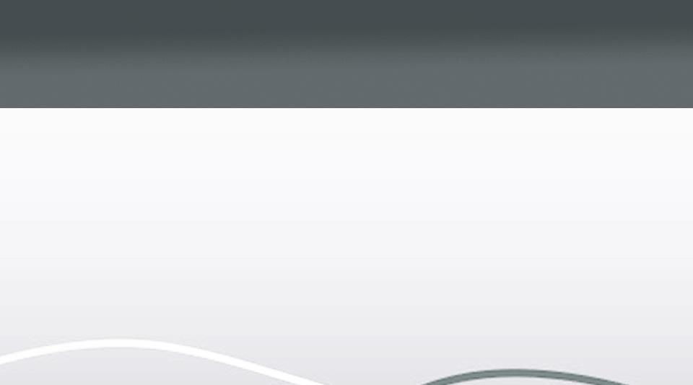
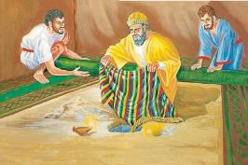

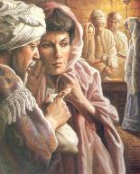
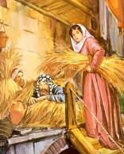
ISONO SIKA-AKAN
“ndabona emaxhobeni ingubo entle yaseShinare yanye, neeshekele zesilivere zaba makhulu mabini, nesinqumka segolide sasinye esiziishekele ezimashumi mahlanu ubunzima baso; ndazinqwenela, ndazithabatha; nanzo zimbelwe emhlabeni phakathi kwentente yam, isilivere ingaphantsi.” (Yoshuwa 7:21)
UYoshuwa wacela uAkan ukuba azukise uThixo aze avume izono zakhe (Yosh. 7:19). Yayilithuba lakhe lokugqibela. Ukuba, xa wayevuma izono zakhe, wayecele uxolo... Kodwa akazange acele uxolo, kwaye akukho xolelo kuye (Num. 15:30-31).
Rahabhi
Wafihla iintlola eluphahleni
Wabonisa ububele kuSirayeli
Akan
Wafihla amaxhoba emhlabeni
Wamzisela intlekele uSirayeli
Wazisa uloyiso ngenxa yokholo
Wazisa ukoyiswa ngenxa yemisebenzi
Wenza umnqophiso noSirayeli
Wophula umnqophiso kaSirayeli
Wasindisa ubomi bakhe nentsapho
Watshabalala nosapho lwakhe
NjengoEva, uAkan “wabona,” “wanqwenela,” “wathabatha,” kwaye isono sakhe sachaphazela abaninzi (Gen. 3:6). NjengoAnaniyas noSafira, uAkan wathabatha ezinye zezinto eziqalekisiweyo ezazinikelwe kuThixo waza wazihlawulela (IZenzo 5:1-2).
Izigqibo ezenziwa nguAkan eYeriko zazichasene ngokupheleleyo nezo zikaRahabhi:

Slide 8

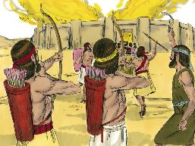
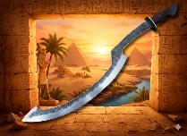
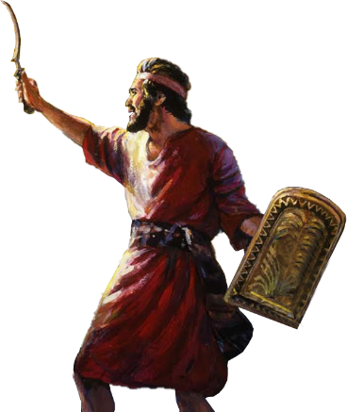
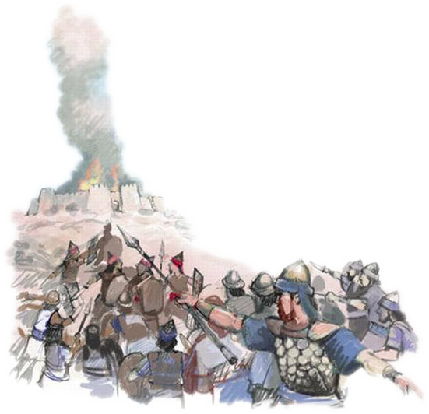
ULOYISO KWAKHONA
“Wathi uYehova kuYoshuwa, Musa ukoyika, ungaqhiphuki umbilini. Thabatha bonke abantu bokulwa, usuke, unyuke, uye eAyi. Yabona, ndimnikele esandleni sakho ukumkani waseAyi, nabantu bakhe, nomzi wakhe, nelizwe lakhe.” (Yoshuwa 8:1)
NjengaseYeriko, uThixo wanika uYoshuwa icebo lokuphumelela ukoyisa iAyi (Yosh. 8:1-2).
Ebusuku, kwamiswa abantu abalaleleyo ngasemva kwesixeko. Kwathi kwakusa, umkhosi wasondela eAyi waza wenza ngathi ubaleka phambi kwawo kwakhona.
Njengoko uMoses wayephakamisa intonga yakhe de woyisa ama-Amaleki, ngokomyalelo kaThixo, uYoshuwa waphakamisa “isixhobo sakhe” (mhlawumbi irhengqe elalisetyenziswa ngamaYiputa), waza wasigcina siphakanyisiwe de woyisa ngokupheleleyo (Yosh. 8:18-22, 26).
UThixo wayephinda enika abantu baKhe uloyiso. INtlambo yaseAkore, apho uAkani nosapho lwakhe babulawelwa khona, yavula ucango loloyiso, “ucango lwethemba” (Hoseya 2:15).
Xa sisamkela uxolelo lukaThixo ngokholo, uThixo ungcwaba izono zethu eAkore, aze avule ucango lwethemba.

Slide 9

“Impembelelo eyoyikwa kakhulu libandla asiyiyo eyabachasi abacacileyo, abangakholwayo, nabanyelisi, kodwa yeyamawexuwexu angqina ngoKristu. Aba ngabo bagcina intsikelelo kaThixo kaSirayeli baze bazise ubuthathaka ebandleni, isingcikivo esingasuki lula...
UbuKrestu abufanele buboniswe ngeSabatha kuphela, buboniswe kwindawo engcwele; bungobemihla ngemihla evekini nakuzo zonke iindawo. Amabango abo kufuneka aqatshelwe kwaye athotyelwe kwindawo yokusebenzela, ekhaya, nakwiintengiselwano zoshishino nabazalwana kunye nehlabathi...”
EGW (Conflict and Courage, April 23)

