Slide 1
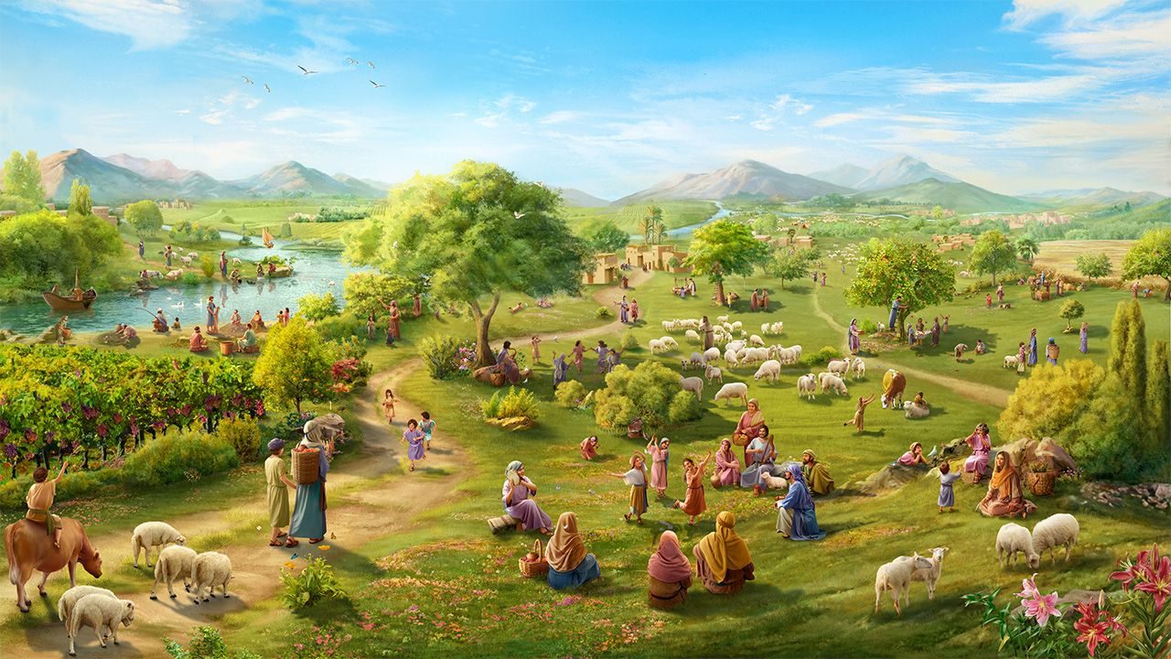
IINDLAMAFA ZAMADINGA,
AMABANJWA ETHEMBA
Isifundo 9 for 29 kweyeNkanga 2025

Slide 2
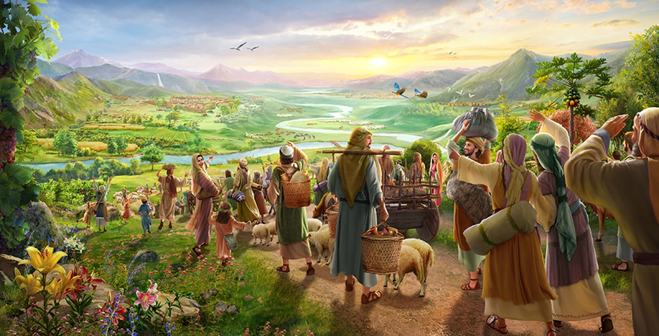
“Buyelane enqabeni, babanjwandini banethemba; nanamhla ndiyaxela, ndithi, Ndiya kukubuyisela ngokuphindiweyo.” (UZakariya 9:12)

Slide 3
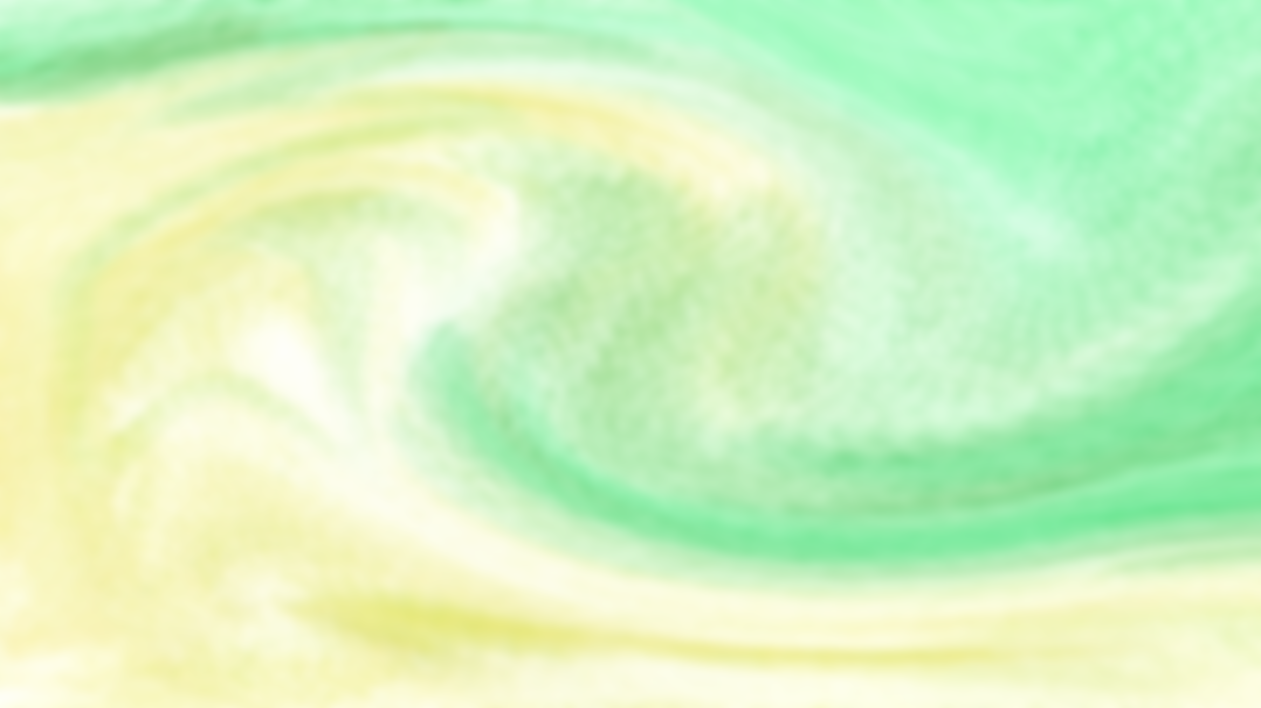
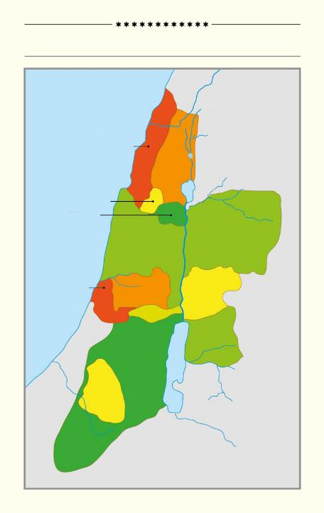
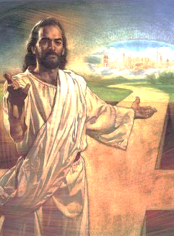
Uninzi lwencwadi kaYoshuwa, isahluko se13 ukuya kwesama21, luthetha ngokusasazwa kwelizwe laseKanan phakathi kwezizwe ezahlukeneyo zakwaSirayeli.
IZIZWE EZILI12 ZAKWASIRAYELI
Ulwandle lweMeditera
Phakathi kweengxelo ngeendawo, abantu, nezizwe, sinokubona ilizwe elalisele lililifa likaSirayeli, kodwa, kwangaxeshanye, ababengalifumani ngokupheleleyo.
UASHERE
UNAFETALI
Ukufa kukaYesu kusiqinisekisa ukuba ngoku silizuzile njengelifa ilizwe abaphulukana nalo uAdam noEva. Nangona kunjalo, sise"ngabathinjwa abanethemba" lokulifumana.
UZEBHULON
UISAKARE
UMANASE
UMANASE
Ilizwe ekwaphulukanwa nalo
Ilizwe elinikwa nguThixo
Yoyisa ilizwe
Londoloza isipho
Ilizwe elibuyiselweyo
UDAN
A
UEFRAYIM
UGADI
UBENJAMIN
URUBHENI
B
UYUDA
C
USIMON
B'
A'

Slide 4



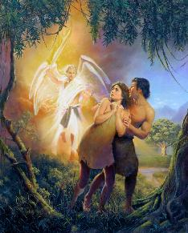
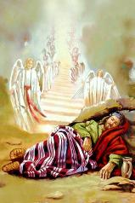
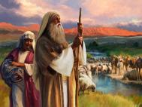
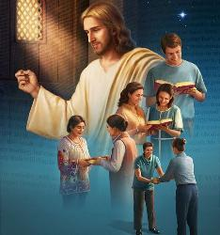
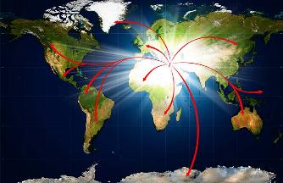
ILIZWE EKWAPHULUKWANA NALO
“uYehova uThixo wamndulula emyezweni we-Eden, ukuba asebenze umhlaba ebethatyathwe kuwo” (Genesisi 3:23).
UThixo wamisela uAdam noEva njengabalawuli beli hlabathi (Gen. 1:27-28), waza wababeka emyezweni wase-Eden (Gen. 2:8).
Bagxothwa ngenxa yokungamthobeli uThixo (Gen. 3:23). Baphulukana nobukhosi phezu koMhlaba.
Kodwa uThixo wayenecebo lokuba uluntu lubuyiselwe ilizwe abaphulukene nalo. Kwinqanaba lokuqala, wanika uAbraham, uIsake, noYakobi isiqwenga somhlaba: iKanan (Gen. 13:14-15).
Kancinci kancinci, ubunini buza kwandiswa bufikelele kwihlabathi lonke, njengoko ulwazi ngoThixo lwalufikelela kubo bonke abantu nezizwe (Isa. 11:9).
Ukungathobeli kukaSirayeli kwakhokelela kutshintsho kwizicwangciso zokuqala. UThixo wavusa abantwana baka-Abraham ematyeni ukuze bazuze izithembiso zaKhe: thina (Luka 3:8; Heb. 6:11-12).

Slide 5



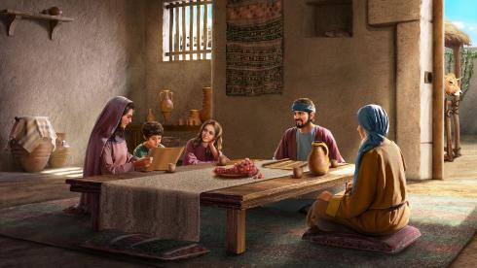
ILIZWE ELINIKWA NGUTHIXO
“LelikaYehova ihlabathi nenzaliseko yalo, Elimiweyo, nabahleli kulo” (INdumiso 24:1).
Njengoko uAdam noEva bengazange bayifanele iGadi yase-Eden, uAbraham kunye nenzala yakhe abazange balifanele iLizwe leDinga. Yayisisipho esivela kuThixo.
Singasithelekisa esi sipho nendlu eqeshiweyo. Nangona uSirayeli wayenokuhlala eKanan, ilizwe lahlala ilelikaThixo (INdu. 24:1).
Umnini wendlu ngulowo unyamekela ukugcinwa kophahla, imibhobho yamanzi, njl. Ngokufanayo, uThixo ngulowo unika imvula, ukhusela izityalo, njlnjl., ukuze uSirayeli ahlale ngokuzithemba kwilizwe uThixo awanike lona.
Njengoko kwakunjalo e-Eden, kwakukho irenti "yokuhlawula": ukuthobela (Lev. 20:22). Yayingumbandela wobudlelwane: ukuthanda uThixo nokonwabela iintsikelelo zaKhe.
Izolo, kunjalo nanamhlanje, iza kuhlala ingumba wokholo (Heb. 11:9-13).

Slide 6


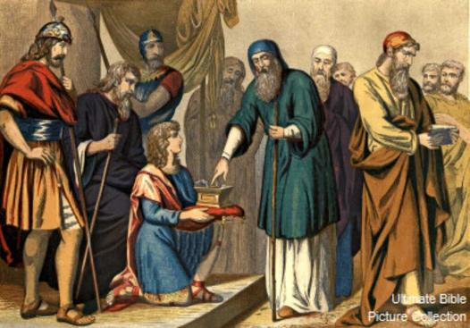
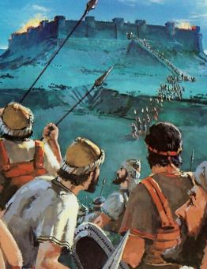
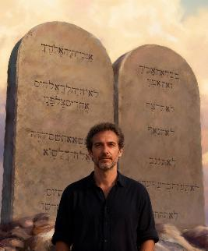

YOYISA ILIZWE
“Ke ngoko labe eli lizwe libe lilifa kwizizwe ezisithoba, kwisiqingatha sesizwe sakwaManase” (Yoshuwa 13:7).
Xa uYoshuwa wayesele emdala, uThixo wamyalela ukuba ahlule ilizwe phakathi kwezizwe zakwaSirayeli, kuquka neendawo ezingoyiswanga (Josh. 13:1-7).
Ilizwe yayilelabo, kodwa kwakufuneka benze umgudu wokulifumana. UThixo akenzi ngokuzimeleyo ngaphandle komntu; Ufuna sidlale eyethu indima.
Nangona balwela uloyiso, impumelelo yabo yayingeyonto yabo, kodwa yayiyekaThixo (Dut. 9:5). NjengoSirayeli, asinakwenza nto ukuze sifumane usindiso size sizuze izithembiso (Efe. 2:8-9; Gal. 3:29). Kodwa ukuba balwa... simele senze ntoni namhlanje?
Nje ukuba basindisiwe, uThixo ufuna izinto ezimbini kwiindlalifa zakhe: ukuthobela (Fil. 2:12) kunye nombulelo (Heb. 12:28).

Slide 7

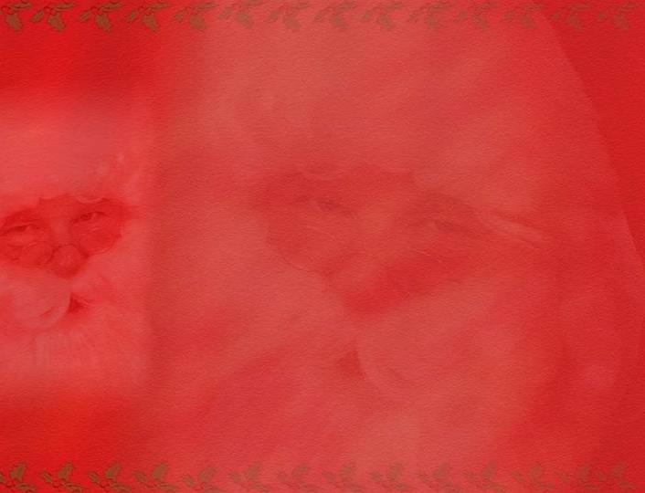
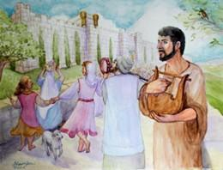
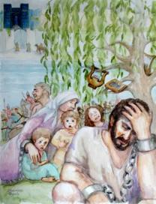
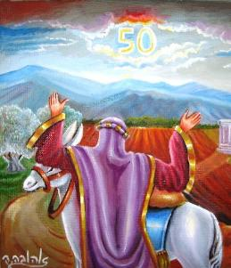
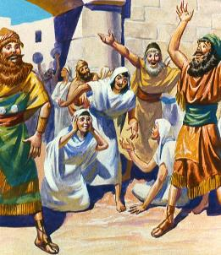
LONDOLOZA ISIPHO
“Ilizwe ze kungathengiswa ngalo, libhange, kuba ilizwe lelam; ngokuba ningabaphambukeli neendwendwe kum” (Levitikus 25:23)
Nje ukuba ilifa lifunyenwe, kwakukho imithetho ekhethekileyo elawula ukusetyenziswa komhlaba: unyaka weSabatha kunye nowentlokoma.
Unyaka weSabatha, ulwandiso olukhulu lweSabatha, wawuvumela umhlaba ukuba uphumle (Lev. 25:2-5). Ukusilela ukugcina lo mthetho yayiyenye yezizathu zokuthinjwa (2 Kron. 36:20-21).
Intlokoma yayiquka ukubuyiselwa kwemihlaba kubanini bayo bokuqala, kuthintelwa ukungalingani kwezentlalo (Lev. 25:10, 23, 40-41).
Ngokwenene, le yeyona njongo iphambili yevangeli: ukususa umahluko phakathi kwezityebi namahlwempu, umqeshi nomqeshwa, abanamalungelo nabasweleyo, kusibeka sonke kwinqanaba elifanayo ngokuqaphela isidingo sethu esipheleleyo sobabalo lukaThixo.

Slide 8

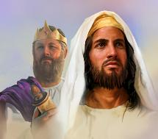
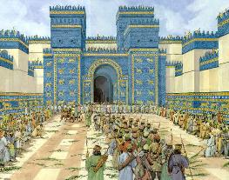
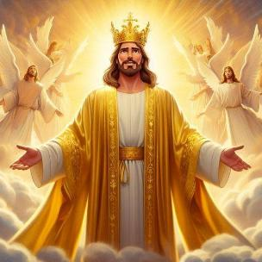
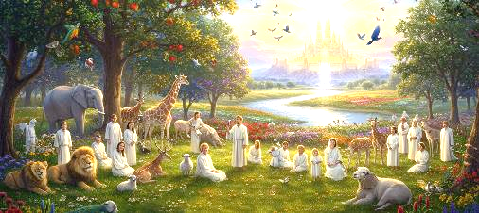
ILIZWE ELIBUYISELWEYO
“Bohlala ezweni elo, ndalinika umkhonzi wam uYakobi, ababehleli kulo ooyise; bahlale ke khona, bona nabantwana babantwana nano kude kuse ephakadeni; uDavide, umkhonzi wam, abe sisikhulu sabo ngonaphakade” (Hezekile 37:25).
Ngenxa yokungathobeli kwabo, uSirayeli wasuswa kwilizwe labo waza waphoswa eBhabhELI. Kodwa uThixo akazange abashiye.
Wathembisa ukubabuyisela, abanike ilizwe ngonaphakade, aze amise uDavide njengokumkani phezu kwabo (Hez. 37:25). Kodwa uSirayeli akazange alithathe elo lizwe ngonaphakade, kwaye uDavide wayesele efile ixesha elide. Sithetha ntoni esi siprofeto?
Apha uYesu uyavakaliswa, uKumkani wokwenene olawula ngonaphakade. Lowo, ngegazi laKhe, usiqinisekisa ngelifa elingunaphakade.
Ukukuzaliseka lwazo zonke izithembiso (Roma 15:8; 2 Kor. 1:20). KuYe sifumana iintsikelelo ngoku kwaye, kwixesha elizayo, sifumana ilifa elithenjisiweyo (1 Pet. 1:3-4). Kungekudala, iinyawo zethu ziya kungena kwiLizwe leDinga.

Slide 9

“Ngokungathobeli uThixo, uAdam noEva balahlekelwa yiEden, kwaye ngenxa yesono umhlaba wonke waqalekiswa. Kodwa ukuba abantu bakaThixo balandela imiyalelo yaKhe, umhlaba wabo wawuya kubuyiselwa ekuchumeni nasebuhleni. UThixo ngokwaKhe wabanika imiyalelo malunga nenkcubeko yomhlaba, kwaye babeza kusebenzisana naYe ekubuyiselweni kwawo. Ngaloo ndlela umhlaba wonke, phantsi kolawulo lukaThixo, wawuya kuba sisifundo senyaniso yokomoya. Njengokuba ekuthobeleni imithetho yaKhe yendalo umhlaba ufanele uvelise ubutyebi bawo, ngokunjalo ekuthobeleni umthetho waKhe wokuziphatha iintliziyo zabantu kwakufuneka zibonakalise isimilo saKhe.”
EGW (Christ's Object Lessons, p. 289)

