Slide 1
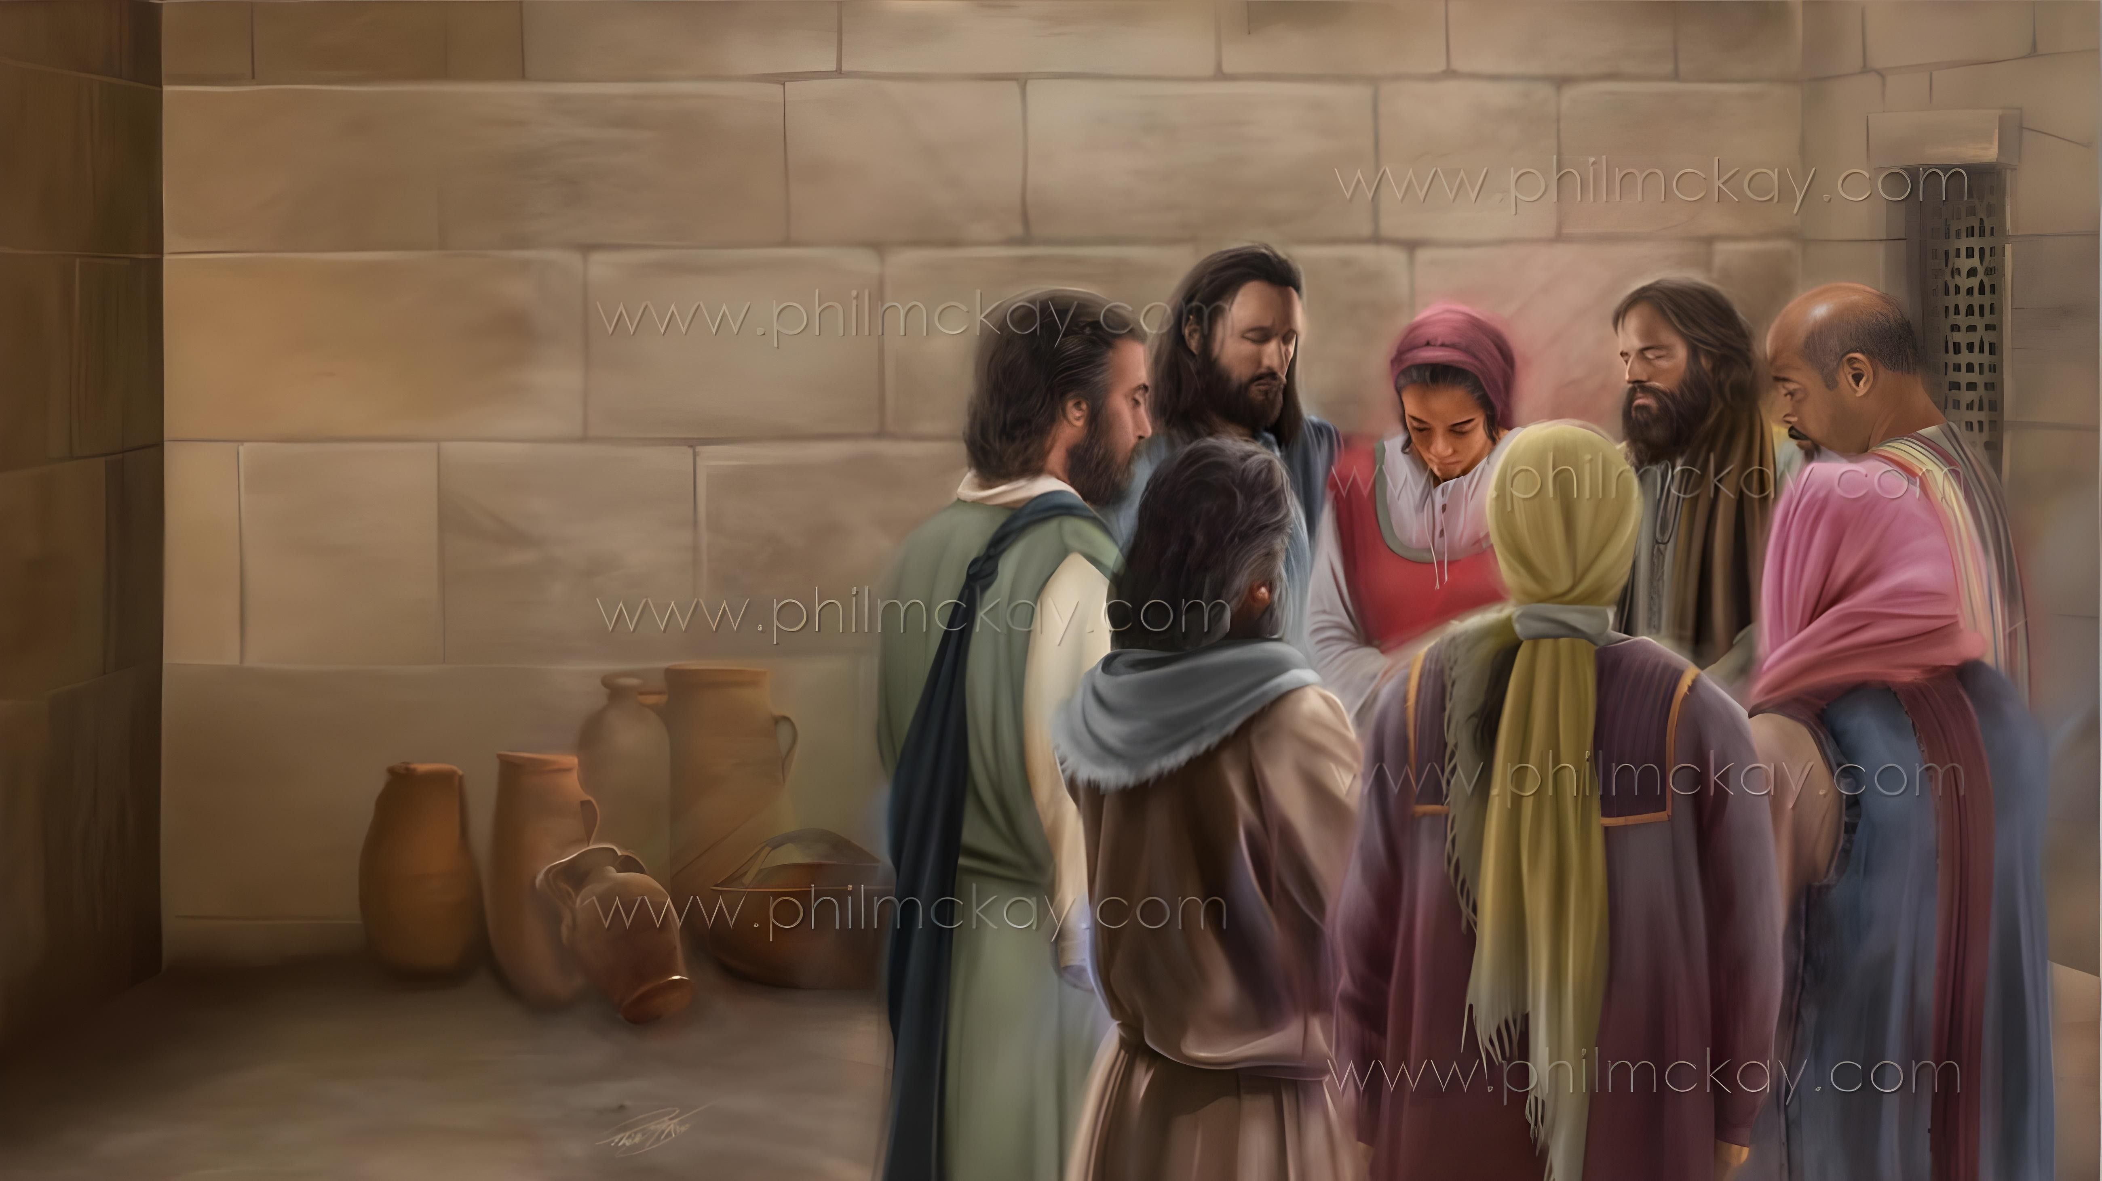
IZIZATHU ZOKUBA NOMBULELO NOMTHANDAZO
Isifundo 2 – 10 kweyoMqungu (Januwari) 2026

Slide 2


“Ekubeni ndikholose ngayo le nto, yokuba lowo wawuqalayo ngaphakathi kwenu umsebenzi olungileyo, wowufeza, ide ibe yiloo mini kaYesu Kristu”
KwabaseFilipi 1:6

Slide 3

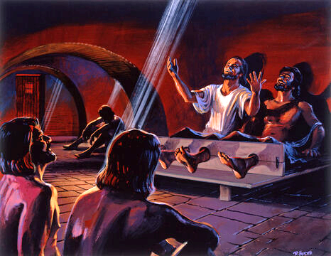
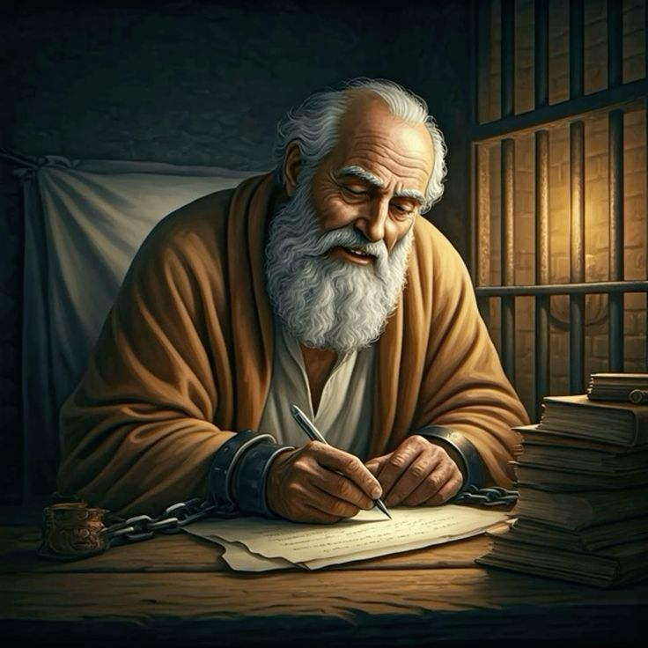







La maxesha ayengelula kuPawulos. Ngekwakulula ukunikezela ekuphelelweni lithemba ngenxa yokulahlekelwa yinkululeko yakhe.
Nangona kunjalo, kanye njengoko wayecula iingoma zokudumisa entolongweni yakhe ebuhlungu yaseFilipi, uPawulos wafumana izizathu zombulelo awayenokuzidlulisela kubazalwana noodade bakhe baseFilipi naseKolose.
Ukuvalelwa kwakhe entolongweni akuzange kumthintele ekuqhubekeni nokunxibelelana noYise, nokuthandazela abanye ngomthandazo.
Izizathu zokuba nombulelo nokuthandaza kwincwadi yabaseFilipi:
Izizathu zokuba nombulelo (KwabaseFilipi 1:3-8)
Imithandazo (KwabaseFilipi 1:9-11)
Ukubulela nokuthandaza ngamaxesha anzima (Fil 1:12-18)
Izizathu zokuba nombulelo nokuthandaza kwincwadi yabaseKolose:
Izizathu zokuba nombulelo (KwabaseKolose 1:3-8)
Imithandazo (KwabaseKolose 1:9-12)

Slide 4
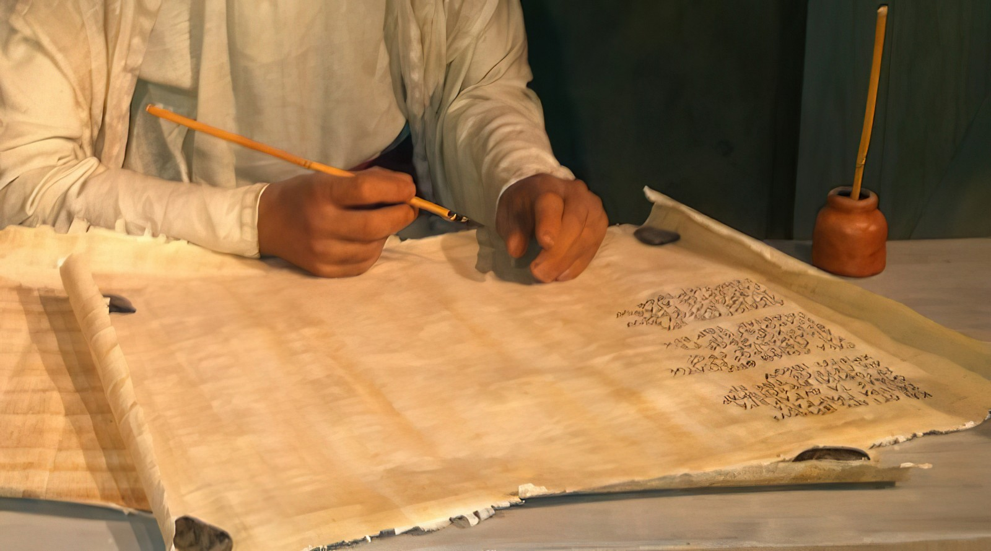
Izizathu zokuBulela nokuThandaza kwiNcwadi yabaseFilipi

Slide 5

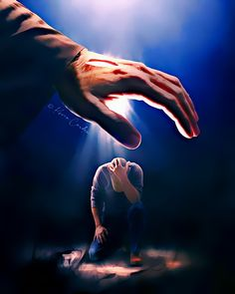
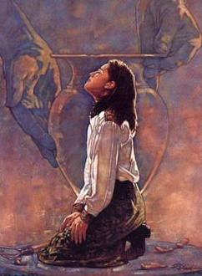
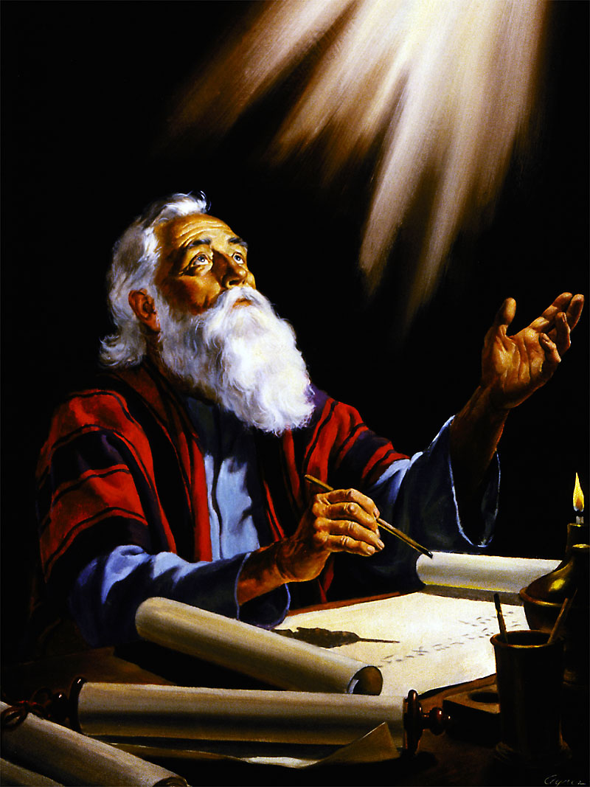
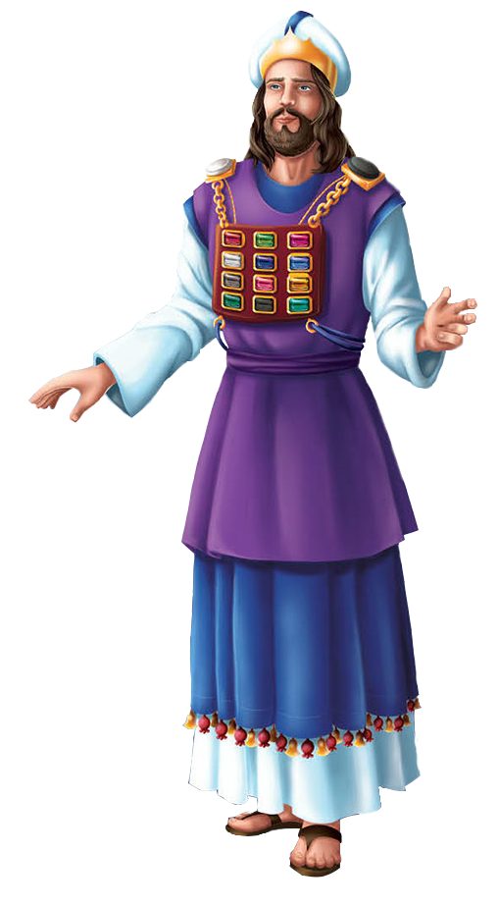
IZIZATHU ZOKUBA NOMBULELO
“Ekubeni ndikholose ngayo le nto, yokuba lowo wawuqalayo ngaphakathi kwenu umsebenzi olungileyo, wowufeza, ide ibe yiloo mini kaYesu Kristu” (Fil. 1:6)
UPawulos uyivula incwadi yakhe ngokubulela uThixo ngamakholwa aseFilipi (Fil. 1:3), nawathanda kunene (Fil. 1:8).
Kanye njengokuba umbingeleli omkhulu wayenxibe isigcinasifuba sakhe, ecaleni kwentliziyo yakhe, amagama ezizwe zakwaSirayeli ayebhalwe kwiilitye ezinqabileyo xa emi phambi koThixo, uPawulos wayephethe “entliziyweni yakhe” ilungu ngalinye lebandla xa emi phambi koThixo ethandaza ukuze alithethelele (Fil. 1:7).
Umbulelo wakhe wawuquka into yokuba amaFilipi ahlala ethembekile kwiindaba ezilungileyo, nokuba uThixo wayebagqibelelisa yonke imihla (Fil. 1:5-6).
Isizathu sesithathu sombulelo kukuba amaFilipi abelana naye “kwiintambo zam, nasekukhuselekeni nasekuqiniseni iindaba ezilungileyo” (Fil. 1:7).

Slide 6


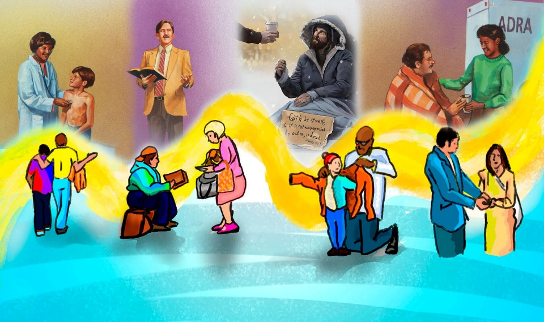
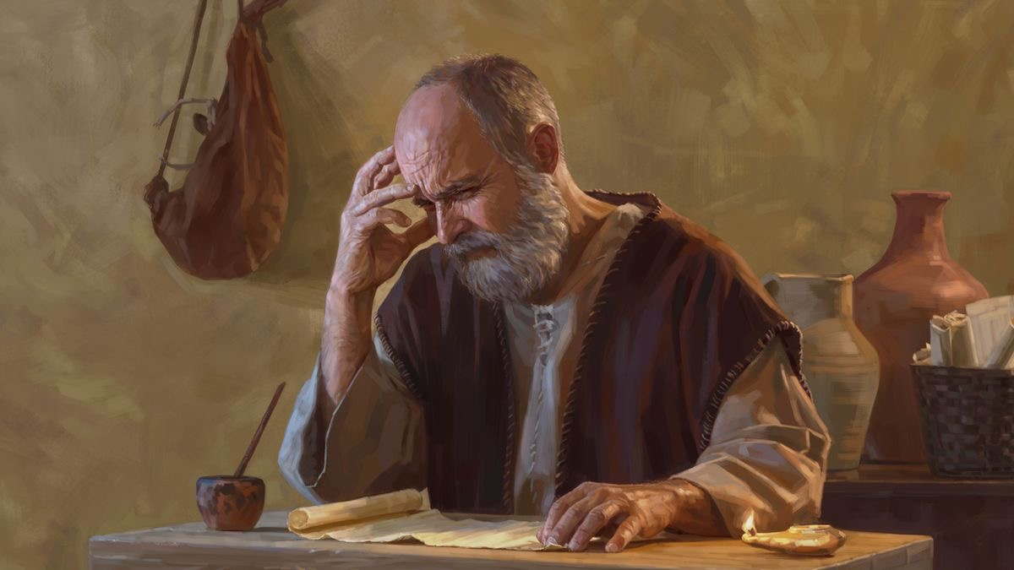
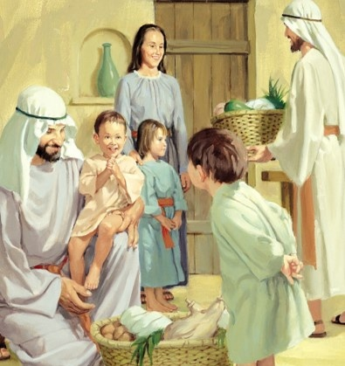
IMITHANDAZO
“Nako oku ndiyakuthandazela, ukuba uthando lwenu lube kukhona luphuphuma ngokuphuphuma ukwazi okukhulu, nako konke ukuqonda, ukuze nibe nizicikide izinto eziziincamisa, ukuze nibe nokusulungeka, ningabi nasiwo, nide nise kwimini kaKristu; nizele ziziqhamo zobulungisa ezingoYesu Kristu, nikhangelise ekuzukiseni nasekudumiseni uThixo.” (KwabaseFilipi 1:9-11)
Singayijonga inkuthazo yomthandazo kaPawulos njengesizathu "esibotshelelweyo" (KwabaseFilipi 1:9-11 ):
Ngamana uthando lungaphuphuma kuni
Luza kukwenza ulumke
Niya kukuqonda okulungileyo
Niya kuba nyulu, nithi tye
Niya kuthwala isiqhamo ngaye uYesu Krestu
This will result in glory and praise for God
Uthando lwethu lunokuphuphuma njani ngakumbi nangakumbi? Kutheni oko kubaluleke kangaka kubomi bobuKristu?

Slide 7
UKUBULELA NOKUTHNDAZA NGAMAXESHA ANZIMA

Slide 8

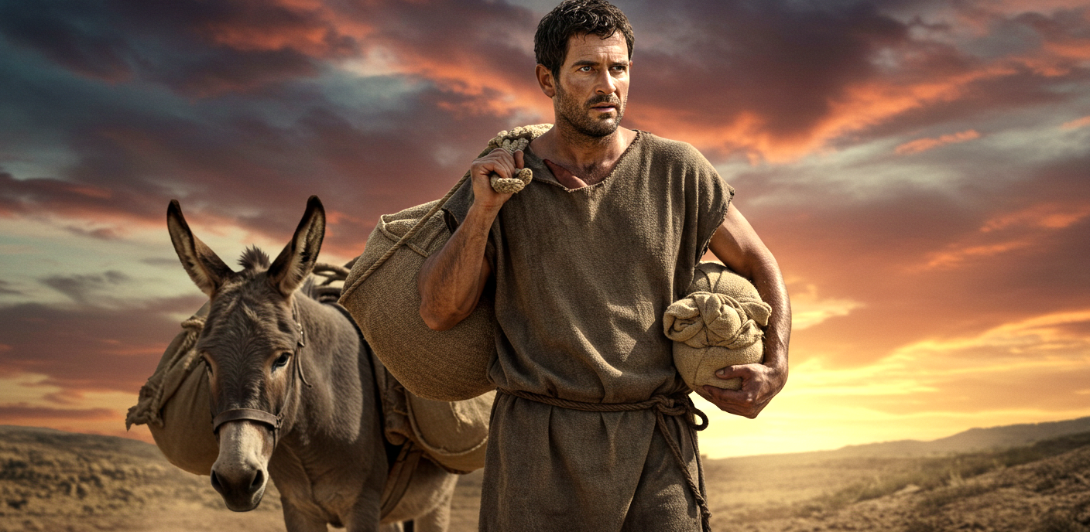
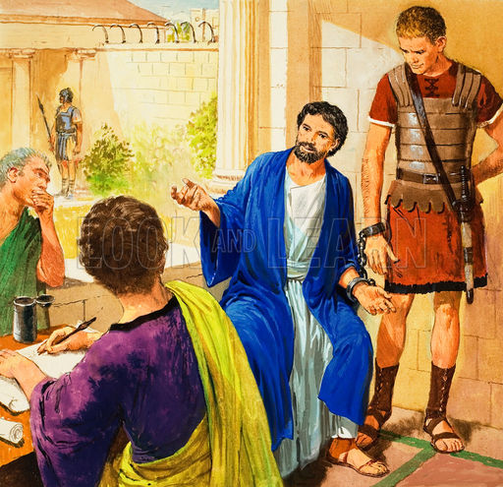
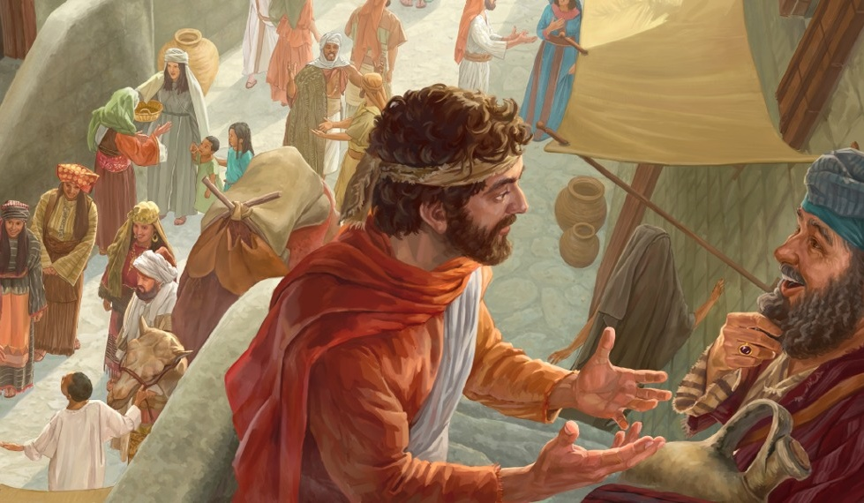
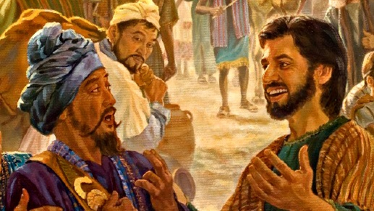
ITHUBA LOKUTHETHELELA IGOSPILE
“Ke kaloku ndinga nigazi, bazalwana, ukuba izinto ezindehleleyo, zibethe kwakukhona zihambayo iindaba ezilungileyo.” (KwabaseFilipi 1:12)
Xa amaFilipi eva ukuba uPawulos uvalelwe entolongweni eRoma, akhathazeka kakhulu, aza athumela uEpafrodito ukuba ancedise umpostile (Filipi 4:18).
Ekubeni ekhathazeke kakhulu, uPawulos wabulela uThixo ngokuvalelwa kwakhe entolongweni. Kutheni ebulela? Kuba ngale ndlela wayekwazi ukushumayela kwabo, ukuba bekungenjalo, wayengenakubafikelela (Fil. 1:13).
Ngaphezu koko, bebona isimo sengqondo sompostile, abanye abazalwana abathembekileyo bakhuthazwa, baza baqalisa ukushumayela ivangeli kungakhathaliseki ubunzima obubandakanyekileyo (Filipi 1:14).
Abanye, becinga ukuba ukuthetha ngokukhululekileyo ngevangeli kuya kuzisa ubunzima kuPawulos, nabo banceda – ngaphandle kwenjongo – ukuba bayisasaze (Filipi 1:15-18).

Slide 9
Izizathu zokuBulela nokuThandaza kwincwadi yabaseKolose

Slide 10


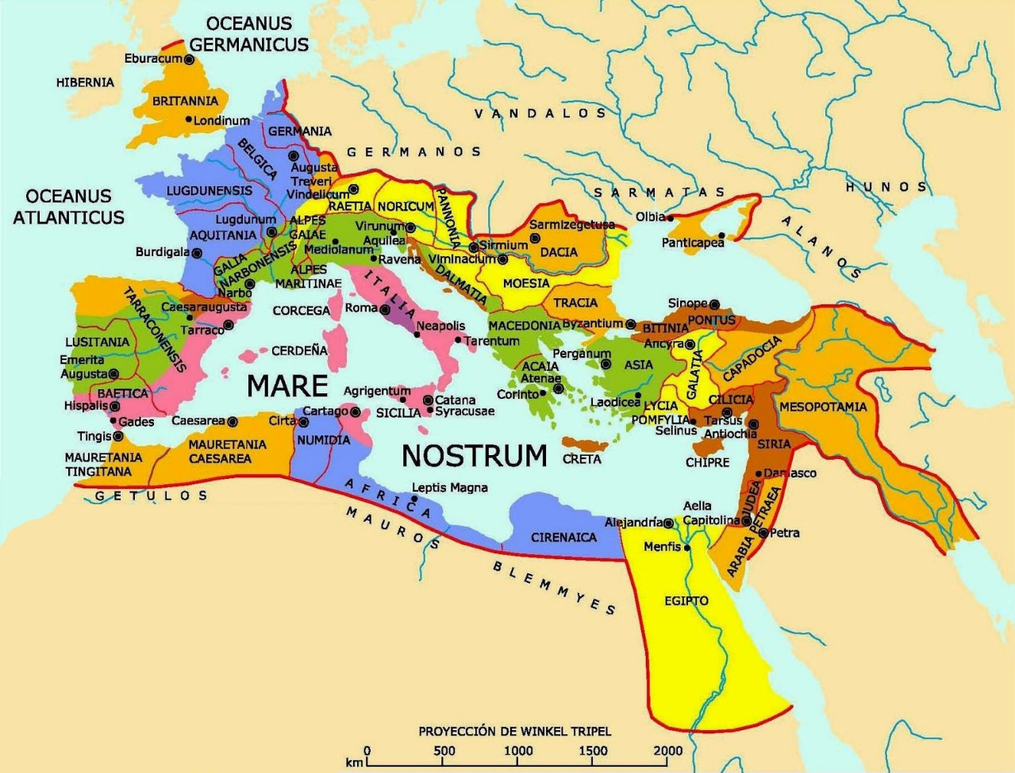
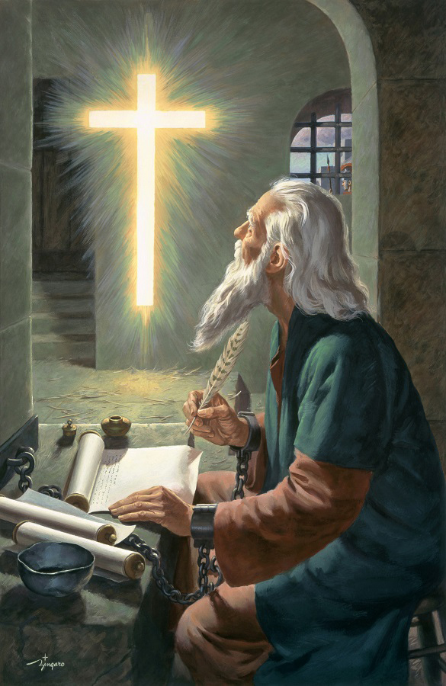

IZIZATHU ZOKUBA NOMBULELO
“Sihlala sibulela kuye uThuxo, uYise weNkosi yethu uYesu Kristu, xa sinithandazelayo” (KwabaseKolose 1:3)
Ephinda amazwi eyoku-1 KwabaseKorinte 13:13, uPawulos ubulela uThixo kuba abaseKolose baneempawu ezintathu zobuKristu: ukholo, ithemba, nothando (KwabaseKolose 1:4-5).
Ezi mpawu zivela “kuKristu Yesu”, zichaphazela ubudlelwane bethu “nabo bonke abangcwele”, kwaye zidluliselwe kuthi “ngelizwi lenyaniso leendaba ezilungileyo”.
UPawulos ugxininisa ukuba le vangeli ayishunyayelwanga kwabaseKolose kuphela, kodwa “kulo lonke ihlabathi” (Kol. 1:6) ... kwaye kwiminyaka engama-30 kuphela!
Amandla kaThixo, adluliselwa ngeendaba ezilungileyo ngomsebenzi woMoya oyiNgcwele, enza iBhayibhile ibe “lilizwi lobomi” (KwabaseFilipi 2:16). Oku kuthetha ukuba, ngokwamkela iindaba ezilungileyo, sinobomi obungunaphakade nelifa “enigcinelwe nina ezulwini” (Kol. 1:5).

Slide 11



IMITHANDAZO
“Ngenxa yoku, kususela kwimini esevayo, nathi asiphezi ukunithandazela nokunicelela, ukuze nizaliswe kukwazi kakuhleukuthanda kwakhe, ninokulumka nokuqonda konke okukokomoya.” (Kol. 1:9)
Isicelo sikaPawulos somthandazo siquka izinto ezininzi ezilungileyo kwabaseKolose (Kol. 1:9-11):
Ngamana bangafumana ulwazi ngoThixo, oluya kubanika ubulumko nokuqonda kokomoya
Philani njengabantwana bakaThixo, nimkholisa ngeendlela zonke
Ngamana bangathwala iziqhamo baze bakhule ekwazini
Ngamana bangaqiniswa ngamandla kaThixo ukuze babe nomonde
Lo mthandazo wenziwa “sibulela uBawo ngovuyo” (Kol. 1:12).
Kukho iindlela ezine uThixo asebenza ngazo ukuze enze umthandazo kaPawulos ube yinyani kuthi:
IBhayibhile (INdumiso 119:105)
Umoya wesiprofeto (Isityh. 19:10), obonakaliswa kuEllen G. White
Ulwalathiso lukaThixo (Kol. 4:3)
UMoya oyiNgcwele (Isa. 30:21)

Slide 12

“Ubomi bethu bufanele bubotshelelwe kubomi bukaKristu; simele sitsale kuYe rhoqo, sidle kuYe, isonka esiphilayo esehla sivela ezulwini, sitsala emthonjeni ohlala uhlaziyekile, sihlala sikhupha ubutyebi baso obuninzi. Ukuba sihlala sigcina iNkosi phambi kwethu, sivumela iintliziyo zethu ukuba ziphume ngombulelo nokudumisa kuYe, siya kuba nobomi obutsha obuqhubekayo kubomi bethu bonqulo. Imithandazo yethu iya kuba yincoko noThixo njengoko besiya kuthetha nomhlobo. Uya kuthetha iimfihlakalo zakhe kuthi ngokobuqu. Sihlala sifumana uvuyo olumnandi lobukho bukaYesu. Iintliziyo zethu ziya kutsha ngaphakathi kuthi njengoko esondela ukuze athethe nathi njengoko wenzayo noEnoki. Xa oku kungamava omKristu, kubonakala ebomini bakhe ubulula, ukuthobeka, ubulali, kunye nokuthobeka kwentliziyo, okubonisa bonke abo anxulumana nabo ukuba ebekunye noYesu kwaye wafunda kuYe.”
EGW (Christ’s Object Lessons, p. 129)

