Slide 1

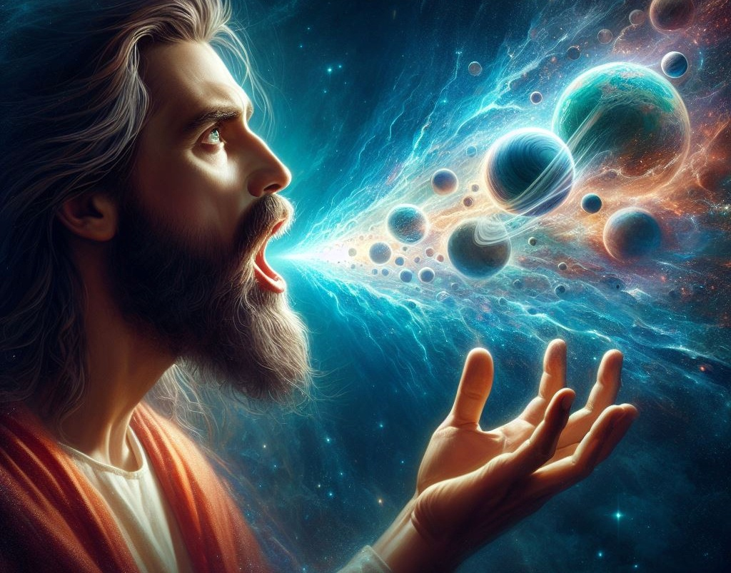
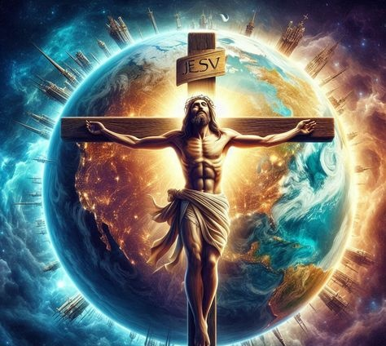
ISifundo 8 – 21 kweyoMdumba 2026
UKUBALASELA KUKAKRESTU

Slide 2
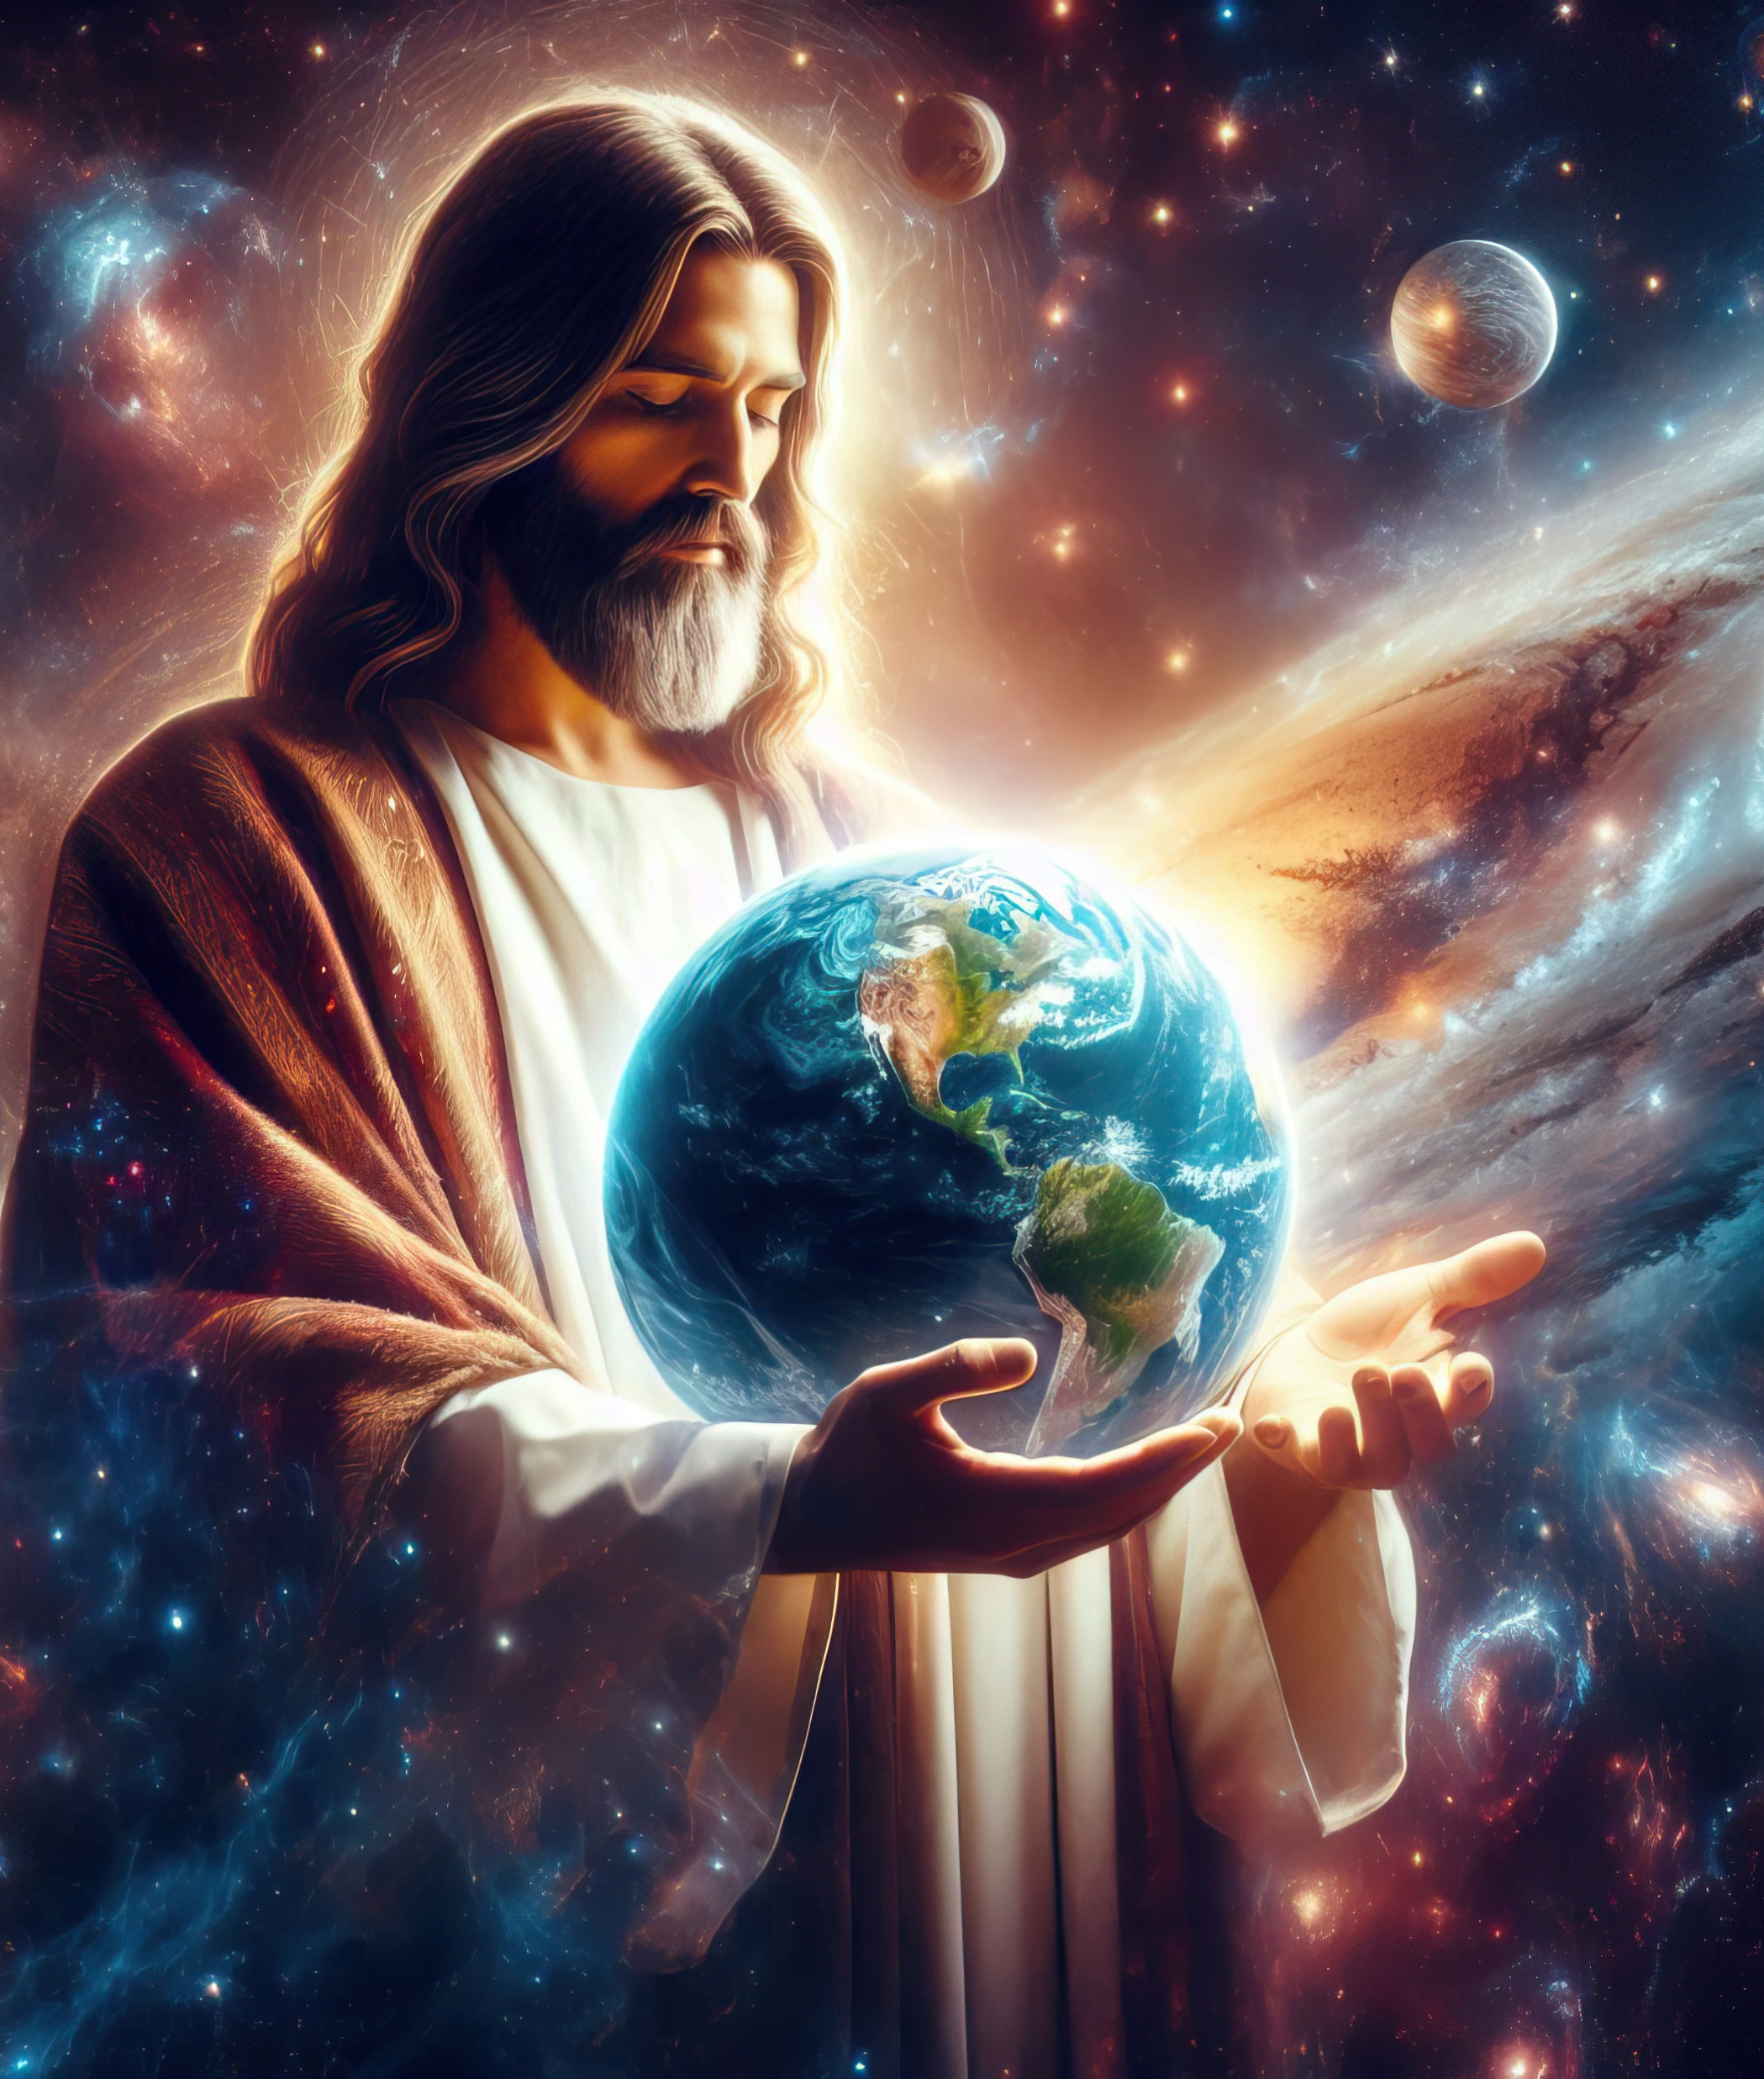
“Ungumfanekiselo kaThixo ongenakubonwa, owamazibulo kwindalo yonke. Ngokubana zadalelzwa kuye zonke izinto, ezisemazulwini nezisemhlabeni, ezinokubonwa nezingenakubonwa, nokuba ziitrone, nokuba zibubukhosi, nokuba zizilawuli, nokuba ngamagunya; zonke izinto zidalwe nguye, zidalelwa yena. Yena ke ungaphambi kweento zonke, nazo zonke izinto zima kuye.”
KwabaseKolose 1:15–17

Slide 3


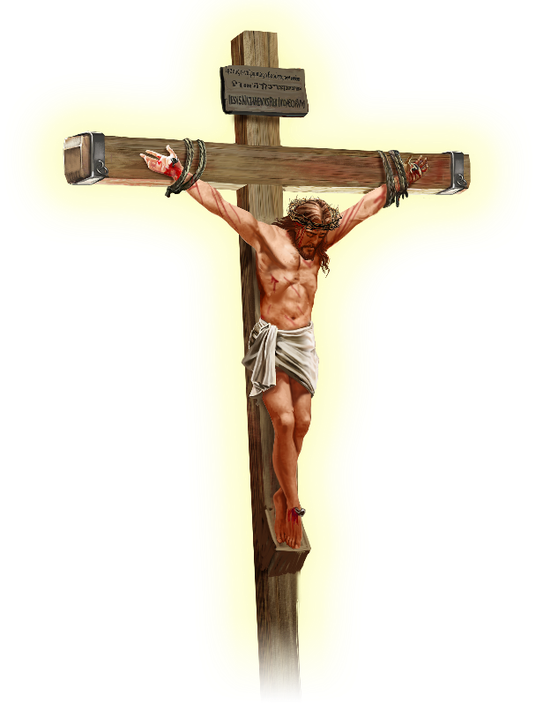






UPawulos uvakalisa ukuba uYesu uye wazisa uxolo kwindalo iphela, “nokuba zizinto ezisemhlabeni okanye ezisemazulwini” (Kol. 1:20).
Ngaphambi kokuba afike kula mazwi, umpostile usixelela ukuba ungubani kanye uYesu. Hayi umfundisi omkhulu, okanye intandabulumko, okanye umprofeti, okanye umshumayeli, okanye umthunywa weendaba ezilungileyo.
UYesu Krestu ngu…
Umfanekiselo kaThixo (KwabaseKolose 1:15a)
Owamazibulo (KwabaseKolose 1:15b-17)
Intloko yeBandla (KwabaseKolose 1:18a)
Oyingqalo (KwabaseKolose 1:18b)
UMxolelanisi (KwabaseKolose 1:19-20)

Slide 4





UMFANEKISELO KATHIXO
“Ungumfanekiselo kaThixo ongenakubonwa” (KwabaseKolose 1:15a)
Umfanekiselo unokuba yikopi yokwenyani (ifoto, ihologram, umfanekiselo oqingqiweyo), okanye kwanokuba yinto entsonkothileyo (umzobo). Kodwa ingcamango yeBhayibhile yomfanekiselo idlulela ngaphaya koko.
UThixo wadala uAdam noEva ngokomfanekiselo waKhe (Gen. 1:27), waza uAdam wazala unyana ngokomfanekiselo waKhe (Gen. 5:3). Le asiyomibhalo yokwenyani, ukulinganisa, okanye intelekelelo yabo. Zizinto ezifanayo ngokwasemzimbeni, ngokwasengqondweni nangokwentlalo...
UPawulos uthi umthetho wawusisithunzi, “kungekhona umfanekiselo wezinto” (Heb. 10:1), nto leyo ethetha ukuba “umfanekiselo = okuyinyani.”
Umbuzo ngulo: Ingaba uYesu wayefana noThixo, okanye wayelingana noThixo? Ukongezelela ekuzibizeni ngokuphindaphindiweyo igama likaThixo elithi “ndim,” uYesu watsho ngokuphandle: “Mna noBawo sibanye” ( Yohane 10:30 ); “Lowo undibonileyo mna umbonile uBawo” (Yohane 14:9).

Slide 5

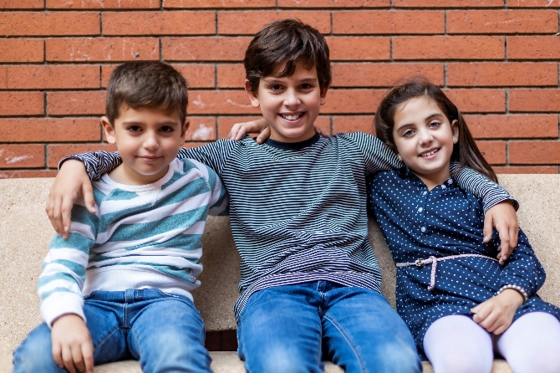


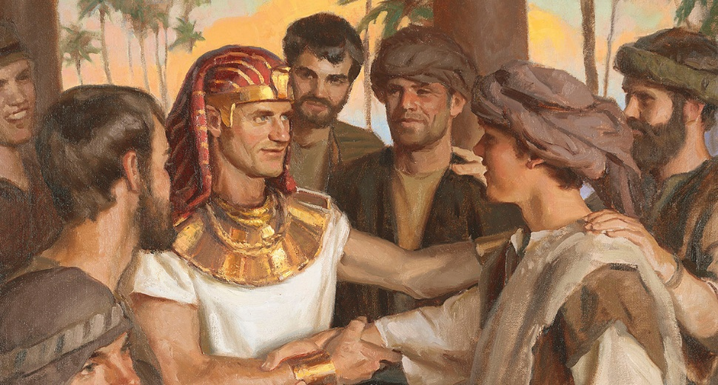
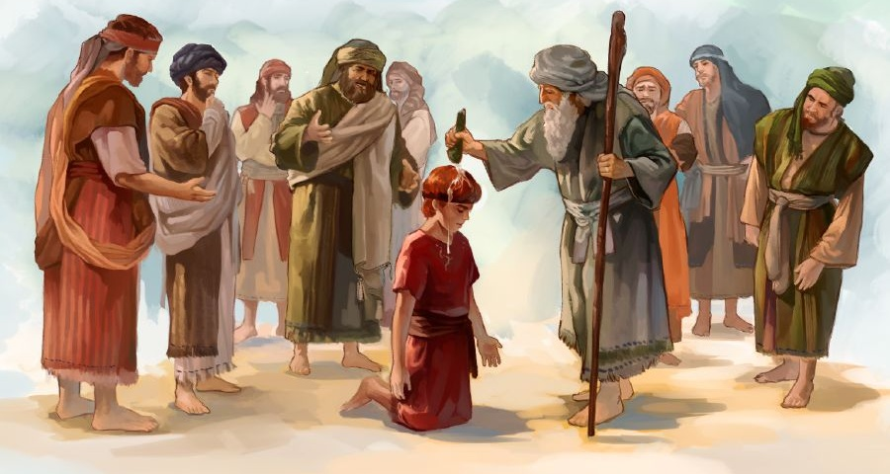


OWAMAZIBULO
“Yena ke ungaphambi kweento zonke, nazo zonke izinto zima zimi kuye.” (KwabaseKolose 1:17)
“Izibulo” lithetha ovele kuqala. Ngenxa yoko, abanye bafundisa ukuba uYesu wayengumntu wokuqala ukudalwa nguThixo ( Kol. 1:15 ). Kodwa, njengokuba kunjalo ngebinzana elithi “umfanekiso,” igama elithi “owamazibulo” linentsingiselo ebanzi yeBhayibhile.
UIsake waba ngowamazibulo esikhundleni sikaIshmayeli; uYakobi waba ngowamazibulo esikhundleni sikaEsawu; UYosefu waba ngowamazibulo esikhundleni sikaRubhen; UDavide wayelizibulo endaweni kaEliyabhi (INdumiso 89:27). Bonke babengamazibulo ngenxa yokuba babekwisigxina esongamileyo kubazalwana babo, kungekhona ngenxa yokuba bezelwe kuqala.
UPawulos ubhekisa kobu bubalaseleyo kwincwadi yabaseKolose. Ukuze aphephe nawaphi na amathandabuzo ngobume bawo, uthi uThixo uneempawu ezimbini: indalo yazo zonke izinto ezikhoyo (Kol. 1:16; Isa. 45:18); nokutya kwayo (Kol. 1:17; INdu. 119:91).

Slide 6



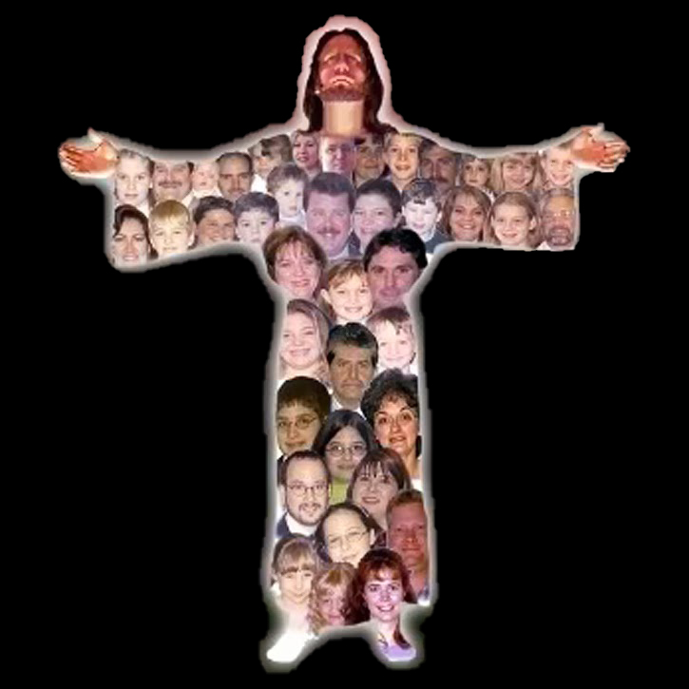
INTLOKO YEBANDLA
“Yena ke uyintloko yomzimba, yebandla” (KwabaseKolose 1:18a)
Kwezinye iilwimi (njengesiCatalan okanye isiNgesi) igama elithi “intloko” likwaguqulelwa ngokuthi “inkosi” okanye “inqununu,” kuba leyo yintsingiselo engokomfuziselo yegama elithi “intloko.” Oku kunjalo nakwisiHebhere. Umzekelo, “bazimisele intloko ibe nye” (Hos. 1:11) kufuneka iguqulelwe ngokuthi “baya kumisela inkokeli ibe nye”
Sonke siyadingeka (1 Kor. 12:15)
Umntu ngamnye unomsebenzi wakhe (1 Kor. 12:17)
Asikwazi ukujongela phantsi namnye (1 Kor. 12:21)
Alikho nalinye ikholwa elingento (1 Kor. 12:22-24)
Siyakhathalelana (1 Kor. 12:25-26)
Le ikwayindlela uPawulos alisebenzisa ngayo eli gama xa ebhekisa kuKrestu (Kol. 1:18a).
Kodwa uPawulos wongeza intsingiselo engokomfuziselo kumzimba. Ukuba ke uKrestu uyintloko, thina ke, ibandla, singumzimba. Kule ngcamango kulandela ukuba:

Slide 7


OYINGQALO
“Oyingqalo, owamazibulo ukuvuka kwabafileyo, ukuze yena abe ngomkhulu ezintweni zonke.”
(KwabaseKolose 1:18b)
Igama eliguqulelwe ngokuthi "isiqalo" ngu-archē (ἀρχή), igama lesiGrike elithetha ukuqala, imvelaphi, isizathu sokuqala okanye umgaqo, kodwa likwathetha umlawuli, amandla, igunya okanye ubunqununu, kuxhomekeke kakhulu kumxholo.
Sinokuthi eli gama, elisetyenziswe kuKrestu, linokuba nazo zonke ezi ntsingiselo (Kol. 1:18). UYesu uyimvelaphi yayo yonke into [umfanekiselo kaThixo], isizathu sokuba yonke into yadalwa [izibulo lendalo], umlawuli owongamileyo [intloko]. Konke oku kumnika ukongama.
UPawulos ufaka isibizo esithi “owamazibulo kwabafileyo” apha (nangona uYesu wayengenguYe owokuqala ukuvuswa, kodwa uMoses). Ukoyisa kwaKhe ukufa kukwathetha ukoyisa kwaKhe isono namandla aKhe okuphinda asidale ngokomfanekiselo waKhe.

Slide 8

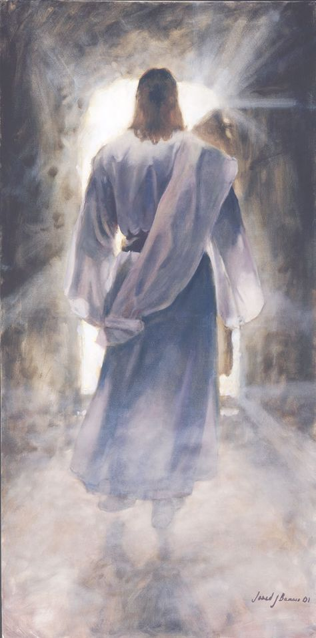



UMXOLELANISI
“nokuthi ngaye azixolelanise naye zonke izinto, elwenzile uxolo ngalo igazi lomnqamlezo wakhe” (KwabaseKolose 1:20)
Okwenziwa nguYesu kwaphumela ekubeni athabathe indawo yokuqala kuyo yonke into. Ngokutsho kukaPawulos, uKristu ufanelwe zizo zonke ezi zibizo “kuba uThixo wakholiswa kukuba konke ukuzala kwakhe kuhlale kuye.”— Kolose 1:19 . Ngamanye amazwi, uYesu wayenguThixo ngokupheleleyo yaye engumntu ngokupheleleyo. “Sibubonile ubuqaqawuli bakhe, […] ezele lubabalo nayinyaniso” (Yohane 1:14).
Ngokufa emnqamlezweni nokuvuka kwakhona, uYesu wazalisekisa iimfuno zokuxolelanisa uluntu noThixo (Kol. 1:20).
Sinokuqonda ukuba uye wazixolelanisa noThixo “izinto ezisemhlabeni.” Kodwa uye wabaxolelanisa njani nabo basezulwini?
Indalo iphela iye yakwazi ukubona ngokucacileyo ubume bobubi. Ngaloo ndlela, isimilo sikaThixo singqinelwa kokubini eZulwini naseMhlabeni.

Slide 9

“UYesu wayengubungangamsha bezulu, umphathimkhosi oyintanda weengelosi, owayekuvuyela ukwenza ukuthanda kwaKhe. Wayemnye noThixo, “esifubeni sikaYise” (Yohane 1:18), kodwa akazange acinge ukuba kwakungeyonto enqwenelekayo ukulingana noThixo ngoxa umntu wayelahlekile esonweni nasentlungwini. Wehla etroneni yaKhe, Washiya isithsaba saKhe nentonga yobukumkani, wambathisa ubuThixo baKhe ngobuntu, wazithoba kwada kwaba sekufeni komnqamlezo, ukuze aphakanyiswe umntu, ahlale naye etroneni yaKhe. […] Ethandweni Uza kutyhila uBawo, ukuxolelanisa umntu noThixo.”
EGW (Selected Messages, Volume 1, p. 321)

