Slide 1
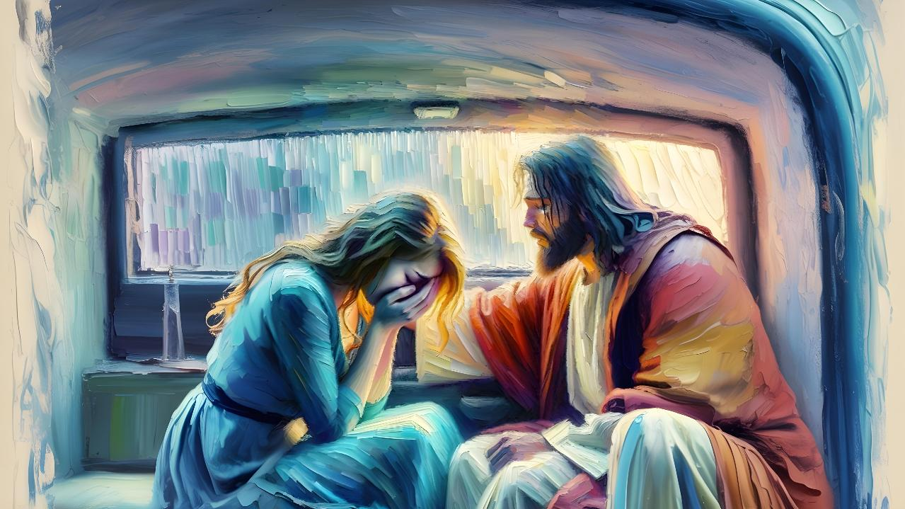
INGUQUKO NOXOLELO
Lesson 10 for June 6, 2026

Slide 2
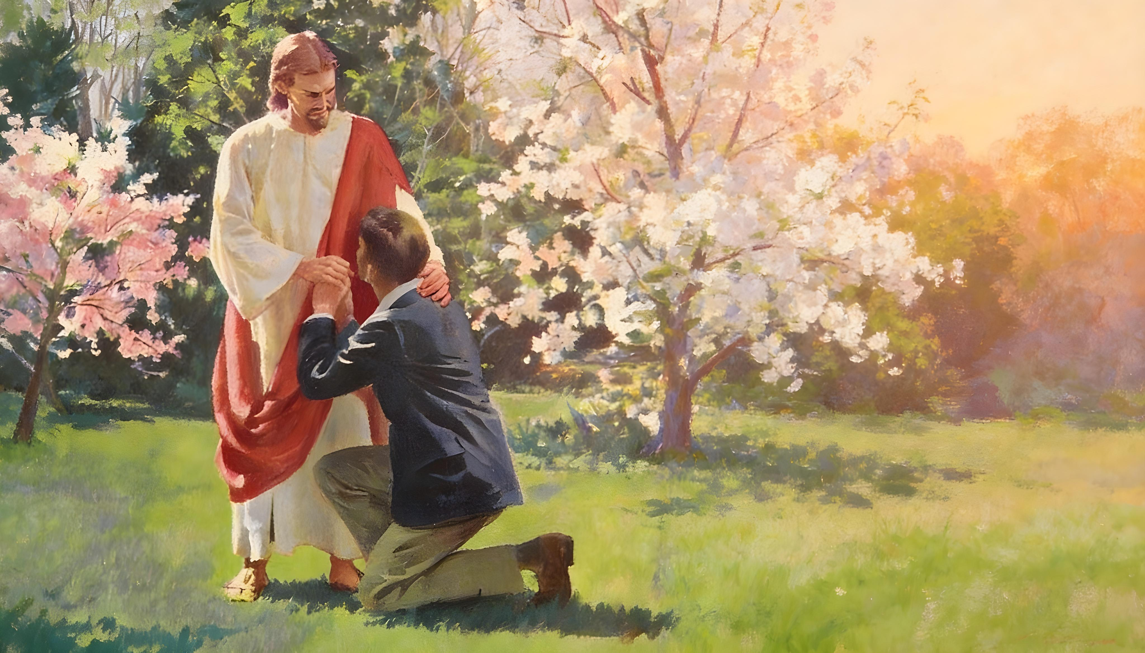
“Ukuba sithi sizivume izino zethu, uthembekile, ululingisa, ukuba asixolelele izono zethu, asihlambulule kuko konke ukungalungisi”
(1 Yohane 1:9)

Slide 3

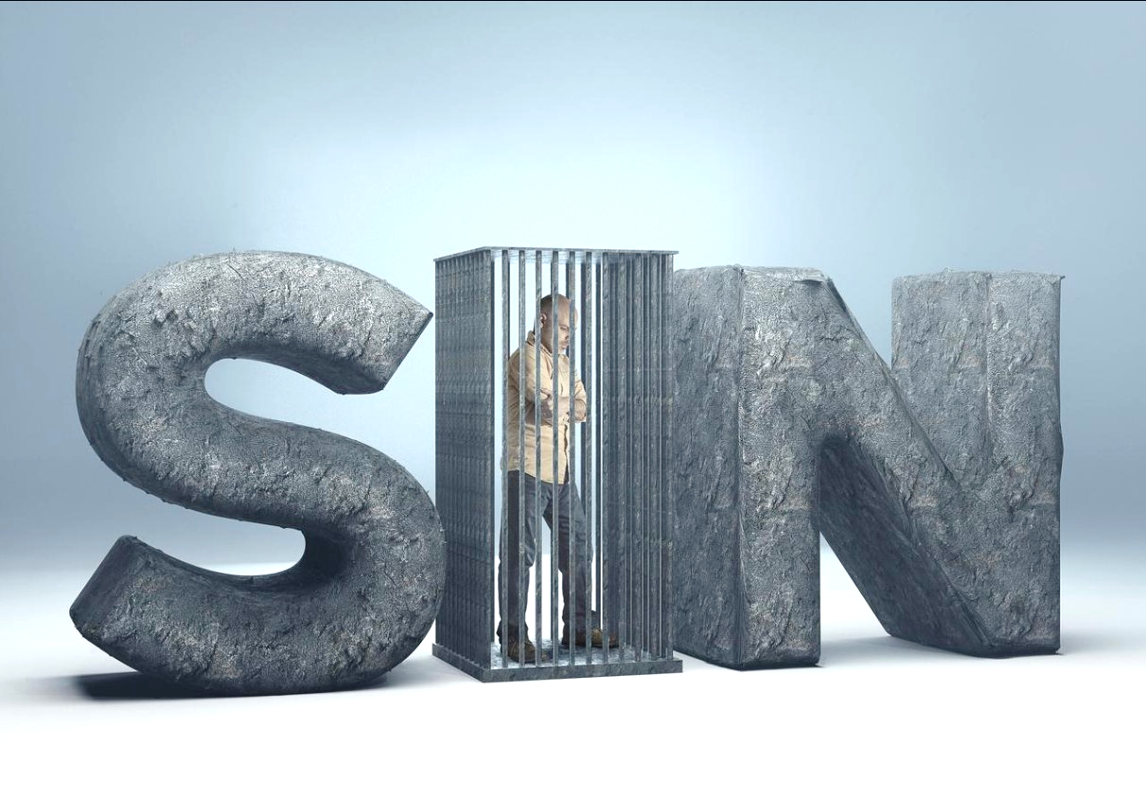
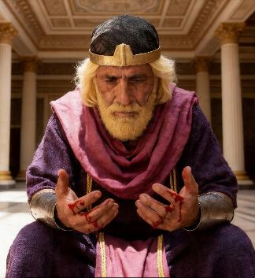
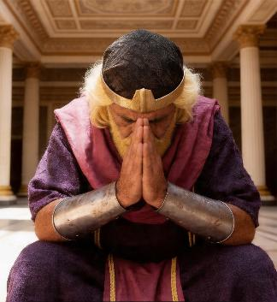






IBhayibhile ikubeka elubala ukuba “bonke bonile kwaye basilela eluzukweni lukaThixo” (Rom. 3:23).
Ikwadandalazisa ukuba asinawo amandla okusiphepha nokusisusa isono sethu. (Jer. 13:23; 2:22).
Kodwa uThixo ukulungele ukuzixolela izono zethu. Akukho sono sikhulu okanye soyikeka ngokumandla ukuba uThixo angangasixoleli (Isaya 1:18).
Kuaele nje into enye kuphela: inguquko.
Inguquko:
  Ukulibazisa ukuguquka
  Ukuguquka kwenene
  Ubizo lwenguquko
Uxolelo:
  Ubabalo loxolelo
  Iingubo zoxolelo

Slide 4

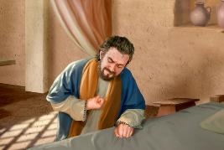
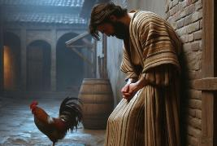
INGUQUKO

Slide 5

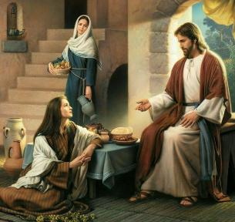
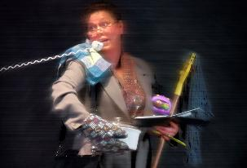

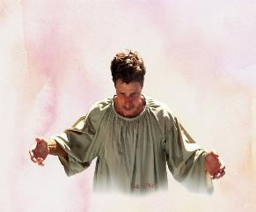
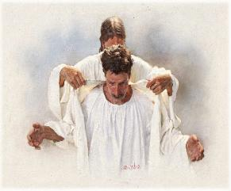
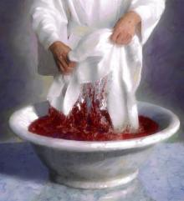
UKULIBAZISA UKUGUQUKA
“Waphendula ke uYesu wathi kuye, Marta, Marta, uxhaliswa uphithizeliswa zizinto ezininzi” (Luka 10:41)
Endlwini kaLazaro, uYesu washukuxa imiba ebalulekileyo, elulutho kusindiso. Kodwa uMarta akazange aphulaphule. Wayengenalo ixesha. Wayezixakekise ngezinto ezininzi awayezenza! (Lk. 10:40-41).
Oku kuyenzeka nakuthi. Xa sithe sona, aze uMoya oyiNgcwele asibizele kwinguquko, uSathana usixakekisa ngento yokwenza, ngamaxhala, okanye ngezinye iziphazamiso ezisithintela ekucamngceni ngemeko yethu yesono nasekufuneni uxolelo.
Kodwa uThixo akancami. Uthi gqolo esibiza (Hez. 33:11). Ufanisa izono zethu nengubo enomzi (Isa. 64:6). Ufuna ukunaniselana nathi: simnike iingubo zethu ezingcolileyo, asinike ezicocekileyo (Zek. 3:4), ingubo ezivaswe egazini likaYesu (Rev. 7:14).

Slide 6

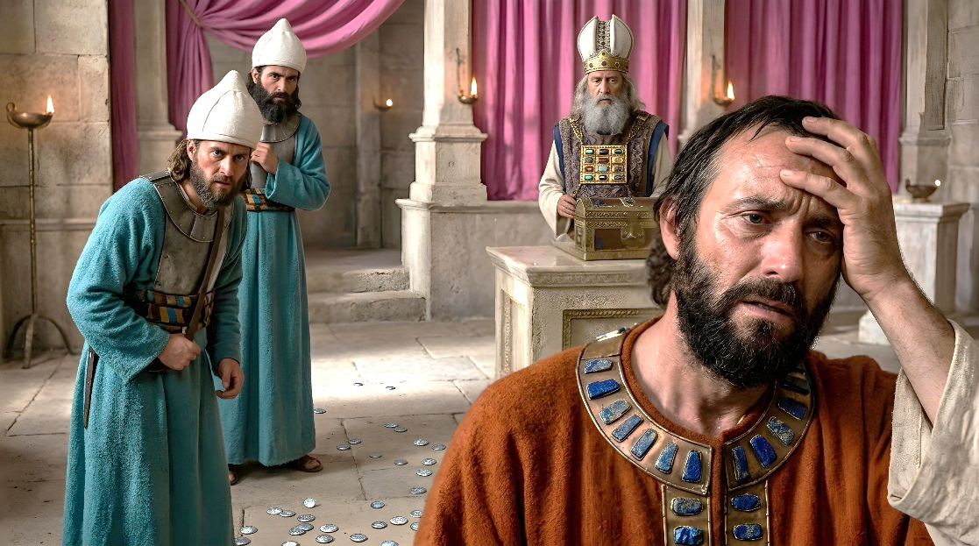
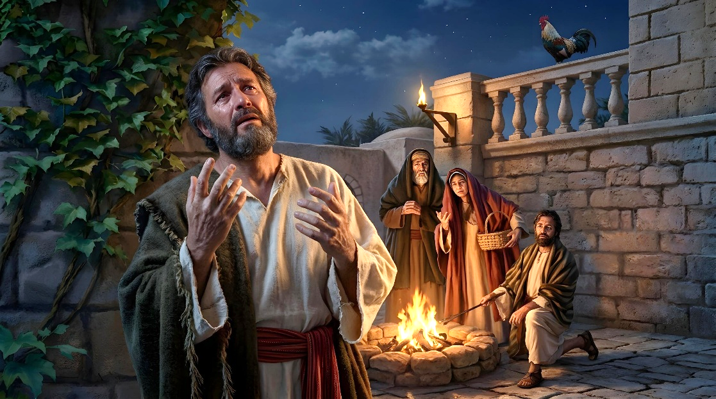
UUGUQUKA KWENENE
“Yizani sibuyele kuYehova; kuba eqwengile, wosiphilisa; uxabele, wosibopha.” (Hoseya 6:1)
Yintoni inguquko? Yintoni umahluko phakathi kwenguquko yokwenene nenguquko yokunkwalambisa? (2 Kor. 7:10)
Xa isono sizisa imiphumela yesiquphe nengathandekiyo, ukuzusola kuma ngeenyawo. Iba lihlazom kuba ebesikwenza akubanga naziphumo zihle. Ukuba bezingakhange zibe mandundu iziphumo, besingazokuzisola ngezenzo zethu. Ayisiyonguquko yenene leyo.
Xa sihlungiswa kukuba sonile, kuze kubekho ulangazelelo olunzulu lokuxolelwa (nokuba imiphumela injani) kusube sijamelene nenguquko yokwenene.
Xa sisona, uMoya oyiNgcwele uyasidlakaza, asingxwelerhe ngobuhlungu obunzulu. Ukuba sisabela ngenguquko yokwenene, uThixo uyasinyanga, asixolele izono zethu (Hos. 6:1).

Slide 7

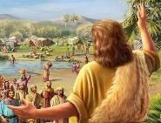
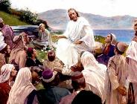
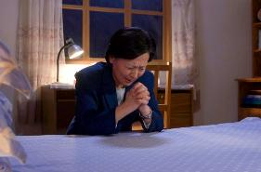

UBIZO LWENGUQUKO
“Guqukani ke ngoko, nibuye, ukuze zicinywe izono zenu; ngokokuze afike amathuba okuphumza, evela ebusweni beNkosi.” (Izenzo 3:19)
UYohane umBhaptizi noYesu babuqala ubulungiselelo babo ngomyalezo ofanayo: “Guqukani” Mt. 3:1-2; 4:17).
Kutheni kubalulekile ukuguquka? Kuba ngaphandle kwako alukho uxolelo lwezono (Izenzo 2:38; 3:19). Yenzeka njani le nkqubo?
Ngenxa yokulunga kwaKhe, uThixo usibizela enguqukweni (Rom. 2:4)
Siyasabela kubizo lwaKhe
Ngosizi olunyanisekileyo ngenxa yobubi esibenzileyo
Ngesigqibo esinyanisekileyo sokuyeka isono
UThixo uxolela izono zethu ngenxa yegazi elaphalazwa nguYesu emnqamlezweni (Kol. 1:13-14)
Phawula ukuba inguquko noxolelo kufuneka zisikhokelele kuhlaziyo: kutshintsho lwesimo sengqondo esisikhokela ekuyekeni isono (Yoh. 5:14).

Slide 8

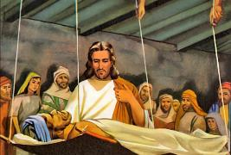
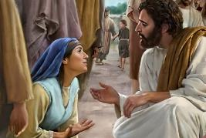
UXOLELO

Slide 9

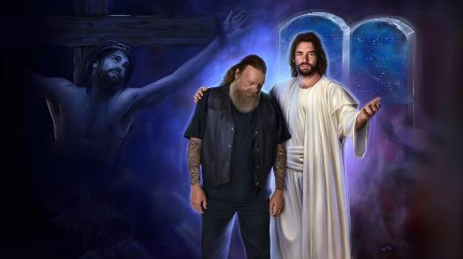
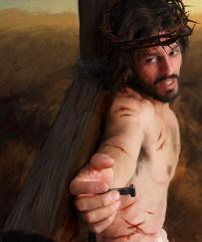

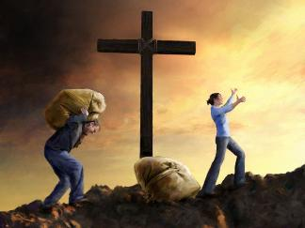
UBABALO LOXOLELO
“Ngenxa yegama lakho, YEHOVA, xolela ubugwenxa bam, ngokuba bukhulu bona” (INdum 25:11)
Akukho nto inyanzela uThixo ukuba asixolele. Akukho nto sinokuyenza ukuze sixolelwe. UThixo usixolela ngobabalo; ngothando lwaKhe olungenasiphelo. Uyaxolela kuba "ulungile, ukulungele ukuxolela, mninzi ngenceba" (INdumiso 86:5; bona iEksodus 34: 6-7).
Uthando lwaKhe lwamqhubela ekuzinikeleni emnqamlezweni, kwaye ahlawule ityala lesono esingasokuze sikwazi ukulihlawula (Efe. 2:4-5).
Xa sizisa izono zethu esikhondweni somnqamlezo, uYesu usothula umthwalo wesono osirhawula ngokusisisulu (Heb. 12:1-2)

Slide 10
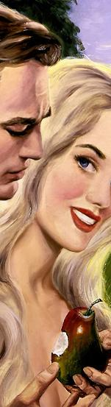
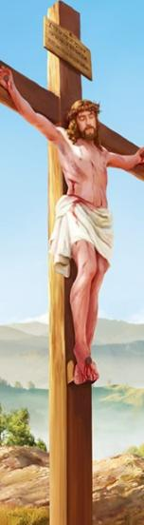
UBABALO LOXOLELO
“Ngenxa yegama lakho, YEHOVA, xolela ubugwenxa bam, ngokuba bukhulu bona” (INdumiso 25:11)
Luthini ulwalamano phakathi kwesono nobabalo?
ULWALAMANO PHAKATHI KWESONO NOBABALO
KwabaseRoma 5:8
KwabaRoma 5:20
KwabaseRoma 5:21
KwabaseRoma 6:23
“sakubon’ ukuba sisengaboni”
“uKristu asifele”
“apho sandayo isono”
“lwaphuphuma ngakumbi ubabalo”
“isono saba nokulawula ngokufa”
“nobabalo lube nokulawula… luse ebomini obungunaphakade”
“umvuzo wesono kukufa”
“isipho sikaThixo bubomi obungunaphakade”

Slide 11
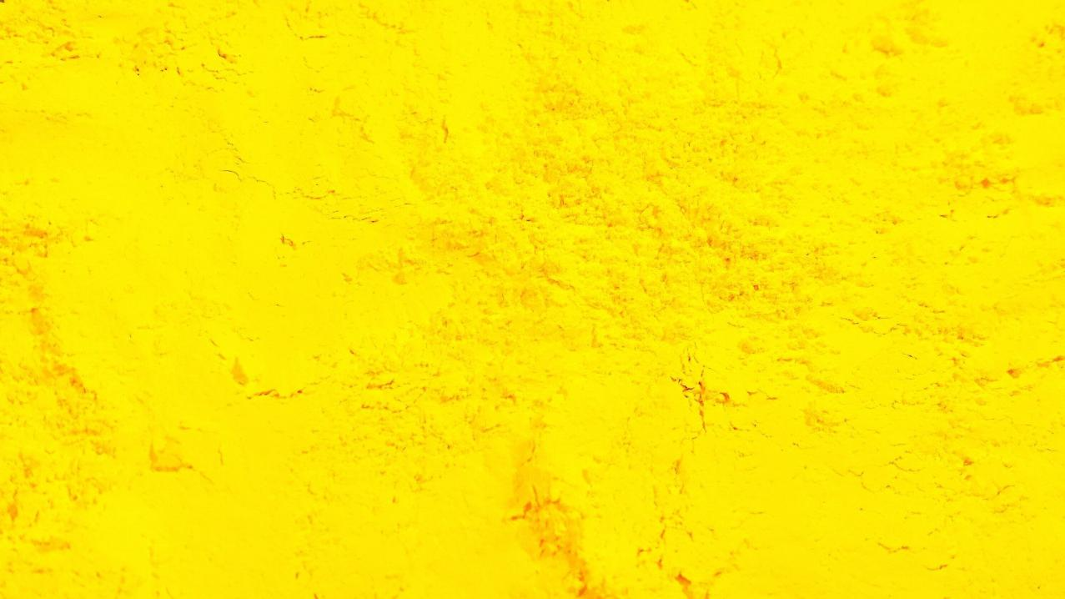
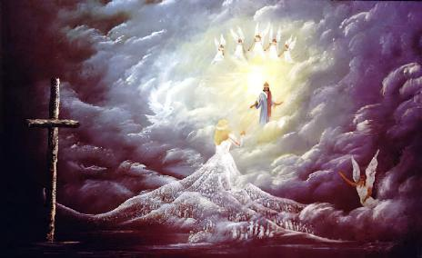

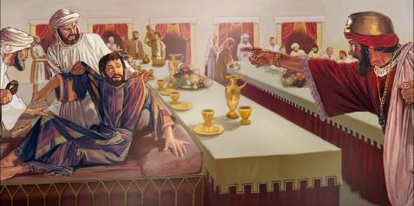
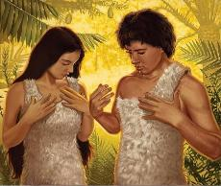
IINGUBO ZOXOLELO
“Athi kuye, Wethu, utheni na ukungena apha, ungenayo ingubo yomsitho?” (Mat. 22:12)
IBandla likaThixo—kananjalo namalungu alo—lithiwe wambu “ngelineni ecikizekileyo, emhlophe, eqaqambileyo” kwaye “lilibandla elingenabala, elingenamibimbi nanye into enjalo” (ISiTyh. 19:8; Efese 5:27).
Le lineni icikizekileyo imele “yimisebenzi elungileyo yabangcwele” (ISiTyh. 19:8b). Kodwa obu bulungisa ayibobabo; babunikwe nguKrestu (ISiTyh. 7:14).
Xa uAdam noEva bonayo, bagquma ubuze babo ngomsebenzi wabo. Kodwa bazibona beseze phambi koThixo (Gen. 3:7-10). Umambeso abawunikwayo nguThixo wawumele “ingubo yomtshato” uKrestu asinika yona: ubulungisa baKhe obugqibeleleyo obucima izono zethu (Gen. 3:21; INdu. 51:7-10).
Akukho namnye oyayo eZulwini ngaphandle kwale ngubo (Mat. 22:1-14).

Slide 12

“Nabani na oza kuba ngumntwana kaThixo kufuneka amkele inyaniso yokuba inguquko noxolelo zifumaneka kuphela ngokucanyagushelwa nguKrestu. Eqinisekisiwe ngale nto umoni umele enze umgudu ngokuvisisana nomsebenzi owenzelwa yena, kwaye ngesibongozo esingadinwayo kufuneka abongoze itrone yobabalo, ukuze amandla okuhlaziya kaThixo angene emphefumlweni wakhe. UKrestu akaxoleli nto ngaphandle kwalowo uguqukayo, kodwa lowo amxolelayo uqala ngokuguquka. Isibonelelo esenziweyo sigqibelele, kwaye ubulungisa obungunaphakade bukaKristu bubekwe kwiakhawunti yawo wonke umphefumlo okholwayo. Ingubo ebiza kakhulu, engenabala, ephothiweyo emazulwini, inikezelwe kumoni oguqukayo, okholwayo.”
EGW (Selected Messages, vol. 1, p. 393)

