Slide 1
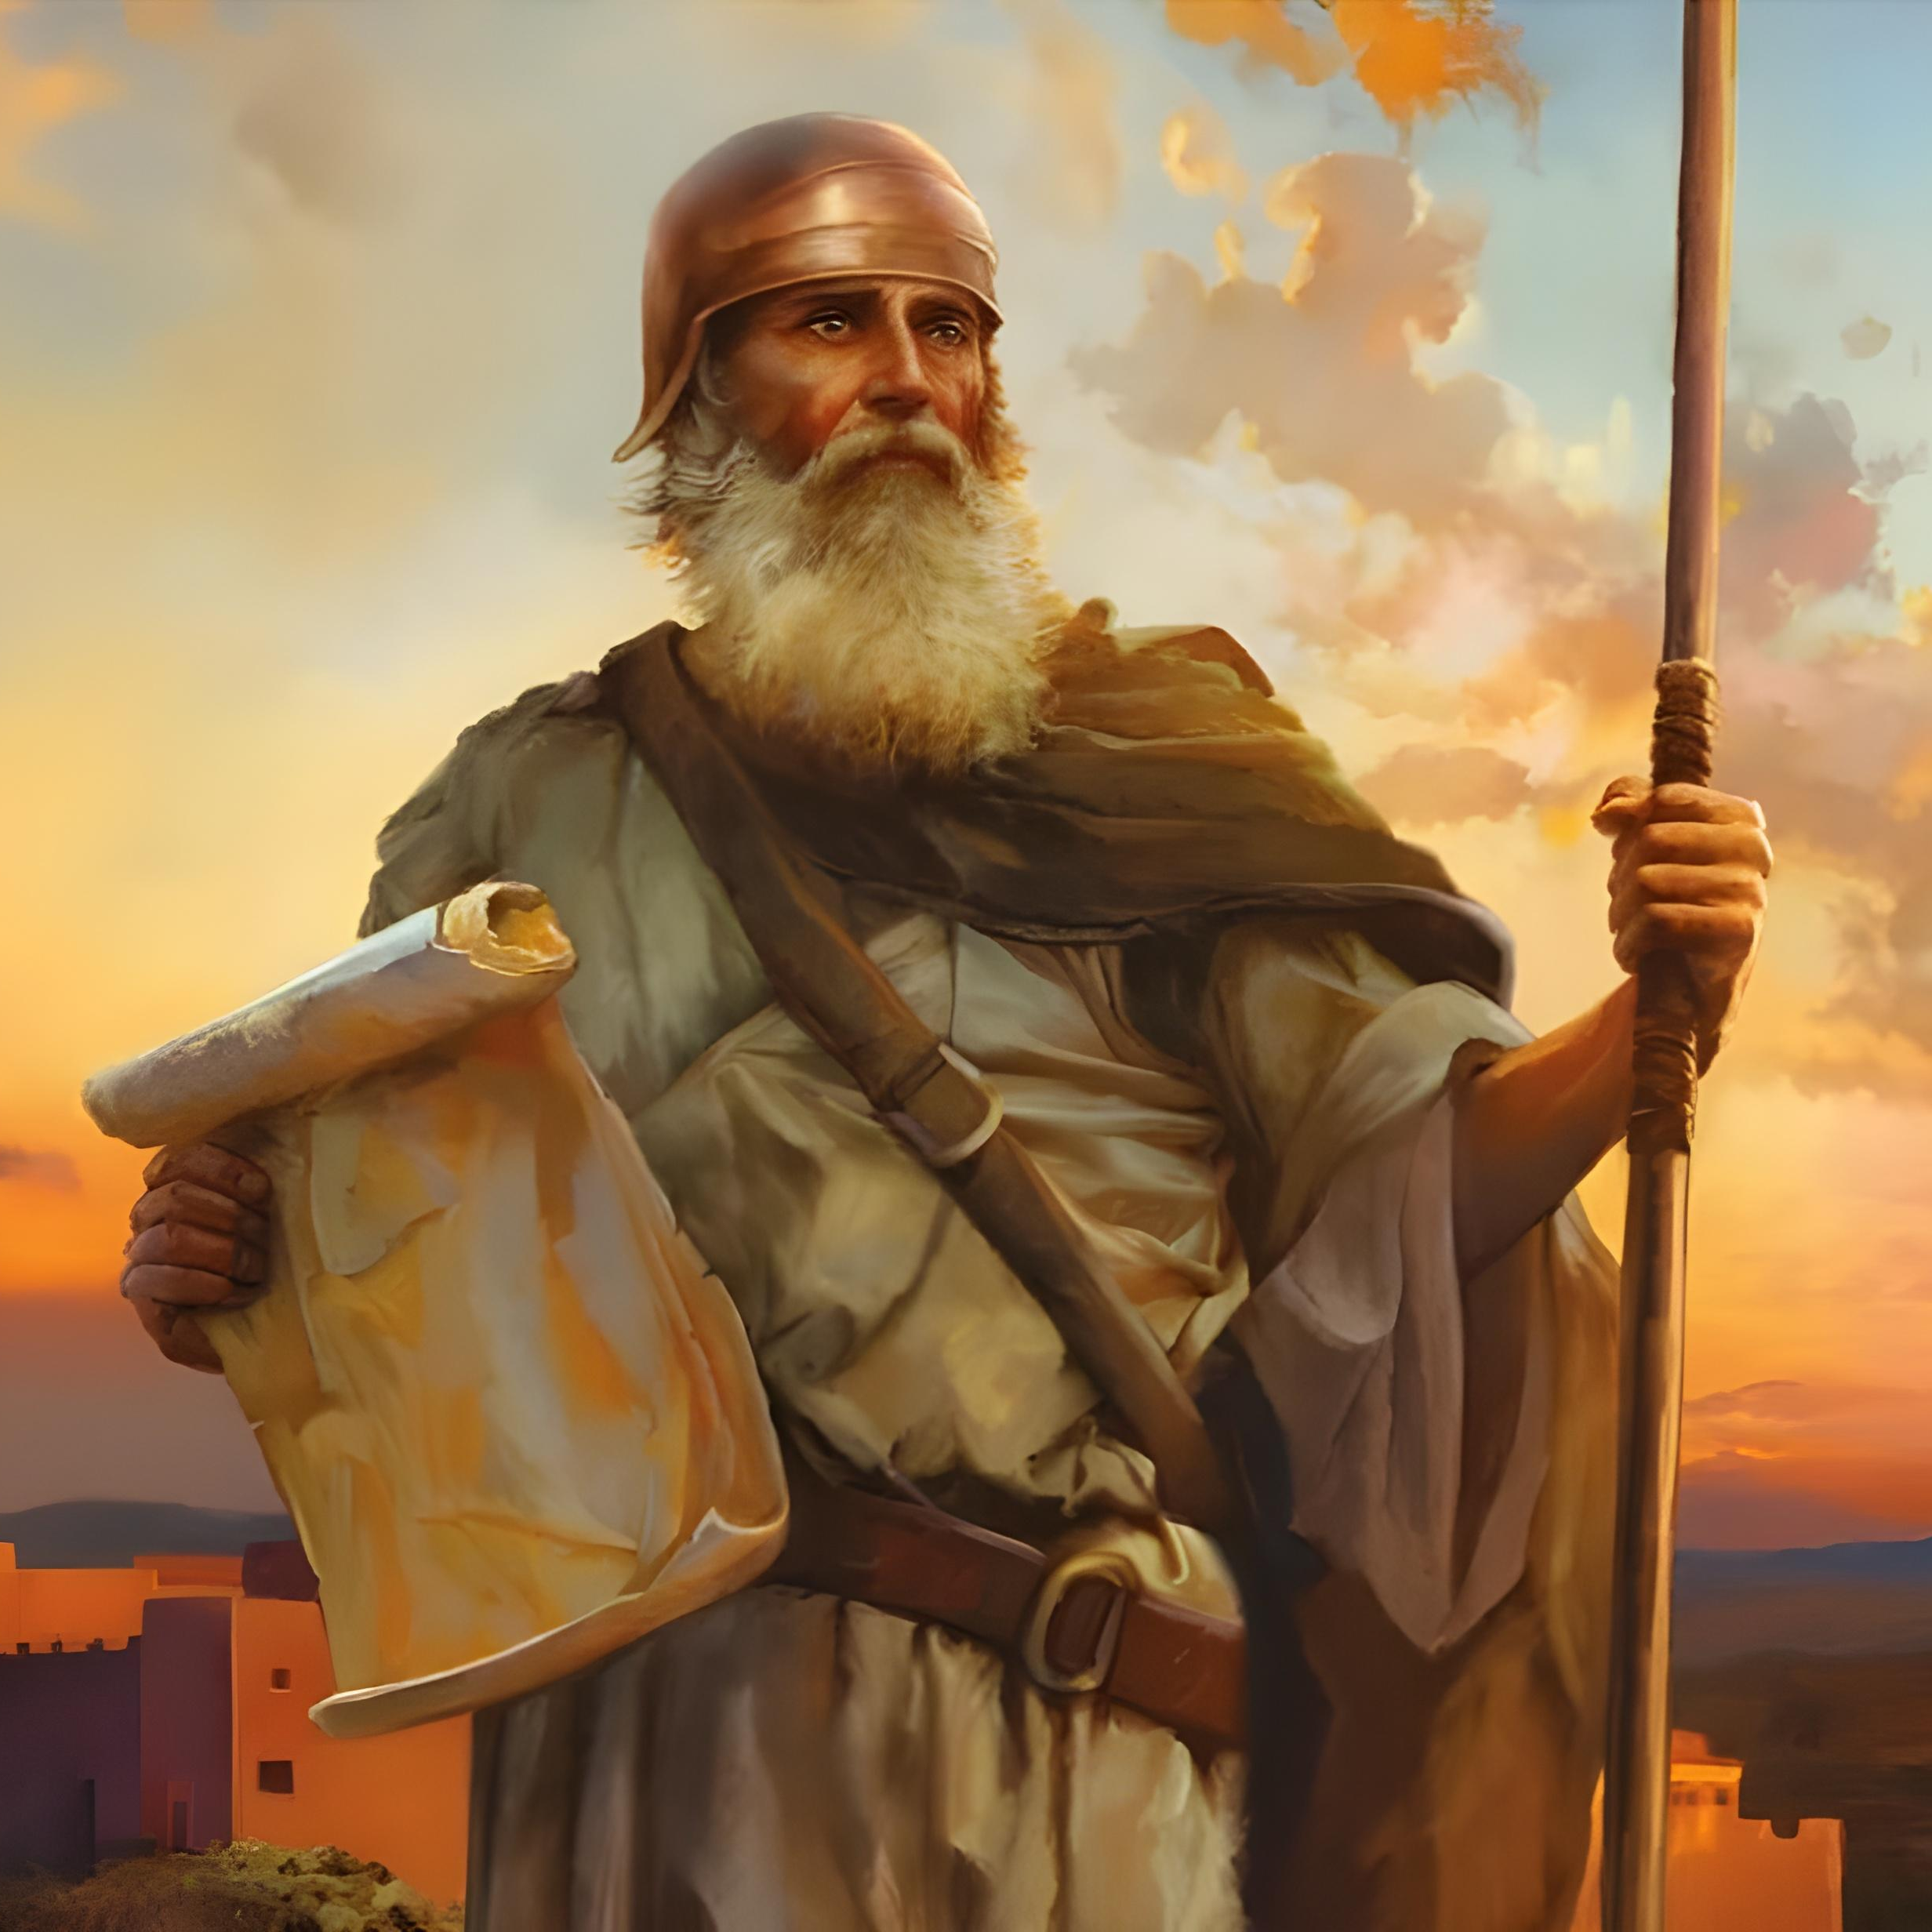
“Kodwa ke yomelela, ukhaliphe kunene, ukuze ugcine ukwenza ngokomyalelo wonke, awakuwisela wona uMoses umkhonzi wam. Musa ukutyekela ekunene ngasekhohlo kuwo, ukuze wenze ngengqiqo apho sukuba usiya khona” Yoshuwa 1:7.

Slide 2

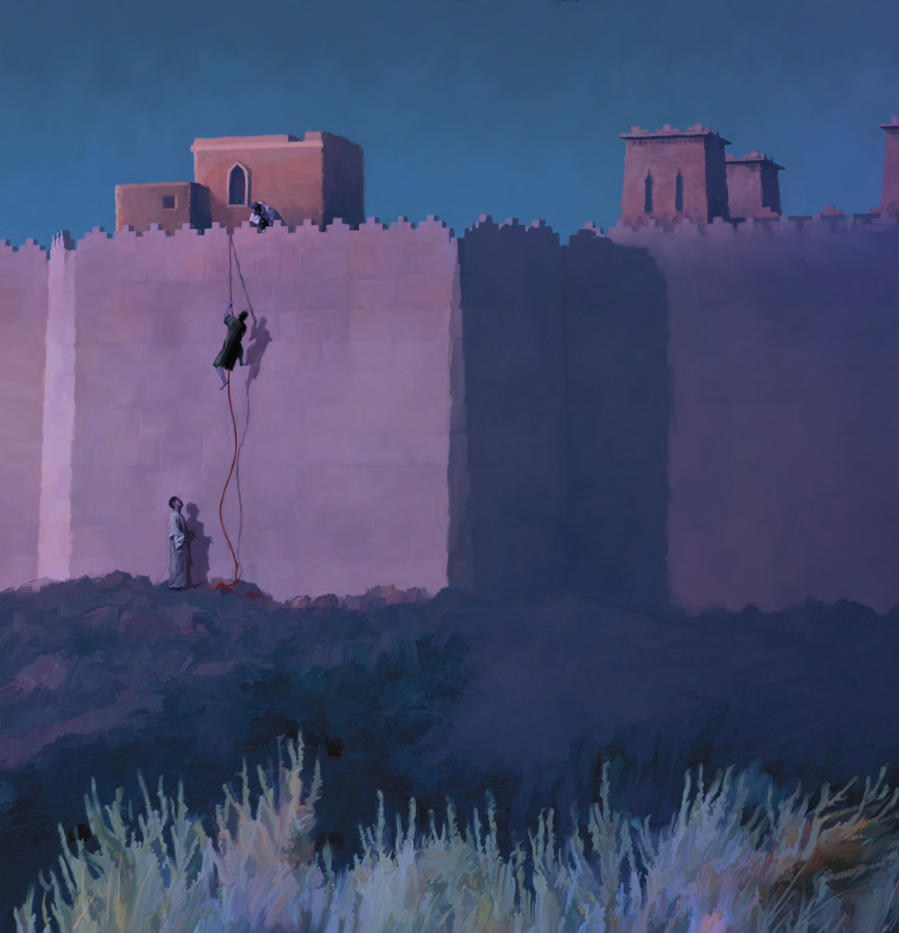
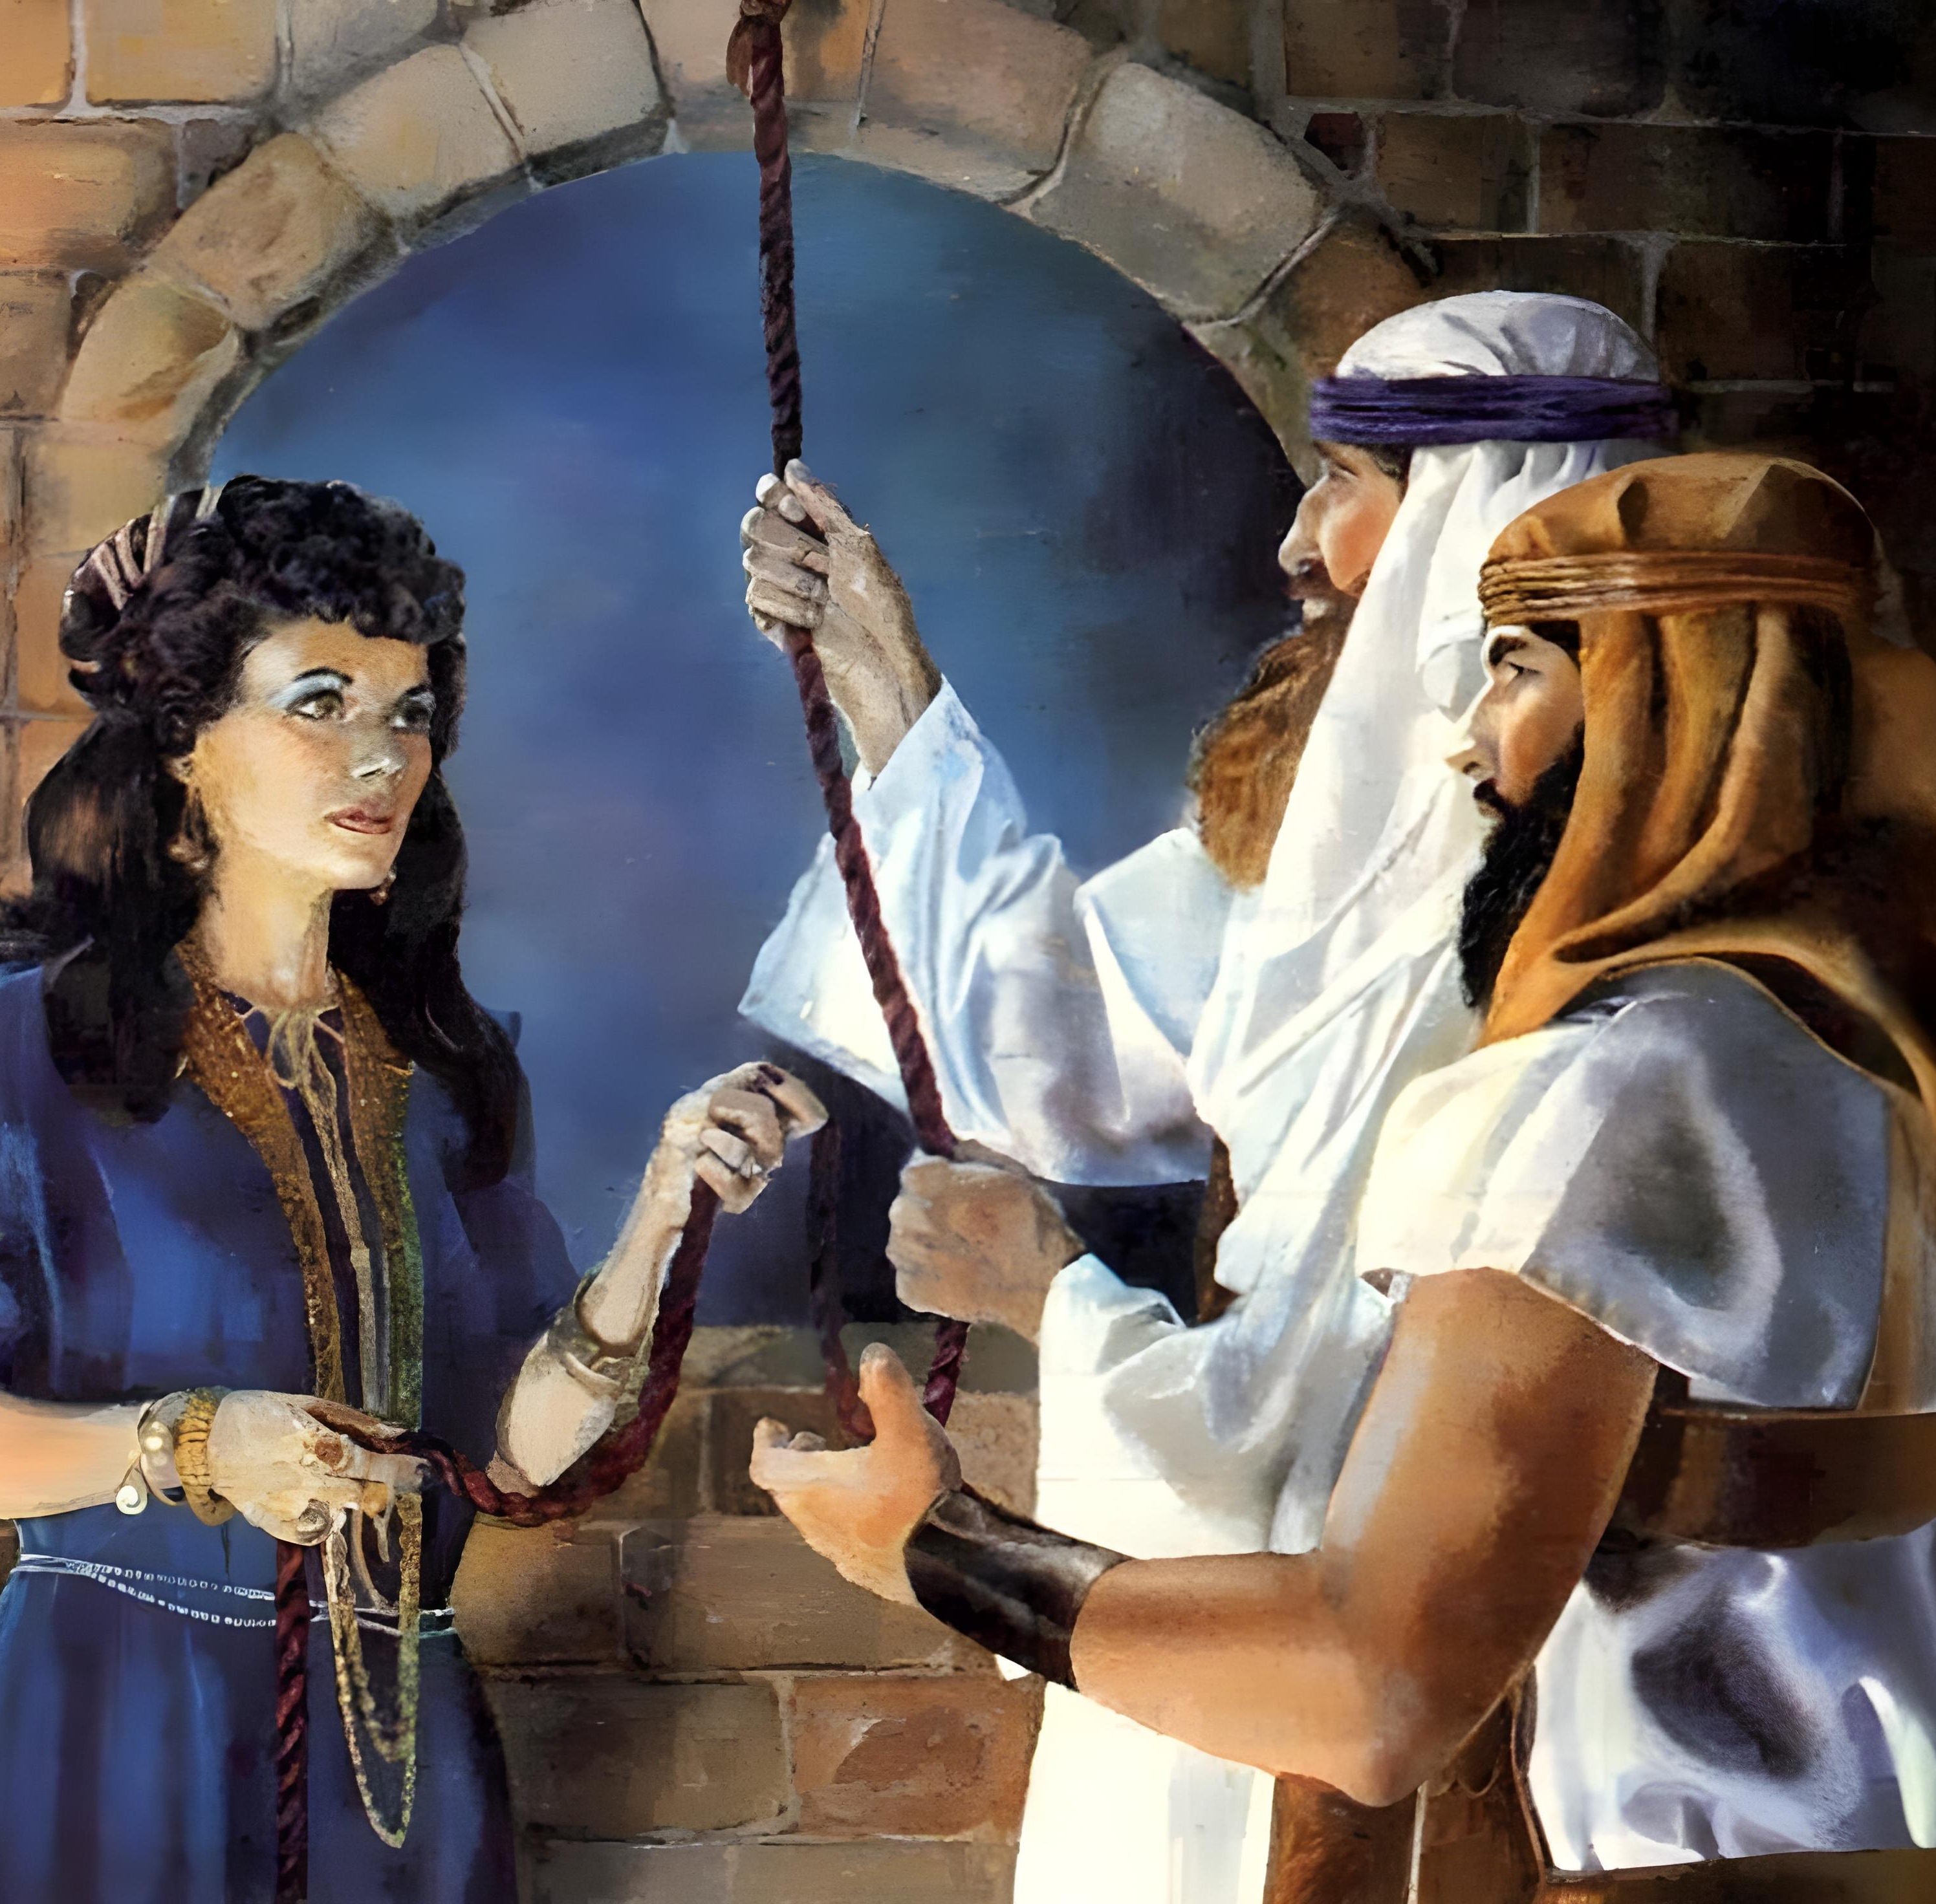
“Ngokholo uRahabhi ihenyukazi akatshabalalanga nabo bangevayo, akuba ezamkele iintlola ngoxolo”
(KumaHebhere 11:31).

Slide 3

“kuba oko uYehova uThixo wenu wenza ukuba atshe amanzi aseYordan phambi kwenu, nada nawela; waxelisa oko uYehova uThixo wenu wakwenzayo kuLwandle oluBomvu, lona wenza ukuba lutshe phambi kwethu, sada sawela; ukuze zonke izizwe zehlabathi zisazi isandla sikaYehova ukuba somelele; ukuze nimoyike uYehova uThixo wenu imihla yonke”
UYoshuwa 4:23, 24.

Slide 4
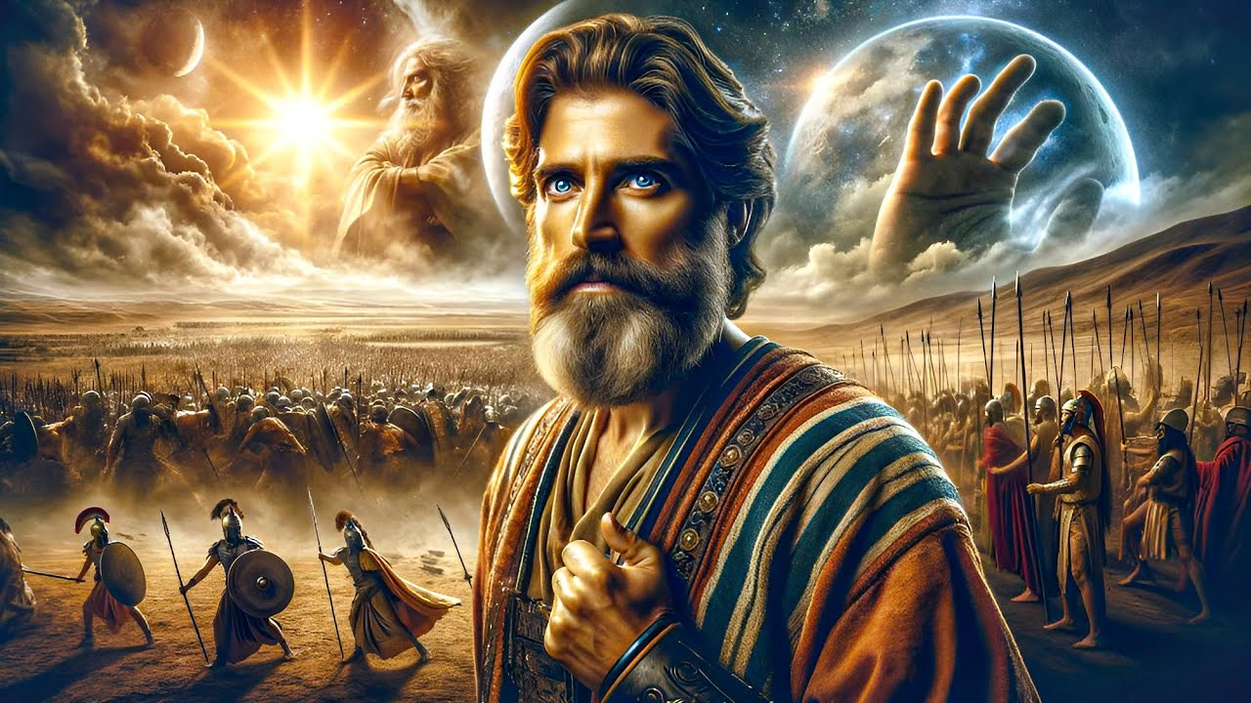
“Akuzanga kubekho mini injengaleyo, phambi kwayo, ngokokude uYehova aliphulaphule ilizwi lomntu; ngokuba uYehova wawalwela amaSirayeli”
Yoshuwa 10:14

Slide 5

“Wabathimba uYoshuwa bonke abo kumkani, nelizwe labo, ngasihlandlo sinye, ngokuba uYehova uThixo kaSirayeli ebewalwela amaSirayell”
Yoshuwa 10:42

Slide 6


“Mna, Yehova ndiyayigocagoca intliziyo, ndiyazicikida izintso, ukuze ndinike ulowo nalowo ngokwendlela yakhe, ngokwesiqhamo seentlondi zakhe”
UYeremiya 17:10

Slide 7



“Funani ke tanci ubukumkani bukaThixo nobulungisa bakhe, zaye zonke ezi zinto ziya kongezelelwa kuni.”
UMateyu 6:33

Slide 8
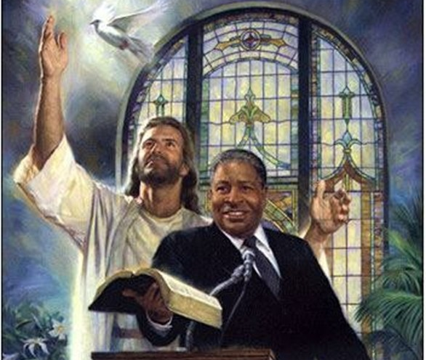
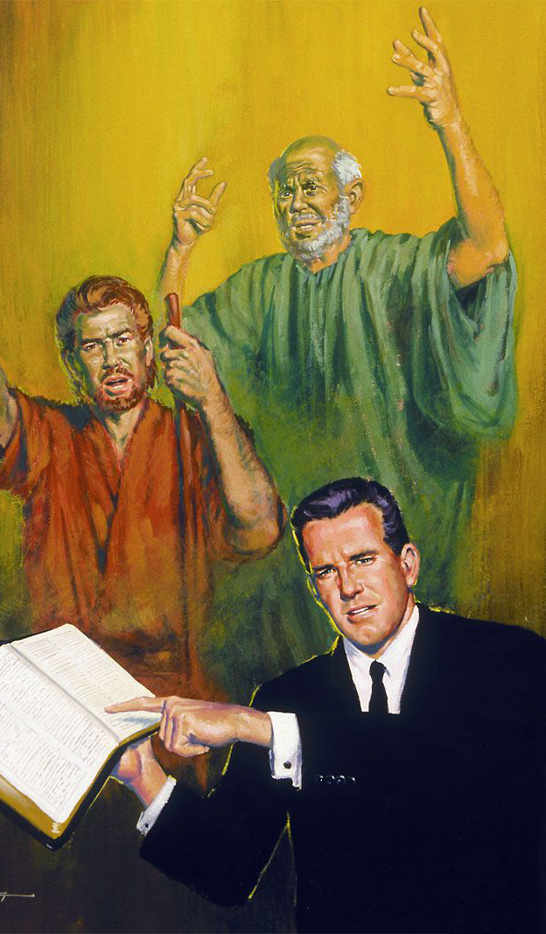
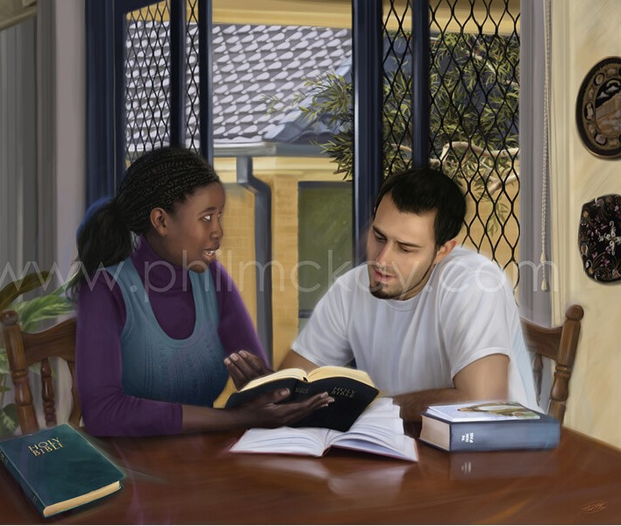
“Bakhumbuleleni abakhokeli benu, abalithethayo kuni ilizwi likaThixo; nisingasinga impumelelo yehambo yabo, nixelise bona elukholweni lwabo”
(KumaHebere 13:7).

Slide 9
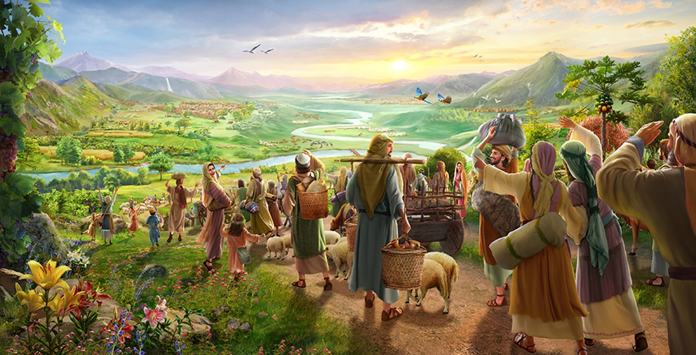
“Buyelane enqabeni, babanjwandini banethemba; nanamhla ndiyaxela, ndithi, Ndiya kukubuyisela ngokuphindiweyo.” (UZakariya 9:12)

Slide 10
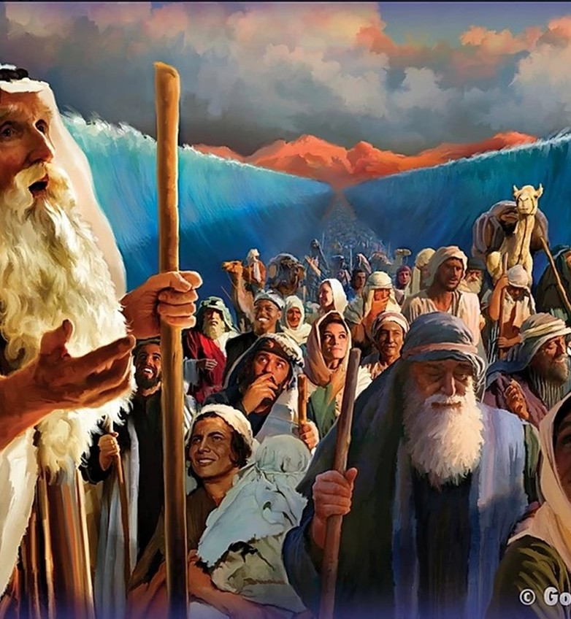
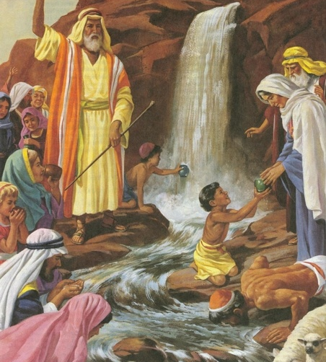
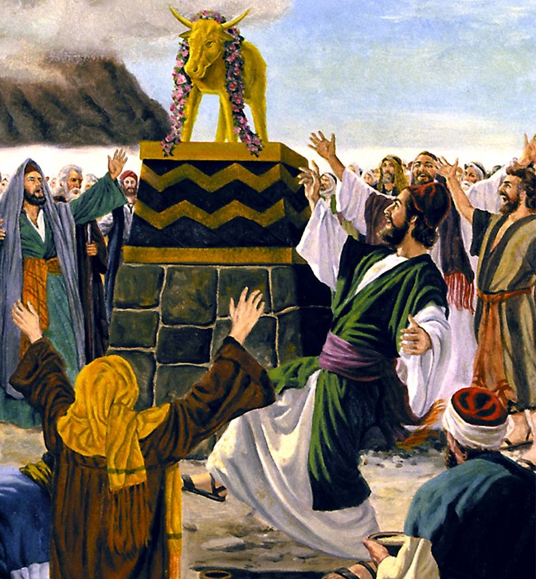
“Zonke ke ezo zinto, zabahlelayo bona, neziyimifuziselo; zabhalelwa ke ukululeka thina aba, bafikelweyo ziziphelo zawo amaphakade.” (1 KwabaseKorinte 10:11)

Slide 11
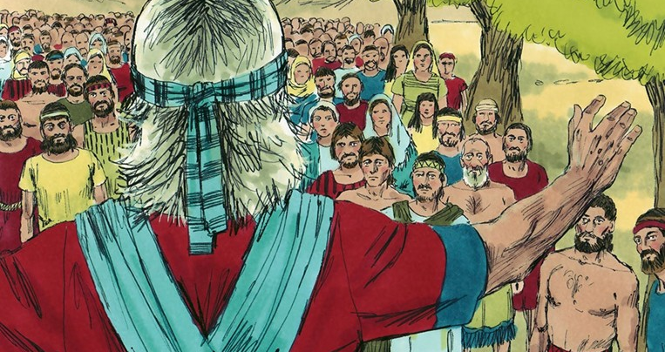

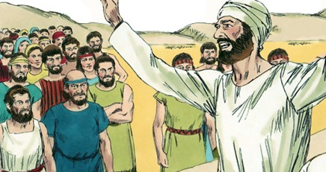
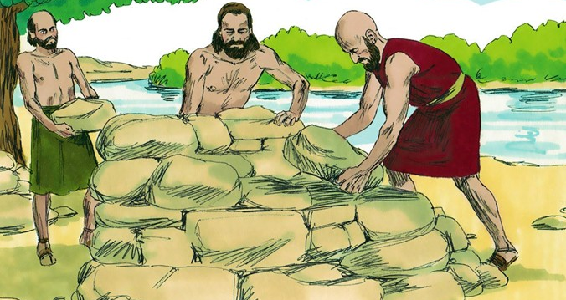
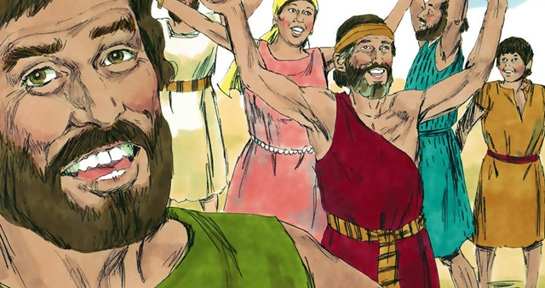
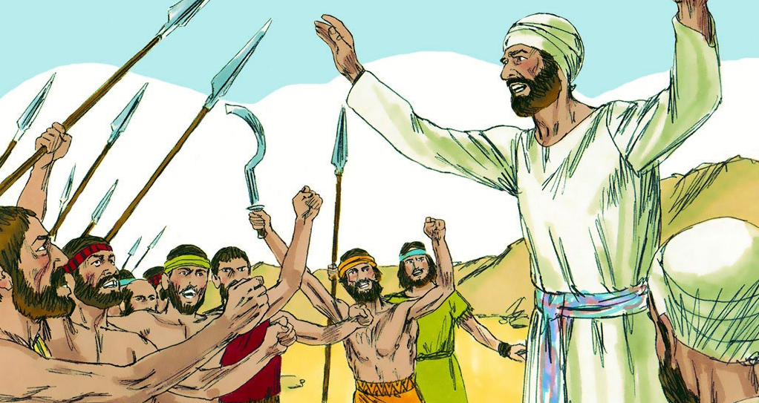
“Impendulo ethambileyo ibuyisa ubushushu; Ilizwi elidubulayo linyusa umsindo” (IMizekeliso 15:1)

Slide 12

“Akuwanga zwi phantsi, emzawini once alungileyo awawathethayo uYehova kwindlu kaSirayeli; enzeka once.” (Yoshuwa 21:45)

Slide 13
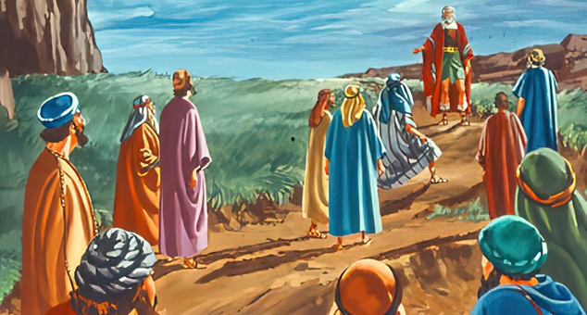
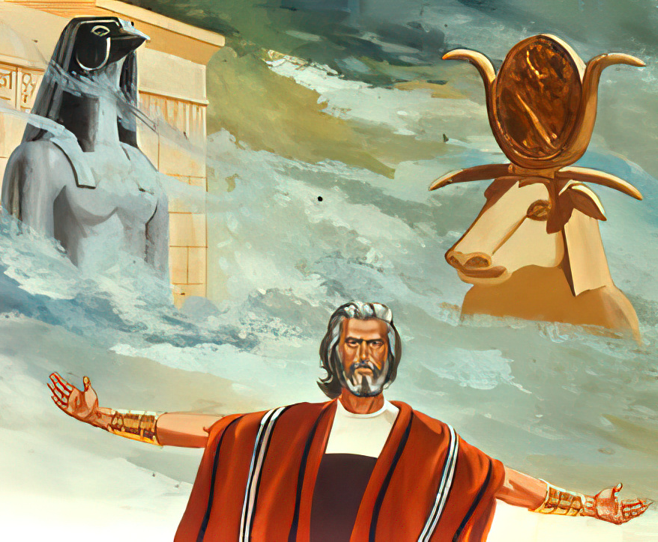
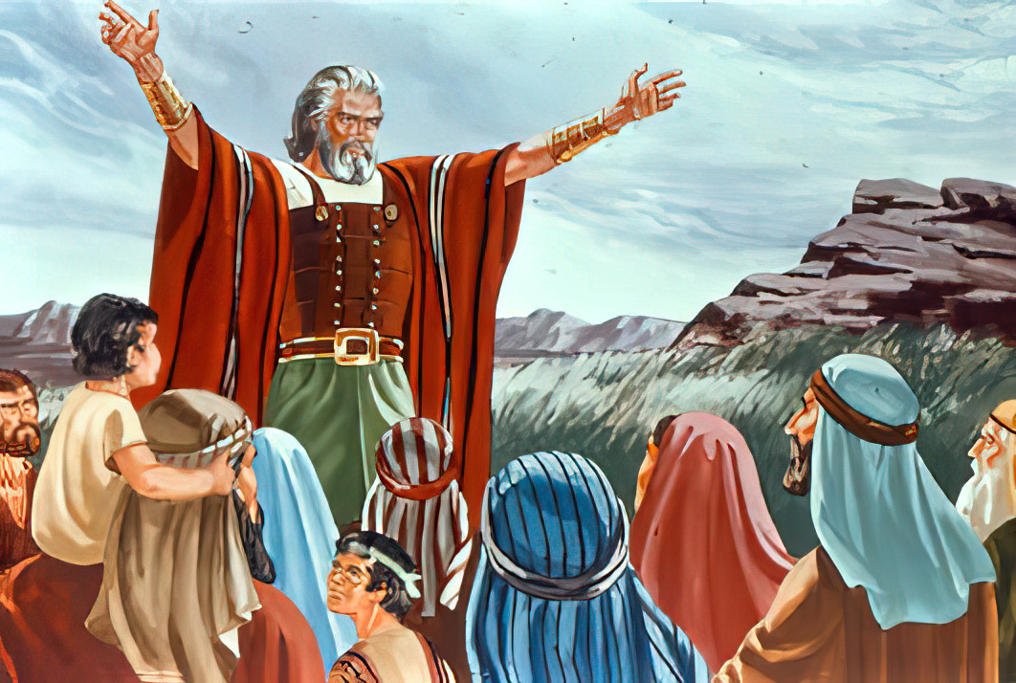
“Ke ukuba kubi emehlweni enu ukumkhonza uYehova, zinyuleleni namhla oyena niya kumkhonza. . . . Ke mna nendlu yam, siya kumkhonza uYehova.”
(Yoshuwa 24:15)

