Slide 1
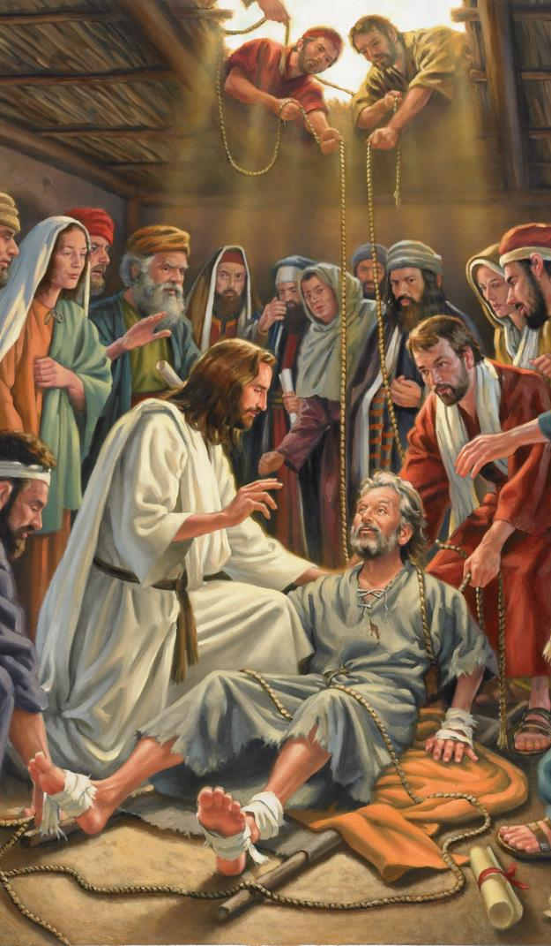
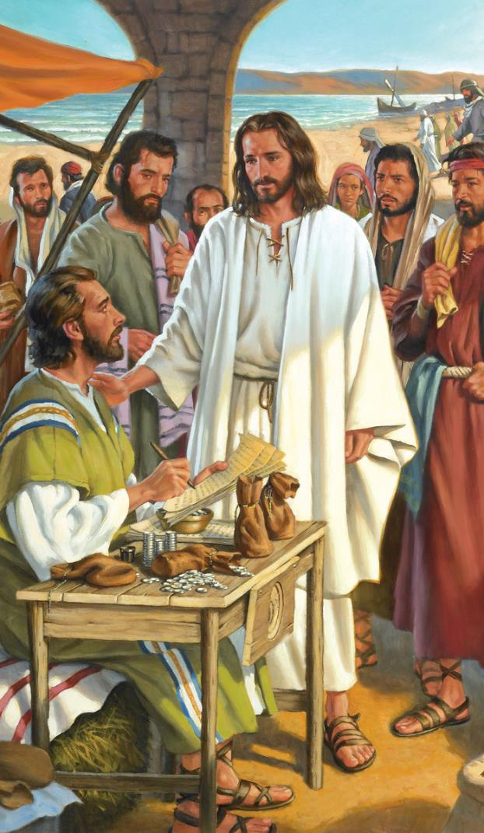
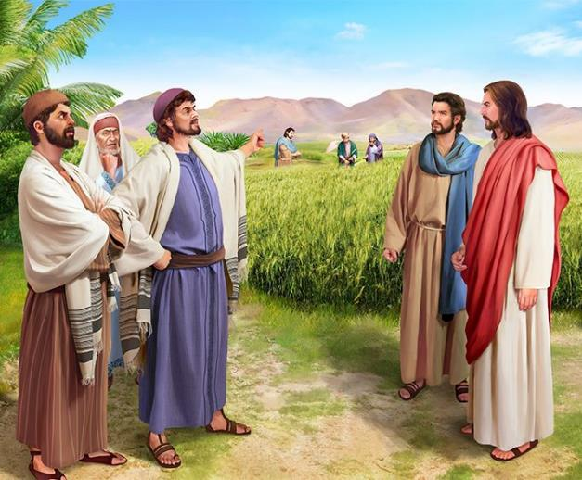
KIDONATE
Lesson 3 ading July 20, 2024

Slide 2
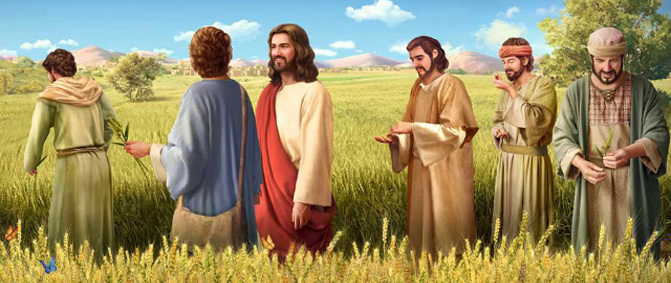
Tua ciangin amah in amaute kiangah, “Sabbath ni pen mite aa dinga kibawl hi-a, mite pen Sabbath ni aa dinga kibawl hilo hi. Tua ahih manin Mihing Tapa in Sabbath Ukpa zong ahi hi,” aci hi. (Mark 2:27, 28, ZSV)

Slide 3
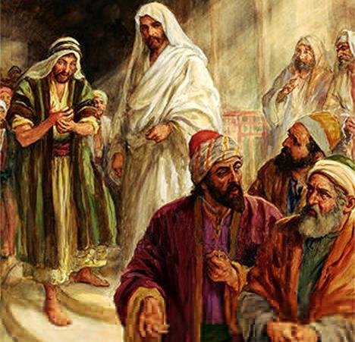
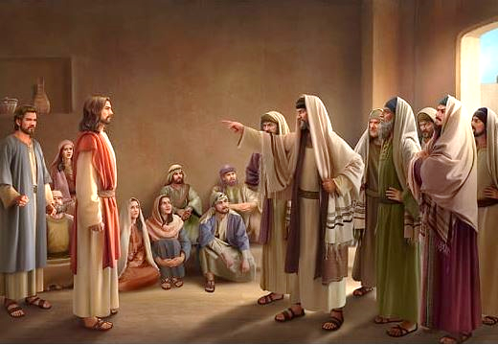
Zeisu’ gamtatna, a thu gen zia le damsaknate khempeuh in biakna thunei makaite ii ngeina zia te tawh kilehngat mah mah hi.
Amaute in amah zahpih ngaihsut uh hi; vai hau le mawhneite lawm; Sabbath palsatpa... Beelzebub ading in nasempa ci-in mawh sak uh hi!
Zeisu in na nak’sep lua ahih main a thu ngaihsutna mansuah hiding hi ci-in a kizoppih pawlkhat in upmawh hi.
Zeisu’ nunna in kidonate tawh kidim nunna ahihlam, lung hian’ nang omlo hi.
Maisakna tawh kisai buaina. Mark 2:1-12.
Nek le dawn buaina. Mark 2:13-22.
Sabbath tawh kisai buaina. Mark 2:23-3:6.
Zeisu tawh kisai buai theih nading dotnate:
Bang hatna tawh nalamdangte sem hiam? Mark 3:22-30.
Zeisu hai maw? Mark 3:20-21, 31-35.

Slide 4
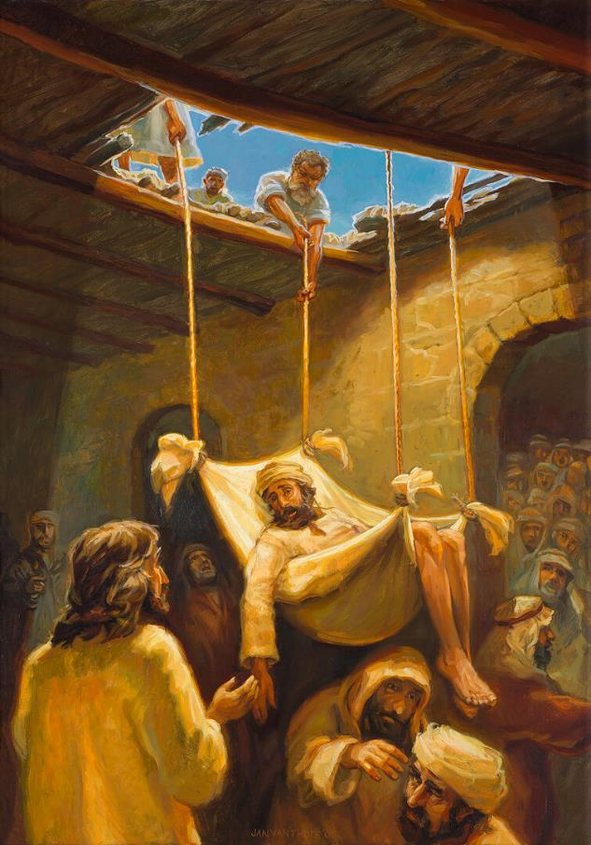
MAI’SAKNA TAWH KISAI BUAINA
“Zeisu in amaute’ upna a muh ciangin pumzawpa kiang ah, “Ka ta aw, na mawhnate hong kimaisak khinzo hi,” aci hi. (Mark 2:5)
Zeisu pen Kapernaum a Peter’ inn ah hong pai kik ciangin mite in ama’ thugen ngai dingin hong pai uh hi (Mark 2:1-2). Pumzaw mikhat a dam nadingin a lawm li te-in Zeisu kiang a zuat pih hangin, a kiang tun’ zolo uh hi. Zeisu kiang tun’ ding cih khensatna nei uh ahih man un, inn khum ah kah in a tungkhuh hong in a tungpan khia suk uh hi. Zeisu thugenna hong khawlvat in, mi khempeuh dai takin hong om a, Zeisu in bang hong semding hiam ci-in ngak uh hi (Mark 2:3-4).
“Na mawhna kimaisak khin hi” (Mark 2:5). Pumzaw mi’pa in kigeen khia nuam ding hi: “ka lampai nuam hi.” Ahih hangin tua bangin hih lo hi. Zeisu in a natna zungpi damsak hi. A lam pai theihloh kik ding pen awlmawhlo hi, ahang in a kha nunna nopna apia mawhmaina hang ahi hi.
Laithei te’ adingin, hih in zahpihna hi (Zeisu in Pasian hikeileh, man hi). Mai sak theihna nei ahihlam lahna in Zeisu in pumzaw mipa a dam hi (Mark 2:8-11).
Mawhnate mai sak theihna vangliatna Zeisu tungah pia ahih manin mite in Pasian phat uh hi (Mark 2:12; Mt. 9:8). Pumzawpa lam pai hi; ahizongin laitheite-in mittaw bang uh a, amaute lungsim Zeisu in a sim theih lam theilo uh hi, mawhneite maisakin, natna damsak hi.

Slide 5
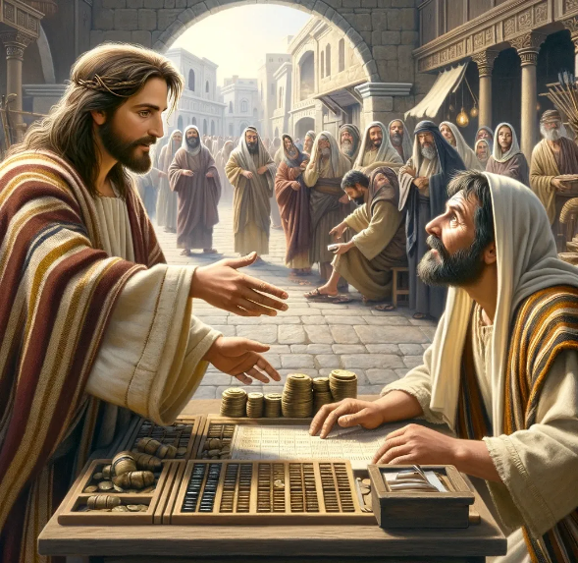
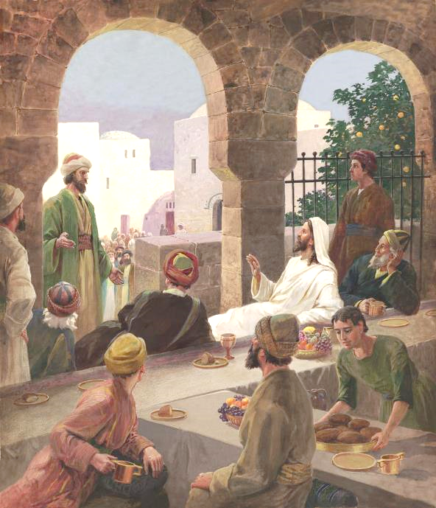
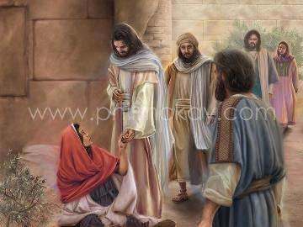
NEK LE DAWN BUAINA
“Tua bangin a paina-ah Alfeas tapa Levi, a siahdon’na zum ah tu-in a om a mu hi. Zeisu in ama kiangah, “Kei hong ui-in,” a ci hi. Levi zong dingin Zeisu’ nung a zuipah hi.” (Mark 2:14).
Levi’te sapna a satsuah buaina pen ngaihsun leng’ haksalo hi (Mark 2:13-14). Jew upna nei khat adingin, siahdong khat pen Gentile te sangin sia zaw hi. Amah in galte tungah zuak na a thuak Jew minam hi. Amaute in an nekhawm lo ahihkeileh kisawh lo uh hi.
Ahizongin hong thusia zaw hi. Zeisu in siahdong pa inn ah anne bek hilo-in, amah tawh a kibang mi tampite in a umcih hi (Mark 2:15). Mawhzong mite in a hun uh mawk bek saklo hi: “Siahdongte le mawh neite tawh anne, tuidawn khawm cih pen, bang himawk hiam?” (Mark 2:16).
Zeisu in amaute a thu ngiat in nial hi: mawhnei te hotkhiat nading himun sang’ ahoih zaw mun ka mu kei hi? (Mark 2:17). Bekthamlo-in, a lung sim puakte uh a sittel ding to hi. Amaute in it theih nadingin sin uh hi (Matt. 9:12-13).

Slide 6
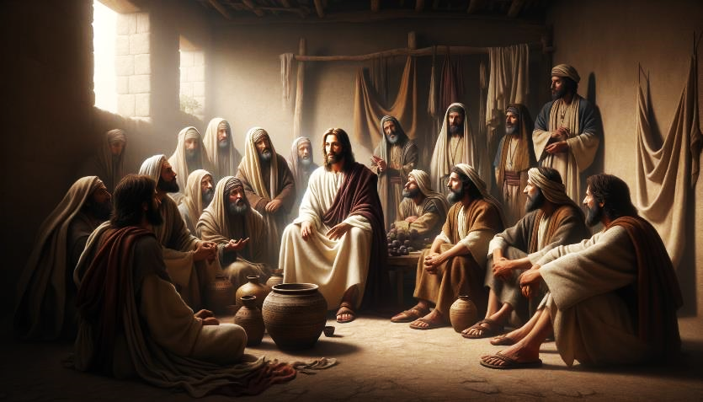
NEK LE DAWN BUAINA (2)
Zeisu in, “Mopawi a siim mite in an nelo dingin um nahi uh hiam? Zineipa tawh a omkhawm sung uh an nelo-in omlo ding uh hi.” (Mark 2:19)
Pharisee te-in itna thusinna tawh kigamla in, John’ nungzuite in tua mawh zonna ah thapia uh hi: “John’ nungzuite le Pharisee’ nungzui te in antang uh a, na nungzuite in tanglo se uh hiam?” ci hi (Mark 2:18).
Mopawi thu gentehna (Mark 2:19-20).
Mopawi ah mi khat in koi bangin an’tang ding hiam? Mopa in Zeisu hi; leengla te in nungzuite hi. Zeisu si in a thawh kik ciangin nungzuite in antan’ ding kisam ahi hi.
A thak le a lui gentehna (Mark 2:21-22).
A nungta Zeisu thuhilh nate in a si khin ngeina luite adingin mun a om kei hi; ahi kik kik cih bang omlo hi.
Zeisu in gentehnate tungtan in genkhia hi:

Slide 7
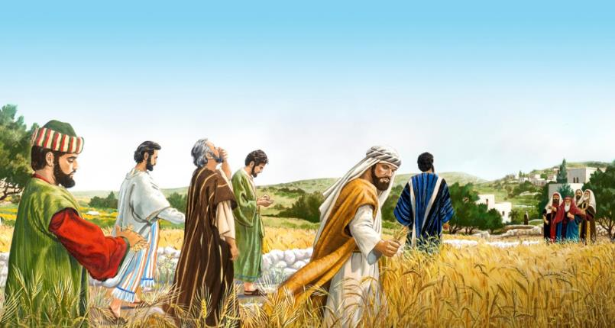
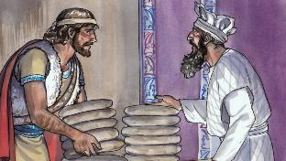
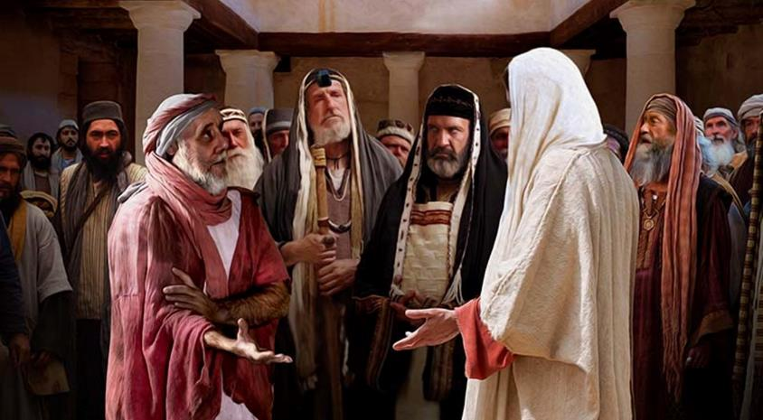
SABBATH TAWH KISAI BUAINA
“Bang hangin Sabbath ni-in gamtatloh dingpi, na nungzuite gamta uh ahi hiam?” (Mark 2:24)
Pharisee te-in Pasian sehsa Sabbath ni pen a khengval zuih ding nam 39 hilh hi.
Buhvui zut khia in nek na hangin, nungzuite in Sabbath ni in a kikhaam thu thum sem uh hi ci hi: buh laakna; buhcilna; le buh haihna. (Mk. 2:23-24; Mt. 12:1-2).
Zeisu’ dawn kikna: David in a gilkial ciang in siampi te bek in a nekzawh a siangtho khomunte a nek lam phawklo na hi uh hiam? (Mark 2:25-26).
Anu’nung ah, Zeisu in thu 39 lak ah a kihel’lo “nasep” damsakna semin Sabbath palsat ci hi (Mark 3:1-3).
Zeisu’ dawn kikna: “Sabbath ni in bang thukhun kicing sak zaw ding: a pha sem ding maw a sia sem ding, nuntakna hon ding maw that ding?” (Mark 3:4).
Atawpna ah, Zeisu in Sabbath ni ii Topa hi-in, eite’ ading in apha hong sepsak hi (Mark 2:27-28).
Alamdang thu in, a lawp mahmah Sabbath a tangte in mi thah ding khat geel uh hi (Mark 3:6).

Slide 8
ZEISU TAWH KISAI BUAI THEIH NADING DOTNATE

Slide 9
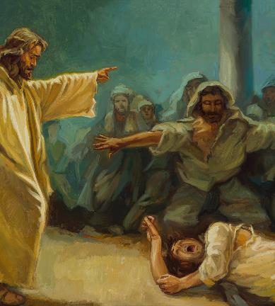
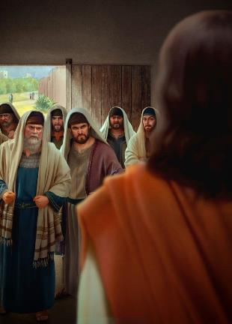
BANG HATNA TAWH NALAMDANGTE SEM HIAM?
“Jerusalem khua pan a hong pai Thukham hilh siate pawlkhat in, "Hihpa sungah Beelzebul lut hi. Dawimangpa in ama tungah dawi hawlkhiat theihna ding vangliatna pia hi," a ci uh hi.” (Mark 3:22)
Zeisu’ innkuan in amah mitsuan
Mark in Zeisu innkuan thu tawh a pat hangin, Pharisee te tawh a buai na thu gen ding nial hi. A nunglam ciangin, amah in tangthu masa ah pai kik hi. Tua thu bangin Marcos in a kibang tangthu nih ah kihel ding in tam veipi zang in a thupi ahihna kilangh dingin pulaak hi.
Mark 3:20-21
Accusation of the Pharisees
Mark 3:22-30
Hih thu ah, a thupi tangthu in Zeisu in dawi gilote hawlkhiat zawh nading in bang vangliatna nei hiam cih laithei te-in mawh zon nopna ahi hi (Mark 3:22).
Zeisu’ innkuan in amah mitsuan
Mark 3:31-35
Khatvei, Zeisu in amah kimawhsaknate a khiatna omloh na a pulaak dingin gentehna zang hi (Mark 3:23-27). Zeisu pen a thahat mipa (Satan) inn sung ah lut in, amah heen cip in, tua bang tawh ama’ neihsate laksak thei hi (dawi vei mi suahtakna).
Kha Siangtho ii sepna pen dawite sepna hi ci-a san’ na in bangzah in lauhuai cih hong thei sak hi (Mark 3:28-30).

Slide 10
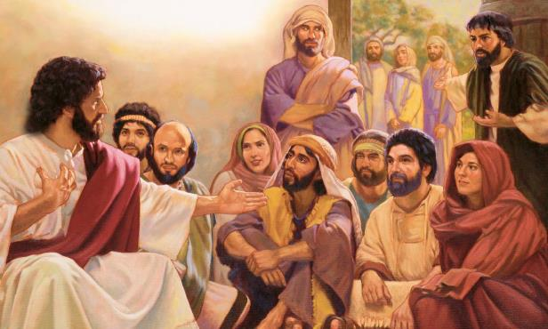
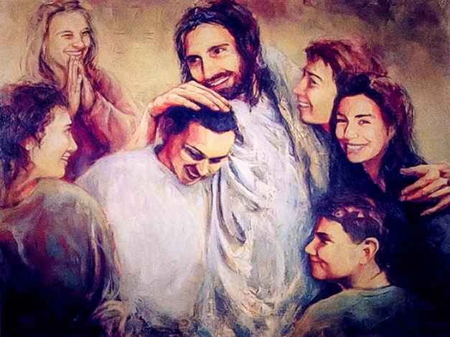
ZEISU HAI MAW?
“A innkuanpihte in hih thu a zak uh ciang in Zeisu a la dingin hong kuankhia uh hi. Bang hang hiam cihleh, “Zeisu mihai suakta hi,” a kicihna thu a za uh hi.” (Mark 3:21 ZIV )
Zeisu a innkuan pihte in bang hangin a hai sa uh hiam (Mark 3:20-21)?
Na tamsep lua, anlim mehlim nelo, laitheite le Pharisee te tawh tatsatlo in thu kikupnate hang in lunggimna tam….
A tom kaih khitciangin, Mark in Zeisu a zong mel theih tanau te tawh theihsakna thu genkik hi: a nu le a sanggam te (Mark 3:31).
Zeisu in a innkuante tungah a thusim loh man hizaw maw! (Mark 3:32-33).
Ahi zongin a kimutheite in hong kheem hi. A nu le a sanggamte khial uh hi. Tua laitak in amaute kiangah aap dingin ama nasep tha koih in ama vaipuak le amaute sukha hi.
Cilesa kizopnate sangin thupi asak zawk pen Zeisu in a kha innkuan pihte tawh kipawl khopna ahi hi: “Pasian’ deihna bangin a gamta mi khempeuh ka nu le ka sanggamte ahi uh hi” (Mark 3:35).

Slide 11
“Nengniam bawlsiatna in Pasian tawh kizopna a neilote ading in lung himawhna omlo ban ah gamtat hoih na neilo uh hi. Leitung lunggulhna zuilo-in, ama upmawhnate, maipha piakna ahihkeileh langpan nate hangin hoi lo-in a citak mite tungah tha piakna a ngah ding hi. Kiphatsakna, aangsung khualna, huaihamna le khua hun zuiluat mawhnate a mawh sak nasepna in leitung le a pua tham bek Khristian te muhdahna thuak ding uh hi.... Zahpihna le bawlsiatna te tuah khak ciangin a hoihzaw kipawl khopna a om hi; a hangin, Zeisu in na khempeuh ah thuakzawhna nei hi. Nang in Pasian ading in a citak mi na hihleh hithu in nang adingin lungdamna hiding hi. A hangsan kha te ahi hi, tua in khat bek ding ahihleh citak, a kisia theilo kham lukhu ngah ding hi."
EGW (The Medical Ministry, pg. 282)

