Slide 1
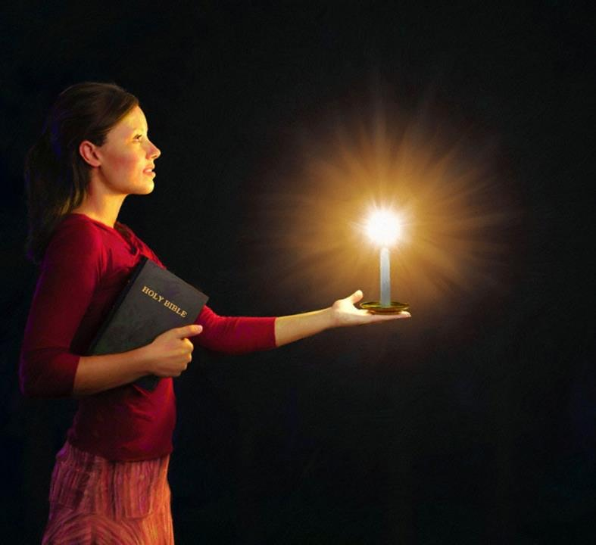


Lesson 5 ading January 31, 2026
ZAN LAI-IN KHUAVAK BANGIN TAANG

Slide 2

“Na khempeuh phunlo kisel lo-in semun. Tuahileh a kawk’banglo a siangtho khialhna aneilo Pasian tate na suak ding uh hi. Lungsim kawi-in lam a khial tulai khang mite sungah note in leitung khuavak bangin na taang ding uh hi.”
Philippi 2:14, 15, ZSV

Slide 3

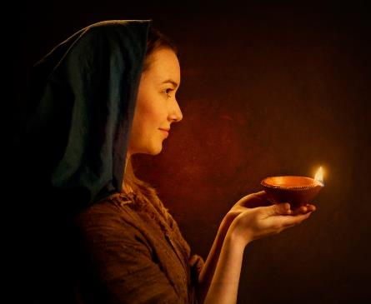



“Tua mah bangin, mite in na nuntakna hoih uh a muh uh a, vantung a om na Pa uh a phat nading un, mite’ mai-ah na khuavak uh tangsak un.” (Matt. 5:16).
Philippi 2:12-18 sungah, Zeisu’ thupiak tawh kisai Paul’ gelh dan i sim thei hi.
Pasian’ Thukham kinawl khinna leitung ah, tua thukham tawh kituak a nungta-in Pasian’ nasepna a deih ei Khristian-te pen khua mialna lak ah a taang khuavakte ihi hi.
Leitung ah khuavake:
Pasian limlakna(Philippi 2:12-13)
Leitung ah khuavak (Philippi 2:14-16)
A nungta biakpiakna (Philippi 2:17-18)
Khuavak Limte:
Timothy (Philippi 2:19-24)
Epaphroditus (Philippi 2:25-30)

Slide 4

LEITUNG AH KHUAVAKTE

Slide 5




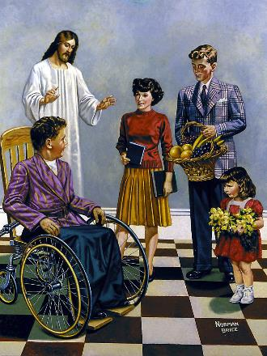
PASIAN’ LIMLAKNA
“Note in utna lungsim na neih nading uhleh ama deihna na zuihzawh nadingin note sungah Pasian in a tawntungin na a hong sem ahi hi” (Philippi 2:13)
Zeisu kiniamkhiatna le thupitna kician takin a gen khit ciangin, Paul in, “tua ahih ciangin” cih kammal behlap hi. Tua ahihmanin, Zeisu in amah le amah kineu-sakin Pahtawina a ngahna tungtawnin, “lei khempeuh in Pa Pasian’ vangliatna dingin, Zeisu Khazih pen Topa ahi hi, ci-in a phat nadingun” (Phil. 2:11) kici ahih manin, Philippi khua –a upna nei mite (leh i vekpi-in) hih thu tawh kisai-in khat peuhpeuh ihih ding a kul hi.
I nasep masak pen dingin “lau na le thahat’na tawh” i hotkhiatna sep khiat ding ahi hi (Phil. 2:12). Pasian in eite hong honkhia ahihleh (Titus 2:11), bang hangin hihthu tawh kisai-in i lungngai ding i hi hiam?
Lau’na le thahatna kici kammalte pen Pasian nasepna tawh kibang kammalte ahi hi (Late 2:11). Tua ahihmanin, eite sungah nahoih sep nopna lungsim a piangsak le tuate a taktak a piangthei nading thahatna apia pen Pasian ahihna thu Paul in limtak gen hi (Philippi 2:13).

Slide 6




LEITUNG AH KHUAVAK
“Tuahileh a lungsim kawi, a hoihlo leitung mite lakah paubaan'na a neilo a siangtho, Pasian' tate nahi ding uh a, nuntakna thu na genna uh hangin leitung mite lakah khuavak bangin na hoihna uh a kilang mite na hi ding uh hi” (Philippi 2:15)
Paul in leitung ah upna neite a vaksak ding thu thum pulaak hi:
Kithutuahna kem un (Phil. 2:14)
Na i sepkhop ciangin i kikaal ah mi kigensiatna, kilang neihna, kidemna, le kiselna omlo ding hi
Paubanna omlo in nungta (Phil. 2:15)
Eite’ Pa thu siangtho takin i manna in i kiim, i paam a om gitlohna le nuntak kisialhnate tawh kilehbulh mahmah hi
Pasian kammal tungah thumanna (Phil. 2:16)
Eite gamtatna le i ngaihsutnate Lai Sianghto sinsakna tawh kituak ding ahí hi
Khuamial mahmah na mun ah, khuavak tang pha zaw hi. Pasian nakpi takin a nialna leitung ah, ei Khristiante in Khaziah khuavak tawh i tan’ ding hi.

Slide 7




A NUNGTA BIAKPIAKNA
“Note' upna hangin biakpiakna-in keimah hong kigo hita le zong, note khempeuh mah bangin kei zong ka lungdam veve ding hi.” (Philippi 2:17)
Paul in hong khenkha ah a tangtung ding ciangin, a thuak ding hi tawh kisam hi. Ama in hih thupiang theih ding pen “biakna dawn ding tui bangin kibuak khia” (Phil. 2:17) cih tawh lak khia hi.
Dawn biakpiakna kichi pen biakpiakna ganhing tungah tui khatpeuh buakna ahi hi (Paikhiatna 29:39-40). Hih thu-ah, kigen biakpiakna pen Philippi mite ahi uhi.
Philippi mite si ding uh hiam? Hi het lo hi. Amaute’ biakpiak na pen “na upna uh tawh nasepna” ahi hi. Tua pen a nungta biakpiakna ahi a, eite Pasian kiangah i piak ding biakpiakna ahi hi (Rom. 12:1).
Paul in sih ding pawi sa lo hi, a hang pen ama teci panna in Lungdamna Thu teci dik tak a pang khin sa, hangsan takin a genkhia, leh Pasian' tate tawh kilawm takin a nungta upna nei mite tha khauhsak semsem ding ahih man ahi hi.

Slide 8

KHUAVAK
LIMTE

Slide 9

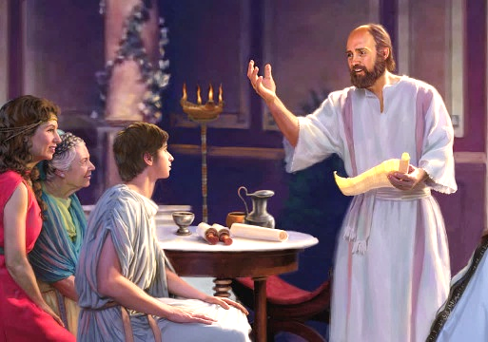


TIMOTHY
“Ahi zongin Timoti ahihleh lungdamna thu nasepna-ah pata bang ka hih manun manpha mahmah hi.” (Philippi 2:22)
Timoti pen Paul tawh nasem khawm gige khat ahi a, laikhak guk (2 Korin, Philippi, Kolose, 1 Thesalonika, 2 Thesalonika, Philemon) ah laigelh khawmpih ahi hi. Paul mahmah in amah pen lungdamna thu hilhpa dingin a teel ahi hi (Sawltak 16:1-3). Hih tangvalpa tungah Paul in bang thupi-na mu a hiam?
A masa in, mi khempeuh in amah phat uh hi. Nasepna adingin amah a kicianna pen kamsang thute tawh kipsakna kinei hi (1 Tim. 1:18). Paul in amah tapa khat bangin ngaihsun a (1 Tim. 1:2; 4:12). Timothy in zong tapa khat in a pa a zahtakna leh a itna bangin Paul zahtakin it hi (Phil. 2:22).
Paul in amah zong amah mah bangin nasem citak khatin ngaihsun hi (1 Korin 6:10). Ama in Corinth (1 Kor. 4:17); Philippi (Phil. 2:19); leh Thessalonica (1 Thes. 3:2) te bangin pawlpi tuamtuamte enkai dingin amah ap hi. Paul mah bangin thongkia-in gimna zong thuak hi (Heb. 13:23).

Slide 10

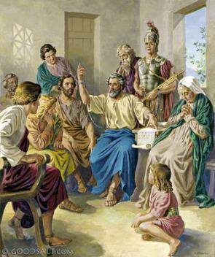


“Note in kamtai ding leh keimah hong huh dingin na hong sawl uh, kei tawh na semkhawmin gal hong simpih, i sanggampa Epafroditas pen note kiangah ka hong ciahsak kik ding kisam hi, ci-in ka ngaihsun hi. ” (Philippi 2:25)
EPAPHRODITUS
Philippi mite in Paul Rome khua-ah thong kia hi cih a zak uh ciangin, a kisapnate (inn thaman, an, puan, cih te) huh nadingin huhna khak ding khensat uh hi. Epaphroditus in hih huhnate sawltak Paul kiangah a tun ding mawlpuak nei hi (Phil. 4:18; 2:25).
Epaphroditus in huhna pia bek hilo-in, Paul tawh kithuah khawm a, a kisap nate ah huh-in, lungdamna thu pulakna ah amah tawh sem khawm hi.
Lungdamna thu hangin a hanciamna-ah, ama nuntakna phal-in nasa takin a damlo hi (Phil. 2:27, 30). Philippi mite'n hih thu a zak uh ciangin, amah lunghimawh pih mahmah uh hi. Hih pen Paul in amau kiangah laikhak va pia dingin amah a sawtna a hang bulpi ahi hi (Phil. 2:26, 28).
Paul in, "amah bang mite zahtak un," (Phil 2:29) ci-in ngen hi. Epaphroditus pen upna a kician Khristian khat ahihna lung ngaihna om lo hi.

Slide 11

“I thumsakpa Zeisu in vantung ah eite adingin thum pihna a neih laitakin, Kha Siangtho in Ama deihna bangin i deihna leh i nasepna a om nadingin eite sungah nasepna nei hi. Vantung khempeuh in kha hotkhiatna tungah lunglutna nei hi. Tua ahihleh Topa in hong huh ding hi cihleh hong huh takpi hi cih i upmawhna ding bang hang om hiam? Mipi a hilh i hi i mite in eimah mah in Pasian tawh nuntakna kizopna thupi i neih ding kisam hi. Kha leh Thu tawh mite adingin tuihual bangin i om ding hi, banghang hiam i cih leh Khrist in nuntak tawn tungna dinga tui a phulkhia tuikhuk bangin i sungah a om hi. Dahna leh gimna in i lungduaina leh i upna te hong sin thei hi; ahi zongin Muhtheihlohpa i ompihna vaksakna in i kiangah om a, Jesu nungah eimah leh eimah i kisel ding ahi hi.”
EGW (You Shall Receive Power, December 8)

