Slide 1
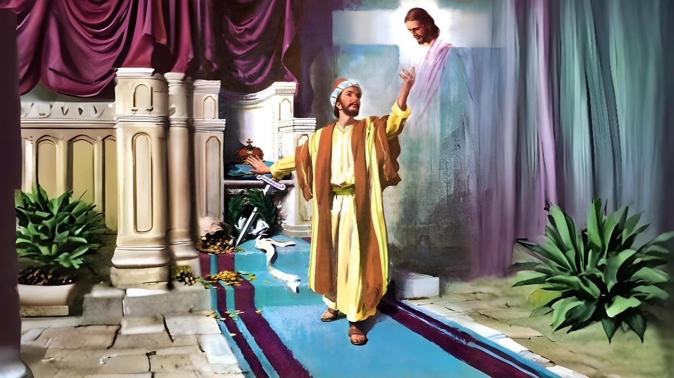
February 7, 2026 ading Lesson 6
KHAZIH SUNGBEKAH KHAMUANNA

Slide 2


“Na khempeuh phunlo kisel lo-in semun. Tuahileh a kawk’banglo a siangtho khialhna aneilo Pasian tate nasuakding uh hi. Lungsim kawi in lam akhial tulai khang mite sungah note in leitung khuavak bangin na tang ding uh hi.”
Philippi 3:10, 11, ZSV

Slide 3










Philippi mite in hotkhiatna lampi thei uh hi, tua khuapi sunga upna a zui masa pawl khat ahi thongcingpa tungah Paul leh Silas in kician takin a gen bang un (Sawltak 16:30-31).
Tu-in pawlpi kipsak khin ta a hih manin, hotkhiatna lampi panin a pialmang nadingun lauhuai dinmun ah om uh hi.
Tua ahih manin, upna tawh hotkhiatna a bulpi bulphuhte Paul in amau phawksak hi.
Hotkhiatna na mansuah loh nading thupi pawlkhat:
Bangte pelh ding hiam (Philippi 3:1-3)
Bangte kinusia (Philippi 3:4-6)
A thupi thu (Philippi 3:7-8)
Hotkhiatna sungah omkip nading athupi thuhilhnate:
Khazih Upna (Philippi 3:9)
Khazih Theihna (Philippi 3:10-16)

Slide 4

HOTKHIATNA NAMAN’ SUAH LOH NADING THUPI PAWLKHAT

Slide 5

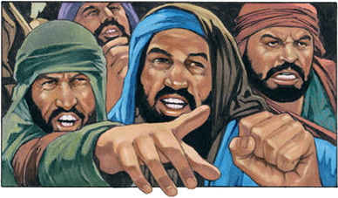

BANGTE PELHDING IHIAM?
“Ui bangin a miginalo, a gitloh gamtat, vun at ding a ci teiteite kiang panin na kidawm un.” (Philippi 3:2)
Upna a ding lauhuai thute i kikum ma-in, Paul in thuhilhna khat hong pia hi: “Topa ah lungdam un” (Phil. 3:1a). Hih tawh kizom-in thupi mahmah khat a behlap hi: i theihsa mah hi napi-in, i neihsa thutak kiphawk sak kik ding pen a hoih ahi hi (Phil. 3:1b).
Receiving God's mercy (Psalm 31:7)
Placing our trust in him (Psalm 5:11)
Receiving the blessings of salvation (Psalm 9:14)
Keeping God's Law (Psalm 119:14; Isaiah 58:13, 14)
Believing in His Word (Psalm 119:162)
Raising Godly Children (Prov. 23:24, 25)
Bangci bangin Topa sungah i lungdam thei ding hiam?
Paul in tua hun lai-a pawlpi ading lauhuai penpen thu a lakkhia hi: tua pen biakna thuzuihna dan thute khauh takin zuih ding a sinsak thuhilh piak nate ahi uhi (Phil. 3:2). Hih mite nam thum in a gen hi: uite (Late 22:16; 2 Pet. 2:21-22); thu hoihlo semte; le pumpi a at-te (vun aatna tungtawnin).

Slide 6

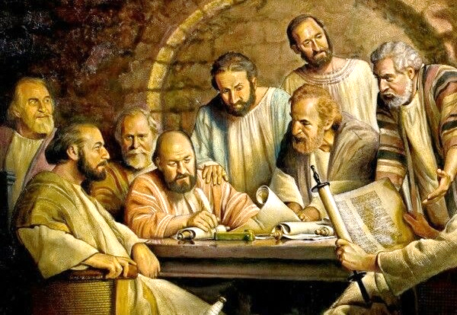
BANGTE KINUSIA
“Ka suahzawh a ni giat ni-in ka vun a ki-at hi. Kei pen Hebru minam citak ka hi a, Israel mite sung panin Benjamin' suante ka hi hi. Jew Thukham zuihna tawh kisai-in Farisi mi pawl ka hi a,” (Philippi 3:5)
Jerusalem kikhopna ah minam dangte Judah-te ngeina thute tawh nawngsangsak lo ding thukimna kinei khin hi (Sawltak 15:19-21). Ahizongin, thuhilhtu khenkhat Philippi khua-ah hong pai-in, vun-atna neih kul hi ci-in hilh uh hi (Phil. 3:2-3).
Hun paisate enkik in, Paul in tua thuhilhte bang a a om lai-in amah bangci bangin a kicing hiam kicih thu amau phawksak hi (Phil. 3:4-6):
Ni giat ni-in vun atna kinei; biakna a lunglut nu leh pa' tapa
Hebru-te lakah Hebru taktak; Benjamin beh suanh siangtho
Thukham tawh kisai-in, a khauh pen Pharisee khat
Hangsanna thu-ah amah in pawlpi a bawlsia khat ahi hi
Mawhsakna ding om lo thukham kempa
Ahizongin Zeisu a theih ma -in hih thute khempeuh tawh a kiphat hi. Tu-in Thu kham pen a tel taktak loh na a kithei khia ta hi (Matt 5:21-22). Tu-in Khazih kia in hotkhiatna a piak theih tak a thei ta hi (Phil. 3:7).

Slide 7

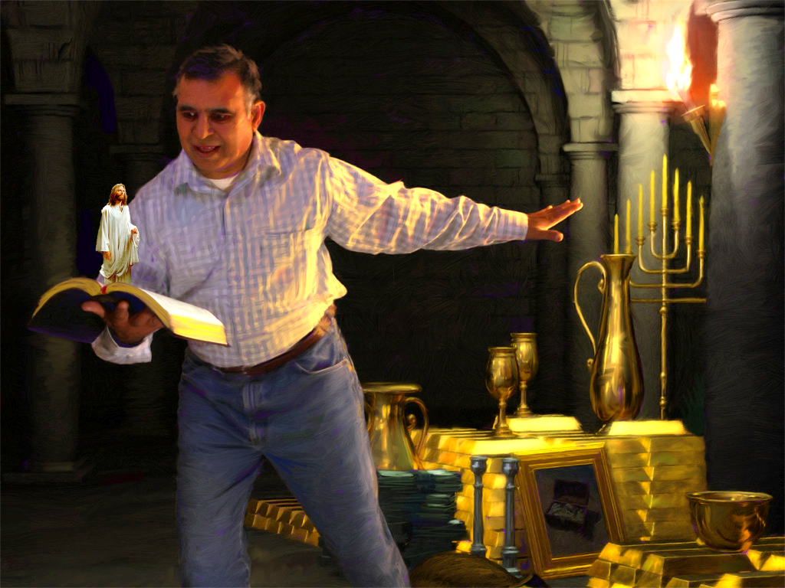



A THUPI THU
“Hamphatna-in ka neih theihding tua bangte khempeuh, Khazih hangin supngam dingin ka ngaihsun hi” (Philippi 3:7)
Paul in a ma-a a nuntakna leh a tu-a a nuntakna tehkak hi. Lang khat lam-ah, a pilna khempeuh, Gamaliel' sangnaupang minthang khat a hihna tawh a neih ding a thupi mahmah a mailam hun, leh Pharisee-te lakah a neih a thupi mahmah a thilpiakte a koih hi. Hih khempeuh pen phattuamna ahi hi.
Tu-in, bukna langkhat lam-ah Khazih a muh khit a kipat a nuntakna va koih in. Phattuamna khempeuh pen nin bangin a kigiat hi, banghang hiam kicileh Khazih' itna tawh tehtheih bangmah om lo hi (Phil. 3:7-8).
Vantung le leithak tung a tawntung nuntakna sangin a thupi zaw bang om thei ding hiam? Ahizongin, leitung thupi bawlna te in mi tampi te mitsuan mial sak in hih thutak mu thei lo sak hi. Hih leitung a thupi kisa thute leh Vantung in a thupi bawl taktak: Khrist tawh kibatna le kha hotkhiatna thute kikal ah kidem na le kilehbulhna om den hi.

Slide 8

HOTKHIATNA SUNGAH
OMKIP NADING A THUPI
THUHILHNATE

Slide 9



KHAZIH UPNA
“Khazih tawh kiptakin kipawl khin kahih manin Thukham zuihna tawh a kingah thei keima hanciamna tawh dik ngahna cihte ka nei nawn kei hi. Tu-in, Zeisu Khazih upna hangin Pasian in a hong piak diksak na ka ngah a, tua pen upna siksanin a hong kipia ahi hi.” (Philippi 3:9)
Paul, ama dikna tungah kinga-in, "Lampi" kici pawlpi-a upna khialte hotkhiatna lampi ah puakkik nadingin Damaska khua ah hoh hi (Sawl. 9:1-2). Ahi zongin amah dikna dang khat, Pasian' dikna in zo-in Damaska khua ah lut hi: "Khrist upna tawnin a kingah dikna" (Philiipi 3:9).
Tua hun a kipan, amah a dikna tungah a muang nawn ngei kei hi. Bang hang hiam kicileh, hotkhiatna ngah nadingin i nasepna tungah muan ding pen bangmah phattuamna om lo hi (Gal. 2:16).
Ama in "Khazih sungah kimu ding" (Phil. 3:9) a lunggulh mahmah hi. Hih in bang a kawk hiam?
1 Korin 1:30 na bangin, "Khazih sungah" omna in hotkhiatna geelna sunga kigawm khempeuh huam a, i kha lam pilna kipatna (pilna) panin, upna tawh diktang tanna (diktatna) leh vantung kiginna (siangthona) tawnin, a tawpna ah Nihveina Hong Paikikna a thupi tanna (hotkhiatna) dong ahi hi.

Slide 10







KHAZIH THEIHNA
“Kei zong sihna panin hong hingsak kik ding hi, ci-in ka lametna hangin ama thuak bangin thuakin, sihna-ah zong amah tawh ka kibat ding ka utpi pen ahi hi.” (Philippi 3:10)
Koici bangci-in Khazih i thei thei ding hiam?(Phil. 3:10-16)?
Ama Thu i sin ciangin
Kha Siangtho makaihna tawh i kalsuan ciangin
Ama thuaknate i thuak khawm ciangin
I tupna lam i manawt ciangin
Khristian nuntakna pen tai kidemna tawh kibang hi. I tupna i lungsim sungah kician takin i nei ding hi. Hih mun ah om den ding leh hih nuntakna nuam sa lel dinga nungta i hi kei hi. Misite thawhkikna ngah ding i lamen hi (Phil. 3:11).
Tua hun a tun mateng, "Khazih Zeisu in kei a mah a dingin a kigupna hangin, tua a kigupna ngimna ka ngah theih nadingin" i hanciam hi (Phil. 3:12). Zeisu in khua khat, pahtawhna khat, le Amah tawh nuntak khawm nading tawntung nuntakna kei kiangah a piak nadingin kei a mah a dingin a kigu hi (Heb. 11:10; Phil. 3:14; 1Thess. 4:17).

Slide 11

“Paul in haksatna leh hanciamnate lakah maban a nawt nadingin a thuzawh tupna thupi in, Khristian nasep khempeuh Pasian nasepna ah amah leh amah kipiakhia siangtho dingin a heisak ding hi. Leitung nopnate in Hotpa pan a lungsim lakkhiatna ding kalsuanpih ding mahleh, amah in tupna lam zuanin kalsuan suak ding a, Pasian' mai muh ding lamenna pen hih lamenna ngah nadingin hanciam na le kipiakkhiatna khempeuh tawh a kituakin a manphatna thu leitung, vantungmite, leh mihingte tungah a lak ding hi.
Khrist nungzui niam penpen nangawn vantung mi suak thei a, Pasian' gouluahna a sia thei lo ding a luah ding mi suak thei hi.”
EGW (Conflict and Courage, December 13)

