Slide 1

PASIAN THEIHTELNA
April 11, 2026 ading Lesson 2

Slide 2
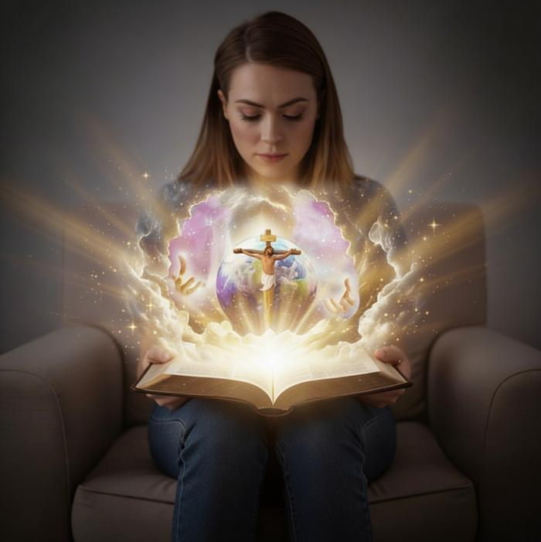
“Tua nuntak tawntungna in nangmah bek a man’ Pasian na hihna le na sawlpa Zeisu Khazih a theih nading uh ahi hi.”
(John 17:3, ZSV)

Slide 3

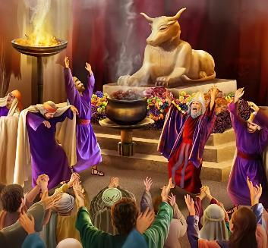

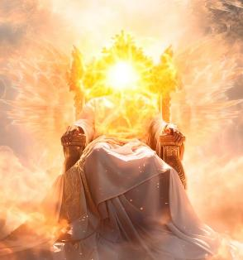

Pasian i telna pen mawhna hangin kisia khin hi. Ganhing ahihkeileh mihing lim tawh kibawl milimte zangin Ama lim lahna dingin i hanciam khin hi. Ama pen lungsim kikhelkhel ahihkeileh thagum zang mi bangin kigen hi. A tawpna ah, mihingte in Pasian lim pen amau lim mah bangin bawlkhia uh hi.
Ahih hangin Pasian taktak pen bangci bang hiam? Amah pen i theih zawh loh ding khop in lian lua ahi hiam? Takpi mah in, bangzah in hanciam mahlehang, i lungsim in Pasian tel zolo hi. Huhna i kisam hi.
Ahih hangin huhna hong tungta hi. Ama bangci dan hiam na thei nuam hiam? Lai Siangtho sungah Pasian' zia taktak kilakna i thei hi.
Pasian’ hihnate.
Pasian’ zialetong:
Pasian siangtho hi
Pasian in itna hi
Pasian theihna:
Pasian in Piansaknate sungah kilak
Pasian in Zeisu sungah kilak (Emmanuel)

Slide 4


PASIAN’ HIHNATE

Slide 5


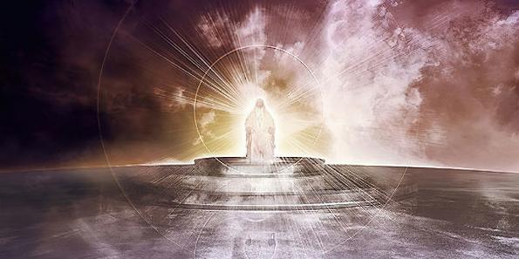

“Vanglian Topa Pasian aw, na khempeuhah na thutak a, nangmah bangin a vanglian kua om ahi hiam, Topa aw.” (Psalm 89:8)
PASIAN’ HIHNATE
Lai Siangtho in Pasian' mel muanhuai pen, kician pen, leh kikhel ngeilo pen in lak hi. Ama zia le omziate tawnin amah i theihnading lampite lakah khat ahi hi.
PASIAN HIHNA PAWLKHAT
Thuman (Late 11:7)
Hehpihna nei (Thu Hilhkikna 4:31)
Lungduai le hehnem (Romans 15:5)
Hehpihna pia (Romans 3:24)
Maisakthei pa (Late 86:5)
Nampi (Late 47:8)
Tawntung (Piancilna 21:33)
Vanglianpen (Piancilna 17:1)
Theihna khempeuh nei (1 John 3:20)
Mailam thu a theipa (Isaiah 46:10)
Amah lam panin, Satan in a kipatcil akipan Pasian’ pian’zia bawhsiat nading hanciam a, amah pen ama’ phat nading bek a zong, angkhual Pasian khat bangin lak hi (Pian. 3:4-5).

Slide 6

PASIAN’ ZIALETONG

Slide 7

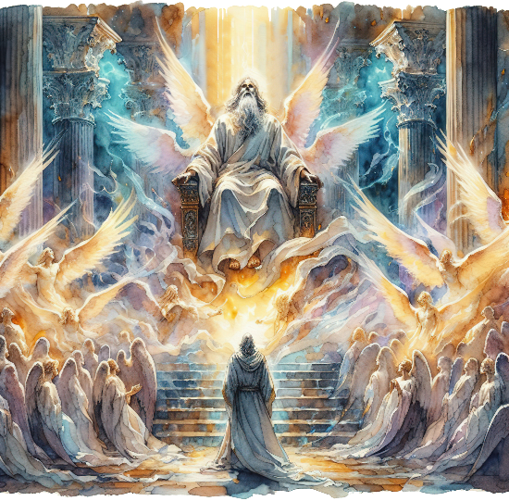
Amaute khatlekhat kisamin: "Vanglian Topa, siangtho, siangtho, siangtho; leitung khempeuh ama minthan'na tawh kidim," ci-in awng uh hi. (Isaiah 6:3)
PASIAN SIANGTHO HI
Pasian kiangah a ding vantungmite in Ama tungah, "Siangtho, siangtho, siangtho," ci-in phat uh hi (Isa. 6:3; Mang. 4:8). Hih zialetong pen Ama zia tawh kigawm cip mahmah ahih manin Isaiah in Pasian' min taktakin bang in zang hi: : “Siangtho Pa in ci hi” (Isa. 40:25; 57:15).
Siangtho cih pen bang cihna hiam? Tua in siangtho sakna, khenkhiatna, siangthona cihna ahi hi. Gitlohna pan i kihei-khia a, Pasian in i sep ding a hong ap nasepte i sep ciangin i siangtho hi. (Gam. 15:40; Siam. 11:44; 1 Pet. 2:9).
Ahi zongin hih pen Pasian tungah bangci kizom hiam? Ama in gitlohna pan kikhenkhia sitset a, mawhna tawh bang mah kizopna neilo hi.
Hih adeihna in, Amah siangtho ahih manin, a itna zong siangtho ahihnaleh angkhualna pan suahtakna ahi hi. Ama Siangtho ahih manin, a vangliatna khempeuh siangtho-in, angkhualna omlo hi. Ama' zialetong khempeuh siangthona le ciimna tawh kidim hi.

Slide 8


PASIAN IN ITNA HI
“Pasian in eite hong itna eite in thei in i umzo hi. Pasian in itna ahi hi. Itna sunga a om mi hi a, Pasian zong tua mi sungah a om hi.” (1 John 4:16)
Pasian in itna nei bek hilo-in, itna zong a pia hi (tua nihte a bawl hangin), "Pasian in itna hi."(1 John 4:8, 16). Siangthona mah bangin, itna pen Pasian' pianzia a laigil thupi khat ahi hi.
Itna hangin amah in mihingte pasal le numei-in bawl a, khat le khat ki-it dingin thupia hi (Pian. 2:24)
Itna hangin, Adam le Eve in mawhna a bawl lai-un, Ama'n amaute zong a, lametna a pia hi (Pian. 3:9, 15)
Itna hangin, Ama in Abraham tawh thuciam bawl a, mihing khempeuh adingin thupha ciam hi (Pian. 26:4)
Itna hangin, i mawhna khempeuh hangin a sih nadingin a Tapa –Zeisu Khazih– a pia hi (John 3:16)
Ama itna bangci-in ka thuk thei ding hiam?
Ama'n hong itna masa ahih manin, eite in i it hi (1 John 4:19).
Notes:
SmartArt with large images (the four “for love”)

Slide 9

PASIAN THEIHNA

Slide 10



PASIAN IN PIAN’SAKNATE SUNGAH KILAK
“Vantung in Pasian’ minthang’na gen a, vanpi in Ama nasep taangko hi.” (Late 19:1)
Lai Siangtho in Pasian pen אֱלֹהִ֑ים (elohim) ci-in genna tawh kipan hi. Hih thulu a kigelh bang lianin 'pasian te' hi mahleh, khat (singular) bangin kizang hi. A kipatcil-in Pasian-te'n vantung le leitung a piangsak hi (Pian. 1:1).
Hih in Thu [Zeisu Khazih] tungtawnin le Kha Siangtho pan pihna tawh na khempeuh a piangsak thei Piangsakpa i mai-ah hong lak hi (Pian.1:1-3; Jn. 1:1-3).
Piancilna alian 2 sungah, Pasian’ min taktak khat kiguang hi: יְהוָ֥ה (Yahweh). Tu-in Amah in, “Piang hen,” ci-in a genlel hilo hi. Amah in mihing la-in a khut tawh bawl hi. Vangliat na nei Pasian in amah le amah mimal khat bangin, naih theih Pasian khat in kilangsak hi.
Ama in eite hong lawng hi, eite hong hopih hi, eite hong hilh hi, ama in eite nasep hong guan hi... ama in eite hong it hi.

Slide 11


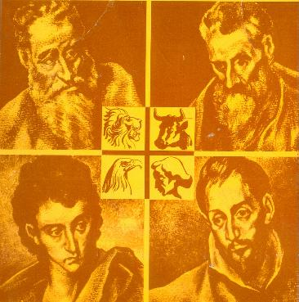
PASIAN IN ZEISU SUNGAH KILAK (EMMANUEL)
“Kuamah in Pasian mu ngeilo hi. Pasian tawh a kinai pen, Pasian mah ahi Tapa khat bek in Pasian hong kilanghsak hi.” (John 1:18)
Pasian bangci bang ahi hiam cih i theih nopleh, Zeisu i theih kul hi. Ama pen mihing a piang Pasian ahi hi (Johan 1:14), eite in amah i muh theih nading leh i zak theih nadingin mihing' pianzia la-in amah le amah a kilak ahi hi (John 1:18; 14:9; 1 John 5:20).
Ama pen a nuntakna tupna a lak genkholhna min khat tawh kigenkhia hi: Emmanuel, Pasian ei tawh om khawm (Isaiah 7:14; Matt. 1:23). Lungdamna Thu gelh mi lite in amah ei kiangah lam tuamtuam in hong lak uh hi.
Matthew
Judah mi khat panin Judah mite tungah
Mark
Judah mi khat pan namdangte kiangah
Luke
Gentile mi khat pan Gentilete tungah
John
Judah mite khat pan Namdangte tungah
Ama pen a kiciamna a tangtun sak Messia ahi hi
Mi dangte nasep sak ding a tawntungin a kiging gige
Cithei leh hehpihna nei
Pumpi leh kha nuntakna a pia

Slide 12

“Mi tul tampi in Pasian leh ama nunzia tungah ngaihsutna diklo nei uh hi... Pasian pen thutak Pasian ahi hi. Dikna le hehpihna in Ama tokhom ziate ahi hi. Ama in itna, hehpihna, le lainatna Pasian ahi hi. Tua bangin Ama pen i Honpa a Tapa munah kilang hi. Ama pen lungduaina le thuakzawhna Pasian ahi hi. I biak Pasian pen tua bang ahih a, ama nuntakna bang i sun nading i hanciam leh, Pasian taktak i bia ahi hi.”
EGW (God Cares for Us, August 8)

