Slide 1
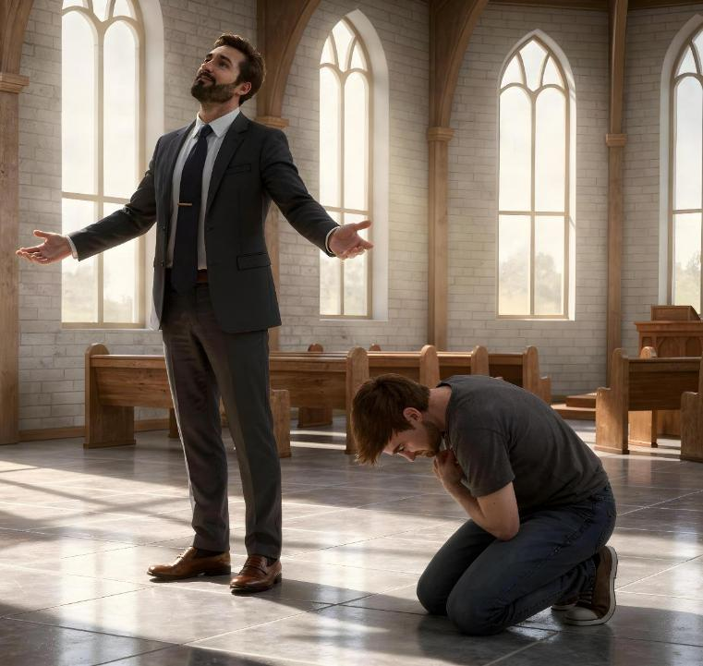
KIPHATSAKNA
LE
KINIAMKHIATNA
April 18, 2026 ading Lesson 3

Slide 2

“Banghang hiam cihleh amah le amah a kilamsang mi peuhmah kiniamkhiat ding a, amah le amah a kiniamkhiat mi kilamsang ding hi.”
(Luke 14:11, ZSV)

Slide 3


Kei tungah bang manpha om hiam? Tua pen dawn ding hamsa mahmah hi.
Kei le kei kiphat in thu tampi ka gen in, ka hihna khempeuh le ka neih khempeuh pen keima hanciamna bek tawh a ngah ka hihna (kiphatsakna) pom ka ahi hi.
Pasian in a tapa-in kei hong ngaihsut manin tampi gen leng bang hiam?
Bangmah pau lo-in ka om leh, ka hihna khempeuh leh ka neih khempeuh Pasian' kiang pan ahihna ka phawk hi.
Kei le kei kimuanna ka neihloh manin bangmah gen kei leng bang hi ding hiam?
Kiphatsakna ettheihdingte
Lucifer
Zeisu nungzuite
Kiniamkhiatna ettheihdingte
Siahdongpa
Moses
Zeisu, etteh ding cing taak pen

Slide 4


KIPHATSAKNA ETTHEIHDINGTE

Slide 5





LUCIFER
“Banghang hiam cihleh pumpi deihna, mit tawh mu-in i deihte, leh mite' kisaktheihpih nate ahi leitung nate khempeuh pen Pa Pasian tawh a kizom thu hilo a, leitung tawh a kizom thu ahi hi. ” (1 John 2:16)
Kiphatsakna thu i genleh, hih lungsim a neimasa penpa Lucifer thu i gen ding ahi. Ama in a dinmun tawh lungkim lo-in, a sang zaw dinmun ah kah dingin khensat hi. A sawt ciangin, amah leh amah kisang sak nuam mahmah a, Pasian' tokhom mahmah luah ding hial a lunggulh hi (Isaiah 14:12-14).
I deih bangbang hih nopna, i deih khempeuh neih nopna, leh minthanna leh hauhna i ngah theih nading dinmun ngah nopna lungsimte i luahkhia hi. Tua pen leitung in eite a hong piak ahi hi!(1 John 2:16).
Ahih hangin lunggulhna khempeuh kisatheina hilo hi. Tate gualzawhna panin a kingah lungkimna, ahih keileh mimal tupna tupna pan a kipiang lungkimna pen a hoih lo kiphatsakna hi kinken lo hi.
I phawk ding thupi pen in, i neih i lamte, i siamnate, leh i hih zawhnate in i manphatna khensat lo hi, cih ahi hi. Kiphatsakna kici pen i nuntakna sungah Pasian in a sepnate hangin ama tungah minphatna piak lohna ahi hi.

Slide 6



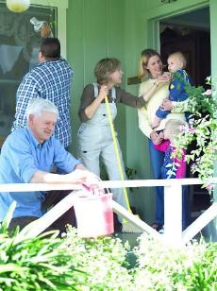

ZEISU NUNGZUITE
“Nungzuite lakah kua a lian penin kingaihsun ding, ci-in kiselna thu hong piang hi.” (Luke 22:24)
Amaute Zeisu tawh kum thum val om khawm uhhi. Ama in amau kheteng silsak khin pan a, mi khempeuh a dinga a kibuakhia a sisan thu amau hilh hi. Ahi hangin, nitak an a nek laitak un, amau thukikupna in hih thute tawh kisai het lo hi: amau lakah kua pen lian pen hiam? (Luke 22:24).
Amaute' kiphatsakna in a sang pen mun a ngah ding kilawm hi ci-in a ngaihsunsak hi. Amau' lungsim thupitna amau a telzo kei uh Amaute in amau kiphat sakna hangin Pasian amau lungtang pan nawlkhia uh hi.hi.
Zeisu in a thugen kician takin gen a: "Kei pen note lakah na sempa bangin ka om hi" (Luke 22:27). A dangin gen leng: na Siapa bangin na lian nuam ahihleh, midangte' nasep sem in.
I kiphatsakna in midangte'n hong sepding i sang hi (amaute sangin i hoihzaw hi) ci-in hong hilh hi. Kiniamkhiat nasemte i suah nadingin Pasian' hehpihna i kisam hi.

Slide 7


KINIAMKHIATNA ETTEH DINGTE

Slide 8





SIAHDONGPA
“Ahi zongin siahdongpa pen a gamla simah ding a, vantung lamah zong dak ngamloin a dip humin kuncip a, 'Pasian aw, kei mimawh mi khialpa hong hehpih in,' ci-in a ngen hi.” (Luke 18:13)
Siahdongpa in amah mawhnei khat ahih manin Pasian kiangah huhna ngen hi. (Luke 18:13). Pasian' mai-ah kiniamkhiatna tawh a kilatna hangin, amah "thuman kici-in a in-ah ciah hi," banghang hiam cihleh, "amah le amah a kiliansak khempeuh kiniam khiat ding a, amah le amah a kiniam khiat khempeuh kiliansak ding hi” (Luke 18:14).
Pharisee khat in a nasep hoih nate le Vantung mai-ah a phat na thute Pasian kiangah a gen hi. Ahih hangin Zeisu’n Pasian kiangah hilo-in, amah le amah thu kingen ahihlam gen hi (Luke 18:11-12). Kiphat sakna lim a kicing mahmah khat.
Kiniamkhiatna taktak pen i mawhnate i phawk a, Khazih' huhna i ngetciangin kipan hi. Tuakhit ciangin...
Midangte neu bawl in i en kei ding hi (Phil. 2:3)
Mipi’ theihpihna i zong kei ding hi (Luke. 14:7-11)
Midangte in pahtawina hongpiak ding i ngak ding hi (Pau. 27:2)
Pasian’ hehpihna i ngah ding hi (James 4:6)
Tua hehpihna midangte tungah i pia ding hi (1 Peter 4:10)

Slide 9

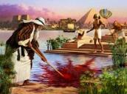






“Moses a gol ciangin Pharaoh’ tanu’ tapa kicih ding a ut nawnloh ngamna zong upna hang mah ahi hi. Tomno sung mawhna sungah nuamtakin omding sangin Pasian’ mite tawh gimna thuakkhawm ding a ut zaw hi.” (Hebrews 11:24-25)
MOSES
Moses pen Egypt gam uk Pharoah hi dingin kisinna nei hi. Ama pen thu khen sat siam mahmah khat ahi a, pilna thuk pi a nei khat zong ahi hi (Sawl. 7:22). Kum 40 a phak ciangin, hih khempeuh nusia-in ama mite tawh kigawm dingin khensat hi. (Hebrews 11:24-25).
Ama pen suahtaksak dingpa hi! A hatna in a sanggamte suahtaksak ding sawm hi! Tua in khialhna lianpi khat hi. Pasian in tua bang kisaktheihna a neih lai-in amah zang theilo hi.
Gamlak ah Pasian tawh kum 40 a kithuahna in amah mi kingiamkhiat mah mah khat suaksak hi (Gam. 12:3). Tu-in Pasian in amah zang thei ta a; hak satna khak nading; tuipi kan nading; thukham sawm san nading; Pasian tawh maituah-in holim nading; suangpi dawt nadingin zang thei ta hi... Ama in a kisaktheihna hanga gimna pen niamkhiatna tawh sang theita a, a sepna khempeuh ama’ mawhpuakna la hi. (Gam. 20:10-12).
Moses' nuntakna panin kiniamkhiatna ei sung pan a piang khia hilo-in, ni simin Pasian kiangah tua kiniamkhiatna hong piak nading i nget ding a thupit lam i mu hi.

Slide 10






ZEISU, ETTEHDING CINGTAAK PEN
“Amah hong kiniamkhiat tawm a, singlamteh tung nangawn ah sihding a ut hi” (Philippi 2:8)
Hih leitung ah kua mah in Zeisu mihing a suah ma-a a neih thupitna bang nei ngeilo a, nei ngei mahmah lo ding hi. Himahleh eite a ding itna hangin amah in na khempeuh nusia hi. Tua bang niamkhiatna tawh kituak in, i neih khempeuh, i hihna khempeuh, i hih theihteng khempeuh pen tehpih tham lo hi.
Zeisu in mihingte aadingin si dingin Vantung nusia a, ama hehpihna i theihsiama amah tawh kizopna ding ama sapna i dawn nading lamen-in ahi hi (Phil. 2:5-8). Amah pen lunghian’ nang om het lo-in, kiniamkhiatna enteh ding a cing pen ahi hi.
Khazih Zeisu sungah a om lungsim bang mah note sungah zong om tahen (Phil. 2:5).
Ama lim zui-in, angkhualna le kisatheina tawh bangmah sem kei unla, ahi zongin kiniamkhiat na tawh midangte amah sangin thupi zaw-in ngaihsun ciat ni. Mi khempeuh in ama noptuam nading bek en loin, midangte noptuamna ding zong a en ding hi uhi” (Phil. 2:3-4).

Slide 11

Topa aw, ka lungsim khempeuh tawh nangma tungah lungdamna kong ko a, pasian-te' mai-ah nangmah phatna ka sa hi.
Na biakinn siangtho lamah kei ka kun a, na itna kip le na thumanna hangin na min kong phat hi. Banghang hiam cihleh na dang khempeuh sangin na min le na thu a liatzawkna na lak hi.
Nang kong sap ciangin kei nong dawng a, na thahatna tawh kei nong thakhauhsak hi.
Topa aw, leitung khempeuh in na thuciamnate za khin uh ahih manin nang hong phat ding uh hi.
Topa' minthan'na lian mahmah ahih manin amaute in Topa' nasepna ziate la-in sa ding uh hi.
Bang hang hiam cihleh Topa lian mahmah napi-in amah in a neute don a, a kiphasakte ahihleh amah in gamlapi panin mu thei veve hi.
Haksatna tuamtuamte ka thuak ciangin kei nong kem hi. A heh ka galte, kei' tangin nong dosak a, na thahatna tawh kei na hong honkhia hi.
Topa in kei-a' dingin a ngaihsutte hong tungsak ding hi. Topa aw, na itna kip tawntung hi.
Late 138 ZIV

Slide 12

“Ama le ama kingaihsutna, ama le ama kiliansakna, leh kiphatsakna sungah hatlohna lianpi om a; ahi zongin kiniamkhiatna sungah thahatna lianpi om hi. I kipiakna taktak pen eimah le eimah i kingaihsut pen ciangin kikem zolo a, ahih hangin i ngaihsutna khempeuh ah Pasian om-in, i Honpa leh i mihing pihte tungah itna tawh i lungsimte a tawn ciangin ahi hi. Gamtatna olno le lungsim kiamna in lungdamna pia ding a, ahih hangin kisatheina in lungkimlohna, phunphun-na le beidong tawntungna piangsak ding hi. Ei le ei kingaihsutna kiam sak a, midangte lungdamna ding i ngaihsut zawhna in Pasian' thahatna i ngahna ding ahi hi.”
EGW (Testimonies for the Church, vol. 3, p. 476)

