Slide 1

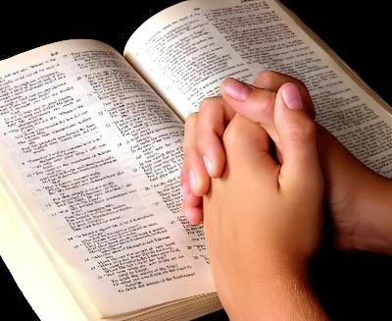
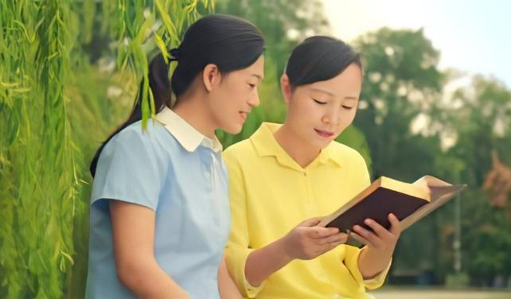
LAI SIANGTHO KOICI SIMDING
May 2, 2026 ading Lesson 5

Slide 2
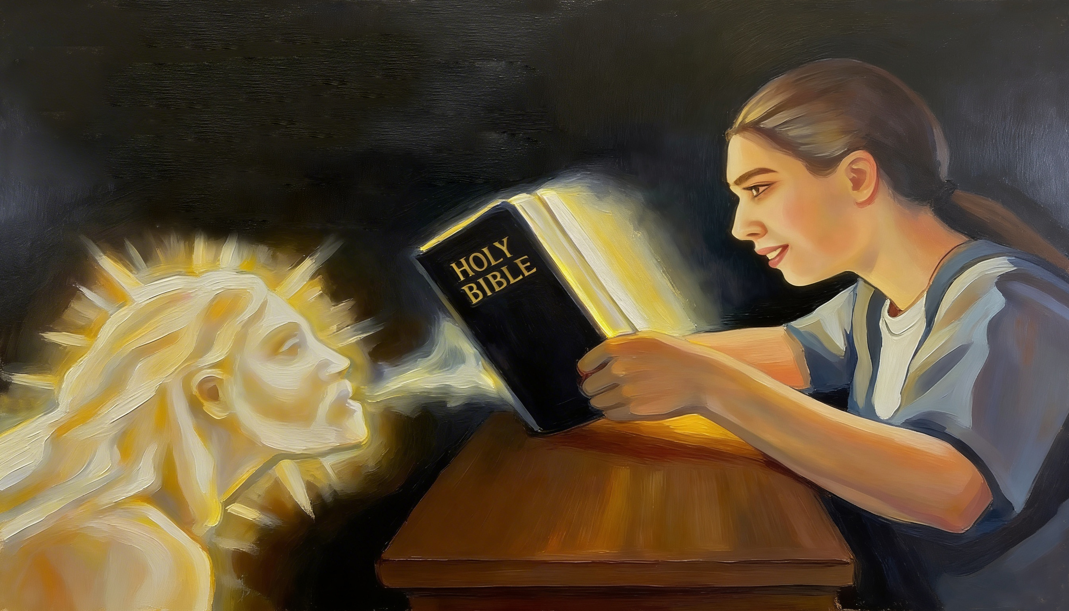
“Ka kam panin a pusuak ka kammal zong tua bang ahi ding hi. Kei kiangah a hawmpi in hong kilehkik lo ding a, Ka geelna tangtung sakin, Ka sawl thu semkhia ding hi” (Isaiah 55:11, ZSV)

Slide 3

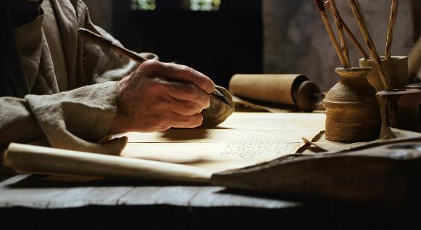

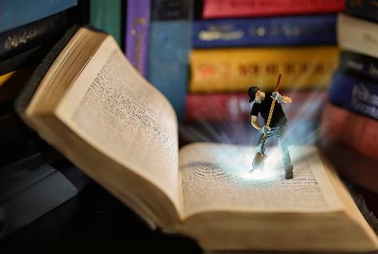
“Pasian’ mi siangtho te in Kha Siangtho sawlna ngah in genkhia uh hi” (2 Peter 1:21), amaute’ thupuak pen Lai Siangtho’ sungah kiciamteh hi.
Hih mun ah luntakna, lametna, hehnepnate a hong pia suangmanpha te i mu thei hi, ... Pawlkhat te pen etpak tawh a kimuh theih hangin, pawlkhat pen hoih takin kantel kul ahi hi..
Lai Siangtho ah Pasian hong geelsak hih a manpha thute koici pholhkhia thei ding i hiam, tuate i sim man in bang hamphatna ngah ding i hiam?
Lai Siangtho koici simding:
Ahun
Amun
Asepzia
Lai Siangtho sim manin hamphatna:
Hawmkhiat man in hamphatna
Tua neekna phattuamna

Slide 4

LAI SIANGTHO KOICI SIMDING

Slide 5

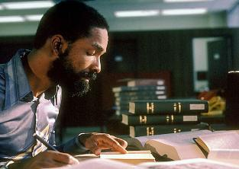
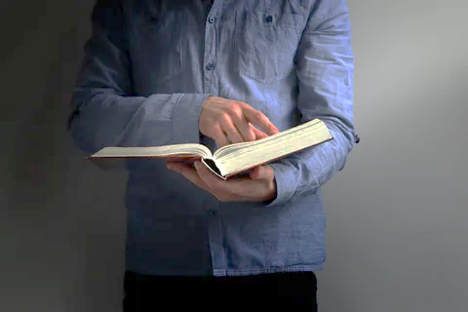

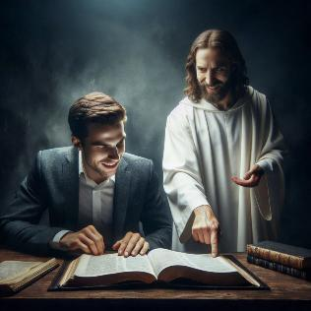
AHUN
“Note in kei nong zong ding uh a, na lungsim khempeuh uh tawh nong zon’ uh ciangin nong mu ding uh hi.” (Jeremiah 29:13)
Lai Siangtho sim ding hun hoih pen bang hun hiam?
Thu nih ngaihsun kawm in eite’ dawn’ kikna telkheh ding hi hang: ahun sepna le ahoih sepnate hi.
Minute nga bek hun i piak sangin Lai Siangtho i sim nading hun i geelna ah nai khat i ciangtan na in hamphatna ngah zaw tham ding ahihna kimu thei hi.
Ahizongin, eite in simding hun i piak pen a tung tham bek sim zual ding hilo hi. Himun ah eite’ lungsim puak in a thupi pen suak hi. Ken’ bang hangin Lai Siangtho sim ka hiam? Thu thang tuamtuam zong ka hiam, ahihkeileh Pasian thu thuuk theih nopna lungsim nei ka hiam?
Pasian tawh omkhop ding hun hita ahih manin eite Lai Siangtho simna pan in a hoih pen i ngah thei hi (Jer. 29:13), Amah sungah lungkimna (Late 37:4); eite adingin a tuam vilvel Pasian thupuak himun ah kimu thei hi.

Slide 6





AMUN
“A zingciang phalvak ma-in Zeisu tho-in gamdaihna mun khatah na pai-in thu a ngen hi.” (Mark 1:35)
Zeisu in Pasian tawh a tuam vilvel in kizop nading hun a deih ciangin zingsang tung’ gamdaihna mun zong tawntung hi (Mark 1:35). Hih pen thungetna le Lai Siangtho simna a nih in kizangh thei hi.
Gamlum’na mun ahihkeileh mi tampi omna mun te ah lai i sim ciangin lunglut ding hamsa hi. Lung muan om theihna, daihna le a tuam om munte ah tua bang hihna pen baih zaw hi.
Gamdaih hun a om pen ni khat i amasa pen ahih keileh a nu’nung hun pen in i ngaihsut nate Pasian tawh lunglut takin kizop theih nading hunte hithei hi.
A kilawm kituak hun le mun i ngah khitciangin, hih pen ngeina nasep khat bangin sem ni. Vai khatpeuh hangin hih hunte pelh kha thei ding hi hang, ahizongin nisim Lai Siangtho simlo-in na hun tampi bei sak kei in.

Slide 7



SEPZIA DING (1)
“Keima kam panin a paikhia ka thu zong tuamah bang ding hi. A hawmpi-in kei kiangah hong tung kiklo ding a…” (Isaiah 55:11)
Lai Siangtho thuuk takin kan na ah khen li om hi.
Thungen
Lai simna le theihtelna [sepziading theihsakna]
Thungen
Hawmkhia
Na sim ciangin Kha Siangtho in hong lamlak dingin sam in
Lai Siangtho sunga laigual ahihkeileh a taang khat teel in
Na sim te natel theih nadingin Amah in na lungsim le na lungtang hong lawng ding hi
Na lungtang sungah a teeng dingin gelh in
Adeihna bulpite lailam giit in
Adiak in ngaihsutna hong tha hatsakte gelhkhia in
Na sin thute zat khiat nading Pasian kiangah huhna ngen in
Na sin thute kua tung ah hawmkhia ding cih ngaihsun in

Slide 8

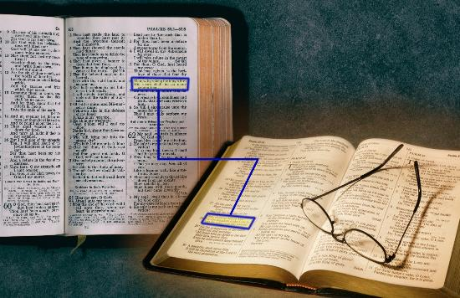
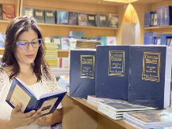
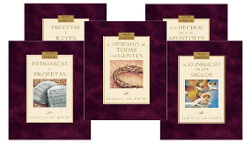
SEPZIA DING (2)
“Keima kam panin a paikhia ka thu zong tuamah bang ding hi. A hawmpi-in kei kiangah hong tung kiklo ding a…” (Isaiah 55:11)
Adang Lai Siangtho sim zia dingte
Taang khat le taang khat etkaak ding (Isaiah 28:10)
Alian te ahihkeileh a bu khempeuh simding
Kituak tak a kipanpihna tawh thulu ahihkeileh kammalte simna
Lai Siangtho hilhcian nate ahihkeileh laimal zui-in simna
Ellen White in a gelh “Conflict of the Ages” series panin laigualte tawh simkhawm in

Slide 9

LAI SIANGTHO SIM MANIN HAMPHATNA

Slide 10






HAWMKHIAT MANIN HAMPHATNA
“A lunggim mite ka thahatsak thei nadingin Topa Pasian in ka gen ding thu hong hilh khin hi. Ama hong hilh nate a ngai dingin Zingsang simin lawpna hong guan’ hi.” (Isaiah 50:4)
Sabbath ni biakpiak hun adingin sermon khat kiging dingin nang hong kingen hi. Kha Siangtho in na teel nadingin a hong thapiak thulu khat thungetna tawh sin dingin hun kikhia khat na zang hi. Sabbath ni-in vangliat na tawh thugen na nei hi. Hih thugen panin kua in phattuampih pen ding hiam?
Laisiangtho sinna midangte tawh i kikum khawm – thugenna ah hitaleh mimal khat le khat kithuzakna ah hitaleh – in phatna nihvei nei hi.
Amasa in, i sinsate panin i phattuampih hi. Nihna ah, hih theihna i kikhawmpih mite in phattuampih uh a, tua theihna sungah thuk zaw sema luh nadingin thapiakna ngah uh hi.
Tua dinmun nih lian ah, Pasian tawh kizopna kipsaksem in thuksem hi. Pasian' Kammal thahatna in tua bang ahi a, "keimah kiangah a thawnin hong kileh kik lo ding hi. (Isaiah 55:11).

Slide 11

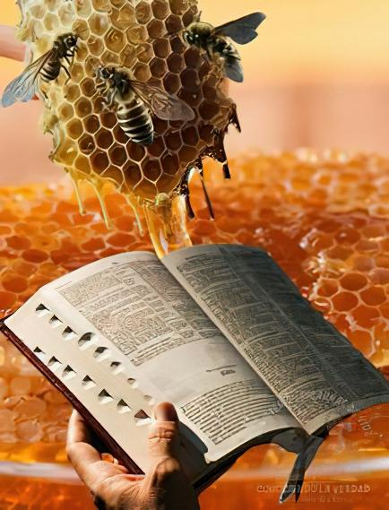

TUA NEEKNA PHATTUAMNA
“Nangma thute khum mahmah a, khuaizu sangin khumzaw hi!” (Late 119:103)
Pasian' Kammal i nek ding kul hi. (Jer. 15:16)!
Khuai-zu sangin khumzaw mahleh, a taktak-in a ne ding hilo hi (Late 119:103). Lai Siangtho simna in kha ading an ahi a, i kha damsak in i nuntakzia a laih thahatna taktak ahi hi.
Tua tham lo-in, hih an a khawng hi (Isaiah 55:1)!
Lai Siangtho tawnin Pasian in eite kiang a hong genna te i naih a, i ngaihkhiat ding bek kisam hi (Isaiah 55:3). A laimai sungah hun i zat zat leh (simna), tha i ngah semsem ding a, thupha zong i ngah semsem ding hi.
" Mihingte' pilna bang zah in khangto mah leh, khuavak thukzaw ngah nadingin Lai Siangtho thukpi le zonzon a kan ding a kisapna om nawn lo hi ci-in khatvei zong ngaihsun kei hen. Minam khat hihna tawh, eite in kamsang sangnaupangte ahi dingin mi kim sapna i ngah hi” Ellen G. White, Counsels to Writers and Editors, p. 41

Slide 12

“Laisiangtho sim lelna in Vantung in a deih bang gualzawhna piangsak zo lo ding hi; sin ding le lungtang sungah it taka kepcing ding ahi hi. Pasian theihna pen lungsim hanciamna kihello-in kingah lo hi. Pasian' Thu i tel theih nadingin Kha Siangtho huhna ngenin Pasian kiangah i nget kawm in, Bible thuhilhnate kuhkal takin i sim ding hi. Tang khat i la-in, tua tang sungah Pasian in eite adingin a koih ngaihsutna kician takin i theih nadingin i lungsim i thum ding hi. […]
Pasian' Kammal pen nuntakna an ahi hi. Hih Thu a ne-a, a zan’sak, amau' gamtatna khempeuh le mizia khempeuh ah a zang mite pen Pasian' thahatna tawh khangto-in khauh ding uh hi. Tua in kha ading si theilo hatna pia a, thumuhna kicing sak-in, tawntung a kip ding lungdamnate hong ngahsak hi.
EGW (Lift Him Up, April 7)

