Slide 1

UPNA NEI
May 23, 2026 ading Lesson 8

Slide 2

“Tu-in upna in i lamet nate tungah lungmuan’na le a kimu nailo nate telcianna ahi hi.”
(Hebrews 11:1, ZSV)

Slide 3






Pasian theihna, Lai Siangtho sinna, le thungetnate i nuntakna ah kikhelna a piangsak thei thute ahih nadingin thukhat neih kul hi: upna.
Upna om lo-in, hih thute pen theihna lel ahihkeileh khiatna neilo biakna ngeina lel suak hi.
Ahi zongin upna tawh, tua te in i kha lam nuntakna a sang pen mun ah hong tunpih ding thahatna thupi takte ahi uh a: "a um mi khempeuh a dingin bang khempeuh hi thei hi" (Mark 9:23).
Upna nam tuamtuamte:
  Upna le ciaptehnate
  Upna tehna
  Upna le lungsim phawngna
Upna icih bang hiam?
  Upna hilhcianna le khantohna
  Zeisu upna

Slide 4

UPNA NAM TUAMTUAMTE

Slide 5
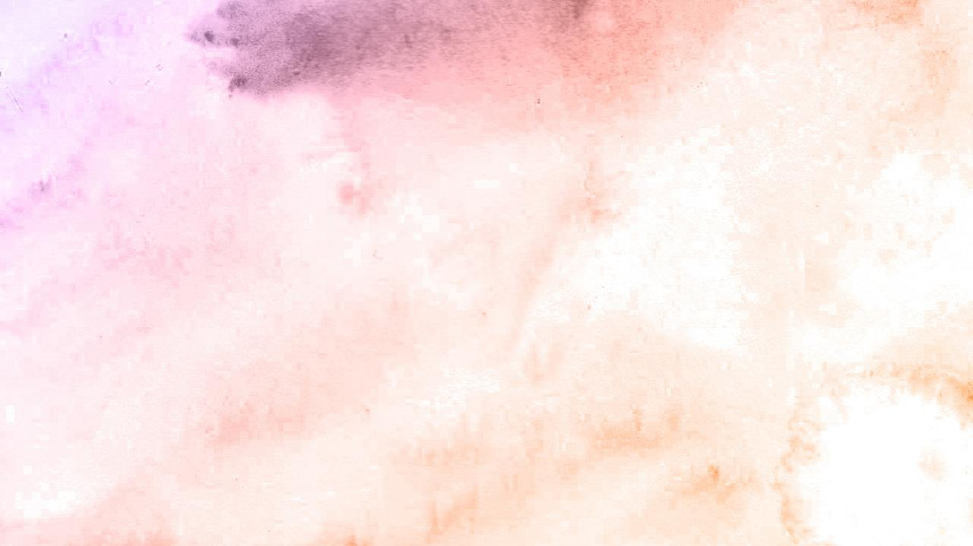




UPNA LE CIAPTEHNATE
Zeisu in ama kiangah, "Note in lim le na lamdang lian ka bawl na muh kei uhleh Topa ka hihna thu na hong um kei ding uh hi" (John 4:48)
Ciaptehna kici pen thupuak khat thukip nadingin ahih keileh Pasian' thu neihna thukip nadingin lahna ahih keileh ciaptehna tuam deuh khat ahi hi. Ciaptehna kici pen thulamdang khat hi-in kingaihsun himahleh—Cana khua-a mopawi bangin (John 2:11)—Israel mite in Pasian bia dingin Sinai Mual mai-ah phual a satna uh thu (Pai. 3:12) zong ciaptehna khat mah in kipia hi.
Phariseete in Zeisu kiangh ah “Messiah na hihna ka up theih nading un teci nalamdang khat hong lak in” ci-in ngen uh hi (Mark 8:11).
Amau in upna a neih lohna uh hangin lim le ciaptehna a ngen uh ciangin Zeisu lungsim gim mahmah hi (Mark 8:12). Mi khat in a up keileh, lim le vang khat zongin a lungsim zozo lo ding hi.
Pasian in Ama Thu le piansak nate sungah teci kicing takin pia khin a, a um nuam khempeuh in a up theih nadingun lampi kicing om hi. Ahizong in uplahna om gige hi. Tua ahihmanin Zeisu in “mulo napi-a a umte” tungah thupha tuam piak hi (John 20:29).

Slide 6



UPNA TEHNA
Topa in, "Ankam tang cia a pha upna nei le uh cin, hih nailung kung kiangah, 'Kizung lot inla tuipi sungah va po in,' cile uh cin nacih bangun piangzo ding hi.” (Luke 17:6)
Upna tehna nam tuamtuam a om hi:
Sawltakte upna
Peter’ upna
Pa’ upna
Canaan numeinu upna
Centurion’ upna
Stephen’ upna
“Banghang in upna neilo na hiam?” (Mark 4:40)
“Upna neu note aw!”
(Matt. 14:31)
“Ka uplah na huh hong huh in” (Mark 9:24)
“Na upna lian hi”
(Matt. 15:28)
“Israel mite lakah hi bang upna lian kamu nei kei hi” (Luke 7:9)
“Upna kidim mipa” (Sawl. 6:5)
Uplahna zungte botkhia ahih ciangin upna khangthei hi cih kician mahmah hi. Upna in uplahna damdam in zo ding hi. I ngetna hi bang hi: “Ka upna hong khang sak in” (Luke 17:5).
Kha Siangtho nasepna, Lai Siangtho sinna, le Pasian tawh i kithuah khaknate tung tawnin, “i upna khang hi" cih i mu thei ding hi. (2Th. 1:3).

Slide 7

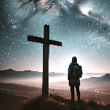


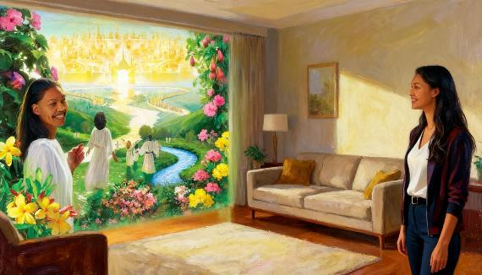
UPNA LE LUNGSIM PHAWNGNA
“Note' upna hangin Pasian' hong hehpihna tawh hotkhiatna a ngah na hi uh hi. Note' thalawhna hangin a ngah hiloin Pasian' hong piakkhong ahi hi.” (Ephesus 2:8)
Upna pen lungsim phawngna pan maw, ahihkeileh ngaihsutna tawh sepna ahi hiam?
Hih dotna a dawnna pen thupi hi. "Hotkhiatna nei KISA ing" cihleh "Hotkhiatna nei cih KA THEI hi" cih pen kibang lo hi.
Ahih hangin a kipatna pan kipan ni. Upna kipatna bang ahi hiam? Upna pen Pasian' kiang pan hong pai hi a, amah in letsong bangin ei hong pia hi (Rom. 12:3; Eph. 2:8).
Tua letsong tungah lungdamna tawh i dawn ciangin—upna i zat ciangin—tua upna in i sungah lungdamna bang lungsimte piangsak hi; daihna; khalam tawldamna phawkna; …
Ahi zongin upna taktak pen lungsim sunga om thu khat hilo-in, "muanna" le "kicianna" ahi hi (Heb. 11:1). I lungsim omzia tungah kinga thil hi lo hi. Ka thanem hun, ahih keileh hotkhiatna gamla lua ka kisak hun, tua hun pen upna neih mahmah hun ding ahi hi.

Slide 8

UPNA ICIH BANG HIAM?

Slide 9




UPNA HILHCIANNA LE KHANTOHNA
“Upna nei i cih ciangin i muhtheih nailoh i lamette ngah takpi ding, ci-in muan'na lungsim neihna ahi hi.” (Hebrews 11:1)
Upna zang in, aneu phail zongin (Matt. 17:20)
Lai Siangtho sim in (Rom. 10:17)
Pasian kiang ah behlap dingin ngen in (Luke 17:5)
Uplahna ah lungkia kei in (Mark 9:23-24)
Ka upna midangte tung ah nga ken (Matt. 25:8)
Kha Siangtho dawnna (Gal. 5:22)
Ka upna mantakin zang (2 Cor. 5:7)
Hebrew 11:1, 3, le 6 in upna kicih bang hiam cih kician takin honglak hi. Upna in Pasian i ngaih sutna tawh kisai mahmah hi. Tua in eite Ama tungah Paiangsakpa le Thaman piapa ci-in upna hong neisak hi.
Hih khen a omlai khempeuh ah, Paul in thupha i ngah ding i ngak laitak lungkiat loh na dingin, etteh ding le tha lakna ahi ding pasal le numei tampite’ upna thu gen hi.
I muhsa mah bangin, upna i neih dan i vekpi in i kibang kim kei hi. Ka upna a tawm hitaleh a tam hitaleh, bangci bnagin khang sak thei ding ka hi hiam?

Slide 10




ZEISU UPNA
“Pasian’ thupiakna zui-in Zeisu tungah a citak Pasian’ mite-a’ dingin thuakzawhna kisam hi.” (Mangmuhna 14:12)
Zeisu hong paikik ding hun tawh a kinai-a a nungta upna a nei mite in, i "kem" (zuih ding ahih keileh cin ding) ding thu nih tawh kilamdangna i nei hi: Zeisu thupiakte le upna
(Mang. 14:12).
Thukham (thupiakte) le Lungdamna Thu (upna) pen kigawm hi. Upna neilo-in thumang theilo a, thumang lo-in zong upna kici theilo hi. Ahih hangin “Zeisu' upna" kici pen bang cihna hiam?
Zeisu le Ama kammal tungah thumang un
Zeisu tawh nisimin kithuah khakna neihna
Zeisu i nuntakna laizang ah koihna
I upna zui-in nungta ding
I upna Zeisu tungah bulphuh ding
I nuntakna ah Zeisu langhsak ding
Ama hehpihna letsong sang in
Zeisu i upna hangin dikna ngah (Rom. 5:1), siangtho i ngah a (Sawltak 26:18), le Pasian' tate cihna i ngah hi (John 1:12).

Slide 11

“Tua ahih ciangin, lampi dik sungah sialsial in nangmah hong makaih nadingin Topa Zeisu muang in. Na kalsuan totohna khempeuh ah muanna le thahatna na ngah thei hi, banghang hiam cihleh na khut pen Ama khut sungah om hi cih na muang thei hi. Na tai hangin na gim kei ding a, na pai hangin na thazawm kei ding hi; banghang hiam cihleh upna tawh Khrist khut sungah na khut a omna na phawk thei hi. Lungkiatna sungah na tum kei ding hi, banghang hiam cihleh Topa na theih semsem nading na zuih a, Ama tungah muanna na ngak ciangin, Ama tungah a muang taktakte a nusia ngeilo Pa in na panpihpa tawntung ahihna muanna na nei ding hi.”
EGW (Our Father Cares, October 27)

