Slide 1
IMPI NGEMUVA KWEZIMPI ZONKE
Isifundo 1 ukulungiselela uMbasa 6, 2024

Slide 2
“Kwase kuba khona ukulwa ezulwini: uMikhayeli nezingelosi zakhe balwa nodrago; Nodrago walwa enezingelosi zakhe, kepha kabaze banqoba, nendawo yabo kayabe isafunyanwa ezulwini” (Isambulo 12:7, 8)

Slide 3
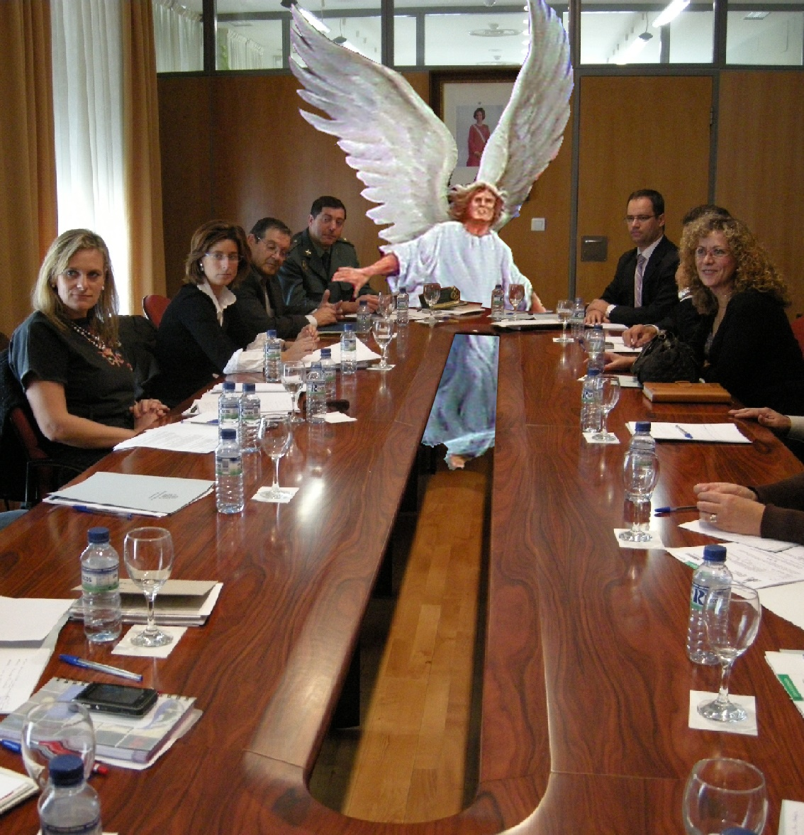
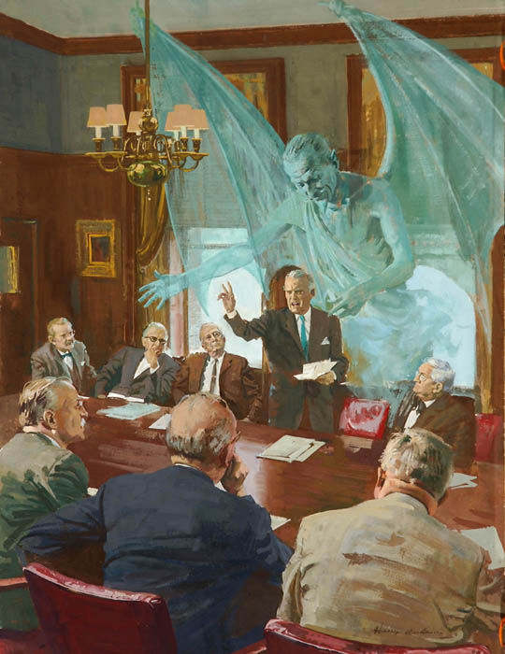
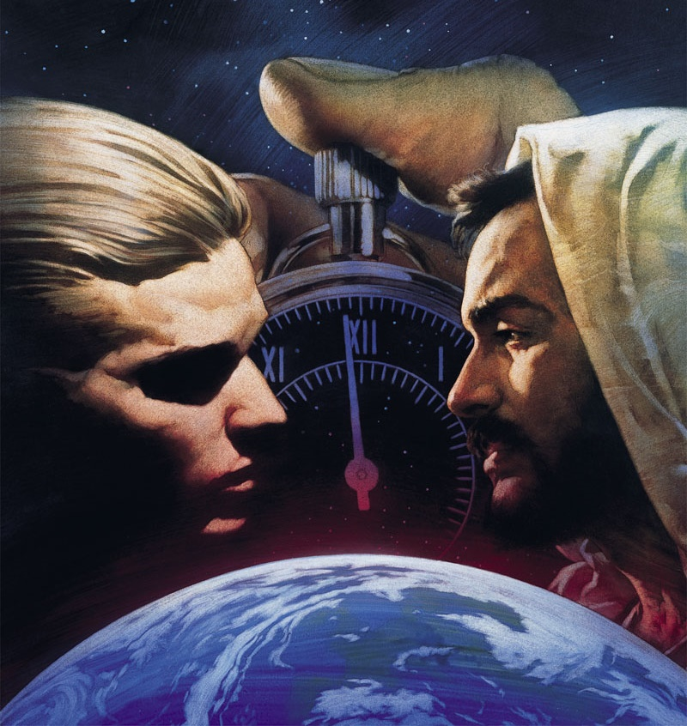
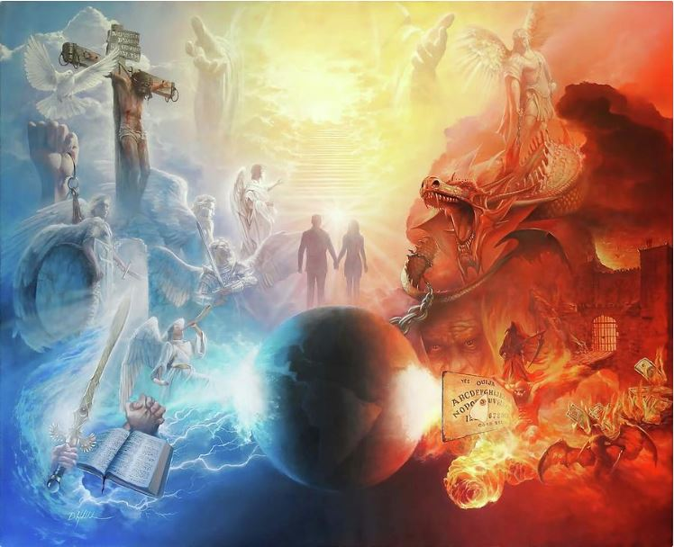
Siphila siphakathi kwempi yasemkhathini kwamazulu. Uma singakuqondi lokho, noma singakholwa ukuthi kungenzeka, lempi ikhona ngempela.
Lamandla alwayo angakomoya, akabonakali kithi (Efesu 6:12). Kodwa, siyawuzwa umphumela wempi. Izinhlekelele, ukonakala kwesimilo, ukufa…
Okubangwayo ngumbuso kaNkulunkulu uqobo, ukwethembeka kwezingelosi kanye namazwe angawelanga esonweni. Namhlanje ukwethembeka kwakho nokwami kuyabangwa.
Isiqalo sempikiswano
Ukuhlubuka ezulwini
Ukuhlubuka emhlabeni
Uthando luyanqoba
Impi namhlanje

Slide 4
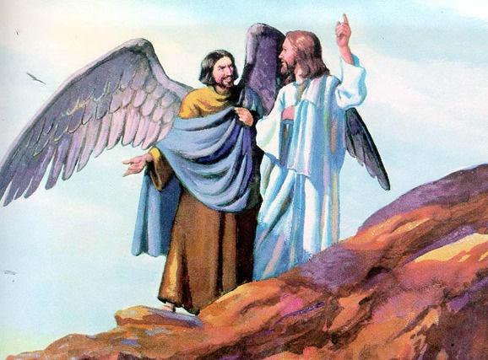
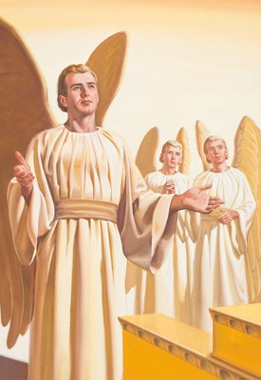
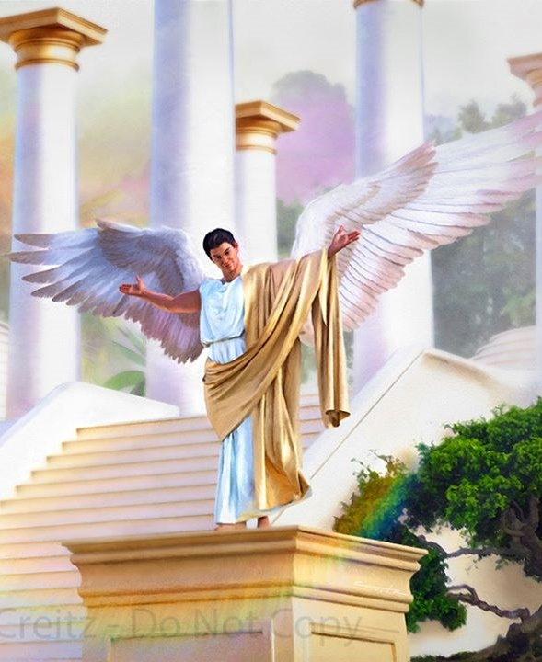
ISIQALO SEMPIKISWANO
“Wawuphelele ezindleleni zakho kusukela osukwini lokudalwa kwakho, kwaze kwafumaniseka ukungalungi kuwe” (Hezekeli 28:15)
Iqiniso lokuthi, e-Edeni, kwakunesidalwa esabangela ukuba u-Eva angamthembi uNkulunkulu, libonisa ukuthi ukuhlubuka kuNkulunkulu kwaba khona engakadalwa umuntu (Gen. 3:1).
UJesu wabiza lesi sidalwa esihlwanyela ukungathembani phakathi kukaNkulunkulu nabantu “ngesitha,” asichasisa ngokuthi nguSathane (Mt. 13:39).
Umbuzo wokuqala esingawubuza wukuthi: ngabe uNkulunkulu wamdala uSathane na, okungukuthi, ngabe uNkulunkulu wadala isidalwa esibi na?
IBhayibheli lisitshela ukuthi uSathane uyingelosi ebizwa ngoLusifa (Is. 14:12). Lena ngelosi yadalwa iphelele iyinhle (Hez. 28:12). Yabekwa esihlalweni esiphezulu kakhulu esingaba ngesengelosi: ikherubi elisibekelayo (Hez. 28:13-14).
Uma uLusifa wayephelele, waba kanjani nguSathane? Yaqala kanjani impi phakathi kwakhe noNkulunkulu na? UNkulunkulu wamnika, njengazo zonke izidalwa zakhe, inkululeko yokuzikhethela, kanjalo, uLusifa wakhetha ukuhlubuka, afune ukuthatha isihlalo sombuso kaNkulunkulu (Hez. 28:15; Is. 14:13-14).

Slide 5
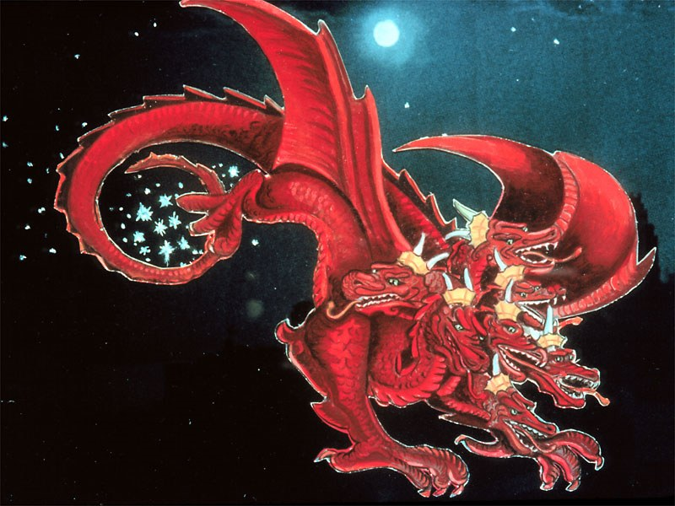
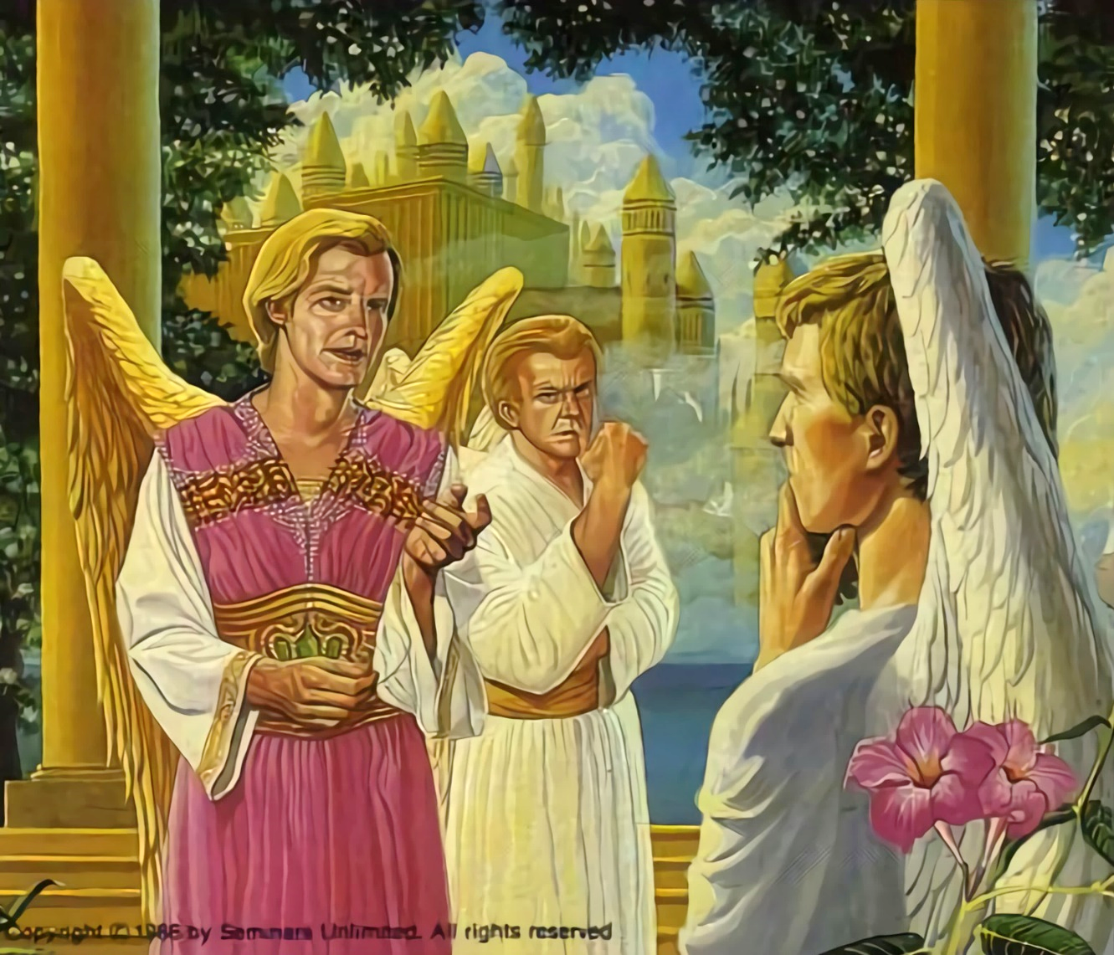
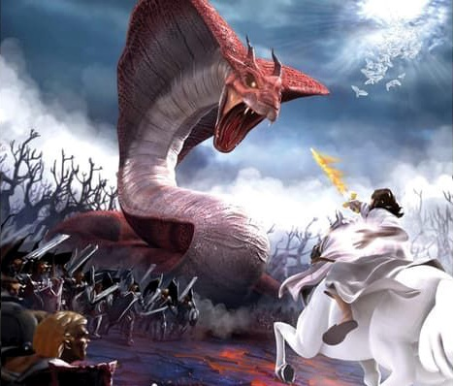
UKUHLUBUKA EZULWINI
“umsila wakhe wadonsa okwesithathu kwezinkanyezi zezulu, waziphonsa emhlabeni…” (Isambulo 12:4a)
Ngokulangazelela kwakhe ukuthatha umbuso wezulu, uLusifa waletha ukungabaza ezingelosini ngokulunga kombuso kaNkulunkulu. Zazingakhululekile zonke na? Kwakungani kufanele zithobele umthetho onzima, noma mhlawumbe ongalungile na?
ULusifa waba nguSathan, ummangaleli (Isamb. 12:10; Job 1:6, 9-10). Wenqaba konke ukumncenga kukaNkulunkulu kothando ukuba aguqule umqondo.
Ukuhlubuka kwaba yimpi ephelele, impi lapho yileyo naleyo ngelosi kwakumele yenze isinqumo. 1/3 yezingelosi zalandela uSathane, lapho ezinye zahlala zithembekile kuNkulunkulu (Isamb. 12:4a).
Namhlanje impi isaqhubeka. USathane usasebenza. Uzama ukuholela bonke abantu ekuhlubukeni uNkulunkulu. Kunezinhlangothi ezimbili kuphela. Labo abafuna ukuthobela umthetho kaNkulunkulu, noma abawenqabayo. Isinqumo ngesethu (Dut. 30:11, 16, 19; Josh. 24:15).

Slide 6
“UNkulunkulu emkhulu wayengamxosha umkhohlisi ngaleso sikhathi ezulwini; kodwa leyo kwakungeyona inhloso yakhe. Wayezonika abahlubuki ithuba elilingene ukubonisa amandla abo uma beqathaniswa naweNdodana yakhe kanye nawezingelosi ezithembekile. Kulempi yileyo naleyo ingelosi yayiyokhetha olwayo uhlangothi izibonakalise kuzo zonke. […] Uma uNkulunkulu wayesebenzise amandla akhe ukujezisa lengelosi ehlubukayo, izingelosi ezithintekile zazingeke zibonakale; ngakho, uNkulunkulu wenza ngenye indlela, ngoba wayefuna kubonakale kahle kuzo zonke izidalwa zasezulwini ukulunga kwakhe nokwahlulela kwakhe.”
EGW (The Story of Redemption, pg. 17)

Slide 7
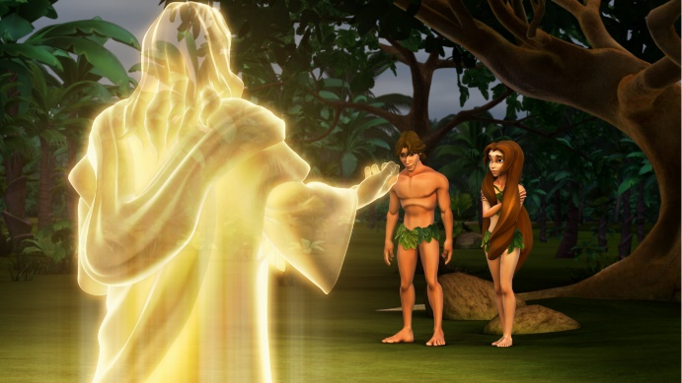
UKUHLUBUKA EMHLABENI
“Khona wathi, ‘Ngubani owakutshela ukuthi uhambaze na? Udlile kulowo muthi engakuyala ngawo ukuthi ungadli kuwo na?’ ” (Genesise 3:11)
UNkulunkulu wadala izingelosi ezingenasono, endaweni ephelele. Ngokunjalo, uNkulunkulu wadala abantu endaweni ephelele, engenasono (Gen. 1:31).
Njengoba kwakwenzekile nasezingelosini, uNkulunkulu nathi wasidala saba nelungelo lokuzikhethela ngokukhululeka. Ngakho, u-Adam no-Eva babengayisebenzisa lenkululeko, wabanika umyalo olula: “kepha ungadli kuwo umuthi wokwazi okuhle nokubi” (Gen. 2:17).
Lelo kwakuyilo lodwa iphuzu uSathane ayengabenza balingabaze. Ngobuqili, waphumelela. U-Adam no-Eva bamngabaza uNkulunkulu, bangamlaleli, basuka kumsuka wempilo (Gen. 3:6, 9-13, 19). U-Adam wavula umnyango wokungena kwesono, kanjalo ukufa kwandlulela kubo bonke abantu (Rom. 5:12).
Kusukela ngaleso sikhathi, siphila emhlabeni wobuhlungu, ukugula nokufa. Ngabe sonke sifela isono sika-Adamu?
Sonke sifela izono zethu: “ngokuba bonke bonile, basilalelwe inkazimulo kaNkulunkulu” (Rom. 3:23).

Slide 8
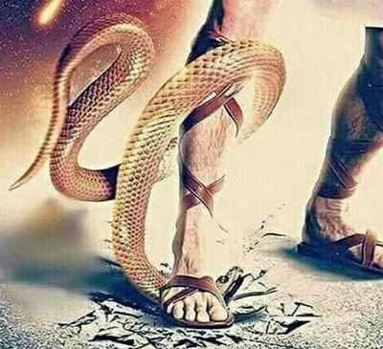
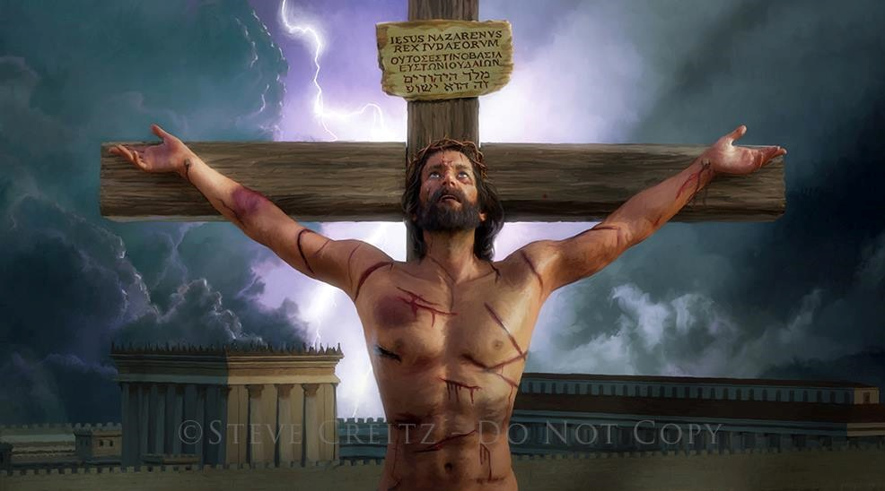
UTHANDO LUYANQOBA
“Uthando lukulokhu: kungesikho ukuthi thina samthanda uNkulunkulu, kepha ukuthi yena wasithanda thina, wathuma iNdodana yakhe ibe yinhlawulo ngezono zethu” (1Jn. 4:10)
Ngisho nangaphambi kokumemezela umphumela wokungalaleli, uNkulunkulu wakhuluma no-Adam no-Eva ukuthi wayenohlelo lokubahlenga (Gen. 3:15).
Abantu bazihlukanela ngokwabo noMdali wabo. Kodwa engabayeki abantwana bakhe abangalaleli, uNkulunkulu waveza isimilo sakhe sangempela ngokubathanda ngokungakholwakali (John 3:16).
Ukufa kwakungenasidingo sokuba yisiphetho sesoni. UJesu wabonisa uthando lwakhe ngokukhokha inhlawulo yesono ngempilo yakhe (Rom. 5:8).
Akukho lutho olukithina olwenza sifanelwe wuthando lukaNkulunkulu. Kodwa, ngeconsi ngalinye legazi likaJesu elacitheka eKhalvari, uNkulunkulu usitshela ukuthi: “Ngiyakuthanda.”

Slide 9
UTHANDO LUYANQOBA
“Uthando lukulokhu: kungesikho ukuthi thina samthanda uNkulunkulu, kepha ukuthi yena wasithanda thina, wathuma iNdodana yakhe ibe yinhlawulo ngezono zethu” (1Jn. 4:10)
UJesu wasibonisa kanjani uthando lwakhe?
UJesu wadala konke okukhona (Johane 1:3)
Waba yisidalwa (Johane 1:14)
Wandlula ebunzimeni, enhluphekweni, indlala kanye nobuhlungu, njengathi (Is. 53:3; Marku 11:12)
Walingwa njengathi (Heb. 4:15)
Engolungileyo, wahluphekela izono zethu ngokuthanda kwakhe (1 Pet. 3:18; Johane 10:17-18)
Ngokufa nangokuvuka kwakhe, wasiqinisekisa ngokuphila okuphakade kanye naye (Rom. 6:3-4)
Konke ngenxa yothando (1Jn. 4:10)

Slide 10
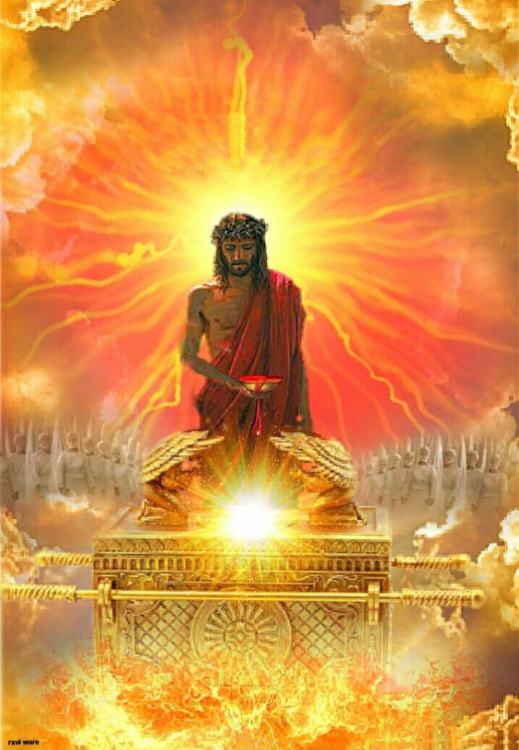
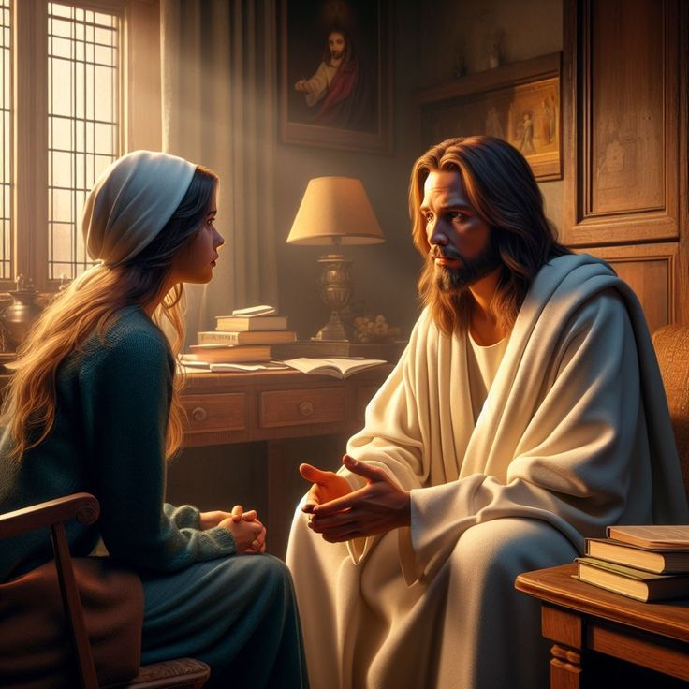
IMPI NAMHLANJE
“ngakho-ke, unamandla okusindisa ngokupheleleyo abeza kuNkulunkulu ngaye, lokhu ephilela njalo ukubamela” (Hebheru 7:25)
Namhlanje, uJesu uyasinxusela endaweni engcwele ezulwini (Heb. 9:24; 7:25).
Ngenxa yegazi lakhe elachitheka esiphambanweni, uJesu usimela phambi kukaYise – kanye nazo zonke izidalwa ezikhona – njengabalungileyo, nabaphelele, nabafanelwe yindawo ezulwini.
Ngakho-ke, simenywa ukuba sisondele kuNkulunkulu ngesibindi esiphelele ngoJesu (Heb. 4:15-16).
UJesu ufuna sithembele kuye ngezidingo zethu zonke empilweni yethu (Johane 14:13-14). Lapho kukhona uvalo khona, uletha ukuthula; lapho kunokuzisola, uletha intethelelo; lapho kunobuthakathaka, uletha amandla.
Ukulangazelela okukhulu kukaJesu kuwukuphila nathi phakade (Johane 17:14). Ingabe lokhu kungukulangazelela kwakho okukhulu na?

Slide 11
“Lapho izilingo zikuhlasela, lapho ukhathazeka, uhlupheka emoyeni, nobumnyama bubonakala bukuzungeze umphefumulo wakho, bheka ngalapho wawugcine kunokukhanya ngakhona. Uncike othandweni lukaKristu kanye nokunakekela kwakhe okuvikelayo. Lapho isono sizama ukubusa enhliziyweni, nokuzizwa unecala kuhlasela umphefumulo kusinde unembeza, lapho ukungakholwa kwemboza ingqondo, khumbula ukuthi umusa kaKristu wanele ukunqoba isono uxoshe ubumnyama. Ungene ebudlelwaneni noMsindisi, ungena endaweni yokuthula."
EGW (The Ministry of Healing, pg. 193)

