Slide 1
INGQIKITHI YENDABA:
UTHANO NOMA UBUGOVU?
Isifundo 2 ukulungiselela uMbasa 13, 2024

Slide 2
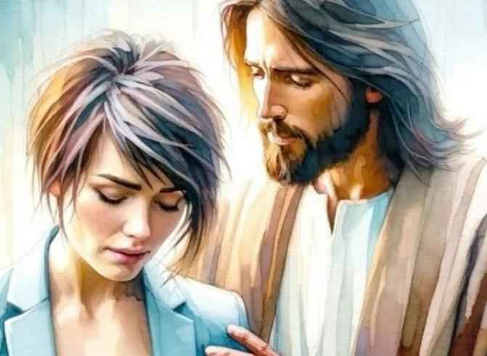
“ungesabi, ngokuba mina nginawe; ungapheli amandla, ngokuba mina nginguNkulunkulu wakho. ngiyakukuqinisa, Yebo, ngiyakukusekela ngesandla sokunene sokulunga kwami” (Isaya 41:10)

Slide 3
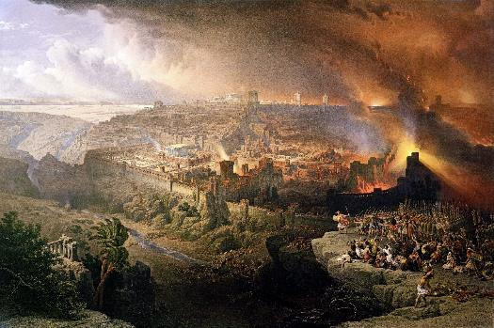
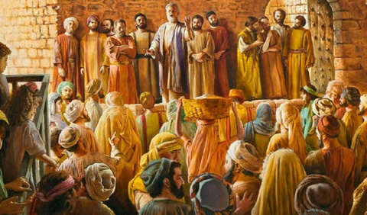
Umnyaka ka 70 wawusho ukuphela kuka-Israyeli njengesizwe. Yize kwakuyiRoma eyaqeda iJerusalema kanye neTempeli, neminye imibuso yayibandakanyeka kulempi.
Ngakolunye uhlangothi, USathane waholela u-Israyeli ekunqabeni uMesiya, wabese uba negunya lokubhubhisa isizwe.
Ngakolunye uhlangothi, uNkulunkulu waxwayisa ephindelela ngemiphumela yokumhlubuka; wanikeza isikhathi ngaphambi kokuba kwehle isahlulelo; walungisa abantu, ibandla, ukuba bathabathe isibane seqiniso bakhanyisele izwe ngomyalezo wothando lukaNkulunkulu.
Izifundo ngokubhujiswa kweJerusalema:
Ukwenqaba uthando lukaNkulunkulu.
Uthando lwakhe kubantu.
Izifundo kumaKristu okuqala:
Ukulandela ukwethembeka.
Siza abeswele.
Uthando, uphawu lwethu.

Slide 4
IZIFUNDO NGOKUBHUJISWA KWEJERUSALEMA

Slide 5
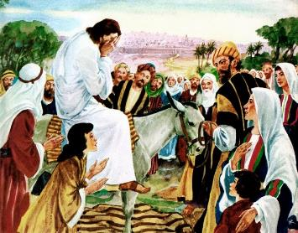
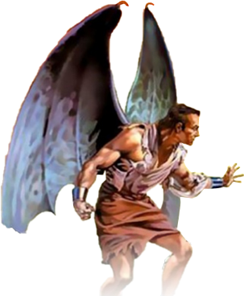
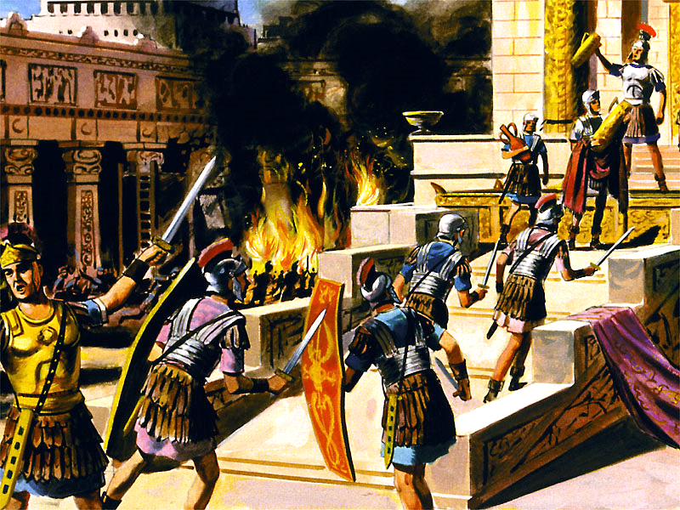
UKWENQATSHWA KOTHANDO LUKANKULUNKULU
“Jerusalema, Jerusalema, wena obulala abaprofethi nokanda ngamatshe abathunyelwe kuwe, kukangaki ngithando ukubuthela ndawonye abantwana bakho, njengesikhukhukazi sibuthela amazinyane aso phansi kwamaphiko aso, kepha anivumanga!” (Mathewu 23:37)
UJesu wakhala lapho esondela eJerusalema (Luka 19:41-44). Wayazi ukuthi babeyohlupheka ngomvuzo wokuqinisa amakhanda kwabo benqabe ubizo lukaNkulunkulu (Matt. 23:37).
Wakhala ngoba lenhlekelele yayingagwemeka. Ngoba uNkulunkulu usithanda kangaka akafuni ukuba kubhubhe ngisho noyedwa, kodwa ukuba babe nokuphila okuphakade (Jn. 5:39-40; Hezek. 18:31-32).
Umlando usitshela ukuthi amaJuda avukela umbuso ngomnaka ka 66 ehlukunyezwa ngamaRoma. Amaqembu ambalwa amaJuda alwa odwa, lapho amaRoma ehlasela umuzi. Ngomnyaka ka 70 kwaphela konke. UTitus wabhubhisa iJerusalema kanye neTempeli. Kwabhubha isigidi nkulungwane sabaJuda.
Kodwa umlando awusitsheli ukuthi uSathane wawaholela kanjani amaJuda ekuhlubukeni, kanye namaRoma ukuba aphindisele. Ukubhujiswa kweJerusalema kwakungumsebenzi kaSathane ngokwakhe. Ngokusuka kumsuka wempilo, u-Israyeli waba semuseni wesitha esasifuna kuphela ukumbhubhisa nokumbulala.

Slide 6
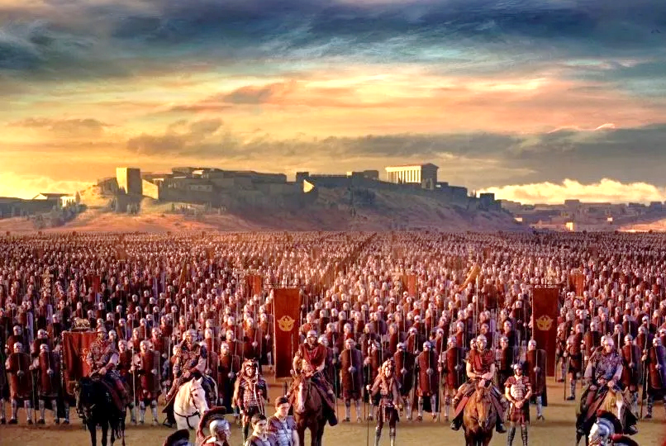
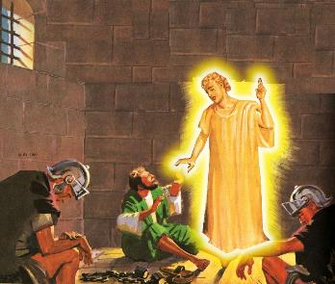
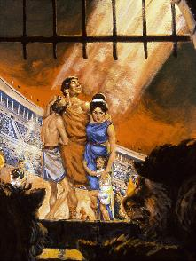
UNKULUNKULU UNAKA ABANTU
“ungesabi, ngokuba mina nginawe; ungapheli amandla, ngokuba mina nginguNkulunkulu wakho. ngiyakukuqinisa, Yebo, ngiyakukusekela ngesandla sokunene sokulunga kwami” (Isaya 41:10)
Ngothando lwakhe, uNkulunkulu wanikeza ithuba kubo bonke ababefuna ukuphunyula ekubhujisweni. Wanikeza uphawu: IJerusalema yazungezwa yimpi (Luka 21:20).
UGaius Cestius Gallus wagcwalisa lelo phawu ngomnyaka ka 66. Ukuhlaselwa kwabuyiselwa emumva, umholi wamaZealot u-Eleazar indodana kaSimon waxosha amaRoma wawanqoba.
Bonke abakholwa amazwi kaJesu basebenzisa lelo thuba lapho iJerusalema yayisele inganamlindi ukuba babaleke.
Izinyanga ezimbalwa ezilandelayo, uNero wathumela uVespasian ukuhlasela abavukela umbuso. Ukusuka emnyakeni ka 67 ukuya ku 70, ukuhlasela kwahlala kukhona.
UNkulunkulu unakho futhi uyafuna ukuvikela abakhe, ngisho nangezikhathi ezinzima (IHubo. 46:1; Is. 41:10). Kodwa, abaningi balahlekelwa yizimpilo zabo ngenxa yokungakholwa kwabo kuNkulunkulu (Heb. 11:35-38).
Kungani abanye bevikelwa kodwa abanye kubonakale sengathi bashiyiwe nguNkulunkulu na?

Slide 7
“Imfihlakalo yokuvumela ukuhlupheka kwabalungileyo ngesandla sababi isihluphe imiqondo yabaningi ababugthakathaka ekukholweni. Abanye sebekulungele nokulahla ukukholwa kwabo kuNkulunkulu ngoba uvumela abantu abaphansi kakhulu ukuba baphumelele, lapho abancono nabalungile behlupheka futhi beshushiswa ngumbuso ononya. Kanjani, kuyabuzwa, ukuthi lowo olungile nonomusa, futhi nonamandla angenakulunganiswa, evumela ukungalungi nencindezelo? Lona ngumbuzo esingeke senze lutho ngawo. UNkulunkulu usinike ubufakazi obanele bothando lwakhe, futhi akufanele singabaze ukulunga kwakhe ngoba singaqondi ukuthi usebenza kanjani.”
EGW (The Great Controversy, pg. 47)

Slide 8
IZIFUNDO KUMAKRESTU OKUQALA

Slide 9
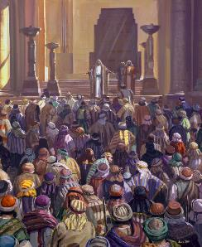
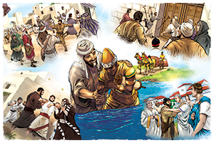
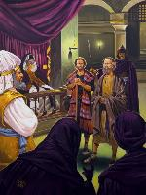
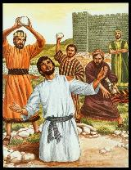
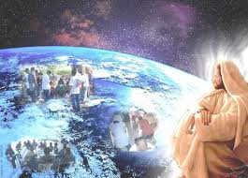
UKWETHEMBEKA EKUSHUSHISWENI
“Kepha uSawula walichitha ibandla. Engena ezindlini ngezindlu, ehudula abesilisa nabesifazane, wabafaka etilongweni” (Izenzo 8:3)
Iziqalo ngempela zazinethemba: abaphendukayo babebalwa ngezinkulungwane
(Izenzo 2:41; 4:4); amakholwa ashumayela ngamandla (Izenzo 4:31; 5:42).
Kodwa isitha sasingenakuphumula. Izinsongo zokuqala (Izenzo 4:17-18); okulandelayo, ukushushiswa (Izenzo 5:40); ekugcineni, ukufa (Izenzo 7:59).
Ngenxa yeshushiso eyasungulwa nguSawule, abafundi babehlakazekile (Izenzo 8:1). Kodwa, kunokuba ukukhanya kucime, sibonga ukwethembeka kwamakholwa, kwakhanya kakhulu emhlabeni wonke owaziwayo (Izenzo 8:4; 11:19-21; Rom. 15:19; Kol. 1:23).
UJesu wayenike ibandla lakhe umsebenzi kanye namandla okuwenza (Izenzo 1:8). Akunamandla, enyameni noma emoyeni, angavimba ukuqhubeka kwevangeli (Matt. 16:18). “Uma uJehova engakithi, akakho ongamelana nathi!” (Rom. 8:31)

Slide 10
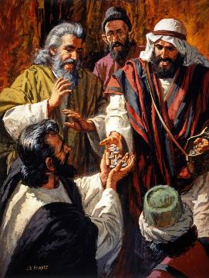
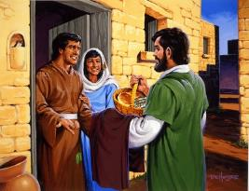
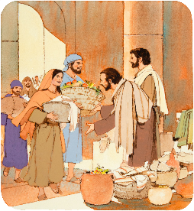
SIZA ABANEZIDINGO
“bathengisa ngemfuyo nangempahla, babela bonke ngayo njengokuswela kwabo” (Izenzo 2:45)
Waba yini umphumela wevangeli ebandleni lokuqala (Izenzo 2:42-47)?
Bakholelwa emfundisweni kaJesu
Labo ababenesiphiwo baphilisa abagulayo.
Babelana ngakho konke
Babelana ngababenakho nababeswele.
Baba nemihlangano yomphakathi
Babehlangana emakhaya, ukuba badle isidlo seNkosi
Babephila ngenjabulo nenhliziyo engenamona
Badumisa uNkulunkulu
Njengabamele uKristu, balingisa uJesu. Ngokunakekela izidingo zalabo ababenabo, bathandwa ngabantu bomuzi bonke.
Njengaleso sikhathi, ibandla kufanele libe nesimilo sothando lwamaKristu ethandana, kanye nokunaka umphakathi walo.

Slide 11
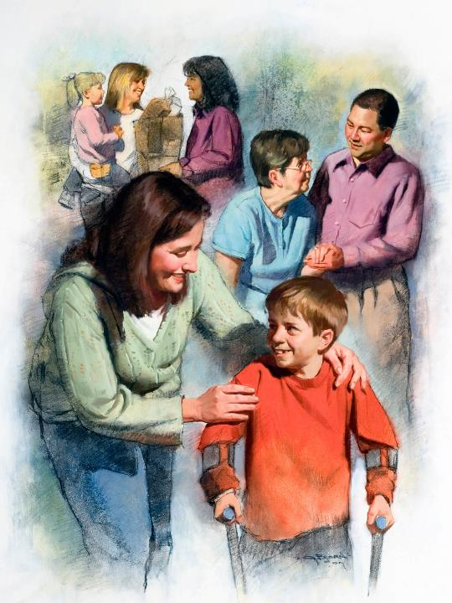
UTHANDO, UPHAWU LWETHU
“Ngalokho bonke bayakwazi ukuthi ningabafundi bami, uma nithandana” (Johane 13:35)
Yilelo nalelo lunga lalabo abalwa lempi yomhlaba linesimilo salo ngokwalo: USathane unenzondo nokubulala; uNkulunkulu uyathanda abuyisele.
Ababalandelayo benza njengabaholi babo. Uma silandela uNkulunkulu, siyobonakala ngothando kwabanye (1Jn. 4:20-21).
Christians of the 2nd and 3rd centuries put selfless love into practice. During two major pandemics (in the years 160 and 265), they dedicated themselves to caring for those affected, without taking into account their own safety.
AmaKristu eminyaka ye 2nd ne 3rd centuries aphila ngothando lokungazicabangeli. Ezehlakalweni ezimbili ezinkulu (eminyakeni ka 160 no 265), bazinikela ekunakekeleni labo ababeshushiswa, ngaphandle kokucabanga ngokuphepha kwabo uqobo.

Slide 12
“Kuyithuba lalowo nalowo ukuba ngumgudu ophilayo uNkulunkulu angakhuluma ngawo nezwe eliyifa lomusa wakhe, ingcebo engenakuphenywa kaKristu. Akukho okufiswa nguKristu njengokuthi labo abayomela yena babe noMoya nesimilo sakhe emhlabeni. Akukho okudingwa yizwe ukwendlula ukubonakaliswa ngabantu kothando loMsindisi. Izulu lonke lilindele imigudu okungathelwa kuyo amafutha angcwele abe yinjabulo kanye nesibusiso ezinhliziyweni zabantu.”
EGW (God's Amazing Grace - Unsearchable Riches, June 28)

