Slide 1
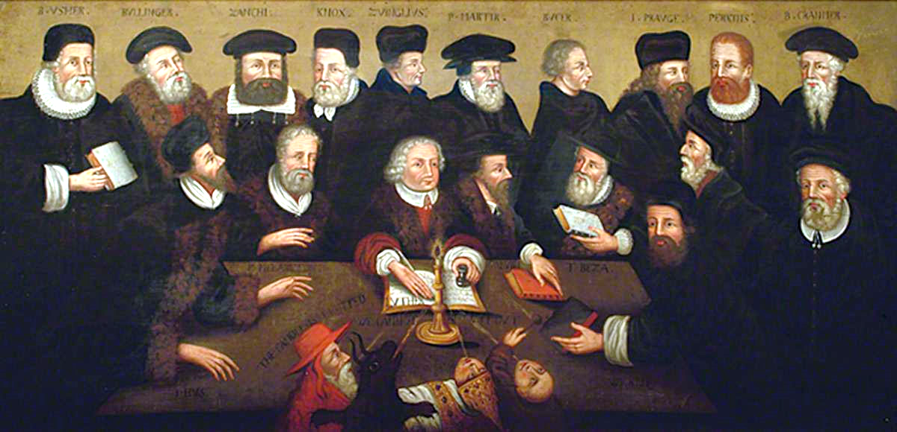
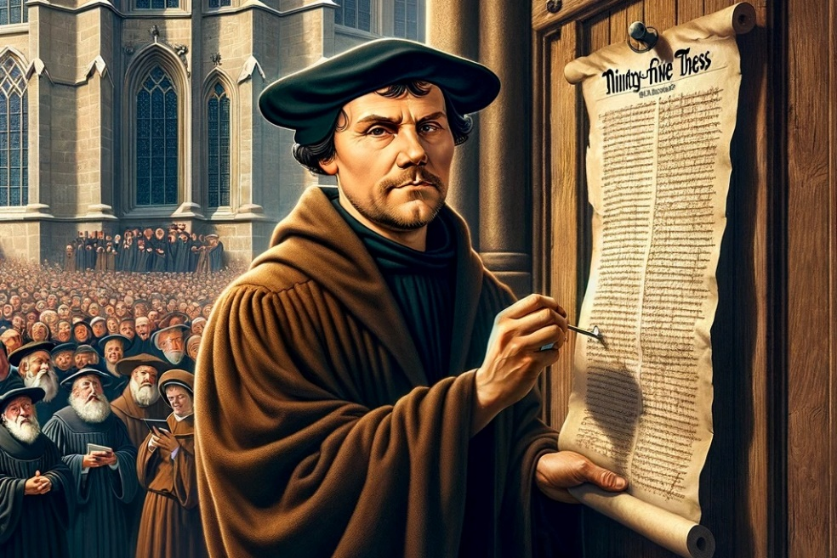
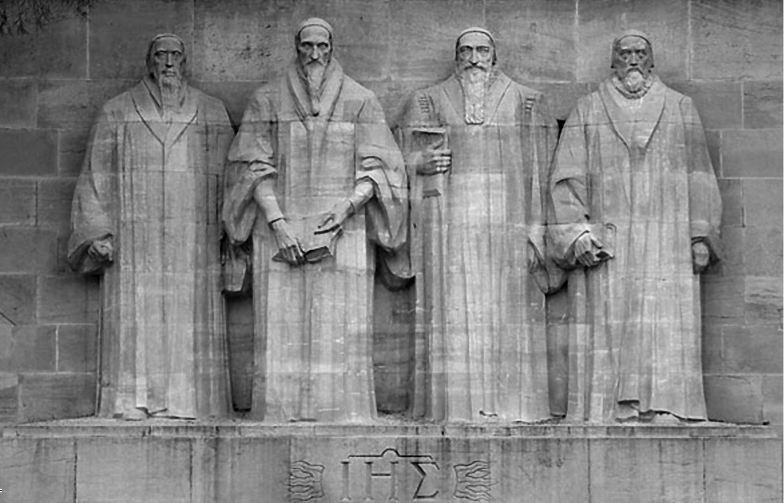
UKHOLO EZIMENI ZONKE
Isifundo 5 ukulungiselela uNhlaba 4, 2024

Slide 2


“Enhliziyweni yami ngiyalonda izwi lakho, ukuze ngingoni kuwe”
(IHubo 119:11)

Slide 3

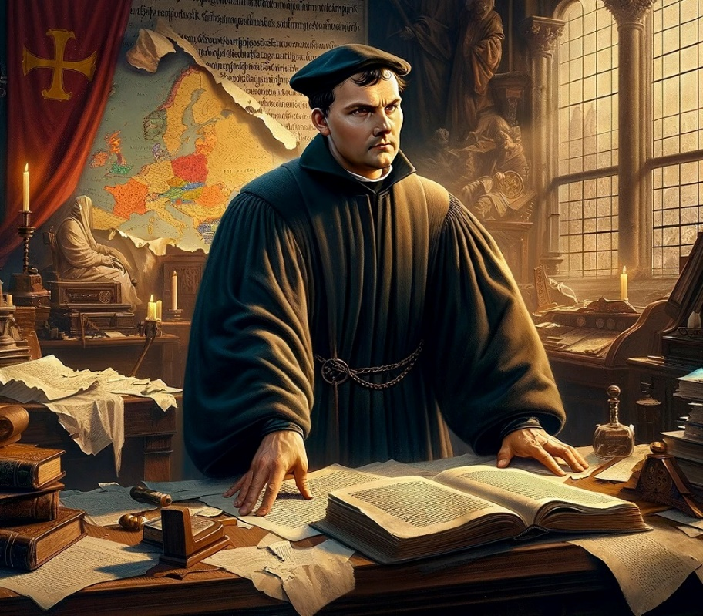








Ngekhulu le 16th century, umsebenzi waqala ngonyaka ka 200 ngaphambili ngu Wycliffe, “inkanyezi ye Reformation,” yaqala ukukhazimula. Inhlansi yemvuselelo yayisifikile.
Imuselelo yayisekelwe kulamaphuzu asemqoka ayisihlanu:
Sola Scriptura (ImiBhalo yodwa)
Sola gratia (umusa wodwa)
Sola fide (ukholo lodwa)
Solus Christus (UKristu yedwa)
Soli Deo gloria (udumo kuNkulunkulu yedwa)
Isisekelo sokholo:
  Sola Scriptura / soli Deo gloria.
  IBhayibheli kubantu bonke.
  Umhumushi weBhayibheli.
Isisekelo sosindiso:
  Sola gratia / sola fide / solus Christus.
  Ukukhula emuseni.

Slide 4

ISISEKELO SOKHOLO

Slide 5

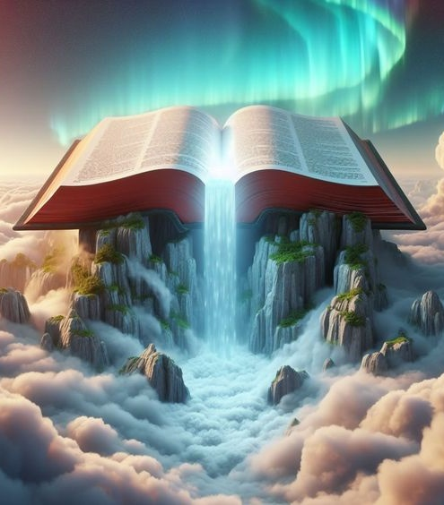
SOLA SCRIPTURA / SOLI DEO GLORIA
“Amazwi akho afunyanwa, ngawadla; amazwi akho aba ngukujabula kimi nokuthokoza kwenhliziyo yami, ngokuba ngibizwa ngegama lakho, Jehova Nkulunkulu Sebawoti” (Jeremiya 15:16)
Abavuseleli bekhulu le 16th century baguqula umhlaba. Kodwa bakwenza kwaba sobala ukuthi akukho okukhethekile ngabo. Babengabantu abaguqulwe nguNkulunkulu. Ngaleso sizathu, basho bathi: “Udumo kuNkulunkulu yedwa.”
Yenzeka kanjani lenguquko kubona na? Kwakungukufunda izwi likaNkulunkulu okwenza izimangaliso.
Yabenzelani iBhayibheli na, futhi ingasenzelani thina na?
Iyisisekelo sokholo
Ngokukholwela ezithembisweni zakhe sivuselela ukholo lwethu nesibindi
Amakhasi alo afana nezithelo zesihlahla sokuphila
Ukubonisa injabulo, ithemba kanye nokukhanya
Liyasiqondisa, lisinike isiqiniseko, amandla kanye nenhlakanipho
Liyasiphilisa emzimbeni, engqondweni, emphefumulweni nasemoyeni
Ngalezi zikhathi zobumnyama, iBhayibheli lalungisisa izimpilo zabo baze banikela ngezimpilo zabo ukuba bahlale bethembekile ezimfundisweni zalo. Futhi namhlanje, ingabe liyayilungisisa impilo yakho na?

Slide 6

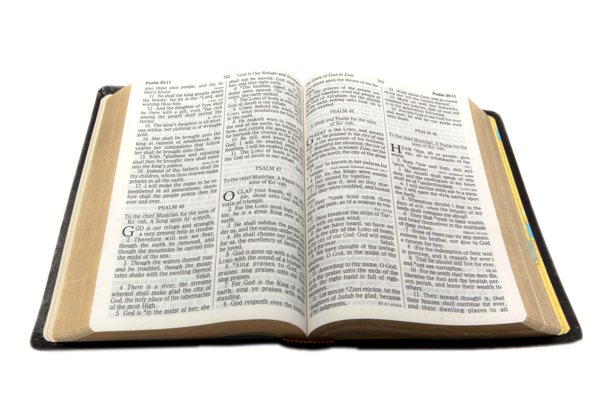
IBHAYIBHELI KUBO BONKE ABANTU
“Kodwa izwi likaNkulunkulu lakhula landa” (Izenzo 12:24)
UTyndale (1494-1536) wazimisela ukulungisa amaphutha eBhayibheli lika Wycleffe (elaguqulelwa lisuka kusi Latin), egululela esusa ezilimini zakuqala. Washiqilela iTestamente elisha eliguqulelwe lisuswa kusi Greek.
UMiles Coverdale waqhubeka waqedela umsebenzi ka Tyndale ngokuguqulela iTestamente elidala lisuselwa kusi Hebrew okungumsuka. Kanjalo, ngo 1535, iBhayibheli lokuqala elashiqilelwa ngesi English lalethwa emphakathini.
Lolu shiqilelo lwasebenza njengesisekelo samaBhayibheli asetshenziswa kakhulu kwabakhuluma isi English: i King James Version, yashiqilelwa ngo 1611. Umsebenzi ka Tyndale, Coverdale, kanye nabafundi abalungiselela i KJV bathinta izinkulungwane zabantu, babaletha ekumazini uNkulunkulu.
Ngokuzibuza, umuntu ongazange avume obala ukwamukela i Reformation waba wusizo olukhulu ekugululelweni kweBhayibheli: UErasmus wase Rotterdam, owashiqilela ngaleso sikhathi iTestamente elisha ngesi Greek (eyasebenza njengesisekelo sazo zonke izinguqulelo zama Reformers).

Slide 7
IBHAYIBHELI KUBO BONKE ABANTU
Yize izinguqulelo zesi English zeBhayibheli zazilungiswa futhi zishiqilelwa, abanye abavuseleli nabo baguqulela iBhayibheli ezilimini zomdabu. Ngaleyondela, iBhayibheli lalingafundwa ngokuqondile ngabantu bonke base Europe, kanye nasemazweni ayesanda kufunyanwa “New World”.
Martín Luther
Pierre Robert Olivétan
French (1535)
Kralice Bible
Czech (1579)
Jonas Bretkunas
Lithuanian (1579)
Jurij Dalmatin
Slovenian (1584)
Italian (1607)
Giovanni Diodati
João Ferreira de Almeida
Portuguese (1691)
Spanish (1569)
Brest Bible
Polish (1563)
Casiodoro de Reina
German (1534)

Slide 8

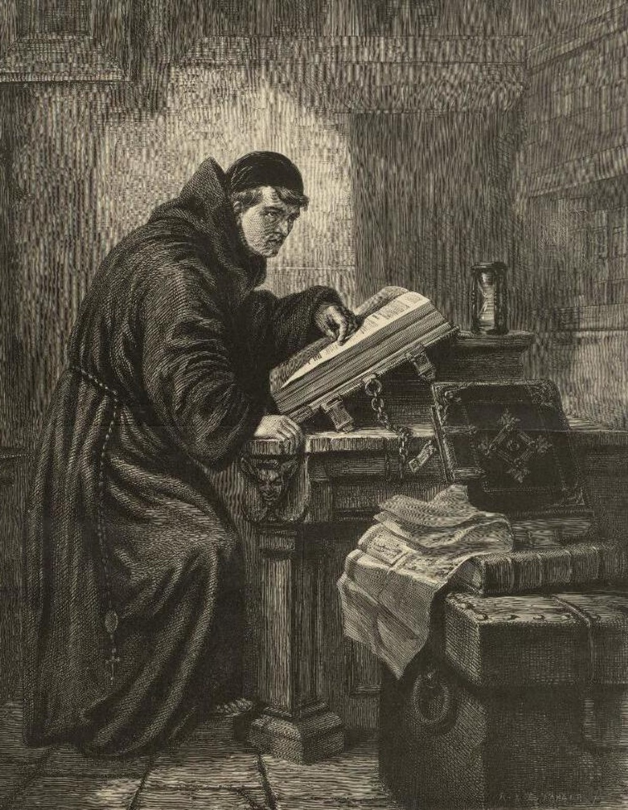

UMHUMUSHI WEBHAYIBHELI
“nazi lokhu kuqala ukuthi kasikho isiprofetho sombhalo esingachasiselwa ngumuntu ngokwakhe” (2 Peter 1:20)
Lapho uMartin Luther aqala ukufunda iBhayibheli ngesi Latin, impilo yakhe yaguquka.
Lapho wayephenya amakhasi alo, wabona ukuthi kunamandla angaphezulu ayekhanyisela ingqondo yakhe. Ivangeli lalphila futhi lasebenza. Amasiko obumnyama ashabalala, nomusa kaKristu wavuswa. Yiwaphi lamandla akhanyisa umqondo wakhe?
NguMoya oNgcwele, umhumushi okunguye yedwa ovunyelwe ukuhumusha iBhayibheli, kwakunguye owembula amaqiniso ayekhona kulo. Futhi yena lowo Moya oNgcwele unikwe thina ukuze sikwazi ukuliqonda nathi! (Johanw 14:26; 16:13).
Kusukela ngaleso sikhathi kwabonakala ukuthi kwakungenakubakhona ukuhambisana phakathi kwamasiko ayefundiswa yibandla elisemthethweni kanye namaqiniso aseBhayibhelini. Okuyilona lodwa elibusa ukholo kanye nesimilo esiseBhayibhelini, futhi silembulelwa nguMoya oNgcwele.

Slide 9

“Ukushunyayelwa kwezwi akuyi kuba namsebenzi ngaphandle kobukhona obuqhubekayo kanye nosizo lukaMoya oNgcwele. Lona nguyena yedwa umfundisi weqiniso onekhono. Kuphela uma iqiniso liphelezelwa enhliziyweni nguMoya lingakwazi ukuvusa unembeza liguqule impilo. Umuntu angakwazi ukukhuluma ngokushiwo yizwi likaNkulunkulu, angaba ngoyejwayele imiyalo yalo kanye nezithembiso; kodwa uma uMoya oNgcwele engamembuleli iqiniso, awukho umphefumulo oyowela edwaleni waphuke”.
EGW (The Desire of Ages, pg. 671)

Slide 10

ISISEKELO SOSINDISO

Slide 11

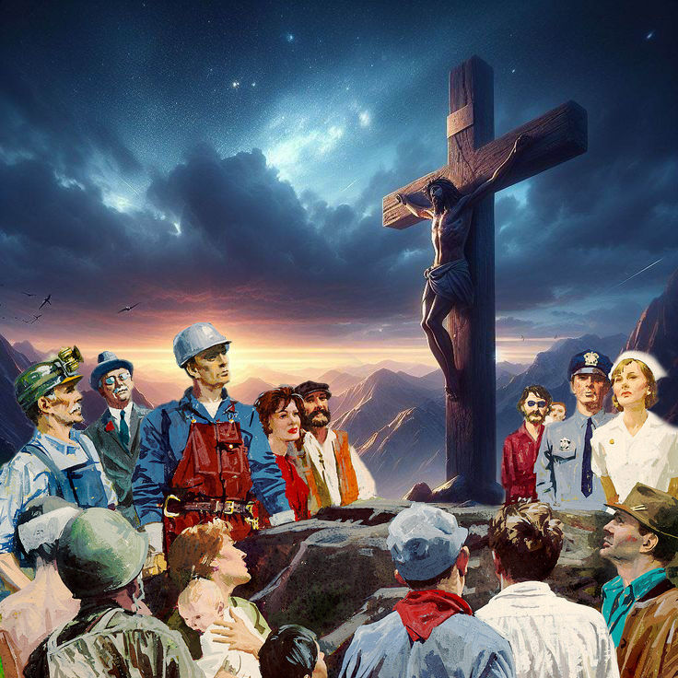
SOLA GRATIA / SOLA FIDE / SOLUS CHRISTUS
“Ngokuba ngomusa nisindisiwe ngokukholwa—nalokhu akuveli kini, kuyisipho sikaNkulunkulu—” (Efesu 2:8)
Kunamaqiniso amathathu asemqoka avela kubase Efesu 2:8.
Sisindiswa ngomusa kuphela
Indlela esithola ngayo umusa wukholo kuphela
Lesi yisipho sikaNkulunkulu, esiyiNdodana yakhe: UKristu kuphela
Ngenxa yesono sethu, silahlwe yicala lokufa okuphakade (Rom. 6:23a). Kodwa, uNkulunkulu usinike indlela esingakhokha ngayo icala lethu wasipha ukuphila okuphakade (Rom. 6:23b).
Futhi kungani sidinga uNkulunkulu ukusikhokhela icala lethu? Kungoba asinakho ukulikhokhela ngokwethu nganoma njani (IHubo. 49:8; Eph. 2:9).
Lapho uMartin Luther athola khona ukuthi uKristu kwakunguye yedwa ongamsindisa, waqala ukushumayela lelo qiniso. Izinkulungwane, ezaziboshwe yinkohliso zesitha, zakhululwa futhi zaguqulwa.
Yize insindiso imahhala, intengo yayo yayingonaphakade, futhi yanele bonke (Johane 3:16; Rom. 8:32).

Slide 12


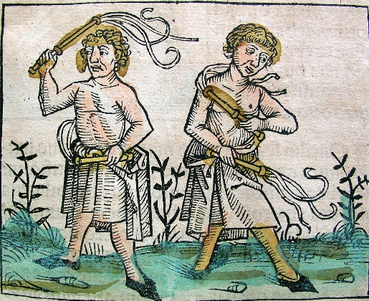
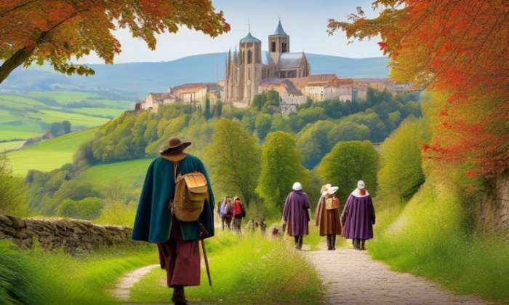
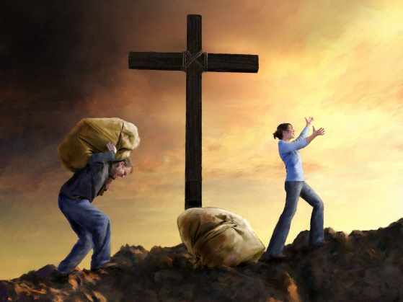
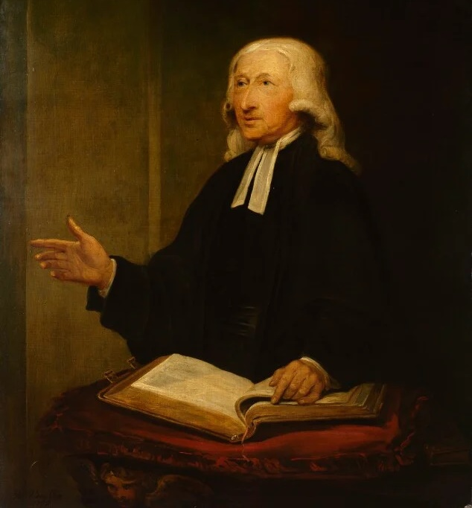
UKUKHULA EMUSENI
“Kepha khulani emseni nasekwazini iNkosi noMsindisi wethu uJesu Kristu. Inkazimulo mayibe kuye namanje nakuze kube lusuku lwaphakade! Amen” (2 Petro 3:18)
Eminyakeni emaphakathi/Middle Ages, abantu babecanga ngokuzuza insindiso yabo (kanye neyabokhokho babo) ngokukhokha imali/masses, bulls, lacerations, pilgrimages...
Konke lokho kwakukhathaza. Kwakungaze kwanele. Baze baqonda umusa kaKristu. Kusukela ngaleso sikhathi bazizwa sebekhululekile ngempela.
Ngabe leyo nkululeko yabaholela ekubukeleni phansi umthetho, noma ukuwulalela?
UJohn Wesley (1703-1791), omunye wabasunguli be Methodist movement, washukunyiswa wukufunda isingeniso sikaLuther kwabaseRoma. Inkolo yakhe entsha yamholela ekufuneni ukukhula emuseni.
Ezazi ukuthi usindiswe ngomusa akumholelanga ekulahleni umthetho, kodwa ekuwufundeni ngokuqophelela okukhulu, ukuze impilo yakhe ihlale ikhula ekuhambisaneni nempilo kaKristu elindeleke kuye.

Slide 13

“Lemigomo eyagcinwa yilawo ma Reformers—eyayifana naleyo eyayigcinwe ngama Waldenses, no Wycliffe, no John Huss, no Luther, uZwingli, kanye nalabo abazihlanganisa nabo—kwakuyigunya elingasoleki lemiBhalo eNgcwele njengebusa ukholo kanye nempilo. Baphika amalungelo abo popes, ama councils, oFathers, kanye nama kings, ukulawula unembeza ezintweni zenkolo. IBhayibheli laliyigunya labo, futhi ngezimfundiso zalo bahlola zonke izimfundiso kanye nezinkolelo. Ukholo kuNkulunkulu kanye nezwi lakhe kwabagcina labo bantu abangcwele njengoba banikela izimpilo zabo ekubulaweni. “Duduzekani,” kwasho uLatimer kulabo ayefa kanye nabo ngomlilo owawuyothulisa amazwi abo, “namhlanje siyokhanyisa leso sibani, ngomusa kaNkulunkulu, e England, njengoba ngikholwa ukuthi asiyi kucinywa.”—Works of Hugh Latimer 1:8”
EGW (The Great Controversy, pg. 249)

